Slide 1
Test Doubles Expanded
Why We Mock The Way We Mock (Expanded)

Slide 2
Introduction
Derick Linkous
dl@steadyscience.com

Slide 3
Test Doubles
A term that encompasses all kinds of “mocks”
Many unit tests do not require test doubles
When code has dependencies, unit tests require test doubles

Slide 4
Purpose
Show what drives the needs our test doubles must meet
Short list; only a few different kinds of needs
Simplicity
Starting with simple example and work up to more complex examples
All test doubles will be created manually; no frameworks will be used

Slide 5
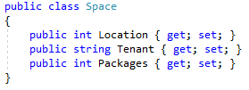
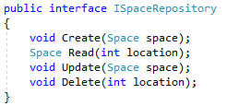
Setup

Slide 6
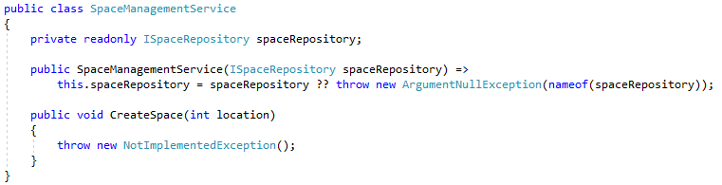
Type I

Slide 7
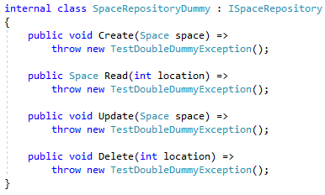
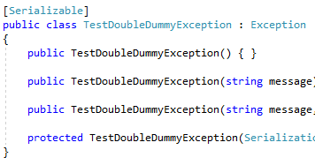
Type I - Dummy

Slide 8
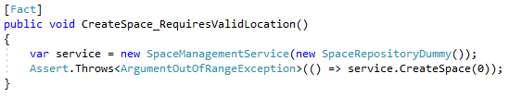
Type I - Dummy

Slide 9
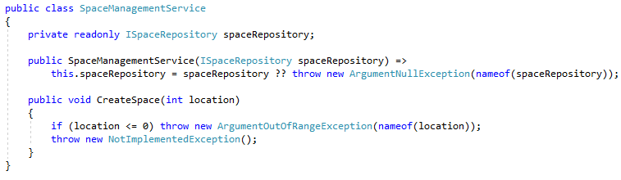
Type I - Dummy

Slide 10
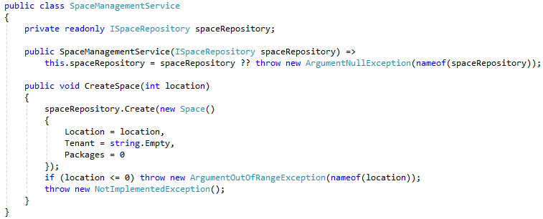

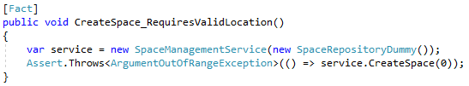
Type I - Dummy

Slide 11

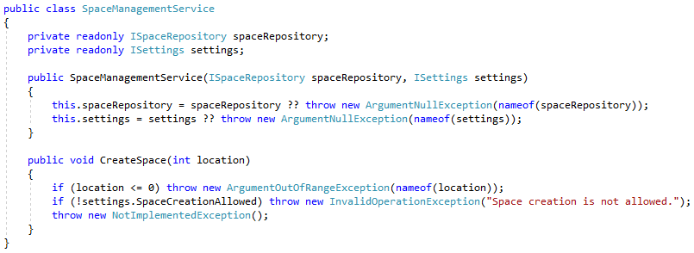

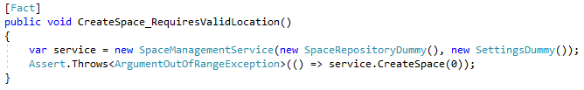
Type II

Slide 12
Type II

Slide 13

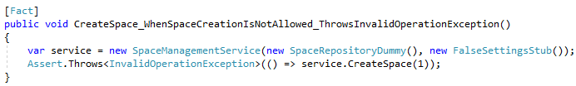
Type II - Stub

Slide 14
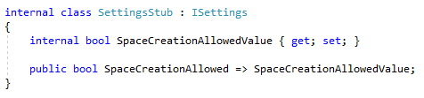
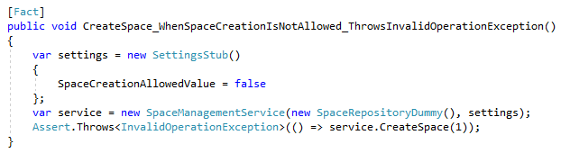
Type II - Stub

Slide 15

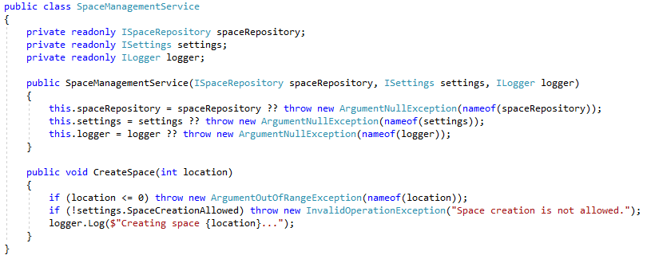

Type III

Slide 16
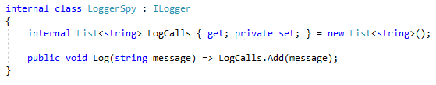
Type III - Spy

Slide 17
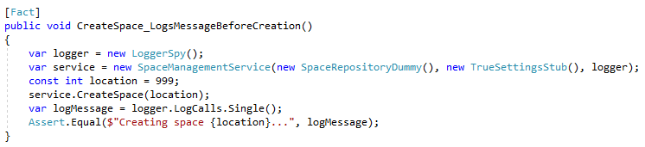
Type III - Spy

Slide 18
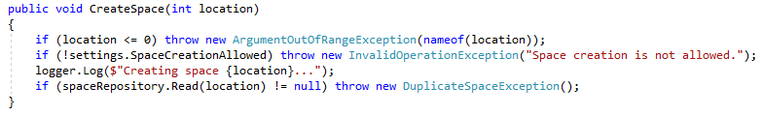
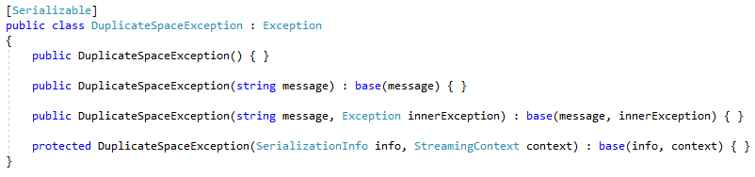
Type IV

Slide 19
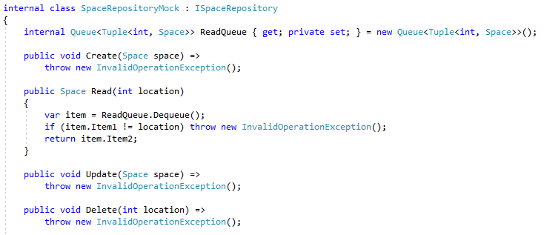
Type IV - Mock

Slide 20
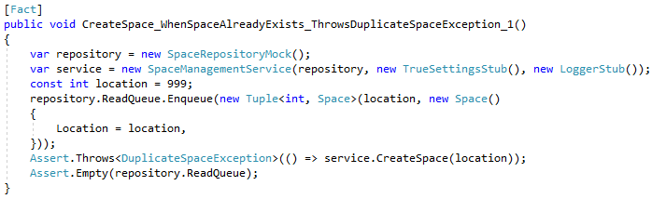
Type IV - Mock

Slide 21
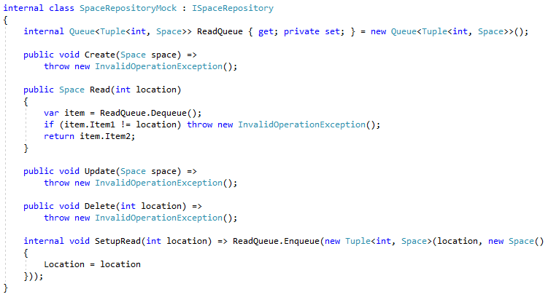
Type IV - Mock

Slide 22
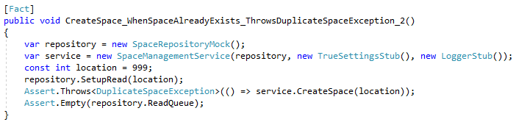
Type IV - Mock

Slide 23
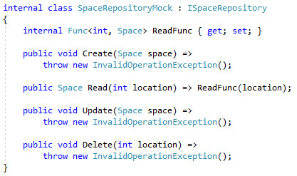
Type IV - Mock

Slide 24
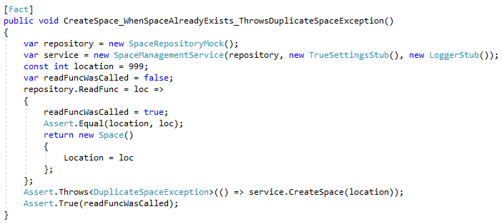
Type IV - Mock

Slide 25
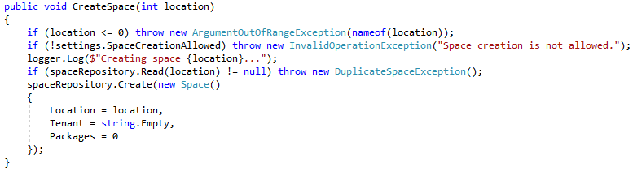
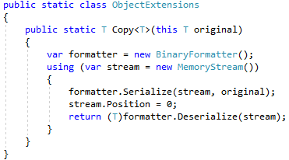
Type V

Slide 26
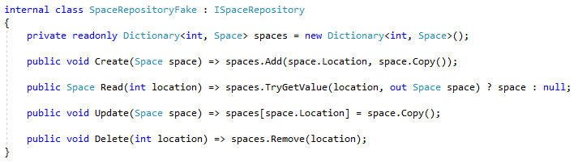
Type V - Fake

Slide 27
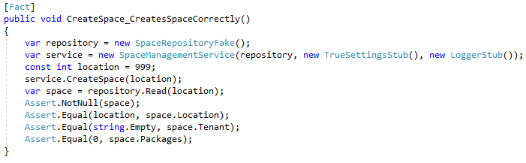
Type V - Fake

Slide 28
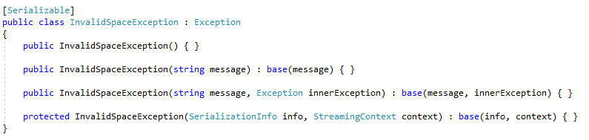
Type V - Fake

Slide 29
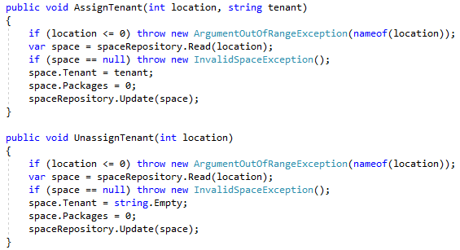
Type V - Fake

Slide 30
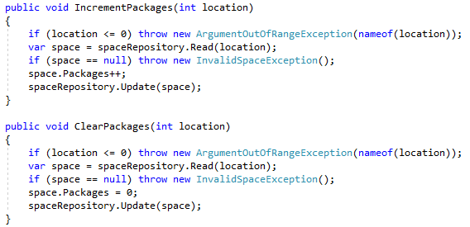
Type V - Fake

Slide 31
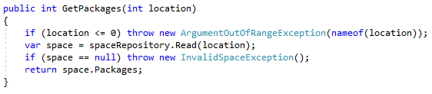
Type V - Fake

Slide 32
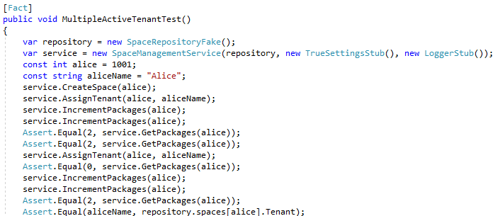
Type V - Fake

Slide 33
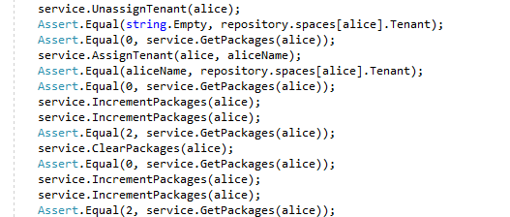
Type V - Fake

Slide 34
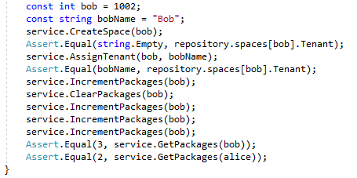
Type V - Fake

Slide 35
Summary
Satisfy compiler / Throw if used: Dummy
Hard-coded / Blind response: Stub
Indirect outputs: Spy
Strict, parameterized, order-specific, controlled: Mock
Realistic, but still not real: Fake

Slide 36
Info
Derick Linkous
dl@steadyscience.com

