Slide 1
To Those Who Await
An introduction to async/await in C#

Slide 2
Introduction
Derick Linkous
dl@steadyscience.com

Slide 3
The Scenario
Bob has some work to do today
Make pizza
Make cookie
Audit finances
Compose song
Many different ways to get this work done

Slide 4
Round 1
Bob prepares and cooks pizza
While cooking pizza, Bob watches the oven, waiting
While cooking cookie, Bob watches the toaster oven, waiting
While working on finances, Bob has to do a lot of math
While composing song, Bob has to do a lot of thinking as well
Alice is unable to get a response from Bob in all cases

Slide 5
Round 1
Bob has 4 primary activities; we call these activities “tasks”
Bob is 1 person; we call him a “worker”
During all tasks, our worker is busy, unresponsive
All tasks take time, either waiting, or working hard
Cooking tasks are mostly about waiting to do the next step
Audit and composition are mostly about thinking, not waiting

Slide 6
Round 1
Regardless of how hard the work is, time is passing
Regardless of how hard the work is, worker is unresponsive
Bob has chosen to work on tasks consecutively
We can create this scenario in code
Code will be synchronous
Code time!

Slide 7
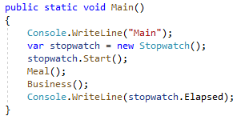
Round 1

Slide 8
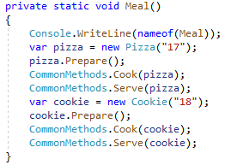
Round 1

Slide 9

Round 1

Slide 10
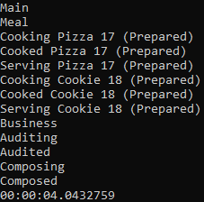
Round 1

Slide 11
Introducing Async/Await
.NET contains Task class
Task class represents our “tasks” from our scenario
Methods can be declared with “async” keyword
Async methods must/should contain at least one “await” keyword
Any Task can be awaited with “await”
Let’s refactor Bob’s synchronous work to be asynchronous

Slide 12
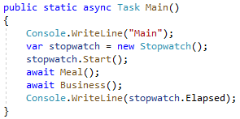
Round 2

Slide 13
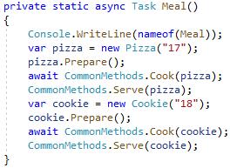
Round 2

Slide 14
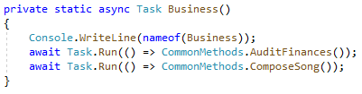
Round 2
???

Slide 15
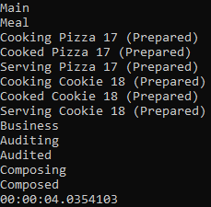
Round 2

Slide 16
Round 2
≈

Slide 17
Categorizing Tasks
Synchronous:
When Bob was cooking, he was staring at a device, waiting
When waiting, Bob was relaxed; the work was easy
Although relaxed, he was 100% consumed by the task
Bob cannot do anything else
Poor Alice was ignored; Bob was enthralled by watching the ovens

Slide 18
Categorizing Tasks
Synchronous:
Bob’s business tasks required intense thought; he waited on nothing
When working, Bob was busy; the work was difficult
He was 100% consumed by the tasks; brain at 100%
Bob cannot do anything else
Poor Alice was ignored; Bob was focused on business work

Slide 19
Categorizing Tasks
Tasks fall into two categories
I/O-Bound
I/O-Bound tasks are limited by I/O performance
CPU-Bound
CPU-Bound tasks are limited by CPU performance

Slide 20
Categorizing Tasks
Tips for figuring out I/O vs CPU
If you increased I/O performance, would task complete faster?
I/O-Bound
If you increased CPU performance, would task complete faster?
CPU-Bound
Network? File system? Database?
I/O-Bound
Math? Algorithmic?
CPU-Bound

Slide 21
Round 2 Redux
Cooking involves waiting on hardware device to complete activity
Cooking is like being I/O-Bound
Auditing finances involves intense calculation
Auditing finances is like being CPU-Bound

Slide 22
When to use Task.Run
When task is I/O-Bound, adding CPU does not help
Creating a thread just to wait on I/O is counter-productive
When I/O-Bound, we simply “await” the target method directly
When CPU-Bound, adding CPU helps
We can utilize other cores, via new threads, for CPU tasks
Use Task.Run to queue other threads to work on CPU tasks

Slide 23
Method Breaking

Slide 24
Method Breaking
Compiler turns async methods into multi-step state machines

Slide 25
Method Breaking
Method body parts still execute in order

Slide 26
Round 3
So far, we’ve directly awaited all Tasks
It is possible, and often useful, to use Tasks themselves
We can use variables to reference Tasks

Slide 27
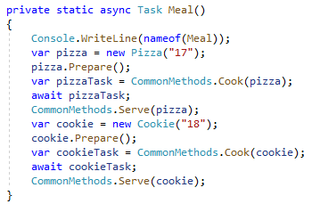
Round 3
The awaits are equivalent

Slide 28
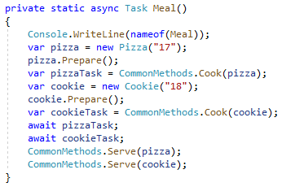
Round 4
Moving await-pizza below cookie-start is profound
Bob starts BOTH cooking, one right after the other
Both complete at almost same time; time elapsed is halved

Slide 29
Round 4
Bob puts pizza in oven
Bob puts cookie in toaster oven
Bob relaxes while both cook
Bob is not working while cooking
Alice can chat with Bob
Bob is free to work on unrelated tasks in the garage
User Interface can respond to events such as mouse clicks
Web Server can respond to events such as web requests

Slide 30
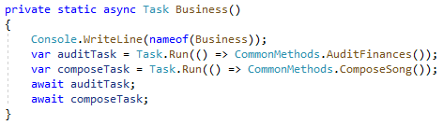
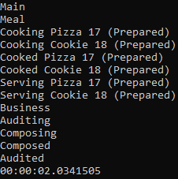
Round 4

Slide 31
Round 4
1
1
2
3
Work in parallel due to
parallel CPU multi-threading
Work in parallel due to
parallel I/O waiting

Slide 32
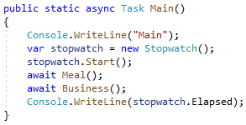
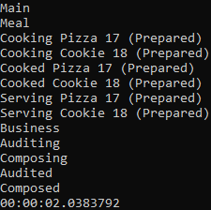
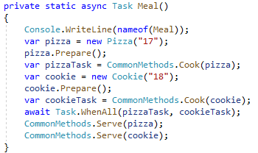
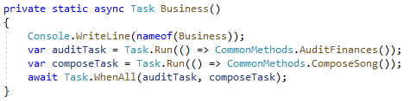
Round 5

Slide 33
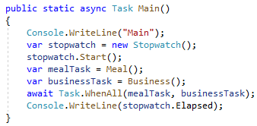
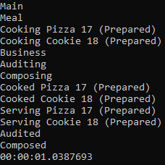
Round 6

Slide 34
Returning Tasks
So far, we’ve only looked at void-equivalent methods
Void-equivalent methods return a Task
When we need to return something, we use Task<T>
Task and Task<T> are normal classes; they can be returned
When in an async method, the language has easy “returns”
Task-returning methods may or may not be async
Calling code does NOT know if called methods are async

Slide 35
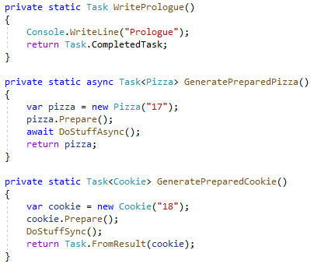
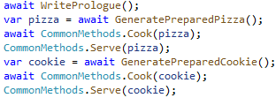
Round 7
All are awaitable
from caller’s perspective!
Completes Synchronously
Not “Task”; “return” in async creates Task
Completes Synchronously

Slide 36
Performance via ValueTask
Tasks are classes
Tasks require allocation, and subsequent garbage collection
For high-frequency high-performance scenarios, allocation is bad
Task and Task<T> have equivalent ValueTask and ValueTask<T>
ValueTasks are structs; they are value types that require no GC
Task and ValueTask are used very similarly
ValueTasks have limitations

Slide 37
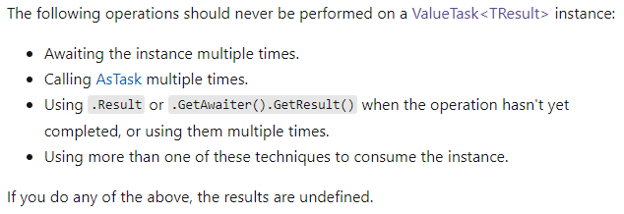
Performance via ValueTask

Slide 38
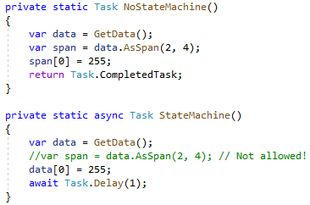
Async Methods are classes

Slide 39
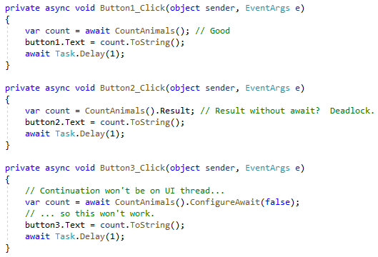
A few problems

Slide 40
Summary
Async/Await keywords work together
Async marks a method to be turned into a state machine
Await keyword breaks a method into pieces/steps
Await and Task are wired-together at the language level
Task, Task<T>, ValueTask, ValueTask<T>
Task-returning methods may or may not be async

Slide 41
Summary
Always know if a task is I/O-Bound or CPU-Bound
I/O-Bound tasks should usually be awaited on the current thread
CPU-Bound tasks should usually be queued via Task.Run
Async methods still contain synchronous code (all non-await code)
Async methods still execute in order; they are not random
When a thread is awaiting, it’s free to do other work

Slide 42
Summary
Task-returning methods can be awaited
Task-returning methods can have the task captured in a variable
Task class has static methods for common uses (e.g. WhenAll)
Callers of Task-returning methods do not know if target is async
Async/Await is not synonymous with threads
Threads come into play via Task.Run

Slide 43
Summary
Async code can call synchronous code safely
Trying to call async code from synchronous code is dangerous
In GUI and Web applications, never get Result before completion
ValueTasks are value types; beware of limitations
By default, continuations occur on original thread
ConfigureAwait can alter the default

Slide 44
Info
Derick Linkous
dl@steadyscience.com

