Slide 1
Unit Testing
An introduction to unit testing using a test-first methodology

Slide 2
Introduction
Derick Linkous
dl@steadyscience.com

Slide 3
Goals
Understand what a unit test is, and what it is not
Understand how to add a unit test framework to a product
Understand how to write unit tests before writing production code
Understand how to write small/simple unit tests
Understand how to guarantee production code without running an app

Slide 4
Initial Notes
This is not a presentation on Test-Driven-Development
(Pure TDD has a strict red-green-refactor cycle)
The example has no dependencies (to keep it simple)
Databases and UIs are outside the scope of this presentation

Slide 5
Testing Individual Pieces
There are thousands of parts in a car
Each part is individually created and tested
Only after a part has been individually tested can it be
safely installed into an automobile
Unit testing a piece of code is no different!

Slide 6
Unit Test Scope And Size
Unit tests should be small
Unit tests should test small pieces of code
Examples of “small”:
A portion of a single method
A small method
A portion of a single class
A small class

Slide 7
When a unit test is not a unit test
Full-stack “spikes” cannot be unit tested
(These would be integration tests.)
Crossing boundaries makes it an “integration test”
Databases
Web Services
Windows Services
Unit Test frameworks can be used for integration testing
Integration testing is outside the scope of this presentation

Slide 8
Unit Tests By Example
Roshambo!
(AKA: Rock-Paper-Scissors)
Task: Write some code to handle the game of Roshambo
But first, we must prepare!

Slide 9
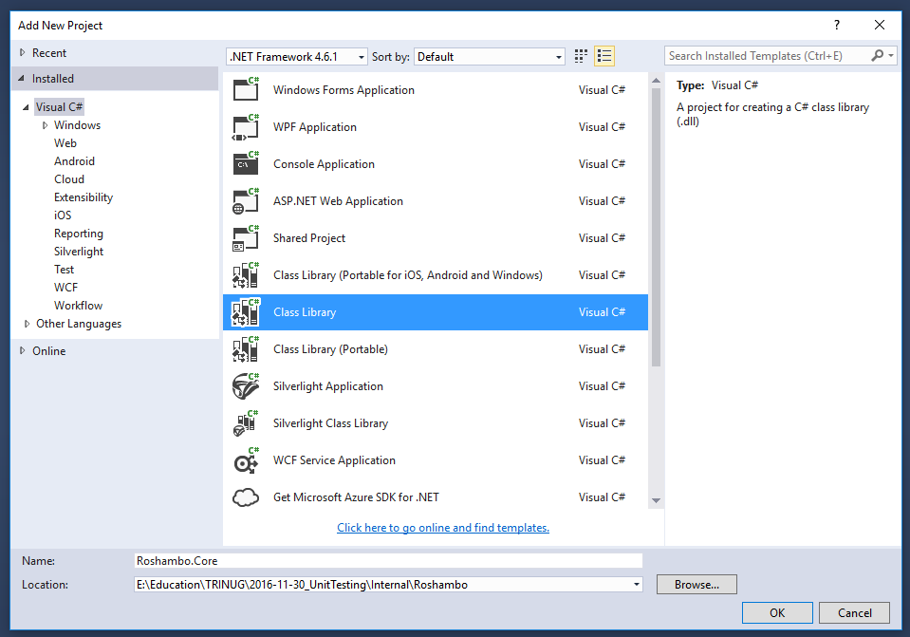
Who’s On First?
Class Library first!
Roshambo.Core
This will hold all of
our business logic.

Slide 10

Who’s On First?
Delete Class1.cs

Slide 11
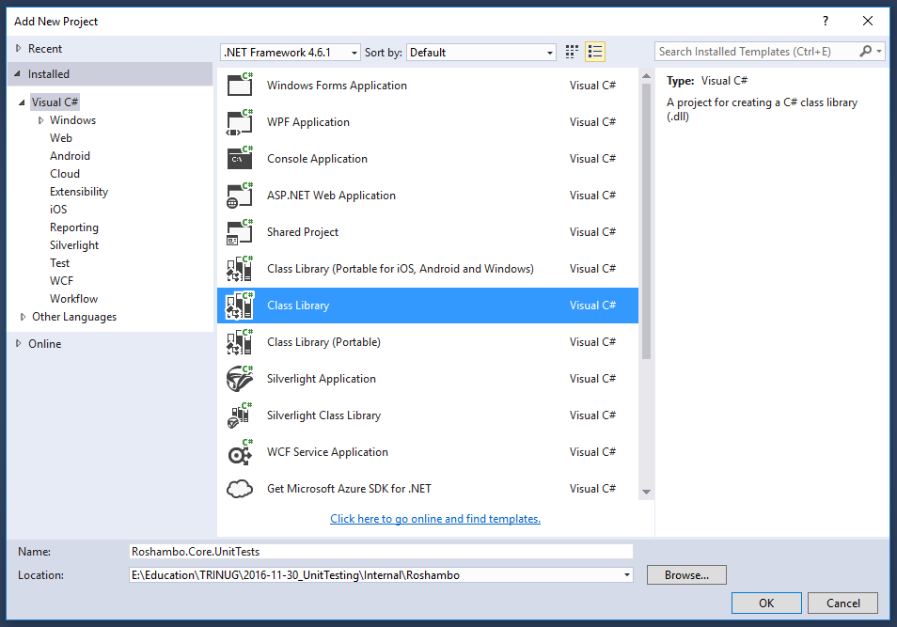
Unit Test Project
Another class library
Roshambo.Core.UnitTests
We will put all of our
unit tests here.

Slide 12
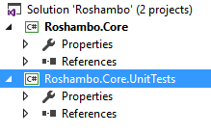
Our Empty Solution
Business logic
Unit Tests

Slide 13
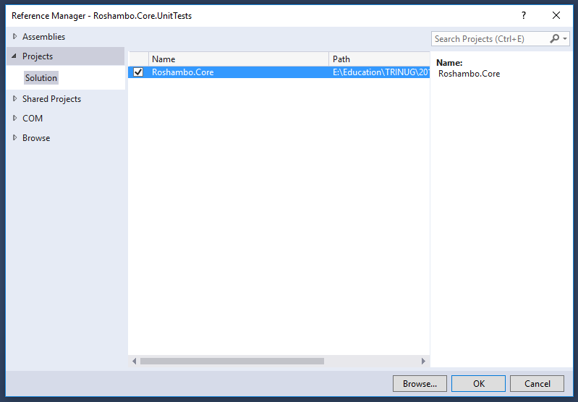
A Good Reference
The Unit Test project
needs to reference the
Core project.

Slide 14
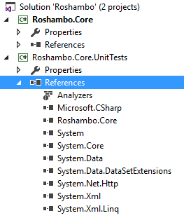
A Good Reference

Slide 15
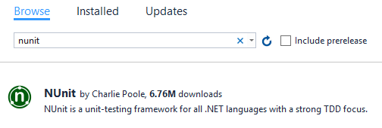
Unit Test Framework

Slide 16
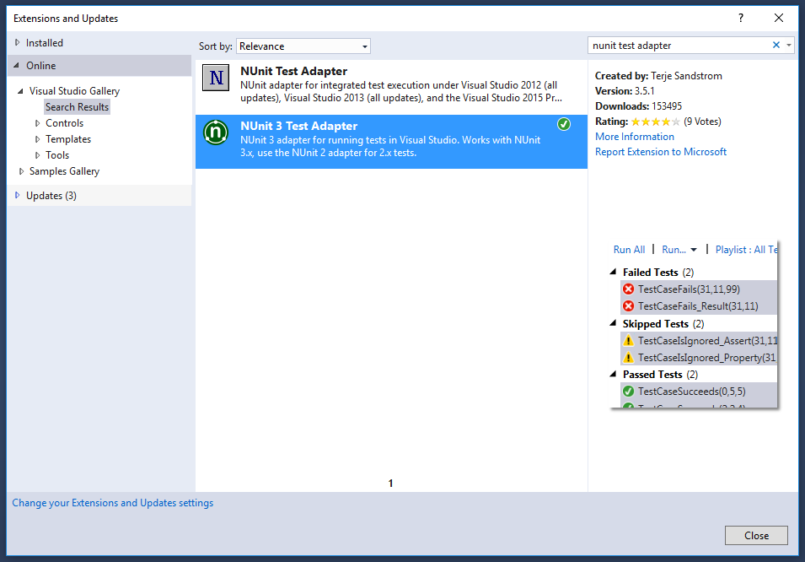
Unit Test Adapter (Nunit-Specific)
Add extension to
Visual Studio

Slide 17
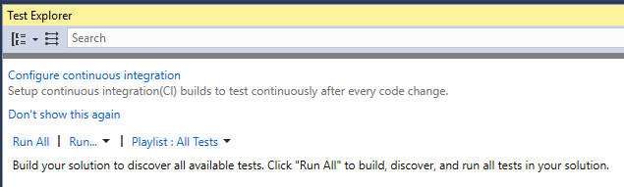
Test Exploration
We will use this window to run and review our tests
There are often many ways to run unit tests

Slide 18
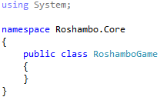
Let’s Add Some Class

Slide 19
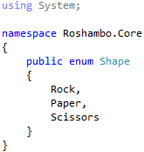
Let’s Get Into Shape

Slide 20
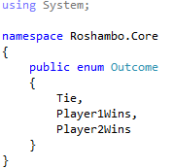
Let’s Prepare For The Outcome

Slide 21
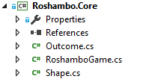
Our New Core

Slide 22
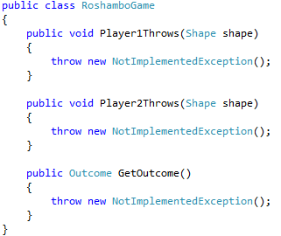
Things We Can Do
Three methods,
with no code yet!

Slide 23

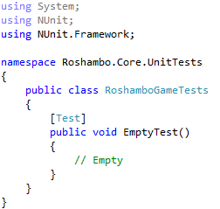
Test Files
We will write an empty test just to confirm we can run our tests.

Slide 24
Our First Test
Tests are…
Normal methods…
In normal classes…
In normal projects.
The only special part of this class is
the attribute on the test method.
The ‘Test’ attribute tells NUnit to run
this method when running tests.

Slide 25
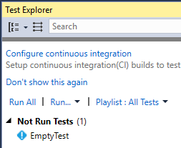
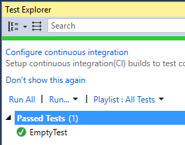
Our First Run
* You must build the project for
Test Explorer to see your test(s)!
Our first test passed!

Slide 26
Planning And Specification
Let’s start by thinking about a quick specification for our class
If no player throws, it’s a tie.
If only one player throws, that player wins.
If both players throw, we will use standard Roshambo rules to
determine who wins, or if there is a tie
If a player makes multiple throws, we will just accept the latest throw

Slide 27
Where To Start Testing
Now that we have a specification,
what tests should we write?
Use the spec!
We will use the specification as a guide for creating unit tests

Slide 28
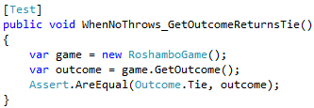
Specification To Unit Tests
If no player throws, it’s a tie.
Instantiate game…
Immediately get outcome…
Assert!
When we ‘assert’, we say, “This better be true. If it is not true, throw an exception.”
A test method ‘fails’ if it throws an exception.
In this case, we require that the outcome be a tie. If it is not a tie, this test will fail.

Slide 29
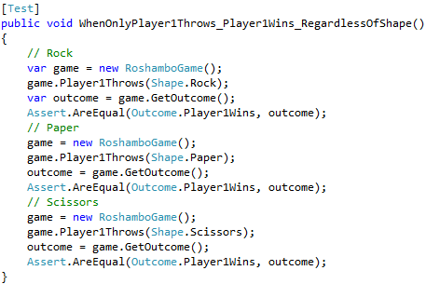
Specification To Unit Tests
If only one player throws, that player wins.
If Player 1 throws,
and Player 2 does not throw,
we simply give Player 1 a win,
regardless of the shape thrown.
Some would argue this test is
already too long… use your
best judgement!

Slide 30
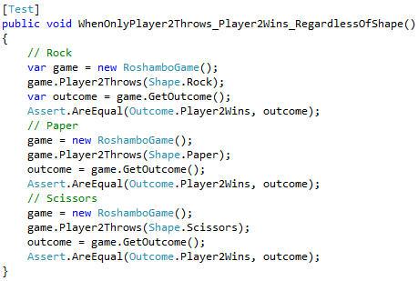
Specification To Unit Tests
If only one player throws, that player wins.
If Player 2 throws,
and Player 1 does not throw,
we simply give Player 2 a win,
regardless of the shape thrown.
Some would argue this test is
already too long… use your
best judgement!

Slide 31
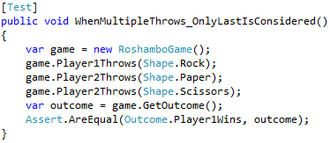
Specification To Unit Tests
If a player makes multiple throws, we will just accept the latest throw
Player 2’s original throw
would have won…
But after throwing scissors…
We expect Player 1 to win
This test technically does not test if the same is true for duplicate
throws by Player 1. It may be an imperfect test, but it is still much
more valuable than it would be if it did not exist!

Slide 32
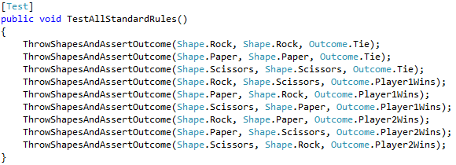
Specification To Unit Tests
If both players throw, we will use standard Roshambo rules to
determine who wins, or if there is a tie
Since unit tests are just normal C#, we can use a private method (visible on next slide)

Slide 33
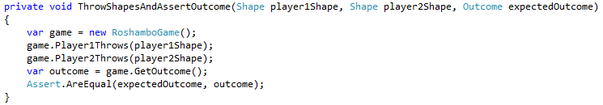
Specification To Unit Tests
If both players throw, we will use standard Roshambo rules to
determine who wins, or if there is a tie
A simple helper method, used by the previously shown test

Slide 34
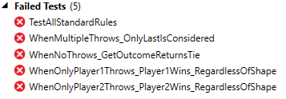
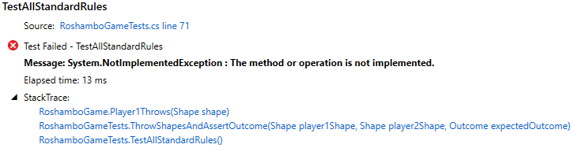
Run Tests
Since we have no code
in the game class, all of
our tests start out as failing

Slide 35
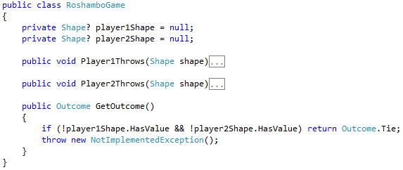
Game Time
If no player throws, it’s a tie.
Let’s store throws in
private fields
If no throws,
it’s a tie

Slide 36
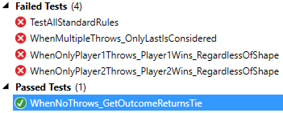
Game Time
If no player throws, it’s a tie.
Test passed!

Slide 37
Game Time
If no player throws, it’s a tie.

Slide 38
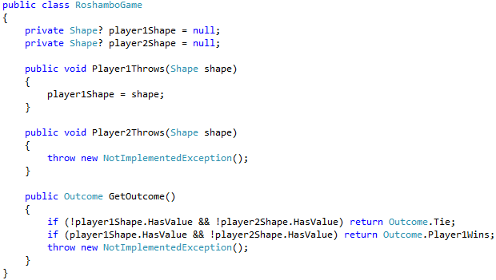
Game Time
If only one player throws, that player wins.
Save Player 1 throws
If only Player 1 throws,
Player 1 wins

Slide 39
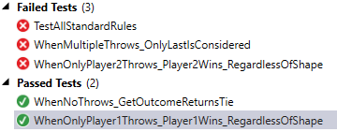
Game Time
If only one player throws, that player wins.
Test passed!

Slide 40
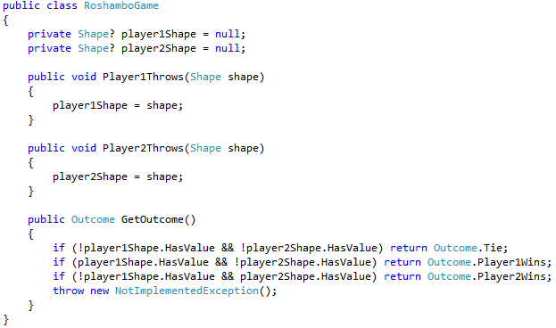
Game Time
If only one player throws, that player wins.
Save Player 2 throws
If only Player 2 throws,
Player 2 wins

Slide 41
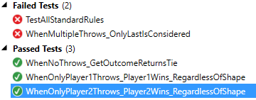
Game Time
If only one player throws, that player wins.
Test passed!

Slide 42
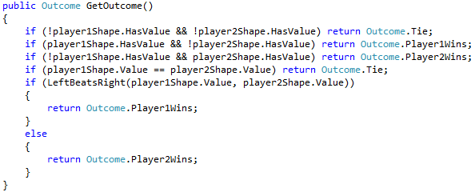
Game Time
If both players throw, we will use standard Roshambo rules to
determine who wins, or if there is a tie
Ties are simple
We’ll use a private method

Slide 43
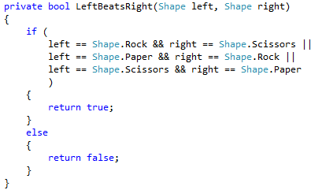
Game Time
If both players throw, we will use standard Roshambo rules to
determine who wins, or if there is a tie
This method checks for all non-tie win conditions

Slide 44
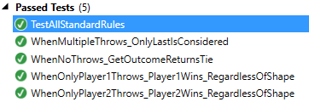
Passing The Test
Two tests were satisfied by our latest code changes
All tests pass!

Slide 45
A Look Back
We chose to create our core logic first
We chose to add unit tests right from the start
We came up with a quick specification
Then we created a set of tests that corresponded to the specification
We added code to the game class…
… until all tests passed

Slide 46
A Look Back
We now have core logic that was tested immediately after its creation
We now have a safety net of unit tests to prevent regression
The core logic can be safely refactored
The unit tests also serve as a form of documentation
Even before having a real executable application…
… we can guarantee our code is working well!

Slide 47
Game Time

Slide 48
Shall we play a game?

