Slide 1
Untangling The Ball
Refactoring to decouple

Slide 2
Introduction
Derick Linkous
dl@steadyscience.com

Slide 3
Motivation
Best practices “good”
But…
“We can’t use them on our project, because…”
<Legacy Reasons>

Slide 4
Dealing With Legacy
One of the most difficult issues we deal with
But…
Best practices can be introduced
One step at a time

Slide 5
An Example
Web Application
A feature that creates a report
Assume one feature out of many
Assume large project with normal constraints

Slide 6
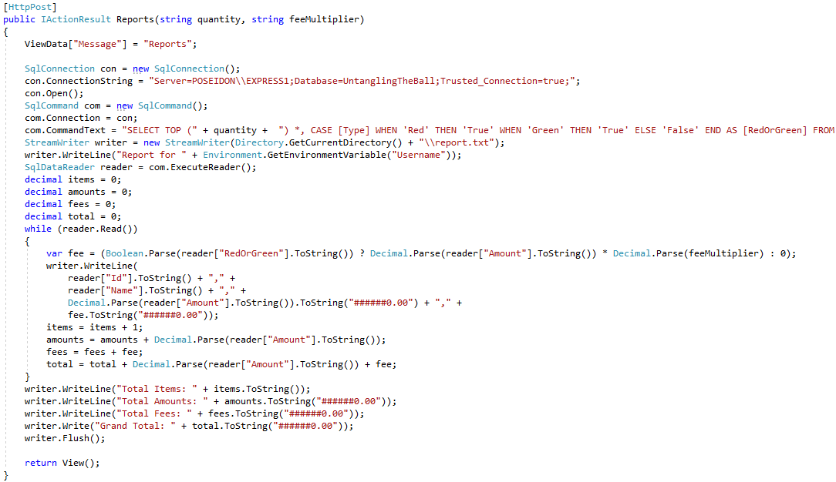
The Method

Slide 7
The SQL

Slide 8
The Method
First impressions?

Slide 9
The Method
Web App
Memory leak!
Coupled to “bottom” of product (i.e. SQL Server)
Hard-coded connection string
Memory leak!
SQL Injection vulnerability
Coupled to “bottom” of product (i.e. File system)
Coupled to environment variables
Decides root
Memory leak!
Deciding report format
Memory leak!
Temporarily-used state, with mutation
Business rule spread across technologies
Business rule calculation, and default value
Deciding report format
Duplicate code
One line mixes reading/formatting/writing
Duplicate code
Duplicate code
Mutation
Duplicate code
Deciding report format
Memory leak band-aid
Web App, with leaks

Slide 10
The Method

Slide 11

The Largest Obstacle
What is the largest obstacle to refactoring?

Slide 12
The Largest Obstacle
We fear that our changes will break something
How do we know if we broke something?
Testing!
How can we test often and efficiently?

Slide 13
The Method
Not Webby

Slide 14
The Plan
Webby
Not Webby

Slide 15


The Plan
SQL
Integration Test
Files
Web App
Business
Env.

Slide 16
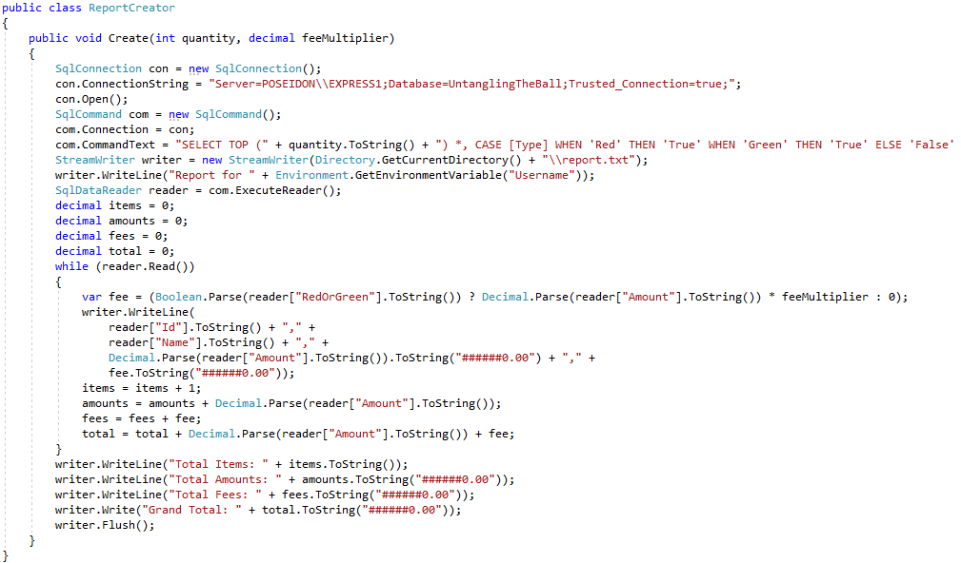
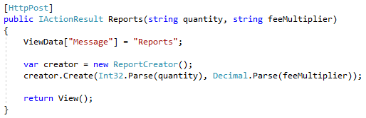
Integration Testing

Slide 17
Integration Testing

Slide 18
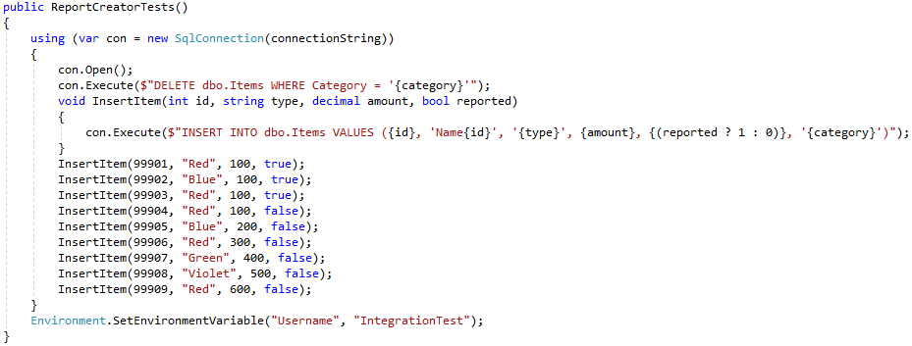
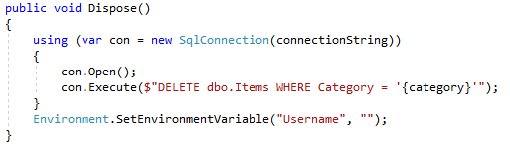
Integration Testing

Slide 19
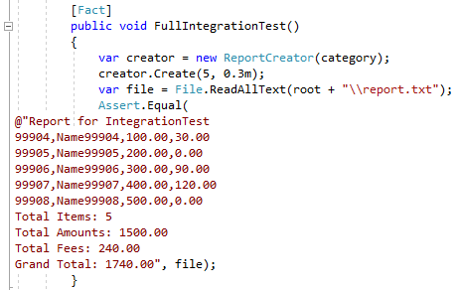
Integration Testing

Slide 20

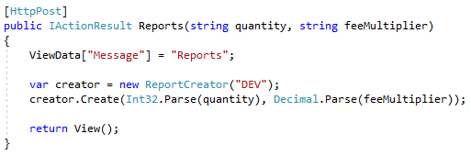
Integration Testing

Slide 21

Integration Testing

Slide 22
Integration Testing
We now have a safety net
We will fear the code no longer
We will run this test over and over again

Slide 23
Refactoring
It’s time to refactor!

Slide 24

Refactoring

Slide 25
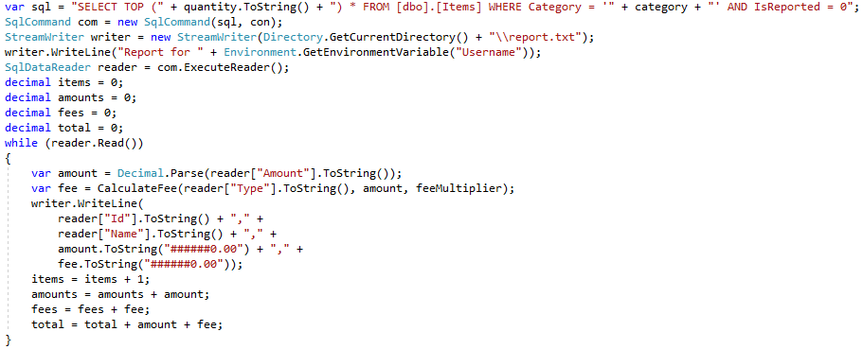
Refactoring

Slide 26
Refactoring
We can separate sections of code via DTOs
Let’s read from SQL, and save those items in a List
We’ll use those items when writing the file

Slide 27
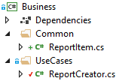
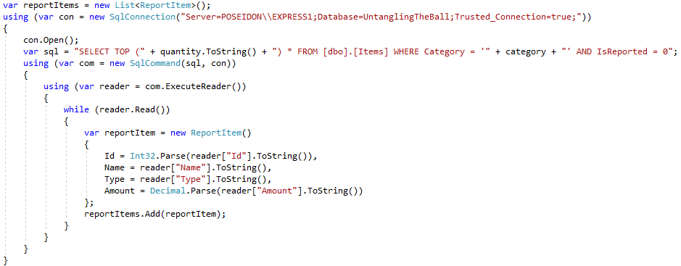
Refactoring

Slide 28
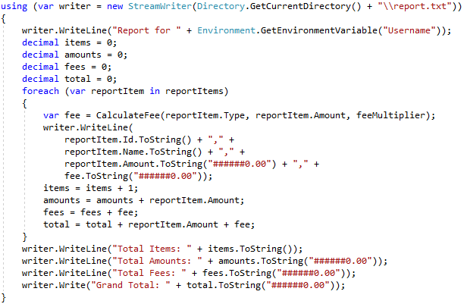
Refactoring
Also wrapped with using
No longer need Dispose (or even the original Flush)

Slide 29
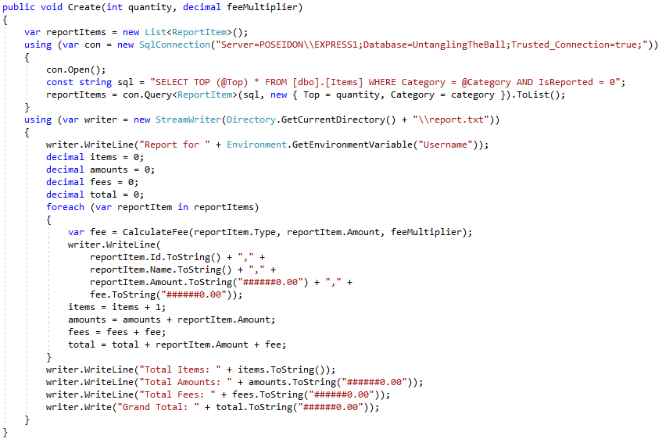
Refactoring

Slide 30
Refactoring
A natural barrier has formed

Slide 31
Refactoring
Calculation and writing is mixed
Let’s separate the two

Slide 32
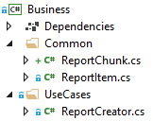
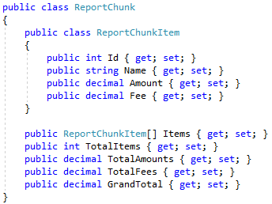
Refactoring

Slide 33

Refactoring
This class has no dependencies
This class contains critical business logic
A perfect candidate for…
Unit Testing!

Slide 34
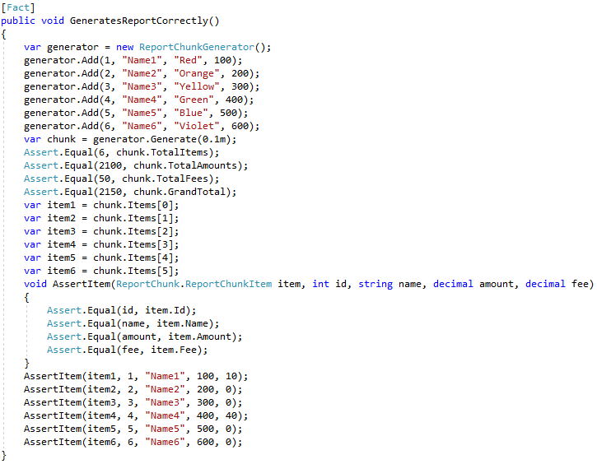
Refactoring

Slide 35
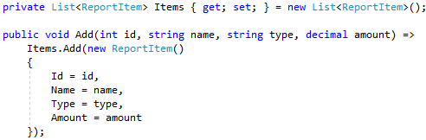
Refactoring

Slide 36
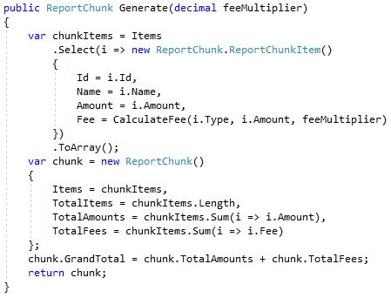
Refactoring

Slide 37
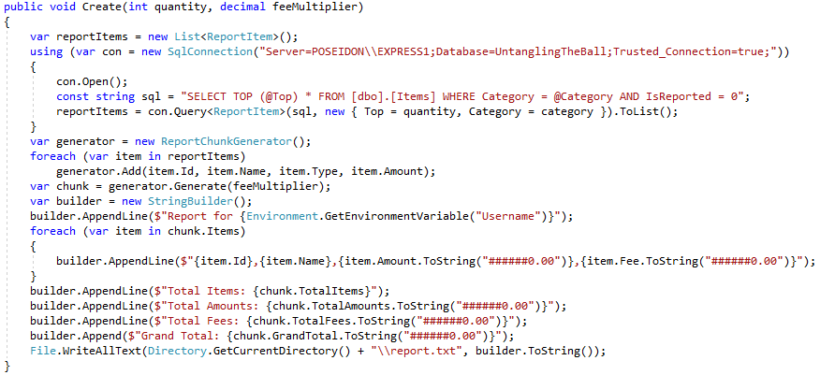
Refactoring
Another natural barrier has formed
Now using StringBuilder

Slide 38
Refactoring
SQL is an implementation detail
File writing is an implementation detail

Slide 39
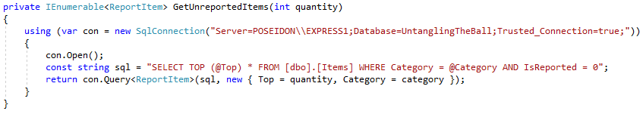
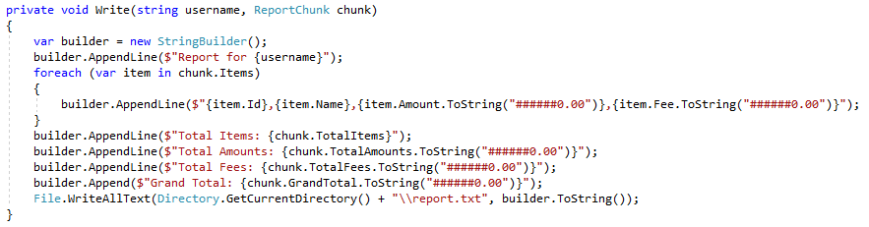
Refactoring
Extract top and bottom as methods…

Slide 40
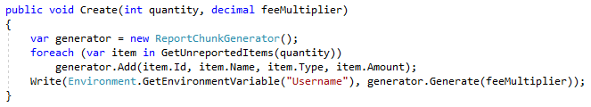
Refactoring

Slide 41
Refactoring
Coupled to Environment…
… and we may change how we acquire “Username”
Let’s use an interface to decouple

Slide 42

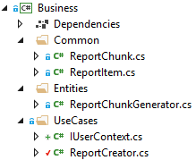
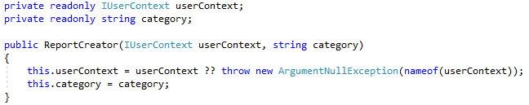
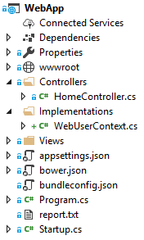

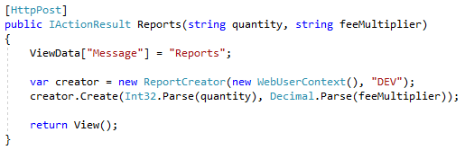
Refactoring

Slide 43
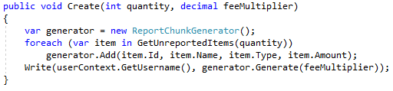
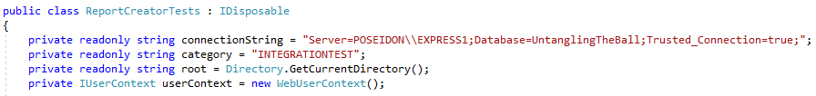
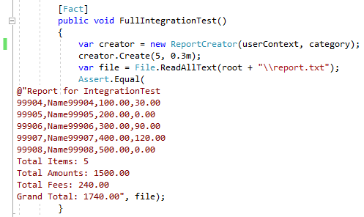
Refactoring

Slide 44
Refactoring
Our extracted methods are really dependencies

Slide 45
The Plan
SQL
Integration Test
Unit Test
Files
Web App
Business
SQL
Files
Env.
We will pull out file writing first

Slide 46
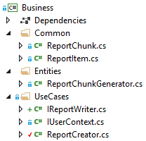


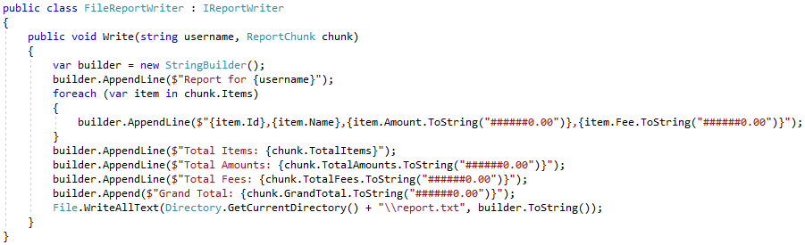
Refactoring

Slide 47
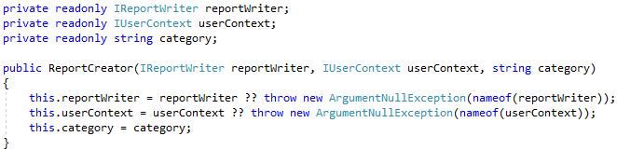
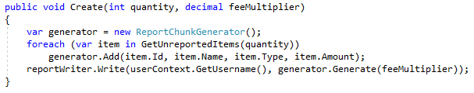
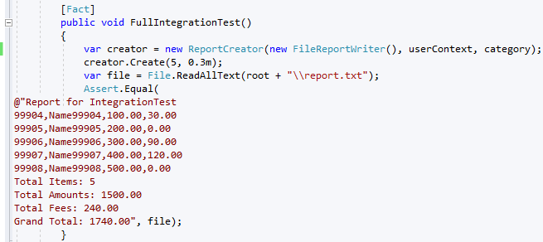
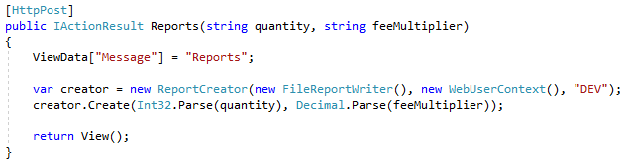
Refactoring

Slide 48
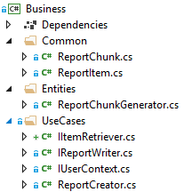



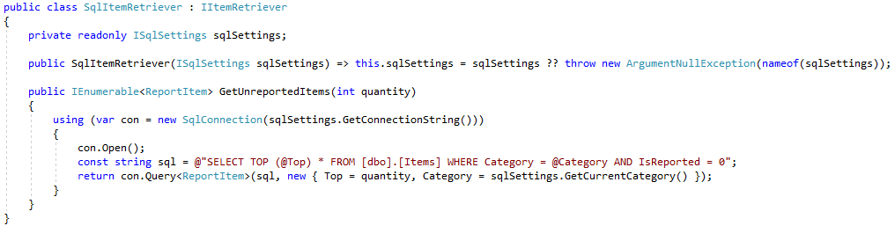
Refactoring

Slide 49
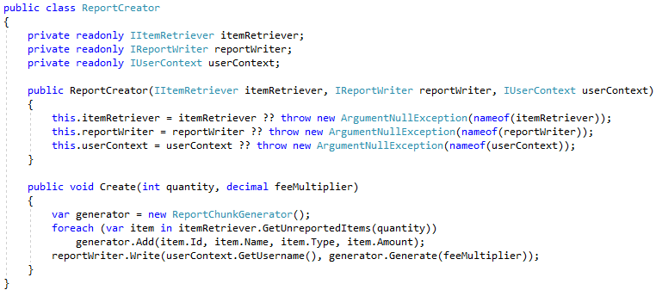
Refactoring

Slide 50
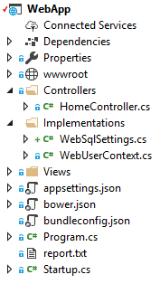


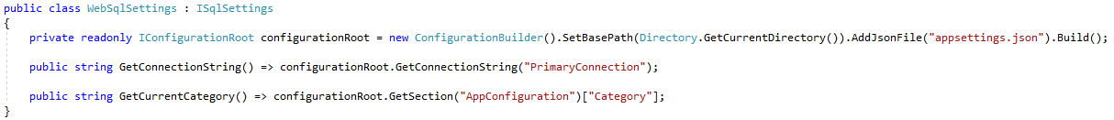

Refactoring

Slide 51
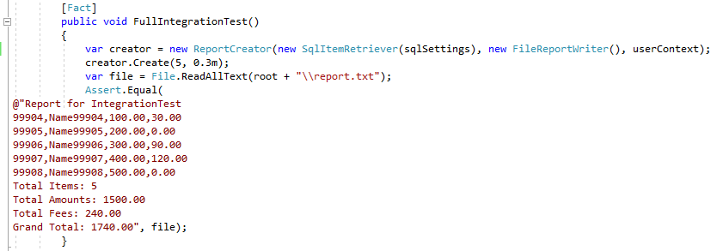
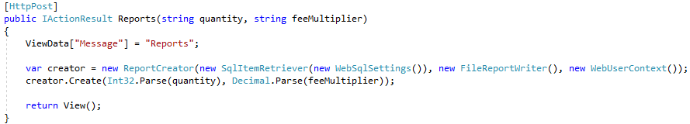
Refactoring

Slide 52
Refactoring
Current directory?
We may turn this into a setting

Slide 53


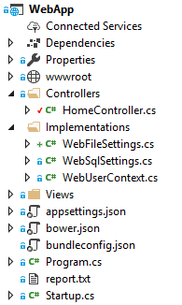
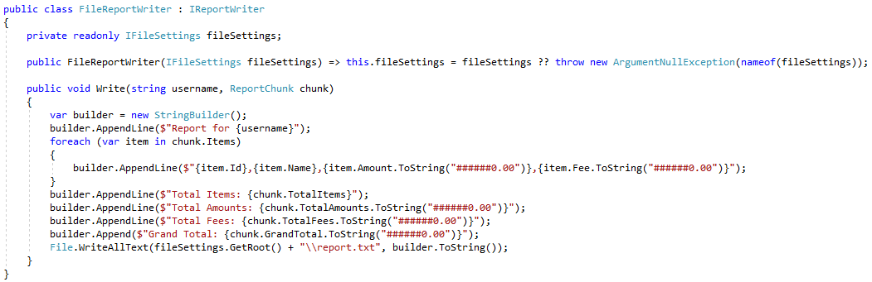

Refactoring

Slide 54

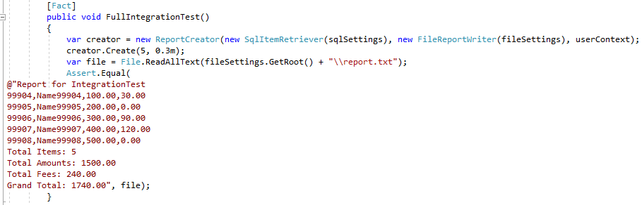
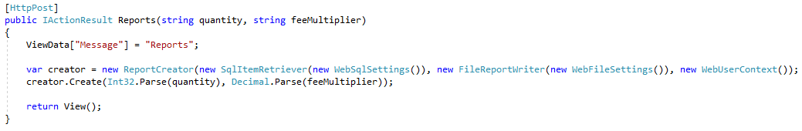
Refactoring

Slide 55
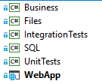
Solution
SQL
Integration Test
Unit Test
Files
Web App
Business
SQL
Files
Env.

Slide 56
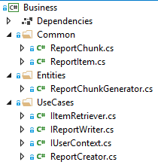
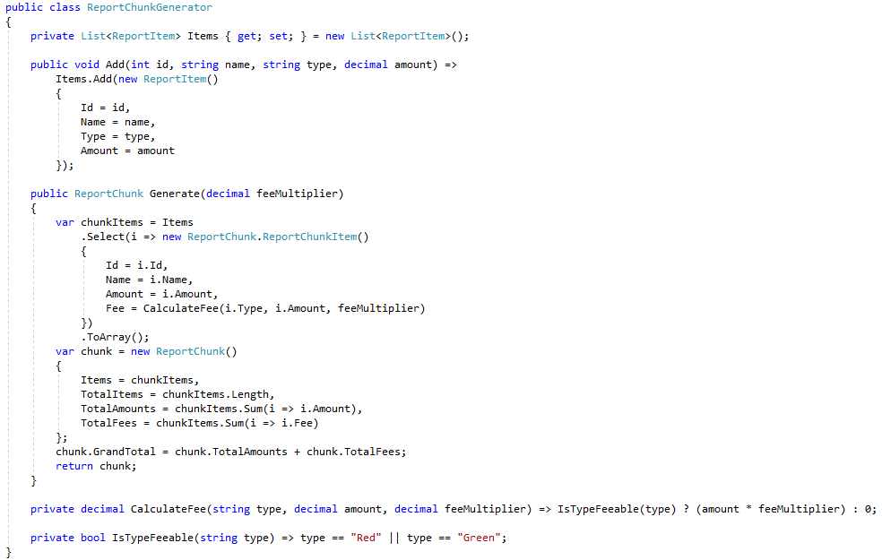
Solution
Primary business logic fully separated
Also fully unit tested
Isolated from knowledge of SQL/Files/Env./etc.

Slide 57
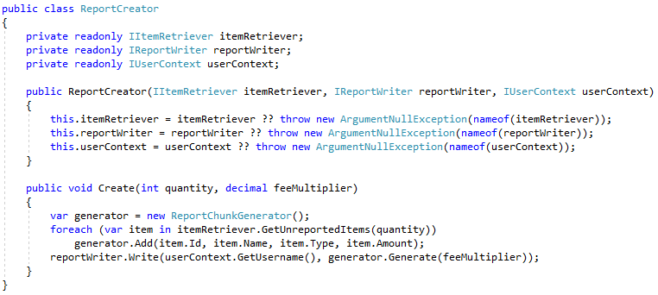
Solution
Class simply orchestrates work, using dependencies
All dependencies are abstracted

Slide 58

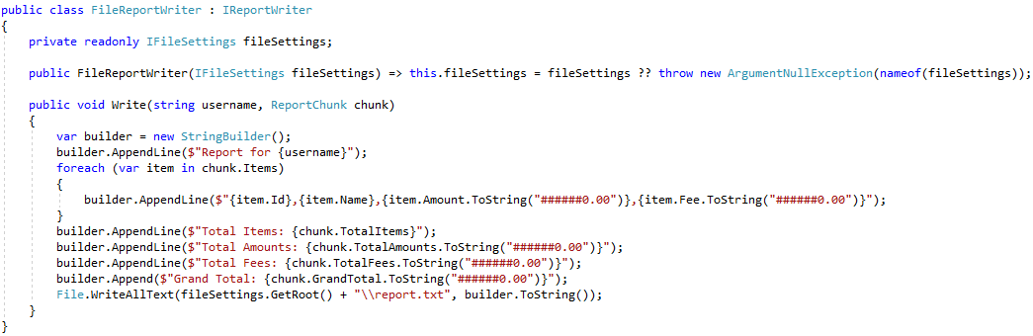
Solution
Files project only contains file-related code

Slide 59


Solution
This integration test removed our fear of refactoring
It can remain in the solution; it may remove future fears

Slide 60


Solution
SQL project only contains SQL-related code

Slide 61





Solution
Web App only contains web-related code

Slide 62
Solution
SQL
Integration Test
Unit Test
Files
Web App
Business
SQL
Files
Env.
Our solution now has a real architecture
The architecture prioritizes the business logic…
… and deprioritizes implementation details.
All projects look at the core business project as an authority

Slide 63
Summary
Best practices, principles, and architecture
can be added to any project
Acknowledge fear as the largest obstacle
Use automated testing as a safety net
Run tests often
Make many small improvements
Separate concepts as much as possible

Slide 64
Info
Derick Linkous
dl@steadyscience.com
“A good architecture maximizes the number of decisions not made.”
- Robert C. Martin

