Slide 1

Psychological Effects of climate change
Do Extreme Climate Events around the world effect climate related anxiety?
Zeev Yampolsky
Lior Degu
DS Name : hurricane_ida_canada_floods.csv

Slide 2
Recap
We tagged 75 comments.
We used 3 questions to measure anxiety level of a comment and cross-validated it with 5 turks.
We combined the 3 question from the 5 turks to a single answer on a [1,5] scale by calculating the mean – anxiety_combined.
We aggregated the final label (anxiety_combined ) from categorial to binary:
If anxiety_combined > 3 than 1
Else 0 (anxiety_combined <= 3)
Model Selection Process:
We tried out a couple of ML models : linear kernel SVM , KNN , Decision Trees , Random Forest and BERT.
For each model the evaluation process was :
Spit the Tagged DS to train/test by 20%:80% ratio.
Train each model with two CV methods :LOO and kFolds with 10 folds,
Calculate the F1 , Accuracy score on the Test DS in each CV iteration.
Calculate the mean F1 , Accuracy score on the Test predictions.
SVM, KNN, DT, RF we TF-IDF select features.
BERT model is advantaged in that that it doesn’t require feature selection , it can process the whole post text.

Slide 3
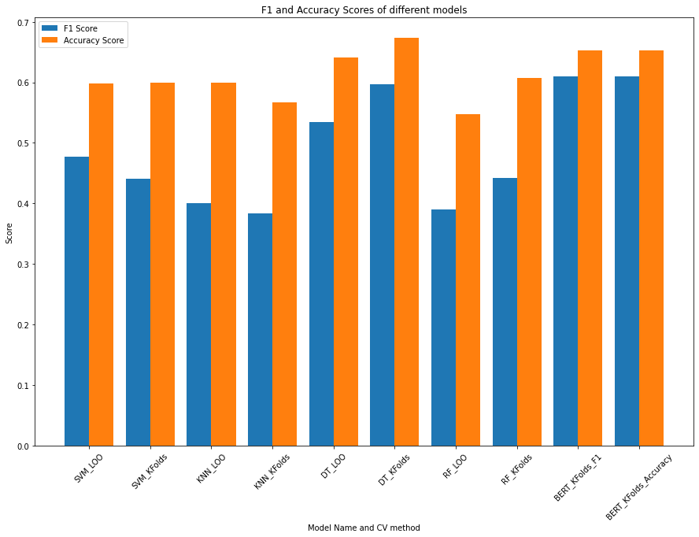
Model Selection Results
Exhaustive search through the models yielded the following result of the F1 and Accuracy scores with LOO and Kfolds CV for each model

Slide 4
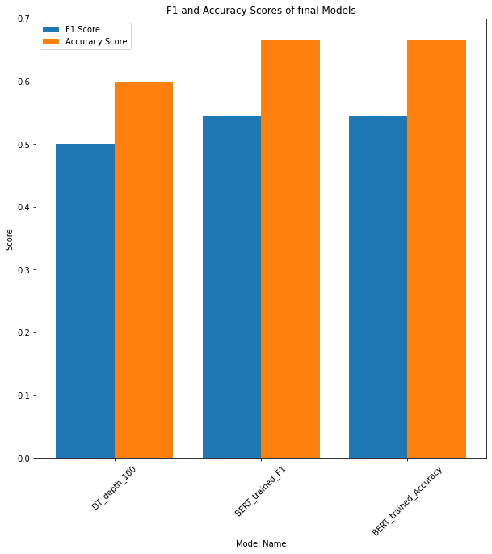

Model Selection Results
Decision Tree with depth = 100 and BERT came in close with:
Accuracy : 0.6-0.65
F1 : 0.5-0.55.
In order to decide we trained the models on the whole train DS and calculated F1, Accuracy on whole Test DS.
Conclusion : BERT wins!

Slide 5
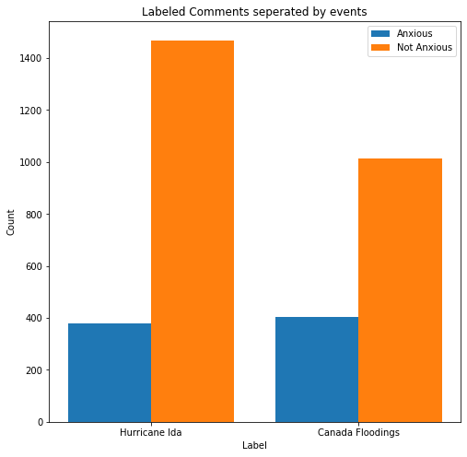
Getting a sense of the full DS now that its tagged
Anxiety labelled comments compered between Hurricane Ida and Canada Flooding's

Slide 6
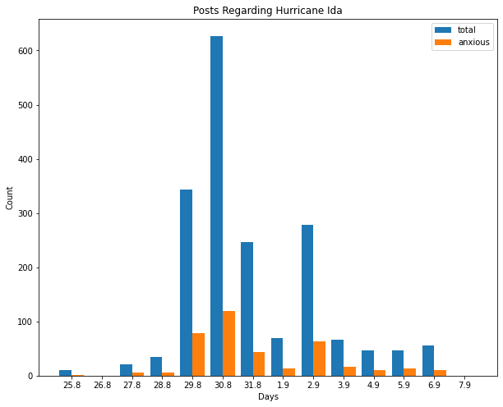
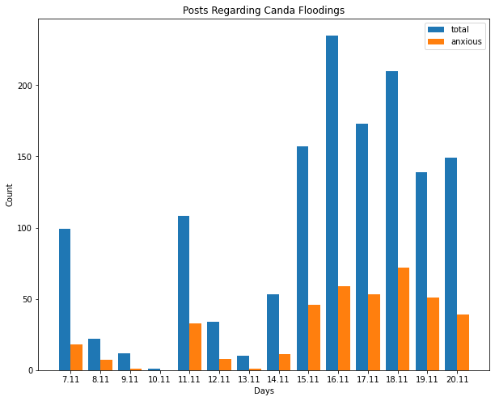
Comparing the anxious labelled comments against the total comments in the climate event time frame
Hurricane Ida happened on 28.8.21-1.9.21
Canada Flooding's happened on 14.11.21-15.11.21

Slide 7
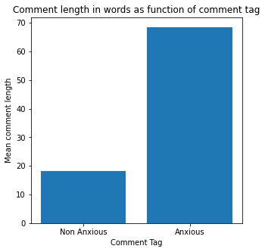
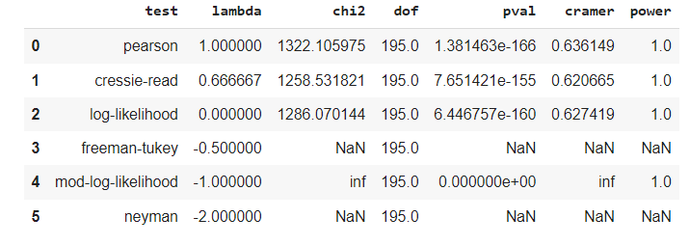
Does Comment length in words number a good indicator for comment anxiety tag?
At first it seems like a good indicator , lets use Pearson chi-square test

Slide 8
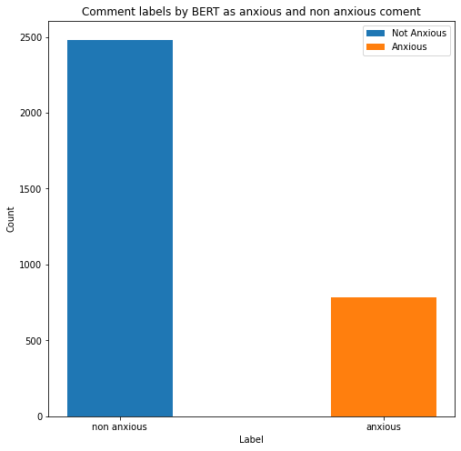
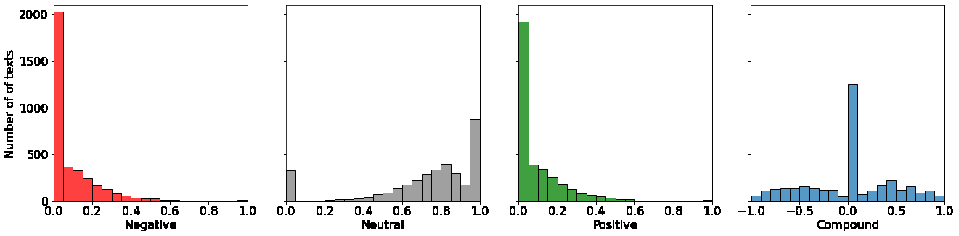
What we learned from the modelling and the features extraction:
Modelling and recognizing the anxiety sentiment from the posts is much more complicated than we expected.
Not as much talk about climate related anxiety as we had expected in the begging :
Very few posts that mention terms as : eco-anxiety/anxiety/anxious.
Very few posts that mention negative words : doom , gloom , sad , frustration.
Most of the chatter in the subreddits was about the science behind climate change.
High number of posts and discussions that express worry which result mostly in call for action and reassurance the not all is lost yet.
This led us to the understanding that probably the eco-anxiety phenomenon is not wide spread as we thought and as we will find out in the full DS analysis.
Sentiment Analysis Vs total Anxious/non-Anxious posts tagged by the model
Sentiment tagged by DARTH on whole DS

