Slide 1


Psychological impact of climate change
Zeev Yampolsky
Lior Degu

Slide 2
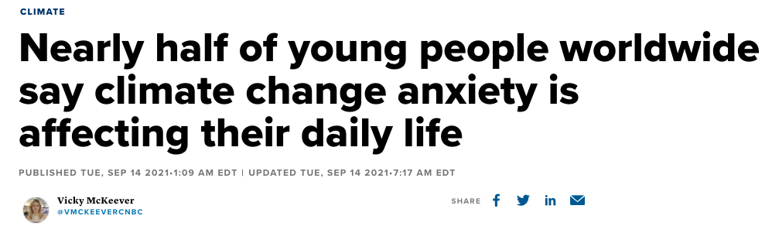
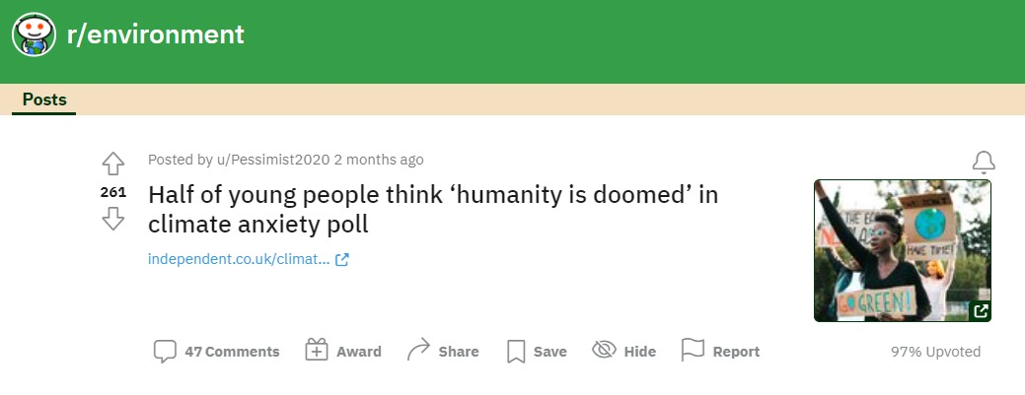

How does climate change affect anxiety?

Slide 3
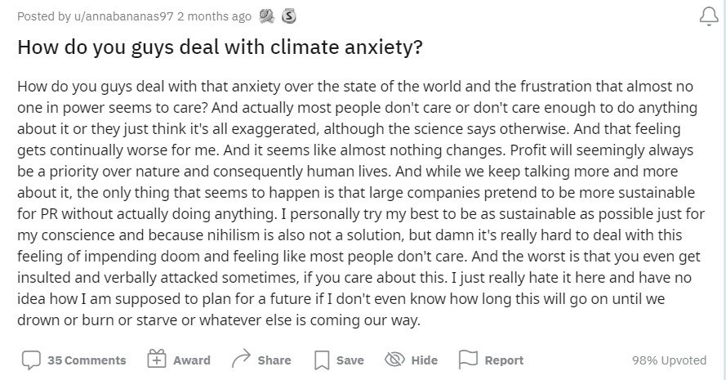
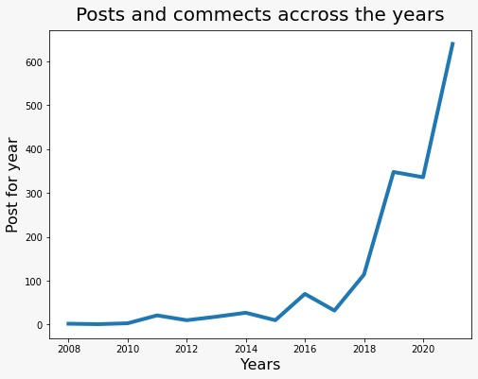
Dataset
We searched for ”anxiety” is these subrettis:
r/climatechange
r/ environment
r/sustainability
r/climate
#Post 224
#Comments 1408
Date range: 08/2008 – 11/2021

Slide 4
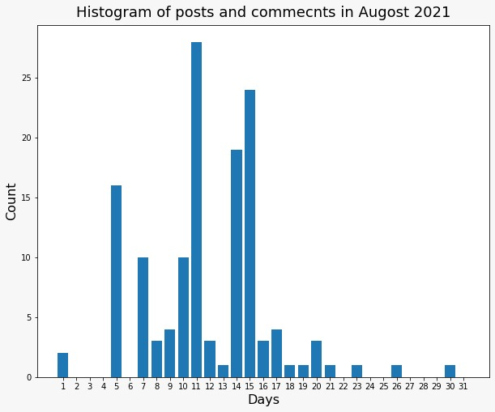
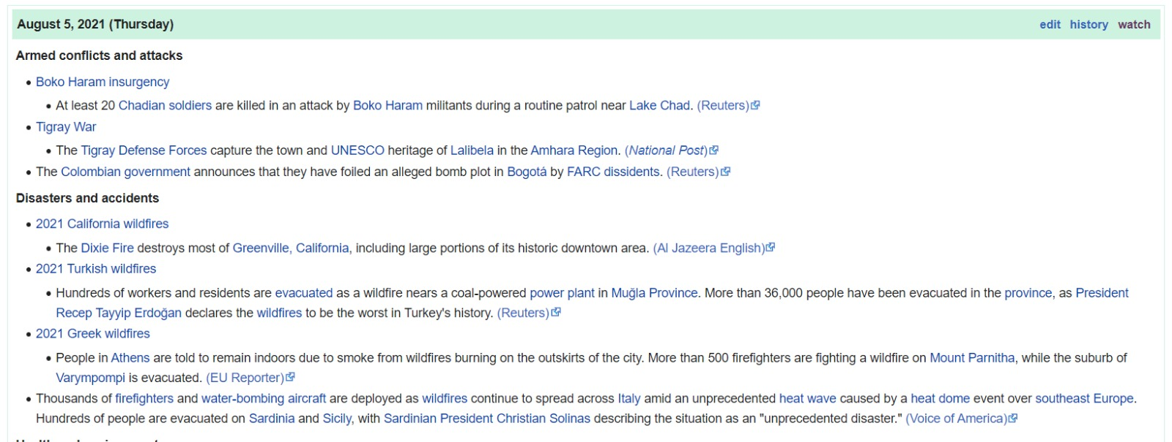
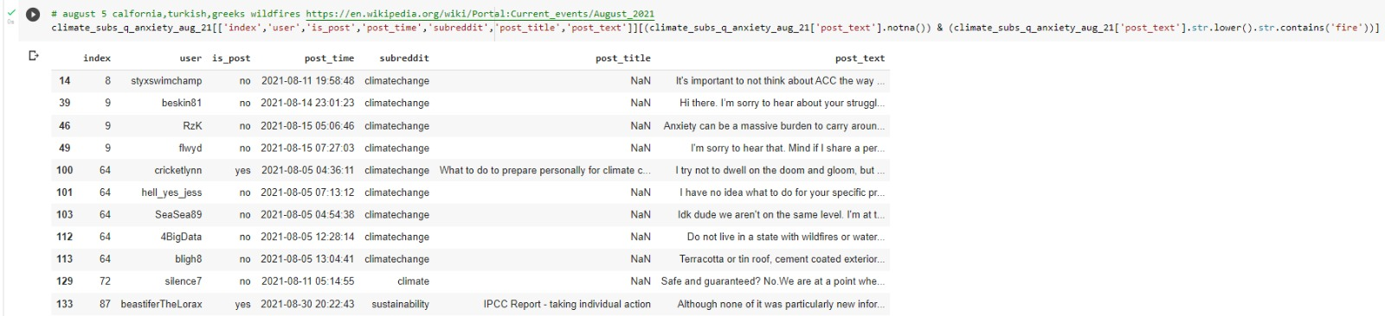
Example from the dataset

