Slide 1

Psychological Effects of climate change
Do Climate Events around the world effect climate related anxiety?
Zeev Yampolsky
Lior Degu
DS Name : subs_scrape_by_events_words.csv

Slide 2
Psychological Effects of climate change
What did we do?
Creating the Initial DS
We changed our search strategy : from hit words to dates around weather events
Heatwave during late June and mid July
Filtering posts from the DS for the questionnaire:
Post length up to 450 chars
Further filtering :
Mention of heatwave events (“heat” ,”heatwave” , “feel” )
First person use ( “I”,”me”,”myself”)
Creating the questionnaire randomly on the filtered posts
DS Name : subs_scrape_by_events_words.csv

Slide 3
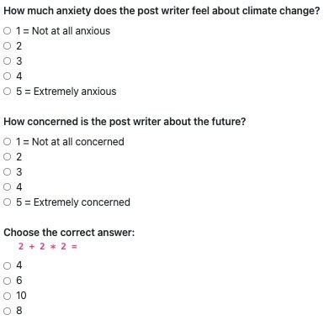
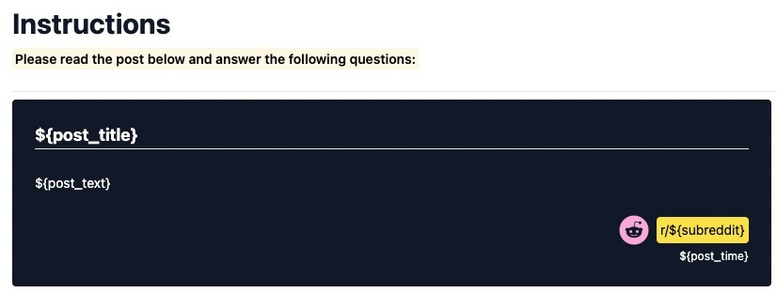
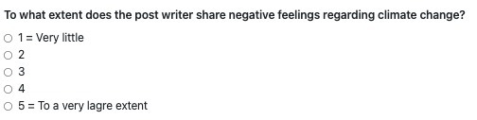
Psychological Effects of climate change
Questionnaire Goal
Our goal is to try and determine whether weather events caused by climate change cause anxiety in the population.
Hence we wanted to determine with the help of the turks if the posts from our data set express anxiety , some negative feeling or non at all.
The Questionnaire
DS Name : subs_scrape_by_events_words.csv

Slide 4
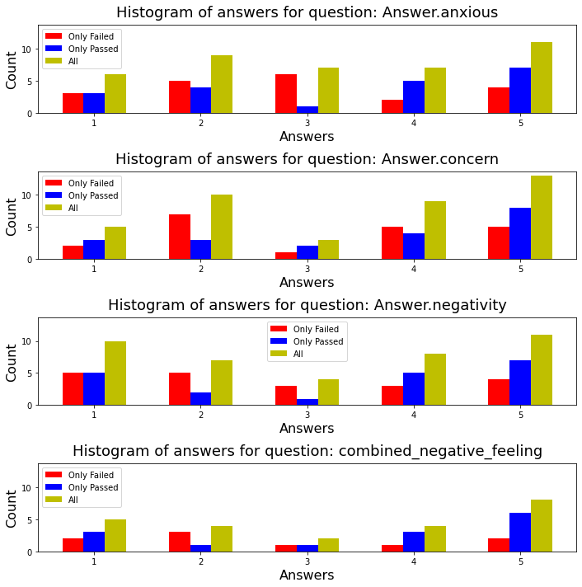
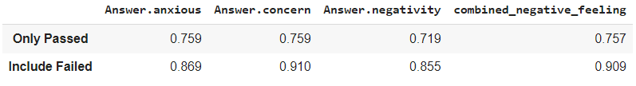
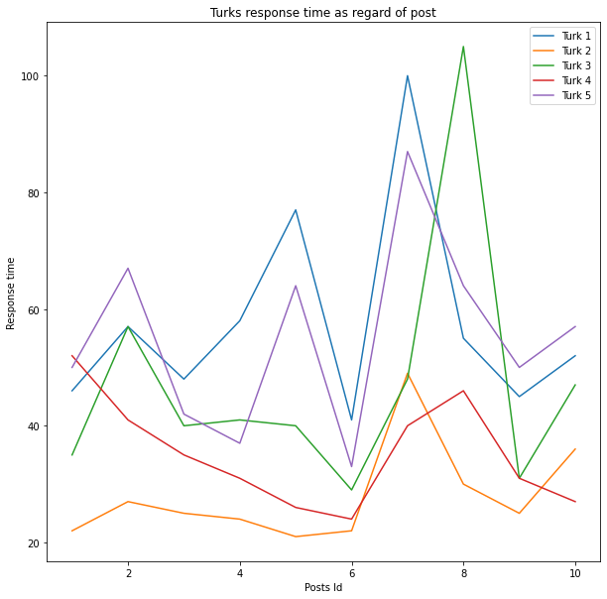
Psychological Effects of climate change
Turks Performance
Cronbach’s
Regardless of Attention Check : 0.933
Only Turks who passed attention Check : 0.982
ICC Per Question
DS Name : subs_scrape_by_events_words.csv

Slide 5
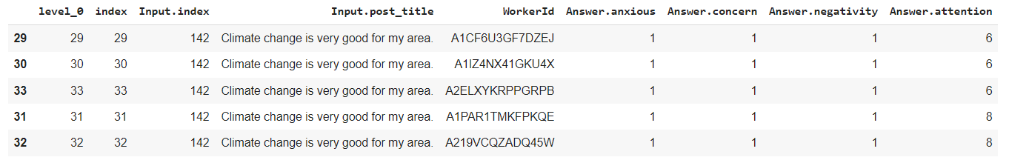
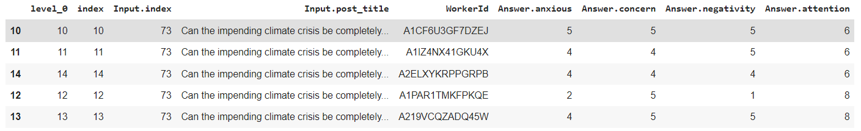
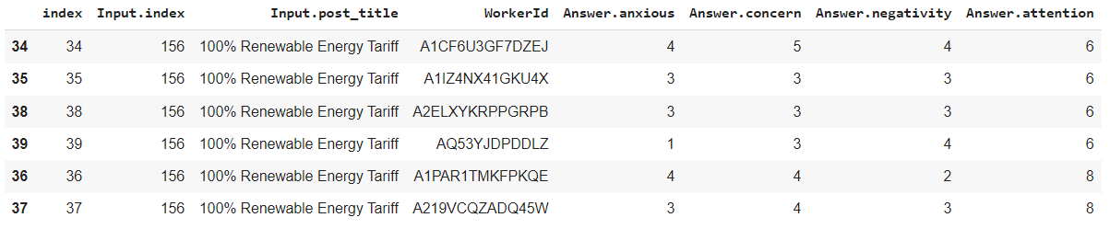
Hunt for the cheaters
Just from looking at the post titles we can infer the conveyed emotion

Slide 6
Expected Costs
On the first try we paid 0.05 per assignment.
On second try we paid 0.11 per assignment.
In the next task we would like to label around 100 posts , considering our tight budget we would need to regroup and rethink how to reward the Turks with decent pay.

