Slide 1

Psychological Effects of climate change
Do Climate Events around the world effect climate related anxiety?
Zeev Yampolsky
Lior Degu
DS Name : hurricane_ida_canada_floods.csv

Slide 2
Psychological Effects of climate change
What did we do?
Creating the Initial DS
We focused on two extreme weather Events:
hurricane Ida (End of August – Start of September)
Canada flooding mainly in British Columbia and Vancouver (middle of November)
We changed our search strategy :by event names and event dates
Filtering posts from the DS for the questionnaire:
Further filtering :
Mention of event name in the post title
Using only first layer comments of the filtered posts
Furter filtering removed/deleted posts
Creating the questionnaire randomly on the filtered posts
DS Name : subs_scrape_by_events_words.csv

Slide 3
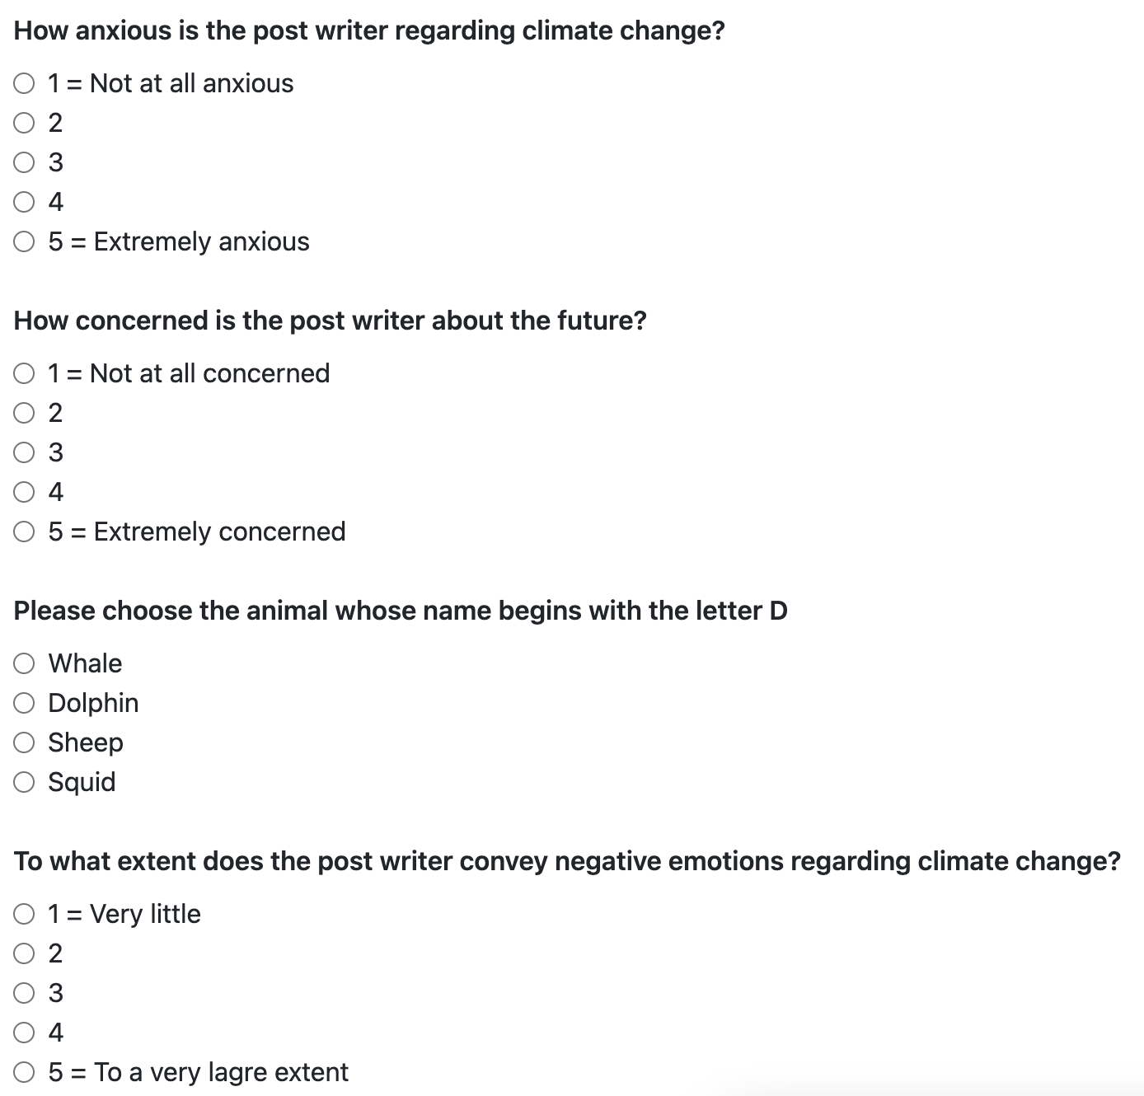
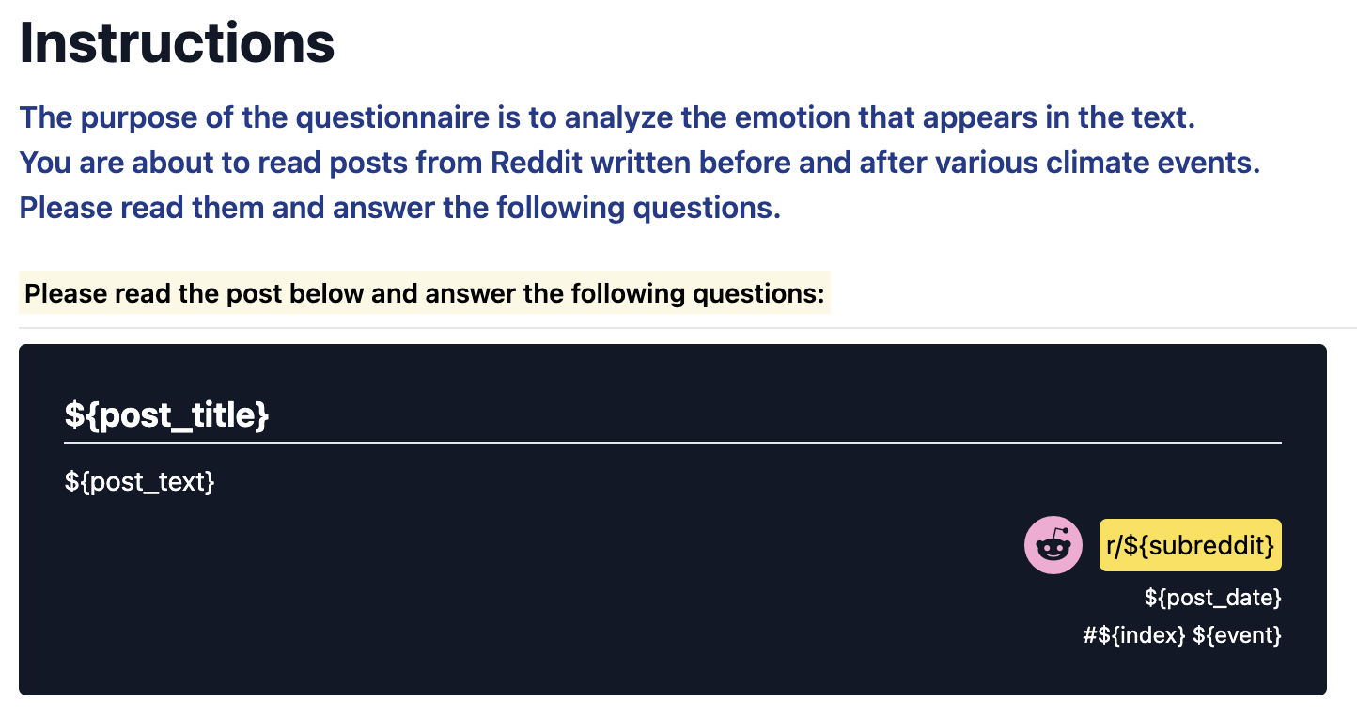
Psychological Effects of climate change
Questionnaire Goal
Our goal is to try and determine whether weather events caused by climate change cause anxiety in the population.
Hence we wanted to determine with the help of the turks if the posts from our data set express anxiety , some negative feeling or non at all.
The Questionnaire
DS Name : subs_scrape_by_events_words.csv

Slide 4
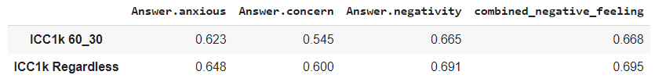
Psychological Effects of climate change
Turks Performance
Catching cheaters:
All of our Turks passed our attention check , but after reviewing the response time for each post we found large variance in overall response time and in response time per post.
We found:
Median Response time : about 30 seconds.
Median , mean comment length(# of words) are : about 36 and 60 words.
We dropped all the following responses which answer the condition:
Response time is longer than 30 seconds AND comment length larger than 60 words.
Dropped 35 Turks responses, left with 340 responses (out of 375 responses ~ 9.3% dropped)
Cronbach’s Alpha :
No drop outs: 0.869
Dropping as said above : 0.867
ICC Per Question
DS Name : subs_scrape_by_events_words.csv

Slide 5
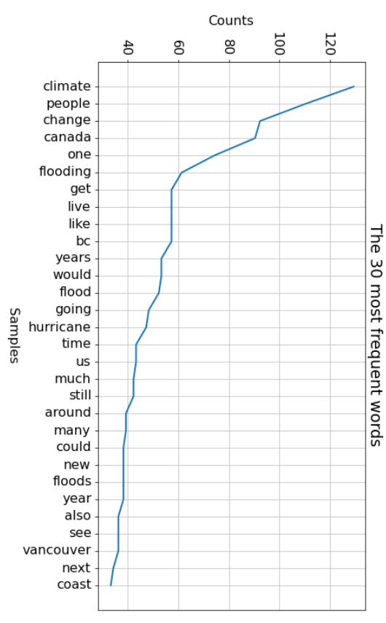
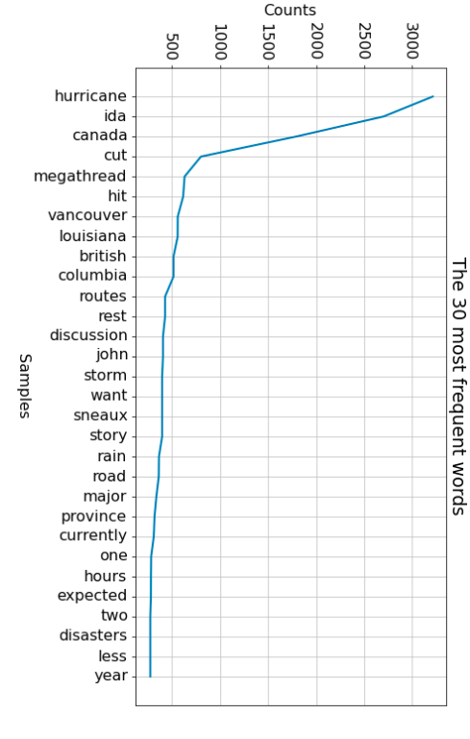
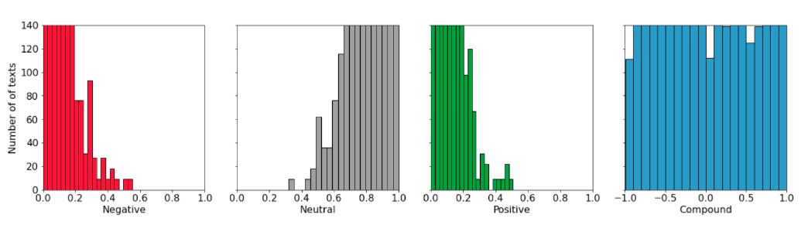
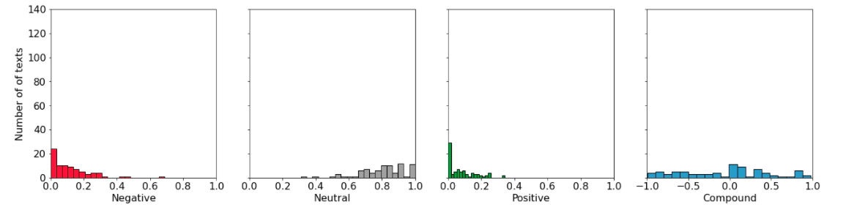
Analysing the Tagged DS and original DS
Common Words in Tagged (by Turks) DS and untagged DS
Sentiment analysis
Untagged data
Tagged data

Slide 6
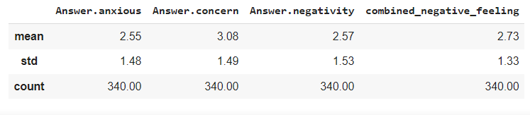
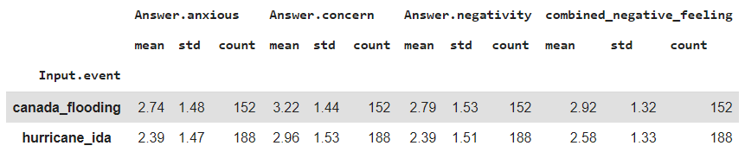
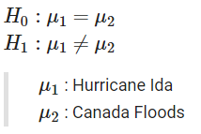
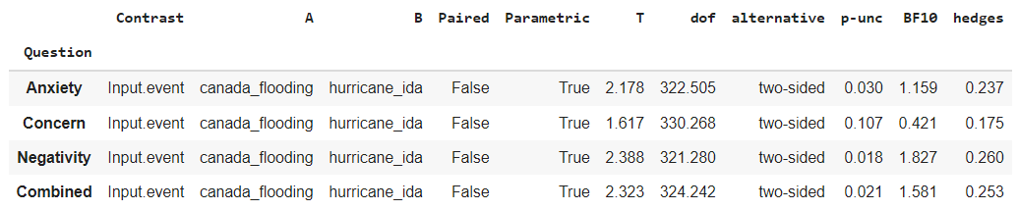
Checking the anxiety level reported by the Turks
Testing whether mean combined negativity for Hurricane Ida is same with Canada flooding’s
Basis for the assumption
Results for the t-test

