Slide 1
Shell Programming
Notes:
CSCI 330 - The UNIX System
NIU - Department of Computer Science

Slide 2
Why Shell Scripting ?
Shell scripts can be used to prepare input files, job monitoring, and output processing.
Useful to create own commands.
Save lots of time on file processing.
To automate some task of day to day life.
System Administration part can be also automated.

Slide 3
What is a “Shell”?
The “Shell” is simply another program on top of the kernel which provides a basic human-OS interface.
  It is a command interpreter
    Built on top of the kernel
    Enables users to run services provided by the UNIX OS
  In its simplest form, a series of commands in a file is a shell program that saves having to retype commands to perform common tasks.
How to know what shell you use
  echo $SHELL
Shell
user
user
OS
user

Slide 4
UNIX Shells
sh Bourne Shell (Original Shell) (Steven Bourne of AT&T)
bash Bourne Again Shell (GNU Improved Bourne Shell)
csh C-Shell (C-like Syntax)(Bill Joy of Univ. of California)
ksh Korn-Shell (Bourne+some C-shell)(David Korn of AT&T)
tcsh Turbo C-Shell (More User Friendly C-Shell).
To check shell:
  $ echo $SHELL (shell is a pre-defined variable)
To switch shell:
  $ exec shellname (e.g., $ exec bash or simply type $ bash)
  You can switch from one shell to another by just typing the name of the shell. exit return you back to previous shell.
Notes:
10/30/20089/25/20089/11/2008
9/25/20089/11/2008
Shell Scripting
9/11/2008
Research Computing Center, UNC-CH

Slide 5
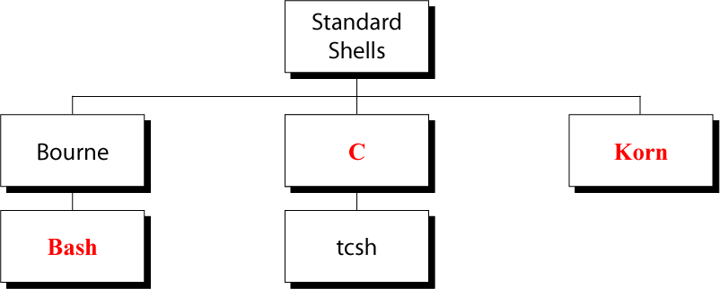
UNIX Command Interpreters

Slide 6
Introduction to Shell Programming
Shell programming is one of the most powerful features on any UNIX/Linux system
If you cannot find an existing utility to accomplish a task, you can build one using a shell script
Notes:
The C Shell
Copyright Department of Computer Science, Northern Illinois University, 2005

Slide 7
What is Shell Script?
A shell script is a script written for the shell
Two key ingredients
  UNIX/LINUX commands
  Shell programming syntax

Slide 8
Shell Program Structure
A shell program contains high-level programming language features:
  Variables for storing data
  Decision-making control (e.g. if and case statements)
  Looping abilities (e.g. for and while loops)
  Function calls for modularity
A shell program can also contain:
  UNIX commands
  Pattern editing utilities (e.g. grep, sed, awk)
Notes:
The C Shell
Copyright Department of Computer Science, Northern Illinois University, 2005

Slide 9
YOUR SHELL PROGRAMMING LIBRARY
Naming of shell programs and their output
  Give a meaningful name
  Program name example: findfile.csh
  Do not use: script1, script2
  Do not use UNIX command names
Repository for shell programs
  If you develop numerous shell programs, place them in a directory (e.g. bin or shellprogs)
  Update your path to include the directory name where your shell programs are located
Notes:
The C Shell
Copyright Department of Computer Science, Northern Illinois University, 2005

Slide 10
Steps to Create Shell Programs
Specify shell to execute program
  Script must begin with #! (pronounced “shebang”)
  to identify shell to be executed
Examples:
    #! /bin/sh (defaults to bash)
    #! /bin/bash
    #! /bin/csh
    #! /usr/bin/tcsh
Make the shell program executable
  Use the “chmod” command to make the program/script file executable
Notes:
The C Shell
Copyright Department of Computer Science, Northern Illinois University, 2005

Slide 11
FORMATTING SHELL PROGRAMS
Formatting of shell programs
  Indent areas (3 or 4 spaces) of programs to indicate that commands are part of a group
  To break up long lines, place a \ at the end of one line and continue the command on the next line
Comments
  Start comment lines with a pound sign (#)
  Include comments to describe sections of your program
  Help you understand your program when you look at it later
Notes:
The C Shell
Copyright Department of Computer Science, Northern Illinois University, 2005

Slide 12
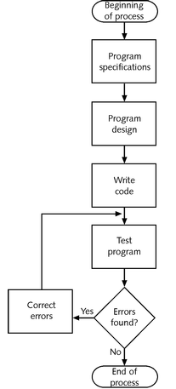
Steps of Programming
Guidelines:
  use good names for
    script
    variables
  use comments
    lines start with #
  use indentation to
  reflect logic and
  nesting

Slide 13
Example: “hello” Script
#! /bin/csh
echo "Hello $USER"
echo "This machine is `uname -n`"
echo "The calendar for this month is:"
cal
echo "You are running these processes:"
ps
Notes:
The C Shell
Copyright Department of Computer Science, Northern Illinois University, 2005

Slide 14
Example script output
% chmod u+x hello
% ./hello
Hello ege!
This machine is turing
The calendar for this month is
February 2008
S M Tu W Th F S
1 2 3 4 5 6 7
8 9 10 11 12 13 14
15 16 17 18 19 20 21
22 23 24 25 26 27 28
You are running these processes:
PID TTY TIME CMD
24861 pts/18 0:00 hello.csh
24430 pts/18 0:00 csh
Notes:
The C Shell
Copyright Department of Computer Science, Northern Illinois University, 2005

Slide 15
Shell script is a high-level language that must be converted into a low-level (machine) language by UNIX Shell before the computer can execute it
UNIX shell scripts, created with the vi or other text editor, contain two key ingredients: a selection of UNIX commands glued together by Shell programming syntax
UNIX/Linux shells are derived from the UNIX Bourne, Korn, and C/TCSH shells
UNIX keeps three types of variables:
  Configuration; environmental; local
The shell supports numerous operators, including many for performing arithmetic operations
The logic structures supported by the shell are sequential, decision, looping, and case

