Slide 1
Internet

Slide 2
INTERNET
The term Internet has been coined from two terms, i.e., interconnection and network.
A network is simply a group of computers that are connected together for sharing information and resources.
Several such networks have been joined together across the world to form what is called as the Internet.
The Internet is thus a network of networks.

Slide 3
INTERNET DEFINITION
It refers to the vast collection of interconnected networks that use the TCP/IP protocols and that evolved from the ARPANET of the late 60’s and early 70’s.
The Internet is the world’s largest computer network that enables computers of all kinds to share services and communicate directly with each other, as if they were part of one giant seamless global computing machine.

Slide 4
INTERNET : composition
The Internet comprises thousands of
local area networks,
groups of computers including government supercomputers,
campus-wide information systems, and
individual workstations.
Each of these different computers, connected on Internet running on different platforms or operating systems, follows certain standards or rules of communication called protocols.

Slide 5
Internet
The standard protocol used for Internet communication is called Transmission Control Protocol / Internet Protocol or TCP/IP.
Standardised communication protocols allow similar, dissimilar, near and distant computers to communicate with one another.
The Federation National Council (FNC) in 1995 referred the Internet as Global Information System that
is logically linked together by a globally unique address space based on the Internet Protocol (IP) or its subsequent extensions
is able to support communications using Transmission Control Protocol/Internet Protocol (TCP/IP) suite or its subsequent extensions, and/ or other IP-compatible protocols.
provides, uses or makes accessible, either publicly or privately, high level services layered on the communications and related infrastructure.

Slide 6
It may be seen that FNC has described the
Internet as a global information system.
Concept of Communication technology
Protocols
End user applications
In many ways, this definition supports the
characterisation of the Internet as an ‘Information Superhighway

Slide 7
INTERNET DEFINITION
Internet Society (ISOC) defines Internet as a
‘global network of networks’ enabling
computers of all kinds to directly and transparently communicate and share services
throughout the world using a common communication protocol. It should not be seen as merely a collection of networks and computers.

Slide 8
History of Internet
Originating from a network owned by the US Defence project, the Internet, till 1970s connected a limited number of computers accessible only to computer scientists and researchers in USA and allied countries for the purpose of defence research.
Initially, it became accessible to universities and research institutions to facilitate easier and faster communication between scientists and researchers.
The history of Internet can be traced back to 1957 when erstwhile Soviet Union launched its first satellite, Sputnik I, prompting US President Dwight Eisenhower to launch Defence Advanced Research Projects Agency (DARPA) to regain the lead in the technological race.

Slide 9
History of Internet
The DARPA developed its first successful satellite in 18 months. By the end of 1960, it began to focus on computer networking and communication technology essentially to establish communication links between research centres and universities established across the country as part of its overall mission
ARPANET was commissioned in 1969 and by 1971 it had 15 nodes and 23 hosts.
The e-mail was invented in 1972 by Ray Tomlinson to send messages across a distributed network.
In 1973, the first international connection to the evolving Internet was established at the University College of London and the Royal Radar Establishment (Norway).

Slide 10
History of Internet
The system of protocols which was developed over the course of this research effort became known as the TCP/IP Protocol Suite, after the two initial protocols developed: Transmission Control Protocol (TCP) and Internet Protocol (IP).
The year 1982 was a year of great significance in the growth and development of Internet.
Defence Communication Agency (DCA) and DARPA adopted Transmission Control Protocol (TCP) and Internet Protocol (IP) suite (commonly known as TCP/IP) as the official protocol suite for ARPANET.

Slide 11
History of Internet
The University of Wisconsin developed ‘Name Server’ in 1982 that facilitated translation of names into strings of numbers.
This development led to the practice of assigning domain names for the sites that is being practiced even now.
Domain Name Servers as distributed databases were introduced in 1984 to facilitate translation from domain names to IP addresses.
Transition to naming standards from numeric addresses proved to be very helpful in popularisation of the Internet. For example, it is much easy to remember www.yahoo.com than its numerical equivalent.

Slide 12
History of Internet
A computer virus for the first time affected approximately 6,000 of total 60,000 hosts on the Internet in the year 1988. The vulnerability of Internet and the need for more security was realised for the first time. DARPA formed the Computer Emergency Response Team (CERT) in response.
In the same year, Department of Defence adopted Open Systems Interconnection (OSI).
During the early 1990’s, OSI protocol implementations also became available and, by the end of 1991, the Internet has grown to include some 5,000 networks in over three dozen countries, serving over 700,000 host computers used by over 4,000,000 people. The ARPANET ceased to exist in 1990.

Slide 13
History of Internet
Access to Internet was first offered on commercial basis by ‘World’(world.std.com), thus it became the first Internet Service Provider (ISP) of Internet dialup access.
Several other countries got connected to the Internet in 1990 including Argentina, Austria, Belgium, Brazil, Chile, Greece, India, Ireland, South Korea, Spain and Switzerland.

Slide 14
History of Internet
The most significant development in the history of Internet was the invention of World Wide Web (WWW) by Tim Berners-Lee at the CERN Laboratory in 1991.
The first web browser called ‘Mosaic’ was released in 1993 that took the Internet by storm.
Several other countries got connected to the Internet in the year 1993.

Slide 15
History of Internet
In 1994, the Internet (ARPANET) celebrated its 25th anniversary. Internet shopping and e-commerce commenced its operation on the net.
Growth on the Internet traffic became geometric, i.e., NSFNet traffic passed 10 trillion bytes/month during 1994.
WWW became the second most popular service on the net (behind FTP) leaving Telnet at third place.

Slide 16
Internet Resources Services
The Internet and web hold tremendous potential for a whole array of activities including online distance education, global digital library, e-commerce, Internet telephony, electronic publishing, electronic journals, virtual museums, etc.
It has particularly established itself as a powerful medium for self-education for people in isolated or remote areas for its ease-to-use, familiarity with masses, availability of tools and wider accessibility.

Slide 17
Internet Resources and Services
Three basic services available of the internet:
E-mail
FTP
Telnet
In order to facilitate provision of these basic services, a number of user-friendly tools have been developed.
Hytelnet, Archie, Gopher, Veronica, WAIS, WWW.
The web has become the most successful networked multimedia hyper-text-based system of our time.
HTML, the de facto language of the web, is extremely simple yet powerful to use.

Slide 18
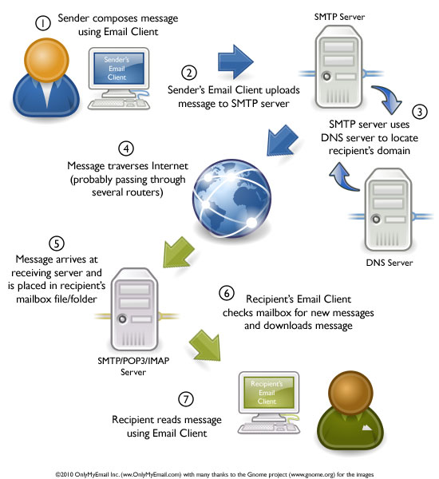
Electronic mail
It enables internet users to communicate with other users individually or collectively by exchanging messages.
Email also allows to share files as attachments.

Slide 19
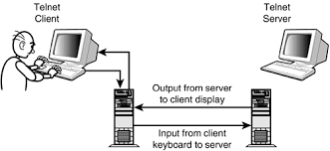
TELNET
Enables a user on one computer in the network to access information or run programs on another computer on the network.
The service was introduced so that an internet user on site (Local Site( could access data, software and other facilities situated at another site (remote site).
Telnet series makes it possible to share services and resources without having to move large amounts of data or programs from one site to another.
“Telnet is an internet exploration tool that allows computers to connect to another network and login as a local user of that network system”.

Slide 20
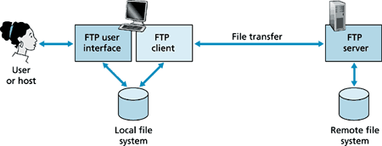
File Transfer Protocol(FTP)
Enables a user to retrieve a file quickly from a remote site.
The service is most effective when the exact location of the file, filename, directory name and the internet address of the remote system is known and used to transfer files between hosts, without a need to register on the remote system.
FTP is the standard, simplest and most secure way to exchange files over the Internet.

Slide 21
Other services
HYTELNET : a directory of Telnet sites. Categorized by the type of services provided namely, library catalogue, database services, bulletin boards, etc. also contained glossary of network terms.
ARCHIE : a tool to locate a file to be retrieved using FTP. File location can be searched using part of file name on a specialist computer called Archie Servers. The Archie Server scans its database and returns the internet location of the file(domain name of the file). The file is retrieved using anonymous FTP.
Gopher : a menu-based document delivery system. Over 3800 Gopher servers connected on the internet, which collectively known as Gopher space. Gopher was used to access various types of information sources like files, documents, address books, and images, sounds and services in the form of telnet servers. This software was designed to work on any computer system that can be connected to the internet viz. workstations, microcomputers, mainframes, It was very simple and menu driven system and is very easy to operate.

Slide 22
Other services
Veronica : stands for Very Easy Rodent Oriented Netwide Index to computer Archives. It was just like an indexed database consists of different titles and Gopher server items. Provided keywords and other searching techniques for files by searching the menus of thousands of gopher servers. Once the file is located it allowed to browse through that file.
Wide Area Information Server (WAIS) : a specialized software for searching and retrieving text document from databases located anywhere on the internet. The search is based up-on the keyword provided by the user using very elementary search techniques. WAIS identifies document after checking the most closely related document to the given topic. There was no explicit connection between the user site and the site that holds the database. The linkage is handled by the WAIS system. WAIS ensures that the databases requested are searched. The list matching items or articles is displayed and the user can select any of the articles from the list to view on the screen, save on a file or send to an internet address via E-mail.

