Slide 1
Search Engines

Slide 2
Questions about the Web
Q: How many computers are in the world?
A: Over 40 million.
Q: How many of them are Web servers?
A: Over 3 million.
Q: How many Web pages in the world?
A: Over 350 million.
Q: What is the most popular formats of Web documents?
A: HTML, GIF, JPG, ASCII files, Postscript and ASP.
Q: What is the average size of Web document?
A: Mean: 5 Kb; Median: 2 Kb.
Q: How many queries does a search engine answer every day?
A: Tens of millions.

Slide 3
Introduction
Search Engine is in the field of IR
Searching authors, titles and subjects in library card catalogs or computers
Document classification and categorization, user interfaces, data visualization, filtering
Should easily retrieve interested information
IR can be inaccurate as long as the error is insignificant
Data is usually natural language text, which is not always well structured and could be semantically ambiguous
Goal: To retrieve all the documents which are relevant to a query while retrieving as few non-relevant documents as possible

Slide 4
Components
Crawler-based search engines have three major components.
1) The crawler
Also called the spider. The spider visits a web page, reads it, and then follows links to other pages within the site. The spider will return to the site on a regular basis, such as every month or every fifteen days, to look for changes.
2) The index
Everything the spider finds goes into the second part of the search engine, the index. The index will contain a copy of every web page that the spider finds. If a web page changes, then the index is updated with new information.
3) The search engine software
This is the software program that accepts the user-entered query, interprets it, and sifts through the millions of pages recorded in the index to find matches and ranks them in order of what it believes is most relevant and presents them in a customizable manner to the user.

Slide 5
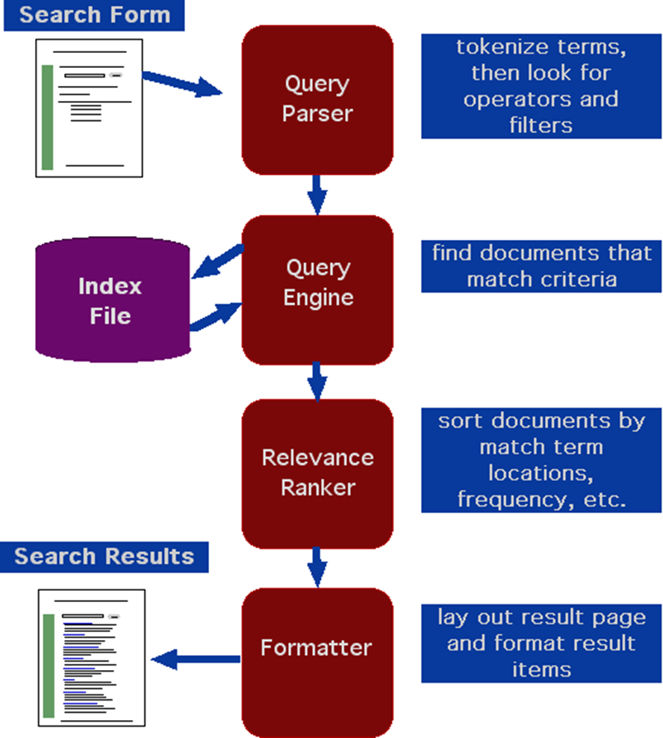
Search Engine Architecture

Slide 6
Web crawlers
Software agents that traverse the Web sending new or updated pages to a main server where they are indexed
Also called robots, spiders, worms, wanders, walkers, and knowbots
The 1st crawler, Wanderer was developed in 1993
Not been publicly described
Runs on local machine and send requests to remote Web servers
Most fragile application
Avoid crawling same pages
Web pages change dynamically
Invalid links: 2% to 9%
Fastest crawlers are able to traverse up to 10 million pages per day

Slide 7
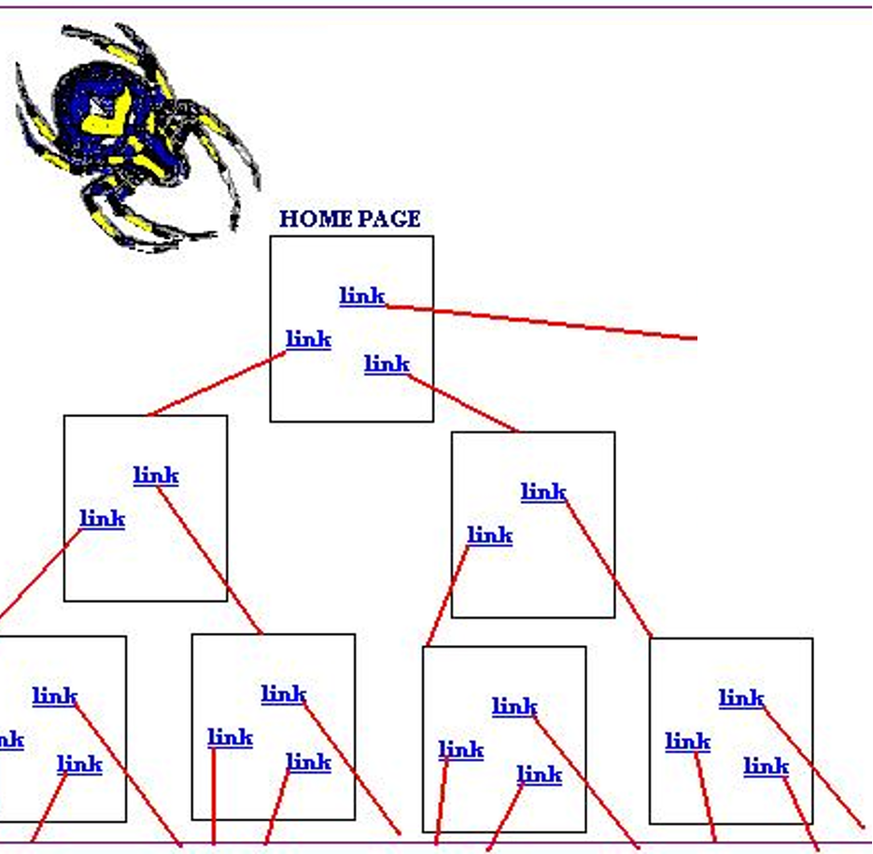
Web Crawling

Slide 8
Types of Search engines
Search by Keywords
Search by categories (e.g. Yahoo!)
Specialize in other languages (e.g. Chinese Yahoo! and Yahoo! Japan)
Meta-search engines (Dogpile, Mamma, and Metacrawler)

