Slide 1
MySQL
Introduction

Slide 2
Introduction to MySQL
Relational databases
Database design
SQL
  Creating databases
  Creating tables
  Selecting from, deleting, and updating tables
Exercises
Useful resource: http://dev.mysql.com/doc/

Slide 3
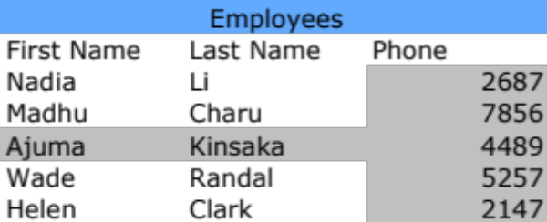
Relational Databases
A relational database is a collection of tables
Columns define attributes of the data
  All data in a column must have the same data type
A record is stored in a row
table name
row
column

Slide 4
Use a Relational Database When…
You have a very large dataset
There is redundant data
  Wastes disk space
  Increases errors
    Information must be updated in multiple locations
Security is important
  Different users can be granted different permissions
Strict enforcement of data types is important

Slide 5
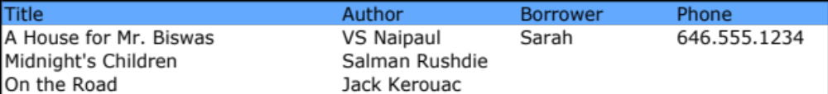
Spreadsheet Example

Slide 6
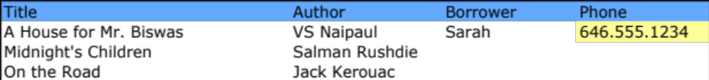
Spreadsheet Example
Data is inconsistent!
Now imagine you are designing the New York Public Library database which has tens of million books and well over a million cardholders.

Slide 7
Database Design
Entity Relationship Design
Entity (“thing”, “object”) |  | Table
Attributes (describe entity) |  | Columns
Entity Instance |  | Row
Relationships between entities preserved in relationships between tables.
The more formal design method is “normalization”.

Slide 8
For example
In a database called ‘library’, there can be following tables
  catalog
  users
  transactions

Slide 9
Our tables
The table ‘user’ can have rows/records of each user
The table ‘catalog’ can have rows/records of each document in the library
The table ‘transactions’ can have row/records of each circulation transaction

Slide 10
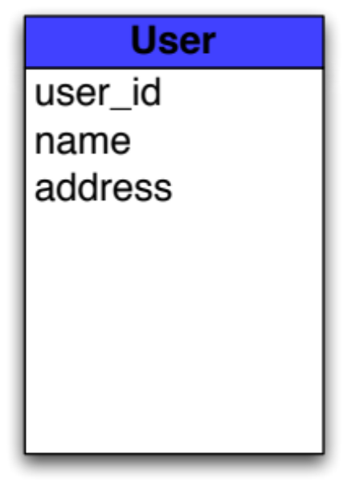
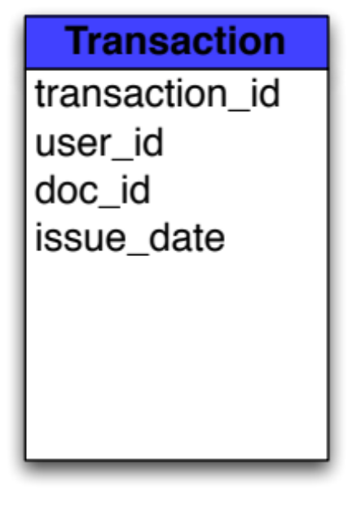
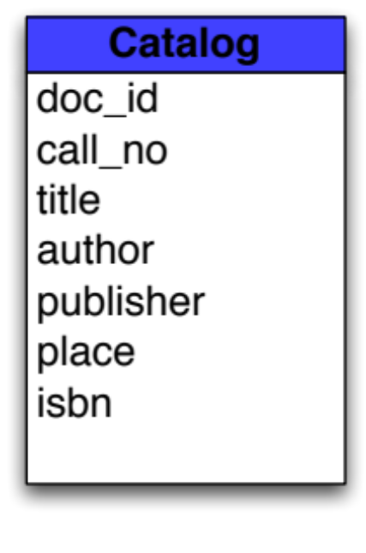

Our Tables
Notes:
An entity relationship diagram describes the tables (table name, columns) and any relationships that exist between the tables. Both the tables and the relationships between the tables should be defined before you create a database.

Slide 11
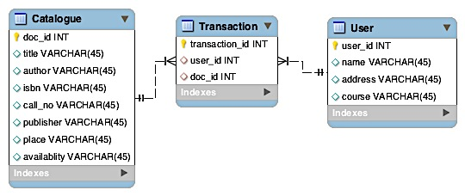
Our Tables
An entity relationship diagram describes the tables (table name, columns) and any relationships that exist between the tables. Both the tables and the relationships between the tables should be defined before you create a database.

Slide 12
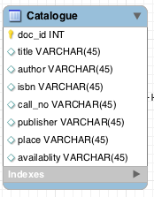
Catalogue Table
The table catalogue comprises of fields/columns
doc_id – storing the unique ID for each document in the library. This id will be used to identify the documents in the database.
Title, author, ISBN, call no, publisher, place and availability of the document is stored in respective fields.

Slide 13
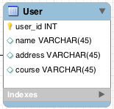
User Table
The table User comprises of fields/columns
user_id – storing the unique ID for each user in the library. This id will be used to identify the users in the database.
Name, address and course of the user is stored in respective fields.

Slide 14
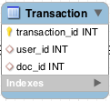
Transactions Table
The table transactions stores the transaction details and comprises of fields/columns
transaction_id – storing the unique ID for each transaction made in the library. This id will be used to retrieve the transaction details from the database.
user_id and doc_id should match from the user table and transaction table.
Also we can store issue_date.

Slide 15
Keys
A primary key is a unique identifier for a record in a table.
A foreign key in one table refers to the primary key of another.
The transaction table has a foreign key, user_id. Each record in the transaction table will have an user id to link it to the correct user record in the user table.

Slide 16
Database Design Caveat
Sometimes design is “sacrificed” for speed.
Use ‘normalisation’
Notes:
For example, sometimes it is faster to have one huge table with redundant data than to have no redundancy and tables that must be joined. If this is the case, and speed is the top priority, design has not really been sacrificed by introducing redundancy since the design meets the need of your situation.

Slide 17
Data Types
float
integer
tinyint
varchar(size)
  stores strings
  size can be between 0 - 255, inclusive
datetime
+ more
Presentation on Mysql datatypes.
Notes:
See “MySQL Pocket Reference” for a complete list of data types.
The presentation on Datatypes can accompany this.

Slide 18
Complete Design
Database name: bu_library

Slide 19
MySQL Installation
Download from
www.dev.mysql.com/downloads

Slide 20
Connecting to MySQL from the Command Line
mysql –u username -p
Example:
>mysql –u root
To EXIT MySQL:
exit;

Slide 21
Basic SQL Commands
SQL statements end with a semicolon
View databases
  SHOW DATABASES;

Slide 22
Importing a Database
Creating a database
  CREATE DATABASE library;
From the command line:
  mysql –u username –p password databasename < filename.sql
Example:
  mysql –u root library< library.sql

Slide 23
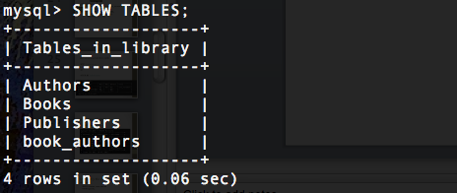
Basic SQL Commands
Open the database for use.
USE databasename;
Display all tables in a database
SHOW TABLES;

Slide 24
Create Table
database name
CREATE TABLE user(
user_id INTEGER NOT NULL AUTO_INCREMENT,
name VARCHAR(35) NOT NULL,
address VARCHAR(60) NOT NULL,
course VARCHAR(10) NOT NULL,
PRIMARY KEY (user_id),
);
column names
Notes:
Create Trii Database
Download http://www.trii.org/courses/introtomysql/trii.sql
Save as trii.sql in the training home directory.
At the command prompt (NOT in MySQL):
mysql -uroot < trii.sql
Run MySQL again
mysql -uroot

Slide 25
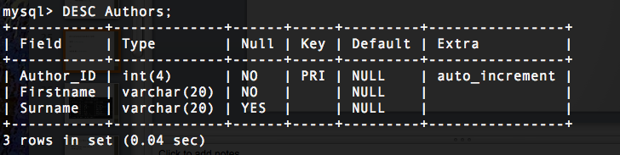
View column details for a table
DESC tablename;
Or
DESCRIBE tablename;

Slide 26
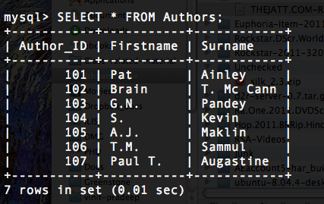
Selecting all data
  SELECT * FROM tablename;

Slide 27
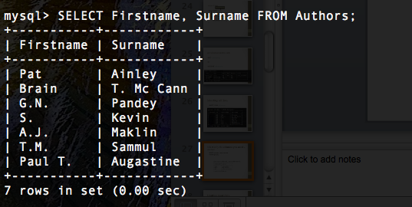
Select only the columns you need (it will be faster)
  SELECT column1, column4
  FROM table;

Slide 28
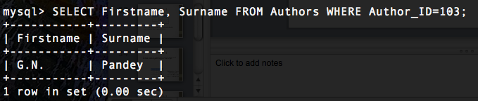
Limiting your data
Get the species name for a specific organism (you have the id)
  SELECT species
  FROM organism
  WHERE organism_id=1;
How do we select all the books issued to an user?

Slide 29
Insert
Inserting a gene
  INSERT INTO tablename
  (column1,
  column2,
  column3,
  Column4) VALUES (‘value-of-column1’,
  Value-of-column2, ‘value-of-column3’, ‘value-of-colum4’);
Get the id of the user:
  SELECT user_id FROM user WHERE name=’Golu';

Slide 30
Delete/Update
Deleting a user
  DELETE FROM user WHERE user_id=2;
Updating a gene
  UPDATE user SET name=‘NEW NAME’
  WHERE name=‘OLDName’;

Slide 31
Table Joins
Sometimes you want data from more than one table. To do this we join the tables. The result is a new (temporary) table.

Slide 32
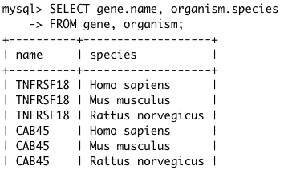
Cross Join
SELECT gene.name, organism.species
FROM gene, organism;
Note: There are only two records in the gene table with the name “TNFRSF18”. One is a mouse gene and the other is a human gene. What do you think happened?

Slide 33
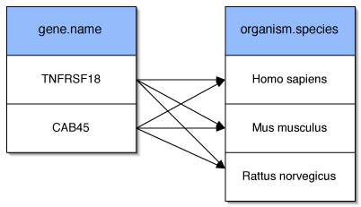
Cross Join (Continued)
Each row of the gene table was joined with every row in the organism table.

Slide 34
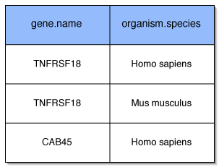
Cross Join (Continued)
We want to use the organism id to match a gene record with the correct organism record so that we get:
Remember there are two gene records with the name “TNFRSF18”.

Slide 35
Cross Join (Continued)
  SELECT gene.name, organism.species
  FROM gene, organism
  WHERE gene.organism_id=organism.organism_id;

Slide 36
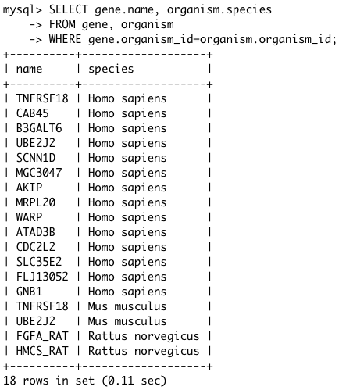
Notice that we have 18 rows and that there are 18 rows in the gene table.

Slide 37
Class #2: Introduction to MySQL (Continued)
Table Joins
Where clause (continued)
Aggregate Functions
Backing up your database
Indexes (if time)
Importing large datasets (if time)

