Slide 1
Multimedia in libraries
MLISc- Class Lecture slides
Vinit Kumar

Slide 2
The primary functions of a library are to collect, organize, preserve, and deliver information to the users.
With the passage of time several techniques and technologies have emerged for handling information more speedily and effectively.
One of the important among them is multimedia.

Slide 3
What?
Multimedia is a combination of some or all forms such as text, data, images, photographs, animation, audio, video; which are converted from different formats into a uni-format digital media and is delivered by computers.

Slide 4
Elements of multimedia
Text: information about an object, event, etc. notes, captions, subtitles, contents, dictionaries, and help facilities.
Data: tables, charts, graphs, spreadsheets, statistics, and raw data.
Graphics: Drawing, printing, maps, etc. (Vector form)
Photographic images: Negative slides, prints. (raster form)
Animation: including both computer generated, video etc.
Audio: including speech and music digitised from cassettes, tapes, etc.
Video: (digital) converted from analog or created with a computer.

Slide 5
The multi
The multimedia creation is possible only if all the forms are converted in digital, so that electronic machines can combine them.

Slide 6
Features of multimedia
Interactivity: users can switch or move to any point
Self paced: user can use the multimedia at his own pace at which he/she feels comfortable
Easy to use: as a lot of media can help in better understanding.

Slide 7
Ex.
Newton’s laws with the help of a bicycle.

Slide 8
Multimedia applications-general
Instructions training and technical presentations
Multimedia communications such as “multimedia email, personal conferencing, video conferencing etc.
Public information points/kiosks for museums hospitals, tourist sites, monuments.
Medical information systems
Multimedia newsletters, books, encyclopedia, dictionaries.
Geographical information systems.
Electronic publishing and bookselling.
Product information catalogues.
Entertainment
Exhibitions such as conference, trade shows,
Interactive displays.
Tourism and entertainment are the industries which are exploiting multimedia.

Slide 9
Multimedia applications: Libraries
Multimedia in libraries can be used for:
Satisfying different information needs; such as reference, enrichment, leisure etc.
Meeting various types of information preferences of the users such as scholarly, scientific, vocational, artistic, recreational, etc.
Serving remote users.

Slide 10
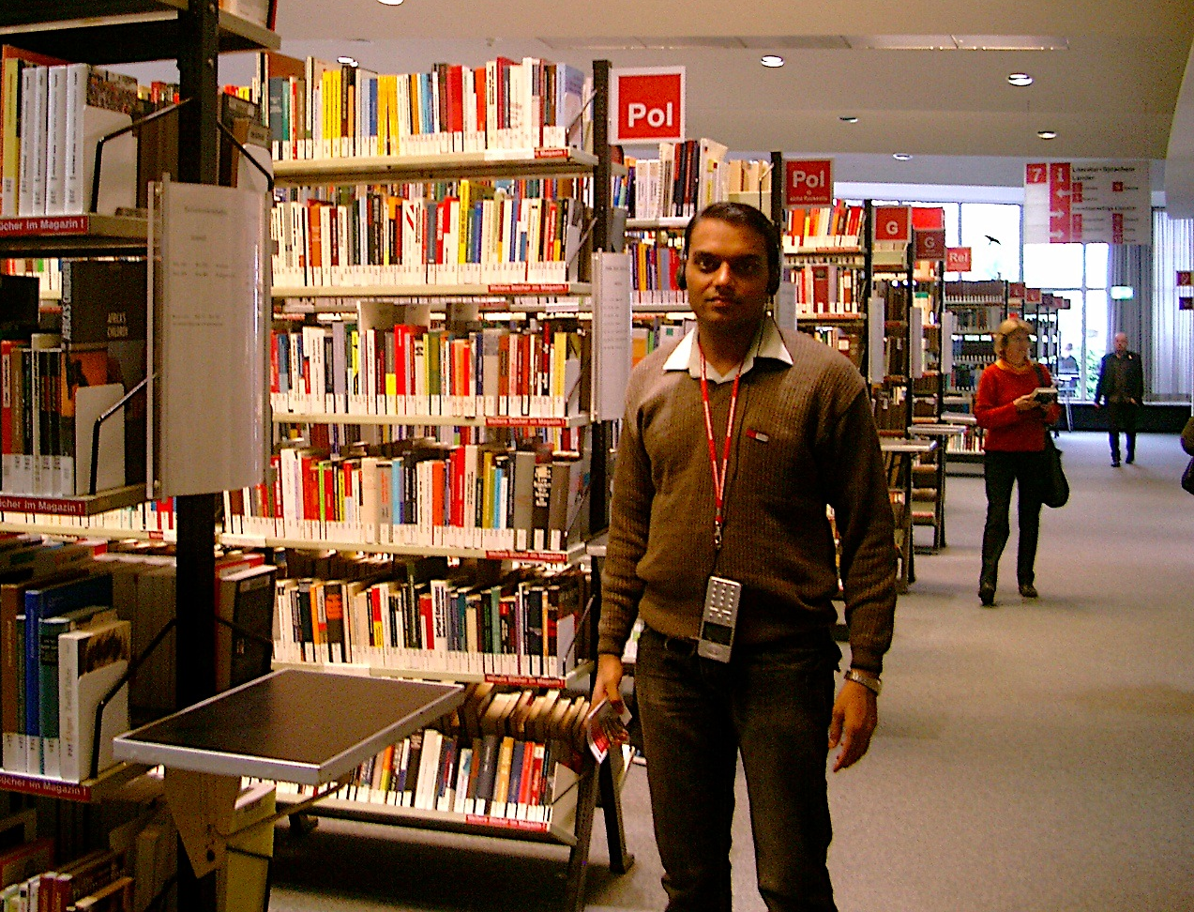
Types of multimedia applications
Multimedia library information kiosks/walk through program.

Slide 11
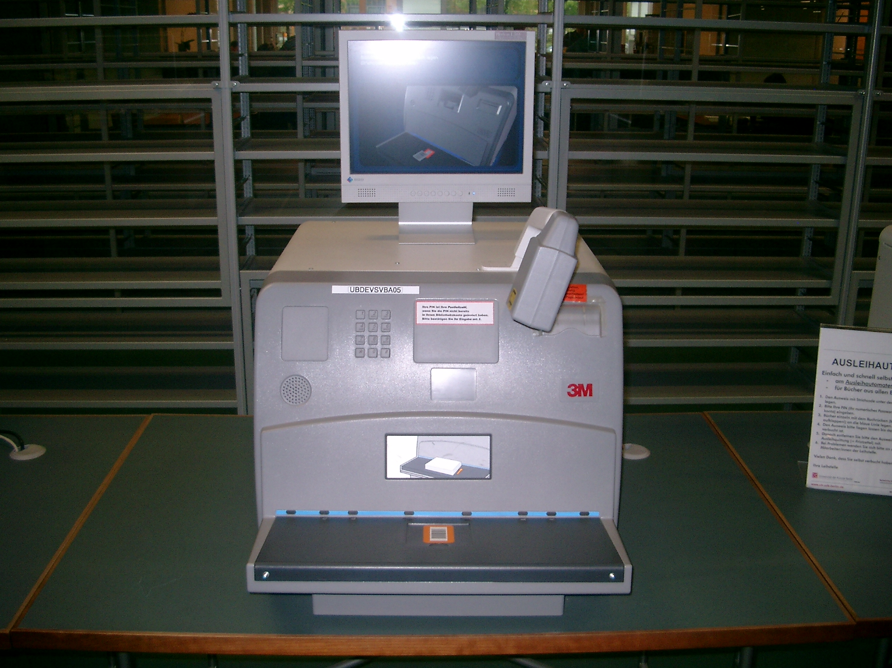
Types of multimedia applications
Multimedia library information kiosks/walk through program.
Instruction /training
Self learning tools
Digital library
Multimedia catalogues
Multimedia information resources
Encyclopedia, dictionaries, reference manuals, e-books, e-newspapers, multimedia fiction.
Geographical information system
Maps with pictures
Call number directories -
Notes:
Call number directories – helps to locate books in different floors showing the picture of those floors and stacks, etc.

Slide 12
Limitations
The requisite HW/SW to setup a multimedia content creation facility is still very expensive.
Lack of proper search and pattern recognition capability for locating information from multimedia databases
Converting all multimedia resources into digital multimedia and storing is difficult.(storage technology limitations)
…

Slide 13
Limitations
High bandwidth is required in distributed networks for successful multimedia databases.
Lack of trained manpower for the development and management of multimedia databases.
Vast amount of work and time is required to create interactive multimedia content.
Lots of other skills are required such as, interpersonal skills, learning and teaching skills
Experience

Slide 14
Hypermedia
Propounded by Ted Nelson.
Logical extension of hypertext.
Any set of multimedia graphics, audio, video, plain text and hyperlinks intertwine to create a generally non-linear medium of information.
BT – Multimedia
NT – Hypermedia
Multimedia with hyperlinks is hypermedia.
Some content on a DVD is linked to some location on the Web.

Slide 15
Basic tools
Screen recorders
Powerpoint presentation software
Image manipulation programs
Movie editors
Quizzing software
Flash card makers
Painting and Drawing tools
OCR software
3-D Modeling and Animation tools
Sound editing programs
Animation software
Notes:
HyperCard

Slide 16
Multimedia authoring tools
Authoring environments that have on-screen tools, like menus prompts, icons, etc. that let users enter text, graphics, branching, logic, etc. and that generate underlying code.
Two types
Entirely point and click types
Require simple scripting
On the basis of display
Card and page based
Icon based-even driven tools
Time based tools

Slide 17
Card and page based
Provides a simple and easily understood metaphor for organising multimedia
1 screen = 1 card = 1 page
Provides a facility for linking objects to pages or cards.
Ex.
HyperCard – linked cards
ToolBox – each page is a screen
+Short development time
+Provide templates
-Platform specific

Slide 18
Icon based-Even driven tools
Easiest authoring process
The events are organized as objects in a flowchart.
Flowchart is built by dragging icons from a library and then adding content to them.
Ex.
Macromedia Authorware,
Iconware
Xerte
Adobe Captivate
+Clear structure
+ easy editing and updating
- difficult to learn
- expensive

Slide 19
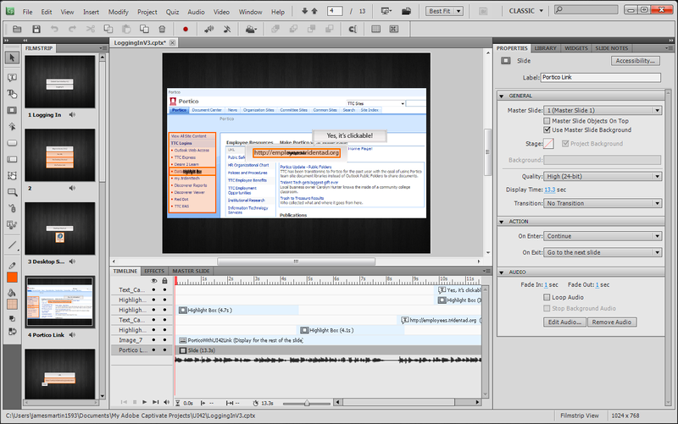

Slide 20
Time based tools
After a specific interval of time another element pops up
Ex. Macromedia Director
Macromedia Flash – allows creation of HTML pages with flash plugins.
A database ‘cast’ contains still images, sound files, text, shapes, scripts, movies and other files.
‘Score’ is a sequence for displaying animating and playing cast members.
‘Lingo’ is scripting language used for interactivity and control

Slide 21
+ Good for animation
+ Good for interactivity
- expensive
- difficult to learn advanced features
‘Cast’ Database
Score
Video
Audio
Image
Text
------------
----------------
--------------Lingo script

Slide 22
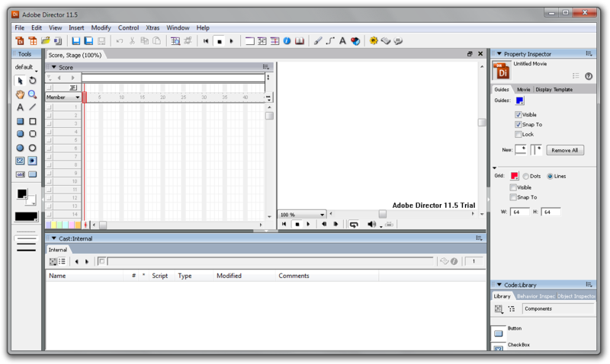

Slide 23
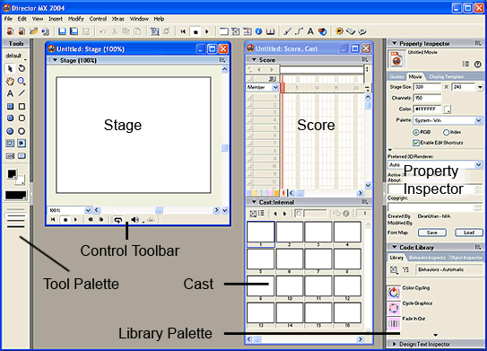

Slide 24
Demos
Screenflow
Java Hotpotatoes
iMovie
Powerpoint
Paint

