Slide 1
Digital Preservation
Practical Tips

Slide 2
What is digital preservation?
Digital preservation is a series of managed activities necessary to ensure continued access to digital materials for as long as they are needed.
The more thoughtful you are about creating and managing your digital files, the longer they'll be around in the future.
Textual, Graphic Illustrations/Artwork/Originals, Maps, Plans, Oversized, Photographs, Aerial Photographs, and Objects/Artifacts

Slide 3
Preservation Principles
Decentralized and distributed preservation (lots of copies keeps stuff safe)
Give libraries local custody and control of their assets
Preserve the publisher’s original authoritative version
Perpetual access – guaranteed and seamless
Affordable and Sustainable

Slide 4
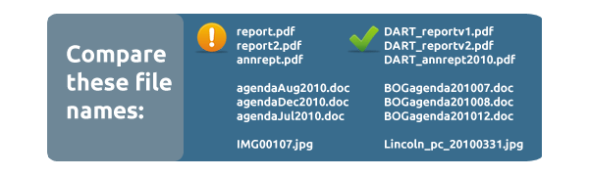
Use good file names
Make them unique, descriptive, and consistent.
Only use letters, numbers, underscores, or periods.
Include a version number or a date (YYYYMMDD) for easy sorting.
http://www.youtube.com/watch?v=Hi_A4Ywn4VU&feature=youtu.be

Slide 5
Back up your files
Store files in a place that is backed up regularly and automatically.
Store important files in multiple places - such as an external hard drive, network storage, or cloud storage - that are in different geographic locations.

Slide 6
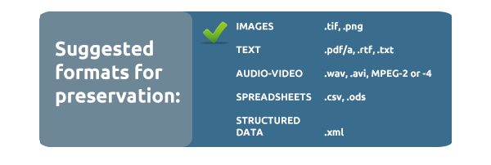
Avoid proprietary file formats
If you can, save your files in open-standard instead of proprietary formats.
Open formats include .png, .tif, .pdf.a, .rtf, OpenDocument formats, .wav, .avi, .csv, and .xml..
http://digitalpreservation.ncdcr.gov/asgii/presentations/archives2011file.pdf

Slide 7
If scanning, use best practices
Create both preservation and access copies. Preservation files should be at a higher resolution, with few or no changes (color correction, cropping, etc.). Access copies can be smaller, altered files.
Where possible, choose lossless file formats for your preservation files.
Scanning guidelines : http://www.archives.gov/preservation/technical/guidelines.pdf

Slide 8
Managing Digital Files
Plan for what you will manage
Identify the possible scope of what you will need to manage to ensure adequate storage space.
Store files you're preserving separate from working files or files used everyday. Your "preservation storage" should only be accessible to a limited number of people.

Slide 9
Keep the context
Metadata, or data about data, are pieces of information that describe a file. Work to keep metadata with a file, to help future managers understand (a) how the file was created (b) when (c) by whom.
PREMIS
METS

Slide 10
Run virus scans, fixity checks
Run a reputable virus scan with the latest virus definitions against each file prior to adding it to your preservation storage.
Run fixity checks on files before you put them in your preservation storage and record the checksum in your metadata.
Fixity is especially important for preservation of materials that must remain authentic, like public records. Without a fixity check, there may be no way to verify that the file you have in storage is identical to the one you initially received.

Slide 11
Lots of Copies Keep Stuff Safe
Store multiple copies of your preservation files, preferably in different geographic locations.

Slide 12
Don't forget online files
If you use Google Docs, Flickr, or Slideshare to store and share documents. Make sure copies are also placed in your preservation storage for the long term.

Slide 13
Watch your aging file formats
When companies go out of business or technology changes, file formats can sometimes become obsolete. If you have files for which the software or hardware to access them is becoming hard to find, consider migrating them to a newer format.
Tools available Tool-Grid-June-231.xlsx
Tools

