Slide 1
Information seeking behaviour
Vinit Kumar
Central University of Gujarat

Slide 2
Information Seeking
“the purposive seeking for information as a consequence of a need to satisfy some goal”. -- Wilson(2000)
‘as a process in which humans purposefully engage in order to change their state of knowledge’ and which is ‘closely related to learning and problem solving’. -- Marchionini(1995)
“purposive acquisition of information from selected information careers” -- Johnson (1997)

Slide 3
Information Seeking Behaviour(ISB)
Attitudes + set of actions performed to achieve desired information needs.
‘the totality of human behaviour in relation to sources and channels of information, including both active and passive information seeking and information use.’ – Wilson(1999)
“Information behaviour encompasses information seeking as well as the totality of other unintentional or passive behaviours (such as glimpsing or encountering information) as well as purposive behaviour that do not involve seeking such as avoiding information” – Case(2002)

Slide 4
“…those activities a person may engage in when identifying his or her own needs for information, searching for such information in any way, and using or transferring that information.” -- Wilson(1999)

Slide 5
Models of ISB
A model may be described as a framework for thinking about a problem and may
evolve into a statement of the relationships among theoretical propositions.
It provides a tentative proposed set of relationships, which can be tested for validity and may ultimately lead to the construct of theory.
The Wilson Model (1981)
Kirkelas’s Model of Information Seeking(1983)
Johnson’s Model(1987)
Ellis’s Model(1989)
Kuhlthau Model(1992)
Leckie’s Model of Information Seeking of Professionals(1996)
The revised Wilson Model (1996)
Marichionini Model (1997)

Slide 6
Theories in ISB
Zipf’s Principle of Least Effort(1949)
Uses and Gratifications Theory(1974)
Sense Making Theory(1992)

Slide 7
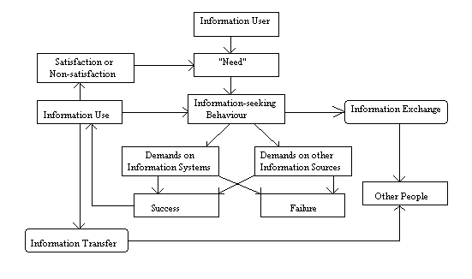
The Wilson Model (1981)

Slide 8
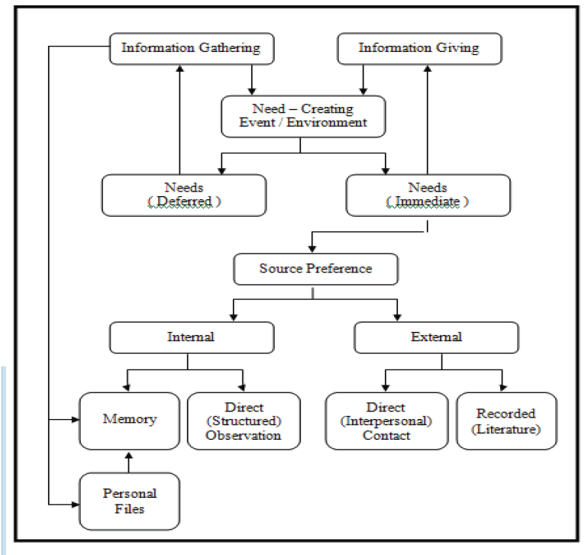
The Krikelas model (1983)
13 compnents
General model applicable to general information seeking
Simple
One dimensional

Slide 9
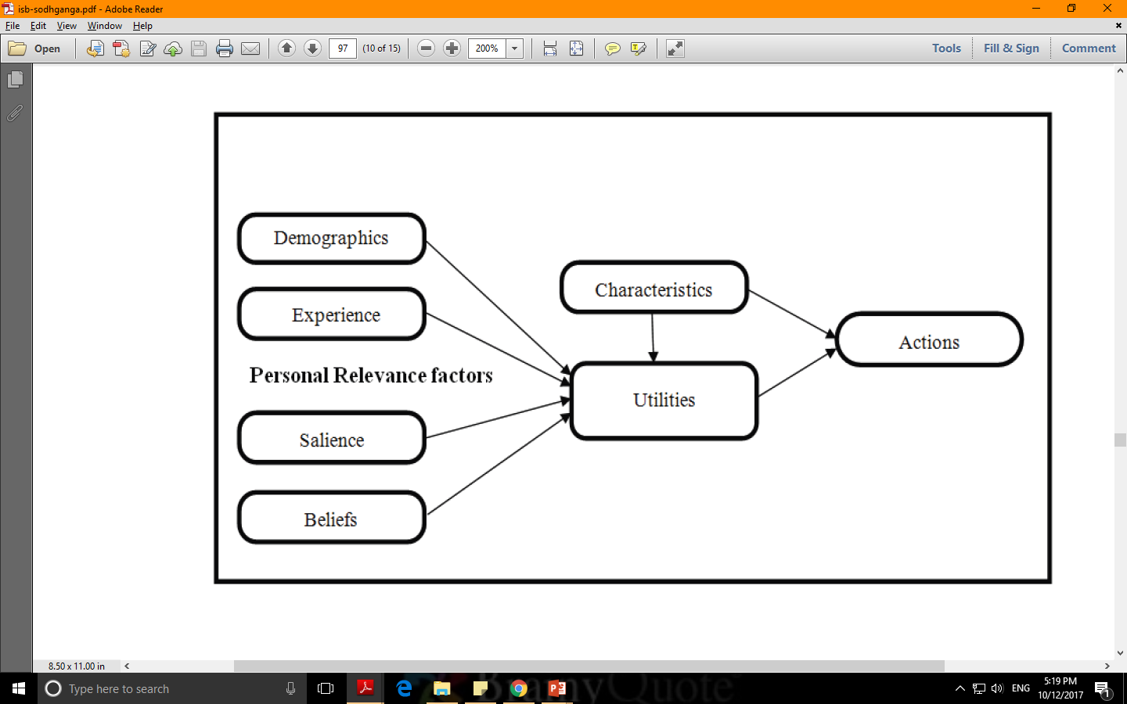
Johnson’s Model(1987)
Seven factors under three headings
Antecedents
Background factors
Personal Relevance factor
Information Carrier
Characteristics and utilities of the information channels

Slide 10
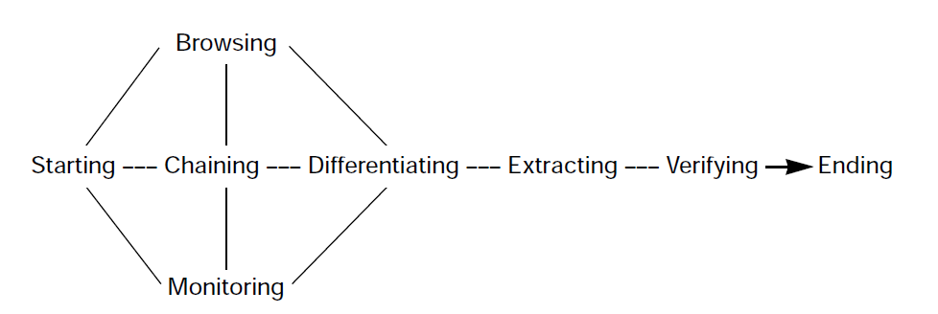
Ellis’s Model(1989)
Ellis (1989); Ellis et al (1993) and Ellis and Hugan (1997) proposed a general model of information seeking after studying the information seeking pattern of different user groups for Social Scientists, researchers, physicists, chemists and engineers.
Ellis’s model illustrates six types of information seeking activities: These are:
starting(activities that form the information search),
chaining(backwards or forwards - following references in initial information sources),
browsing(semi-directed search),
differentiating(filtering and selecting sources based on judgments of quality and relevance),
monitoring(keeping track of developments in an area), and
extracting(systematic extraction of material of interest from sources).
Later studies by Ellis (focusing on academic researchers in other disciplines) resulted in the addition of two more activities;
Verifying (checking accuracy),
Ending (a final search, checking all material covered).

Slide 11
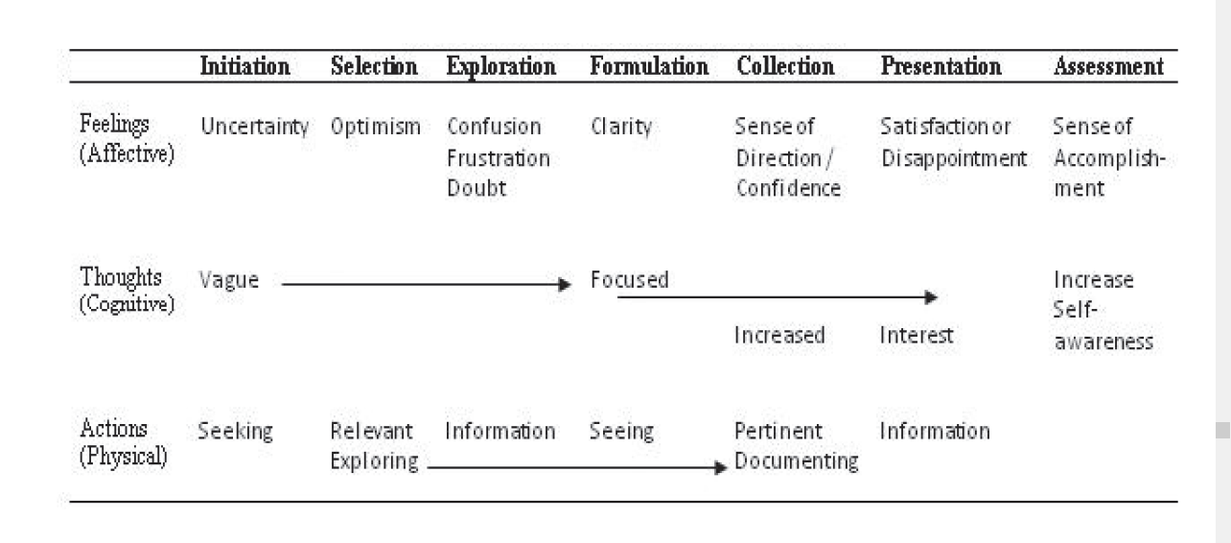
Kuhlthau Model(1992)
Kuhlthau complemented, Ellis by attaching the associated feelings, thoughts and actions and the appropriate information tasks. He proposes ISB as phenomenal rather than cognitive.

Slide 12
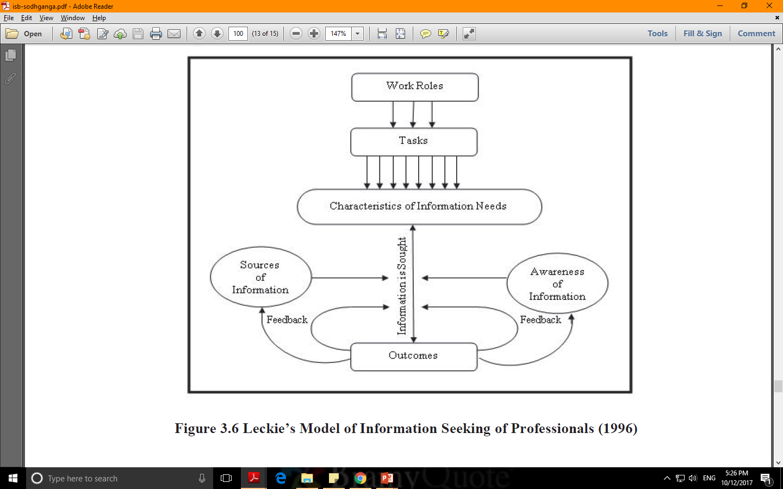
Leckie’s Model of Information Seeking of Professionals(1996)
concentrates on professionals such as engineers, doctors and lawyers.
the factor ‘work role’ enables ‘tasks’ to perform.
Bidirectional arrow between outcomes and information needs.

Slide 13
The revised Wilson Model (1996)
why some seek more prompt information than others?
based on the perception on their own efficacy.
Barriers are identified as intervening variables
recognizes search behaviours: Passive attention, Passive search, Active search and ongoing search.

Slide 14
Marchionini Model(1997)
Marchionini proposed in his model in 1997, tailored purposely towards electronic environment.
According to him, the information seeking process consists of eight sub processes as follows:
Recognition and acceptance of the problem itself,
Defining and understanding the problem,
Choosing a search system,
Formulating a query,
Executing the search,
Examining the result,
Extracting the information, and
Reflecting/Iterating/Stop.

Slide 15
Allen Foster’s non-linear model(2004)
The non-linear model of information behaviour is represented in term of three core processes and three level of contextual interaction.
Opening: seeking, exploring and revealing information.
Orientation: involves problem definition which varies from previous interpretation.
Consolidation: judging and integrating information and deciding whether further information seeking information seeking is necessary.

Slide 16
We can say that every model has their own applicability and strength, none of them is complete.
So there is always a continuous need to make some required modifications according to the change in the environment.

Slide 17
Theories in ISB
Zipf’s Principle of Least Effort(1949)
Uses and Gratifications Theory(1974)
Sense Making Theory(1992)

Slide 18
Zipf’s Principle of Least Effort(1949)
Proposed by George Kingsley Zipf, and Harvard Linguist.
According to Zipf (1949) each individual will adopt a course of action that will involve the expenditure of the probable least average of his work, in other words the least effort.
In terms of ISB, the information seeker chooses a course of action that will involve most convenient search method for information seeking.
The user will apply the searching tools that are most familiar and easy to use so as to find results in spite of user having proficiency in advanced searching.

Slide 19
Uses and Gratifications Theory
Uses and Gratifications theory has been developed by Katz,
Blumler and Gurevitch (1974).
“the paradigm of uses and Gratifications is ‘the social and psychological origins of needs which generate expectations of mass media or other sources, which lead to differential patterns of media exposure (or engagement in other activities), resulting in need gratifications and other consequences, perhaps mostly unintended ones”.

Slide 20
Sense Making Theory(1992)
Developed by Brenda Dervin in the context of information science.
The concept was also explained as an active two-way process of fitting data into a frame (mental model) and fitting a frame around the data.
Neither data nor frame comes first; data evoke frames and frames select and connect data. When there is no adequate fit, the data may be reconsidered or an existing frame may be revised.

Slide 21
Research Trends in ISB
Allen & Dervin asked
“How do people define needs in different situations, how do they make use of what systems and how do they make use of what systems offer them”
Initially, these methodologies did not focus on system use or resources utility but rather on how individuals go about fulfilling a need to know.

Slide 22
Categories of studies in Information needs and seeking behaviour
Studies Based on Information Needs
Students
Faculty/researchers scientists
Industrial workers
Studies Based on Information Seeking Behaviour
Psychological perspectives
Linkage between ISB and learning
Influence of internet and electronic resources(environment)
Defining models and theories.
Application of different models and theories
ISB of students, faculty, researchers, scientists, managers and special information users.
Studies Based on User Studies
User Studies Related to Usage of Library Resources
Use of resources in electronic environment.
Studies Based on User Education and Training
To define better user education and training programmes.

Slide 23
Some common trend in ISB research
Mostly based on survey method.
ISB research has shifted to Information literacy.
Repetitions with change in user category and the region
There is need to conduct more studies based on, experimental or Ethnographical methods like, Focused group, Observation, etc.

Slide 24
Thank you
Questions?

