Slide 1
Sampling in Marketing Research

Slide 2
Basics of sampling I
A sample is a “part of a whole to show what the rest is like”.
Sampling helps to determine the corresponding value of the population and plays a vital role in marketing research.
Samples offer many benefits:
Save costs: Less expensive to study the sample than the population.
Save time: Less time needed to study the sample than the population .
Accuracy: Since sampling is done with care and studies are conducted by skilled and qualified interviewers, the results are expected to be accurate.
Destructive nature of elements: For some elements, sampling is the way to test, since tests destroy the element itself.

Slide 3
Basics of sampling II
Limitations of Sampling
Demands more rigid control in undertaking sample operation.
Minority and smallness in number of sub-groups often render study to be suspected.
Accuracy level may be affected when data is subjected to weighing.
Sample results are good approximations at best.
Sampling Process
Defining the
population
Developing
a sampling
Frame
Specifying
Sample
Method
Determining
Sample
Size
SELECTING THE SAMPLE

Slide 4
Sampling: Step 1
Defining the Universe
Universe or population is the whole mass under study.
How to define a universe:
  What constitutes the units of analysis (HDB apartments)?
  What are the sampling units (HDB apartments occupied in the last three months)?
  What is the specific designation of the units to be covered (HDB in town area)?
  What time period does the data refer to (December 31, 1995)
Sampling: Step 2
Establishing the Sampling Frame
A sample frame is the list of all elements in the population (such as telephone directories, electoral registers, club membership etc.) from which the samples are drawn.
A sample frame which does not fully represent an intended population will result in frame error and affect the degree of reliability of sample result.

Slide 5
Step - 3
Determination of Sample Size
Sample size may be determined by using:
  Subjective methods (less sophisticated methods)
    The rule of thumb approach: eg. 5% of population
    Conventional approach: eg. Average of sample sizes of similar other studies;
    Cost basis approach: The number that can be studied with the available funds;
  Statistical formulae (more sophisticated methods)
    Confidence interval approach.

Slide 6
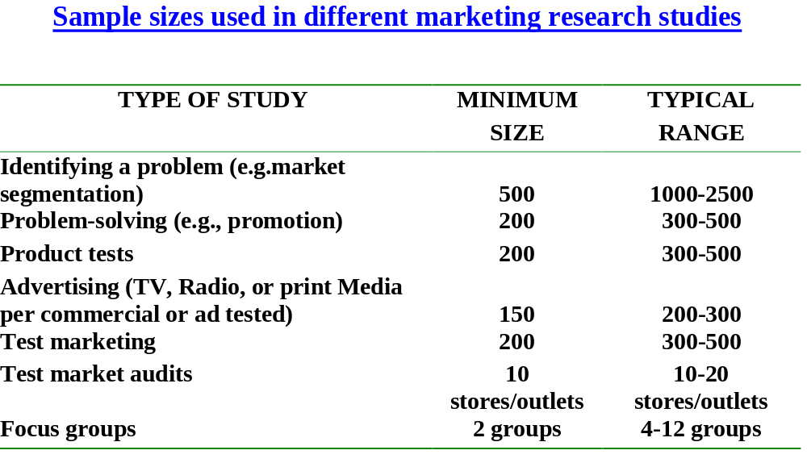
Conventional approach of Sample size determination using

Slide 7
Sample size determination using statistical formulae:
The confidence interval approach
To determine sample sizes using statistical formulae, researchers use the confidence interval approach based on the following factors:
  Desired level of data precision or accuracy;
  Amount of variability in the population (homogeneity);
  Level of confidence required in the estimates of population values.
Availability of resources such as money, manpower and time may prompt the researcher to modify the computed sample size.
Students are encouraged to consult any standard marketing research textbook to have an understanding of these formulae.

Slide 8
Step 4:
Specifying the sampling method
Probability Sampling
  Every element in the target population or universe [sampling frame] has equal probability of being chosen in the sample for the survey being conducted.
  Scientific, operationally convenient and simple in theory.
  Results may be generalized.
Non-Probability Sampling
  Every element in the universe [sampling frame] does not have equal probability of being chosen in the sample.
  Operationally convenient and simple in theory.
  Results may not be generalized.

Slide 9
Probability sampling
Four types of probability sampling
Appropriate for homogeneous population
  Simple random sampling
    Requires the use of a random number table.
  Systematic sampling
    Requires the sample frame only,
    No random number table is necessary
Appropriate for heterogeneous population
  Stratified sampling
    Use of random number table may be necessary
  Cluster sampling
    Use of random number table may be necessary

Slide 10
Non-probability sampling
Four types of non-probability sampling techniques
  Very simple types, based on subjective criteria
    Convenient sampling
    Judgmental sampling
  More systematic and formal
    Quota sampling
  Special type
    Snowball Sampling

Slide 11
Simple Random Sampling
Also called random sampling
Simplest method of probability sampling
1 2 3 4 5 6 7 8 9 10 11 12 13 14 15 16 17 18 19 20
1 37 75 10 49 98 66 03 86 34 80 98 44 22 22 45 83 53 86 23 51
2 50 91 56 41 52 82 98 11 57 96 27 10 27 16 35 34 47 01 36 08
3 99 14 23 50 21 01 03 25 79 07 80 54 55 41 12 15 15 03 68 56
4 70 72 01 00 33 25 19 16 23 58 03 78 47 43 77 88 15 02 55 67
5 18 46 06 49 47 32 58 08 75 29 63 66 89 09 22 35 97 74 30 80
6 65 76 34 11 33 60 95 03 53 72 06 78 28 14 51 78 76 45 26 45
7 83 76 95 25 70 60 13 32 52 11 87 38 49 01 82 84 99 02 64 00
8 58 90 07 84 20 98 57 93 36 65 10 71 83 93 42 46 34 61 44 01
9 54 74 67 11 15 78 21 96 43 14 11 22 74 17 02 54 51 78 76 76
10 56 81 92 73 40 07 20 05 26 63 57 86 48 51 59 15 46 09 75 64
11 34 99 06 21 22 38 22 32 85 26 37 00 62 27 74 46 02 61 59 81
12 02 26 92 27 95 87 59 38 18 30 95 38 36 78 23 20 19 65 48 50
13 43 04 25 36 00 45 73 80 02 61 31 10 06 72 39 02 00 47 06 98
14 92 56 51 22 11 06 86 88 77 86 59 57 66 13 82 33 97 21 31 61
15 67 42 43 26 20 60 84 18 68 48 85 00 00 48 35 48 57 63 38 84
Need to use
Random
Number Table

Slide 12
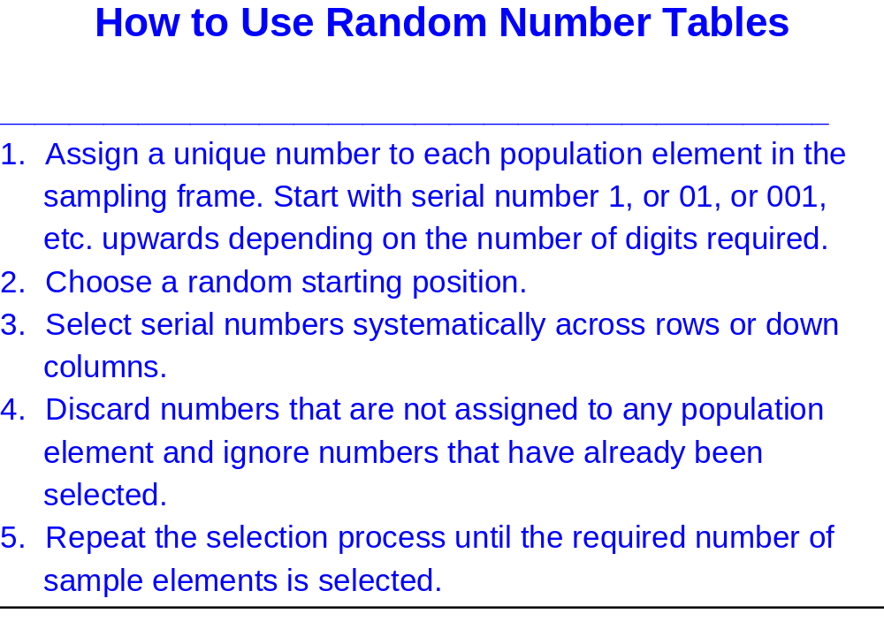

Slide 13
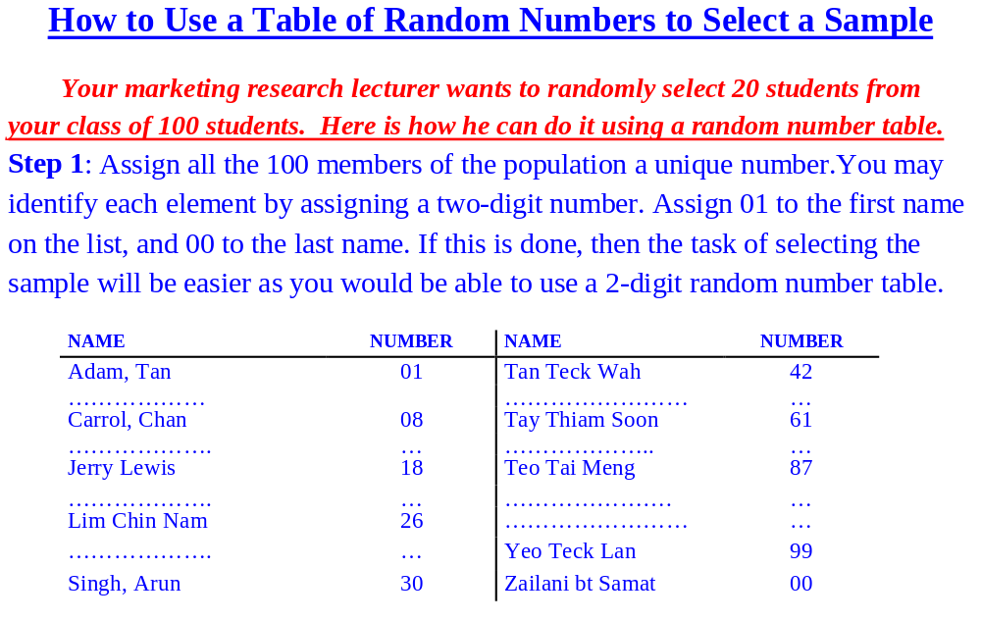

Slide 14
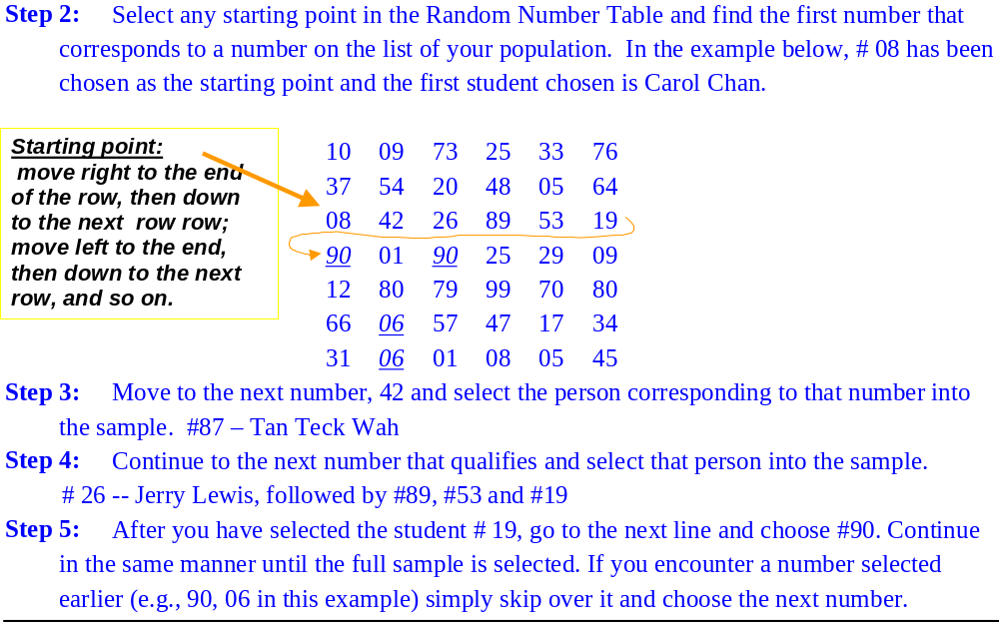
How to use random number table to select a random sample

Slide 15
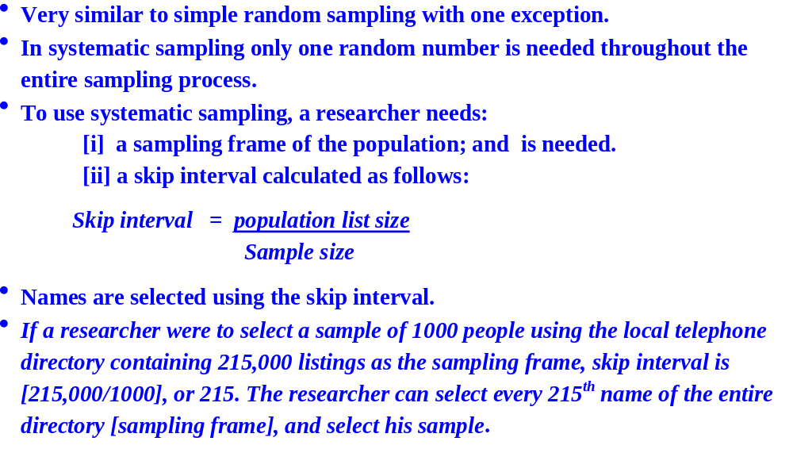
Systematic sampling

Slide 16
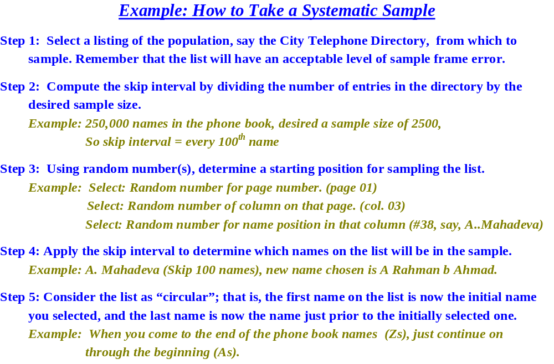

Slide 17
Stratified sampling I
A three-stage process:
Step 1- Divide the population into homogeneous, mutually exclusive and collectively exhaustive subgroups or strata using some stratification variable;
Step 2- Select an independent simple random sample from each stratum.
Step 3- Form the final sample by consolidating all sample elements chosen in step 2.
May yield smaller standard errors of estimators than does the simple random sampling. Thus precision can be gained with smaller sample sizes.
Stratified samples can be:
Proportionate: involving the selection of sample elements from each stratum, such that the ratio of sample elements from each stratum to the sample size equals that of the population elements within each stratum to the total number of population elements.
Disproportionate: the sample is disproportionate when the above mentioned ratio is unequal.

Slide 18
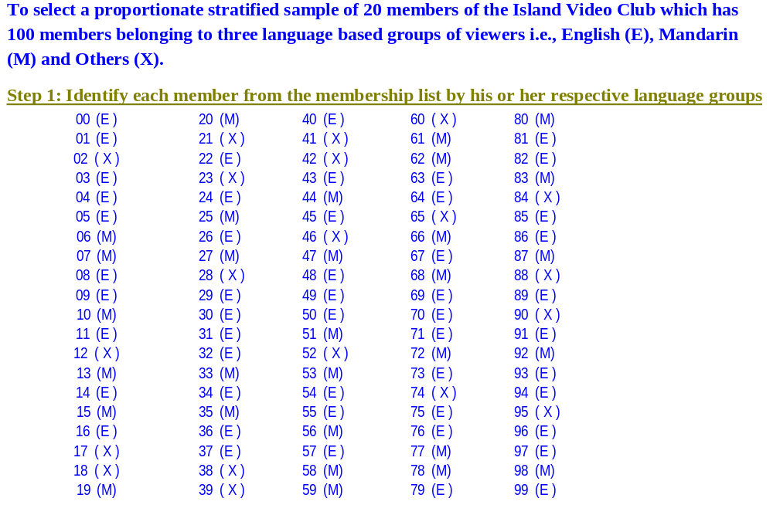
Selection of a proportionate Stratified Sample

Slide 19
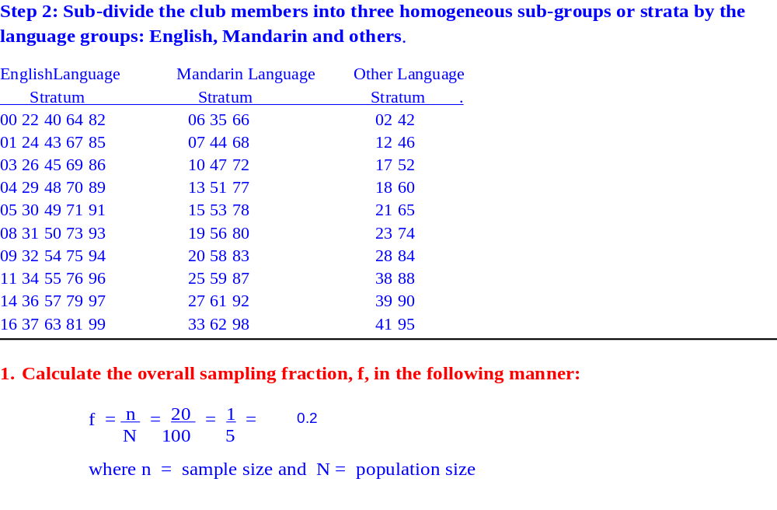
Selection of a proportionate stratified sample II

Slide 20
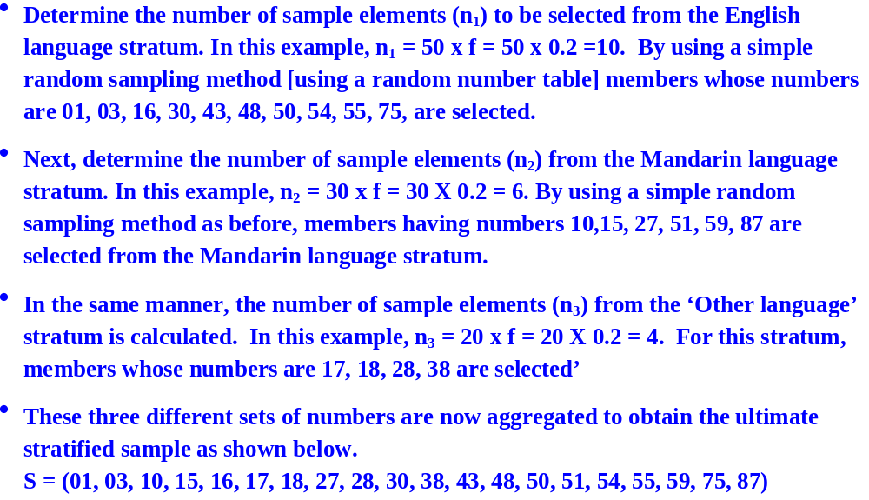
Selection of a proportionate stratified sample III

Slide 21
Cluster sampling
Is a type of sampling in which clusters or groups of elements are sampled at the same time.
Such a procedure is economic, and it retains the characteristics of probability sampling.
A two-step-process:
  Step 1- Defined population is divided into number of mutually exclusive and collectively exhaustive subgroups or clusters;
  Step 2- Select an independent simple random sample of clusters.
One special type of cluster sampling is called area sampling, where pieces of geographical areas are selected.

Slide 22
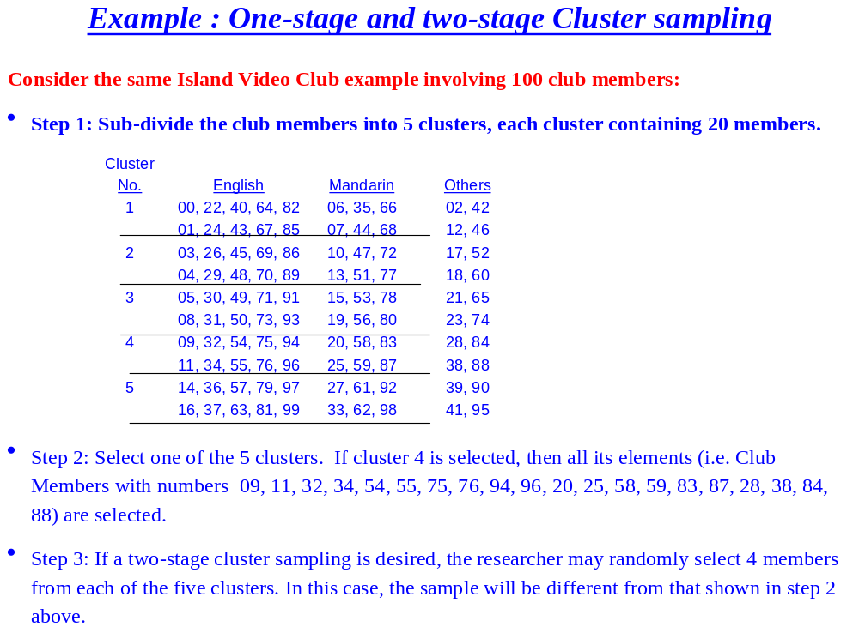

Slide 23
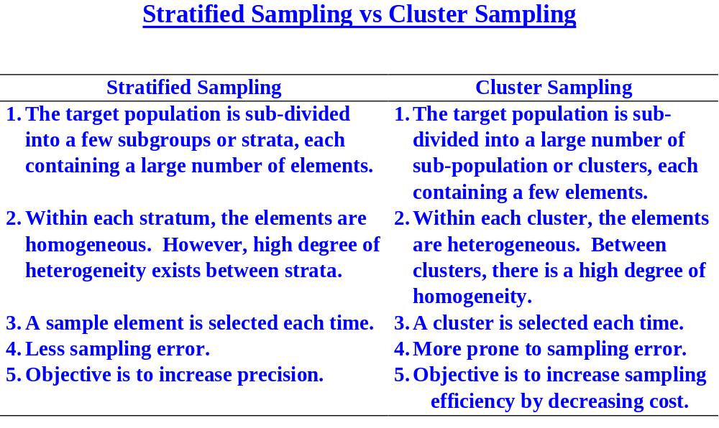

Slide 24
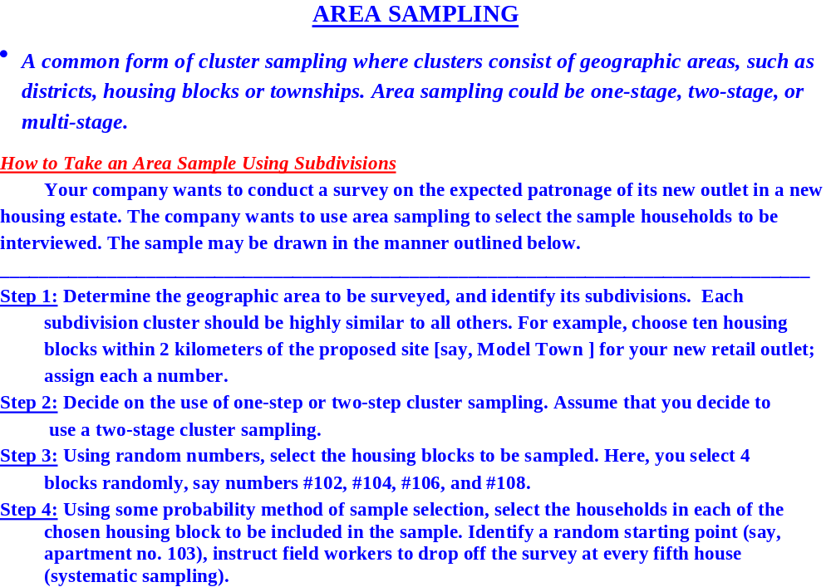

Slide 25
Non-probability samples
Convenience sampling
  Drawn at the convenience of the researcher. Common in exploratory research. Does not lead to any conclusion.
Judgmental sampling
  Sampling based on some judgment, gut-feelings or experience of the researcher. Common in commercial marketing research projects. If inference drawing is not necessary, these samples are quite useful.
Quota sampling
  An extension of judgmental sampling. It is something like a two-stage judgmental sampling. Quite difficult to draw.
Snowball sampling
  Used in studies involving respondents who are rare to find. To start with, the researcher compiles a short list of sample units from various sources. Each of these respondents are contacted to provide names of other probable respondents.

Slide 26
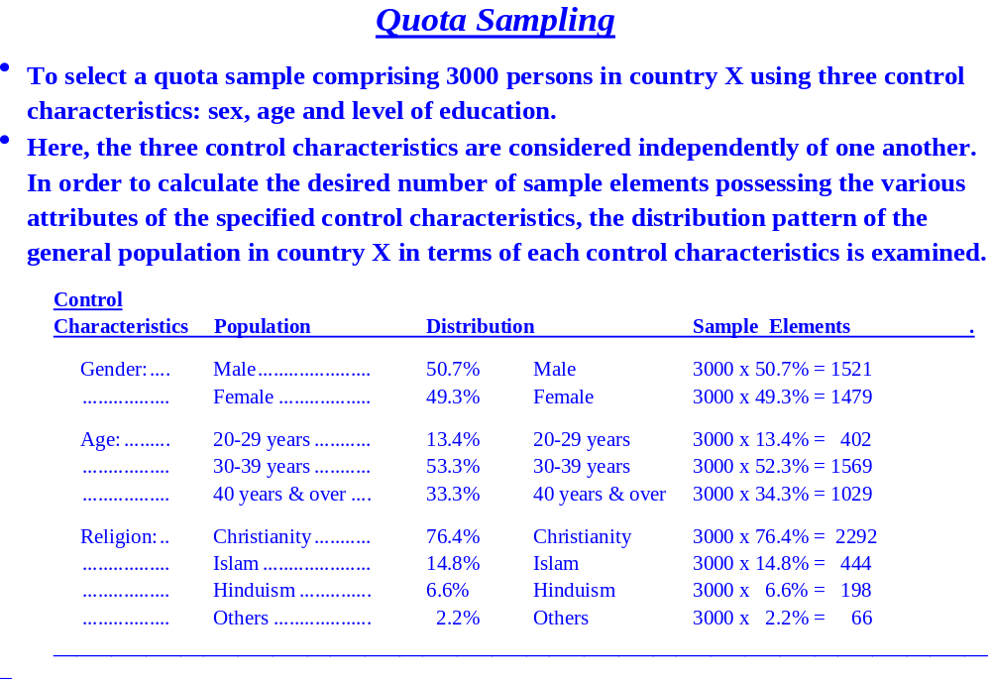

Slide 27
Sampling vs non-sampling errors
Sampling Error [SE] Non-sampling Error [NSE]
Very small sample Size
Larger sample size
Still larger sample
Complete census

Slide 28
Choosing probability vs. non-probability sampling
Probability Evaluation Criteria Non-probability
sampling sampling
Conclusive Nature of research Exploratory
Larger sampling Relative magnitude Larger non-sampling
errors sampling vs. error non-sampling error
High Population variability Low
[Heterogeneous] [Homogeneous]
Favorable Statistical Considerations Unfavorable
High Sophistication Needed Low
Relatively Longer Time Relatively shorter
High Budget Needed Low

