Slide 1
SRU Class Scheduler
Dean Lisko, Autumn Kriebel, Katherine Settle

Slide 2
Outline
Motivation
Abstract
What We've Done
Updates to Timetables
Updating Information
Reporting Ability
Continual Development
Summary
Conclusion

Slide 3
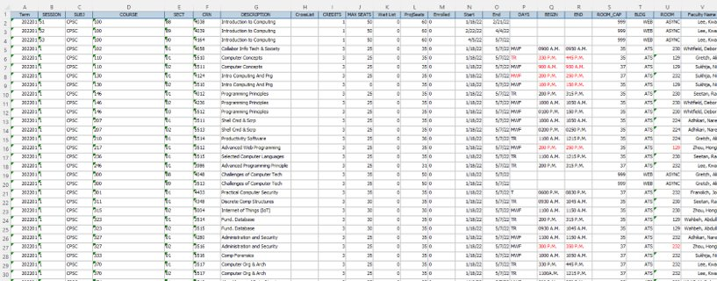
Motivation
Simplifies the class scheduling process for college department chairs

Slide 4
Abstract
SRU Class Scheduler
Edit and add to existing C# code
User inputs an Excel file containing class scheduling information
Program allows the user to interact with all aspects of class scheduling data
Increased ease of class scheduling
Decreased conflicts within the schedule

Slide 5
Updating Information
Classrooms
Show classroom information
Ability to edit/add related information
Class Information
Show class information
Ability to edit/add related information
All edited information saves for the next use of the program
All aspects of Excel worksheet can be edited

Slide 6
Editing Class Times
Classes
Class's time, day, and room can be edited.
Time Slots
Default Timeslots provided
Ability to add/edit timeslots
Conflicts
Conflicts Removed automatically

Slide 7
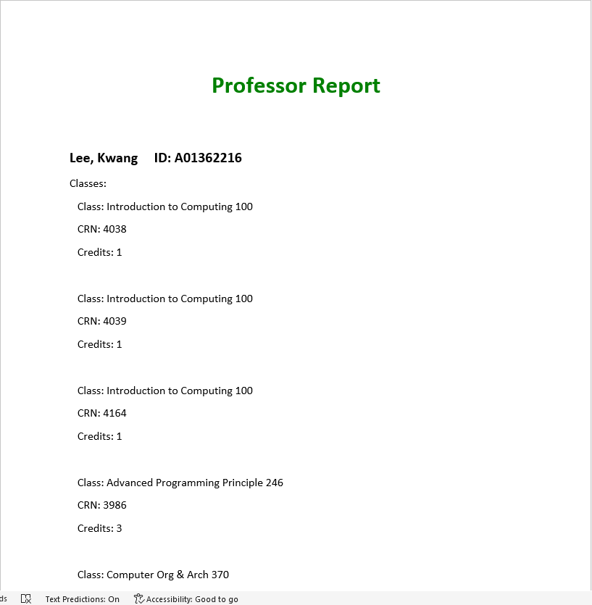
Reporting ability
Headers Excel File
Ability to create a classroom/ professor profile
Error Log
Display conflicts for user to correct
Professor Report
Show Professor Information
Show class list for each professor

Slide 8
Continual development
Some changes that we would want to implement in the future are
Classes associated to certain classrooms
Modify how timeslots are determined
Modify class grid display
Dynamic error log

Slide 9
Summary
Increased ease of use with lower risk of conflicts and user errors
Created additional features for class scheduling application
Increased user abilities:
Creation of dynamic times
Ability to handle single day classes
Updates to editing classes
Updates to editing classrooms
Professor option
Error Log

Slide 10
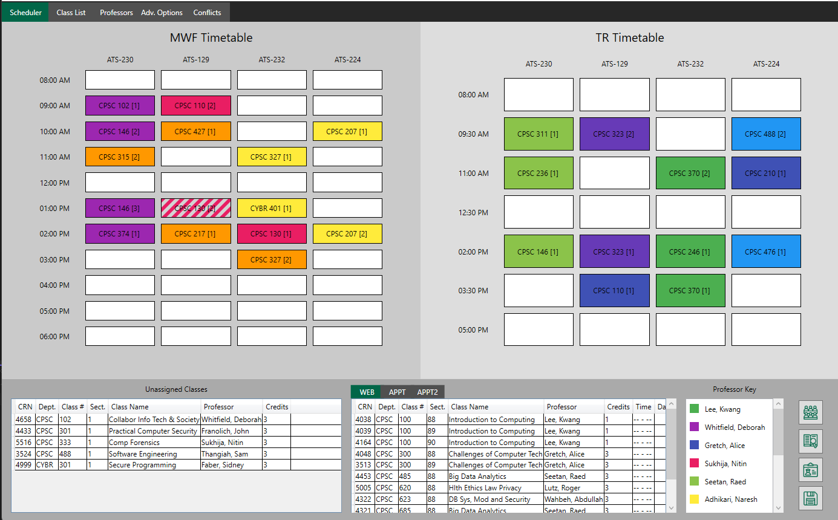
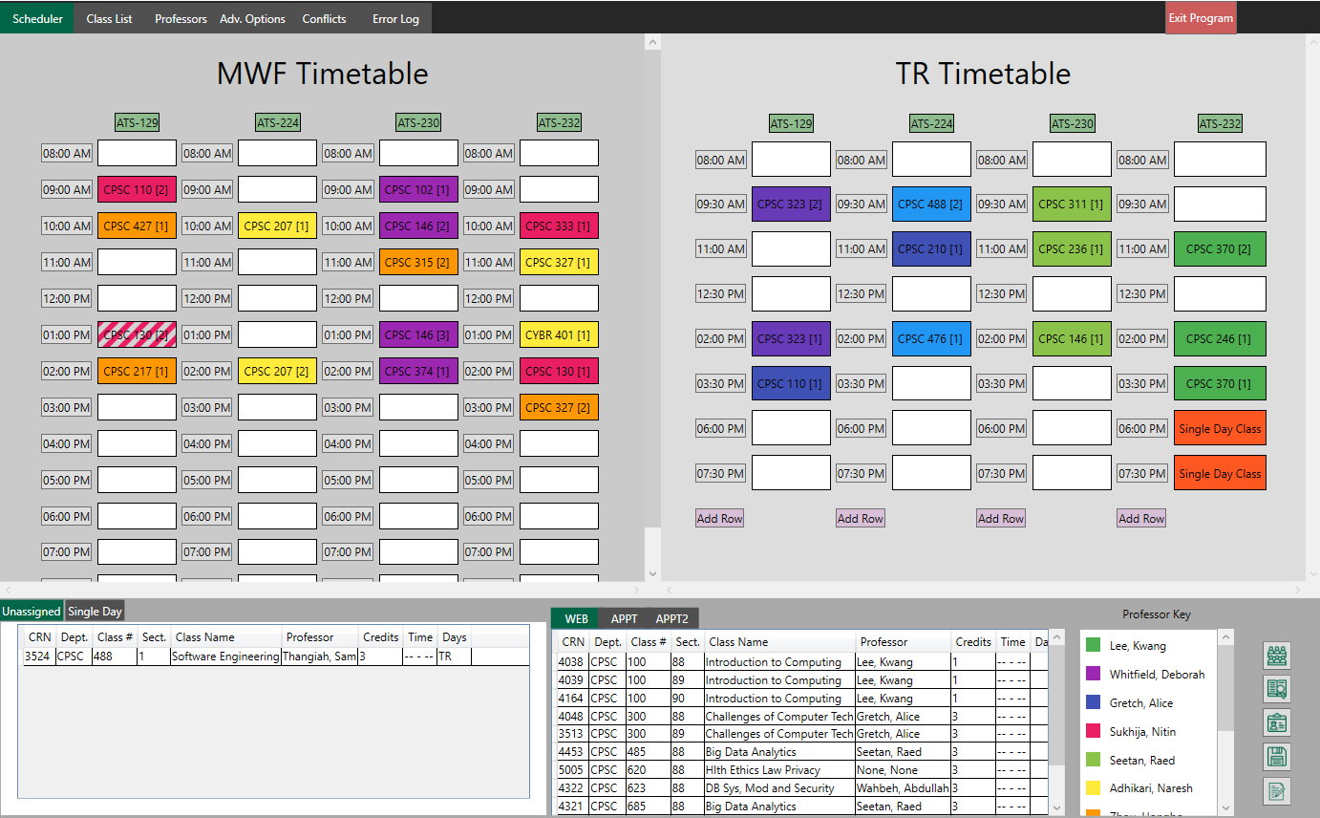
Conclusion
Added scheduling features:
Ability to change Timeslot values
Editing classrooms, classes, professors
Allows for single day classes
Allow the program to "speak" to the user about conflicts

