Slide 1
The Technology Value Stream
Web-430
Douglas Jenkins

Slide 2
Defining Lead Time vs. Processing Time
When it comes to the lean community lead time is often times going to be one of two measures
The measures are commonly used to measure performance in value streams
The other one is being processing time
Processing time is also know as touch time or task time
The lead clock time starts when the request is made
It ends when the request that was created is fulfilled

Slide 3
Defining Lead Time vs. Processing Time
The process time will only start when the work that has begun
The process time will often fall into work started and work completed
Not to long after the ticket is created is when this all will be taking into affect
Lead time is mostly what the customer will be experiencing during their process
While the customer is going through their experience the would be a emphasis on improvement
This will be done during the process timing as you will be trying to multitask in this environment

Slide 4
Defining Lead Time vs. Processing Time
The proportion of process time to lead time serves as an important measure of efficiency
It is important to achieve fast flow times
It is also important that you get short lead times to go with the fast flow times
When you are doing this you also may need to reduce the time that the work is waiting in queues
It may seem tough but the balance is what can make all this
You will need two manage the efficiency closely so that you will be able to make the best of your lead time and processing time.

Slide 5
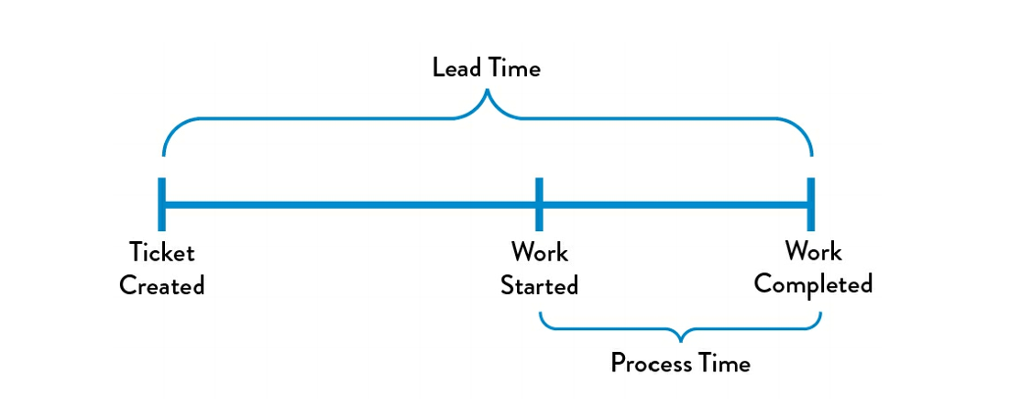
Defining Lead Time vs. Processing Time Graphic Example
Lead time vs Process time of a deployment operation

Slide 6
The Common Scenario: Deployment Lead Timers Requiring Months
The next scenario comes when you find yourself in a situation where the deployment lead time can require months
There can be various reasons that cost for the time to be that much when it comes to this
This is something that is known to happen in large complex organizations
Typically when the large organizations work with tightly coupled, monolithic applications.
All this should be considered when looking at large organizations

Slide 7
The Common Scenario: Deployment Lead Timers Requiring Months
The organization will deal with deployment lead times because of the following
Scarce integration test environments
Long test environment lead times
Production environment lead times
High reliance on manual testing
Multiple required approval processes

Slide 8
The Common Scenario: Deployment Lead Timers Requiring Months
With the addition of the long deployment lead times heroics are required
Someone and/or everyone needs to step up the process at almost ever stage of the value stream
Sometimes you may discover that nothing works when you get to the end of the project
The things that can typically happen are the code no longer builds correctly or passes any of our test when they merge all the development teams together..
Fixing the problems that arise can take days or weeks of investigation
During the investigation it determines who the code and how can it be fixed

Slide 9
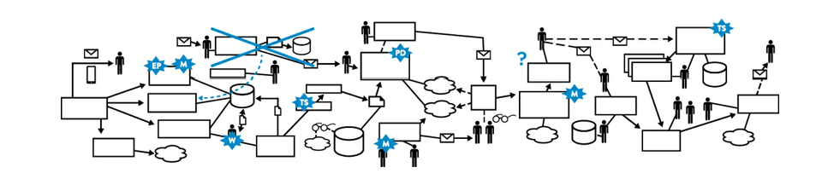
The Common Scenario: Deployment Lead Timers Requiring Months Graphic Example
A technology value stream with a
deployment lead time of three months

Slide 10
Our DevOps Ideal: Deployment Lead Times of Minutes
When it comes to DevOps developers try to receive fast and constant feedback of their work
This allows the following to happen:
It enables them to quickly
Enables them to independently implement things
Integrate and validate their code
Have the code deployed into the production environment

Slide 11
Our DevOps Ideal: Deployment Lead Times of Minutes
The feedback is often times achieved by continually checking small code changes
This are the following that checked every time there is a code change:
Version control repository
Performance automated and exploratory
Testing against the performance automated and exploratory
Deploying it into production

Slide 12
Our DevOps Ideal: Deployment Lead Times of Minutes
When working with the constant checking of the small code you will see improvements
This will allow higher degree of confidence that the changes will operate as designed in production
With this method any problems can and will be quickly detected and corrected
This is easier to operate when you have a n architecture that is a modular
One that is particularly well encapsulated and loosely coupled so that small teams are able to work with high degrees of autonomy
Doing this way will help contain failures big and small

Slide 13
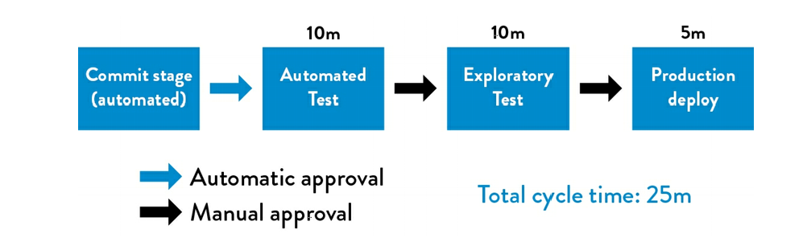
Our DevOps Ideal: Deployment Lead Times of Minutes Graphic
The technology value stream
with a lead time of minutes

Slide 14
Sources
Kim, Gene; Humble, Jez; Debois, Patrick; Willis, John. The DevOps Handbook: (p. 55-57). IT Revolution Press. Kindle Edition.

