Slide 1
Hypermedia Design
Web-420
Douglas Jenkins

Slide 2
Santa Clarita Library
Santa Clarita is opening up a new library in the close to where Newhall is located.
The have been getting information together on what books they will be having
They are separating the books by age range and genre
They wanted an API that will allow someone to put books on hold at the Library
The point of this is so that they will save time by having to look for the book
They also will have a certain amount of Tim to get the book before it is allowed to be placed on hold

Slide 3
Return on Investment
With the creation of this it will help the library be to cut back the amount of time it takes for the public to have to get books and check them out
Library typically are non profit but with the ability to get more people in is what helps keep the library open
A lot it will be based on many people come in and I believe that doing this will help bring in more people
As well as it can give an indication on who is using the API
Since the Return of Investment cannot really be determined with money and income that will be brought in when it comes to this site
As I stated since it is a non profit we will only base it on how many people will come in which contributes to keeping it open

Slide 4
Semantic Descriptors
Library Member
First Name
Last Name
Library Card Number
Book
Title
Author
ISBN
Reserve time

Slide 5
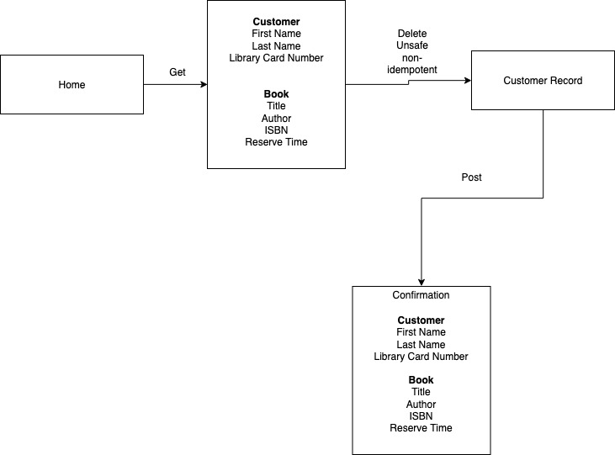
State Diagram

Slide 6
Reconcile Names
First name = firstName
Last Name = lastName
Library Card Number = cardNumber
Title = bookTitle
Author = authorName
ISBN = bookIsbn
Reserve time = reserveTime

Slide 7
Media Type
The Media type I am selecting to use is AtomPub (The Atom Publishing Protocol)
Below are what is provided from using AtomPub
Media types such as application/atom+xml, application/atomsvc+xml, and application/atomcat+xml
Defined in RFC 502 and RFC 4287
Medium is XML
Protocol semantics are collection pattern that use GET, POST, PUT and DELETE
The application semantics must have the semantics of a blog post such as using author, title and category which seem to fail in exactly what I am doing and planning for this API.

Slide 8
Profile
Application-Level Profile Semantics (ALPS) is what I would be using to help with the Profile
<link rel="profile" href="http://alps.io/name"/>
<link rel="profile" href=“http://alps.io/librarynumber“/>
<link rel="profile" href=“http://alps.io/bookname"/>
<link rel="profile" href=“http://alps.io/bookauthor"/>
<link rel="profile" href=“http://alps.io/reservetime”/>

Slide 9
Implementation
This is where the code portion of the API creation will be done at
When it comes to implementing the code it will be the same as stated earlier
The task is make a way where you can reserve books so that they will be on hold when you arrive to the library
Once you reserve the book you have a certain amount of time before the reservation expires and it will not be on hold for you anymore
It will be able to be done through app that can be download
If you try to request in on the computer you will be redirected to the app

Slide 10
Publication
This app will be available to be added through common app stores such as google play, the apple app store and some that are compatible with laptops
You will run through some things then you will proceed to publish the billboard URI
The next step is to publish the profile of this
Since you do not use a new media design you will just register the new media types
Next is using link relations which will be less trouble if you use extension relations
The final step is now publish your documentation with this such as human readable documentation that is similar to your API.

Slide 11
Sources
Richardson, Leonard; Amundsen, Mike; Ruby, Sam. RESTful Web APIs: Services for a Changing World . O'Reilly Media. Kindle Edition.

