Slide 1
PHASE 4 PRODUCT FINISH
SETU - DISCOVER
Operating ladder
From trusted source to client evidence packet.
Local intelligence layer for finding, qualifying, matching, sending, and exporting client-ready profile-building opportunities.
Source registry
45 canonical EB-1A sources
Postgres local
Human-approved
SETU handoff
Guarded refresh
Canonical domains and link checks
45
20
6
Human review
Approve uncertain discoveries
Canonical sources
Active paths
Match signals
Hybrid match
Imported from master registry
Vetted real opportunities
Including semantic fit
Criteria, credibility, semantic fit
SETU export
Evidence packet for handoff
Review entry: http://localhost:3004
GitHub target: dlk710/setu-discover
SETU - DISCOVER
01

Slide 2
PRODUCT SYSTEM
A source-to-evidence operating system
The product is built around one durable inventory spine. Every automation either enriches that spine, asks for review, or produces a client handoff.
1
2
3
4
5
Source governance
Discovery engine
Review gate
Inventory spine
Client output
Registry rank, canonical domain, tier, refresh flag
Phase 2 ingestion plus Phase 3 constrained agent
Low-confidence and policy-flagged items wait for human approval
Postgres events table with status, links, source, and added date
Hybrid recommendations, email log, and SETU JSON export
System promise
No opportunity becomes active inventory unless it has a public, client-facing source/apply link and passes the product guardrails.
SETU - DISCOVER
02

Slide 3
INVENTORY TRUST
Active inventory now shows real client-action paths
The source registry remains broad, but active inventory is deliberately narrow: standing opportunities are created only where a client can go to the source site and act.
45
20
0
Added date visible
Inventory rows now expose the date each opportunity was added, so the team can scan freshness without opening details.
Registry rows
Standing records
Active fixtures
Master EB-1A source list
Inserted as active inventory
Old demo records archived
Example active list
The Conversation
MIT Tech Review
NIH CSR
ACM
Pitch an article
Innovators Under 35
Early Career Reviewer
Senior Member nomination
Published Material
Awards
Judging
Membership
SETU - DISCOVER
03

Slide 4
HYBRID MATCHING
Matching is explainable enough for operations
Phase 4 keeps deterministic scoring visible, then adds a local semantic signal so related profile language can rank even when exact words differ.
Score components
Sample ranked match
Gap fit
20 pts
Targets open EB-1A criteria first
Anika Rao
Artificial intelligence - United States
Credibility
20 pts
Rewards higher-trust sources
Keyword
14 pts
Finds exact profile language
Research Leadership Profile Series
69.6
Semantic
14 pts
Local similarity across field and summary
Published Material - AI safety, research, public impact
Actionability
12 pts
Prefers clear apply or submit paths
Location
8 pts
Remote, national, or regional fit
Open criteria gap, high source trust, strong semantic overlap, and a client-action source link.
Why it ranked
SETU - DISCOVER
04

Slide 5
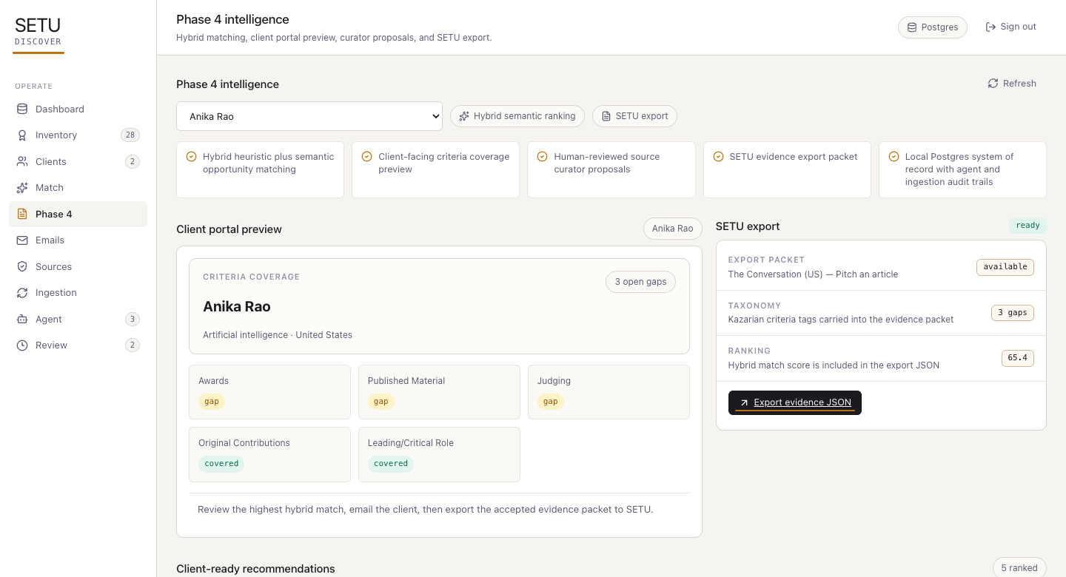
PHASE 4 WORKSPACE
Phase 4 turns discovery into client-ready intelligence
The admin can preview what a client should see, export evidence packets, and expand the source registry from demand-aware proposals.
1
Client portal preview
Coverage, gaps, next best action, and ranked recommendations.
2
SETU export
JSON evidence packet with source, apply link, criteria, and score evidence.
3
Curator proposals
New source ideas scored by client demand and inventory gaps.
Local QA render of the Phase 4 tab
SETU - DISCOVER
05

Slide 6
GOVERNANCE
AI assists the workflow, humans keep the controls
The product uses local deterministic logic by default and optional OpenAI extraction when configured. It does not approve records, send emails, or bypass domain guardrails.
Automation assists
Human controls
Detect source-page changes
Maintain trusted source registry
Extract candidate opportunity records
Approve or reject review items
Score client/opportunity matches
Confirm client communications
Recommend source additions
Accept curator proposals
Build SETU export packets
Use final evidence in petitions
Guardrail: broad pages and missing client links stay out of active inventory.
SETU - DISCOVER
06

Slide 7
LOCAL ARCHITECTURE
Postgres-backed and inspectable on localhost
The product is intentionally simple to run locally: Next.js serves the portal and APIs, repository functions centralize writes, and Postgres holds the durable operating record.
API routes
Next.js portal
/api/state - Dashboard data spine
Repository layer
PostgreSQL
Admin UI, Phase 4 tab, inventory list
/api/events - Inventory CRUD
Guarded writes, status derivation, match logs
events, sources, clients, runs, review
/api/matches - Rank and log recommendations
/api/phase4 - Client preview and curator proposals
/api/exports/setu - SETU evidence packet
Worker scripts
Optional OpenAI
phase2:run, phase2:schedule, phase3:run
Used only for extraction escalation when configured
SETU - DISCOVER
07

Slide 8
REVIEW AND HANDOFF
Ready for Phase 4 review and signoff
The product is now a local SETU discovery system with documentation, technical architecture, and a review deck included in the repository.
What the product can do
Review checklist
- Maintain clients and opportunity inventory
- Dashboard reads active inventory by category
- Import 45 canonical EB-1A sources
- Inventory shows added date for scanability
- Refresh guarded source pages
- Run constrained Phase 3 discovery agent
- Only real client-action links are active
- Review uncertain candidates
- Phase 4 preview and export work locally
- Rank matches with semantic signal
- Send or simulate recommendation emails
- Docs and deck are committed to GitHub
- Export SETU evidence packets
Local app
http://localhost:3004
GitHub
github.com/dlk710/setu-discover
Docs
README + docs folder + product deck
SETU - DISCOVER
08

