Slide 1
Hidden Markov Models
and the Forward-Backward Algorithm
600.465 - Intro to NLP - J. Eisner

Slide 2
Please See the Spreadsheet
I like to teach this material using an interactive spreadsheet:
  http://cs.jhu.edu/~jason/papers/#tnlp02
  Has the spreadsheet and the lesson plan
I’ll also show the following slides at appropriate points.
600.465 - Intro to NLP - J. Eisner

Slide 3
Marginalization
SALES | Jan | Feb | Mar | Apr | …
Widgets | 5 | 0 | 3 | 2 | …
Grommets | 7 | 3 | 10 | 8 | …
Gadgets | 0 | 0 | 1 | 0 | …
… | … | … | … | … | …
600.465 - Intro to NLP - J. Eisner

Slide 4
Marginalization
Write the totals in the margins
SALES | Jan | Feb | Mar | Apr | … | TOTAL
Widgets | 5 | 0 | 3 | 2 | … | 30
Grommets | 7 | 3 | 10 | 8 | … | 80
Gadgets | 0 | 0 | 1 | 0 | … | 2
… | … | … | … | … | …
TOTAL | 99 | 25 | 126 | 90 |  | 1000
Grand total
600.465 - Intro to NLP - J. Eisner

Slide 5
Marginalization
Given a random sale, what & when was it?
prob. | Jan | Feb | Mar | Apr | … | TOTAL
Widgets | .005 | 0 | .003 | .002 | … | .030
Grommets | .007 | .003 | .010 | .008 | … | .080
Gadgets | 0 | 0 | .001 | 0 | … | .002
… | … | … | … | … | …
TOTAL | .099 | .025 | .126 | .090 |  | 1.000
Grand total
600.465 - Intro to NLP - J. Eisner

Slide 6
Marginalization
Given a random sale, what & when was it?
joint prob: p(Jan,widget)
prob. | Jan | Feb | Mar | Apr | … | TOTAL
Widgets | .005 | 0 | .003 | .002 | … | .030
Grommets | .007 | .003 | .010 | .008 | … | .080
Gadgets | 0 | 0 | .001 | 0 | … | .002
… | … | … | … | … | …
TOTAL | .099 | .025 | .126 | .090 |  | 1.000
marginal
prob:
p(widget)
marginal prob:
p(anything in table)
marginal prob: p(Jan)
600.465 - Intro to NLP - J. Eisner

Slide 7
Conditionalization
Given a random sale in Jan., what was it?
Divide column through by Z=0.99 so it sums to 1
joint prob: p(Jan,widget)
prob. | Jan | Feb | Mar | Apr | … | TOTAL
Widgets | .005 | 0 | .003 | .002 | … | .030
Grommets | .007 | .003 | .010 | .008 | … | .080
Gadgets | 0 | 0 | .001 | 0 | … | .002
… | … | … | … | … | …
TOTAL | .099 | .025 | .126 | .090 |  | 1.000
p(… | Jan)
.005/.099
.007/.099
0
…
.099/.099
marginal prob: p(Jan)
conditional prob: p(widget|Jan)=.005/.099
600.465 - Intro to NLP - J. Eisner

Slide 8
Marginalization & conditionalization in the weather example
Instead of a 2-dimensional table,
now we have a 66-dimensional table:
  33 of the dimensions have 2 choices: {C,H}
  33 of the dimensions have 3 choices: {1,2,3}
Cross-section showing just 3 of the dimensions:
Weather =C
3
Weather =H
3
 | Weather₂=C | Weather₂=H
IceCream₂=1 | 0.000… | 0.000…
IceCream₂=2 | 0.000… | 0.000…
IceCream₂=3 | 0.000… | 0.000…
600.465 - Intro to NLP - J. Eisner

Slide 9
Interesting probabilities in the weather example
Prior probability of weather:
p(Weather=CHH…)
Posterior probability of weather (after observing evidence):
p(Weather=CHH… | IceCream=233…)
Posterior marginal probability that day 3 is hot:
p(Weather₃=H | IceCream=233…)
= ∑_{w such that w3=H} p(Weather=w | IceCream=233…)
Posterior conditional probability
that day 3 is hot if day 2 is:
p(Weather₃=H | Weather₂=H, IceCream=233…)
600.465 - Intro to NLP - J. Eisner

Slide 10


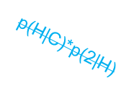
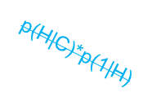
The HMM trellis
Day 1: 2 cones
Day 2: 3 cones
Day 3: 3 cones
C
p(C|C)*p(3|C)
C
p(C|C)*p(3|C)
C
p(C|Start)*p(2|C)
0.8*0.1=0.08
0.8*0.1=0.08
0.5*0.2=0.1
p(H|C)*p(3|H)
p(C|H)*p(3|C)
p(H|C)*p(3|H)
p(C|H)*p(3|C)
Start
0.1*0.7=0.07
0.1*0.1=0.01
0.1*0.7=0.07
0.1*0.1=0.01
p(H|Start)*p(2|H)
0.5*0.2=0.1
H
p(H|H)*p(3|H)
H
p(H|H)*p(3|H)
H
0.8*0.7=0.56
0.8*0.7=0.56
This “trellis” graph has 2³³ paths.
  These represent all possible weather sequences that could explain the observed ice cream sequence 2, 3, 3, …
C
p(C|C)*p(3|C)
C
The trellis represents only such explanations. It omits arcs that were a priori possible but inconsistent with the observed data. So the trellis arcs leaving a state add up to < 1.
p(H|C)*p(3|H)
600.465 - Intro to NLP - J. Eisner
H

Slide 11
The HMM trellis
The dynamic programming computation of α works forward from Start.
Day 1: 2 cones
Day 2: 3 cones
Day 3: 3 cones
α=0.1*0.08+0.1*0.01
=0.009
α=0.009*0.08+0.063*0.01
=0.00135
α=0.1
C
p(C|C)*p(3|C)
C
p(C|C)*p(3|C)
C
α=1
p(C|Start)*p(2|C)
0.8*0.1=0.08
0.8*0.1=0.08
0.5*0.2=0.1
p(H|C)*p(3|H)
p(C|H)*p(3|C)
p(H|C)*p(3|H)
p(C|H)*p(3|C)
Start
0.1*0.7=0.07
0.1*0.1=0.01
0.1*0.7=0.07
0.1*0.1=0.01
p(H|Start)*p(2|H)
0.5*0.2=0.1
H
p(H|H)*p(3|H)
H
p(H|H)*p(3|H)
H
0.8*0.7=0.56
0.8*0.7=0.56
α=0.1
α=0.1*0.07+0.1*0.56
=0.063
α=0.009*0.07+0.063*0.56
=0.03591
This “trellis” graph has 2³³ paths.
  These represent all possible weather sequences that could explain the observed ice cream sequence 2, 3, 3, …
What is the product of all the edge weights on one path H, H, H, …?
  Edge weights are chosen to get p(weather=H,H,H,… & icecream=2,3,3,…)
What is the α probability at each state?
  It’s the total probability of all paths from Start to that state.
  How can we compute it fast when there are many paths?
600.465 - Intro to NLP - J. Eisner

Slide 12
Computing α Values
All paths to state:
α = (ap₁ + bp₁ + cp₁)
+ (dp₂ + ep₂ + fp₂)
a
p₁
α₁
b
C
C
c
p₂
α
d
e
H
= α₁⋅p₁ + α₂⋅p₂
α₂
f
Thanks, distributive law!
600.465 - Intro to NLP - J. Eisner

Slide 13
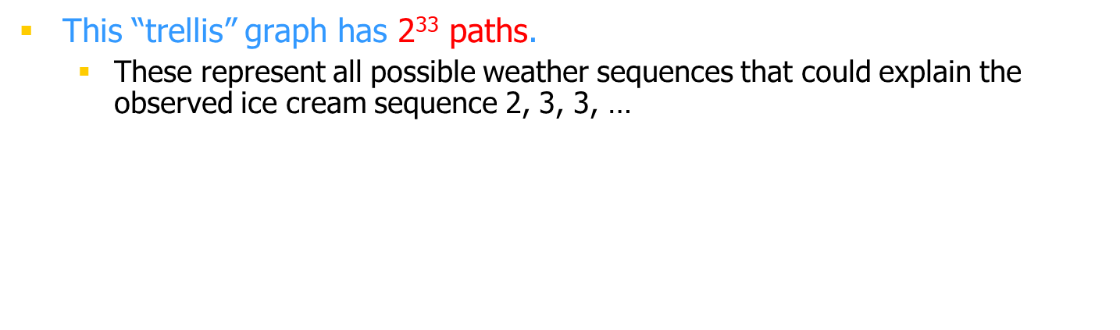
The HMM trellis
The dynamic programming computation of β works back from Stop.
Day 32: 2 cones
Day 33: 2 cones
Day 34: lose diary
β=0.16*0.018+0.02*0.018
=0.00324
β=0.16*0.1+0.02*0.1
=0.018
β=0.1
C
p(C|C)*p(2|C)
C
p(C|C)*p(2|C)
C
0.8*0.2=0.16
0.8*0.2=0.16
p(Stop|C)
p(H|C)*p(2|H)
p(C|H)*p(2|C)
p(H|C)*p(2|H)
p(C|H)*p(2|C)
0.1
0.1*0.2=0.02
0.1*0.2=0.02
Stop
0.1*0.2=0.02
0.1*0.2=0.02
p(Stop|H)
H
p(H|H)*p(2|H)
H
p(H|H)*p(2|H)
H
0.1
0.8*0.2=0.16
0.8*0.2=0.16
β=0.16*0.018+0.02*0.018
=0.00324
β=0.16*0.1+0.02*0.1
=0.018
β=0.1
What is the β probability at each state?
  It’s the total probability of all paths from that state to Stop
  How can we compute it fast when there are many paths?
600.465 - Intro to NLP - J. Eisner

Slide 14
Computing β Values
All paths from state:
β = (p₁u + p₁v + p₁w)
+ (p₂x + p₂y + p₂z)
u
p₁
v
β₁
C
C
p₂
w
β
x
= p₁⋅β₁ + p₂⋅β₂
H
y
β₂
z
600.465 - Intro to NLP - J. Eisner

Slide 15
Computing State Probabilities
All paths through state:
ax + ay + az
+ bx + by + bz
+ cx + cy + cz
a
x
α
b
y
β
c
C
z
= (a+b+c)⋅(x+y+z)
= α(C) ⋅ β(C)
Thanks, distributive law!
600.465 - Intro to NLP - J. Eisner

Slide 16
Computing Arc Probabilities
All paths through the p arc:
apx + apy + apz
+ bpx + bpy + bpz
+ cpx + cpy + cpz
x
y
β
C
z
p
a
α
b
c
H
= (a+b+c)⋅p⋅(x+y+z)
= α(H) ⋅ p ⋅ β(C)
Thanks, distributive law!
600.465 - Intro to NLP - J. Eisner

Slide 17
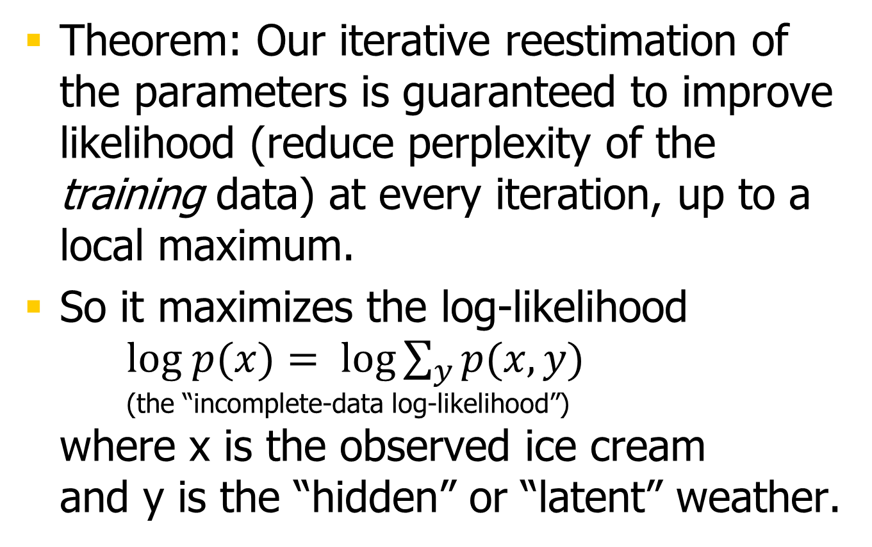
Maximizing (Log-)Likelihood
600.465 - Intro to NLP - J. Eisner

Slide 18
Local maxima?
We saw 3 solutions, all local maxima:
600.465 - Intro to NLP - J. Eisner

Slide 19
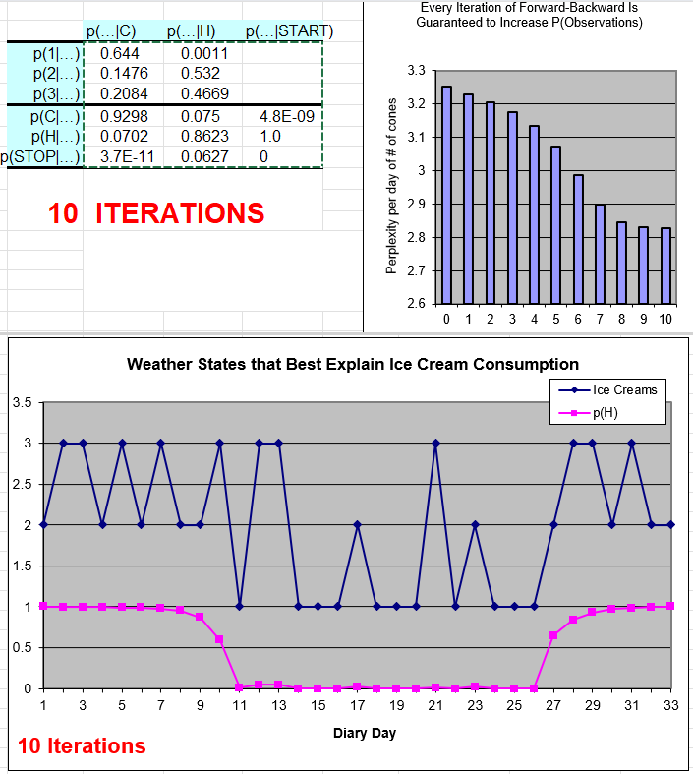
600.465 - Intro to NLP - J. Eisner

Slide 20
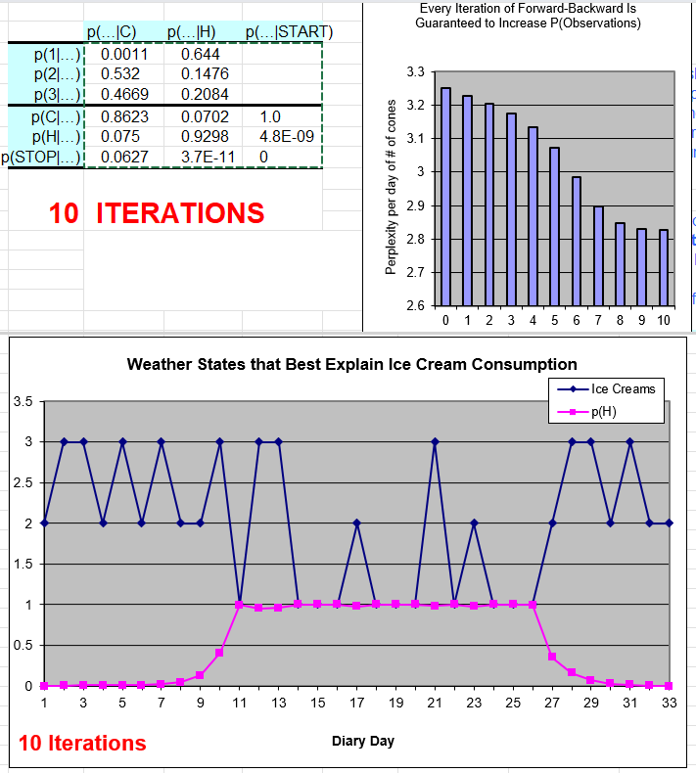
600.465 - Intro to NLP - J. Eisner

Slide 21
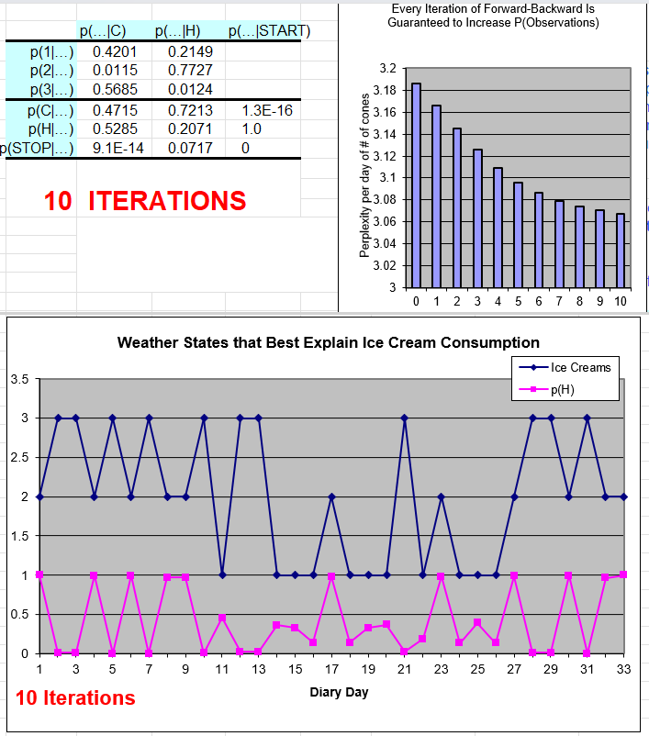
600.465 - Intro to NLP - J. Eisner

Slide 22
Local maxima?
We saw 3 solutions, all local maxima:
  H means “3 ice creams”
  H means “1 ice cream”
  H means “2 ice creams”
There are other optima as well
Fitting to different actual patterns in the data
How would we model all the patterns at once?
600.465 - Intro to NLP - J. Eisner

Slide 23
HMM for part-of-speech tagging
correct tags
PN Verb Det Noun Prep Noun Prep Det Noun
Bill directed a cortege of autos through the dunes
PN Adj Det Noun Prep Noun Prep Det Noun
Verb Verb Noun Verb
Adj some possible tags for
Prep each word (maybe more)
…?
Each unknown tag is constrained by its word
and by the tags to its immediate left and right.
But those tags are unknown too …
600.465 - Intro to NLP - J. Eisner

Slide 24
HMM for part-of-speech tagging
correct tags
PN Verb Det Noun Prep Noun Prep Det Noun
Bill directed a cortege of autos through the dunes
PN Adj Det Noun Prep Noun Prep Det Noun
Verb Verb Noun Verb
Adj some possible tags for
Prep each word (maybe more)
…?
Each unknown tag is constrained by its word
and by the tags to its immediate left and right.
But those tags are unknown too …
600.465 - Intro to NLP - J. Eisner

Slide 25
HMM for part-of-speech tagging
correct tags
PN Verb Det Noun Prep Noun Prep Det Noun
Bill directed a cortege of autos through the dunes
PN Adj Det Noun Prep Noun Prep Det Noun
Verb Verb Noun Verb
Adj some possible tags for
Prep each word (maybe more)
…?
Each unknown tag is constrained by its word
and by the tags to its immediate left and right.
But those tags are unknown too …
600.465 - Intro to NLP - J. Eisner

Slide 26
In Summary
We are modeling p(word seq, tag seq)
The tags are hidden, but we see the words
Is tag sequence X likely with these words?
Find X that maximizes probability product
probs
from tag
bigram
model
0.4
0.6
Start PN Verb Det Noun Prep Noun Prep Det Noun Stop
0.001
probs from
unigram
replacement
Bill directed a cortege of autos through the dunes
600.465 - Intro to NLP - J. Eisner

Slide 27
Another Viewpoint
We are modeling p(word seq, tag seq)
Why not use chain rule + some kind of backoff?
Actually, we are!
p(
Start PN Verb Det …
Bill directed a …
)
= p(Start) * p(PN | Start) * p(Verb | Start PN) * p(Det | Start PN Verb) * …
* p(Bill | Start PN Verb …) * p(directed | Bill, Start PN Verb Det …)
* p(a | Bill directed, Start PN Verb Det …) * …
600.465 - Intro to NLP - J. Eisner

Slide 28
Another Viewpoint
We are modeling p(word seq, tag seq)
Why not use chain rule + some kind of backoff?
Actually, we are!
p(
Start PN Verb Det …
Bill directed a …
)
= p(Start) * p(PN | Start) * p(Verb | Start PN) * p(Det | Start PN Verb) * …
* p(Bill | Start PN Verb …) * p(directed | Bill, Start PN Verb Det …)
* p(a | Bill directed, Start PN Verb Det …) * …
Start PN Verb Det Noun Prep Noun Prep Det Noun Stop
Bill directed a cortege of autos through the dunes
600.465 - Intro to NLP - J. Eisner

Slide 29
Posterior tagging
Give each word its highest-prob tag according to forward-backward.
  Do this independently of other words.
  Det Adj 0.35
  Det N 0.2
  N V 0.45
Output is
  Det V 0
Defensible: maximizes expected # of correct tags.
But not a coherent sequence. May screw up subsequent processing (e.g., can’t find any parse).
← exp # correct tags = 0.55+0.35 = 0.9
← exp # correct tags = 0.55+0.2 = 0.75
← exp # correct tags = 0.45+0.45 = 0.9
← exp # correct tags = 0.55+0.45 = 1.0
600.465 - Intro to NLP - J. Eisner
600.465 - Intro to NLP - J. Eisner

Slide 30
Alternative: Viterbi tagging
Posterior tagging: Give each word its highest-prob tag according to forward-backward.
  Det Adj 0.35
  Det N 0.2
  N V 0.45
Viterbi tagging: Pick the single best tag sequence (best path):
  N V 0.45
Same algorithm as forward-backward, but uses a semiring that maximizes over paths instead of summing over paths.
600.465 - Intro to NLP - J. Eisner
600.465 - Intro to NLP - J. Eisner

Slide 31
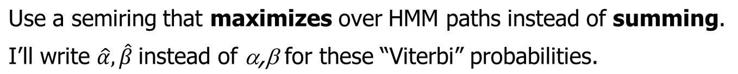






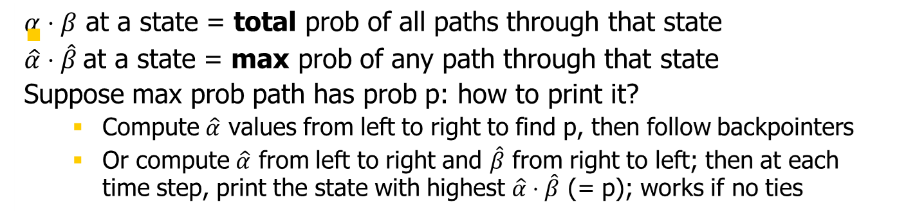
The Viterbi algorithm
Day 1: 2 cones
Day 2: 3 cones
Day 3: 3 cones
C
p(C|C)*p(3|C)
C
p(C|C)*p(3|C)
C
p(C|Start)*p(2|C)
0.8*0.1=0.08
0.8*0.1=0.08
0.5*0.2=0.1
p(H|C)*p(3|H)
p(C|H)*p(3|C)
p(H|C)*p(3|H)
p(C|H)*p(3|C)
Start
0.1*0.7=0.07
0.1*0.1=0.01
0.1*0.7=0.07
0.1*0.1=0.01
p(H|Start)*p(2|H)
0.5*0.2=0.1
H
p(H|H)*p(3|H)
H
p(H|H)*p(3|H)
H
0.8*0.7=0.56
0.8*0.7=0.56
600.465 - Intro to NLP - J. Eisner

