Slide 1

FREE5GC INSTALLATION

Slide 2
1) Creating ubuntu machine on virtualbox.
2) Installing ubuntu.
3) Clone Virtual machine and name it as free5gc.
4) Edit the hostname and change IP of free5gc.
5) Install go and mongodb.
6) Setup Routing.
7) Install free5gc.
8) Testing free5gc.
9) Clone virtual machine and name it as ueransim.
10) Edit the hostname and change IP of ueransim.
11) Install UERANSIM.

Slide 3
12) Building Webconsole.
13) Add a UE using webconsole.
14) Configuring free5gc and ueransim.
15) Running free5gc and ueransim.

Slide 4
Live mpeg-dash video streaming cache management with cognitive mobile edge computing

Slide 5
In practice, MPEG-DASH could be carried over the File delivery over Unidirectional Transport (FLUTE) protocol.
Different quality of a video, in terms of bit rates is encoded into separate DASH files whose metadata are described by a media presentation description (MPD) file.
For each quality of each video, a FLUTE session is created.
MEC servers join these FLUTE sessions transparently by the assistance of the SDN controller.
With the help of the SDN network, multiple requests for the same live video stream from users under an MEC server could retrieve video data from the cache of the MEC server.
By analyzing the MPD files, MEC servers could either cache or pre-cache live video streams that could be shared by live video subscribers in their service areas.

Slide 6
OVERVIEW
Network architecture design for delivering live video streaming over the cellular core network with cognitive mobile edge computing (MEC) servers.
Optimal cache management by considering several issues, include QoE, cache size, backhaul bandwidth,
pre-cache mechanism, and user mobility.
Prototype of the proposed MEC-assisted live video streaming system.

Slide 7

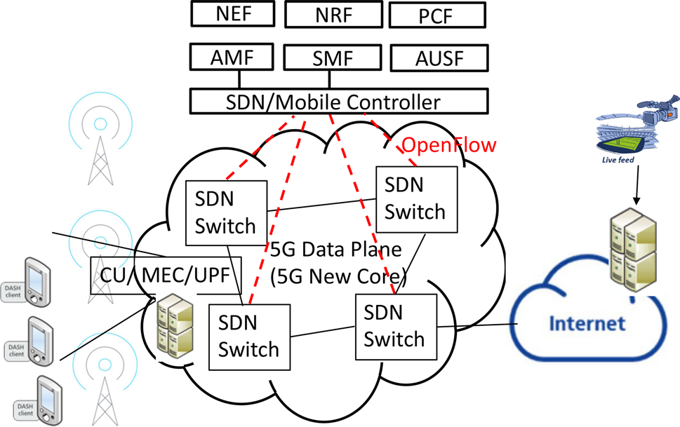
SYSTEM ARCHITECHTURE

Slide 8
MEC servers serve as live streaming video proxy and cache servers.
All live streaming video requests (MPEG-DASH over HTTP) are intercepted by MEC servers. Responses to video requests will be generated by MEC servers, which contain video data files from their cache.
If there is a cache miss, the MEC server acts as an HTTP/FLUTE proxy, redirect the request to the DASH/FLUTE server, relay the response from the DASH/FLUTE server to the user as well as store the content (either MPD file or video data file)to the cache repository.

Slide 9
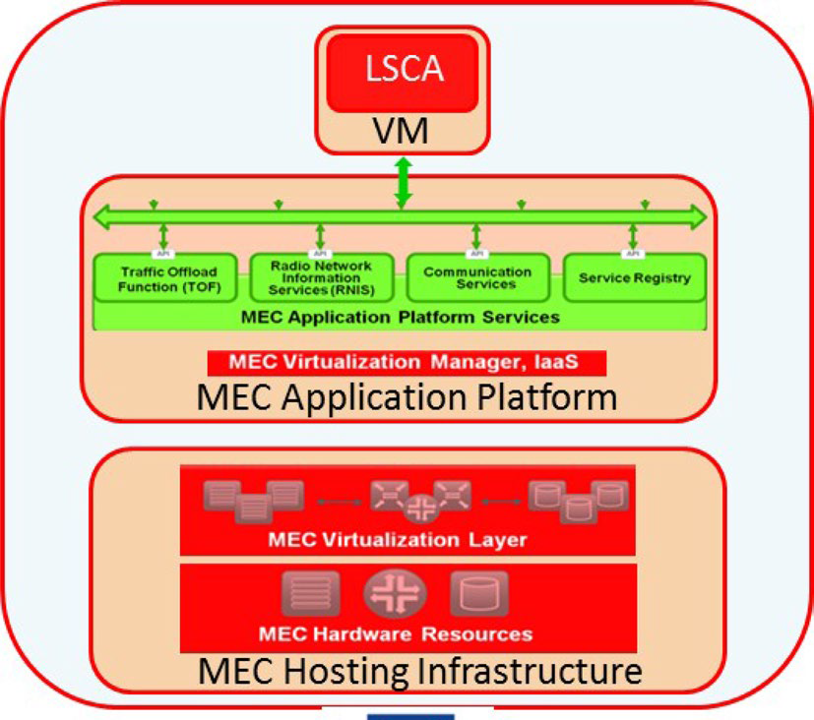
SYSTEM DESIGN

Slide 10
As shown in figure, MEC server consists of three layers, namely MEC Host Infrastructure, MEC Application Platform, MEC Applications.
The Host Infrastructure consists of a virtualization layer over the hardware resources.
Above the Host Infrastructure is a MEC virtualization manager that provides Infrastructure as a Service to MEC applications.
At the top layer, we have an application for handling live video streaming cache service, referred to
as Live Streaming Cache Application (LSCA).
LSCA is the application that implements the live streaming video proxy and caching mechanisms.
LSCA on each MEC server acts as a local video proxy and cache server, it can collect video subscriber's information.
Since it is located close to base stations (gNB), thus it can also collect LTE/RAN network information from base stations within its service area.

Slide 11
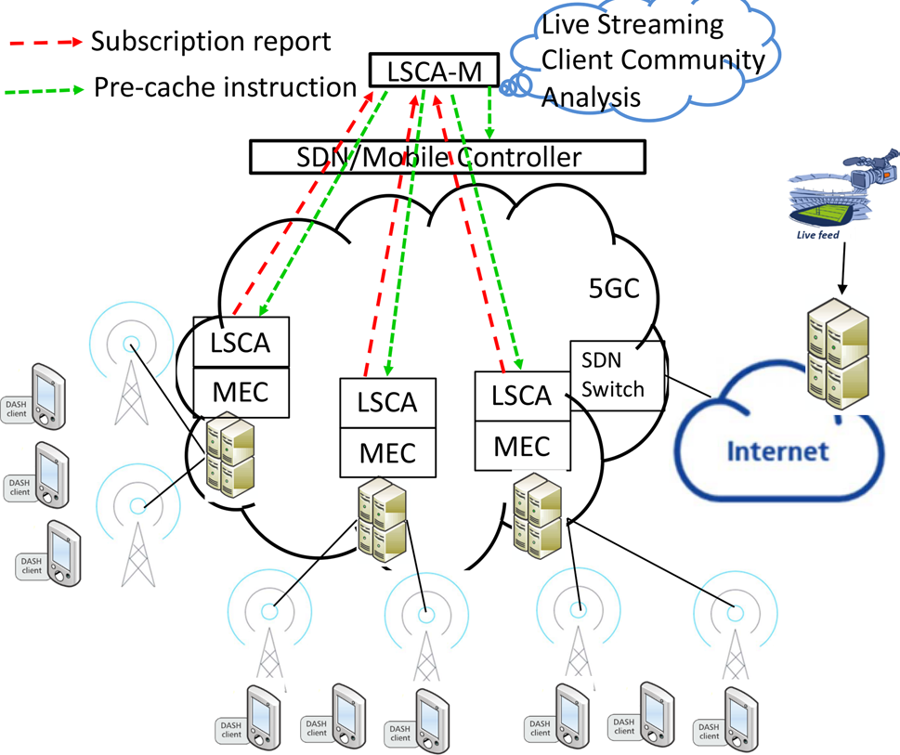
At the control plane, a Virtualized Network Function (VNF), called Live Streaming Cache Application Management System (LSCA-M) is deployed.
Proposed live streaming service as a network function on both MEC (LSCA) and the 5G control plane (LCSA-M).

Slide 12
The communication between LSCA and LSCA-M follows the MPEG Server And Network assisted DASH (SAND) standard.
There are three types of elements in the SAND architecture: DASH Client, DASH assisting network elements (DANE), Regular Network Elements (RNE).
DASH client is the client that requests and receives video streams through MPEG-DASH protocol.
DANE are network devices that can interpret some DASH messages, such as recognize and analyze MPD files and DASH segments. But they have the flexibility to process these DASH messages in their way.
RNE are general network devices who do not understand DASH messages and treat or transmit DASH delivery objects just like any other object.
The proposed LSCA and LSCA-M are DANE devices in SAND architecture. LSCA will send status messages containing local information it collected to LSCA-M. Upon receiving this information, LSCA-M provides information for the SDN controller for better multicast routing and resource allocation.

Slide 13
When a user subscribes to a live video streaming, it sends out an HTTP request for an MPD file first. The message is intercepted by the LSCA.
If this is a new request, i.e., not found in the cache, LSCA redirects the request to the video source. The responded MPD file will be cached and also forwarded to the subscriber.
On the other hand, if the MPD file is found in the cache, LSCA retrieves the MPD file and sends an HTTP response back to the subscriber on behalf of the video source.
When a subscriber received the MPD file, it will send HTTP requests for video/audio segments (each video/audio segment is a file). Similar behavior will be performed at LSCA, either behaves as a proxy to forward request and relay response or a cache server to provide cached content.

Slide 14
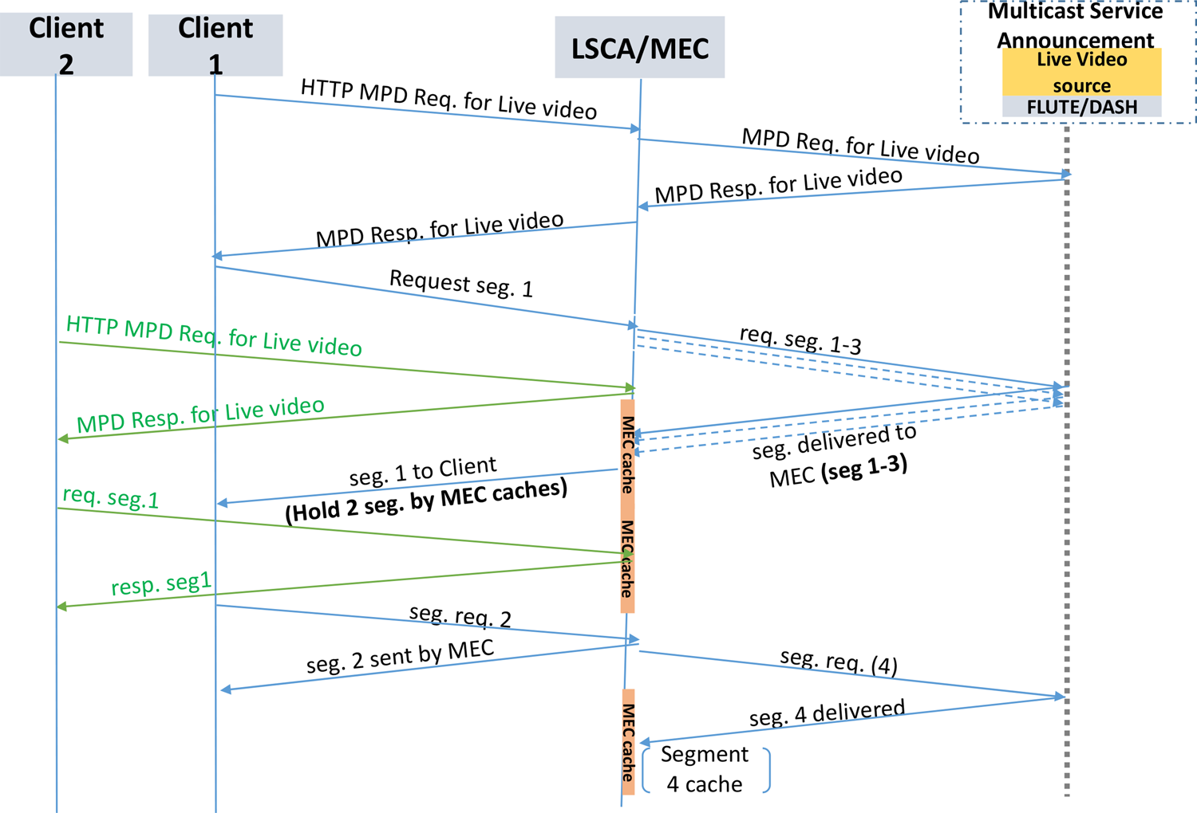
LSCA CACHE&PRE-CACHE MECHANISM

Slide 15
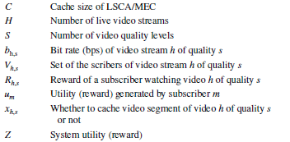


CACHE MANAGEMENT
Subject to
MPEG-DASH encodes video into video segments, each segment contains t seconds of video data. Each video segment has its unique URL described in the MPD file.

Slide 16
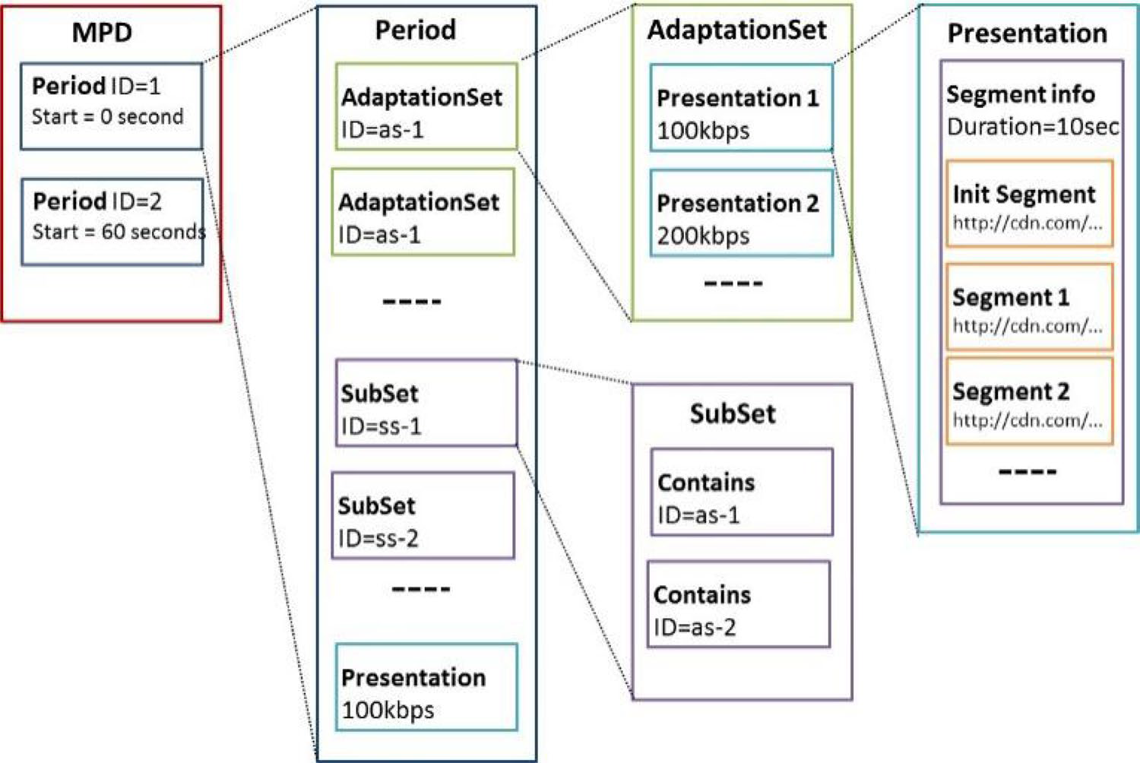
PRE-CACHE MANAGEMENT
LSCA at MEC also analyses the MPD file and deploys a pre-fetch mechanism to pre-fetch next available video segments from the video sources before the subscribers send out their DASH/HTTP requests.

Slide 17
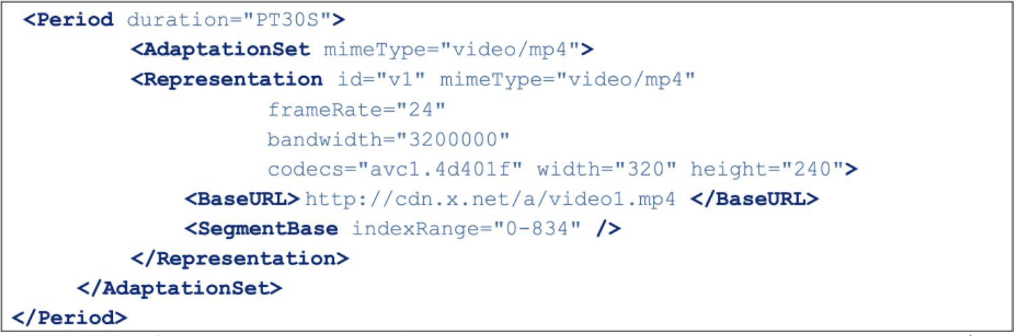
Example of a segment in a presentation frame. It contains the duration, data type (mimeType), data rate, size, URL of the video segment.

Slide 18
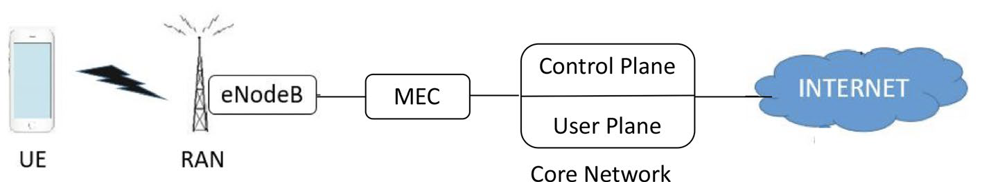
PROTOTYPE NETWORK ARCHITECTURE

Slide 19
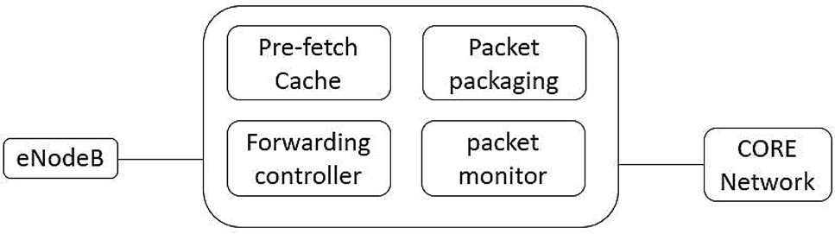
Software Architecture for the MEC prototype

Slide 20
Packet monitor
It monitors the request packets transmitted from the UE to the core network, and the response packets from the Internet to the eNB/UE.
The HTTP GET request packet sent by the user who watches the live streaming video using the mobile phone will be intercepted and analyzed by this module such that the packet’s detailed information can be obtained, including ports, acknowledgment number, sequence number, etc.
The information is passed to the packet packaging module for further process and analysis.

Slide 21
PRE-FETCH CACHE
After LSCA recognizes a live streaming video is demanded by more than one user, it actives the pre-fetch mode by sending requests to receive future video segments before users send their requests.
Upon receiving the segment files from the live streaming video sever, LSCA stores them in the cache repository. Later on, when LSCA receives requests from users, it retrieves the segment files from the cache repository and forwards them to the Packet Packaging module.

Slide 22
Packet packaging
Whenever a UE sends an HTTP GET request packet to a live streaming video server, the user information obtained from the Packet Monitor mechanism is immediately stored and analyzed by the packet packaging module.
To send out the GET request to the live video stream server or clone response to the users, the packet packaging module use GPRS tunneling protocol.
The header of packets includes following protocol headers (in order): IP → UDP → GTP →IP → TCP → HTTP.
The first three headers are for transmission in the LTE/5G core network. LSCA retreives this information from MEC appication platform.
The last three headers are for DASH/HTTP applications. The required information is passed from the packet monitor module.

Slide 23
FORWARDING CONTROLLER
It is mainly responsible for packets to be forwarded to the UEs through eNB.
When the packet monitor module intercepts an HTTP GET request, it may retrieve the response content from the cache repository, and send back the response to the UE.
The response packet will be packaged by the packet packaging module and then sent to the eNB.
The eNB will then forward the response to the UE.

