Slide 1
Internet Safety
Networks, Legal and Ethical Behaviors
BSU CS4MS - 4/9/19
http://www.cs.bsu.edu/cs4ms/docs/InternetSafetyLessonPlan.pdf
http://www.cs.bsu.edu/cs4ms/docs/InternetSafetySlides.pptx

Slide 2

What is the Internet?
The internet is a massive network of networks that connect computers all around the world.
Think of the internet as the hardware of our online world.
The internet was first created in the 1960s. It was first known as ARPANET.

Slide 3









What is the World Wide Web?
In the 1990s, technology advanced a point where the internet took on a more recognizable from.
Computer Scientist Tim Berners-Lee invented the world wide web.
Think of the world wide web as the software of the online world.

Slide 4


Understanding The Layers
Surface Web
The web is divided to to three categories:
Surface Web
Deep Web
Dark Web
Each category holds public, confidential, and classified information.
Think of an iceberg. The portion above the surface is what everyone can see. This represents the surface web. The area below the surface is the deep web and dark web.
Deep Web
Dark Web

Slide 5
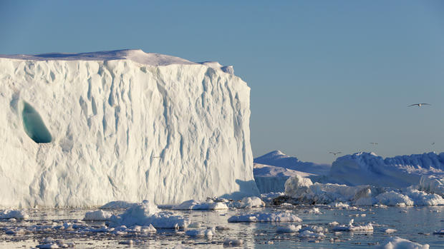
The Surface Web
Anyone can access the surface web.
Many popular websites reside on this layer:
Google
Facebook
Instagram
Snapchat
Twitter
YouTube
Xbox Live
PlayStation Network
The surface web is only 4% of the web.

Slide 6

The Deep Web
The deep web is where confidential documents and websites reside
The deep web holds information like:
Legal documentation
Medical records
Criminal records
Driving records
Financial records
Scientific reports
Government documentation
Academic records
The Deep Web is about 90% of the web.

Slide 7

The Dark Web
The Dark Web is where illegal activities occur. Modern search engines don’t see sites on the dark web because they are encrypted.
The dark web contains information that is not meant to be seen by the public eye. People can purchase illegal goods and services on the dark web.
The dark web is home to predators and hackers that seek out individuals’ personal data.
The dark web makes up 6% of the web.

Slide 8

Ways To Stay Safe On The Internet
NEVER give out your passwords.
Think TWICE before posting things online.
When you’re done online, LOGOUT of your accounts.
Avoid SHARING personal information.
Do NOT write down passwords and security questions.
Do NOT include any part of your name in your usernames.
Do NOT use the same password for multiple websites.

