Slide 1
Troubleshooting
BSU CS4MS - 4/9/19
http://www.cs.bsu.edu/cs4ms/docs/Troubleshooting.pdf

Slide 2

What is troubleshooting?
Troubleshooting is when you step by step try to fix a problem. This could be like making a checklist of things to try if your computer isn’t working.
When your computer isn’t working properly, what can you do?

Slide 3
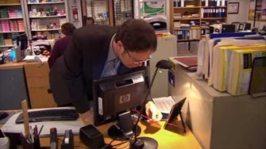
Basic Troubleshooting Strategies
Check cable connections.
Restart the device.
Watch for error messages.
Use process of elimination.
Keep track of issues you’ve ruled out.
Understand key shortcuts to important computer processes.
Ctrl + Alt + Delete opens a menu allowing operating system functions.
Ctrl + Shift + Escape open the task manager.
Alt + F4 closes the current window.
Find trustworthy troubleshooting solutions with Internet searches.

Slide 4
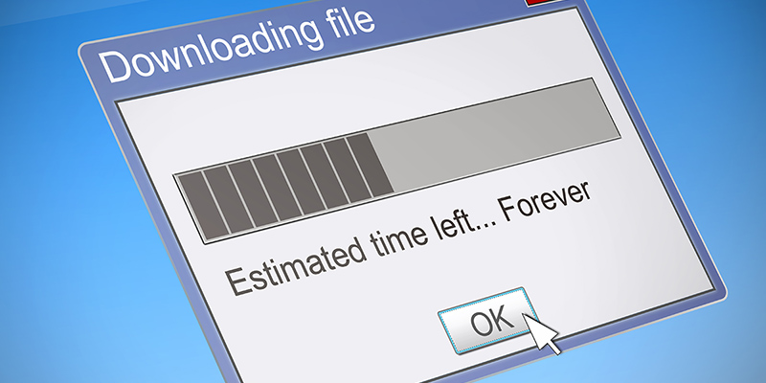
SLOW COMPUTER
1. Close tabs/programs you don’t need.
2. Close internet browser and open again.
3. Restart the computer.
4. Remove large programs you don’t need.

Slide 5
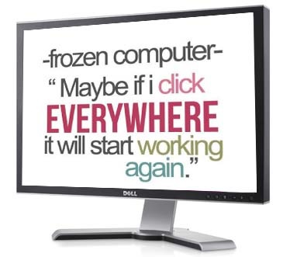
COMPUTER FREEZES
1. If mouse won’t move, press Control + Alt + Delete.
2. Click “start task manager.”
3. Click “applications,”
click on frozen programs and click “end task”.

Slide 6

PAGE WON’T LOAD
1. Press F5 to refresh.
2. Close browser and open again.
3. Try a different browser (Firefox, Chrome or Internet Explorer).
4. Check internet is connected.

Slide 7
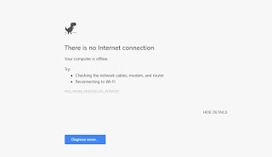
INTERNET WON’T WORK
1. Click network/wireless icon in your taskbar. Check that you’re connected.
2. Restart your networking device (control panel–> internet options –> connections).
3. If using Ethernet, check your internet cables
Most Ethernet ports are equipped with lights
to inform you that the port is active. If no
lights are present, there’s likely an issue.

