Slide 1


Explainable Machine Learning Credit Card Fraud Detection
Dalle Luche Leonardo
Master in Data Analytics – University of Roma Tre

Slide 2
Introduction
Nowadays, it is important for credit card companies to recognize fraudulent credit card transactions.
In this assignment we are going to use the dataset provided by Datacamp to train a XGBoost Classifier model, then explain its output with SHAP and LIME.
Before the feature selection we are going to explore the dataset and make assumptions in order to simplify the process.
The dataset consists of credit card transactions in the western United States. It includes information about each transaction including customer details, the merchant and category of purchase, and whether or not the transaction was a fraud.
Reference: https://www.datacamp.com/workspace/datasets/dataset-python-credit-card-fraud

Slide 3
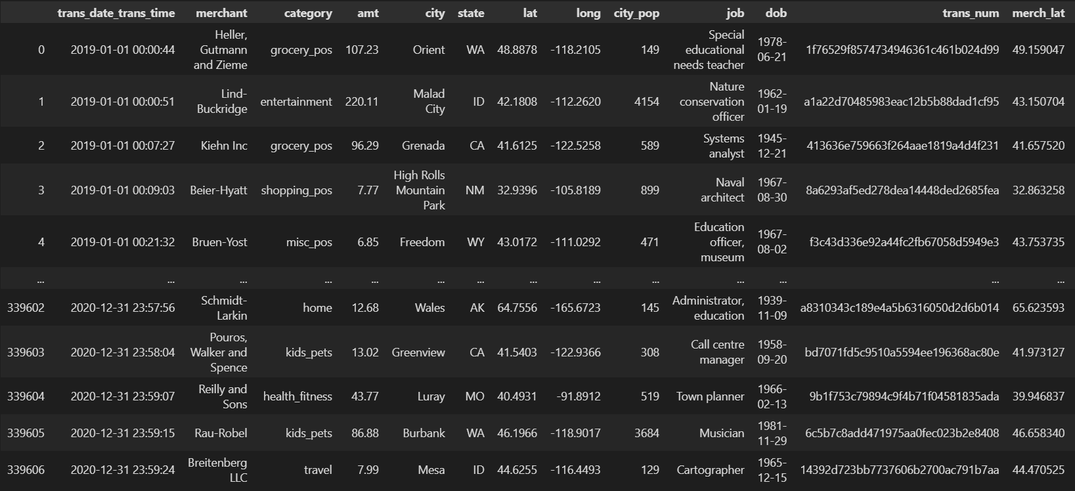
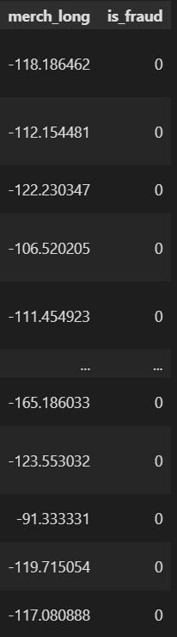
Dataset Schema & Overview
merchant: merchant name (object)
category: category of merchant (object)
amt: amount of transaction (float)
city: city of credit card holder (object)
state: state of credit card holder (object)
lat: latitude location of purchase (float)
long: longitude location of purchase (float)
city_pop: credit card holder’s city population (int)
job: job of credit card holder (object)
dob: date of birth of credit card holder (object)
trans_num: transaction number (object)
merch_lat: latitude location of merchant (float)
merch_long: longitude location of merchant (float)
is_fraud: whether transaction is fraud (1) or not (0) (int)
# of records: 339 607
# of columns: 15

Slide 4
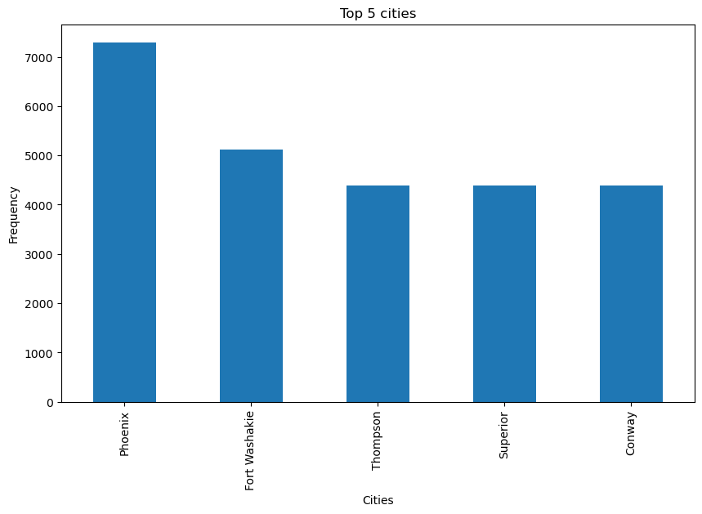
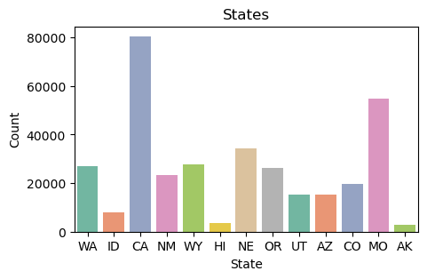
Data Exploration (1)
Let’s take a look at the distribution of ‘state’ and ‘city’ variables.
Both variables variable contain various categorical values, we are going to encode them properly if we want to include them as features of the model.
Please note that due to plot dimension the barchart related to ‘city’ variable have been simplified selecting only the top five cities.

Slide 5
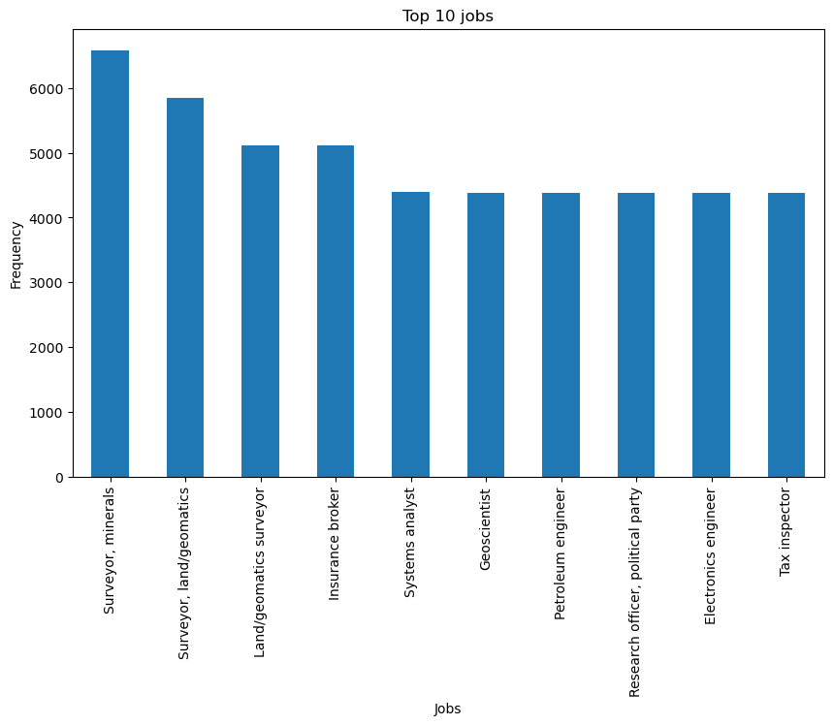
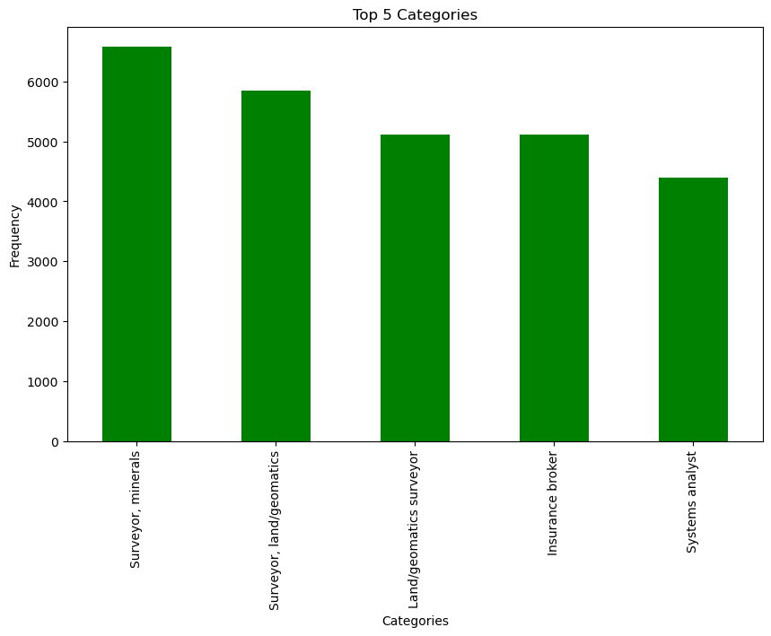
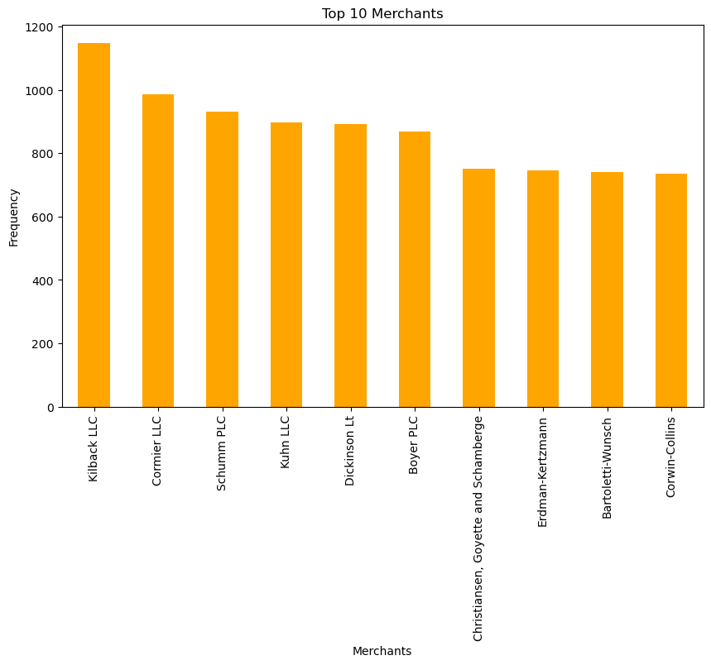
Data Exploration (2)
Now, let’s look at the distributions of other categorical columns such as ‘merchant’, ‘job’, and ‘category’.
The categorical variables contain various values, as for ‘city’ variable we are going to encode them as well.
Please note that due to plot dimension only the top n values for each variable have been printed out.

Slide 6
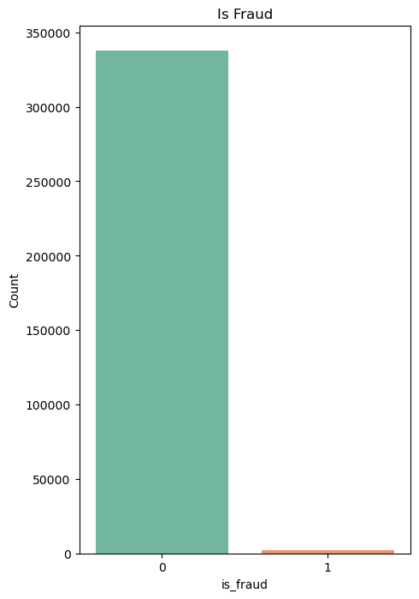
Data Exploration (3)
Let’s see ‘is_fraud’ distribution.
The distribution is unbalanced, only 1782 out of 337 825 have been
classified as fraud.
We need to use a robust model such as Random Forest or XGBoost and appropriately set up its hyperparameters in order to manage such unbalanced dataset.
Furthermore, the metrics are probably going to not represent the real performance of the model, since there aren’t enough ‘fraud’ cases.
Non-Fraud (0): 337 825
Fraud (1): 1782

Slide 7
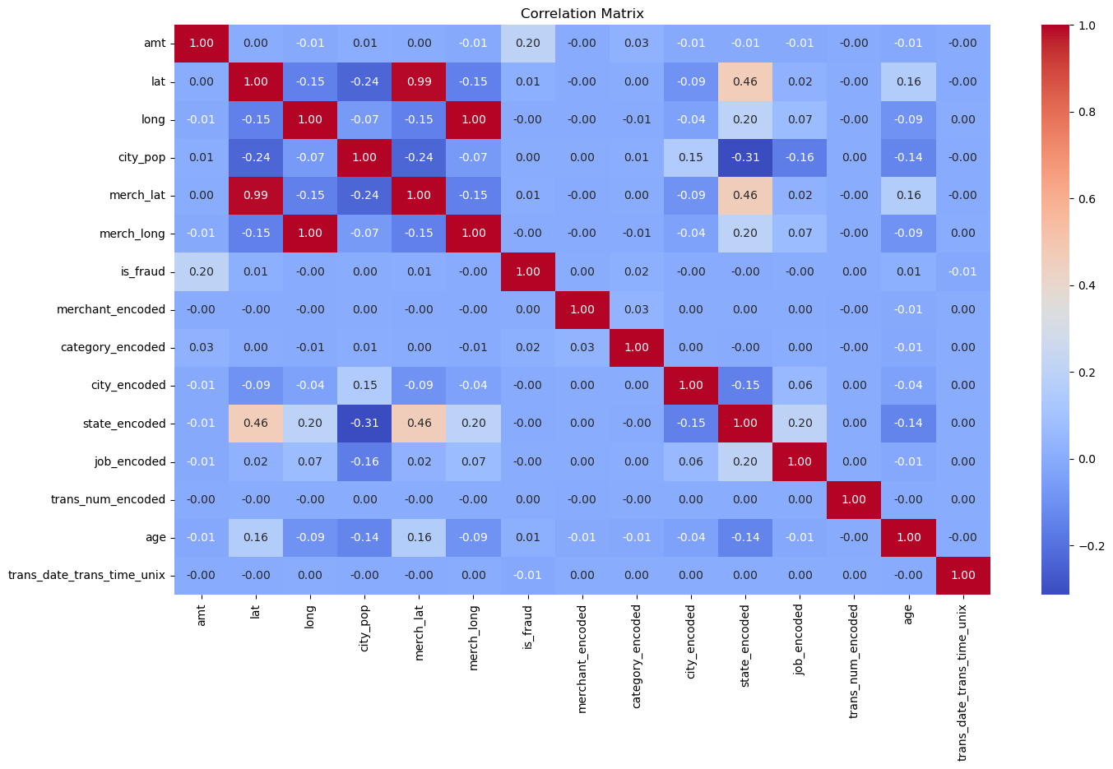
Data Exploration (4)
From the correlation matrix we can see that ‘is_fraud’ column is slightly correlated to ‘amt’ column, while other columns, especially ones representing geographical coordinates, are strongly correlated (‘merch_lat’ and ‘lat’, ‘merch_long’ and ‘long’).

Slide 8
Features & Model Selection
Based on the previous findings, we are going to use the XGBoost Classifier model paying particular attention to the settings of its hyperparameters, due to the unbalanceness of the dataset.
Furthermore, the following columns will be considered as features of the model:
features = ['amt', 'lat', 'long', 'merch_lat', 'merch_long', 'category_encoded', 'city_encoded', 'state_encoded', 'age', 'trans_date_trans_time_unix']
Since amount, merchant and geographical information are likely to be useful to recognize a fraudulent transaction. In addition, also because from the correlation matrix we can see a slight linear relation between amount and is_fraud.

Slide 9
Tuning of XGBoost Model
In order to improve the performance of the model, the following hyperparameters will be used:
model_XGB = xgboost.XGBClassifier(n_estimators = 100, max_depth = 2, subsample = 0.7, eta = 0.25,
scale_pos_weight = xgb_scale_pos_weight, max_delta_step = 1)
subsample: subsample ratio of the training instances. Setting it to 0.5 means that XGBoost would randomly sample half of the
training data prior to growing trees, and this will prevent overfitting. Subsampling will occur once in every boosting iteration.
eta (alias learning rate): step size shrinkage used in update to prevents overfitting. After each boosting step, we can directly
get the weights of new features, and eta shrinks the feature weights to make the boosting process more conservative.
scale_pos_weight: control the balance of positive and negative weights, useful for unbalanced classes. A typical value to
consider: sum(negative instances) / sum(positive instances).
max_delta_step: maximum delta step we allow each leaf output to be. If the value is set to 0, it means there is no constraint.
If it is set to a positive value, it can help making the update step more conservative. Usually this parameter is not needed, but
it might help in logistic regression when class is extremely imbalanced. Set it to value of 1-10 might help control the update.
Please note that the previous information has been taken from the references below.
References:
https://xgboost.readthedocs.io/en/stable/parameter.html
https://xgboost.readthedocs.io/en/stable/tutorials/param_tuning.html

Slide 10
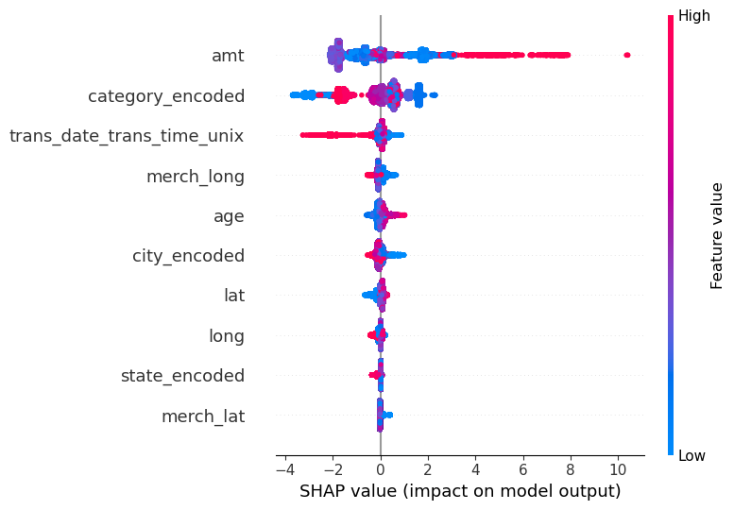
SHAP – Global Explanation (1)
explainer = shap.Explainer(model_XGB, X_train)
shap_values = explainer.shap_values(X_test)
shap.summary_plot(shap_values,
X_test,
feature_names = features)
First of all, let’s give a general explanation.
From the summary plot we can see the impact of each variable on the model output.
On average ‘amt’ (amount) and (merchant) ‘category_encoded’ variables are the most important in terms of impact on model output.
Generally speaking, the higher amount value is, the more positive its impact. The lower its value, the more negative its impact.

Slide 11
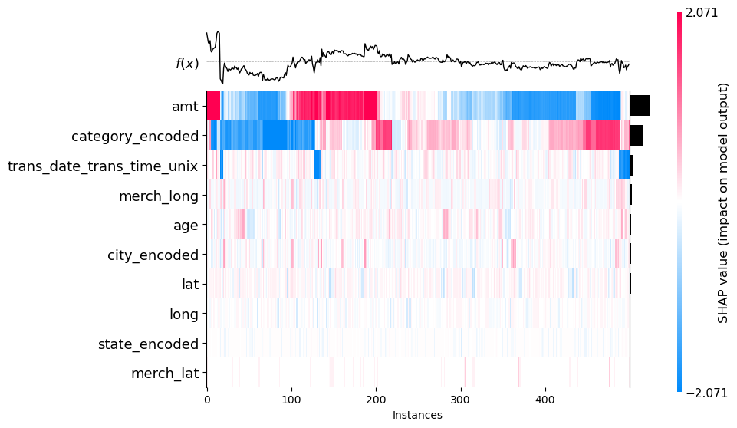
SHAP – Global Explanation (2)
shap_values = explainer(X_test.iloc[:500])
shap.plots.heatmap(shap_values)
Let’s take a set containing the first 500 records of the test dataset and explain their outputs.
From the heatmap we can see the impact of the features for each instances within the set.
Looking at amt (amount) feature: from instance number ~100 to ~200 its impact is very high, while from instance number ~350 to ~500 its impact is very negative.

Slide 12
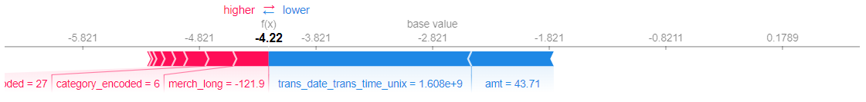
SHAP – Local Explanation (1)
instance_idx = 8
shap_values = explainer(X_test.iloc[instance_idx])
shap.force_plot(explainer.expected_value, shap_values.values, X_test.iloc[instance_idx])
Let’s randomly choose two indexes (8, 64) in order to locally explain their predictions.
From the force plot, we can see that the (negative) contribution given by the features in blue has had a negative impact on the local prediction. In other words, the plot shows which features are pushing the prediction to the right or left.
In this particular case, we can see how amt (amount) and trans_date_trans_time_unix pushed the prediction to the left of the base value.

Slide 13
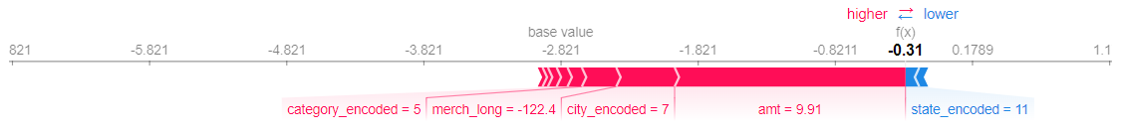
SHAP – Local Explanation (2)
instance_idx = 64
In this case we can see how ‘amt’, ‘city_encoded’ and ‘merch_long’ features majorly pushed the prediction to the right of the base value.
The top two contributors are ‘amt’ and ‘city_encoded’ features.

Slide 14

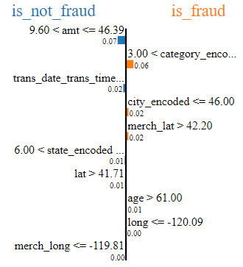
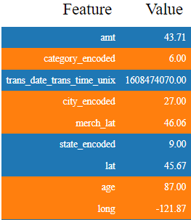

LIME (1)
instance_idx = 8
lime_explainer = LimeTabularExplainer(X_train.values,
mode="classification",
feature_names=features,
class_names=[‘is_not_fraud‘,’is_fraud’])
explanation = lime_explainer.explain_instance(X_test.values[instance_idx],
model_XGB.predict_proba,
num_features=len(X_test.columns))
explanation.show_in_notebook()
Now, let’s apply LIME to the same local instances (8, 64).
In this case (instance id = 8), from the prediction probabilities we can see that the amt feature pushed the model to classify the prediction as not-fraud.
Trans_date_trans_time_unix feature had a slight impact as well.

Slide 15

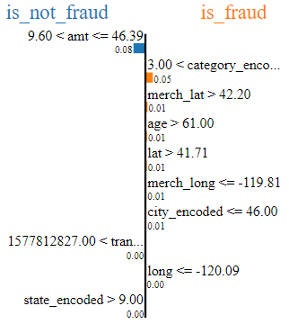
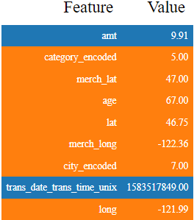

LIME (2)
instance_idx = 64
In this case, we can see the negative impact of ‘amt’ feature on the prediction, while ‘category_encoded’, ‘merch_lat’, ‘age’, etc. gave a positive impact, pushing the prediction probability to classify the prediction as fraud.

Slide 16
SHAP VS LIME
Let’s consider the last instance (index = 64) and compare its (local) SHAP and LIME results.
From the plots, we can see that the impact of the most important features has been captured by both methods, such as ‘amt’, ‘trans_date_trans_time_unix’, ‘category_encoded’, ‘merch_long’, etc.
In conclusion, to explain this local prediction both methods look valid.

Slide 17
CONCLUSION
Both (local) SHAP and LIME captured the contribution from the most important features of a single prediction.
For sure, SHAP is more complete, since we can explain both global and local predictions.
In this particular use case (credit card fraud detection), SHAP is probably more suited, since it can capture both global and local importance of each feature.

