Slide 1


Explainable Machine Learning Credit Card Fraud Detection
Dalle Luche Leonardo
Master in Data Analytics – University of Roma Tre

Slide 2
Introduction
Nowadays, it is important for credit card companies to recognize fraudulent credit card transactions.
In this assignment we are going to use the dataset provided by Kaggle to train a XGBoost Classifier model, then explain its output with SHAP and LIME.
Please note that due to confidentiality issues some of the features have been transformed with PCA (Principal Component Analysis). Such features probably contain sensitive data about the transactions like credit card owner, address, contact information, country, date of birth, etc.
However, during the feature selection process we are going to explore such features in order to choose the most relevants and make some assumptions.
Reference: https://www.kaggle.com/datasets/mlg-ulb/creditcardfraud/data

Slide 3
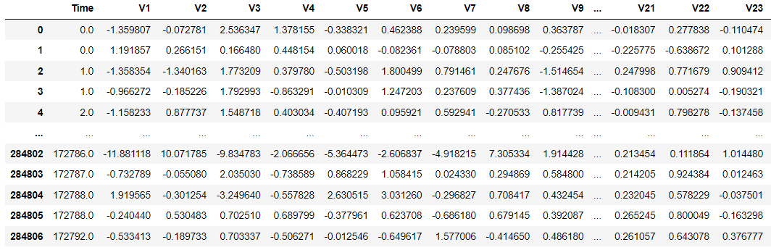
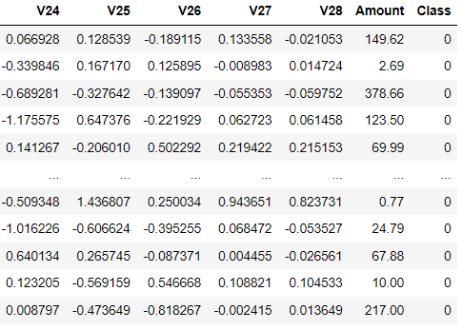
Dataset Schema & Overview
Time: contains the seconds elapsed between each transaction and the first transaction in the dataset, type = float
V1, V2, V3, … V28: principal components obtained with PCA, type = float
Amount: transaction amount (please note that the unit of measure has not been specified), type = float
Class: response variable, it takes value 1 in case of fraud and 0 otherwise, type = integer
# of records: 284 807
# of columns: 31

Slide 4
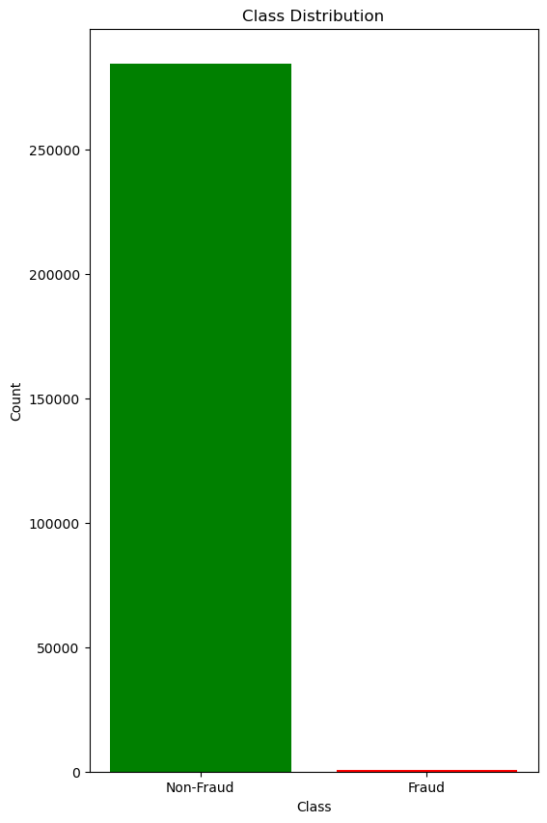
Data Exploration (1)
Domain of each column
Column 'Time': Min = 0.00, Max = 172792.00
Column 'V1': Min = -56.41, Max = 2.45
Column 'V2': Min = -72.72, Max = 22.06
Column 'V3': Min = -48.33, Max = 9.38
Column 'V4': Min = -5.68, Max = 16.88
Column 'V5': Min = -113.74, Max = 34.80
Column 'V6': Min = -26.16, Max = 73.30
Column 'V7': Min = -43.56, Max = 120.59
Column 'V8': Min = -73.22, Max = 20.01
Column 'V9': Min = -13.43, Max = 15.59
Column 'V10': Min = -24.59, Max = 23.75
Column 'V11': Min = -4.80, Max = 12.02
Column 'V12': Min = -18.68, Max = 7.85
Column 'V13': Min = -5.79, Max = 7.13
Column 'V14': Min = -19.21, Max = 10.53
Column 'V15': Min = -4.50, Max = 8.88
Column 'V16': Min = -14.13, Max = 17.32
Column 'V17': Min = -25.16, Max = 9.25
Column 'V18': Min = -9.50, Max = 5.04
Column 'V19': Min = -7.21, Max = 5.59
Column 'V20': Min = -54.50, Max = 39.42
Column 'V21': Min = -34.83, Max = 27.20
Column 'V22': Min = -10.93, Max = 10.50
Column 'V23': Min = -44.81, Max = 22.53
Column 'V24': Min = -2.84, Max = 4.58
Column 'V25': Min = -10.30, Max = 7.52
Column 'V26': Min = -2.60, Max = 3.52
Column 'V27': Min = -22.57, Max = 31.61
Column 'V28': Min = -15.43, Max = 33.85
Column 'Amount': Min = 0.00, Max = 25691.16
Column 'Class': Min = 0, Max = 1
Since ‘Class’ is our target variable, let’s see its distribution:
The distribution is unbalanced, only
492 out of 284’315 have been
classified as ‘Fraud’. We need to use
a robust model such as Random Forest
or XGBoost and appropriately set up its
hyperparameters in order to manage
such unbalanced dataset.
Non-Fraud (0): 284 315
Fraud (1): 492

Slide 5
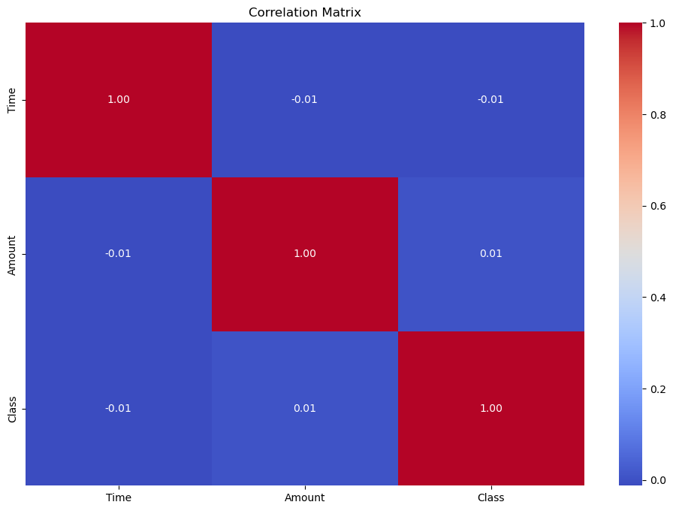
Data Exploration (2)
Let’s see if there is a correlation between ‘Class’, ‘Amount’ and ‘Time’ columns:
From the correlation matrix we can see that
the columns are not correlated.
The columns ‘Amount’ and ‘Time’ are going
to be excluded from the features selection
process due to lack of correlation with
‘Class’ column.

Slide 6
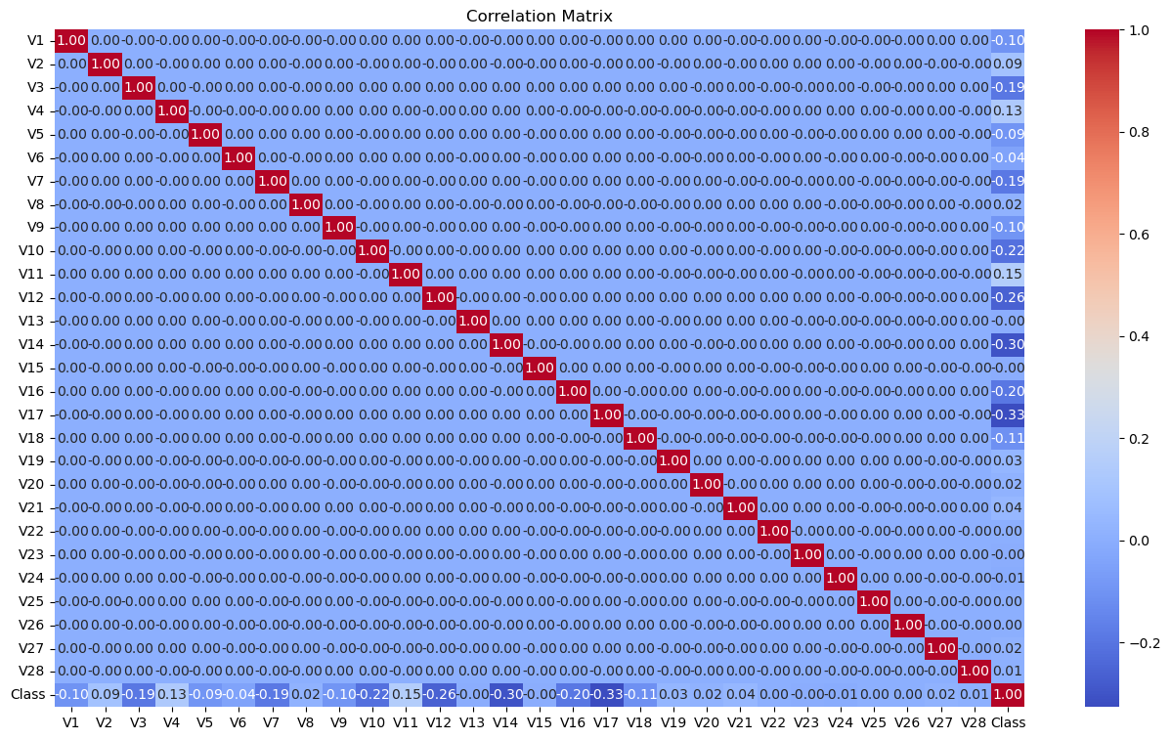
Data Exploration (3)
From the correlation matrix
we can see that a bunch of
columns from ‘V1’ to ‘V28’
are (more or less) correlated
to ‘Class’ column.
Such columns are good
candidates to become
features of the model.

Slide 7
Features & Model Selection
Based on the previous findings, we are going to use the XGBoost model paying particular attention to
the settings of its hyperparameters, due to the unbalanceness of the dataset.
Furthermore, the following columns will be considered as features of the model:
features = ["V1","V2","V3","V4","V5","V6","V7","V8","V9","V10","V11","V12","V14","V16","V17","V18","V19","V20","V21","V24","V27","V28"]
Since they are likely to be correlated to ‘Class’ column. In addition, for simplicity reason we are going to assume
that ‘Time’ and ‘Amount’ columns are not related to a potential fraud.

Slide 8
Tuning of XGBoost Model
In order to improve the performance of the model, the following hyperparameters will be used:
model_XGB = xgboost.XGBClassifier(n_estimators = 100, max_depth = 2, subsample = 0.7, eta = 0.25,
scale_pos_weight = xgb_scale_pos_weight, max_delta_step = 1)
subsample: subsample ratio of the training instances. Setting it to 0.5 means that XGBoost would randomly sample half of the
training data prior to growing trees, and this will prevent overfitting. Subsampling will occur once in every boosting iteration.
eta (alias learning rate): Step size shrinkage used in update to prevents overfitting. After each boosting step, we can directly
get the weights of new features, and eta shrinks the feature weights to make the boosting process more conservative.
scale_pos_weight: Control the balance of positive and negative weights, useful for unbalanced classes. A typical value to
consider: sum(negative instances) / sum(positive instances).
max_delta_step: Maximum delta step we allow each leaf output to be. If the value is set to 0, it means there is no constraint.
If it is set to a positive value, it can help making the update step more conservative. Usually this parameter is not needed, but
it might help in logistic regression when class is extremely imbalanced. Set it to value of 1-10 might help control the update.
Please note that the previous information has been taken from the reference.
References:
https://xgboost.readthedocs.io/en/stable/parameter.html
https://xgboost.readthedocs.io/en/stable/tutorials/param_tuning.html

Slide 9
Fit & Metrics
# Defining features and target variable
X = df[features]
y = df["Class"]
# Splitting the dataset
X_train, X_test, y_train, y_test = train_test_split(X, y, test_size = 0.2, random_state = 42)
model_XGB = model_XGB.fit(X_train, y_train)
y_pred = model_XGB.predict(X_test)
Metric | Value
Precision | 0.1485
Recall | 0.9184
F1 | 0.2557
AUC-ROC | 0.9546
A brief consideration about the metrics: the accuracy score has not been
included due to its unrealistic high value, probably caused by the distribution
of ‘Class’ values. The dataset only contains 492 ‘non-fraud’ cases, which means
the model can’t properly distinguish this particular case (in other words, the
model needs to see enough ‘non-fraud’ records to be properly trained).
However, after setting the hyperparameters, the values of other metrics
look reasonable, even if precision and F1 scores are quite low.

Slide 10
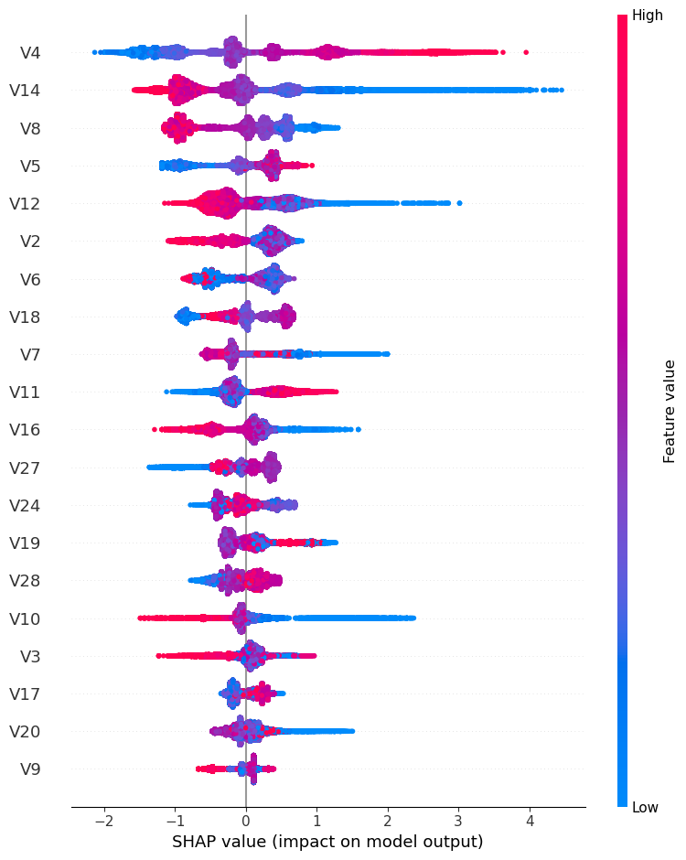
SHAP – Global Explanation (1)
explainer = shap.Explainer(model_XGB, X_test)
shap_values = explainer.shap_values(X_test)
shap.summary_plot(shap_values, X_test, feature_names = features)
First of all, let’s give a general explaination.
From the summary plot we can see the impact of each variable on the model output.
On average the V4 and V14 variables are the most important in terms of impact on model output.
Generally speaking, the higher V4 value is, the more positive its impact. The lower V14 value is, the more negative its impact.
Unfortunately we do not know what they exactly represent, but, as already said, we are assuming that they contain sensitive data about credit card transaction.

Slide 11
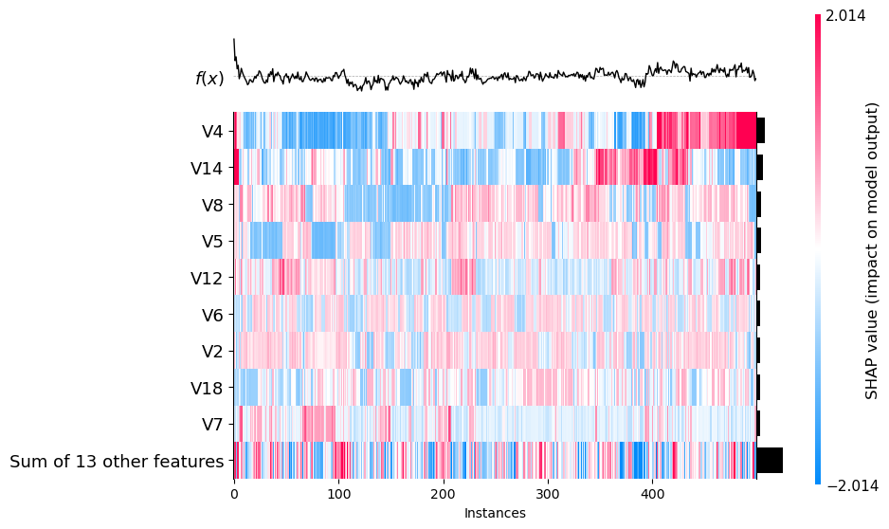
SHAP – Global Explanation (2)
shap_values = explainer(X_test.iloc[:500])
shap.plots.heatmap(shap_values)
Let’s take a set containing the first 500 records of the test dataset and explain their outputs.
From the heatmap we can see the impact of the features for each instances within the set.
Looking at V4 feature: from instance number 400 to 500 its impact has a positive effect on the prediction, while from instance number ~50 to ~100 its impact is negative.
V7 feature has a very slight impact for the most of instances, since its SHAP value is close to 0.

Slide 12
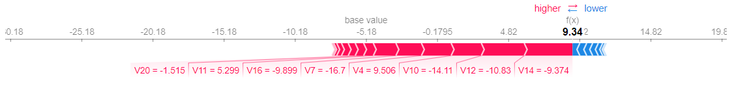
SHAP – Local Explanation (1)
instance_idx = 0
shap_values = explainer(X_test.iloc[instance_idx])
shap.force_plot(explainer.expected_value, shap_values.values, X_test.iloc[instance_idx])
Let’s randomly choose three indexes (0, 22, 51) in order to locally explain their predictions.
From the force plot, we can see that the contribution given by the features in red has had a high impact on the local prediction. In other words, the plot shows which features are pushing the prediction to the right or left.
In this particular case (index = 0), we can see that the features V14, V12, V10, V4, V7 has had a high impact on the prediction.

Slide 13
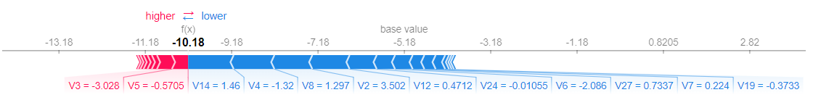
SHAP – Local Explanation (2)
instance_idx = 22
In this case (index = 22), the group of blue features on the right has had a negative impact on the prediction,
pushing its value lower than the base value.
The top two contributors are V14 and V4, followed by V8, V2, V12, etc.

Slide 14
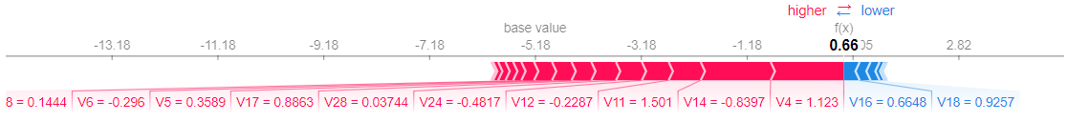
SHAP – Local Explanation (3)
instance_idx = 51
In this case (index = 51) the group of red features on the left has had a positive impact on the prediction,
pushing its value higher than the base value.
The top two contributors are V4 and V14, followed by V11, V12, etc.

Slide 15
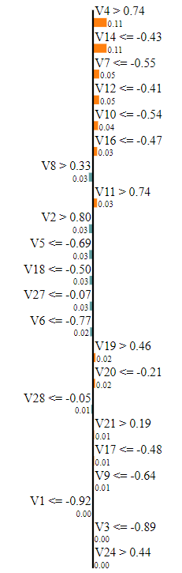
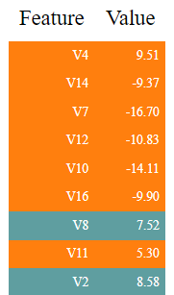

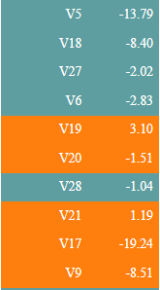

LIME (1)
instance_idx = 0
lime_explainer = LimeTabularExplainer(X_train.values,
mode="classification",
feature_names=features,
class_names=['Class'])
explanation = lime_explainer.explain_instance(X_test.values[instance_idx],
model_XGB.predict_proba,
num_features=len(X_test.columns))
explanation.show_in_notebook()
Now, let’s apply LIME to the same local instances (0, 22, 51).
From the prediction probabilities we can see that

Slide 16
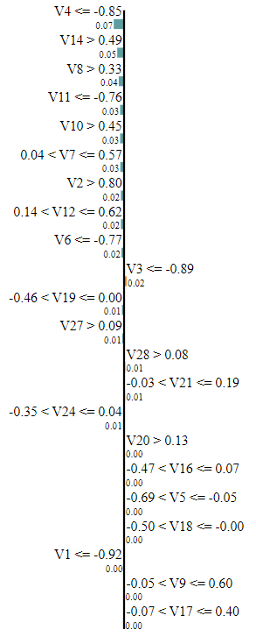
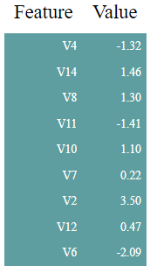

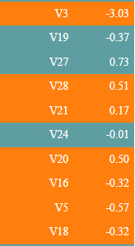

LIME (2)
instance_idx = 22

Slide 17
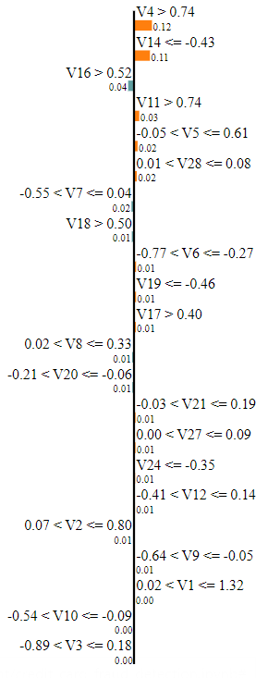

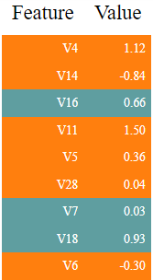

LIME (3)
instance_idx = 51

Slide 18
SHAP VS LIME

Slide 19
CONCLUSION

