Slide 1
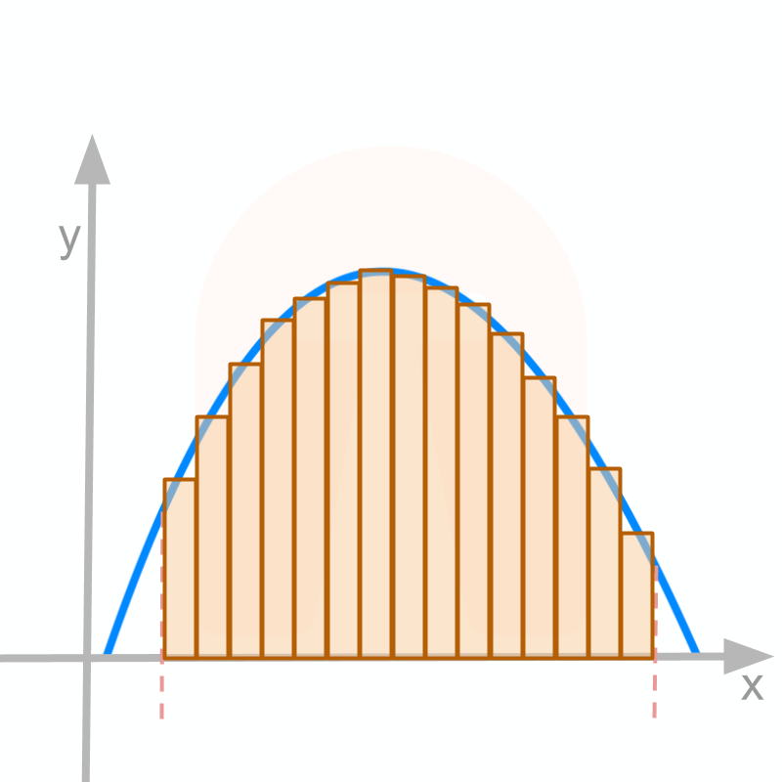
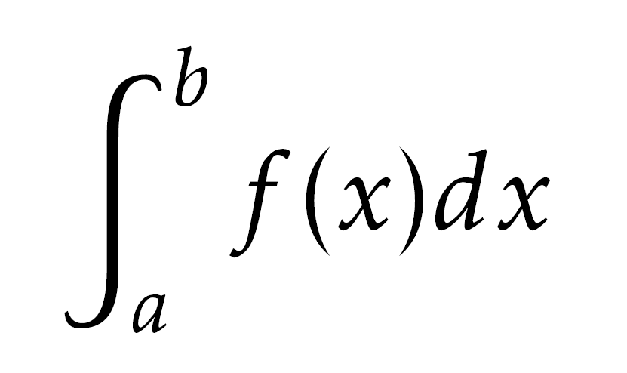
CALCULUS – INTEGRATION
Chapter 15
PAGE 371

Slide 2
15.1 INTEGRATION – DIFFERENTIATION REVERSED
KEY WORDS (P.371)
Integration | 积分
Indefinite integral | 不定积分
Definite integral | 定积分

Slide 3

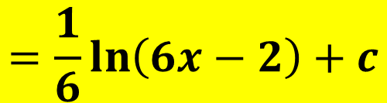
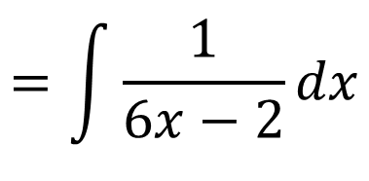
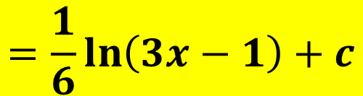
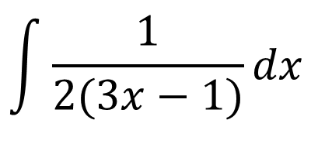
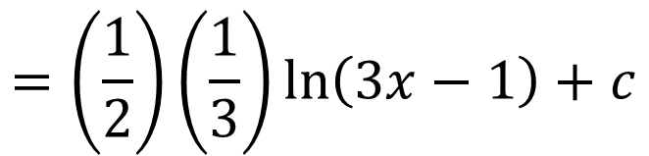
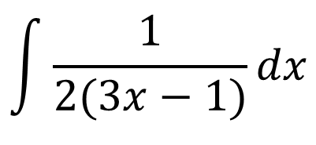
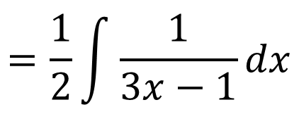
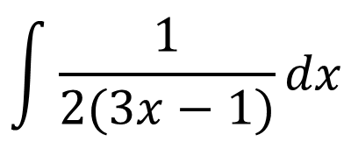
15.6 INTEGRATION OF FUNCTIONS IN THE FORM $\frac{1}{x}$ AND $\frac{1}{ax+b}$
CLASS DISCUSSION (P.384)
Raju and Sara are asked to find
$$\int{\frac{1}{2(3x−1)}dx}$$
Raju writes:
$$\int{\frac{1}{2(3x−1)}dx}$$
$$=\int{\frac{1}{6x−2}dx}$$
$$=\frac{1}{6}\ln\left(6x−2\right)+c$$
Sara writes:
$$\int{\frac{1}{2(3x−1)}dx}$$
$$=\frac{1}{2}\int{\frac{1}{3x−1}dx}$$
$$=\left(\frac{1}{2}\right)\left(\frac{1}{3}\right)\ln\left(3x−1\right)+c$$
Decide who is correct and discuss the reasons for your decision with your classmates.
$$=\frac{1}{6}\ln\left(3x−1\right)+c$$

Slide 4
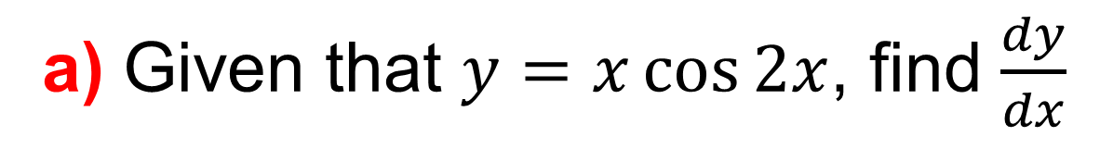
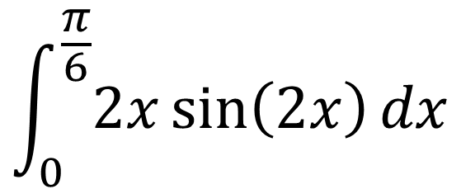
15.9 FURTHER DEFINITE INTEGRATION
EXAMPLE 18 (W.E.18, P.394)
a) Given that $y=x\cos{2x}$, find $\frac{dy}{dx}$
$$\int_{0}^{\frac{π}{6}}{2x\sin\left(2x\right)dx}$$
b) Hence evaluate

Slide 5
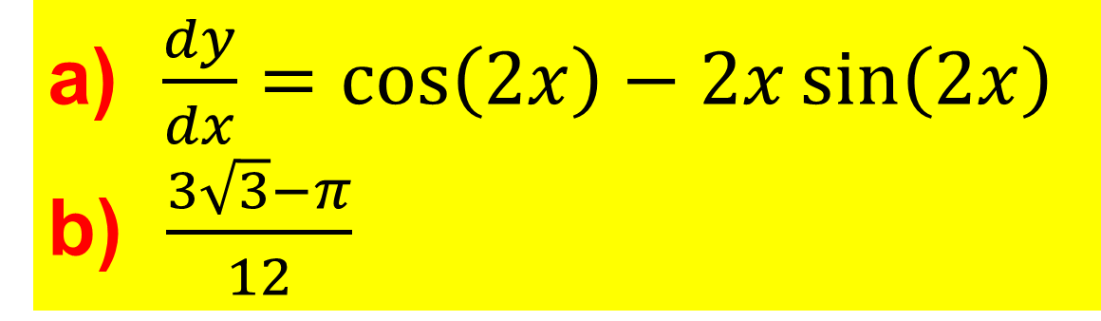
15.9 FURTHER DEFINITE INTEGRATION
EXAMPLE 18 (W.E.18, P.394)
a) Given that $y=x\cos{2x}$, find $\frac{dy}{dx}$
a) $\frac{dy}{dx}=\cos\left(2x\right)−2x\sin\left(2x\right)$
b) $\frac{3\sqrt{3}−π}{12}$
$$\int_{0}^{\frac{π}{6}}{2x\sin\left(2x\right)dx}$$
b) Hence evaluate

Slide 6

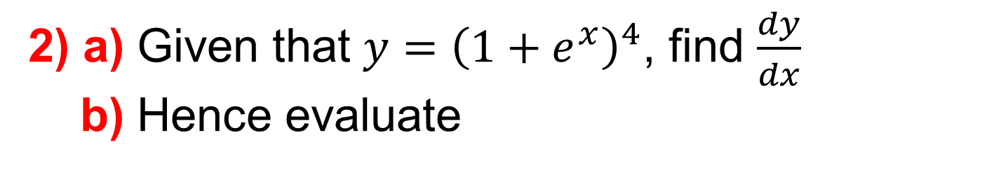
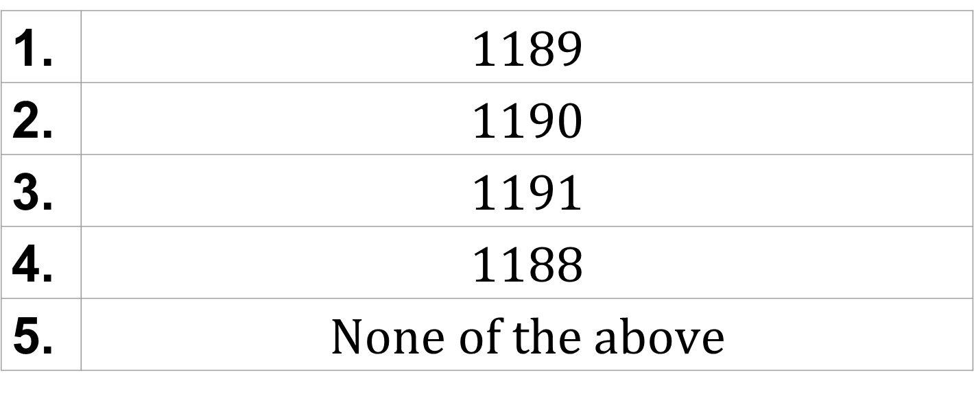

15.9 FURTHER DEFINITE INTEGRATION (EX.2)
CHECK YOUR UNDERSTANDING
Answer on the next slide…
2) a) Given that $y={\left(1+e^{x}\right)}^{4}$, find $\frac{dy}{dx}$
b) Hence evaluate
$$\int_{1}^{2}{e^{x}{\left(1+e^{x}\right)}^{3}dx}$$
1. | $$1189$$
2. | $$1190$$
3. | $$1191$$
4. | $$1188$$
5. | $$None of the above$$

Slide 7

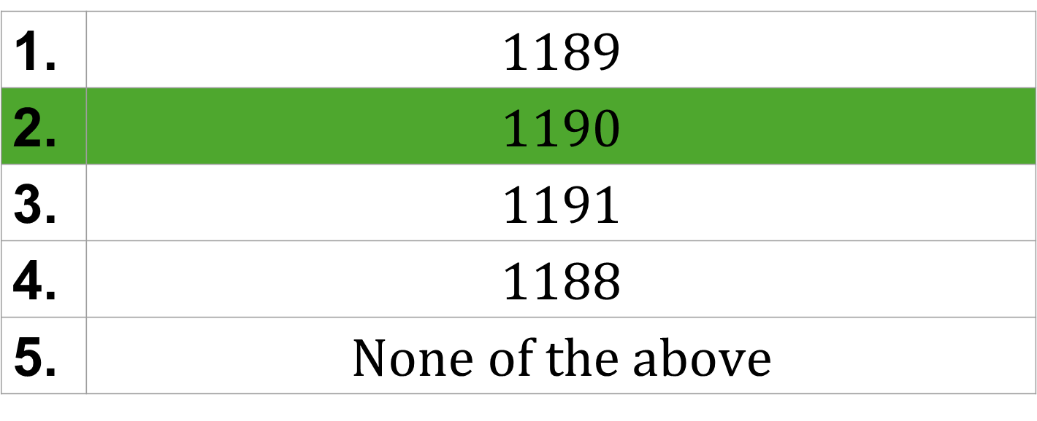
15.9 FURTHER DEFINITE INTEGRATION (EX.2)
CHECK YOUR UNDERSTANDING
2) a) Given that $y={\left(1+e^{x}\right)}^{4}$, find $\frac{dy}{dx}$
b) Hence evaluate
$$\int_{1}^{2}{e^{x}{\left(1+e^{x}\right)}^{3}dx}$$
1. | $$1189$$
2. | $$1190$$
3. | $$1191$$
4. | $$1188$$
5. | $$None of the above$$

