Slide 1
Vortex dipole colliding against no-slip wall with tracer analysis
David Llewellyn Smith

Slide 2
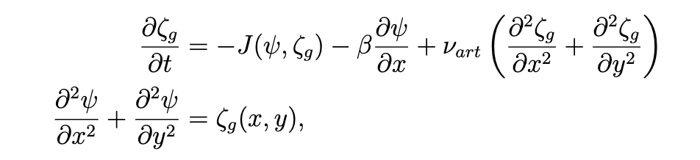
Equations
Same as MT06
QG barotropic vorticity equations
f-plane approximation
Used Arakawa Jacobian

Slide 3
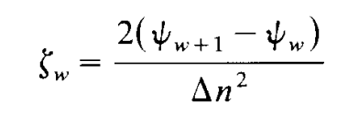
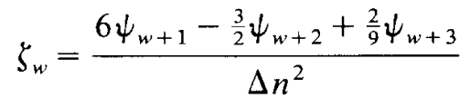
No-slip boundary condition
Forces the velocity tangent to the surface to be zero.
Slightly tricky to deal with in vorticity-streamfunction formulation since we don’t deal with the velocities directly.
The condition creates vorticity near the wall because the particles being moved by the vortices are sliding past the particles stuck at the wall.
Initially estimated the vorticity at the wall:
This blew up, but a paper Professor Chamecki provided instead suggested:

Slide 4
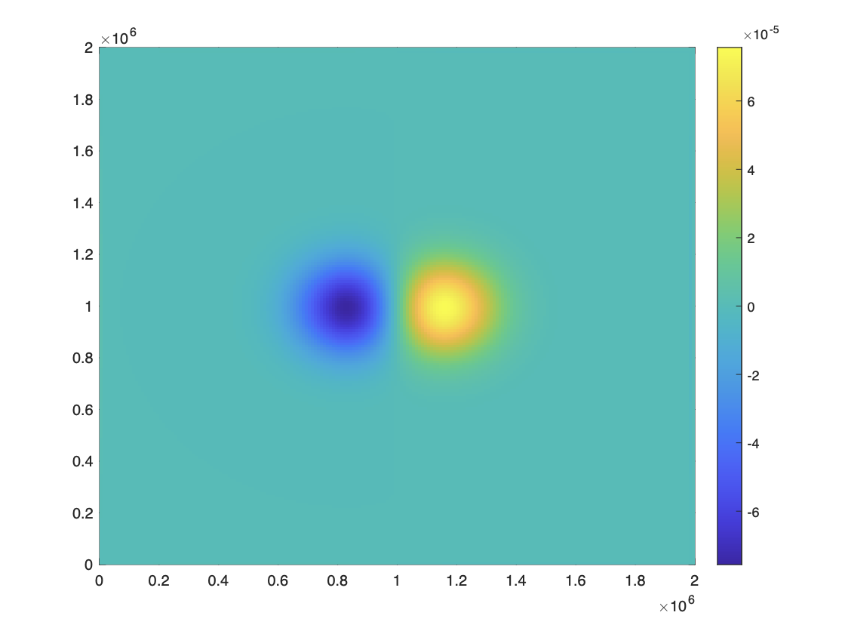
Initial Condition
Used almost the same parameters as in Modeling Task 6
Changed the magnitude of one of the vortices so that they form a dipole and ran the simulation for longer
Γ/(πa²) = 8 × 10⁻⁵ s⁻¹
a = 180 km
b = 300 km
L_{x}= L_{y}= 2000 km
T_{total}= 30 days
dt = 12 minutes
dx = dy = 10 km
β = 0
𝝂 = 0.01
tol = 10⁻¹⁰

Slide 5
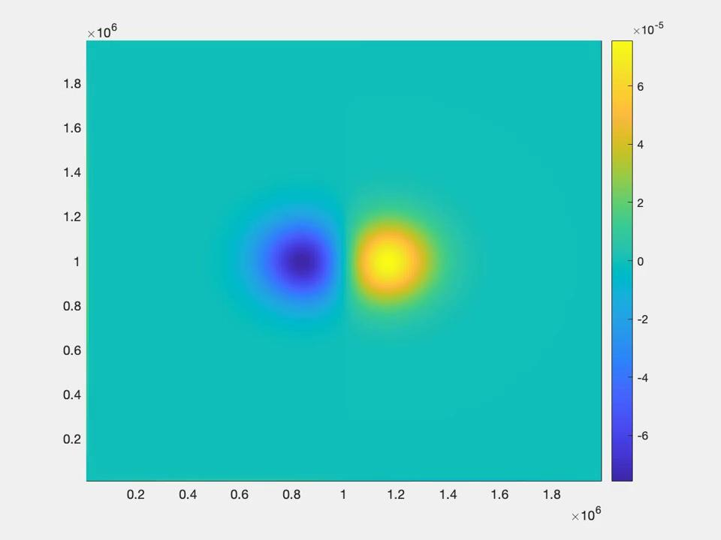
Vorticity
Animation

Slide 6
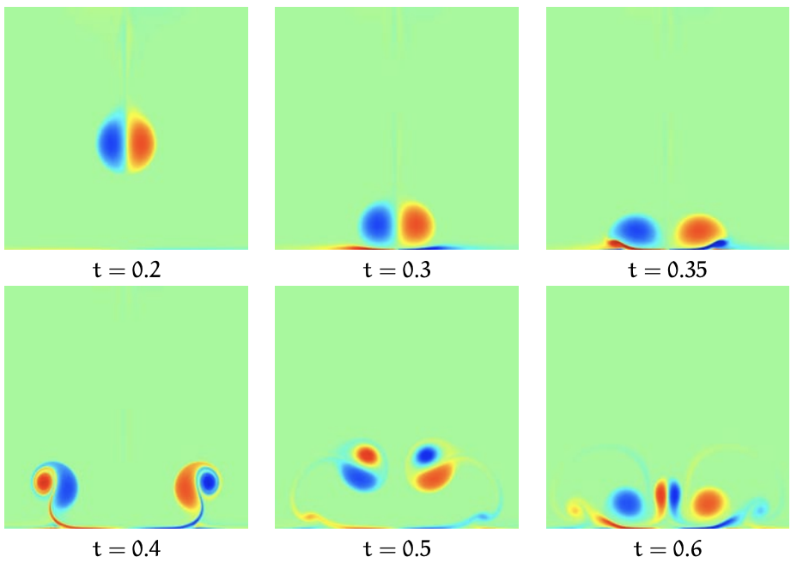
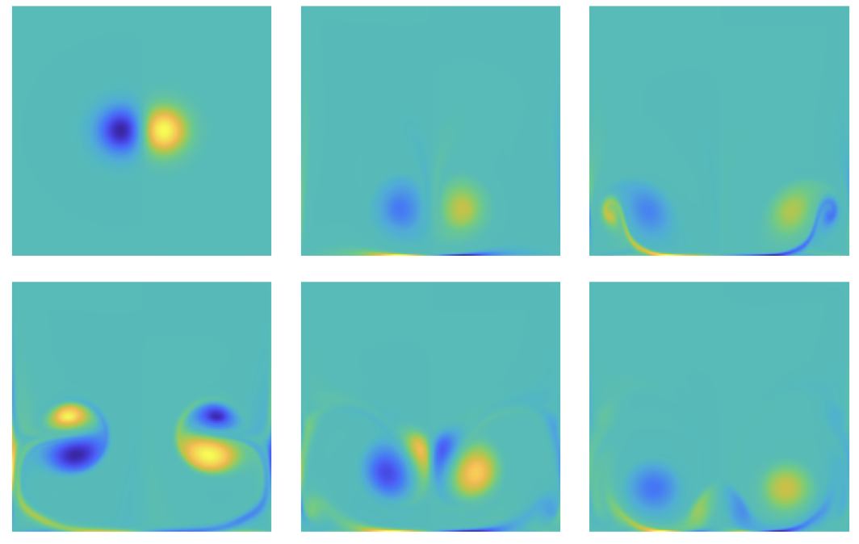
Comparison
My result
Result from Kramer (2007)

Slide 7
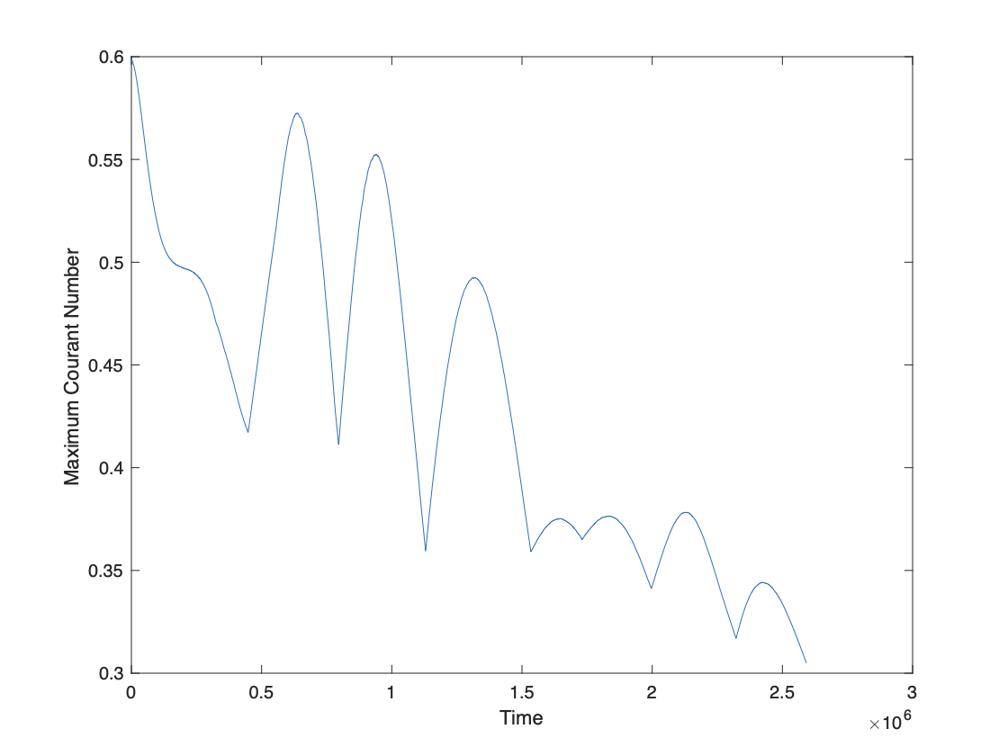
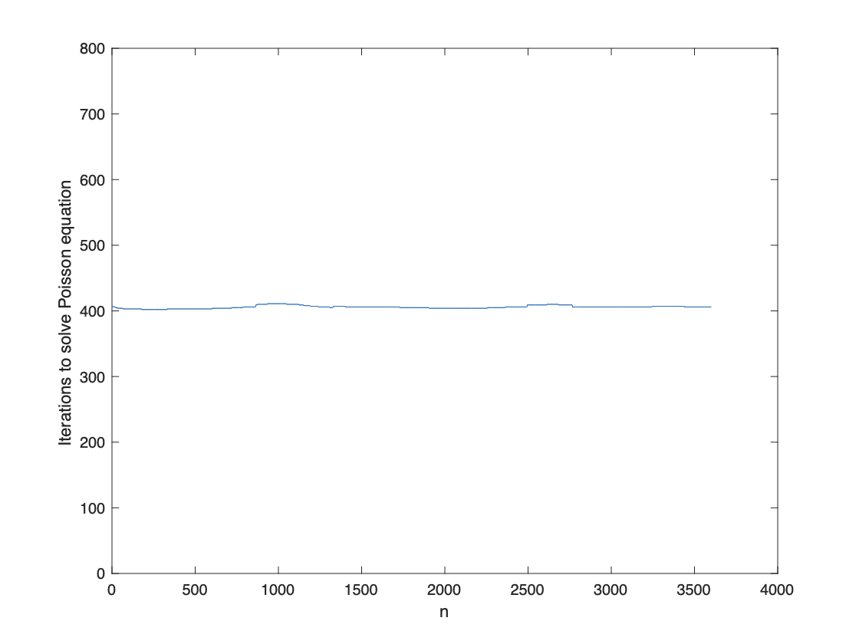
Courant number and iterations

Slide 8
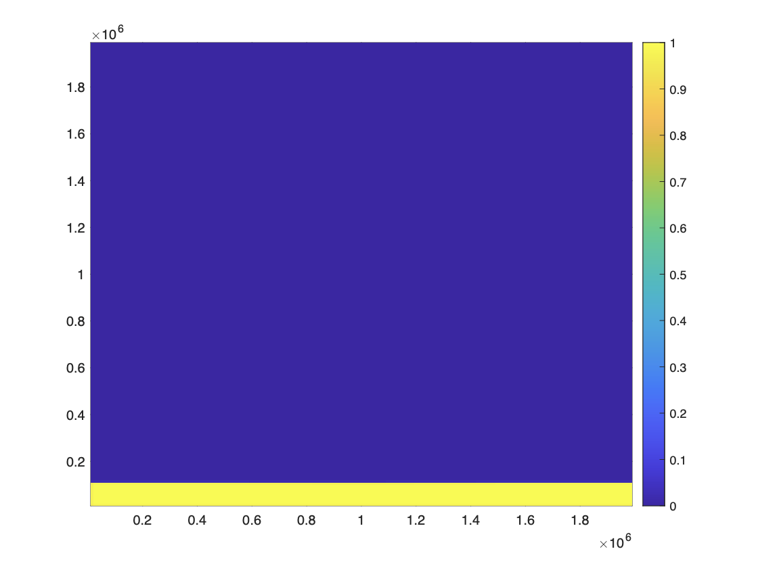
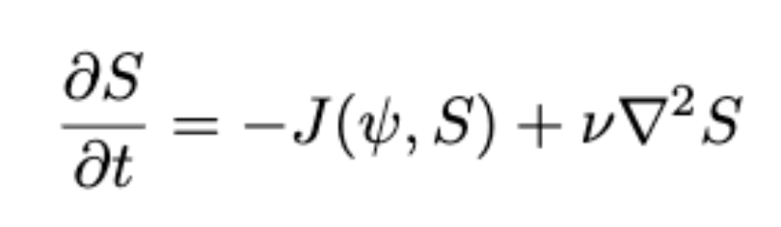
Tracer Initial Condition

Slide 9
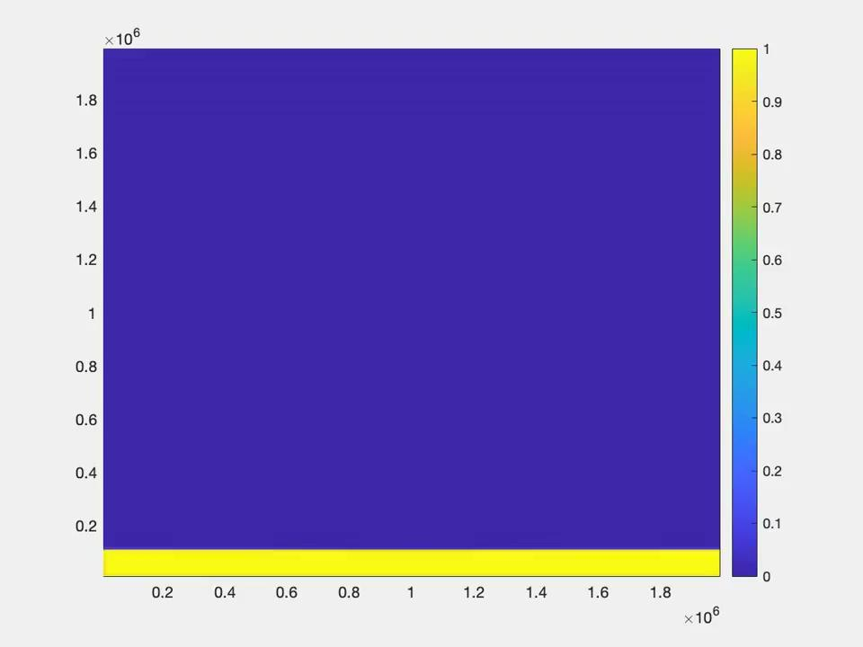
Tracer Animation

Slide 10
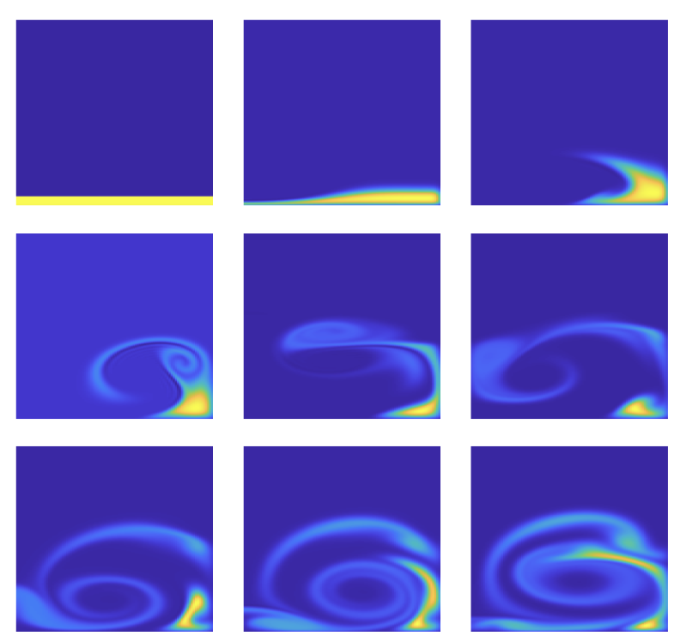
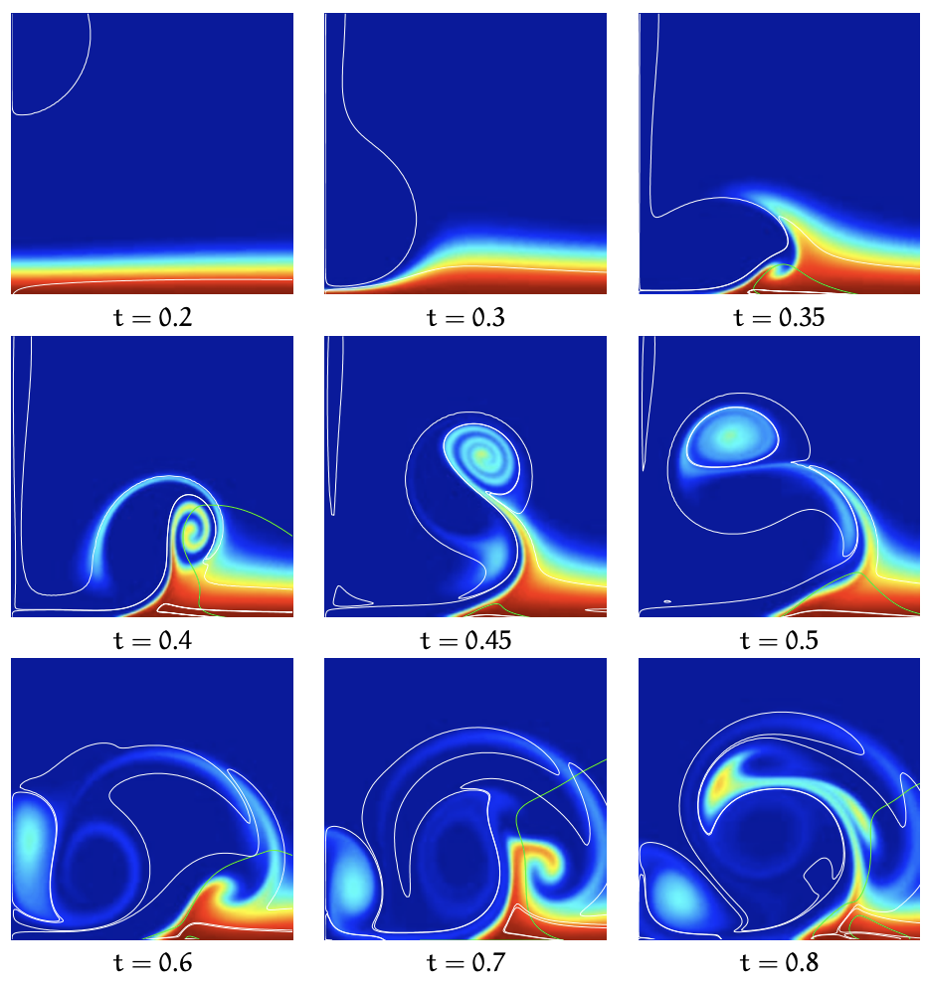
Comparison

Slide 11
References
Kramer, W. (2007). Dispersion of tracers in two-dimensional bounded turbulence. [Phd Thesis 1 (Research TU/e/ Graduation TU/e), Applied Physics and Science Education]. Technische Universiteit Eindhoven.
Foreman, M.G.G. and Bennett, A.F., 1988. On no-slip boundary conditions for the incompressible Navier-Stokes equations, Dyn. Atmos. Oceans, 12: 47-70.

