Slide 1
Large-Scale Parallel Matching of Social Network Profiles
Alexander Panchenko^{1,2}, Dmitry Babaev^{1,4}, Sergey Objedkov³
1 – Digital Society Laboratory, 2 – TU Darmstadt, 3 – HSE
4 - Tinkoff Bank
30.03.2015

Slide 2
Outline
The problem
The data
The method
Results

Slide 3
Problem
Motivation
input: a user profile of one social network
output: profile of the same person in another social network
immediate applications in marketing, search, security, etc.
Contribution
precision of 0.98 and recall of 0.54
the method is computationally effective and easily parallelizable

Slide 4
Related work
Several researchers recently tried to tackle this problem:
Balduzzi et al. Abusing social networks for automated user profiling. Springer, 2010.
Bartunov et al. Joint link-attribute user identity resolution in online social networks. SNA-KDD Workshop at KDD, 2012.
P. Jain et al. I seek ’fb.me’: Identifying users across multiple online social networks. WWW, 2013.
Malhotra et al. Studying user footprints in different online social networks. IEEE Computer Society, 2012.
Sironi. Automatic alignment of user identities in heterogeneous social networks. 2012.
Veldman. Matching profiles from social network sites. 2009.
BUT: Our experiment is the most large-scale up to date.

Slide 5
Outline
The problem
The data
The method
Results

Slide 6
Dataset
 | VKontakte | Facebook
Number of users in our dataset | 89,561,085 | 2,903,144
Number of users in Russia ¹ | 100,000,000 | 13,000,000
User overlap | 88 % | 29 %
training set: 92,488 matched FB-VK profiles
¹ According to to comScore and http://vk.com/about

Slide 7
How training data can be obtained?
. . . also valid for the “cheap matching”!
Link to FB in VK profile
Link to FB and VK in a third network, e.g. LJ or Foursquare
Linking by email
Linking by phone

Slide 8
Outline
The problem
The data
The method
Results

Slide 9
Profile matching algorithm
Candidate generation. For each VK profile we retrieve a set of FB profiles with similar first and second names.
Candidate ranking. The candidates are ranked according to similarity of their friends.
Selection of the best candidate. The goal of the final step is to select the best match from the list of candidates.

Slide 10
Candidate generation
Retrieve FB users with names similar to an input VK profile.
Two names are similar if:
the first letters are the same
the edit distance between names ≤ 2
Levenshtein Automata for edit distance of names
Use an automatically extracted dictionary of name synonyms:
“Alexander”, “Sasha”, “Sanya”, “Sanek”, etc.

Slide 11

Candidate ranking
The higher the number of friends with similar names in VK and FB profiles, the greater the similarity of these profiles.
Two friends are considered to be similar if:
First two letters of their last names match
Similarity between first/last names sims are greater than thresholds α, β:
Contribution of each friend to similarity simp of two profiles pvk and pfb is in inverse proportion to name popularity:
Here si^{f} and si^{s} are first and second names of a VK profile, correspondingly, while sj^{f} and sj^{s} refer to a FB profile.

Slide 12

Best candidate selection
FB candidates are ranked according to similarity simp to an input profile pvk
The best candidate pfb should pass two thresholds to match:
its score should be higher than the score threshold γ:
either the only candidate or score ratio between it and the next best candidate p′fb should be higher than the ratio threshold δ:

Slide 13
Outline
The problem
The data
The method
Results

Slide 14
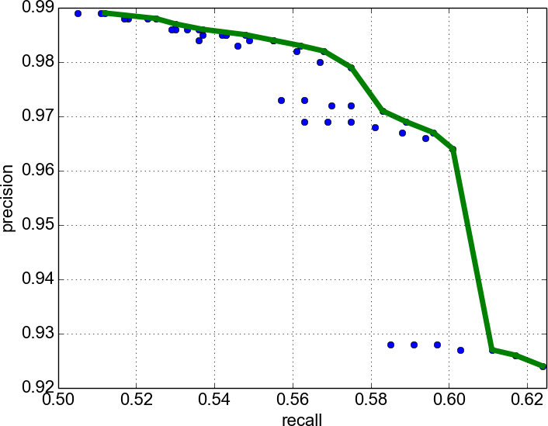
Results
Figure : Precision-recall plot of the matching method. The bold line denotes the best precision at given recall

Slide 15
Results: numbers
First name threshold, α | 0.8
Second name threshold, β | 0.6
Profile score threshold, γ | 3
Profile ratio threshold, δ | 5
Number of matched profiles | 644,334 (22%)
Expected precision | 0.98
Expected recall | 0.54

Slide 16
Execution parameters
AWS EMR
100 nodes of type m2.xlarge (2 vCPU, 17 GB RAM)
4 hours of execution time
Source code: https://github.com/dllllb/sn-profile-matching

Slide 17
Thank you! Questions?

