Slide 1
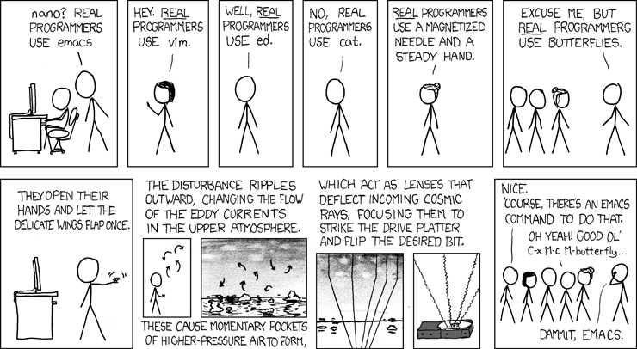
Assembly to Binary Reverse Engineering
From XOR EAX, EAX to INC EAX

Slide 2
Agenda
QQBnAGUAbgBkAGEA
x86 32 bit
x86 64 bit
C to 64 bit
C Preprocessing
C Compilation
C Assembly
C Linking
Ghidra
<Getting weird with GO>

Slide 3
Things to Install
Using Gentoo? I’ll wait…
linux
gcc
g++
nasm
texinfo
gdb (7.7 or higher for gef. Start this now if going with gef)
gef or pwndbg

Slide 4
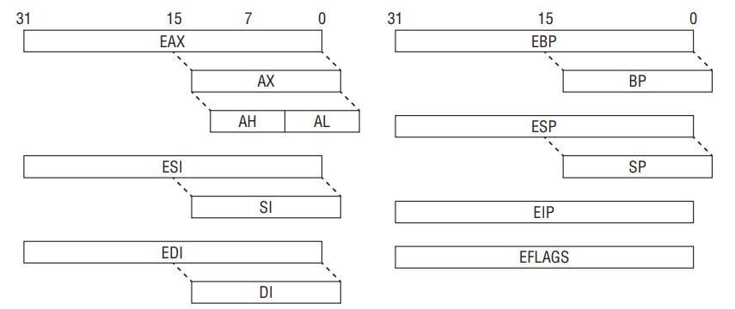
X86 32 Bit
Registers
EAX = Return register
ESI = Source for string/memory operations
EDI = Dest for string/memory operations
EBP = Stack frame base pointer
ESP = “Top” of stack pointer
EIP = Instruction pointer
EFLAGS = Register holds various flags including those used in arithmetic operations
DWORD
WORD
BYTE
BYTE
DWORD
WORD

Slide 5
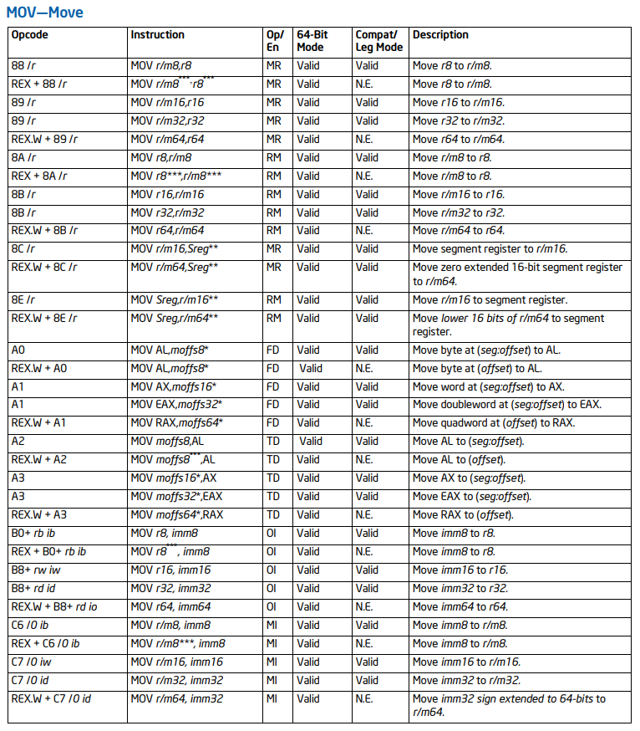
X86 32 Bit
mov and lea
mov <r>,<r> mov <r>,<m> mov <m>,<r> mov <r>,<imm> mov <m>,<imm>
lea <r32>,<m>

Slide 6
X86 32 Bit
mov and lea
mov dword ptr [eax], 0x20
mov ebx, dword ptr [eax]
mov dword ptr [ecx], dword ptr [ebx]
mov edx, 0x21
mov dword ptr [eax], edx
mov eax, dword ptr [ebp-ebx] ;nonsense without context
mov dword ptr [ebp-ebx], eax ;nonsense without context
mov dword ptr [eax], dword ptr [ebp-ebx] ;nonsense without context
lea eax, [ebx+edx]
ret

Slide 7
X86 32 Bit
Stack Structure
Instruction | Pointers | Stack | 0x00000000
 | ESP,EBP -> | Saved EBP | 0x1000
 |  |  | 0xFFFFFFFF
ESP | 0x1000
EBP | 0x1000
EAX
ESI
EDI
EDX
EBX
ECX
push <r32> push <m> push <imm32>
pop <r32> pop <m>

Slide 8
X86 32 Bit
push and pop
Instruction | Pointers | Stack | 0x00000000
push 0x1 | ESP -> | 0x01000000 | 0XFFC
 | EBP -> | Saved EBP | 0X1000
 |  |  | 0xFFFFFFFF
ESP | 0xFFC
EBP | 0x1000
EAX
ESI
EDI
EDX
EBX
ECX

Slide 9
X86 32 Bit
push and pop
Instruction | Pointers | Stack | 0x00000000
 |  | 0x01000000 | 0XFFC
pop eax | ESP,EBP -> | Saved EBP | 0X1000
 |  |  | 0xFFFFFFFF
ESP | 0x1000
EBP | 0x1000
EAX | 0x00000001
ESI
EDI
EDX
EBX
ECX
Notes:
Endianness only makes sense with addressable memory where the CPU is reading the memory byte by byte. Registers are values, not addressable.

Slide 10
X86 32 Bit
push and pop
Instruction | Pointers | Stack | 0x00000000
 | ESP -> | 0x01000000 | 0XFFC
sub esp, 0x4 | EBP -> | Saved EBP | 0X1000
 |  |  | 0xFFFFFFFF
ESP | 0xFFC
EBP | 0x1000
EAX | 0x00000001
ESI
EDI
EDX
EBX
ECX
Notes:
Endianness only makes sense with addressable memory where the CPU is reading the memory byte by byte. Registers are values, not addressable.

Slide 11
X86 32 Bit
push and pop
Instruction | Pointers | Stack | 0x00000000
 | ESP -> | 0x01000000 | 0XFFC
pop DWORD[ebp] | EBP -> | 0x01000000 | 0X1000
 |  |  | 0xFFFFFFFF
ESP | 0xFFC
EBP | 0x1000
EAX | 0x00000001
ESI
EDI
EDX
EBX
ECX
Notes:
Endianness only makes sense with addressable memory where the CPU is reading the memory byte by byte. Registers are values, not addressable.

Slide 12
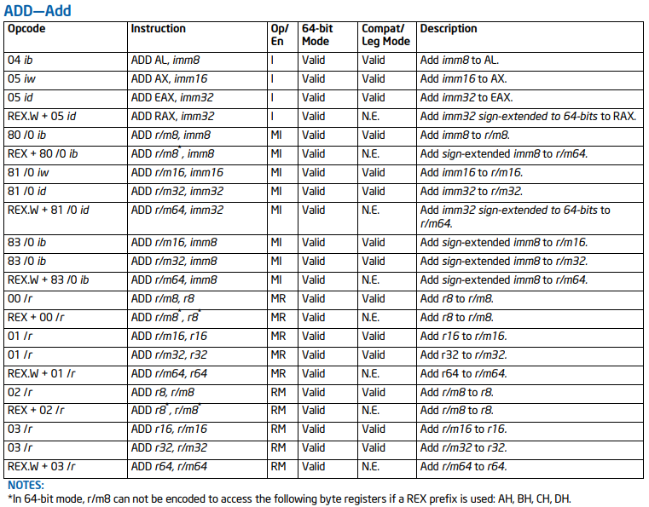
X86 32 Bit
Ok, lets make sense out of add

Slide 13
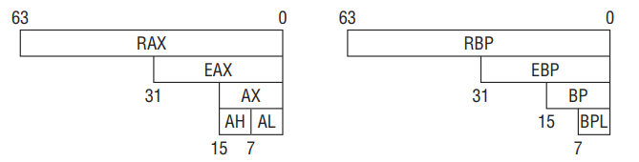
X86 64 Bit
Registers
RAX = Return register
RSI = Source for string/memory operations
RDI = Dest for string/memory operations
RBP = Stack frame base pointer
RSP = “Top” of stack pointer
RIP = Instruction pointer
R8-R15
EFLAGS = Register used to hold excess
Info on arithmetic operations
QWORD
DWORD
WORD
BYTE

Slide 14
X86 64 Bit
First we nasm
Objective: Write a 64 bit asm program that takes in a string of a length 0x20 bytes or less and changes all lower case letters in the string to uppercase letters.
nasm -f elf hello32.asm
ld -m elf_i386 hello32.o -o hello32
nasm -f elf64 hello64.asm
ld -s -o hello64 hello64.o
Resources:
http://asm.sourceforge.net/intro/hello.html
http://briansteffens.com/introduction-to-64-bit-assembly/01-hello-world/
https://www.intel.com/content/dam/www/public/us/en/documents/manuals/64-ia-32-architectures-software-developer-instruction-set-reference-manual-325383.pdf
https://www.cs.virginia.edu/~evans/cs216/guides/x86.html

Slide 15
Basic Disassembly
objdump -M intel –d <elf>
gcc -g -o <elf> <source.c>

Slide 16
C to 64 Bit
Hello World!
#include <stdio.h>
int main() {
printf(“Hello World!\n”);
return 0;
}
0000000000400526 <main>:
400526: 55 push rbp
400527: 48 89 e5 mov rbp,rsp
40052a: bf c4 05 40 00 mov edi,0x4005c4
40052f: b8 00 00 00 00 mov eax,0x0
400534: e8 c7 fe ff ff call 400400 <printf@plt>
400539: b8 00 00 00 00 mov eax,0x0
40053e: 5d pop rbp
40053f: c3 ret

Slide 17
C to 64 Bit
What does an if statement look like?
#include <stdio.h>
int main() {
int a = 2;
if(2 == a)
printf(“Two equals two!”);
return 0;
}
Notes:
The cmp (compare) instruction is identical to the sub instruction with one crucial difference - it does not store the difference back into the destination operand. The syntax for the cmp instruction is very similar to sub, the generic form is

Slide 18
C to 64 Bit
What does an if-else statement look like?
#include <stdio.h>
int main() {
int a = 2;
if(2 == a) {
printf(“Two equals two!”);
} else {
printf(“The world no longer makes sense”);
}
return 0;
}

Slide 19
C to 64 Bit
What does a for loop look like?
#include <stdio.h>
int main() {
for(int i = 0; i < 10; i++) {
printf(“i is %d”, i);
}
return 0;
}

Slide 20
C to 64 Bit
What does a function call look like?
#include <stdio.h>
int func1(int a, int b, int c, int d, int e, int f, int g) {
return a+b+c+d+e+f+g;
}
int main() {
func1(1,2,3,4,5,6,7);
}

Slide 21
C to 64 Bit
What does a switch statement look like?
#include <stdio.h>
int main()
{
int x = 2;
switch (x)
{
case 1: printf("Choice is 1");
break;
case 2: printf("Choice is 2");
break;
case 3: printf("Choice is 3");
break;
default: printf("Choice other than 1, 2 and 3");
break;
}
return 0;
}

Slide 22
C Compilation
We will make sense of this insanity
??=include <stdio.h>
#pragma pack(1)
#ifdef DEBUG
#define TWO 0x2
#else
#define TWO 0x1
#endif
int main() ??<
// haha?????????????????????/
return 0;
//line splicing\
printf("haha");
int a = TWO;
int b = 0;
b = b+++a;
if(2 == a && 1 != b)
printf(__DATE__);
return 0;
??>

Slide 23
C Preprocessing
Four Phases
Trigraph | Equivalent
??= | #
??/ | \
??' | ^
??( | [
??) | ]
??! | |
??< | {
??> | }
??- | ~
Trigraph(C)/Digraph(C)/Token(C++) Replacement (gcc only takes this step this if –trigraphs is used)
Pretty obscure, but good to know it exists
Line splicing
Also obscure. Basically getting rid of comments and dealing with escaped newlines.
Tokenization
Preprocessing tokens are items that will make sense to the compiler, separated by appropriate boundaries
Identifiers (combo of letters, digits, and underscores)
Preprocessing numbers (2,0x2,etc)
String literals (“Hello world!”, “stdio.h”, etc)
Punctuators (=, !=, >, etc)
Other (most likely something that will break compilation)
Macro expansion and directive handling
Inclusion of files
Breaks out #define, #ifdef, #ifndef, #else, #elif, #endif, #undef, #error
Expands macros -- __FILE__, __DATE__, __TIME__
gcc -DDEBUG -E preprocessing.c -trigraphs > preprocessing.i && tail -n15 preprocessing.i
gcc -DDEBUG -g preprocessing.i –o preprocessing
Notes:
Various reasons exist for using digraphs and trigraphs: keyboards may not have keys to cover the entire character setof the language, input of special characters may be difficult, text editors may reserve some characters for special use and so on. Trigraphs might also be used for some EBCDIC code pages that lack characters such as { and }.
https://en.wikipedia.org/wiki/Digraphs_and_trigraphs

Slide 24
C Compilation
The second step in compilation is compilation…
Compiles output of preprocessing stage into assembly code.
gcc -DDEBUG -S preprocessing.i > preprocessing.s
gcc -g preprocessing.s -o preprocessing
main:
.LFB0:
.cfi_startproc
pushq %rbp
.cfi_def_cfa_offset 16
.cfi_offset 6, -16
movq %rsp, %rbp
.cfi_def_cfa_register 6
subq $16, %rsp
movl $2, -8(%rbp)
movl $0, -4(%rbp)
movl -4(%rbp), %eax
leal 1(%rax), %edx
movl %edx, -4(%rbp)
movl -8(%rbp), %edx
addl %edx, %eax
movl %eax, -4(%rbp)
cmpl $2, -8(%rbp)
jne .L2
cmpl $1, -4(%rbp)
je .L2
movl $.LC0, %edi
movl $0, %eax
call printf

Slide 25
C Assembly
gcc -g -c preprocessing.s -o preprocessing.o
objdump -r preprocessing.o
RELOCATION RECORDS FOR [.text]:
OFFSET TYPE VALUE
0000000000000034 R_X86_64_32 .rodata
000000000000003e R_X86_64_PC32 printf-0x0000000000000004
RELOCATION RECORDS FOR [.debug_line]:
OFFSET TYPE VALUE
0000000000000033 R_X86_64_64 .text
objdump –s preprocessing.o
Contents of section .rodata:
0000 41756720 20342032 30313900 Aug 4 2019.
objdump -M intel -d preprocessing.o
0000000000000000 <main>:
0: 55 push rbp
1: 48 89 e5 mov rbp,rsp
4: 48 83 ec 10 sub rsp,0x10
8: c7 45 f8 02 00 00 00 mov DWORD PTR [rbp-0x8],0x2
f: c7 45 fc 00 00 00 00 mov DWORD PTR [rbp-0x4],0x0
16: 8b 45 fc mov eax,DWORD PTR [rbp-0x4]
19: 8d 50 01 lea edx,[rax+0x1]
1c: 89 55 fc mov DWORD PTR [rbp-0x4],edx
1f: 8b 55 f8 mov edx,DWORD PTR [rbp-0x8]
22: 01 d0 add eax,edx
24: 89 45 fc mov DWORD PTR [rbp-0x4],eax
27: 83 7d f8 02 cmp DWORD PTR [rbp-0x8],0x2
2b: 75 15 jne 42 <main+0x42>
2d: 83 7d fc 01 cmp DWORD PTR [rbp-0x4],0x1
31: 74 0f je 42 <main+0x42>
33: bf 00 00 00 00 mov edi,0x0
38: b8 00 00 00 00 mov eax,0x0
3d: e8 00 00 00 00 call 42 <main+0x42>
42: b8 00 00 00 00 mov eax,0x0
47: c9 leave
48: c3 ret

Slide 26
C Linking
gcc -g preprocessing.o -o preprocessing
objdump -R preprocessing (dynamic relocation)
.got
DYNAMIC RELOCATION RECORDS
OFFSET TYPE VALUE
0000000000600ff8 R_X86_64_GLOB_DAT __gmon_start__
0000000000601018 R_X86_64_JUMP_SLOT printf@GLIBC_2.2.5
0000000000601020 R_X86_64_JUMP_SLOT __libc_start_main@GLIBC_2.2.5
objdump -M intel -d preprocessing | grep plt
40055e: e8 9d fe ff ff call 400400 <puts@plt>
*Other useful info
objdump -t preprocessing
objdump -s -j.got.plt preprocessing
objdump -d -j.plt preprocessing

Slide 27
C Compilation – Preprocessing
sdf

Slide 28
https://www.intel.com/content/dam/www/public/us/en/documents/manuals/64-ia-32-architectures-software-developer-instruction-set-reference-manual-325383.pdf
https://www.cs.virginia.edu/~evans/cs216/guides/x86.html

