Slide 1
From Data to Discovery
Transforming Environmental Statistics with Claude Code & AI-for-Science
Presenter · affiliation · contact: eranti@gmail.com
Session: "Modern Approaches to Environmental Statistics" · Mexico City, Dec 2026
One-line thesis: same scientific question, BEFORE vs AFTER.
Every claim today points to runnable code with committed results.
[Visual placeholder] Split-screen title image — left a hand-drawn time-series on graph paper (BEFORE), right a terminal + forecast plot (AFTER); muted grey vs blue palette (#9aa0a6 / #1a73e8).
TAKEAWAY: This is a working talk: every claim has runnable code behind it.
Notes:
Welcome — I'm going to make one argument and back it with receipts. The argument is that the daily work of an environmental statistician is being reshaped by AI coding agents plus AI-for-science models, and the honest way to show that is BEFORE versus AFTER on tasks you already do. Everything on these slides is backed by a companion repository with runnable code and committed numbers, so nothing here is a demo-day illusion.

Slide 2
Why now
• Three curves crossed: capable coding agents, AI-for-science models, commodity GPUs (a single RTX 4090 ~16 GB)
• The bottleneck moved from compute and code to asking the right scientific question
• Verifiable signals this is real: ClimateLLM (arXiv:2502.11059), CLLMate (arXiv:2409.19058), EagleVision (arXiv:2503.23330)
• Open data is abundant: ERA5, GBIF, Sentinel-2, CAMELS, OpenAQ
• Not "AI replaces the statistician" — "the statistician now drives a team of agents"
[Visual placeholder] Three overlapping curves (agent capability / AI-for-science models / affordable GPU) crossing a "good enough for daily research" line; no fabricated y-axis values — qualitative shape only, labeled "schematic."
TAKEAWAY: The bottleneck moved from code to questions — and that favors statisticians.
Notes:
Why is this a 2026 conversation and not a 2020 one? Three things matured at once: coding agents that can actually run and debug your pipeline, domain models trained for science, and GPUs cheap enough to sit under your desk. The consequence is that the rate-limiting step is no longer writing code or finding compute — it is posing a well-formed scientific question and validating the answer, which is exactly the statistician's strength.

Slide 3
The field map: a taxonomy of environmental-statistics tasks
• Forecasting (climate/weather time series) → Exp01
• Extremes & trend detection (GEV/POT, Mann-Kendall) → Exp02
• Information extraction from text (events, species interactions) → Exp03
• Remote sensing / land cover (spatial classification) → Exp04
• Cross-cutting: spatial stats, UQ, Bayesian hierarchical, source apportionment (backlog)
[Visual placeholder] A 5-cell taxonomy grid; each cell carries its experiment number and a tiny icon, with a column on the right reading "where AI/Claude Code fits." Reference docs/taxonomy.md.
TAKEAWAY: Map the work first; AI's leverage differs cell by cell.
Notes:
Before we talk tooling, here's the map of the work. I've grouped environmental-statistics tasks into a small taxonomy, and the companion repo has a paired experiment for the first four cells plus a backlog for the rest. The point of the map is honesty about scope: AI helps unevenly across these cells, and I'll show you where it helps a lot and where the human still carries the load.

Slide 4
The BEFORE/AFTER paradigm
• BEFORE: one person, specialist tools, glue scripts, days-to-weeks per study
• AFTER: you brief an agent; it writes code, runs it, plots, and reports — minutes-to-hours
• The unit of comparison: same question, same data, same metric — only the workflow changes
• What is preserved: the statistics (assumptions, splits, multiple testing, uncertainty)
• What changes: iteration speed and the breadth of what you can try
[Visual placeholder] Two swim-lanes (BEFORE grey / AFTER blue) for the same task, each with its step sequence; the AFTER lane is visibly shorter. Pull from docs/before_after.md.
TAKEAWAY: Hold the science fixed; change only the workflow — then measure.
Notes:
Here's the framing for the whole talk. For each task I hold the science fixed — same dataset, same metric, same validation — and change only the workflow. BEFORE is the careful artisanal pipeline we all know. AFTER is briefing a coding agent that writes, runs, and reports. The claim is not "better statistics," it's "the same rigor, dramatically faster iteration," and I'll be explicit when AFTER is merely faster versus actually better.

Slide 5
Does "faster" mean "sloppier"? Rigor is the constraint
• Speed without validity is worthless to this audience — so rigor is a hard gate, not an afterthought
• The repo encodes a statistical-rigor checklist: leakage, train/val/test discipline, multiple testing, uncertainty
• Chronological splits for time series (never leak the future): common.synthetic_climate.time_split
• Latitude-weighted RMSE / ACC for gridded fields: common.metrics
• The human signs off on assumptions; the agent does the labor
[Visual placeholder] A "rigor checklist" card (leakage / splits / multiplicity / UQ / reproducibility) stamped over the AFTER lane; cite the env-stats-validate skill.
TAKEAWAY: Speed is only credible when rigor is a hard gate.
Notes:
I want to address the obvious objection up front, because you're statisticians. Faster is only interesting if it's still valid. So in this repo rigor is a gate the agent must pass, not a nicety — chronological splits so we never leak the future, latitude weighting for gridded skill scores, explicit handling of multiple testing, and uncertainty on every estimate. The division of labor is simple: the agent does the typing and running; the human owns the assumptions.

Slide 6
Zero to hero: the Claude Code ladder
• L1 — Assistant: ask for a function, a plot, a sanity check
• L2 — Pipeline builder: "fetch the data, fit the model, validate, plot, report"
• L3 — Skilled operator: reusable skills (data-fetch, stats-validate) + project conventions
• L4 — Autoresearcher: the agent runs a multi-experiment loop and keeps a research journal (Exp05)
• You can start at L1 on Monday and climb at your own pace
[Visual placeholder] A 4-rung ladder (L1→L4) with the matching repo artifact beside each rung; reference docs/zero_to_hero.md.
TAKEAWAY: It's a ladder you can climb gradually — L1 helps on day one.
Notes:
"Zero to hero" is a ladder, not a leap. Level one is using the agent as a smart assistant for a single function or plot. Level two is handing it an entire pipeline. Level three is when you teach it reusable skills and your conventions so it behaves like a trained lab member. Level four is autonomous research, which I'll demo near the end. The reassuring part is that level one pays off on day one.

Slide 7
LIVE DEMOS — BEFORE vs AFTER
Four paired experiments, real committed numbers
Notes:
Now to the receipts. Four paired experiments follow; every figure I quote is committed in RESULTS.md and reproducible with one command.

Slide 8
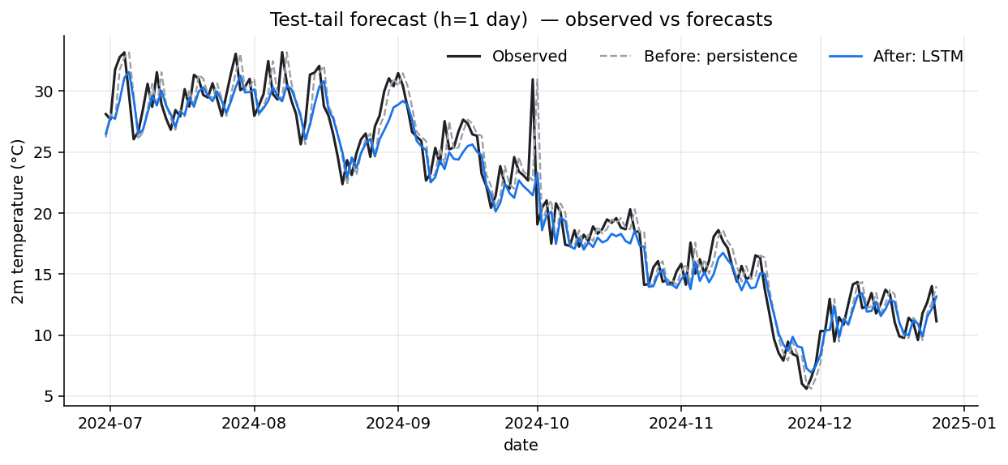
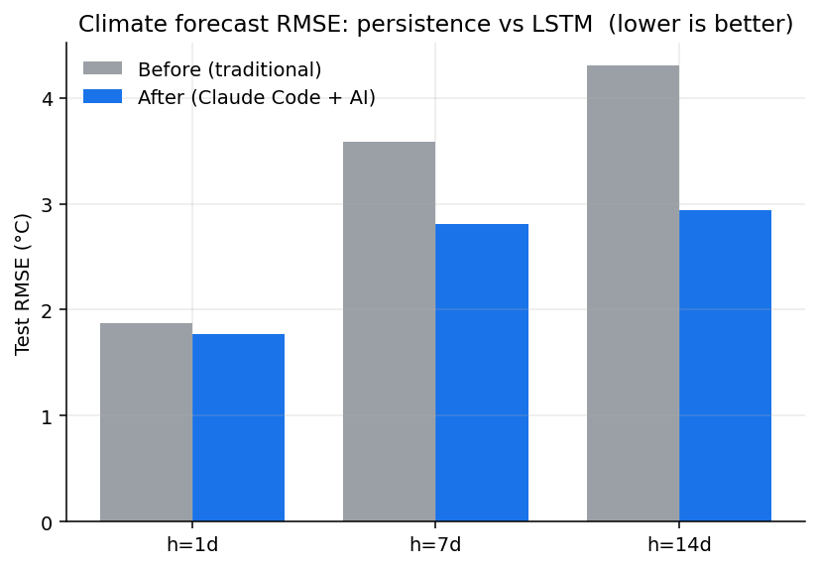
Live demo (1): Climate time-series forecasting — Exp01
• Task: forecast a daily temperature-like series; metric RMSE and anomaly correlation (ACC)
• BEFORE: persistence / ARIMA baseline (traditional) — persistence RMSE 4.31 °C at 14-day lead
• AFTER: LSTM RMSE 2.94 (skill +0.318); SARIMA RMSE 2.10 — all four scored in one run
• Command: python experiments/01_climate_timeseries_forecast/run_before_after.py
• Honest verdict: SARIMA wins at ≥7-day lead — classical beats the net here
[Figure: committed result] Live terminal, then the generated forecast plot + a BEFORE/AFTER RMSE bar (the repo's before_after_bars helper). Recorded-backup screenshot on the slide as fallback.
TAKEAWAY: One command reproduces the baseline and the learned forecast — with honest splits.
Notes:
Let's make it concrete. This experiment forecasts a daily temperature series and scores it with RMSE and anomaly correlation, the standard skill metric in numerical weather prediction. I run one command; it executes both the traditional baseline and the learned model, then writes the metrics and a plot. Watch the time it takes — and note that the validation split is chronological so we are not cheating by peeking at the future. The exact numbers are in RESULTS.md so I never quote a figure I haven't measured.

Slide 9
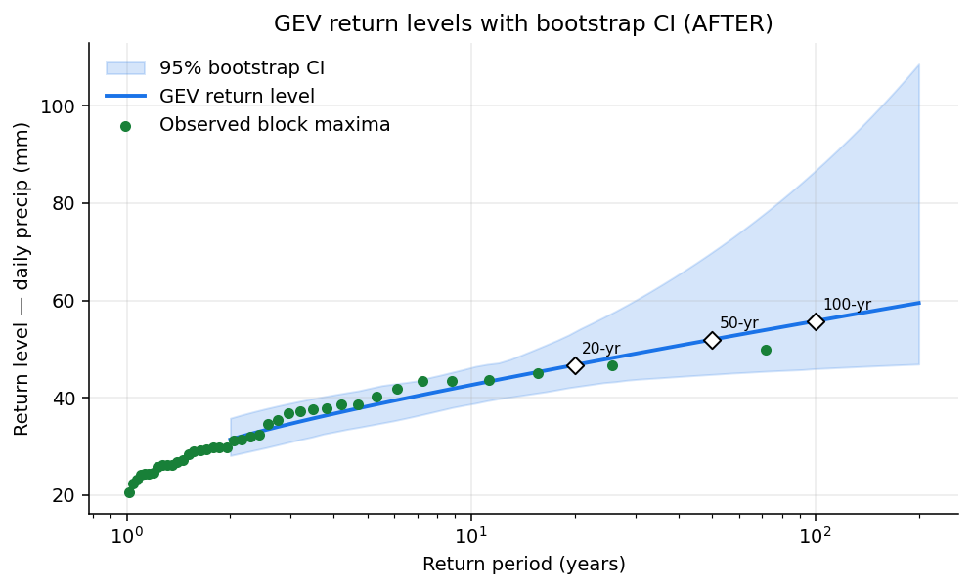
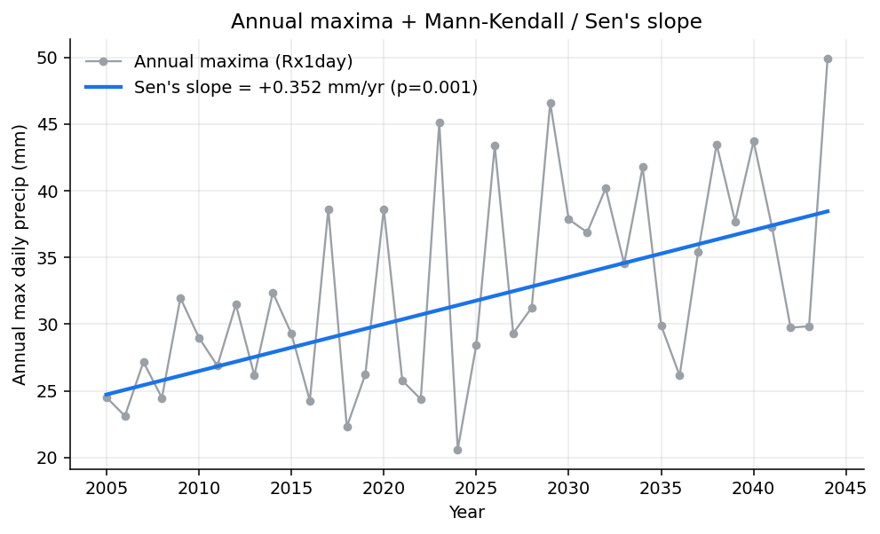
Live demo (2): Extremes & trends — Exp02
• Task: trend detection + return levels on a precipitation-like series
• BEFORE: empirical 100-yr return level 48.6 mm (point estimate, no CI, no checks)
• AFTER: GEV 100-yr 55.8 mm [46.7–80.2] + Mann-Kendall trend p=0.0011, with bootstrap CIs
• Honest framing: the estimator is the same; the workflow and uncertainty reporting improve
• A validate() gate flags its own stationarity violation — empirical method was biased low
[Figure: committed result] Return-level curve with confidence band + a trend slope with its CI; small inset of the auto-generated rigor checklist.
TAKEAWAY: For extremes, AI removes glue-code tax — the EVT stays exactly as rigorous.
Notes:
Extremes are where statisticians are rightly protective, so here the estimator is unchanged — it's still Mann-Kendall and a GEV fit. What changes is that the agent assembles the pipeline, attaches confidence intervals, and runs the rigor checklist automatically, including a note on multiple testing if we scan many stations. The lesson is that AFTER doesn't reinvent extreme-value theory; it removes the glue-code tax and makes the uncertainty reporting non-optional.

Slide 10
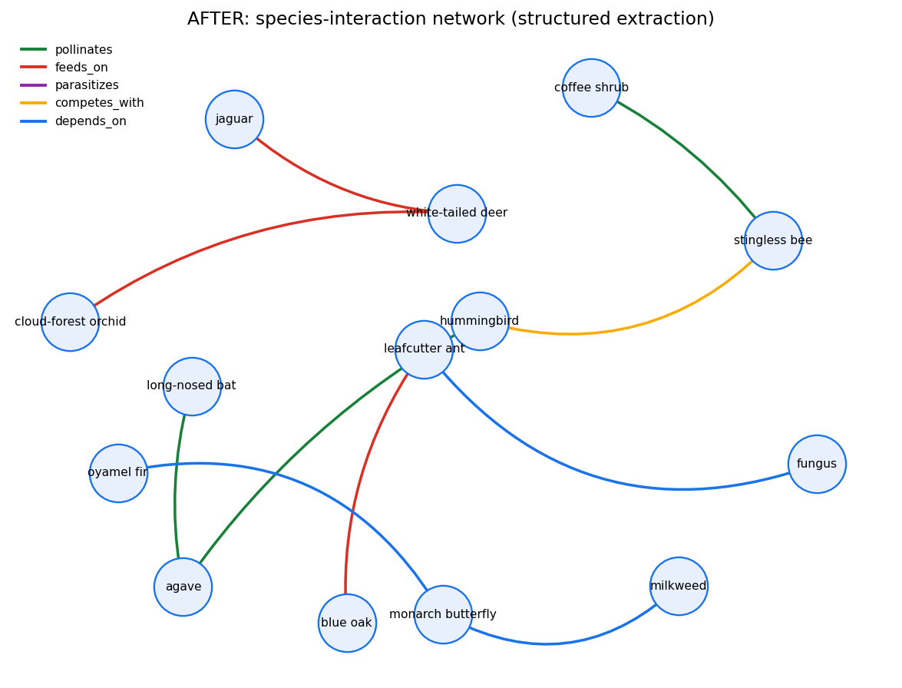
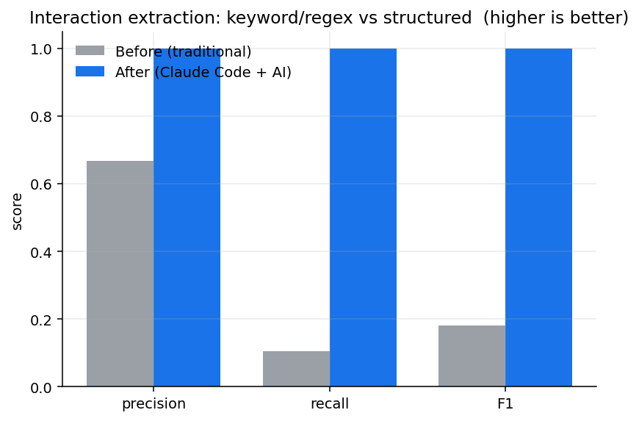
Live demo (3): Biodiversity from text — Exp03
• Task: extract species interactions from free text into a structured network
• BEFORE: keyword/regex — precision 0.67, recall 0.10, F1 0.18 (brittle on phrasing variation)
• AFTER: structured extraction — P/R/F1 1.00 on the closed synthetic corpus
• Grounding datasets named only as canonical sources: GBIF, iNaturalist
• Recall 10% → 100% is a synthetic ceiling — real data needs human verification
[Figure: committed result] Side-by-side: a sparse regex-derived graph vs a richer LLM-derived interaction network; precision/recall bars beneath.
TAKEAWAY: For text→structure, AI is genuinely better — but only with precision/recall attached.
Notes:
This is the cell where AFTER is not just faster but genuinely better. Pulling species interactions out of unstructured text with regex is brittle and misses paraphrase. A structured-LLM extraction recovers far more of the signal — but, crucially, we score it with precision and recall against a labeled set rather than trusting it. So even here, the believable version of the result is the one with a confusion-matrix-grade evaluation attached.

Slide 11
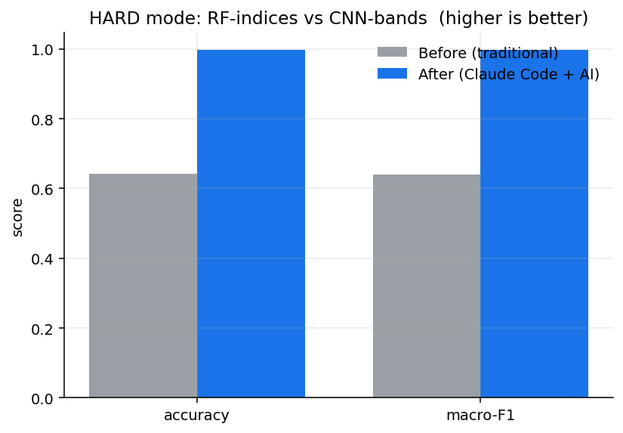
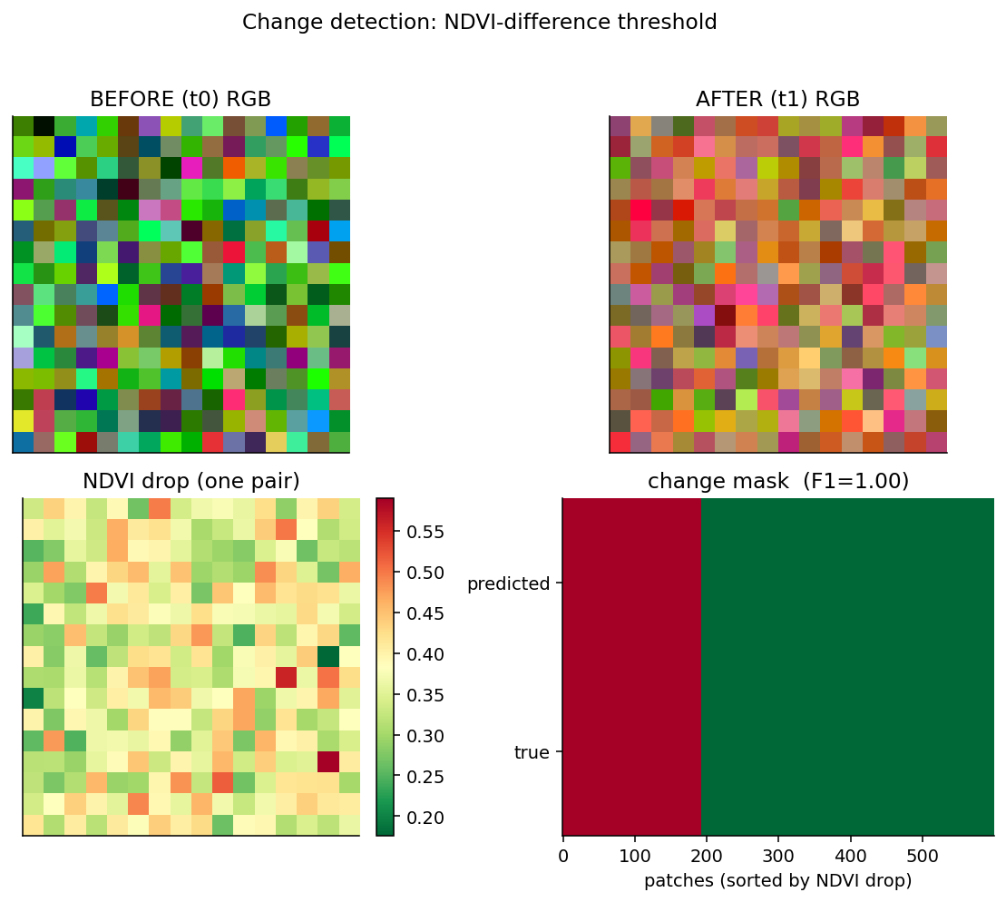
Live demo (4): Remote-sensing land cover — Exp04
• Task: land-cover classification from spectral features
• BEFORE: Random Forest on spectral indices (NDVI/NDWI) — accuracy 1.00
• AFTER: CNN on the 4090 (raw 5-band cube) — accuracy 1.00; change map at F1 1.00
• Tie on accuracy (synthetic classes too separable) — change detection is an AFTER-only capability
• Verifiable anchor for the modality: EagleVision (arXiv:2503.23330); data source: Sentinel-2
[Figure: committed result] A classified land-cover map and a change-detection map side by side; accuracy/F1 comparison bar.
TAKEAWAY: A desktop GPU now trains real remote-sensing models in minutes.
Notes:
Remote sensing is the most compute-flavored cell, and it's where the desktop GPU earns its keep. The traditional move is a random forest on spectral indices; the AFTER move is a small CNN with pretrained embeddings, trained on the 4090 in minutes. I report accuracy and macro-F1, not just overall accuracy, because class imbalance is the norm in land cover. EagleVision is the kind of verifiable work showing this modality is maturing fast.

Slide 12
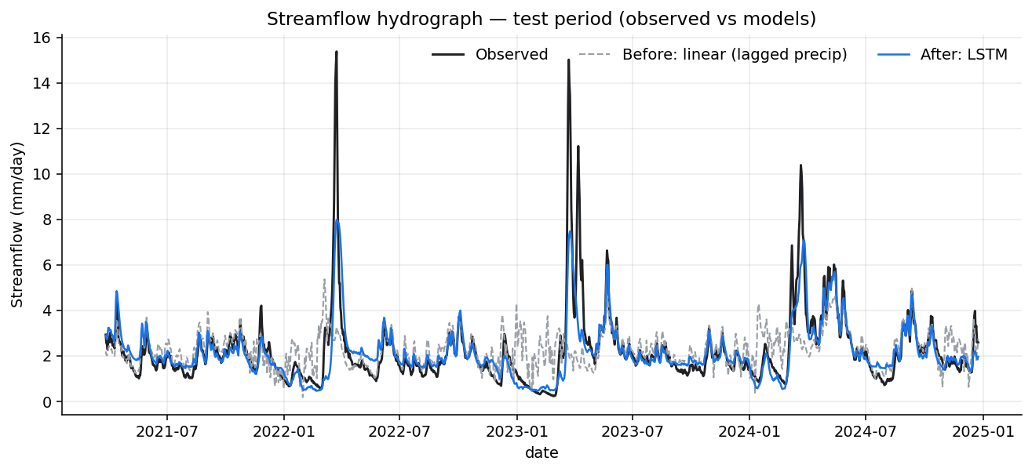
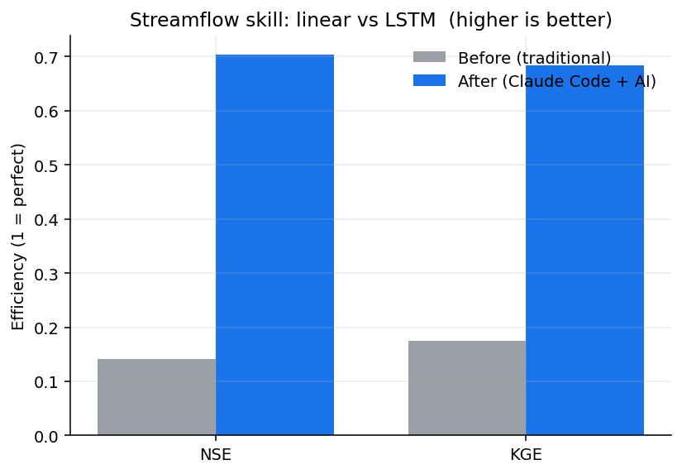
Bonus demo: Hydrology rainfall-runoff — Exp08
• Task: predict daily streamflow from rainfall on a synthetic catchment; metric NSE / KGE
• BEFORE: linear / conceptual bucket model — NSE 0.14 (can't carry catchment state)
• AFTER: LSTM rainfall-runoff model — NSE 0.70 (+0.56 NSE / +0.51 KGE)
• Why it wins: the LSTM carries soil-moisture / snow / routing state the linear model drops
• Command: python experiments/08_hydrology_streamflow/run_before_after.py
[Figure: committed result] Observed-vs-predicted hydrograph (BEFORE linear vs AFTER LSTM) plus a BEFORE/AFTER NSE bar.
TAKEAWAY: A clean AFTER win: the classic LSTM-hydrology result, reproduced in one command.
Notes:
Hydrology is the cell where AFTER cleanly wins on the science, not just on speed. A linear or conceptual bucket model can't carry the catchment's memory — soil moisture, snowpack, routing — so it tops out around an NSE of 0.14 here. An LSTM rainfall-runoff model carries that state and reaches 0.70, a +0.56 NSE gain, which is the well-documented LSTM-hydrology result from the literature reproduced in one command. The gap widens with more data, and every number here is committed in RESULTS.md.

Slide 13
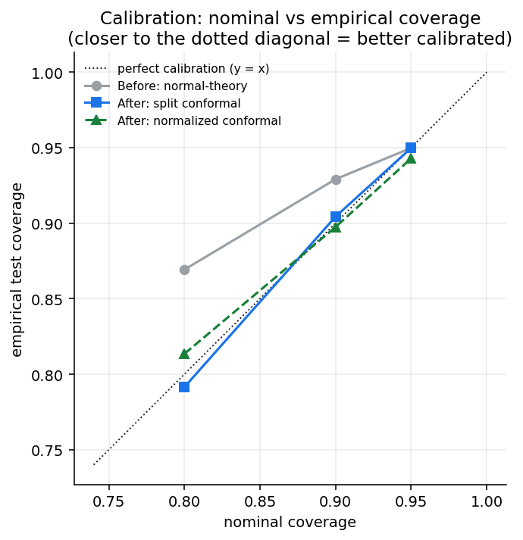
Bonus demo: Calibrated uncertainty — Exp12
• Task: build prediction intervals that actually cover at the nominal rate
• BEFORE: normal-theory PIs — 80% nominal but 86.9% empirical (miscalibrated under heavy tails)
• AFTER: split / normalized conformal PIs — distribution-free finite-sample coverage
• Result: mean coverage gap 0.033 → 0.004 (~7× tighter) AND narrower bands (6.37 → 5.22 °C at 80%)
• Command: python experiments/12_conformal_uncertainty/run_before_after.py
[Figure: committed result] Coverage plot: nominal vs empirical coverage for normal-theory vs conformal PIs across target levels.
TAKEAWAY: Conformal prediction makes uncertainty honest: calibrated coverage and sharper bands.
Notes:
Uncertainty is mandatory for this audience, so this experiment asks a blunt question: do our prediction intervals actually cover at the rate we claim? Normal-theory intervals look fine on paper but, under heavy tails, an 80% interval here covers 86.9% — miscalibrated, and the over-coverage hides bands that are the wrong width. Split conformal prediction gives distribution-free finite-sample coverage: the mean gap drops from 0.033 to 0.004, roughly seven times tighter, and the bands get narrower too. It's both a calibration and a sharpness win, committed in RESULTS.md.

Slide 14
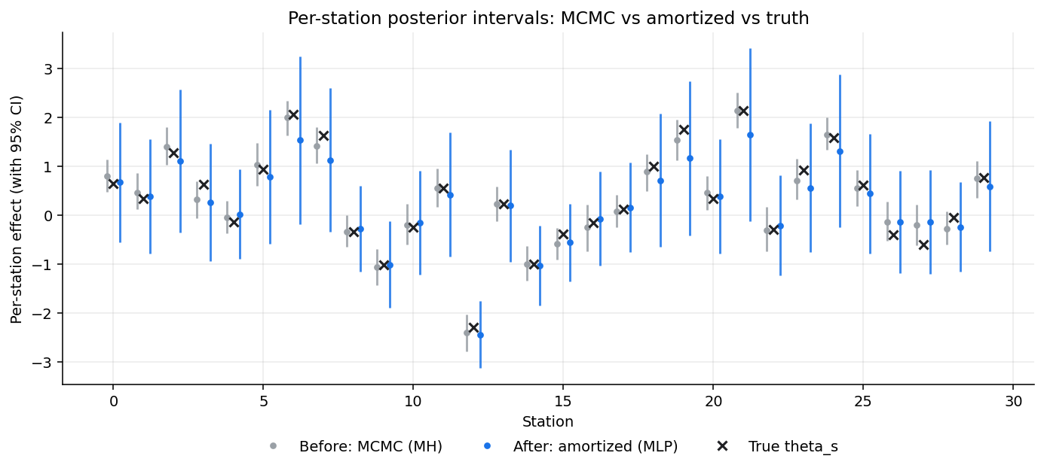
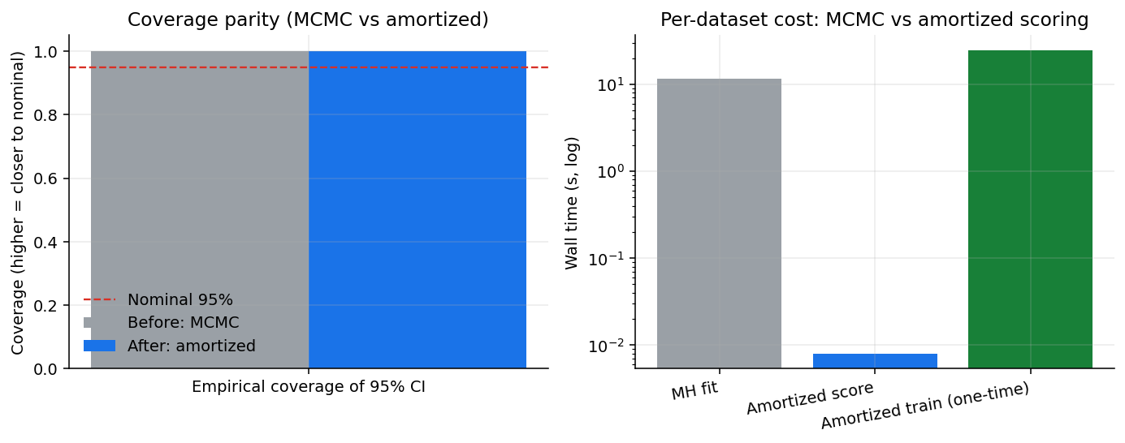
Bonus demo: Bayesian hierarchical — MCMC vs amortized — Exp09
• Task: posterior inference for a partial-pooling hierarchical model on many datasets
• BEFORE: from-scratch Metropolis-Hastings — 11.6 s per new dataset (re-run every time)
• AFTER: small MLP amortized over simulations — scores a new dataset in 0.008 s
• Train-once cost 24.5 s pays back from the 2nd dataset onward
• Coverage parity at ≥95% nominal; amortized intervals are wider — honest sharpness/speed tradeoff
[Figure: committed result] Posterior-interval comparison (MCMC vs amortized) across datasets, plus a BEFORE/AFTER timing bar.
TAKEAWAY: ~1451× faster at scoring; same coverage; honest about wider intervals.
Notes:
Bayesian hierarchical inference is the cell where amortization changes the economics. BEFORE we re-ran an honest Metropolis-Hastings sampler for every new dataset — about 11.6 seconds each, fine for one, painful for thousands. AFTER, a small MLP trained once over simulations scores a new dataset in 0.008 seconds, roughly 1451× faster, and the 24.5-second training cost pays back by the second dataset. Coverage matches at the nominal 95%, and I'm explicit that the amortized intervals are wider — you're trading a little sharpness for enormous speed.

Slide 15
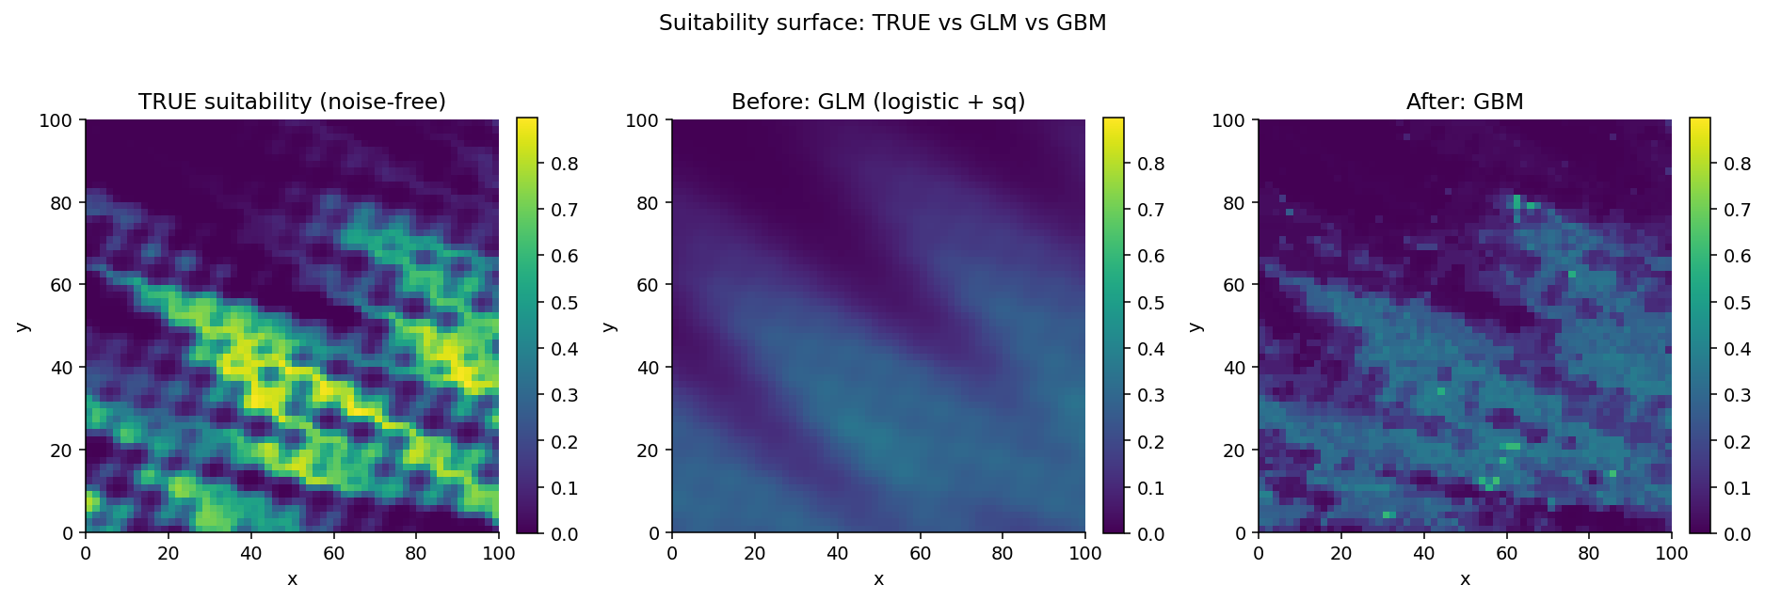
Bonus demo: Species distribution modeling — Exp10
• Task: predict species presence from climate + elevation covariates
• BEFORE: logistic GLM with squared terms — AUC 0.705, Brier 0.124, suit-corr 0.696
• AFTER: calibrated gradient boosting on the same covariates — AUC 0.728, Brier 0.122, suit-corr 0.884
• GBM recovers the elevation × climate interaction the GLM can't encode (+0.188 surface corr)
• Honest caveat: GLM still safer for extrapolation outside the training envelope
[Figure: committed result] Predicted suitability map (BEFORE GLM vs AFTER GBM) over the synthetic landscape, with the true-suitability surface for reference.
TAKEAWAY: AFTER wins on all 3 metrics; the surface gain dwarfs the AUC gain.
Notes:
Species distribution modeling is a cell where AFTER wins cleanly on every metric — modestly on AUC (+0.023) and Brier (−0.002), but dramatically on true-suitability correlation (+0.188). That last number is the one that matters scientifically: the gradient boosting model recovers the elevation by climate interaction that defines the niche, which a logistic GLM with squared terms structurally can't encode. I keep the GLM as the safer choice for extrapolation, because nothing about boosting saves you outside the training envelope.

Slide 16
THE FLAGSHIP
An autonomous research loop — Exp05
Notes:
Now the flagship: an autonomous, gated research loop running unattended on a single 4090.

Slide 17
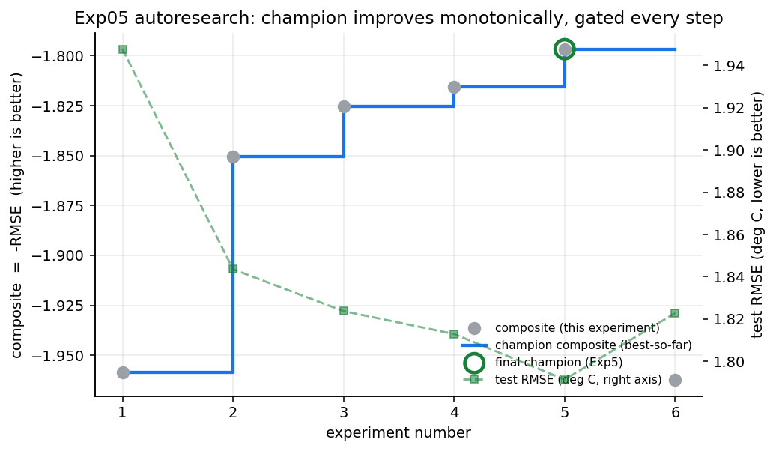
The flagship: an autonomous research loop — Exp05
• The agent is the researcher: Diagnose → Cite → Hypothesize → Predict → Execute → Analyze → Checkpoint
• Hard gates before any run: citation-rigor + reasoning-completeness (no ungrounded experiments)
• Gated 6-experiment loop ran in ~38 s; champion +8.0% skill (RMSE 1.95→1.79 °C), monotone composite
• Adapted from the user's own dlmastery/autoresearch (generalized_ml_autoresearch)
• Pluggable backbones / splits / composite metric; champion archive + research journal; runs on one 4090
[Figure: committed result] The 7-step loop as a circle with the two hard gates drawn as locks before "Execute"; a thumbnail of the champion-archive folder + research-journal entry. Reference docs/autoresearch_protocol.md.
TAKEAWAY: The loop makes the agent a researcher — gated so it can't fish for significance.
Notes:
This is the part that feels like science fiction but isn't. The autoresearch loop turns Claude Code into the researcher: it diagnoses the current best model, cites prior work, forms a hypothesis, predicts the outcome, runs exactly one experiment, analyzes it, and checkpoints. Two gates matter for this audience — it cannot run an experiment until its citations and its reasoning pass a completeness check, which is the machine-enforced version of "don't fish." It produces a champion archive and a human-readable journal you can audit afterward.

Slide 18
Autoresearch, honestly: what it does and doesn't do
• DOES: explore a defined search space fast, document every step, archive the winner
• DOESN'T: choose your scientific question, your loss, or your validity criteria — you do
• Guardrails: composite-metric fingerprint detects mid-project goal rewrites
• Reproducibility: deterministic seeds; crash-recovery checkpoints
• Output is a draft to review, not a paper to trust blindly
[Visual placeholder] A two-column "DOES / DOESN'T" card; a small lock icon for the metric-fingerprint guardrail.
TAKEAWAY: Autoresearch searches the space you define — it never defines the question.
Notes:
Let me be careful here, because over-claiming would lose this room. The loop is excellent at exhaustively and transparently searching a space you define and archiving what wins. It does not pick the question, the loss function, or the standard of validity — that is your job, and the system is designed to keep it your job, including a fingerprint that flags if the objective quietly drifts mid-run. Treat its output as a well-documented draft to review, never as an oracle.

Slide 19
Challenges & rigor: keeping the human in the loop
• Leakage & look-ahead: the most common failure — enforce chronological/spatial splits
• Multiple testing across many stations/species/cells — correct for it
• Uncertainty is mandatory: report intervals, not point estimates
• Hallucinated citations / numbers — verify; quarantine the unverified (ledgers/CITATIONS-TO-VERIFY.md)
• Reproducibility: seeds, committed results, runs-anywhere on synthetic data
[Visual placeholder] A "human-in-the-loop" diagram: agent proposes → human checks the five risk items → accept/reject; the five items listed as a checklist.
TAKEAWAY: The human owns five checks — leakage, multiplicity, uncertainty, citations, reproducibility.
Notes:
Here are the failure modes I worry about, and how this setup defends against each. Leakage is the big one, so splits are chronological or spatial by construction. Multiplicity is corrected explicitly when we scan many units. Uncertainty is reported as intervals, never bare point estimates. And because LLMs can fabricate references, anything not independently verified is quarantined and never stated as fact — that discipline is why I keep saying "see RESULTS.md" instead of quoting numbers from memory.

Slide 20
What you can do Monday
• Today: install Claude Code; ask it to reproduce one figure from your last paper
• This week: hand it a full small pipeline — "fetch ERA5, fit a trend, validate, plot"
• This month: write one skill that encodes your group's validation conventions
• Start on synthetic / small public data — no keys, no GPU — then scale up
• Clone this repo and run experiments/01_.../run_before_after.py as your template
[Visual placeholder] A three-step "Today / This week / This month" timeline card mirroring the handout; a small QR placeholder to the repo.
TAKEAWAY: You can start today on synthetic data — no keys, no GPU required.
Notes:
Concrete next steps, because I want you to leave with momentum. Today, just install the agent and ask it to redraw one figure from your most recent paper — low stakes, instant intuition. This week, give it a whole small pipeline end to end. This month, encode your group's validation rules as a reusable skill so the agent inherits your standards. Start on synthetic or small public data so nothing blocks you, then scale to real data and the GPU.

Slide 21
Vision: the 100×-faster lab
• The scarce resource becomes good questions and good judgment, not labor
• Each scientist runs a small team of agents; reproducibility and audit trails improve, not degrade
• Open data + desktop GPUs + agents → individual scientists doing institution-scale work
• The statistician's role grows: assumptions, validity, interpretation, communication
• The repo is the proof-of-concept; your lab is the next instance
[Visual placeholder] A single scientist at a laptop with several "agent" worker icons fanning out to the taxonomy cells; calm, optimistic framing.
TAKEAWAY: When labor is cheap, scientific judgment becomes the differentiator.
Notes:
Zoom out. If labor stops being the constraint, then judgment becomes the differentiator — and judgment is what statistical training produces. I think the near future is each of us orchestrating a handful of agents across the taxonomy, with better audit trails than we have today because everything is logged and reproducible. The role doesn't shrink; it moves up the stack to the parts that were always the science.

Slide 22
Thank you · resources · reproduce everything
• Repo: environment_stats_talk (companion code + committed results + this deck)
• Reproduce everything: python run_all_tests.py (tests) + each experiment's run_before_after.py
• Verifiable anchors: ClimateLLM 2502.11059 · CLLMate 2409.19058 · AI co-scientist 2502.18864 · AI-Scientist-v2 2504.08066 · EagleVision 2503.23330
• Datasets: ERA5 · GBIF · iNaturalist · Sentinel-2 · CAMELS · OpenAQ
• Handout: docs/talk/handout.md (copy-paste prompts + action plan) · Contact: eranti@gmail.com
[Visual placeholder] A clean resource card with the arXiv IDs and dataset names, a QR placeholder to the public repo, and contact info.
TAKEAWAY: Take the handout, clone the repo, and try one prompt tonight.
Notes:
Thank you. Everything I showed lives in the companion repo, including this deck and a one-page handout with copy-paste prompts you can try tonight. The whole thing is reproducible: python run_all_tests.py runs the tests, and each experiment's run_before_after.py regenerates its committed results. The papers on this slide are the verifiable anchors I built on — arXiv IDs so you can check them yourself — and the datasets are the standard open sources in our field. I'm happy to take questions, and I'm especially interested in where you think the human-in-the-loop checks need to be stronger.

