Slide 1
A codelab in 23 steps · companion deck
Zero to Hero: Generative UI
When the agent's answer is an interface, not a paragraph. Seven sub-themes, every step with theory, a code walkthrough and a recorded result.
Heading
Card
BarChart
Button
GeneratedView · sandboxed iframe
github.com/dlmastery/simple-coding-harness · genui/README.md is the written codelab; this deck follows it step by step
Notes:
This deck accompanies the generative UI codelab in the simple-coding-harness repository. Every step in the deck maps to a directory you can run. The slides give the theory and the walkthrough; the README gives the same material in prose with the full code. The motif at the bottom is the pattern the whole series builds towards: catalog components by default, one sandboxed generated view where the catalog does not reach.

Slide 2
WHY GENERATIVE UI
A chat box is the wrong shape for most answers
Ask an agent how sales went this week. The best reply is three numbers, a chart and a button, not four paragraphs.
model
decides what to show
Generative UI is the layer where an agent's output becomes an interface composed at run time.
The agent still calls a model in a loop; what changes is what the loop emits and what renders it.
The harness codelab built the loop. This series builds what the user sees.
Zero: a page that draws one metric card when the model asks for it.
Hero: the same agent in a browser, a terminal and a host you do not control, on three open formats, with the costs measured.
spec or events
what crosses the wire
renderer
your catalog, your rules
the user
a card, a chart, a button
The loop did not change. The output did, and so did the thing that renders it.
Takeaway Every step is a directory you can run, with an offline test and a recorded demo.
2
Notes:
Start with the problem. Most agent answers are not prose; they are numbers, lists, choices. A chat transcript forces them into paragraphs. Generative UI lets the agent emit an interface. The important framing: the agent loop is unchanged. We only change what it emits and what renders that. That is why this is a companion to the harness codelab rather than a replacement.

Slide 3
THE MAP
Two choices, not one: where the UI appears, and what the agent emits
The State of Generative UI report (June 2026) separates transport from generation. Every step in this series sits in one cell.
static generation
declarative generation
open-ended generation
your own product (AG-UI)
the agent picks a component
a spec from a catalog
raw HTML in a sandbox
you drew it; the agent fills props · 01.1, 02.2
JSON tree, element map, or a DSL · 01.2, 03, 04, 05, 07
five to ten times the tokens · 01.3, 01.4, 04.4
a third-party host (MCP Apps)
a prebuilt HTML resource
structured content into a view
not recommended
developer-authored, mounted by the host · 06.1
the view is yours, the data is the tool's · 06.1, 06.2
the host, not you, owns the sandbox
Takeaway Choose the transport first, then the generation mode. They are independent.
3
Notes:
This grid is the whole series in one picture. Columns are what the agent emits: static, declarative, open-ended. Rows are where the UI appears: your own product over AG-UI, or a third-party host over MCP Apps. The report's advice is to choose the row first, because it is decided by your product, and then the column, which is a cost and control trade. Point at the cells and name the steps.

Slide 4
THE MAP · GENERATION MODES
Static, declarative, open-ended: who decides the layout
​Static. Components exist before the model runs. The agent selects one and supplies its props. Lowest cost, safest.
​Declarative. The agent composes a spec from a catalog: a JSON tree, a flat element map, or a line-oriented language. The renderer walks the spec.
​Open-ended. No catalog. The model writes HTML, CSS and JavaScript; the host runs it in a sandboxed iframe. Five to ten times the tokens.
​Hybrid. A catalog with one open-ended component in it. The report's recommended default.
The declarative middle is where the open formats compete: A2UI, OpenUI Lang, json-render.
Heading
GeneratedView
catalog primitive
Card
catalog primitive
BarChart
sandboxed iframe: open-ended only where the catalog does not reach
catalog primitive
Button
catalog primitive
The report's diagram: catalog primitives by default
Takeaway Sub-theme 01 builds all four by hand; sub-theme 04 builds the hybrid on OpenUI's reference implementation.
4
Notes:
Three modes, one axis. Static is a menu: the agent orders, you cook. Declarative is a kitchen: the agent cooks with your ingredients and your recipes. Open-ended is a blank cheque: anything, at a price, behind glass. The hybrid on the right is the report's answer: keep the catalog as the default and allow one dashed box for the rest.

Slide 5
THE ROADMAP
Seven sub-themes, 23 steps, in the order to read them
Sub-theme | Steps | You learn
01 Foundations | static · declarative tree · open-ended HTML · hybrid | the three modes with no framework, measured in tokens and first paint
02 AG-UI | server · tools and state · from the harness | the transport for your own product: runs, events, state patches, client tools
03 A2UI | by hand · from a model · Lit over AG-UI | Google's protocol: surfaces, flat components, a separate data model, actions
04 OpenUI Lang | parser · React renderer · benchmark · html artifact | the DSL with forward references; the report's token table reproduced; the hybrid on OpenUI's example
05 json-render | catalog · streaming patches · actions and targets | Vercel's element map: one catalog for prompt, validator and registry; one spec, two renderers
06 MCP Apps | an app resource · in a real host · hybrid inside an app | UI inside a host you do not control: a tool result that carries HTML, a bridge, a CSP
07 In the harness | render_ui tool · TrueForge generative UI · hybrid on TrueForge | one agent with two surfaces; a hosted harness's UI language parsed by your own page
Read the sub-themes in order the first time. Each one is self-contained after that.
5
Notes:
The roadmap. Foundations first, because every later library is one of those three mechanisms with a package around it. Then the transport, AG-UI. Then the three declarative formats, each in its own sub-theme, with the benchmark in the middle. Then the other transport, MCP Apps. Finally the two harnesses meet the UI layer.

Slide 6
HOW TO READ A STEP
Every step has the same shape, in the deck and in the README
​Theory. The idea in the report's terms, why it comes now, and a diagram.
​Code walkthrough. One or two snippets read from the real source at build time, with numbered callouts.
​Recorded result. The demo output, its real numbers, and the screenshot the demo script took headlessly.
​Checkpoint and takeaway in the README: one thing to try, one sentence to keep.
Every step directory has an offline test that needs no key, and a Files section that names every file.
theory
why, in the report's terms
code walkthrough
real snippets, numbered callouts
recorded result
numbers and the screenshot
run it yourself
cd genui/<sub-theme>/<step> && python demo.py
Takeaway Numbers on these slides come from recorded runs, never from estimates.
6
Notes:
Set expectations for the walkthrough format. Each step is three or four slides: theory, code, result. The code on the slides is extracted from the repository when the deck is built, so it cannot drift from what runs. The numbers are the ones the demo scripts printed. When a step could not run something on the recording machine, the slide says so.

Slide 7
SETUP
What you need to run every step
Python 3.10 or newer and Node 22. pip install -r requirements.txt from the repository root.
A key in API_KEY, or OPENAI_API_KEY=... in ~/.simple-harness/env. Every step's llm.py reads both; BASE_URL and MODEL are optional.
​python -m playwright install chromium once, for the demo screenshots.
Steps with a browser part have a package.json; npm install there fetches one or two packages. A few steps run one esbuild command for a library that ships no browser build.
​python run_tests.py genui runs every offline test; python check_snippets.py genui verifies every README snippet against the code.
23
30
0
steps, each a directory you can run
recorded screenshots
keys needed for the tests
3
2
656
declarative formats measured side by side
transports: AG-UI and MCP Apps
README snippets verified against the code in CI
7
Notes:
Practicalities. One requirements file, one key, Node for the browser parts. The tests never touch a model, so a reader can verify every step without spending anything. The screenshot count is there because every result slide in this deck shows one of them.

Slide 8
Sub-theme 01 · Levels 1 to 4 of 23
Foundations: static, declarative and open-ended
The report separates two choices: transport is where the UI appears, generation is what the model emits. This sub-theme is about generation. It builds the report's three modes with no framework, so the mechanism stays visible: one FastAPI server, one page with a hand-written renderer, and one prompt, a dashboard for a lemonade stand. Each step copies the previous one and adds one idea, and the last step lands on the report's recommended default with a click that drives the next model turn.
01.1 Static components: the model selects, the page draws
01.2 Declarative tree: the model composes from a catalog
01.3 Open-ended HTML: the model writes the page, in a box
01.4 Hybrid escape hatch: the sandbox as a component
8
Notes:
Four steps, one prompt, one server shape. The point of doing this without a framework is that every later sub-theme is one of these three mechanisms with a package around it. Static: the model picks a component and fills its props. Declarative: the model composes a layout from a catalog, as data. Open-ended: the model writes HTML and the host runs it in a sandbox. The fourth step is the report's recommendation, a catalog with one sandboxed component in it, plus the loop that turns a click into the next turn. Every number on the next slides comes from the recorded demos in the step READMEs.

Slide 9
STEP 01.1 · LEVEL 1 OF 23 · STATIC GENERATION · YOUR OWN PRODUCT
The smallest generative UI: components exist first, the model only selects and fills
In static generation the components are built ahead of time. The model sees each one as a tool and calls it with typed props.
model
calls show_metric, show_table, show_chart
Three components, Metric, Table, Chart, each a strict function-calling schema with every property required.
The API enforces the schema before the server sees the call, so the renderer never meets a prop it did not expect.
Each finished tool call becomes one {component, props} message on a server-sent event stream.
The page holds three pure functions from props to HTML and appends each frame as it arrives.
The model gives up layout: it cannot nest a metric in a card or put two charts side by side. The page decides that.
It gains safety and cost: every message is small, every prop is typed, every render is one function call.
server
one SSE frame per finished call
page
render[component](props)
the user
cards in arrival order
The page never learns that a model exists; it renders messages.
Takeaway Static generation trades layout for safety and cost; the model chooses only the order of its calls.
9
Notes:
Start with the least machinery that can turn a model reply into components. The contract is a JSON Schema per component, and the model sees that schema as a tool. Strict mode means the API rejects any call that does not match, so validation is done before the server sees anything. What crosses the wire is one small JSON object per component. What the model cannot do is layout: no nesting, no grouping. That is deliberate, and it is what the next step gives back. Keep this slide short; the code slides carry the detail.

Slide 10
STEP 01.1 · CODE WALKTHROUGH
One model turn becomes a stream of messages: component, note, or done
1 def components(prompt):
2 """Run one model turn and yield one message per component the model chose."""
3 messages = [{"role": "system", "content": SYSTEM_PROMPT}, {"role": "user", "content": prompt}]
4 for event in llm.stream_chat(messages, tools=catalog.TOOL_SCHEMAS):
[1] if event["type"] == "tool_call":
6 message = catalog.message_from_call(event["name"], event["arguments"])
7 if message is not None:
8 yield message
9 elif event["type"] == "text":
[2] yield {"note": event["text"]} # the model spoke instead of calling a tool
11 elif event["type"] == "usage":
[3] yield {"done": True, "usage": {k: v for k, v in event.items() if k != "type"}}
1
A finished tool call becomes a {component, props} message. A call that does not fit the catalog becomes None and is dropped, never a broken frame.
2
Prose the model wrote instead of calling a tool becomes a note, so nothing the model said is lost.
3
The usage event closes the stream with done and the token counts the demo reports.
01_foundations/step_01_static_components/server.py
/api/run wraps each message as one SSE frame: a data: line with the JSON, then a blank line.
10
Notes:
This generator is the whole server. It runs one streamed chat completion with the three tool schemas attached and switches on the event type. Three branches: a tool call becomes a component message, text becomes a note, usage closes the stream. Point out that the page never sees a tool name or a model; it sees messages with a component field. That shape, one JSON object per component, is the one every later step keeps. The SSE wrapper is two lines: data, JSON, blank line.

Slide 11
STEP 01.1 · CODE WALKTHROUGH
The contract is the schema: strict, every prop required, nothing extra allowed
1 def tool(name, description, properties):
2 """One function-calling schema. Every property is required; nothing else is allowed."""
3 return {
4 "type": "function",
5 "function": {
6 "name": name,
7 "description": description,
[1] "strict": True,
9 "parameters": {
10 "type": "object",
11 "properties": properties,
[2] "required": list(properties),
[3] "additionalProperties": False,
14 },
15 },
16 }
1
strict: True makes the API reject any call that does not match the schema, before the server sees it.
2
Every property is required: the required list is derived from the properties, so the two cannot drift.
3
additionalProperties: false closes the contract. The renderer receives exactly the props it was written for.
01_foundations/step_01_static_components/catalog.py
Adding a fourth component is one schema here and one function in render.mjs; nothing else changes.
11
Notes:
Every tool is built by this one helper, so every component has the same contract. Strict mode plus a complete required list plus no additional properties means the model cannot invent a prop, omit one, or misspell one and still get through. The checkpoint in the README is to add a fourth tool. It takes one schema in catalog.py and one renderer in render.mjs, which is the whole cost of a new component in static mode. Note that the renderers escape every prop: the model wrote it, so the page treats it as text, never markup.

Slide 12
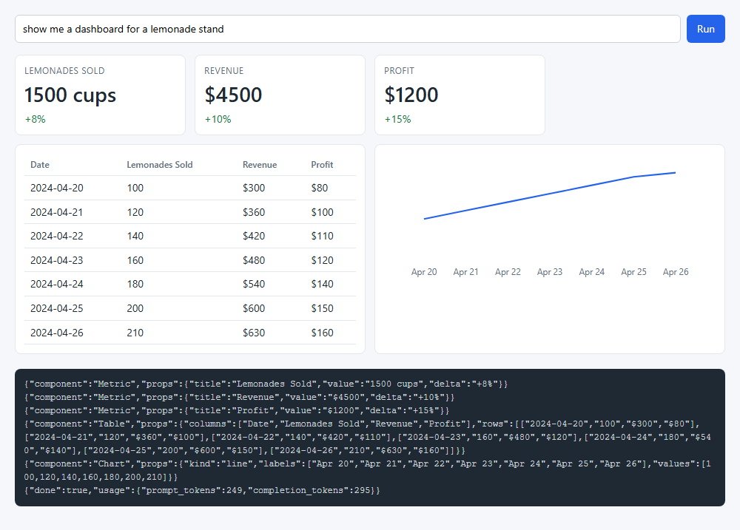
STEP 01.1 · QUICK DEMO
Six SSE frames in 7.9 seconds: three metrics, a table, a chart, then done
6
SSE messages in 7.9s
249 / 295
prompt / completion tokens
Three Metric frames, one Table, one Chart, then done with the usage: the wire panel at the bottom lists all six.
The first metric was drawn while the chart was still streaming: a new tool-call index means every earlier call is complete.
The model chose only the order of its calls. The page put the metrics in a row; the model could not ask for that.
Prompt: show me a dashboard for a lemonade stand. Recorded with python demo.py.
12
Notes:
The recorded run. Six messages: three metrics, a table, a chart, and the done frame with 249 prompt tokens and 295 completion tokens. The page appended each card as its frame arrived, so the first metric was on screen before the chart finished streaming. Look at the layout: the three metrics sit in a row because the page's stylesheet puts them there, not because the model asked. That is the limit of static generation and the reason for step 01.2. The wire panel at the bottom is the exact stream, one JSON object per line.

Slide 13
STEP 01.2 · LEVEL 2 OF 23 · DECLARATIVE GENERATION · YOUR OWN PRODUCT
The model composes a layout as data, and the shape of that data decides how it streams
In declarative generation the components stay prebuilt and typed, but the model decides which ones, in what order, nested how. The output is data, not code.
root = "card"
card: Card [metricsRow, dataRow]
metricsRow: Row [sales, visitors, profit]
sales: Metric {title, value, delta}
visitors: Metric {…}
profit: Metric {…}
dataRow: Row [table, chart]
Card: Lemonade Stand Dashboard
A catalog of eight components drives three things: the prompt the model reads, the JSON Schema the server checks, the renderer table the page uses.
The page does not wait for the document: a tolerant partial-JSON parser re-parses after every chunk and re-renders.
Two shapes of the same document: a nested tree, and a flat element map with ids where the root is written first.
The tree's root closes last, so its layout is known only at the final chunk.
The flat map puts the root and its child ids first, so the layout is known before any detail arrives.
That ordering is why A2UI and json-render chose the flat shape.
Row: three metrics, one arrived
waiting for its statement
Row: table and chart
waiting for its statement
A flat map, part way through the stream: the layout is fixed, the details fill in.
Takeaway Declarative generation makes the catalog the single source of truth, and a flat element map puts the layout before the details.
13
Notes:
Two ideas on this slide. First, the catalog is the single source of truth: one Python dict generates the prompt, the schema and the renderer table, so adding a component in one place updates all three. Second, streaming. The page re-parses the partial JSON on every chunk, which only looks good if the document's shape puts the layout before the details. A nested tree cannot: its root object closes last. A flat element map can: the root and its list of child ids are the first thing written, and a missing child renders as a pending slot. The diagram shows that state: the layout holds still while the details fill in.

Slide 14
STEP 01.2 · CODE WALKTHROUGH
The prompt asks for the root first and the elements top-down; that ordering is the trick
1 SHAPE_RULES = {
[1] "tree": "Answer with one JSON object: the root node. A node is {\"type\", \"props\", \"children\"}; "
3 "children is a list of nodes and is only allowed on components that take children.",
[2] "flat": "Answer with one JSON object {\"root\", \"elements\"}. Write \"root\" first. \"elements\" maps an id to a node "
5 "{\"type\", \"props\", \"children\"}, where children is a list of ids. Write the root element first, "
[3] "then its children in order, then their children: top-down, so the layout is known before the details.",
7 }
1
The tree rule: the answer is the root node, and children are nodes inside it. The root object cannot close until every descendant has.
2
The flat rule: root is written first, and elements maps an id to a node whose children are ids, not nodes.
01_foundations/step_02_declarative_tree/catalog.py
3
Top-down: the root element, then its children in order, then theirs. The layout is on the wire before any detail.
The same catalog generates both prompts; only these rules and the child type in the schema differ.
14
Notes:
Both shapes come from the same catalog and the same prompt builder; the difference is these two rules and, in the schema, whether a child is a node reference or a string id. Read the flat rule aloud: write root first, then the root element, then its children in order, top-down. That is what puts the skeleton at the front of the stream. The schema for the flat shape adds one check the JSON Schema cannot express: every child id must name an element. Validation runs on the finished document; the partial one is rendered on trust with unknown names shown as stubs.

Slide 15
STEP 01.2 · CODE WALKTHROUGH
A child id whose element has not arrived renders as a pending slot
1 export function renderFlat(spec, id = spec?.root, seen = new Set()) {
2 // A flat element map. A child id whose element has not arrived yet renders
3 // as a pending slot, so the layout holds still while the details stream in.
4 const node = spec?.elements?.[id];
[1] if (node === undefined || seen.has(id)) return PENDING;
6 seen.add(id);
7 if (!isComponent(node)) return PENDING;
[2] const children = (node.children ?? []).map((child) => renderFlat(spec, child, seen)).join("");
9 const html = render(node.type, node.props, children);
[3] return isPartial(node) ? `<div class="pending-wrap">${html}</div>` : html;
11 }
1
An id with no element yet, or one already seen, returns PENDING: an empty slot at the right place, so the layout holds still.
2
Recursion is by id, not by nested object. The child is looked up in the map, which is what lets it arrive later.
01_foundations/step_02_declarative_tree/page/render.mjs
3
A node the parser left open is wrapped as pending; a node the model closed renders plain. The parser types tell them apart.
renderTree is the same walk over nested nodes; an open node renders with whatever closed children it already has.
15
Notes:
This is the flat walker. Start at the root id, look up the element, render its children by id. Two things make streaming work. A missing element returns a pending slot rather than nothing, so the layout does not jump when it arrives. And the parser returns open objects as PartialDict, distinct from a dict the model closed, so the renderer can wrap a half-written node as pending. The seen set guards against a cycle the model might write. The tree walker is the same shape without the lookup, which is why it cannot draw a slot for a child that has not started.

Slide 16
STEP 01.2 · QUICK DEMO · MEASURED
A flat element map paints and fixes its layout at chunk 33; a tree waits for chunk 408
Same prompt, same model, same eight components. Only the JSON shape differs.
​Tree: first paint at chunk 91 (3.22s), layout known at chunk 408 of 408 (6.10s), the last one.
​Flat: first paint and layout known both at chunk 33 of 266 (1.08s); done at 3.41s.
The flat root element is short and closes early; the tree root closes last because everything is inside it.
Both documents validated.
Recorded by progress.py during python demo.py: the chunk at which the first component closed and the root's children became final.
16
Notes:
The measurement behind the claim. progress.py asks two questions after every chunk: how many catalog components are closed and reachable from the root, and is the root's list of children final. For the tree the answer to the second question is the last chunk, 408 of 408, because the root object is the outermost brace. For the flat map it is chunk 33 of 266, because the root element with its child ids is the first thing the model wrote. First paint is a separate number, 91 against 33, and also favours the flat map because its root is short. This is the reason the declarative protocols in sub-themes 03 and 05 use a flat map with ids.

Slide 17
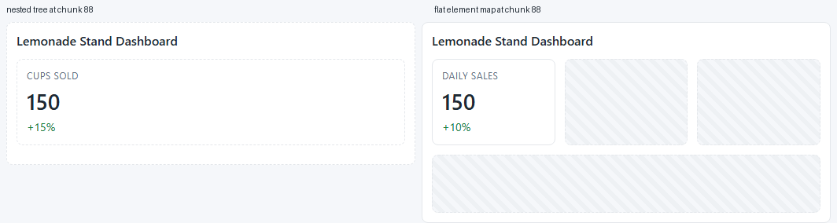
STEP 01.2 · QUICK DEMO · BOTH STREAMS REPLAYED TO CHUNK 88
At the same chunk, the tree has one metric in an open card; the flat map has the whole layout
chunk 88
of 408 (tree) and of 266 (flat), replayed
Left, the nested tree: a card with one metric inside, both still open, and no sign of what comes next.
Right, the flat map: the title, the metric row with two pending slots, and the row below already in place.
The hatched boxes are ids whose elements have not arrived; they hold the layout still.
The page's replay hook re-plays each recorded delta stream to a chosen chunk; this is what a user would see at that instant.
17
Notes:
The demo replays both recorded streams to the same chunk, 88, and screenshots them side by side. On the left the tree has produced a card and a first metric, both still open, and nothing about the rest of the page is known. On the right the flat map has the title, a row with one metric and two pending slots, and a second row waiting below. Same information budget, different order. The hatched slots are the PENDING return in renderFlat. Nothing will move when the remaining elements arrive; they fill the slots that already exist.

Slide 18
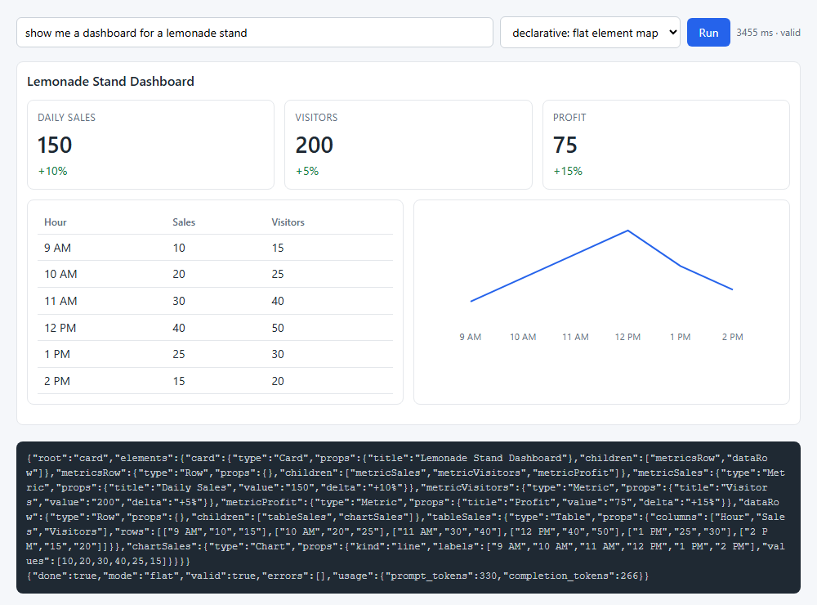
STEP 01.2 · QUICK DEMO · THE FINISHED FLAT LAYOUT
The finished flat map: a card, a row of three metrics, a table beside a chart, 266 tokens
266
completion tokens, flat map (330 prompt)
3.41s
to the last chunk; valid against the schema
The model chose the layout: metrics grouped in a Row, table and chart in a second Row, all inside one Card.
The wire panel shows the element map: root first, then card with its child ids, then the children.
The done frame carries valid: true and an empty errors list from the server's validator.
Same prompt as step 01.1; the difference is that the model, not the page, grouped the components.
18
Notes:
The finished page in flat mode. Compare it with step 01.1: the metrics are in a row and the table sits beside the chart because the model wrote a Row around them, not because the stylesheet did. Read the JSON at the bottom from the left: root, then the card element with its two child ids, then the metrics row, then the metrics. That order is what the prompt asked for and what made chunk 33 the layout-known point. The done frame reports valid true with no errors, from the schema the server generated out of the catalog.

Slide 19
STEP 01.3 · LEVEL 3 OF 23 · OPEN-ENDED GENERATION · YOUR OWN PRODUCT
The model writes the whole page; the host runs it in a box and accepts one message shape
Open-ended generation removes the catalog. The model writes HTML, CSS and JavaScript, and can draw any layout at a price on three fronts: tokens, trust and consistency.
srcdoc = sandboxed(html), CSP injected
host page
sandboxed iframe
Tokens: a page is text, and the text of a page is long. The report says five to ten times a spec; this step measures it.
Trust: the code came from a model and may do anything code does, so it must run in a box.
The box has two layers. sandbox="allow-scripts" gives the document a unique origin and denies forms, popups and navigation.
A Content Security Policy injected as the first tag in <head> denies every network request: inline code can compute but cannot phone home.
The only way back out is postMessage, and the host keeps one shape from the one window it mounted.
Consistency: nothing ties the page to the product's components, so every reply looks different.
sandbox="allow-scripts" (no allow-same-origin)
app.js: mounts, listens, filters
the model's document, unique origin
postMessage({type: "event", name, payload})
accepted only if source matches and isEvent(data)
Two arrows in, one shape out. The CSP inside the document blocks every request the code might make.
Takeaway Open-ended generation buys any layout at ten times the tokens, no streaming paint, and a page that must run in a box.
19
Notes:
The third mode gives the model everything and this slide is about what that costs. Tokens and consistency are shown on the next slides; trust is solved here. Two layers of containment. The iframe attribute allow-scripts, and only that, gives the document its own opaque origin so it cannot reach the host's cookies or DOM. The CSP is injected into the document itself, first tag in head, so it governs the inline code that follows: default-src none means no fetch, no image, no font leaves the box. What remains is postMessage, and the host accepts one shape, from one window.

Slide 20
STEP 01.3 · CODE WALKTHROUGH
The box: a CSP that denies all network, injected first in the document, behind allow-scripts
[1] export const CSP = "default-src 'none'; style-src 'unsafe-inline'; script-src 'unsafe-inline'; img-src data:";
2
3 export const META = `<meta http-equiv="Content-Security-Policy" content="${CSP}">`;
4
5 export function sandboxed(html) {
6 // Put the CSP meta tag first in <head>, or first in the document if there is no <head>.
[2] const head = /<head[^>]*>/i.exec(html);
8 if (head) return html.slice(0, head.index + head[0].length) + META + html.slice(head.index + head[0].length);
9 return META + html;
10 }
11
12 export function mount(iframe, html) {
[3] iframe.setAttribute("sandbox", "allow-scripts");
14 iframe.srcdoc = sandboxed(html);
15 }
1
default-src 'none': no fetch, no image, no font, no script from anywhere. Inline style and script are allowed because that is what the model writes.
2
The meta tag goes first in `<head>`, or first in the document, so it applies to every inline block after it.
3
allow-scripts without allow-same-origin. With both, the document would share the host's origin and could read its cookies and DOM.
01_foundations/step_03_open_ended_html/page/sandbox.mjs
isEvent, further down the same file, is the one shape the host accepts: {type: "event", name, payload?}.
20
Notes:
Walk the file top to bottom. The CSP string denies everything by default and re-allows only inline style and script, plus data-URI images, because that is what a self-contained page needs. sandboxed puts the meta tag at the front of head so it governs everything after it; a document with no head gets it as the first bytes. mount sets exactly one sandbox token and assigns srcdoc. The checkpoint in the README: remove the meta tag and add an image with an https source, and the request now leaves the box. Put it back and it does not.

Slide 21
STEP 01.3 · CODE WALKTHROUGH
The bridge back: only the mounted window, only the one shape
1 window.addEventListener("message", (event) => {
2 // Only the mounted iframe, and only the one shape the host accepts.
[1] if (event.source !== frame.contentWindow || !isEvent(event.data)) return;
4 inbox.push(event.data);
[2] inboxPanel.textContent += JSON.stringify(event.data) + "\n";
6 });
1
Two checks before the host believes anything: the source must be the iframe the page mounted, and the data must pass isEvent.
01_foundations/step_03_open_ended_html/page/app.js
2
An accepted event lands in the inbox panel. Step 01.4 turns it into the next model turn.
A sandboxed iframe has an opaque origin, so event.origin is the string "null" and cannot be checked; the source comparison does that job.
21
Notes:
The listener is six lines and it is the whole contract between the two sides. The iframe can post anything it likes; the host keeps only messages from the one window it mounted whose data is an object with type event and a string name. Mention the origin detail: a sandboxed document has an opaque origin, so event.origin reads as the string null and cannot be used to filter. Comparing event.source with the mounted frame's contentWindow does the same job. In this step an accepted event is only logged; the next step acts on it.

Slide 22
STEP 01.3 · QUICK DEMO · MEASURED
The same dashboard: 196 tokens as tool calls, 328 as a flat map, 3013 as HTML
Same prompt, same model, three modes in one page. The HTML document is 9.2x the flat map.
Time to the last byte: static 4.7s, flat 4.0s, HTML 32.5s.
Two earlier runs gave 9.8x and 10.4x. The report's range is five to ten.
The HTML was 8718 characters and 208 tags with one button.
The HTML mode has no partial paint: a half-written document cannot be mounted, so the user waits for all of it.
tokens.py counts what each mode made the model write; for the text modes the count matches the API's completion_tokens.
22
Notes:
The report's five-to-ten-times claim, checked. The demo runs the same prompt in all three modes and counts the raw text of each reply with tiktoken's o200k_base, the vocabulary of the GPT-4.1 family. Static: 196 tokens. Flat map: 328. HTML: 3013, which is 9.2 times the flat map; two earlier runs landed at 9.8 and 10.4. Time follows tokens: 32.5 seconds against 4. And there is a cost the chart does not show: the JSON modes painted their first component after about a second, while the HTML page could not be mounted until the last byte arrived.

Slide 23
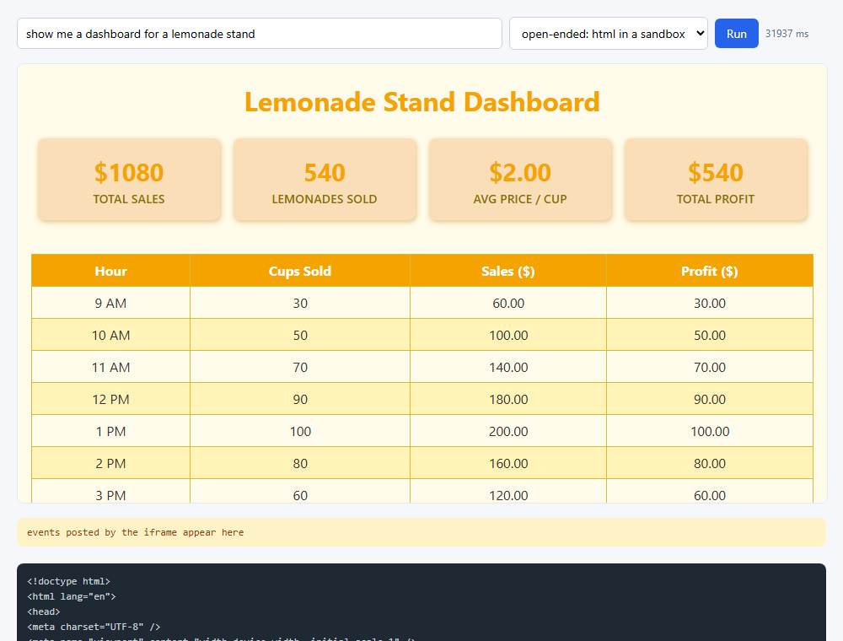
STEP 01.3 · QUICK DEMO
The model's own page in the sandbox: any layout, in yellow, 32 seconds later
3013
tokens for the HTML document, 9.2x the flat map
32.5s
to the last byte; 8718 chars, 208 tags, 1 button
Four headline numbers, a table and a chart, none of them from the catalog: the model drew its own components and chose the colour.
The page is mounted whole in the iframe; the raw document is in the panel below, starting with <!doctype html>.
The demo clicked the page's one button and the host received {type: "event", name: "refreshData", payload: ...} through the bridge.
The consistency cost is visible: this looks nothing like steps 01.1 and 01.2, and the next reply would look different again.
23
Notes:
The recorded page. Everything on it was written by the model: the layout, the amber palette, the table styling, the SVG chart further down, and one button. It looks nothing like the two previous steps, which is the consistency cost the report names. The demo clicked that button headlessly and the host's inbox received a refreshData event with a payload, proving the bridge works both ways inside the sandbox. Note the timing in the corner: about 32 seconds, and nothing was on screen until the last byte arrived.

Slide 24
STEP 01.4 · LEVEL 4 OF 23 · HYBRID · YOUR OWN PRODUCT
The report's default: declarative by default, one sandboxed escape hatch, and a click that becomes the next turn
The hybrid puts the step 01.3 container inside the step 01.2 catalog. GeneratedView is a component like any other, with one string prop; its renderer is the sandbox.
Card
GeneratedView
The catalog gains one entry plus two prompt rules: what the hatch is for, and how small to keep it.
Nothing in the server knows GeneratedView is special; it is a string prop that passes the schema. Only the renderer treats it differently.
A Button carries an action name the model chose. The page does not know what it means; it posts it back.
The server keeps a session transcript. A click becomes a user message on it and the model answers with the next layout.
The first turn and every later turn share one code path and one stream.
The catalog stays in charge; the sandbox is rented for one component.
catalog primitive
Metric
catalog primitive
Table
the step 01.3 sandbox as a component: a 481-character gauge, not a 9000-character page
catalog primitive
Chart
catalog primitive
Catalog primitives everywhere; the dashed box only where the catalog does not reach.
Takeaway The hybrid keeps the catalog in charge, rents the sandbox for one component, and makes a click the next user message.
24
Notes:
Two ideas close the sub-theme. First, the hatch. Step 01.2 showed why declarative should be the default: typed props, a schema, a renderer the product owns, a tenth of the tokens. Step 01.3 showed what open-ended costs and how to contain it. Now the container is a catalog entry whose renderer is the sandbox, and the prompt tells the model to use it at most once and keep it short. Second, the loop. A dashboard that cannot be clicked is a report. A button's action name is opaque to the page and the server; only the model interprets it, on the same transcript, with the same generator that streamed the first layout.

Slide 25
STEP 01.4 · CODE WALKTHROUGH
The escape hatch is a renderer: the step 01.3 sandbox, as an entry in the table
1 export function GeneratedView({ html }) {
2 // The escape hatch: model-written HTML in the step 03 sandbox. The document
3 // goes through esc() because it is an attribute value here; the browser
4 // unescapes it when it reads srcdoc.
[1] return `<iframe class="card generated" sandbox="allow-scripts" srcdoc="${esc(sandboxed(String(html ?? "")))}"></iframe>`;
6 }
7
[2] export const RENDERERS = { Card, Row, Column, Text, Metric, Table, Chart, Button, GeneratedView };
1
Same box as step 01.3: sandbox="allow-scripts" and the CSP injected by sandboxed. The document is escaped because here it is an attribute value; the browser unescapes srcdoc.
01_foundations/step_04_hybrid_escape_hatch/page/render.mjs
GeneratedView is one more name in RENDERERS. The walker, the schema and the prompt pick it up from the catalog like any other.
2
In catalog.py the entry is one line, "GeneratedView": ({"html": STRING}, False), plus two prompt rules that say what it is for and to keep it short.
25
Notes:
The whole hatch is this function. It takes the one string prop, runs it through sandboxed to inject the CSP, escapes it because it is going into an attribute, and returns an iframe with the allow-scripts token. The last line matters as much as the function: GeneratedView is a plain entry in the renderer table, so renderFlat and renderTree need no special case. The catalog side is one line and two prompt rules. The server never learns that one component is different; the schema sees a string prop and passes it.

Slide 26
STEP 01.4 · CODE WALKTHROUGH
The loop closes: the click becomes a user message, and the same generator streams the reply
1 @app.post("/api/action")
2 def action(body: Action):
3 """The loop closes: the event becomes a user message, the model answers with the next layout."""
4 session = SESSIONS.get(body.session)
5 if session is None:
6 raise HTTPException(404, "unknown session")
7 session["turn"] += 1
[1] session["messages"].append({"role": "user", "content": EVENT_PROMPT.format(action=body.action, payload=json.dumps(body.payload))})
[2] return stream(declarative_turn(body.session))
1
The event is appended to the session's transcript as text: EVENT_PROMPT names the action and its payload and asks for the whole updated dashboard, changing only what the event changes.
2
declarative_turn is the generator that streamed turn 1. It appends the model's reply to the transcript, so the next click continues from the layout on screen.
01_foundations/step_04_hybrid_escape_hatch/server.py
In page/app.js, a click on any catalog Button and a postMessage from any generated iframe both go through one act function that posts here and hands the reply to the same consume that rendered turn 1.
26
Notes:
The action endpoint is nine lines. Look up the session, count the turn, append one user message built from the event prompt, and return the same stream the first run returned. There is no second code path for later turns. On the page side, act collects two sources of events, a click on a catalog button and a postMessage from a generated iframe, posts them here, and feeds the response to the consume function that rendered the first layout. The action name is never in a schema; the page treats it as opaque, the server as text, and only the model interprets it.

Slide 27
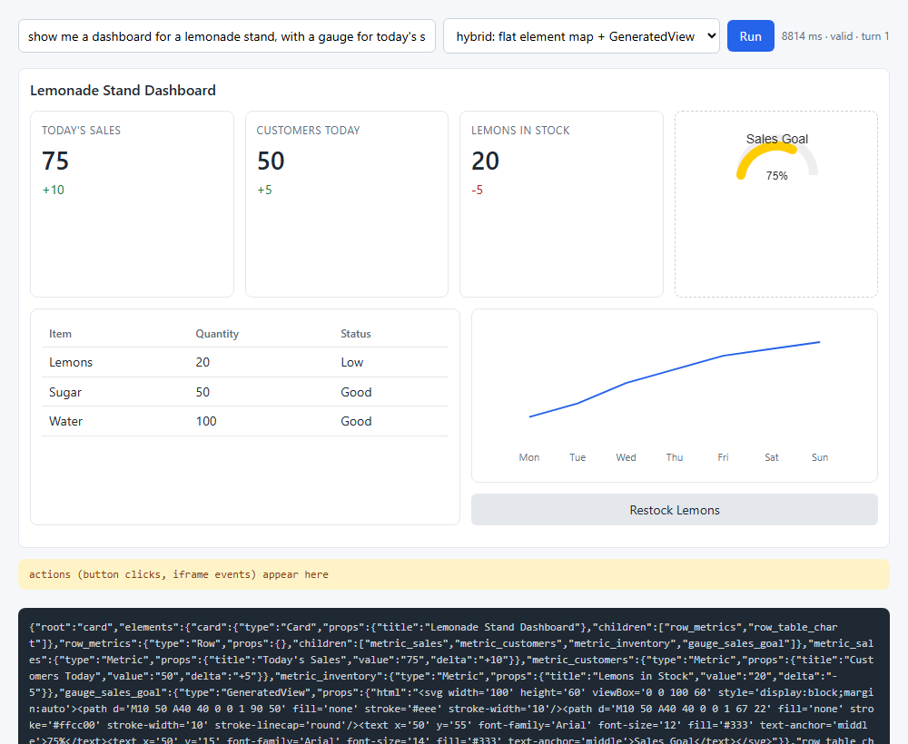
STEP 01.4 · QUICK DEMO · TURN 1
Turn 1: ten catalog components and one GeneratedView holding a 481-character gauge
11
elements, valid: 10 from the catalog, 1 GeneratedView
481
characters of HTML for the gauge; the whole page in 01.3 was about 9000
The dashed card at the top right is the hatch: an inline SVG gauge for the sales goal, the one thing the catalog cannot show.
Everything else is catalog: three Metrics in a Row, a Table, a Chart, and a Button labelled Restock Lemons with action restock_lemons.
The wire panel shows the flat map; gauge_sales_goal is a GeneratedView whose html prop is the SVG.
Prompt: a dashboard for a lemonade stand, with a gauge for today's sales goal and a button to restock lemons.
27
Notes:
Turn one of the recorded demo. The prompt asked for a gauge, which the catalog does not have, and a restock button. The model answered with a valid flat map of eleven elements: a card, a row of three metrics, the gauge as a GeneratedView, a row with a table and a column holding a chart and the button. The dashed border marks the hatch. Its html prop is 481 characters of inline SVG; the same dashboard as a whole page in step 01.3 was about nine thousand. That is the hybrid's economics: the catalog everywhere, the sandbox for one thing.

Slide 28

STEP 01.4 · QUICK DEMO · TURN 2, AFTER THE CLICK
After the click, two elements changed and nine are byte-for-byte the first layout
2 / 9
elements changed / unchanged; none added or removed
20 → 100
Lemons in Stock; delta -5 became +80, the table row followed
The page sent {"source": "button", "action": "restock_lemons", "payload": {"label": "Restock Lemons"}}; it is in the yellow inbox panel.
​metric_inventory and table_inventory changed; the gauge, the chart and the other metrics came back identical.
The whole layout was re-sent. A patch protocol would send only the two elements; sub-themes 03 and 05 do that.
The action name restock_lemons appears in no schema. The page treats it as opaque, the server as text, and only the model interprets it.
28
Notes:
Turn two. The demo clicked Restock Lemons; the page posted the action with its payload, and the inbox panel shows exactly what went to the server. The model answered with the whole dashboard again: the inventory metric went from 20 to 100 with the delta rewritten, the table row followed, and the other nine elements came back unchanged because the prompt asked for that and the transcript held the previous layout. This step re-sends the whole layout, which is simple and costs a second turn of tokens; the diff-based protocols later in the series send only the changed elements.

Slide 29
Sub-theme 02
AG-UI, the transport
The report separates what the model generates from how it travels to the screen. Sub-theme 01 was about generation; this sub-theme is about transport. AG-UI is the transport for a product you own: one RunAgentInput request in, one stream of typed events out. Three steps build the server with ag-ui-protocol, write the client by hand so the wire stays visible, then replace it with @ag-ui/client and put the harness codelab's coding agent behind the protocol.
02.1 An AG-UI server: RUN_STARTED, TEXT_MESSAGE_*, RUN_FINISHED over SSE
02.2 Tool calls and shared state: STATE_SNAPSHOT, STATE_DELTA, a client tool
02.3 The harness codelab's loop over AG-UI, with HttpAgent in the page
29
Notes:
Sub-theme 01 sent hand-made JSON over an ad-hoc SSE stream, so only its own page could read it. This sub-theme keeps the SSE and replaces the payload with a fixed vocabulary of events. The order matters: first the smallest possible agent so the wire format is visible, then tool calls and state so generative UI becomes an object the model edits, then a real coding agent behind the same endpoint with the official client library on the page. At the end the harness codelab's loop runs from a browser with no change to its functions.

Slide 30
STEP 02.1 · LEVEL 5 OF 23 · YOUR OWN PRODUCT
A run is a request; the reply is a stream of typed events
AG-UI fixes the vocabulary of what crosses the wire, so any AG-UI client can read any AG-UI agent.
RUN_STARTED
threadId and runId: the run has an identity
The request is one object, RunAgentInput: threadId, runId, messages, tools, context, state.
The reply is text/event-stream: one JSON event per data: line, camelCase keys.
A text message is three kinds of event joined by one messageId.
Every run ends with exactly one terminal event: RUN_FINISHED or RUN_ERROR.
The server is stateless between runs; the client owns the history and sends all of it.
EventSource only does GET, so the page reads the body with fetch.
TEXT_MESSAGE_START
a new messageId, role assistant
TEXT_MESSAGE_CONTENT
one delta per model chunk, same messageId
TEXT_MESSAGE_END
the message is complete; the client stores it
RUN_FINISHED
the one terminal event on success
RUN_ERROR
the one terminal event on failure
The whole vocabulary of step 02.1. Tool calls and state arrive in step 02.2.
Takeaway A transport is a fixed vocabulary of events with a join key; the messageId is that key.
30
Notes:
This is the smallest AG-UI agent there is: a run that starts, streams one text message delta by delta, and finishes. Point at the chips: five kinds of event, one message id linking start, every delta and end. Two things to stress. First, the request carries the whole history and the state, so the server keeps nothing between runs. Second, there are exactly two ways out of a run, RUN_FINISHED or RUN_ERROR, and the client can rely on seeing one of them. The browser's EventSource cannot POST a JSON body, which is why the page reads the stream with fetch.

Slide 31
STEP 02.1 · CODE WALKTHROUGH
The agent is a generator with two exits and one join key
1 def run(input: RunAgentInput):
2 """Yield the events of one run. A model failure becomes RUN_ERROR, not a broken stream."""
[1] yield RunStartedEvent(thread_id=input.thread_id, run_id=input.run_id)
[2] message_id = str(uuid4())
5 try:
6 yield TextMessageStartEvent(message_id=message_id, role="assistant")
7 for delta in stream_text(to_openai(input.messages)):
8 yield TextMessageContentEvent(message_id=message_id, delta=delta)
9 yield TextMessageEndEvent(message_id=message_id)
[3] except Exception as error: # noqa: BLE001 - the client must see a terminal event
11 yield RunErrorEvent(message=str(error))
12 return
13 yield RunFinishedEvent(thread_id=input.thread_id, run_id=input.run_id)
1
The run announces itself with the ids from the request. The generator yields pydantic events from ag_ui.core and never touches HTTP.
2
One message_id for the start, every delta and the end. The client joins them on it.
02_ag_ui/step_01_ag_ui_server/agent.py
3
A model failure becomes RUN_ERROR, not a broken stream. Success ends with RUN_FINISHED. Exactly one terminal event either way.
server.py wraps this in EventEncoder and a StreamingResponse, so the first event leaves before the model has finished.
31
Notes:
Read the function top to bottom. RUN_STARTED with the thread and run ids from the input. A fresh message id. Inside the try, the start event, one content event per delta from the model, the end event. The except turns any model failure into RUN_ERROR and returns, so the client still gets a terminal event. Outside the try, RUN_FINISHED. The generator knows nothing about HTTP; the tests iterate it directly. The endpoint in server.py is ten lines: EventEncoder from ag_ui.encoder encodes each event as a data: line, and a StreamingResponse sends them as they are produced.

Slide 32
STEP 02.1 · CODE WALKTHROUGH
The page reads the stream with fetch, because the request has a body
1 export async function* readEvents(response) {
[1] const reader = response.body.getReader();
3 const decoder = new TextDecoder();
4 let buffer = "";
5 while (true) {
6 const { value, done } = await reader.read();
7 if (done) break;
[2] buffer += decoder.decode(value, { stream: true });
9 let cut;
[3] while ((cut = buffer.indexOf("\n\n")) >= 0) {
11 const block = buffer.slice(0, cut);
12 buffer = buffer.slice(cut + 2);
13 const event = parseBlock(block);
14 if (event) yield event;
1
response.body.getReader() gives raw bytes. EventSource would parse SSE for free, but it cannot POST a RunAgentInput.
2
A chunk can end in the middle of an event. The buffer holds the remainder until the next blank line.
02_ag_ui/step_01_ag_ui_server/sse.mjs
3
One block is the data: lines up to a blank line; parseBlock turns it into one JSON event, and app.js switches on event.type.
app.js keeps the messages array; a finished assistant message joins it, so the next run sends the whole conversation back.
32
Notes:
This is the hand-written client, kept deliberately small so the wire stays visible. The reader pulls bytes, the decoder turns them into text, and the loop cuts the buffer at every blank line. Each block becomes one event. In app.js a switch on event.type creates a message element on TEXT_MESSAGE_START, appends the delta on TEXT_MESSAGE_CONTENT, and pushes the finished message into the history on TEXT_MESSAGE_END. The point to make: none of this is specific to this agent. Step 02.3 replaces the whole file with a library that does the same thing.

Slide 33
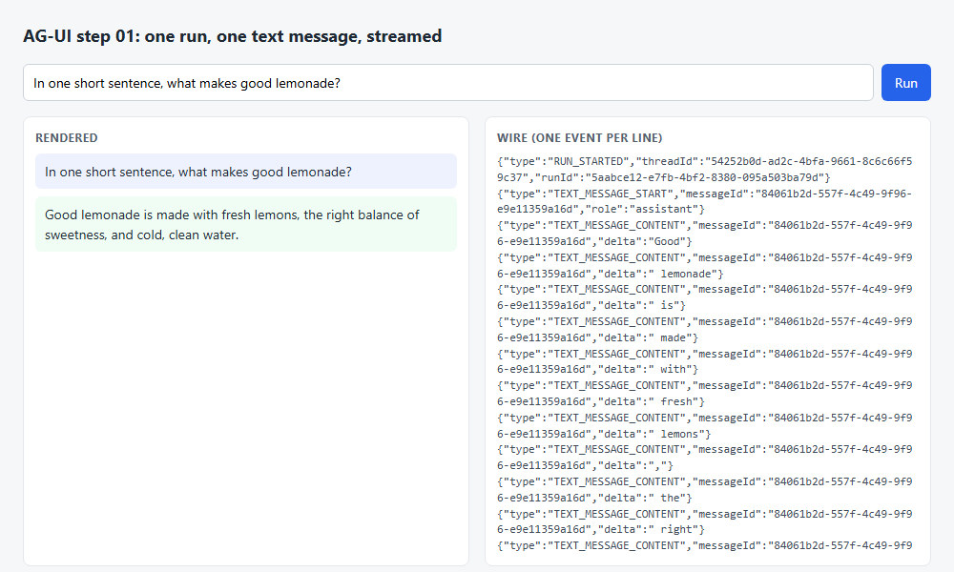
STEP 02.1 · QUICK DEMO
One request, 22 events, one terminal event
18
TEXT_MESSAGE_CONTENT events in the recorded run
5
event kinds on the wire
Left: the answer rendered word by word from the deltas.
Right: every event as one line, camelCase keys, the same messageId on start, content and end.
The page ran the prompt as a second request and got a different sentence; the wire looked the same.
Checkpoint: set API_KEY to a wrong value. The stream still ends with one terminal event, now RUN_ERROR, and the page still reaches a final status.
33
Notes:
The recorded demo posts one RunAgentInput and gets 200 text/event-stream back: RUN_STARTED, TEXT_MESSAGE_START, eighteen TEXT_MESSAGE_CONTENT events, TEXT_MESSAGE_END, RUN_FINISHED. The page then ran the same prompt and rendered a different sentence, which is the model, not the protocol. Show the right panel: each line is one JSON object with a type field. The checkpoint is worth doing live if there is time: break the API key and watch the run end with RUN_ERROR instead of a hung page.

Slide 34
STEP 02.2 · LEVEL 6 OF 23 · YOUR OWN PRODUCT
Generative UI as shared state: the model patches an object, the page renders it
Nothing on the wire says "metric card". A tool returns a JSON Patch to a dashboard object; the page re-renders the object.
STATE_SNAPSHOT
the state this run starts from, sent or empty
Tool calls stream in three parts joined by toolCallId; the result is a fourth event.
STATE_SNAPSHOT opens the run with the whole object; STATE_DELTA carries a patch.
Server tools draw nothing: show_metric returns an add on /dashboard/metrics/-.
The client owns the object and sends it back, so the next run continues from the same dashboard.
A client tool is declared in RunAgentInput.tools; the server streams the call and ends the run.
The page answers as a tool message and starts the next run with no user text.
TOOL_CALL_START
toolCallId and toolCallName
TOOL_CALL_ARGS
the JSON arguments, in pieces as the model streams
TOOL_CALL_END
the arguments are complete; the server parses them now
STATE_DELTA
a JSON Patch: add, replace or remove at a JSON Pointer
TOOL_CALL_RESULT
the tool's answer, role tool; absent for a client tool
The step 02.1 events are still there. These six are new.
Takeaway The component vocabulary lives in the state shape and the renderers, not in the protocol.
34
Notes:
Step 02.1 streamed text only and its state field was empty. This step fills it. The report's static generation mode has the agent pick a component and fill its props; sub-theme 01 sent one JSON message per pick. AG-UI does it as state: the page never receives render a metric, it receives the dashboard now has one more metric, as a patch, and re-renders. Three consequences: the client can send the object back, a patch is small, and everything that reads the state stays in sync. Client tools close the other direction: the model calls confirm_purchase like any tool, the server cannot run it, so it streams the call and finishes the run.

Slide 35
STEP 02.2 · CODE WALKTHROUGH
Apply the patch on the server first, then send it; stop the run for a client tool
1 waiting_on_client = False
2 for call_id, call in calls.items():
[1] if call["name"] in client_tools:
4 waiting_on_client = True # the page runs it; its result opens the next run
5 continue
6 result, operations = execute(call["name"], json.loads(call["arguments"] or "{}"))
[2] if operations:
8 apply_patch(state, operations)
9 yield StateDeltaEvent(delta=operations)
10 yield ToolCallResultEvent(message_id=str(uuid4()), tool_call_id=call_id, content=result, ro…
11 messages.append({"role": "tool", "tool_call_id": call_id, "content": result})
[3] if waiting_on_client:
13 break
1
A tool the page declared gets no result on the server. The flag is set and the loop moves on; the answer arrives on the next run.
2
apply_patch on the server copy, then the same operations go out as STATE_DELTA. Both copies stay equal.
3
The run ends with the call still open. The page draws the buttons; the click becomes a tool message.
02_ag_ui/step_02_ag_ui_tools_and_state/agent.py
The run opened with yield StateSnapshotEvent(snapshot=state), where state is the client's copy or initial_state().
35
Notes:
This is the inner part of the loop, after the model has stopped streaming and the tool calls are assembled. For each call: if its name is one of the client tools, set the flag and continue, no result. Otherwise execute it, which returns a result string and a list of patch operations. Apply the patch to the server's state, then yield it as STATE_DELTA, then yield the result and append it to the history. After the loop, if a client tool was called, break: the run finishes, and the page has the call. Above this snippet the run began with a snapshot of the state the client sent, or of an empty dashboard.

Slide 36
STEP 02.2 · CODE WALKTHROUGH
Server tools return patches; not one of them draws anything
1 def show_metric(title: str, value: str, delta: str = "") -> list:
2 """Add one metric card to the dashboard."""
[1] return [{"op": "add", "path": "/dashboard/metrics/-", "value": {"title": title, "value": va…
4
5
6 def show_table(columns: list, rows: list) -> list:
7 """Set the dashboard table (one table, replaced each time)."""
[2] return [{"op": "replace", "path": "/dashboard/table", "value": {"columns": columns, "rows":…
9
10
11 def show_chart(kind: str, labels: list, values: list) -> list:
12 """Set the dashboard chart. kind is 'bar' or 'line'."""
[3] return [{"op": "replace", "path": "/dashboard/chart", "value": {"kind": kind, "labels": lab…
1
/dashboard/metrics/- is JSON Pointer for append. Three metrics in the recorded run became three add operations.
2
One table, replaced each time. The page's renderer decides what a table looks like; the protocol only moves the object.
02_ag_ui/step_02_ag_ui_tools_and_state/tools.py
3
Each tool is a pure function from arguments to operations. json_patch.py and json-patch.mjs apply them identically on both sides.
render.mjs rebuilds the dashboard from the state object on every STATE_SNAPSHOT and STATE_DELTA.
36
Notes:
Three tools, three patches. show_metric appends a card object to the metrics array. show_table and show_chart replace one slot each. The model sees these as ordinary function-calling tools with schemas; what it cannot see is that the result is a patch, not a drawing. On the page, render.mjs is the sub-theme 01 idea reduced to what this step needs: one function per component, props in, DOM out, called on every state change. The same three JSON Patch operations exist in Python and in JavaScript, and the tests check both.

Slide 37
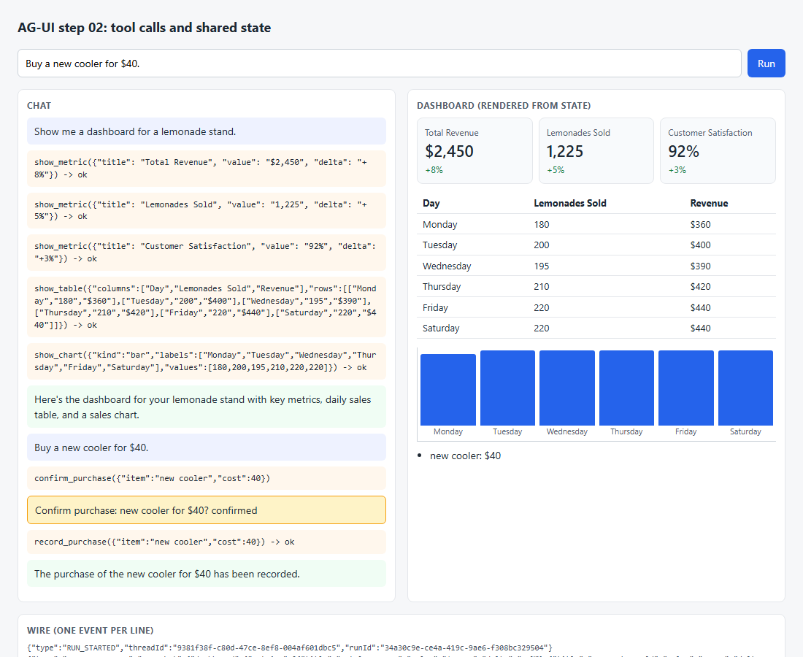
STEP 02.2 · QUICK DEMO
Three runs: build the dashboard, ask the page, record the answer
64
TOOL_CALL_ARGS events to stream show_table's arguments
3
metrics in the second run's STATE_SNAPSHOT: the page sent the dashboard back
Run 1 opens with STATE_SNAPSHOT at 0 metrics, then show_metric three times, show_table, show_chart, each followed by a STATE_DELTA.
Run 2: the model calls confirm_purchase and the run finishes with no TOOL_CALL_RESULT; the confirm panel appears on the left.
Run 3, after the click: record_purchase adds to /dashboard/purchases/-.
Right: the dashboard rendered from state, never from a component message.
Checkpoint: remove confirm_purchase from CLIENT_TOOLS in app.js and ask to buy something. Why does the run no longer stop early?
37
Notes:
Walk through the three runs in order. The first builds the dashboard: three metrics, a table streamed in sixty-four argument events, a chart in thirty-four, each followed by a patch. The second run's snapshot says three metrics, which proves the page sent the state back and the server continued from it. The model calls confirm_purchase and the run ends without a result; the result exists only in the page's history, as a tool message. The third run starts from that message with no user text, calls record_purchase, and the purchases list gains one entry. The checkpoint asks why removing the client tool changes the run's shape: the model then only has server tools, so nothing stops the loop.

Slide 38
STEP 02.3 · LEVEL 7 OF 23 · YOUR OWN PRODUCT
A terminal and AG-UI are two transports for the same loop
The harness codelab's coding agent runs from a browser with no change to harness/. A bridge translates its side effects into events.
STATE_SNAPSHOT
{"todos": [...]}: the harness's plan, module global
TEXT_MESSAGE_CONTENT
one per on_delta callback from call_llm
harness/ is a verbatim copy of the harness codelab's step 21: call_llm, execute, todos, permissions.
A text delta from on_delta becomes TEXT_MESSAGE_CONTENT; an assembled tool call becomes three TOOL_CALL_* events.
The plan is shared state: STATE_SNAPSHOT {todos} at the start, STATE_DELTA replace /todos after every write_todos.
A permission question becomes a CUSTOM event named permission, because the browser has no prompt.
Token usage the harness already collects rides on RUN_FINISHED in the TokenUsage shape.
The page uses HttpAgent from @ag-ui/client: no SSE parsing, no message bookkeeping.
TOOL_CALL_ARGS
one delta: the harness assembles the call first
TOOL_CALL_RESULT
the return of tools.execute, permission layer included
CUSTOM permission
reason and decision; the terminal asked at the prompt
STATE_DELTA
replace /todos after write_todos
RUN_FINISHED
with usage: input and output tokens
The same vocabulary as steps 02.1 and 02.2, plus one CUSTOM event.
Takeaway A second transport costs a bridge and a page, not a new agent.
38
Notes:
Steps 02.1 and 02.2 wrote the client by hand to show the wire. A product would use the official client and a real agent, and this step does both. The harness codelab built an agent loop for a terminal: call_llm streams text through a callback and assembles tool calls, execute runs one call through the permission rules, write_todos keeps a plan. None of that is about the terminal. The terminal is one transport in the report's word, and AG-UI is another. The bridge calls the same functions and translates their side effects, and never edits harness/. The one thing a terminal has that a browser lacks is a prompt, so a permission question becomes a CUSTOM event.

Slide 39
STEP 02.3 · THE BRIDGE
Callbacks push, an event stream pulls; a queue between two threads joins them
call_llm blocks and reports text through on_delta. A worker thread runs it and puts every callback on a queue; a generator drains the queue and yields events; HttpAgent reads them in the page.
harness loop
queue
generator
AG-UI events
HttpAgent
call_llm(on_delta), execute, write_todos
("delta", text) then ("message", result)
bridge.run(): one harness turn
TEXT_*, TOOL_CALL_*, STATE_*, CUSTOM
@ag-ui/client in the page
server.py moves into the work directory before it imports the harness, which reads the current directory at import time.
Takeaway The bridge is 150 lines and the page is 90; harness/ has no diff against the harness codelab.
39
Notes:
This is the mechanism behind the step. The harness's call_llm is a blocking function that reports text through a callback, and an SSE endpoint needs a generator that yields. The bridge's streamed function runs call_llm in a worker thread, and the callback puts each delta on a queue; the generator side pulls from the queue and yields delta tuples until the message tuple arrives. Around that, run() turns each side effect into an event and streams it through the same EventEncoder endpoint as steps 02.1 and 02.2. On the page, HttpAgent posts the RunAgentInput, verifies the event order, rebuilds the messages and applies the state patches.

Slide 40
STEP 02.3 · CODE WALKTHROUGH
Every side effect of one tool call becomes an event; execute is the harness's own
1 for tool_call in message.tool_calls:
2 yield ToolCallStartEvent(tool_call_id=tool_call.id, tool_call_name=tool_call.function.name,…
[1] yield ToolCallArgsEvent(tool_call_id=tool_call.id, delta=tool_call.function.arguments)
4 yield ToolCallEndEvent(tool_call_id=tool_call.id)
5
6 ASKED.clear()
[2] args, result = execute(tool_call)
8 for reason in ASKED:
9 yield CustomEvent(name="permission", value={"reason": reason, "decision": "allow"})
10 yield ToolCallResultEvent(message_id=str(uuid4()), tool_call_id=tool_call.id, content=resul…
11 messages.append({"role": "tool", "tool_call_id": tool_call.id, "content": result})
[3] if tool_call.function.name == "write_todos":
13 yield StateDeltaEvent(delta=[{"op": "replace", "path": "/todos", "value": copy.deepcopy…
1
The arguments go out as one TOOL_CALL_ARGS delta, because the harness assembles the call before the loop sees it. Step 02.2 streamed them in pieces; both are legal.
2
execute is the harness's function, permission layer included. ui.approve is replaced by a stand-in that records the reason, allows, and each reason becomes a CUSTOM event.
3
After write_todos, the plan goes out as a replace on /todos. The page's copy of the state is refreshed from the module global.
02_ag_ui/step_03_ag_ui_from_the_harness/bridge.py
The run closes with RunFinishedEvent(..., usage=[token_usage(usage)]): the same dict the terminal prints after every reply.
40
Notes:
Read it as a translation table. Start, args, end: the three-part tool call shape, from a call the harness already assembled. Then clear the list of asked permissions, run execute, and turn every reason it recorded into a CUSTOM event named permission with decision allow. Then the result event, appended to the history as a tool message. If the tool was write_todos, the plan changed, so a STATE_DELTA replaces /todos. A real product would end the run on a permission question with an interrupt outcome and let the page answer on the next run; the harness codelab's step 35 covers that pattern on the terminal side.

Slide 41
STEP 02.3 · CODE WALKTHROUGH
The page subscribes instead of parsing: HttpAgent keeps the buffer, the messages and the state
1 agent.subscribe({
[1] onEvent({ event }) {
3 wire.textContent += JSON.stringify(event) + "\n";
4 },
5 onTextMessageStartEvent() {
6 textElement = addMessage("assistant", "");
7 },
[2] onTextMessageContentEvent({ textMessageBuffer }) {
9 textElement.textContent = textMessageBuffer; // the client keeps the buffer
10 },
11 onToolCallStartEvent({ event }) {
[3] toolElements[event.toolCallId] = addMessage("tool", `${event.toolCallName}(`);
13 },
1
onEvent sees every event, which is how the wire panel is still drawn. The subscriber gets one method per event type.
2
textMessageBuffer is the text so far, kept by the client. sse.mjs and the messages array from steps 02.1 and 02.2 are gone.
3
Later handlers draw tool results, the permission line from CUSTOM, and the todo list from onStateChanged. After the run, agent.messages and agent.state hold everything the next run sends.
02_ag_ui/step_03_ag_ui_from_the_harness/app.js
agent.addMessage(...) then await agent.runAgent() is the whole run. The bundle exists because @ag-ui/client imports rxjs and zod by bare name.
41
Notes:
Compare this file with app.js from step 02.1. There, the page read bytes, cut blocks, switched on the type and kept the history by hand. Here, HttpAgent does the request, the parsing, the verification that events arrive in a legal order, the message rebuilding from TEXT and TOOL events, and the state patching. The page only subscribes to what it draws. The one build step in this sub-theme, an esbuild call that flattens @ag-ui/client into vendor/ag-ui-client.js, exists because the library under study needs it. An offline test replays the bridge's exact event sequence from a Node http server into the real HttpAgent and checks messages and state.

Slide 42
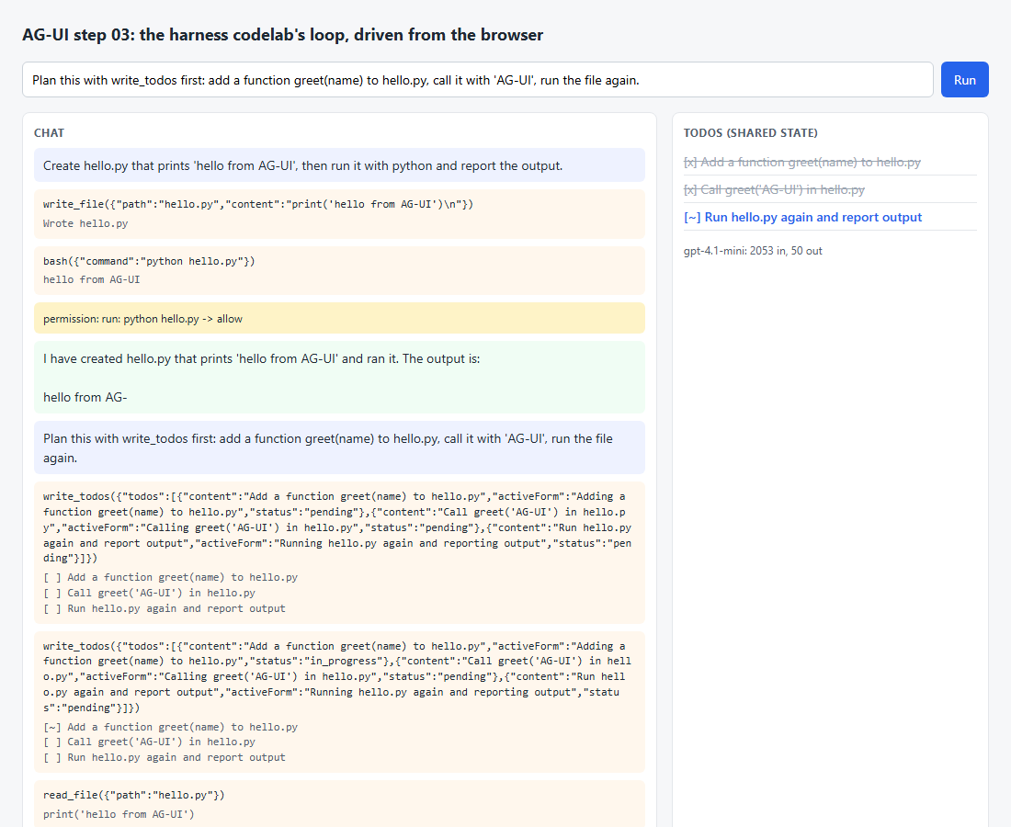
STEP 02.3 · QUICK DEMO
A coding task from the browser: files written, a command run, a plan as state
1,148 / 28
tokens in / out on the first RUN_FINISHED
2,053 / 50
tokens in / out on the second, 46 event lines
Task 1: write_file hello.py, bash python hello.py, CUSTOM permission: run: python hello.py -> allow, then 27 text deltas.
Task 2 plans with write_todos first; the page ends with two todos completed and one in progress, drawn from agent.state.
Right: the todo panel is shared state, not chat.
Checkpoint: set HARNESS_WORKDIR to a project of your own and ask for a change from the browser. Then diff harness/ against the harness codelab's step 21: it is empty.
42
Notes:
Two tasks in the recorded demo. The first writes hello.py, runs it through bash, reports the permission the harness asked for and the allow the bridge gave, streams twenty-seven text deltas and closes with usage 1148 in, 28 out. The second asks for a plan first, so write_todos runs and a STATE_DELTA with three todos follows the first tool result; it closes with usage 2053 in, 50 out. The second run's snapshot says zero todos because the first task was a single step and the harness skips the plan for those. One caveat worth saying aloud: the client owns the transcript, so the harness's history stripping and compaction do not apply; a product would move that logic to the client or keep a server-side thread store.

Slide 43
Sub-theme 03 · Levels 8 to 10 of 23
A2UI, Google's declarative protocol
Sub-theme 01 found that a flat element map streams best. A2UI v0.9.1 is that shape as a published protocol: four envelope messages, a flat component list joined by ids, a data model addressed by JSON Pointer, and a swappable catalog. The report places it in the declarative middle of the generation axis. This sub-theme builds the messages by hand, has the model write them through the official SDK, then renders them with Google's Lit renderer over the AG-UI transport from sub-theme 02.
03.1 A2UI messages by hand
03.2 A2UI from a model
03.3 The official renderer, over AG-UI
43
Notes:
Three steps, one protocol. The first step builds the four A2UI messages in Python with no library on either side, validates them against the official schemas, and renders the spec's own contact form with a hand painter. The second step has a model write the same messages through the official a2ui-agent-sdk, with the stream parser painting progressively and a correction loop catching mistakes. The third step swaps in the official Lit renderer and carries the same messages as AG-UI events. At the end the reader has A2UI over AG-UI running, with the cost of prompt-first generation measured in tokens and seconds.

Slide 44
SUB-THEME 03 · THE SHAPE OF THE PROTOCOL
Structure and data are two messages; a binding is the only join
updateComponents says there is a text field bound to /contact/email. updateDataModel says what is at /contact/email. Neither message resends the other.
updateComponents
{ "path": "/contact/email" }
updateDataModel
a flat list; Card -> form_container -> children, all by id
a binding: the component names a place, not a value
one JSON document per surface, addressed by JSON Pointer
The client keeps a component map and a data model per surface. A tree is never on the wire; it is rebuilt at paint time from the ids.
Takeaway A client that keeps a map of components and a pointer-addressed document can render any catalog.
44
Notes:
This is the picture to hold for the whole sub-theme. On the left, structure: components arrive as a flat list, each with an id, and a parent names its children by id. The client stores them in a map and rebuilds the nested tree only when it paints, so order on the wire does not matter and a child may arrive after its parent. On the right, data: one JSON document per surface, written and read through JSON Pointer paths. The join is a binding: a component property that says path instead of a literal. Later data updates never resend the structure, and an input writes into the same local document a bound Text reads from.

Slide 45
STEP 03.1 · LEVEL 8 OF 23 · DECLARATIVE GENERATION · YOUR OWN PRODUCT
The whole server-to-client protocol is four messages; everything else is the catalog
A2UI v0.9.1 is the flat element map from sub-theme 01, published as a protocol with a schema.
createSurface
surfaceId, catalogId, optional theme and sendDataModel
Each message is a JSON object with a version and exactly one of four keys.
createSurface opens a surface and names the catalog it will use.
updateComponents sends a flat list; one component must have the id root.
updateDataModel writes a value at a JSON Pointer path, or deletes it.
deleteSurface drops the surface and every piece of state under it.
Validation runs against three official schemas; a registry plugs the catalog in.
updateComponents
a flat list of components joined by ids
updateDataModel
path (JSON Pointer) and value, or path alone to remove
deleteSurface
the client forgets the surface and its state
The envelope schema. Which components may appear inside updateComponents is the catalog's business, not the envelope's.
Takeaway A2UI is a flat map plus a data model; a client that keeps those two things can render any catalog.
45
Notes:
Level 8. Step 01.2 measured that a flat map with ids paints layout before the leaves arrive. A2UI is that shape standardised. The server-to-client half is only four messages. Say them in order: create a surface, send components, send data, delete the surface. Everything about what a Button or a TextField is lives in a separate catalog schema, which is why the protocol can be rendered by any catalog. This step builds the four messages in Python, validates them against the official schema files, and finds that the spec's own example stream fails its own schema. That is worth a beat: validate before rendering, and expect the validator to disagree with prose.

Slide 46
STEP 03.1 · CODE WALKTHROUGH
Three of the four builders fit on one slide; the shape is the lesson
1 def update_components(surface_id, components):
2 """An updateComponents message: a flat list; one component must have id 'root'."""
[1] return {"version": VERSION, "updateComponents": {"surfaceId": surface_id, "components": list(components)}}
4
5
6 def update_data_model(surface_id, path="/", value=None, remove=False):
7 """An updateDataModel message. Omit value (remove=True) to delete the key at path."""
[2] body = {"surfaceId": surface_id, "path": path}
9 if not remove:
10 body["value"] = value
11 return {"version": VERSION, "updateDataModel": body}
12
13
14 def delete_surface(surface_id):
15 """A deleteSurface message: the client drops the surface and its state."""
[3] return {"version": VERSION, "deleteSurface": {"surfaceId": surface_id}}
1
A flat list under components. The nested tree never crosses the wire; the client rebuilds it from ids.
2
path is a JSON Pointer into the surface's data model. Omitting value turns the write into a delete.
3
deleteSurface carries only the id. The page keeps nothing else; the server owns the conversation.
03_a2ui/step_01_a2ui_messages_by_hand/a2ui.py
Each builder returns the envelope: a version and exactly one of the four keys. validate() checks the result against the official schemas.
46
Notes:
The builders are small on purpose. updateComponents takes a surface id and a list; the only rule the envelope adds is that one component must be called root. updateDataModel takes a path and a value, and the same message with no value deletes the key at that path. deleteSurface is one id. What is not here matters as much: no tree, no parent pointers, no component definitions. The catalog schema, wired in through a registry under the envelope's placeholder name, decides whether a component is well formed. In the demo, the spec's own updateComponents fails that check because a TextField rule is written without the condition wrapper; a three-rule repair makes it validate.

Slide 47
STEP 03.1 · CODE WALKTHROUGH
The client state has no DOM in it: a map for structure, a pointer write for data
1 apply(message) {
2 const kind = messageType(message);
3 const body = message[kind];
4 if (kind === 'updateComponents') {
[1] for (const component of body.components) this.components.set(component.id, component);
6 } else if (kind === 'updateDataModel') {
[2] if ('value' in body) pointerSet(this.data, body.path ?? '/', body.value);
8 else pointerDelete(this.data, body.path ?? '/');
9 } else {
[3] throw new Error(`${kind} is not a surface update`);
11 }
12 }
1
Components go into a Map keyed by id. Any order, any time; a parent may name a child that has not arrived.
2
Data goes through pointerSet. A bound Text reads the same document at paint time, so typing shows at once.
03_a2ui/step_01_a2ui_messages_by_hand/static/surface.mjs
3
Anything else is not a surface update. createSurface and deleteSurface are the store's business, not the surface's.
tree() rebuilds the nested view from the map when the page paints, marking ids that have not arrived as {missing: true}.
47
Notes:
This is the class a node test can exercise with no browser. A Surface is two fields: components, a Map, and data, a plain object. apply routes one message to one of them. Notice there is no tree here at all. The painter calls tree(), which walks child ids from root and returns a placeholder for any id the map does not hold yet, so missing refs zero in the demo log is a fact about the map, and a child that arrives later fills its placeholder on the next paint. Typing into a field calls set, which is a pointer write into the same object, which is why a Text bound to that path updates without any message from the server.

Slide 48
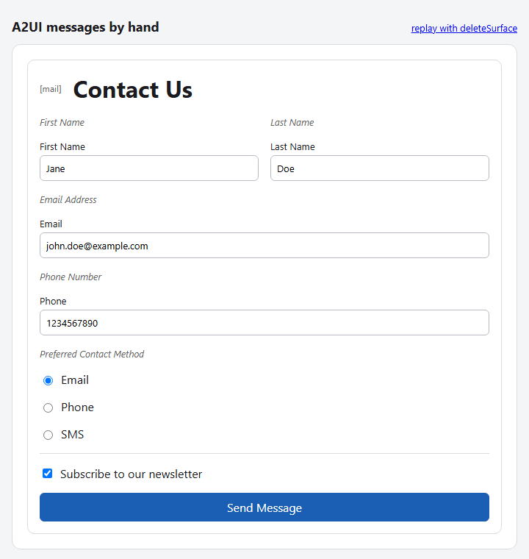
STEP 03.1 · QUICK DEMO
The spec's contact form: 4 messages, 25 components, 0 missing refs, one repaired rule set
25
components in the map after updateComponents, missing refs 0
3
check rules repair_checks rewrote so the spec's own stream validates
The second message fails the spec's own schema at /updateComponents/components/14/checks/0: condition is required.
After updateDataModel the page shows 8 inputs, first name John, newsletter box checked.
Clicking Send Message produces a submitContactForm action with its context resolved at click time.
deleteSurface leaves 0 surfaces on the page; nothing else was ever stored there.
Checkpoint: reorder contact_form.jsonl so a child precedes its parent. The page renders the same form; the map ignores order.
48
Notes:
The recorded demo replays the four messages from the A2UI v0.9.1 protocol document, unchanged. The first surprise is that message two does not validate: the TextField checks are written in a shape the CheckRule schema does not accept, and the error path is a JSON Pointer into the message. That path format is what the spec asks a client to send back so a model can correct itself; step 03.2 relies on it. After repair, the map holds 25 components with no missing references. The browser shows eight inputs with the data model's values, and a click yields an action whose context was read from the data model at that moment, including isNewsletterSubscribed true.

Slide 49
STEP 03.2 · LEVEL 9 OF 23 · DECLARATIVE GENERATION · YOUR OWN PRODUCT
Prompt-first: the catalog rides in the prompt, so a loop has to check the output
Nothing constrains the model at generation time; the protocol pairs the prompt with a generate, validate, correct loop.
prompt
role + workflow rules + catalog schema
DirectJsonFormat renders the Basic Catalog schema into the system prompt.
DirectJsonStreamParser yields updateComponents as soon as a component is reachable from root.
Children not seen yet become empty loading_<id> rows, so the page never has a missing ref.
The full parser repairs small faults such as trailing commas and validates each block.
On failure the partial surfaces are deleted and the error becomes the next user turn, once.
The report calls this the cost of the declarative middle: someone has to check.
stream parser
progressive updateComponents
full parser + repair
runs on the finished reply
validate
each block against the catalog
correction turn
the validator's text, back to the model
Streaming is an optimisation on top of the validated result, never a replacement for it.
Takeaway Prompt-first generation is cheap to build and costs a full catalog schema per request, plus a second request whenever validation fails.
49
Notes:
Level 9. Step 03.1 replayed messages written by people; now the model writes them. A2UI v0.9 is prompt-first: the whole catalog schema goes into the system prompt and the model writes JSON that should match. Nothing enforces that at generation time, so the protocol pairs the prompt with a loop. Walk the diagram left to right. The stream parser paints while the model is still writing, standing an empty loading row in for children it has not seen. When the reply is complete, the full parser repairs and validates. If that fails, every surface the stream created is withdrawn and the validator's message goes back to the model as a user turn. The recorded run needed one attempt; the tests force the second.

Slide 50
STEP 03.2 · CODE WALKTHROUGH
The SDK gives three things: a prompt, a stream parser and a full parser
1 def system_prompt():
2 """Role text, the SDK's workflow rules, then the full JSON schema of the catalog."""
[1] return inference_format().prompt_generator.generate(role_description=ROLE, include_schema=True)
4
5
6 def stream_parser():
7 """Feed model text chunks in; get A2UI messages out as soon as they are usable."""
[2] return DirectJsonStreamParser(inference_format()._supported_catalogs[0])
1
include_schema=True puts the full Basic Catalog JSON schema in the prompt: 41,083 characters before the user types.
03_a2ui/step_02_a2ui_from_a_model/prompt.py
2
The stream parser is fed model chunks and yields messages as soon as they are usable. It does not repair.
parse_reply() is the third piece: it runs the full parser on the finished text and raises with the validator's message when the reply cannot be made valid.
50
Notes:
prompt.py wraps the a2ui-agent-sdk package. system_prompt builds the role paragraph, the SDK's own workflow rules, root first, parents before children, blocks in a2ui-json tags, and then the JSON schema of the entire catalog. That is where the 41 thousand characters come from, and why the request cost 9,929 prompt tokens before a word of user input. stream_parser returns a fresh DirectJsonStreamParser per attempt. It heals cut strings and re-sends components as they grow, but it does not repair syntax; a trailing comma stops it. The full parser, behind parse_reply, does repair and does validate, which is why the final pass always runs even when the progressive pass gave up.

Slide 51
STEP 03.2 · CODE WALKTHROUGH
The correction loop: withdraw what streamed, hand the error back, try once more
1 text = "".join(reply)
2 try:
[1] messages, prose = prompt.parse_reply(text)
4 except ValueError as error:
5 yield "note", {"attempt": attempt, "error": str(error)[:300]}
6 for surface_id in created:
[2] yield mirror(envelope.delete_surface(surface_id))
8 conversation += [{"role": "assistant", "content": text},
[3] {"role": "user", "content": f"The reply failed validation. Fix it and send the complete reply again.\n{error}"}]
10 continue
1
The full parser runs on the finished reply. This is the validated result the page will keep.
2
Every surface the stream created is deleted first. The page must not keep a half-rendered, invalid form.
03_a2ui/step_02_a2ui_from_a_model/server.py
3
The validator's message becomes the next user turn, and the loop goes round once more; ATTEMPTS is 2.
Before this block, the same loop fed each chunk to the stream parser and yielded its updateComponents messages straight to the page.
51
Notes:
This is the except branch of the generate loop, the part the README asks the reader to look at. When the finished reply fails the full parser, three things happen in order. First a note goes to the page with the error text. Then, for every surface the streaming pass created, a deleteSurface is sent, so the user is not left with a partially painted form that the server knows is wrong. Then the failed reply and the validator's message are appended to the conversation as an assistant turn and a user turn, and the for loop continues to attempt two. That second attempt costs another ten thousand prompt tokens, which is the price the report attaches to the declarative middle.

Slide 52
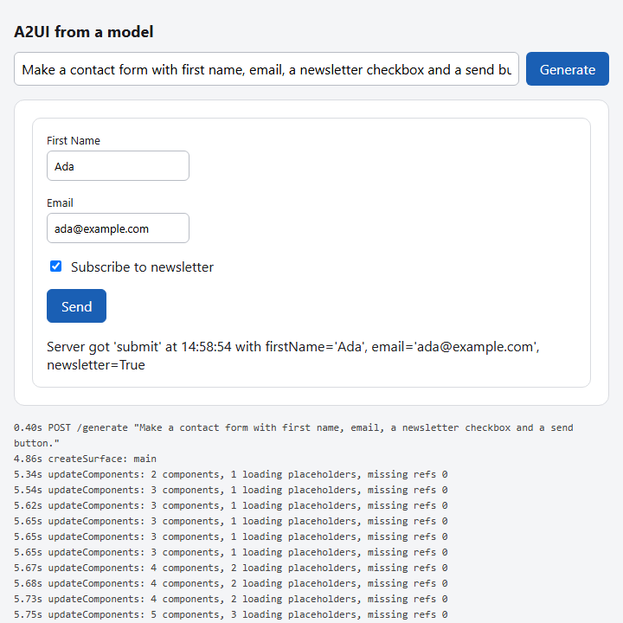
STEP 03.2 · QUICK DEMO
createSurface at 4.86s, 38 progressive updates, the final form at 10.81s, one attempt
9,929
prompt tokens on gpt-4.1-mini; 600 completion tokens
38
progressive updateComponents messages before the final one
The POST went out at 0.40s; createSurface arrived at 4.86s; the final updateComponents at 10.81s.
The click at 11.00s posted {firstName: Ada, email: ada@example.com, newsletter: true}; the status Text showed the server's reply.
Many of the 38 messages are the same components again: the stream parser re-sends a component each time a cut string heals.
Checkpoint: a custom catalog with fewer components is the usual answer to the 41K-character prompt.
52
Notes:
The numbers to read out. The system prompt is 41,083 characters, about 9.9 thousand tokens, on every request. The first message reached the page four and a half seconds after the POST, and 38 progressive updateComponents messages painted the form before the final validated one at 10.81 seconds. One attempt was enough; no correction turn ran. Then the round trip: typing changed only the local data model, the click resolved the Button's context from it and posted the action, and the server answered with one updateDataModel into the status path its mirror found. Ask the room why so many of the 38 are duplicates; the answer is that the SDK heals cut strings and re-sends.

Slide 53
STEP 03.3 · LEVEL 10 OF 23 · DECLARATIVE GENERATION · YOUR OWN PRODUCT
A2UI is a generation format and AG-UI is a transport; one CUSTOM event joins them
Each layer stops where its vocabulary ends: A2A moves messages between agents, AG-UI moves runs to a browser, A2UI names components.
A2A
agent to agent: A2UI messages as parts of A2A messages
AG-UI does not know what a surface is; A2UI does not know what a run is.
Every A2UI envelope becomes the value of one CUSTOM event named a2ui.
Correction attempts become STEP_STARTED and STEP_FINISHED; usage rides in RUN_FINISHED.
A click is a second run; the action and the client data model travel in forwardedProps.
The official @a2ui/lit renderer replaces render.mjs: markdown Text and catalog functions run.
This step has no second agent, so A2A is not on the wire; its slot is where run() reads the last user message.
AG-UI
agent to browser: a run, ordered events, forwardedProps
A2UI
the four envelope messages and the catalog
The report's stack. Nothing in A2UI changes to ride AG-UI, and nothing in AG-UI changes to carry it.
Takeaway Transport and generation format are separate choices; one AG-UI event type carries the whole A2UI protocol.
53
Notes:
Level 10, the top of this sub-theme. The report separates where the UI appears from what the agent emits, and this step shows the two side by side. AG-UI, from sub-theme 02, is the transport: a run with a thread id, ordered events on one stream, and forwardedProps for whatever the application must carry. A2UI is the generation format. The join is a single CUSTOM event whose value is one envelope. The diagram nests the report's full stack; A2A would sit outside when a second agent exists, and here its slot is the point where the server reads the last user message. The other swap is the renderer: the official Lit package, which renders markdown and runs catalog functions.

Slide 54
STEP 03.3 · CODE WALKTHROUGH
On the page, the join is one case in the event switch
1 function onEvent(event) {
2 switch (event.type) {
3 case 'CUSTOM':
[1] if (event.name === 'a2ui') {
[2] processor.processMessages([event.value]);
6 const kind = Object.keys(event.value).find((k) => k !== 'version');
7 const count = event.value.updateComponents?.components.length;
8 note(`CUSTOM a2ui ${kind}${count ? ` (${count} components)` : ''}`);
9 } else {
[3] note(`CUSTOM ${event.name} ${JSON.stringify(event.value).slice(0, 120)}`);
11 }
12 break;
1
A CUSTOM event named a2ui is the whole join. Its value is one A2UI envelope, handed to the official MessageProcessor.
2
processMessages is @a2ui/web_core's state machine; A2uiSurface elements re-render from signals, nothing is torn down.
03_a2ui/step_03_a2ui_lit_and_ag_ui/src/page.mjs
3
Other CUSTOM names, such as a2ui.note, are logged. AG-UI carries them without knowing what they mean.
The processor was built once over the Lit Basic Catalog, with an alias so the spec's v0_9_1 catalog id resolves to the v0_9 registration.
54
Notes:
This is the page side of the join. The AG-UI client in agui.mjs splits SSE frames and calls onEvent for each event. The switch has cases for RUN_STARTED, STEP events, TEXT_MESSAGE_CONTENT for the model's prose, and this one. When a CUSTOM event named a2ui arrives, its value goes straight to the processor from @a2ui/web_core, the same object the official renderer uses. No translation, no wrapper. The rest of the case is logging for the demo. Point out what the official renderer does that step 03.1's painter did not: Text renders markdown through an injected renderer, catalog functions such as required and formatDate run, and typing writes into web_core's own DataModel.

Slide 55
STEP 03.3 · CODE WALKTHROUGH
On the server, one function maps the loop's (kind, payload) pairs onto AG-UI event classes
1 def to_events(agent_input, pairs):
2 """Map the loop's (kind, payload) pairs onto AG-UI event objects."""
3 ids = dict(thread_id=agent_input.thread_id, run_id=agent_input.run_id)
4 yield RunStartedEvent(**ids)
5 for kind, payload in pairs:
[1] if kind is None:
7 yield CustomEvent(name="a2ui", value=payload)
8 elif kind == "note":
9 yield CustomEvent(name="a2ui.note", value=payload)
[2] elif kind == "step":
11 step = StepStartedEvent if payload["started"] else StepFinishedEvent
12 yield step(step_name=f"attempt {payload['attempt']}")
1
kind is None is an A2UI envelope: it becomes the value of a CustomEvent named a2ui.
2
Attempts of the correction loop become AG-UI steps, so a client can show 'attempt 2' without reading A2UI.
03_a2ui/step_03_a2ui_lit_and_ag_ui/server.py
Below this, text becomes a TEXT_MESSAGE triple, error a RUN_ERROR, and done a RUN_FINISHED whose result carries the usage. EventEncoder writes the frames.
55
Notes:
The server side of the join. The generate loop from step 03.2 is unchanged except that it now yields step, text, done and error kinds alongside the envelopes. to_events wraps the whole thing: a RunStartedEvent first, then one AG-UI event per pair. An envelope, kind None, becomes a CustomEvent named a2ui. A step pair becomes StepStarted or StepFinished with the attempt number as the step name. Prose becomes a text message triple, and done becomes RunFinished with the token usage in its result. The endpoint validates the body with RunAgentInput and writes each event with EventEncoder. The ag-ui-protocol package, not hand-written SSE lines, owns the wire.

Slide 56
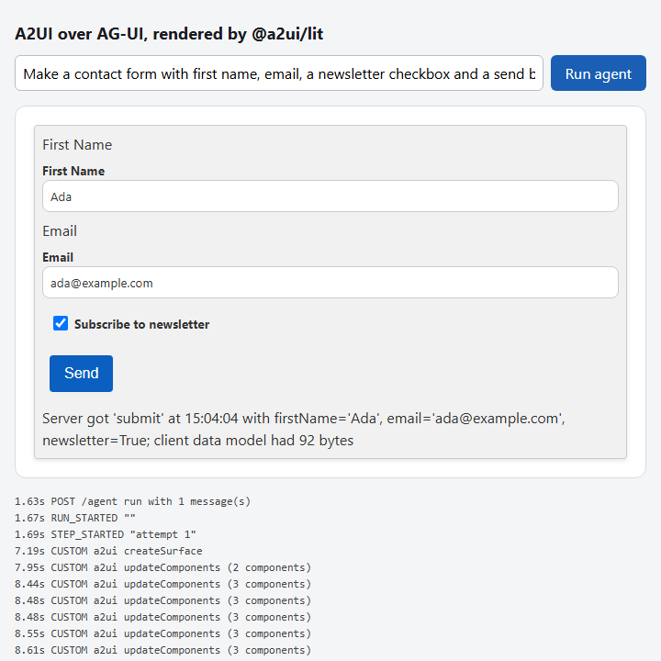
STEP 03.3 · QUICK DEMO
The same form drawn by @a2ui/lit 0.11.0, fed by 54 CUSTOM a2ui events between RUN_STARTED and RUN_FINISHED
54
CUSTOM a2ui updateComponents events before RUN_FINISHED at 15.64s
9,929
prompt tokens; 686 completion tokens, reported in RUN_FINISHED.result
The run started at 1.63s; createSurface arrived at 7.19s; STEP_STARTED and STEP_FINISHED bracket attempt 1.
The click at 15.78s sent a second run; RUN_FINISHED for it came at 15.81s with {answered: submit}.
The Text reading # Contact Us is a heading here; in step 03.1 it was raw text. The official renderer renders markdown.
Checkpoint: compare a Text reading # Contact Us here and in step 03.1. The official renderer renders markdown and runs catalog functions; the hand renderer did neither.
56
Notes:
The recorded page. Same prompt as step 03.2, same generate loop, two swaps. The renderer is the official Lit package, so the heading is a real heading and the catalog's validation functions run. The transport is AG-UI: the run started at 1.63 seconds, createSurface arrived at 7.19, and 54 CUSTOM updateComponents events followed before RUN_FINISHED at 15.64 with the usage in its result. Over fifty events for one form is the SDK's stream parser re-sending reachable components as strings heal; the Lit renderer absorbs them because MessageProcessor updates a component in place. The click became a second run carrying the action and a 92-byte client data model in forwardedProps.

Slide 57
STEP 03.3 · QUICK DEMO · THE WIRE OF AN ACTION RUN
A click's whole answer is three lines: RUN_STARTED, one CUSTOM a2ui event, RUN_FINISHED
click -> 15.78s action submit from sendButton
{"firstName":"Ada","email":"ada@example.com","newsletter":true}
15.81s RUN_FINISHED {"answered":"submit"}
wire of an action run (POST /agent), one AG-UI event per data: line:
data: {"type":"RUN_STARTED","threadId":"t1","runId":"r2"}
data: {"type":"CUSTOM","name":"a2ui","value":{"version":"v0.9.1",
"updateDataModel":{"surfaceId":"main","path":"/form/status",
"value":"Server got 'submit' at 15:04:04 with firstName='Ada', ...
data: {"type":"RUN_FINISHED","threadId":"t1","runId":"r2",
"result":{"answered":"submit"}}
3
AG-UI events in the action run, answered in 0.03s
The action and the client data model arrived in forwardedProps; AG-UI has no message type for them.
The answer is one updateDataModel into /form/status, the path the server's mirror found the status Text bound to.
One threadId for the page, a new runId per generation or click. A surface lives across runs until deleteSurface.
The status Text read: Server got 'submit' at 15:04:04 with firstName='Ada', email='ada@example.com', newsletter=True; client data model had 92 bytes.
57
Notes:
End on the wire, because it is the proof of the takeaway. A click on the official renderer resolves the Button's context, and the page starts a second AG-UI run with the action and its client data model in forwardedProps. The server routes that run to answer_action without a model call and replies with three frames: RUN_STARTED, one CUSTOM a2ui event carrying an updateDataModel into the status path, and RUN_FINISHED with the answered action name. Nothing in AG-UI changed to carry A2UI, and nothing in A2UI changed to ride AG-UI. The thread id is the page's; the run id is new per click. That is the AG-UI unit, and an A2UI surface outlives it.

Slide 58
Sub-theme 04 · Levels 11 to 14 of 23
OpenUI Lang, the line-oriented format
This sub-theme is about generation, not transport. OpenUI Lang is the language the report places in the declarative middle of its spectrum and measures as the most token-efficient open format: one statement per line, id = Component(args), positional arguments, references allowed before their definition. Sub-theme 01 streamed a JSON element map and paid for every key and bracket; this sub-theme replaces the JSON with the language, builds the parser by hand, swaps in the real packages, recomputes the report's token table cell by cell, and builds the report's hybrid on OpenUI's own reference implementation.
04.1 OpenUI Lang, parsed by hand
04.2 lang-core and react-lang
04.3 The token benchmark, reproduced
04.4 OpenUI's html artifact
58
Notes:
Four steps, one language. The first step writes a parser for the core of OpenUI Lang twice, in Python and in JavaScript, with a catalog as plain JSON Schema and a DOM renderer that draws forward references as skeletons. The second step replaces all of that with the official packages: a Zod catalog generates the prompt, the parser's parameter map and the React renderers from one source. The third step has no page at all; it recomputes the report's benchmark on the seven scenarios and says which numbers reproduce. The fourth step adds one open-ended component to the catalog, on OpenUI's html-artifact example, and measures what that escape hatch costs when the model takes it.

Slide 59
STEP 04.1 · LEVEL 11 OF 23 · DECLARATIVE GENERATION · YOUR OWN PRODUCT
One statement per line, positional arguments, forward references: the layout paints first
A JSON tree cannot render until its closing bracket arrives. An OpenUI Lang program is renderable after its first line.
root = Stack([title, kpis, chart])
title = Text("Week 37", "heading")
kpis = Stack([revenue, cups], "row")
revenue = Metric("Revenue", "$482")
cups = Metric("Cups sold", 241)
chart = BarChart("Cups", days, [..])
days = ["Mon", "Tue", "Wed"]
title
A newline outside brackets and strings ends a statement; the parser acts on every complete line.
Text("...", "heading") has no key names; the catalog's property order names the arguments.
root names chart five lines before chart is defined; the resolver turns a missing name into a placeholder.
The renderer draws a placeholder as a grey skeleton box, so the layout appears and fills in top-down.
The resolver is re-run on every pushed line, never patched; a half-written line is held back, not guessed at.
Two parsers, Python for the tests and JavaScript for the page, produce byte-identical trees.
revenue
waiting for its statement
cups
waiting for its statement
chart
waiting for its statement
A shortened program after three lines: the Stack and the title are drawn, three names wait for their statements.
Takeaway One statement per line, positional arguments and forward references are the whole design; the catalog, not the parser, names the arguments.
59
Notes:
Level 11. Step 01.2 measured that a flat element map paints before a nested tree does. OpenUI Lang keeps that property and drops the JSON around it. Three rules carry the design. A newline outside brackets ends a statement, so every complete line is actionable. Arguments are positional, so the model never writes a key name; the catalog's property order supplies them. And a reference may appear before its definition: the resolver returns a placeholder for a name with no statement yet, and the renderer draws it as a skeleton. The diagram shows the page after three lines: the layout exists, the title is drawn, and the metrics and the chart are grey boxes waiting for their lines. Nothing is patched; the whole buffer is re-resolved on every push.

Slide 60
STEP 04.1 · CODE WALKTHROUGH
A name with no statement yet becomes a placeholder, and the renderer draws that as a skeleton
1 def reference(name: str) -> object:
[1] if name not in program.statements or name in visiting:
3 unresolved.append(name)
[2] return {"type": "placeholder", "name": name}
5 visiting.add(name)
6 try:
7 result = value(program.statements[name])
8 finally:
9 visiting.discard(name)
[3] if isinstance(result, dict) and result.get("type") == "element":
11 result["statementId"] = name
12 return result
1
Two reasons to give up: the statement has not arrived, or the name is already on the stack, which is a cycle.
2
The placeholder is a real node in the tree. The page shows it as a grey box; unresolved lists its name.
04_openui_lang/step_01_openui_lang_parser/openui_parse.py
3
An element that came from a statement remembers its id, so the page can find the DOM node it produced.
The resolver walks from root. It runs again on every pushed line, so a placeholder is replaced the moment its statement arrives.
60
Notes:
This is the forward-reference mechanism in twelve lines. reference is called for every identifier the resolver meets. If the program has no statement for that name, or if the name is already being visited, which would be a cycle, the function records the name in unresolved and returns a placeholder node. Otherwise it resolves the statement's expression and, when the result is an element, stamps the statement id on it. There is no patching and no dependency graph: the streaming parser re-parses the whole buffer on every chunk, so a placeholder simply stops being produced once its line has arrived. The reference implementation caches completed statements; the behaviour is the same.

Slide 61
STEP 04.1 · CODE WALKTHROUGH
The parser never knows what "row" means; the catalog zips the positional arguments with names
1 def element(node: dict) -> object:
2 name = node["name"]
[1] if name not in catalog:
4 errors.append(f"unknown component {name}")
5 return None
6 params = catalog[name]
7 if len(node["args"]) > len(params):
8 errors.append(f"{name} takes {len(params)} arguments, got {len(node['args'])}")
[2] props = {param: value(arg) for param, arg in zip(params, node["args"])}
[3] return {"type": "element", "typeName": name, "props": props}
1
The catalog is a map from component name to its parameter names, read from the properties order in catalog.json.
2
zip pairs each positional argument with a parameter name. Change the order in the catalog and the same text renders differently.
04_openui_lang/step_01_openui_lang_parser/openui_parse.py
3
The element node carries a typeName and named props; the renderer keys one DOM function on the name.
Checkpoint: swap direction and gap under Stack in catalog.json and render program.oui again. The catalog, not the parser, names the arguments.
61
Notes:
The second return worth reading. A component call is a name and a list of positional arguments. The parser looks the name up in the catalog, which in this step is plain JSON Schema: one entry per component, and the order of its properties is the order of its arguments. Unknown names are errors; too many arguments are errors; then zip pairs what the model wrote with what the catalog expects, and the result is an element node with named props. The point of the checkpoint is that the same program text has no meaning on its own. Swap two properties in the catalog and the Stack that was a row becomes a column. In step 02 the Zod key order is that contract.

Slide 62
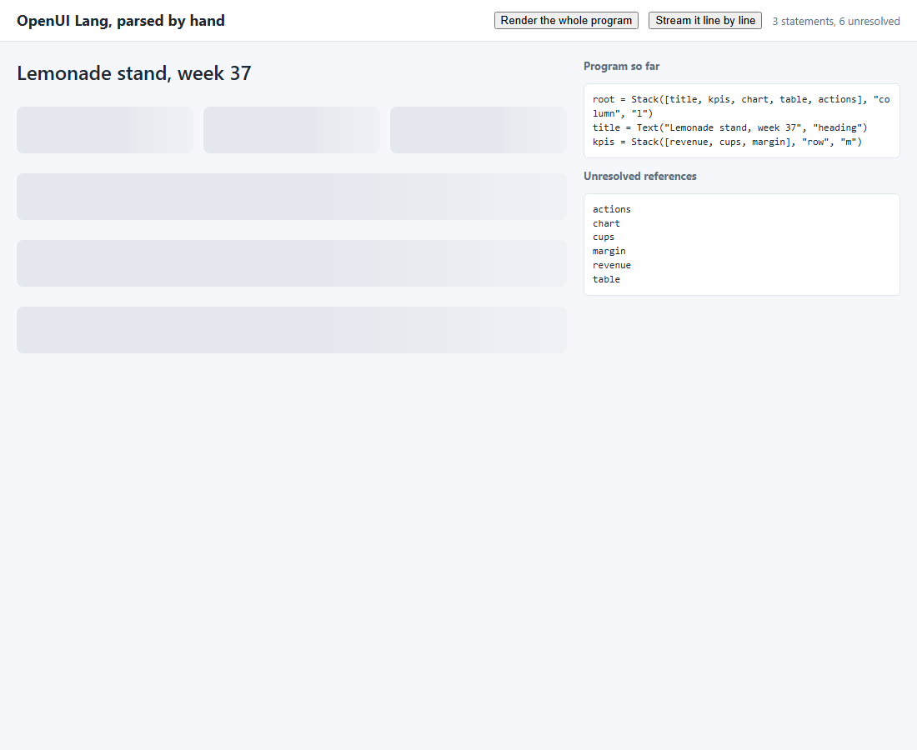
STEP 04.1 · QUICK DEMO
After three lines the title is drawn and six forward references are skeletons
5
names unresolved after line 1, and the layout already exists
6
skeleton boxes on the page after three lines
Line 1 is root = Stack([title, kpis, chart, table, actions], ...): five placeholders, one Stack.
Line 3 adds kpis with three more names; the count goes up before it comes down.
Each grey box is a placeholder node the resolver returned for a name with no statement yet.
Nothing in a JSON tree format is renderable at this point; the root object has not closed.
The recorded run streams program.oui one line per SSE message and re-renders after every push.
62
Notes:
The first screenshot is the whole argument for the format. Three lines in, the page has a Stack with a heading at the top and six grey boxes below it. The heading is real, the boxes are placeholders. The unresolved list on the right names them. Point at the shape: the reader can already see this is a dashboard with KPIs, a chart, a table and a card of actions, before any number has arrived. In step 01.2 the same moment in a nested JSON tree showed nothing, because the root object had not closed. The count of unresolved names goes up at line 3, when kpis introduces three more references, and then falls line by line.

Slide 63
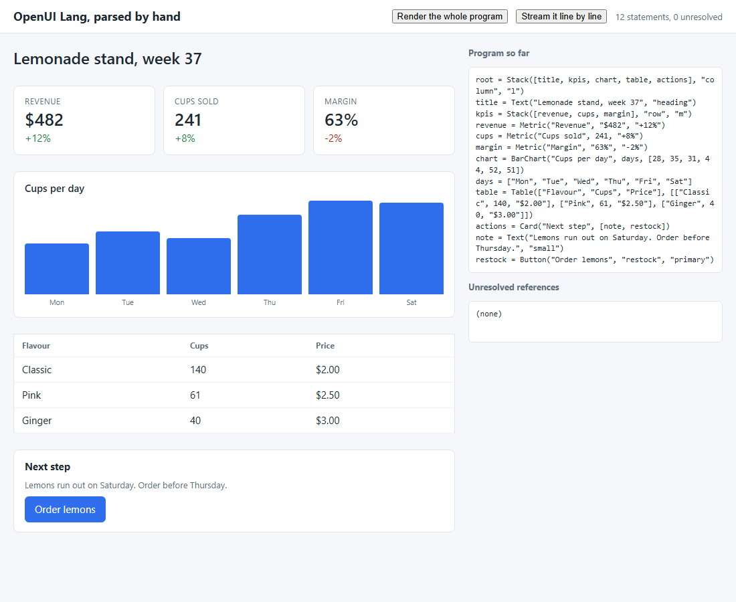
STEP 04.1 · QUICK DEMO
After the last line every skeleton has been replaced; both parsers agree byte for byte
12
statements parsed from program.oui
0
unresolved references and 0 errors after line 12
Line 7 references days one line before line 8 defines it; the chart is a skeleton for one line, then replaced.
kpis = Stack([revenue, cups, margin], "row", "m") has no key names at all; the catalog supplied them.
The Python and JavaScript parsers produce byte-identical trees for program.oui; test_step.py checks that.
The reference parser goes one step further and auto-closes the pending line so a half-written statement renders too.
Checkpoint: swap the order of direction and gap under Stack in catalog.json. The same text renders differently.
63
Notes:
The second screenshot is the finished page: twelve statements, no unresolved names, no errors. Two things to point at. First, line 7 uses days before line 8 defines it, so the chart spends one line as a skeleton and then fills in. That is the whole hoisting mechanism, and it costs nothing because the resolver is re-run rather than patched. Second, the tree that produced this page is the same, byte for byte, whether the Python or the JavaScript parser built it; the offline test diffs them. The checkpoint is about ownership: reorder two properties in the catalog, and the same program draws a column where it drew a row.

Slide 64
STEP 04.2 · LEVEL 12 OF 23 · DECLARATIVE GENERATION · YOUR OWN PRODUCT
One Zod catalog generates the prompt, the parser's parameter map and the renderers
Step 04.1 kept the catalog, the parser and the renderer in three files. The official packages derive all three from one source.
defineComponent()
a name, a description, a Zod props schema, a React function
defineComponent() takes a name, a description, a Zod props schema and a React function.
library.prompt() prints one signature line per component, in Zod key order, plus the language rules.
library.toJSONSchema() is the step 04.1 catalog shape; the streaming parser reads it to name the arguments.
<Renderer> from @openuidev/react-lang re-parses the accumulated text on every chunk and draws the catalog's components.
The server forwards every model delta as one SSE message and never parses the program itself.
React 19 ships CommonJS only, so esbuild bundles the page once; no config file, no dev server.
library.prompt()
one signature line per component, in Zod key order
createStreamingParser()
toJSONSchema() maps positional arguments to prop names
<Renderer>
the same React functions draw the element nodes
One definition, three uses. Add a component and the prompt, the parser and the renderer change together.
Takeaway In the declarative mode the catalog is code, not prose, and the model can only produce what the catalog allows.
64
Notes:
Level 12. The mechanism does not change; the contract around it does. In step 04.1 the catalog was a JSON file, the parser a separate module, and the renderer a third. Here all three come from the Zod schemas in library.mjs. defineComponent pairs a schema with a React function; createLibrary collects them with Stack as the root. library.prompt turns the schemas into signature lines, and the key order of each z.object is the positional argument order the model must use. The parser reads the same schemas as JSON Schema. So a ninth component added to library.mjs appears in the prompt, is accepted by the parser and is drawn by the renderer, with no other file touched. The one engineering detail is the bundler: react-lang imports bare specifiers and React 19 is CommonJS on npm, so esbuild runs once.

Slide 65
STEP 04.2 · CODE WALKTHROUGH
Three Zod keys become the signature line, the parameter map and the props the renderer receives
1 const Metric = defineComponent({
2 name: "Metric",
[1] description: "One number with a label and an optional change",
[2] props: z.object({
5 label: z.string(),
6 value: z.union([z.string(), z.number()]),
7 delta: z.string().optional().describe('such as "+12%"'),
8 }),
[3] component: ({ props }) =>
10 h("div", { className: "metric" },
11 h("div", { className: "label" }, props.label),
12 h("div", { className: "value" }, String(props.value)),
13 h("div", { className: `delta ${String(props.delta ?? "").startsWith("-") ? "down" : "up"}` }, props.delta ?? "")),
14 });
1
The description goes into the prompt after the signature. Text on a prop's .describe() does not; put what the model must know here.
2
Key order is argument order: Metric(label, value, delta?). The prompt, the parser and the renderer cannot disagree.
3
The React function receives { props } with names already mapped. It is React without JSX, so h is createElement.
04_openui_lang/step_02_openui_react_lang/library.mjs
The same object produces Metric(label: string, value: string | number, delta?: string) — One number with a label and an optional change in the prompt.
65
Notes:
One component, read three ways. The name and the description are what the model sees after the signature. The props schema is a z.object with three keys, and the order of those keys is the order of the positional arguments; that is the entire contract that keeps the prompt, the parser and the renderer aligned. The component function is plain React with createElement, because the page ships no JSX transform. Notice what is not shown to the model: the describe text on delta appears nowhere in the signature line, so anything an argument needs explained belongs in the component description or in the prompt's additional rules. The next slide shows what this object becomes in the prompt.

Slide 66
STEP 04.2 · CODE WALKTHROUGH
The system prompt is generated, not written: eight signature lines in Zod key order
1 ## Component Signatures
2
[1] Arguments marked with ? are optional. Sub-components can be inline or referenced; prefer refere…
4
5 Stack(children: any[], direction?: "column" | "row", gap?: "s" | "m" | "l") — Lays children out…
6 Text(text: string, size?: "small" | "body" | "heading") — A run of text
[2] Metric(label: string, value: string | number, delta?: string) — One number with a label and an …
8 Table(columns: string[], rows: (string | number)[][]) — A table with column headers and rows of…
9 BarChart(title: string, labels: string[], values: number[]) — A bar chart with one series
10 Card(title: string, children: any[]) — A bordered box with a title and children
11 Button(label: string, action: string, variant?: "primary" | "secondary") — A button that fires …
[3] Input(name: string, placeholder?: string, type?: "text" | "email" | "number") — A single-line t…
1
The library's own streaming advice: prefer references over inline calls, so the layout paints before its contents.
2
The Metric line from the previous slide. A ? marks an optional argument; optional arguments can be omitted from the end.
3
The whole prompt is 48 lines and 3163 characters; server.py caches it in prompt.txt and sends it as the system message.
04_openui_lang/step_02_openui_react_lang/prompt.txt
npm run prompt regenerates the file. Add a ninth defineComponent() and a ninth signature line appears, with no other file touched.
66
Notes:
This is the output of library.prompt, cached by the server. The signatures section is the part the catalog controls: one line per component, arguments in Zod key order, optional ones marked with a question mark, the description after the dash. Around it the library adds the syntax rules, the hoisting and streaming advice, and a final verification list, all fixed text. The streaming advice matters for step 04.3: the prompt asks the model to write root first and to prefer references over inline calls, because that is the order in which the page can paint. The checkpoint is the point of the step: add a component to library.mjs, run npm run prompt, and the new line is here.

Slide 67
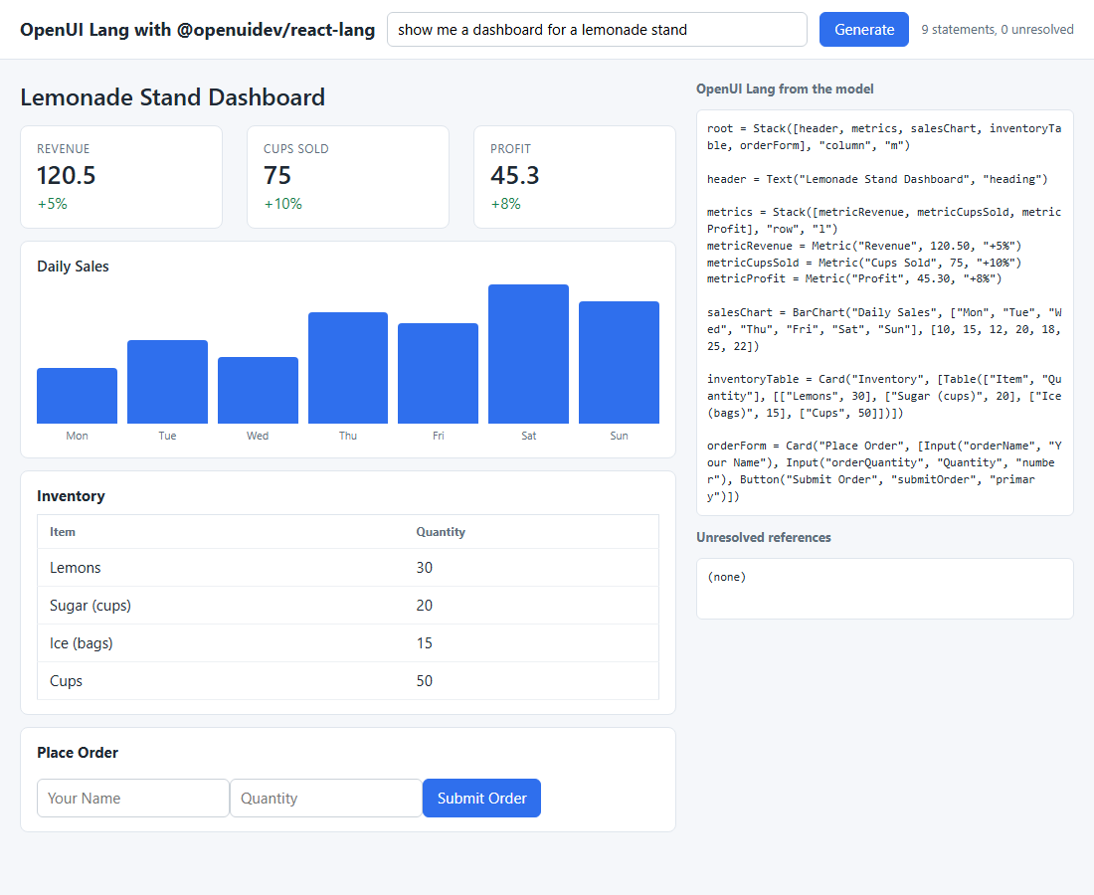
STEP 04.2 · QUICK DEMO
The model wrote 9 statements with 0 unresolved, and the catalog's React components drew them
48
lines, 3163 characters, in the generated system prompt
9
statements from gpt-4.1-mini for the lemonade-stand prompt, 0 unresolved
A heading, three metrics in a row, a seven-day bar chart, an inventory table inside a card, and an order form.
The model wrote an inline Table(...) inside a Card and left blank lines between groups; the parser accepts both.
parse.meta.errors carries codes such as unknown-component and missing-required; a production app would send them back as a repair turn.
Every delta is one SSE message; the page accumulates them in one string and hands it to <Renderer>.
Recorded with gpt-4.1-mini. The whole system prompt is in prompt.txt.
67
Notes:
The recorded run. The prompt asked for a dashboard for a lemonade stand and the model answered in OpenUI Lang: a root Stack, a heading, a row of three metrics, a bar chart with seven labels and seven values, a card with a table, and a card with two inputs and a button. Nine statements, none unresolved. Two things the model did that the prompt did not ask for: it put blank lines between groups, and it wrote the Table inline inside the Card rather than as a reference. The parser accepts both; the prompt only prefers references for better streaming. The page's status line reads the parse result's meta, which also carries error codes the app could send back to the model.

Slide 68
STEP 04.3 · LEVEL 13 OF 23 · MEASUREMENT
The report's token table, recomputed cell by cell: every one of the 28 numbers reproduces
Steps 04.1 and 04.2 asserted that the line-oriented syntax is cheaper than JSON. This step measures the claim on the report's own seven scenarios.
4800
9122
10180
samples/ holds the seven .oui programs the report's benchmark recorded and the 53-component schema.json.
convert.py projects each parsed tree into Thesys C1 JSON, json-render's element map and patch stream, and YAML.
All four texts are projections of one parsed tree, so syntax is the only variable.
Every text is counted with tiktoken's o200k_base; seconds are the token count at 60 tokens per second.
The projections are byte-identical to the OpenUI repository's committed artifacts; test_step.py checks that.
Not reproduced: the model run. The .oui samples are the ones the report generated; this step does not regenerate them.
tokens, OpenUI Lang, seven scenarios
tokens, YAML, the cheapest JSON-shaped format
tokens, json-render patches, the most expensive
28 of 28
3.04x
23%
per-scenario cells that match the report's table
contact form, complete render, patches over OpenUI Lang
cheaper: the element map without its patch envelope
Takeaway The ratio is stable near 2x because JSON pays per field; first paint is a different quantity and favours OpenUI Lang only when the program is written root-first.
68
Notes:
Level 13, and no page this time. The report's claim is that a line-oriented DSL is the most token-efficient declarative format because JSON pays for keys, quotes and brackets on every field. This step makes the sentence checkable. The seven scenario programs are the ones the report's benchmark generated; convert.py parses each one with the step 04.1 parser and writes the same tree out as C1 JSON, as json-render's element map and its patch stream, and as YAML, porting the yaml npm package's quoting and folding rules so the bytes match. tiktoken counts everything with o200k_base. Every total and every per-scenario cell reproduces. Two of the repository's committed files do not count like the table, which is worth a sentence: prettier reformatted the C1 files after the numbers were taken, and formatting alone moves C1 by up to ten percent.

Slide 69
STEP 04.3 · CODE WALKTHROUGH
One parsed tree, four texts: the projection is the whole experimental design
1 def projections(oui: str) -> dict[str, str]:
2 """The same UI in every format. The .oui text is the model's own output."""
[1] result = parse(oui if oui.endswith("\n") else oui + "\n", CATALOG)
[2] if result.root is None or result.unresolved or result.errors:
5 raise ValueError(f"sample did not parse cleanly: {result.unresolved} {result.errors}")
6 spec = to_spec(result.root)
[3] return {
8 "oui": oui,
9 "yaml": to_yaml(spec),
10 "c1": c1_text(result.root),
11 "jsonl": to_jsonl(spec),
12 "map": compact(spec),
13 }
1
The step 04.1 parser, copied unchanged, with the benchmark's 53-component schema as the catalog.
2
A sample that does not parse cleanly stops the run. Every scenario must be one complete tree before it is projected.
3
The .oui text is the model's own output; the other four are projections of its tree, which is also how the report produced them.
04_openui_lang/step_03_format_benchmark/benchmark.py
map is the element map as one compact document, a column the report does not have; it sits between OpenUI Lang and YAML.
69
Notes:
The function that makes the comparison fair. It parses the OpenUI Lang sample with the same parser step 04.1 wrote, using the benchmark's own schema for the argument names, and refuses any sample that leaves references unresolved. Then it returns five texts. The first is the sample itself, the model's actual output. The other four are projections of the tree it produced: YAML through a port of the yaml npm package's emitter, C1 JSON as the raw JSON.stringify text, the json-render patch stream with one add per element, and the element map as a single compact document. Because every text describes the same tree, the token counts differ only by syntax. The map column is extra; it isolates the cost of the patch envelope.

Slide 70
STEP 04.3 · CODE WALKTHROUGH
First paint is a different quantity: only OpenUI Lang has a renderable prefix
1 def first_paint_tokens(texts: dict[str, str]) -> dict[str, int]:
2 """Tokens that must arrive before a renderer can draw anything.
3
[1] OpenUI Lang: the first line (`root = ...`) is a complete statement.
[2] json-render patches: the `/root` patch names an element that arrives in
6 the last line (children are added before parents), so the whole stream.
7 C1 and YAML are one nested document: the whole text.
8 """
[3] first_line = texts["oui"].split("\n", 1)[0] + "\n"
10 return {"oui": count(first_line), "yaml": count(texts["yaml"]), "c1": count(texts["c1"]),
11 "jsonl": count(texts["jsonl"]), "map": count(texts["map"])}
1
root = Stack(...) is a complete statement on line 1. A renderer can draw the shell after those tokens.
2
The report's patch projection inserts children before parents, so the /root patch arrives last and first paint is the whole stream.
04_openui_lang/step_03_format_benchmark/benchmark.py
3
For C1 and YAML the count is the whole text: a nested document renders nothing before its last bracket.
The report's 3.04x is a ratio of complete-render times at a constant token rate. First paint favours OpenUI Lang far more, but only root-first.
70
Notes:
The report's latency figure, 3.04x on the contact form, is a ratio of complete-render times: 893 tokens against 294 at the same rate. This function measures something else, the tokens a renderer must have before it can draw anything. For OpenUI Lang that is the first line, because root = Stack is a complete statement. For C1 JSON and YAML it is the whole document, because a nested tree closes at the end. For the patch stream in the report's projection it is also the whole stream, because the children are added before their parents and the root patch is the last line. Sub-theme 05 shows json-render streaming root-first, where the patch shape pays off. The lesson is that first paint depends on statement order, which is why the step 04.2 prompt insists on root first.

Slide 71
STEP 04.3 · THE REPORT'S TABLE
OpenUI Lang totals 4800 tokens across seven scenarios; every JSON-shaped format is near 2x
Every cell of the report's table reproduces: the four totals and all 28 per-scenario numbers.
The savings column is nearly flat, 42.4% to 61.4% against YAML, because JSON pays per field, not per string.
YAML is the cheapest JSON-shaped format: it drops quotes and most brackets but still pays for every key name.
The patch stream is the most expensive: about 11 tokens of envelope per element, over 212 elements.
The committed .c1.json files were reformatted by prettier after the count and come out 10 to 94 tokens lighter than the table; the .oui and patch files count exactly as tabled.
71
Notes:
The totals, as the report printed them and as this step recomputes them. OpenUI Lang at 4800, YAML at 9122, Thesys C1 JSON at 9948, json-render patches at 10180. The interesting number is not the ratio but its flatness: the smallest scenario saves 53 percent against YAML and the largest 42, because the overhead of JSON is per field and scales with the UI rather than shrinking for big ones. YAML wins among the three JSON-shaped formats by dropping quotes and brackets, and still pays for every key name; OpenUI Lang drops the key names too because the catalog supplies them positionally. The patch stream pays one add envelope per element, about eleven tokens each.

Slide 72
STEP 04.3 · FIRST PAINT
At 60 tokens per second the contact form paints at 0.2 s in OpenUI Lang and after the whole document elsewhere
Only OpenUI Lang has a renderable prefix: root = Stack(...) is a complete statement on line 1.
C1 JSON and YAML are one nested document; nothing renders before the last bracket.
The report's patch projection inserts children before parents, so its /root patch is the last line.
Complete render: 4.9 s against 14.9 s for patches, the report's 3.04x.
First paint favours OpenUI Lang only when the program is written root-first; the generated prompt insists on it.
Seconds are token counts at a constant 60 tokens per second, the report's own convention; no model was timed.
72
Notes:
The same contact form, measured as time to first paint at the report's constant rate of 60 tokens per second. OpenUI Lang paints its shell after the first line, a fraction of a second in. The three other formats paint nothing until the whole document has arrived: 12.7 seconds for YAML, 14.2 for C1 JSON, 14.9 for the patch stream. Say clearly that this is not the report's 3.04x, which compares complete renders, 4.9 seconds against 14.9. First paint is a stronger claim and a more conditional one: it holds only when the model writes root first, which is exactly what the library's generated prompt asks for, and it does not hold for the patch stream as the report projected it, because that stream adds children before parents.

Slide 73
STEP 04.3 · QUICK DEMO
The table as printed: four totals, 28 cells, and the report's own numbers underneath
tokens (o200k_base)
scenario OpenUI YAML C1 JSON patches vs YAML
simple-table 148 316 357 340 -53.2%
chart-with-data 231 464 516 520 -50.2%
contact-form 294 762 849 893 -61.4%
dashboard 1226 2128 2261 2247 -42.4%
pricing-page 1195 2230 2379 2487 -46.4%
settings-panel 540 1077 1205 1244 -49.9%
e-commerce-product 1166 2145 2381 2449 -45.6%
TOTAL 4800 9122 9948 10180 -47.4%
report TOTAL 4800 9122 9948 10180
seconds at 60 tokens/s: complete (first paint)
contact-form 4.9 (0.2) 12.7 (12.7) 14.2 (14.2) 14.9 (14.9)
e-commerce-product 19.4 (0.2) 35.8 (35.8) 39.7 (39.7) 40.8 (40.8)
28 of 28
per-scenario cells equal to the report's table
-47.4%
OpenUI Lang against YAML in total; -51.7% against C1, -52.8% against patches
7873
tokens for the element map alone, 23% under the patch stream
The savings column runs from -42.4% (dashboard) to -61.4% (contact form): flat, because the overhead is per field.
Checkpoint: the map column is not in the report. The difference to patches is the {"op":"add","path":...} envelope, about 11 tokens per element over 212 elements.
python demo.py; the third table, not shown, counts the repository's committed C1 and YAML files as checked in and marks the cells that differ.
73
Notes:
The printed output, trimmed to the columns that matter. Read the TOTAL and report TOTAL rows first: they are equal in every column. Then the savings column, which is what the flatness argument rests on: the biggest UI saves the least, 42 percent, and the smallest form saves the most, 61, and neither is far from the total's 47. The seconds rows below show the two quantities side by side for two scenarios: complete render and, in brackets, first paint. The map column in the stats is the extra measurement this step adds: the element map as a plain document is 23 percent cheaper than the same map as a patch stream, and that difference is the envelope alone. The third table, which the slide omits, is where the two committed artifacts that do not match are listed.

Slide 74
STEP 04.4 · LEVEL 14 OF 23 · HYBRID GENERATION · YOUR OWN PRODUCT
The hybrid is one prompt rule and one component: catalog by default, an HtmlArtifact where the catalog does not reach
Step 04.2 gave the model a catalog and nothing else, so an interactive request had nowhere to go. This step builds the escape hatch on OpenUI's examples/miscellaneous/html-artifact reference implementation.
Text
HtmlArtifact
The catalog keeps the eight step 04.2 components and adds Markdown and HtmlArtifact(title, document).
Two prompt rules from the example: never put a dashboard into an HtmlArtifact; only use one when the user asks for something interactive.
The document is the second string argument of one statement; it streams like any other string, with no second endpoint and no tool call.
useIsStreaming() shows the raw source while the document grows, then Raw and Rendered tabs.
sandbox.mjs injects a Content Security Policy first in <head>, lists external resources, and accepts one message shape from the iframe.
The example defers the CSP, the document check and the message check to "before production"; this step does them.
catalog primitive
Metric
catalog primitive
BarChart
catalog primitive
sandboxed iframe with an injected CSP, only when the user asks for something interactive
Table
catalog primitive
Button
catalog primitive
The report's diagram on OpenUI's reference implementation: catalog primitives by default
Takeaway Open-ended generation took 86% of one reply, so the catalog is the default and the sandbox the exception.
74
Notes:
Level 14, the last of the sub-theme. The report's recommended default is a catalog with one open-ended component in it, and OpenUI ships a reference implementation of exactly that: the html-artifact example, with a Markdown component for conversation and an HtmlArtifact whose second argument is a whole HTML document. This step puts it on the step 04.2 stack with the real catalog kept, so a dashboard still renders as Metric, BarChart and Table. The mechanism is the same as the example's and there is nothing new on the wire: the document is a string argument inside one OpenUI Lang statement, so it streams like any other string, and the streaming parser exposes the partial value on every chunk. What the example leaves for production, the CSP, a validation pass and a message check, is done here.

Slide 75
STEP 04.4 · CODE WALKTHROUGH
useIsStreaming() decides between the raw source and the iframe; sandboxed() adds the CSP before srcDoc
1 function HtmlArtifactRenderer({ props }) {
[1] const isStreaming = useIsStreaming();
3 const [view, setView] = useState(isStreaming ? "raw" : "rendered");
4 useEffect(() => {
5 if (!isStreaming) setView("rendered");
6 }, [isStreaming]);
7
[2] isStreaming || view === "raw"
9 ? h("pre", { className: "artifact-raw" }, props.document)
10 : h("iframe", {
11 title: props.title,
12 className: "artifact-frame",
[3] sandbox: "allow-scripts",
14 referrerPolicy: "no-referrer",
15 srcDoc: sandboxed(props.document),
1
The library's own streaming flag, read through a hook. The renderer needs no prop from the page to know the document is still arriving.
2
While streaming, or on the Raw tab, a pre shows the document as it stands: the partial value grows on every chunk, not a spinner.
3
sandbox="allow-scripts" gives the document a unique origin and no access to the host; sandboxed() takes the network away too.
04_openui_lang/step_04_openui_html_artifact/html-artifact.mjs
The full component is 31 lines; the head, the tabs and the problems list are elided here. The Zod schema underneath is two strings: title and document.
75
Notes:
The renderer for the open-ended component, with its head and tabs elided. useIsStreaming comes from react-lang and tells the component whether the Renderer is still receiving text, so it needs no prop from the page. The view state starts as raw while streaming and flips to rendered when the stream ends. The ternary is the whole behaviour: while streaming, or when the reader picks the Raw tab, a pre shows the document as it stands; otherwise an iframe with sandbox allow-scripts, no referrer, and a srcDoc that has been through sandboxed. React renders through srcDoc, so a re-parse that leaves the document unchanged does not reload the frame. The Raw tab unmounts it, so the document's state resets on the way back.

Slide 76
STEP 04.4 · CODE WALKTHROUGH
The CSP goes first in <head>, and a policy the model wrote itself is removed before it can loosen ours
[1] export const CSP = "default-src 'none'; style-src 'unsafe-inline'; script-src 'unsafe-inline'; img-src data:";
2
3 export const META = `<meta http-equiv="Content-Security-Policy" content="${CSP}">`;
4
5 const CSP_META_RE = /<meta[^>]+http-equiv\s*=\s*["']?content-security-policy["']?[^>]*>/gi;
6
7 export function sandboxed(html) {
[2] const cleaned = html.replace(CSP_META_RE, "");
9 const head = /<head[^>]*>/i.exec(cleaned);
[3] if (head) return cleaned.slice(0, head.index + head[0].length) + META + cleaned.slice(head.index + head[0].length);
11 return META + cleaned;
12 }
1
default-src 'none': no fetch, no WebSocket, no external script or stylesheet. Inline style and script stay allowed because the prompt asks for them.
2
Any Content-Security-Policy meta the model wrote is stripped first, so the document cannot loosen the policy it is about to receive.
3
A CSP meta tag applies only to what comes after it: insert right after the opening <head>, or prepend when there is none.
04_openui_lang/step_04_openui_html_artifact/sandbox.mjs
checkDocument() lists external resources, network calls and meta refresh next to the artifact; isEvent() keeps one message shape from the iframe and drops the rest.
76
Notes:
The hardening the example's README defers. The example's iframe has sandbox and referrerpolicy only, so an inline fetch or a script src would still reach the network. This module closes that. The policy denies everything by default and allows inline style and script, because that is what the prompt tells the model to write, plus data URIs for images. sandboxed first strips any Content-Security-Policy meta the model produced, so the document cannot relax the policy, then inserts ours immediately after the opening head tag, or at the very start if there is no head. Two more functions in the same file: checkDocument, which reports external resources and network calls for the reader and the logs, and isEvent, the one message shape the page accepts from the iframe.

Slide 77
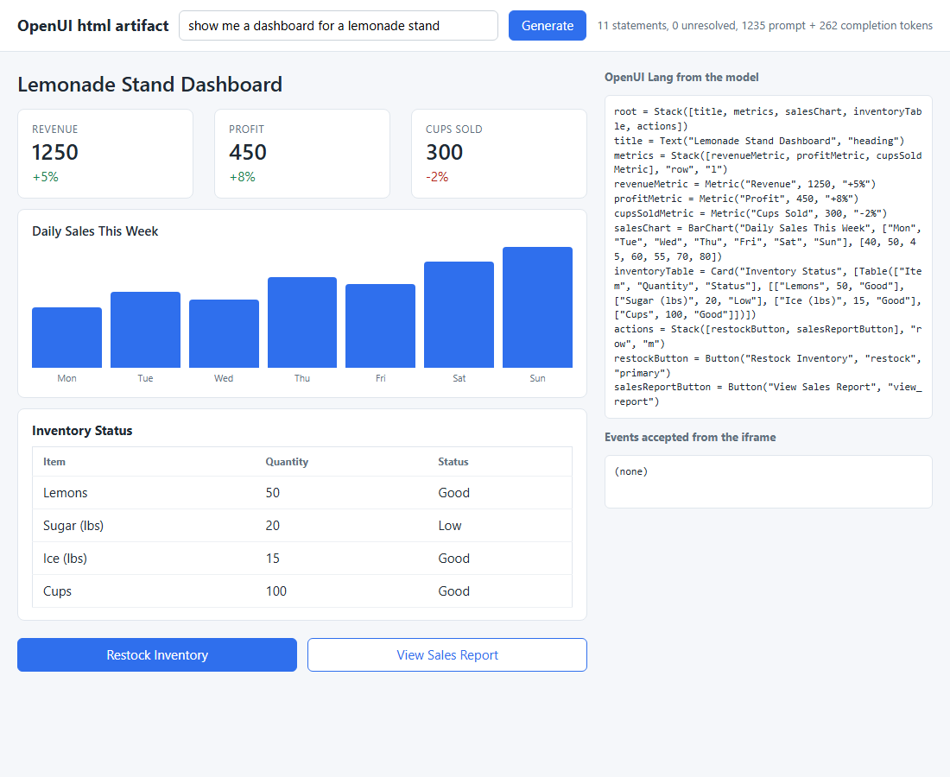
STEP 04.4 · QUICK DEMO
The dashboard prompt stays in the catalog: 11 statements, 262 completion tokens, no artifact
11
catalog statements for "show me a dashboard for a lemonade stand"
262
completion tokens, 1235 prompt tokens
Metric, BarChart, a Table inside a Card, and two Buttons in a row: the same components as step 04.2.
The rule that kept it here: "Never put a dashboard into an HtmlArtifact."
The completion token count from the API equals the o200k_base count of the program, so the token shares are exact.
Checkpoint: remove that rule from PROMPT_OPTIONS, ask again, and compare the completion tokens with 262.
Recorded with gpt-4.1-mini. The decision is the model's, steered by two prompt rules.
77
Notes:
First of the two recorded prompts. Asked for a dashboard, the model answered with eleven catalog statements: a heading, three metrics in a row, a bar chart, an inventory table inside a card, and two buttons. No Markdown, no artifact. 262 completion tokens against 1235 in the prompt. The point of this screenshot is what did not happen: the model had an open-ended component available and did not use it, because the prompt rule says dashboards belong to the catalog. The checkpoint is to delete that one rule and ask again; the completion token count is the measure of what the rule is worth. The API's completion count equals the tiktoken count of the program, which makes the shares on the next slides exact.

Slide 78
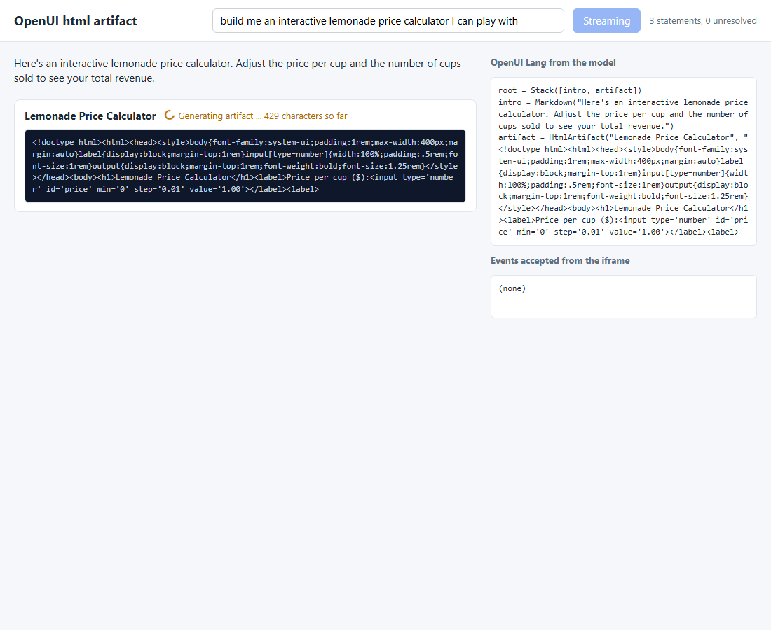
STEP 04.4 · QUICK DEMO
The calculator reply mid-stream: the Markdown intro rendered, the raw document growing
460
characters of the document at the moment of the screenshot
2
children of root: a Markdown, then one HtmlArtifact
The status line reads "Generating artifact ... 460 characters so far"; the pre below it is the partial value the streaming parser exposes.
parse.meta.incomplete is true for most of the stream, because the document is one string that has not closed.
The Markdown child arrived first, as the prompt rule asks, and is already rendered above the artifact.
No iframe exists yet: useIsStreaming() is true, so the renderer shows source, not a sandbox.
The prompt: "build me an interactive lemonade price calculator I can play with".
78
Notes:
Second prompt, caught mid-stream. The model introduced the reply with a Markdown child, which the prompt rule asks for and which is already rendered at the top. Below it the artifact shows its title, a status line with the character count so far, and the raw HTML as it stands. This is the property the step relies on: the document is one long string argument, the streaming parser exposes the partial value of that string on every chunk, and the renderer shows it. There is no spinner; the growing source is the progress indicator. No iframe has been created, because useIsStreaming is true. The Node test pins this behaviour by cutting the program inside the document and checking that the partial value ends where the cut was.

Slide 79
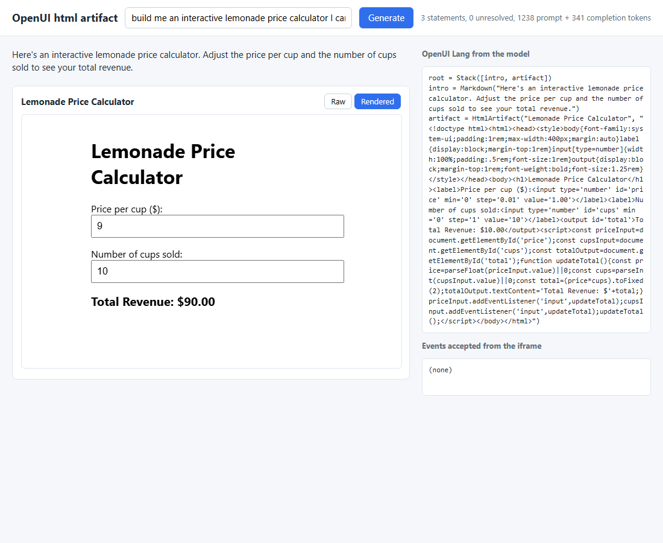
STEP 04.4 · QUICK DEMO
The calculator runs in its sandboxed iframe: typing 9 into the price field changed the total to $90.00
341
completion tokens for the calculator reply, 1238 prompt tokens
292
of those 341 tokens are the document: 86% of the reply
sandbox='allow-scripts', and the CSP meta is first in <head>: the document's script ran under the policy.
Events accepted from the iframe: none. The document posted nothing, and isEvent() would have dropped anything else.
The dashboard reply cost 262 tokens; open-ended generation is paid only for the one component that needs it.
The report's cost of open-ended generation, paid once: the catalog is the default and the sandbox the exception.
79
Notes:
The same reply once complete. The Rendered tab is active and the iframe shows the calculator; the headless test typed 9 into the price field inside the sandbox and the total moved from ten dollars to ninety, so the script ran under the injected policy. The numbers to leave the audience with: 341 completion tokens, of which the document took 292, 86 percent. The dashboard reply on the previous prompt was 262 tokens with no artifact. That is the report's hybrid in one pair of screenshots: open-ended generation is expensive, so the catalog answers by default and the sandbox is used only when the request needs it. Nothing crossed the iframe boundary; had the document posted a message, isEvent would have accepted one shape and dropped the rest.

Slide 80
Sub-theme 05
json-render, Vercel's declarative renderer
json-render is one of the open formats in the declarative middle of the report: the model emits a JSON document that names components from a catalog you wrote, and a renderer draws it. Sub-theme 01 built that loop by hand. This sub-theme hands the prompt, the parser and the renderer to the library: one defineCatalog object produces the system prompt, the typed component map, the validation and the JSON Schema. The spec is a flat element map that streams as RFC 6902 patches, and the same spec renders in a browser and in a terminal.
05.1 A catalog and the React Renderer
05.2 Streaming JSON Patch into the element map
05.3 Actions, and a second target
80
Notes:
Sub-theme 05 is the third open format in the declarative middle, after A2UI and OpenUI Lang. The difference from sub-theme 01 is not the idea but who does the work: the library. One catalog object with Zod props produces four things at once, and the spec shape is a flat map of elements addressed by id, which is what makes streaming and later edits cheap. Three steps: a whole spec painted once, the same spec streamed as patches, and then buttons that drive the next model turn plus a terminal renderer. Packages are pinned at 0.20.0 in every step.

Slide 81
STEP 05.1 · LEVEL 15 OF 23 · YOUR OWN PRODUCT
The catalog is the contract: one object, four outputs
defineCatalog with Zod props produces the prompt, the JSON Schema, the typed registry and the validator, and the page paints once when the whole spec arrives.
catalog.mjs
defineCatalog: six components, Zod props
Six components with Zod props; .nullable() marks a prop the model may skip and the prompt shows it as subtitle?.
​catalog.prompt() writes the system prompt; four extra rules ask for one JSON object instead of the library's native JSONL.
Python never imports the catalog: prompt.mjs and catalog_json.mjs run once and the text is cached in prompt.txt and catalog.json.
​spec.py checks the reply against that JSON Schema: unknown types, dangling child ids, wrong prop types.
​defineRegistry maps each entry to a React function written with htm; no JSX, no bundler, an import map of pinned esm.sh builds.
The spec is a flat element map {root, elements, state}, not a nested tree; elements name each other by id.
prompt.txt
catalog.prompt(), about 4,100 tokens
catalog.json and spec.py
JSON Schema; the Python check
registry.mjs
defineRegistry: one React function per entry
Change a prop in the catalog and three of the four outputs regenerate; only the registry needs a hand edit.
Takeaway One annotation in the catalog reaches three layers: the prompt, the JSON Schema and the Python check.
81
Notes:
This step gives the hand-built loop of sub-theme 01 to a library. The single idea to land is that the catalog is the contract. One object with Zod props produces the prompt the model reads, the JSON Schema the server checks against, the typed component map the page renders with, and the validator. Point at the diagram: the prompt and the schema are cached text files, so the Python server never runs Node at request time. Note the spec shape: a flat map of elements keyed by id. That shape looks odd now and pays off in the next step. The demo still paints once, after the whole object arrives.

Slide 82
STEP 05.1 · CODE WALKTHROUGH
Six components, Zod props, one description each
[1] export const catalog = defineCatalog(schema, {
2 components: {
3 Card: {
4 props: z.object({
5 title: z.string(),
[2] subtitle: z.string().nullable(),
7 }),
[3] description: "A titled container. Put related elements inside it.",
9 },
10 Row: {
11 props: z.object({
12 gap: z.enum(["small", "large"]).nullable(),
13 }),
14 description: "Lays its children out side by side.",
1
schema from @json-render/react/schema fixes the spec shape: {root, elements: {id: {type, props, children}}}.
2
.nullable() is the one annotation: the prompt shows subtitle?, the JSON Schema allows null, spec.py accepts it.
05_json_render/step_01_json_render_catalog/catalog.mjs
3
The description goes into the generated prompt word for word; it is the model's only guide to when to use the component.
The same file serves the prompt export, the JSON Schema export, the page and the Node tests.
82
Notes:
Read the file top down. defineCatalog takes the React schema and an object of components. Each component is a Zod props object and a description. Line 6 is the one to dwell on: nullable is a single annotation, and it shows up in three places, the prompt, the JSON Schema and the Python check. Line 8 matters more than it looks: the description is the whole of what the model knows about when to pick Card over Row. The four custom rules that follow in the file ask for one complete object; step 05.2 deletes them and streams.

Slide 83
STEP 05.1 · CODE WALKTHROUGH
The server checks the spec for the three faults a renderer fails on quietly
1 for element_id, element in elements.items():
2 kind = element.get("type")
[1] if kind not in components:
4 problems.append(f"{element_id}: unknown type {kind!r}")
5 continue
6 for child in element.get("children", []):
[2] if child not in elements:
8 problems.append(f"{element_id}: child {child!r} is not in elements")
[3] props = {k: v for k, v in element.get("props", {}).items() if not is_expression(v)}
10 expressions = set(element.get("props", {})) - set(props)
11 validator = jsonschema.Draft202012Validator(props_schema(components[kind], expressions))
12 for error in validator.iter_errors(props):
13 where = "/".join(str(p) for p in error.path) or "props"
14 problems.append(f"{element_id}: {kind}.{where}: {error.message}")
1
An unknown type: the catalog has no such component, so the renderer would draw nothing for that element.
2
A dangling child id: a parent names an element that is not in the map.
3
Expression props such as {"$state": ...} are set aside; the renderer resolves them before the component sees them.
05_json_render/step_01_json_render_catalog/spec.py
Python cannot run the Zod schema, so it validates against the JSON Schema catalog_json.mjs exported: two runtimes, one catalog.
83
Notes:
This is the validator output of the catalog, on the Python side. Three faults are checked because those are the ones a renderer fails on without an error: an unknown type, a child id that points nowhere, and a prop of the wrong type. Line 9 is the subtle one. The model may write a prop as an expression, a $state or $template reference, and the renderer resolves those before the component sees them, so the check skips them rather than failing on a string where it expected a number. The jsonschema validator runs the exported schema; catalog.validate does the same job in Node.

Slide 84
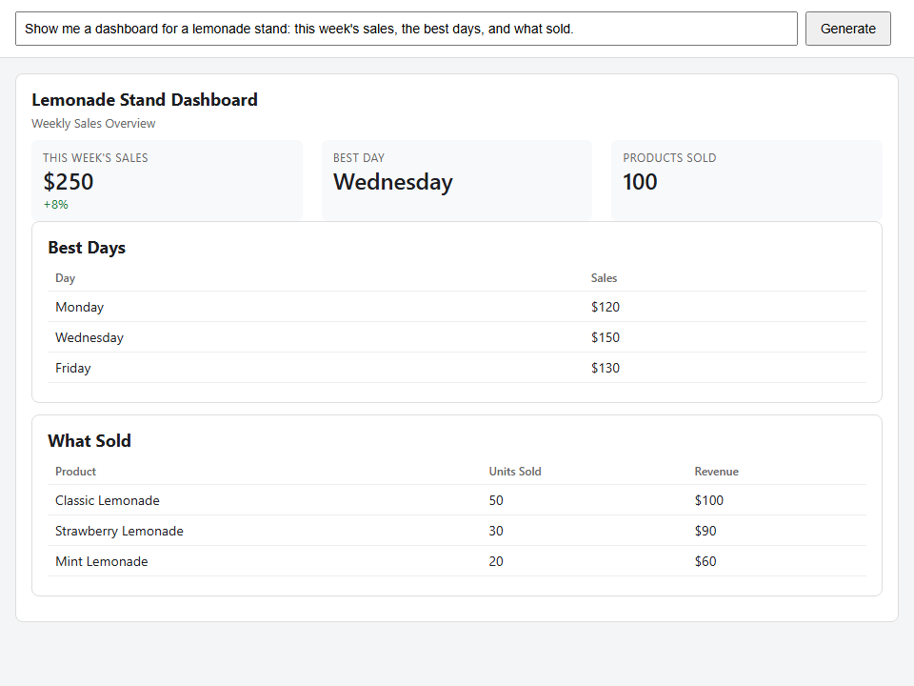
STEP 05.1 · QUICK DEMO
The whole dashboard arrived at 5.8 s and painted once
5.8 s
first paint, after the complete spec
9
elements in the spec
Three metrics in a row, then two cards with tables: the model's own layout from six components.
The three numbers live in state; the metrics read them with $state and $template props.
Nothing rendered before 5.8 s; the reply was 351 tokens, the prompt 4,109.
Most of the 4,100-token prompt is the library's text about state, repeats, events and visibility: the price of a general renderer.
84
Notes:
The recorded run. One request, one complete spec, one paint at 5.8 seconds. The picture is the lemonade dashboard the model composed from six components: a card, a row of three metrics, two cards with tables. Look at the token split: 4,109 in the prompt against 351 in the reply. The prompt is that long because the library describes its whole feature set, state, repeats, events, visibility, for six components. Sub-theme 04 measured the other side of that trade with a smaller DSL. Also note the model put numbers in state and referenced them from props, which the prompt suggests and the renderer resolves.

Slide 85
STEP 05.2 · LEVEL 16 OF 23 · YOUR OWN PRODUCT
A flat element map paints on its second line
The library's native format is one RFC 6902 patch per line; each element is a line complete on its own, so the page renders after every patch.
add /root
the root id, "dashboard"; nothing to draw yet
The four "one object" rules are gone; llm.py streams with no JSON mode, because JSONL is many objects.
The first line sets /root; the second adds the root element, and the page can paint.
A parent lists children that have not arrived; the renderer skips them until their line comes.
​json_patch.py mirrors the library's compiler with its two tolerances: add creates a missing parent, replace a missing target.
​server.py relays every chunk unchanged and compiles a copy, so it ends with the spec, the patches and the timings.
​app.mjs pushes each chunk into createSpecStreamCompiler; Renderer gets an empty element map until /elements exists.
add /elements/dashboard
a Card with a title: the page paints, first paint
add /elements/row-metrics
a Row the card already named as a child
add /elements/metric-sales
a Metric whose value is a $state reference
add /state/sales/total
the number the metric reads; it fills in on arrival
… 13 patches in all
9 elements; the last line may arrive without a newline
The element map fills one line at a time; every line is a complete JSON object with an op, a path and a value.
Takeaway Streaming changes when the user sees something, not the prompt cost: 4,043 prompt tokens, 487 completion tokens.
85
Notes:
Step 05.1 showed nothing until the whole object arrived. This step removes the four rules and uses the library's own format: JSON Patch, one operation per line. Walk the chips: the first line names the root, the second line adds the root element and the page paints. From then on each line is an element or a state value, and a parent may name a child that has not arrived yet. That property is why the report favours flat element maps over nested trees. The Python json_patch.py is a small RFC 6902 with the library's two tolerances so both sides build the same spec. Stress the takeaway: the prompt still costs 4,000 tokens.

Slide 86
STEP 05.2 · CODE WALKTHROUGH
Push each chunk into the compiler; render only when a patch applied
1 for await (const chunk of chunks(response)) {
[1] const { result, newPatches } = compiler.push(chunk);
3 if (newPatches.length === 0) continue;
4 // The first patch sets /root alone; Renderer reads spec.elements[spec.root]
5 // with no guard, so give it an empty map until /elements arrives.
[2] setSpec(result.elements ? result : { ...result, elements: {} });
7 if (firstPaint === null && result.root && result.elements?.[result.root]) {
8 firstPaint = seconds();
9 setStatus(`first paint at ${firstPaint} s`);
10 }
11 }
[3] setSpec(compiler.getResult()); // applies a last line that had no newline
1
push returns the spec so far and the patches this chunk completed; newPatches is empty while a line is still partial.
2
The first patch sets /root alone and Renderer has no guard for that, so the page hands it an empty element map.
05_json_render/step_02_json_render_streaming_patches/app.mjs
3
A stream may end without a newline; getResult() applies that last line.
result is a new object whenever a patch applied, so setSpec re-renders only on a real change.
86
Notes:
The page side of streaming in twelve lines. Chunks arrive at any boundary, mid-line included, so the compiler buffers and only reports patches for complete lines; the continue on line 3 skips renders when nothing new applied. Line 6 is a real edge the library does not cover: after the very first patch the spec has a root id and no elements map, and Renderer reads elements[root] without a guard, so the page supplies an empty map. The first-paint timestamp is taken when the root element exists. Line 12 handles the last line with no trailing newline, which the fixture in tests exercises: twelve in the loop, the thirteenth here.

Slide 87
STEP 05.2 · CODE WALKTHROUGH
The server forwards every chunk and compiles a copy on the way
1 def relay(prompt):
2 """Forward each chunk as it arrives, and compile a copy on the way."""
3 started = time.perf_counter()
4 stream = llm.stream_text(system_prompt(), prompt)
[1] compiler = SpecStream()
6 timings = {"first_chunk": None, "first_paint": None, "complete": None}
7 for chunk in stream:
8 if timings["first_chunk"] is None:
9 timings["first_chunk"] = time.perf_counter() - started
10 compiler.push(chunk)
[2] if timings["first_paint"] is None and compiler.has_root():
12 timings["first_paint"] = time.perf_counter() - started
[3] yield chunk
14 compiler.finish()
15 timings["complete"] = time.perf_counter() - started
1
SpecStream is the Python mirror of createSpecStreamCompiler: the same lines, the same two tolerances.
2
has_root() is the moment a first paint became possible; the demo compares it with the page's own timestamp.
05_json_render/step_02_json_render_streaming_patches/server.py
3
The chunk goes to the page unchanged; the server never re-encodes the model's text.
The server ends with the compiled spec, the patch list, the usage and three timings, all at GET /last.
87
Notes:
The server is a relay with a tap. Each chunk from the model goes straight to the page, and a copy goes into SpecStream, so when the stream ends the server holds the same spec the page built, plus the patches and the timings. Line 11 is where the server records when a first paint became possible: 3.46 seconds in the recorded run, against 3.48 on the page. Line 13 is the design decision: the server never reshapes the text, so what the page compiles is exactly what the model wrote. The tests compile one fixture with both compilers and assert the same spec.

Slide 88
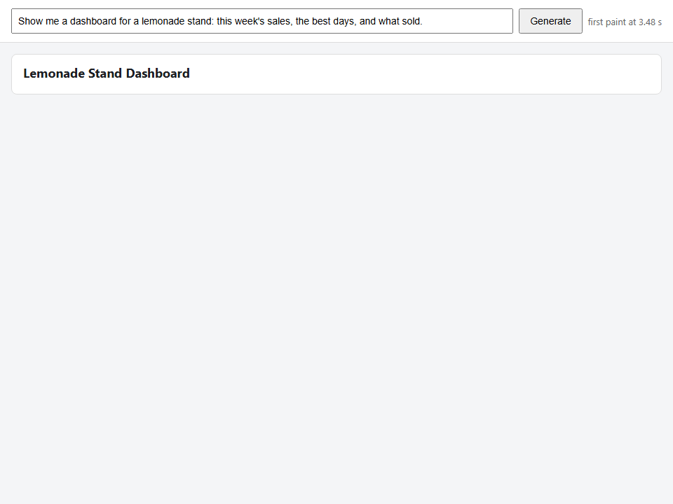
STEP 05.2 · QUICK DEMO, FIRST PAINT
At 3.48 s the page shows one card with a title and no children yet
3.48 s
first paint on the page
2.53 s
first chunk at the server
The status line reads "first paint at 3.48 s": the root Card has painted with its title alone.
The Card already names row-metrics as a child; the renderer skips it until its line arrives.
The 2.5 s before the first chunk is the model reading a 4,000-token prompt; no format removes that.
Step 05.1 showed nothing until 5.8 s; this page shows something 2.3 s earlier.
88
Notes:
The first of two screenshots from one run. At 3.48 seconds the page has one card and its title, and nothing else. That is the second patch line: the root id came first, then the root element. The card's children list already names elements that have not arrived, and the renderer simply draws nothing for them. The server saw the first chunk at 2.53 seconds, so about a second of the difference is the model writing the first two lines. The 2.5 seconds before that is prompt reading and is the floor for any format with a 4,000-token prompt.

Slide 89
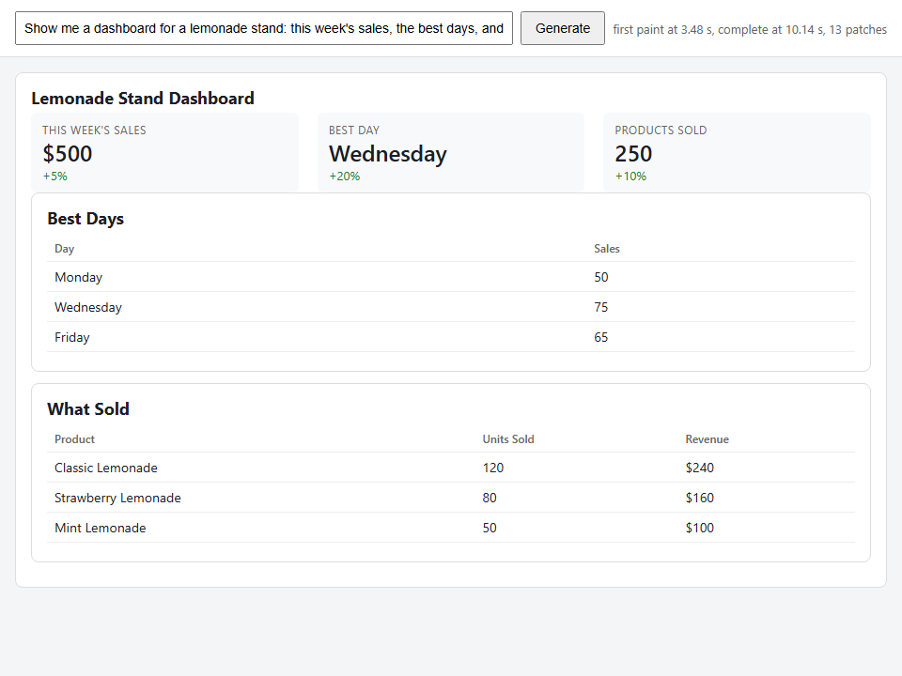
STEP 05.2 · QUICK DEMO, COMPLETE
The same page when the stream ends at 10.14 s, after 13 patches
10.14 s
complete on the page
13
patches, 9 elements
The status line now reads first paint 3.48 s, complete 10.14 s, 13 patches.
Three metrics filled in from /state/... patches; a fresh copy of spec.state per version is what lets them reach the store.
The catalog check passed on the compiled spec, the same check as step 05.1.
The whole reply took longer than step 05.1's 5.8 s; what changed is when the first element appeared.
89
Notes:
The end of the same run. Thirteen patches, nine elements, the same dashboard shape as step 05.1. The complete time, 10.14 seconds, is later than step 05.1's single paint, and that is worth saying out loud: streaming did not make the model faster, and runs vary with the model's speed. What it changed is that the user saw a card at 3.5 seconds and watched it fill. The metrics read state, and the page makes a fresh copy of spec.state per version because the state provider compares by reference. Token cost is unchanged: about 4,000 in, under 500 out.

Slide 90
STEP 05.1 VERSUS 05.2 · FIRST PAINT AND COMPLETE
One paint at 5.8 s, or a first element at 3.48 s and the last at 10.14 s
In step 05.1 first paint and complete are the same moment: nothing renders before the last bracket closes.
Streaming moved the first paint 2.3 s earlier and the last element 4.3 s later in this pair of runs.
Both runs paid about 4,000 prompt tokens; the reply was 351 and 487 tokens.
The 2.5 s to the first chunk is prompt reading and belongs to neither format.
Numbers from the recorded demos of steps 05.1 and 05.2; runs vary with the model's speed.
90
Notes:
Two bars per step. On the left, step 05.1: first paint and complete coincide at 5.8 seconds because a single JSON object cannot be rendered until it closes. On the right, step 05.2: the first element at 3.48 seconds and the last at 10.14. The honest reading is that streaming trades a later finish for an earlier start, and the user experience follows the start. The prompt cost is the same in both. Say clearly that these are single recorded runs, not averages; the point is the shape of the difference, not the exact seconds.

Slide 91
STEP 05.3 · LEVEL 17 OF 23 · YOUR OWN PRODUCT
A press is data the model answers with more data
A Button binds its press with an `on` field on the element; catalog actions go to the server for the next turn, setState stays in the page.
press
on.press: { action: "refresh_numbers" }
Two catalog actions, refresh_numbers and show_details, declared with Zod params; the model's press carries a typed metric.
The page maps each action to one handler: POST /action, then push the reply into the same compiler, kept in a ref.
​server.py keeps one transcript per session; a press becomes a user message that asks for patches against the spec already produced.
Built-in actions (setState, pushState, removeState) change the state model and never leave the page.
​spec.py now checks every on binding against the declared actions, before the page drops one with a console warning.
The loop the report describes: the model edits a document, and the document is the UI.
POST /action
the handler sends the name and params
one more model turn
appended to the session transcript
JSONL patches
replace on state paths, add for new elements
the spec on screen
the same compiler, the same ids
setState takes the short path: the page changes its state model and the server never hears about it.
Takeaway The compiler lives in a ref so the second turn's patches land on the spec the first turn built.
91
Notes:
Step 05.2 streams a spec and stops. This step closes the loop. A button element carries an on field that names an action; that is data in the spec, not code in props. Two kinds of action: built-in ones change state inside the page, catalog actions are names you declare and the page maps to handlers. Here every handler does the same thing, tell the server, run one more model turn, feed the reply into the compiler already holding the spec. Follow the diagram down. The server's user message asks for patches against the spec the model already produced, so the reply is small: replace values, keep ids.

Slide 92
STEP 05.3 · CODE WALKTHROUGH
Every catalog action is the same handler: post it, then compile the reply
1 async function serverAction(action, params) {
2 const started = performance.now();
3 note(`${action} ${JSON.stringify(params)} -> server`);
4 const response = await fetch("/action", {
5 method: "POST",
6 headers: { "content-type": "application/json" },
7 body: JSON.stringify({ action, params }),
8 });
[1] const patches = await consume(response);
[2] note(`${action}: ${patches} patches applied in ${((performance.now() - started) / 1000).toFix…
11 }
12
13 const handlers = {
[3] refresh_numbers: (params) => serverAction("refresh_numbers", params ?? {}),
15 show_details: (params) => serverAction("show_details", params ?? {}),
1
consume is shared with the first turn: it pushes the reply into the compiler in the ref and returns the patch count.
2
The action log under the dashboard in the demo is these note calls: name, params, patches, seconds.
05_json_render/step_03_json_render_actions_and_targets/app.mjs
3
Two catalog actions, two handlers, one function; params comes from the spec's on binding.
setState never reaches a handler; the page's onStateChange is the only trace it keeps of a built-in action.
92
Notes:
The handler side of the loop. serverAction posts the action name and its params to the server and hands the streamed reply to consume, the same function that compiled the first turn, so the patches apply to the spec on screen. The handlers object maps the two catalog actions to that one function. Line 16 is the design decision made visible: setState is handled by the library inside the page and no handler sees it; onStateChange exists only so the demo can log it. That is why the last press in the recorded demo shows as handled in the page and no request leaves the browser.

Slide 93
STEP 05.3 · CODE WALKTHROUGH
The second target: the same catalog, a component map of ink Box and Text
1 export const components = {
[1] Card: ({ element, children }) =>
3 h(Box, { flexDirection: "column", borderStyle: "round", paddingX: 1, marginBottom: 0 },
4 h(Text, { bold: true }, element.props.title),
5 element.props.subtitle ? h(Text, { dimColor: true }, element.props.subtitle) : null,
6 children),
[2] Row: ({ children }) => h(Box, { flexDirection: "row", gap: 2 }, children),
8 Metric: ({ element }) =>
9 h(Box, { flexDirection: "column", marginRight: 2 },
10 h(Text, { dimColor: true }, element.props.label.toUpperCase()),
11 h(Text, { bold: true }, String(element.props.value)),
12 element.props.delta ? h(Text, { color: "green" }, element.props.delta) : null),
13 Button: ({ element }) => h(Text, { color: "cyan" }, `[ ${element.props.label} ]`),
14 };
15
[3] export const InkRenderer = createRenderer(catalog, components);
1
The ink package hands components the whole element; the React one hands them props. The catalog and the spec are shared.
2
A Row is a horizontal Box; a Card is a bordered column. Layout words change, the spec does not.
3
createRenderer(catalog, components) wraps the providers; a state prop seeds the $state expressions.
05_json_render/step_03_json_render_actions_and_targets/ink_render.mjs
tests/targets.test.mjs renders one spec through both targets and checks that every text the page shows, the terminal shows.
93
Notes:
The second half of the step, and the reason to choose this format at all. The element map never mentions HTML, so a second component map is all a second target needs. Here it is written with ink's Box and Text. Line 2 shows the one API difference between the two packages: ink components receive the element, React components receive props. Everything else, the catalog, the spec, the state expressions, is shared. The test in the step renders one spec through react-dom/server and through a fake terminal and asserts every text appears in both; that is the one spec, two renderers claim as a test.

Slide 94
STEP 05.3 · ONE SPEC, TWO RENDERERS
One catalog, one spec, two component maps
The element map is data about components and state, not about a medium; each target supplies its own component map and nothing else changes.
catalog.mjs
seven components and two actions with Zod props; the prompt, the schema and the validator come from it
demo_spec.json
the spec after generate, refresh_numbers and show_details: root, elements, state, on bindings
registry.mjs in the browser · ink_render.mjs in the terminal
React functions with htm, or ink Box and Text; the json-render family also has React Native, Vue, Svelte, PDF and email
The same demo_spec.json produced the page screenshot and the terminal render on the next slides.
Takeaway Write the catalog once; add a target by writing one component map for it.
94
Notes:
This is the picture to leave people with for sub-theme 05. The outer layer is the catalog: the contract, from which the prompt, schema and validator are derived. Inside it, one spec, the one the recorded demo ended with after three model turns. Inside that, the two component maps: React with htm for the page, ink Box and Text for the terminal. The json-render family ships renderers for several more targets, and each one asks for exactly this, a component map per target. Nothing in the spec says div or Box. Next, the two renders of the same file.

Slide 95
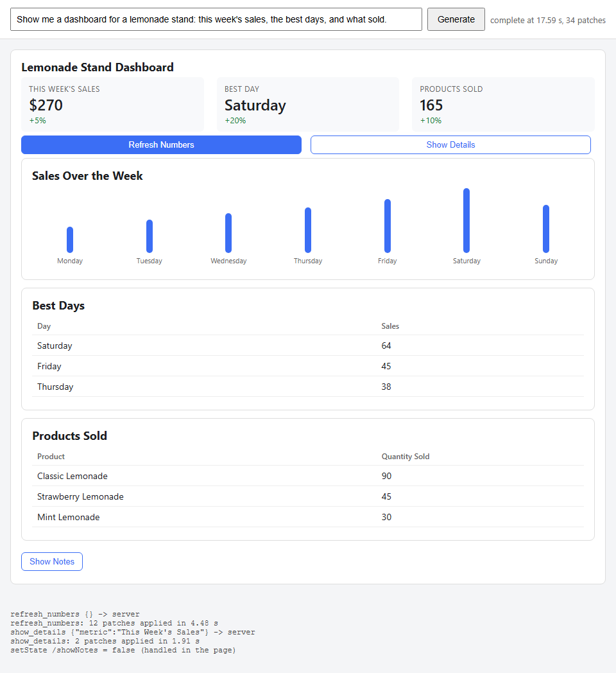
STEP 05.3 · QUICK DEMO, THE PAGE
Three presses: two went to the model as turns, one stayed in the page
34
patches in the first turn, 17.59 s, 1,228 completion tokens
12
patches for refresh_numbers, 4.48 s, 282 tokens
The action log at the bottom: refresh_numbers {} -> server, then show_details {"metric": "This Week's Sales"}, then setState /showNotes = false (handled in the page).
The refresh turn was all replace on state paths, one of them a single array cell, /state/sales/dailySales/0; the metrics and the chart changed without a new spec.
The toggle reads "Show Notes" because the last press hid the card locally; the server's spec still has /showNotes at true.
Twelve patches refreshed a whole dashboard for 282 output tokens, because the first turn put the numbers in state.
95
Notes:
The page after the recorded demo pressed every button. Read the log at the bottom in order. Refresh Numbers went to the server and came back as twelve replace patches on state paths in 4.48 seconds; the metrics and chart changed on screen with no new spec. Show Details went to the server with the metric's label as a typed parameter; the model wrote a note into state and set showNotes, so a notes card appeared and the toggle's label flipped. The last press was that toggle: setState, handled in the page, no request. The numbers are small because the model edits state, not elements.

Slide 96
STEP 05.3 · QUICK DEMO, THE TERMINAL
The same spec in the terminal, and it shows the notes card the page hid
╭──────────────────────────────────────────────────────────────╮
│ Lemonade Stand Dashboard │
│ THIS WEEK'S SALES BEST DAY PRODUCTS SOLD │
│ $270 Saturday 165 │
│ +5% +20% +10% │
│ [ Refresh Numbers ] [ Show Details ] │
│ ╭──────────────────────────────────────────────────────────╮ │
│ │ Sales Over the Week │ │
│ │ Monday ████████ 22 │ │
│ │ Saturday ████████████████████████ 64 │ │
│ ╰──────────────────────────────────────────────────────────╯ │
│ [ Hide Notes ] │
│ ╭──────────────────────────────────────────────────────────╮ │
│ │ Notes │ │
│ │ Detailed sales analysis: │ │
│ ╰──────────────────────────────────────────────────────────╯ │
╰──────────────────────────────────────────────────────────────╯
1
spec file, demo_spec.json, through both targets
0
lines skipped by the catalog check
​node ink_render.mjs demo_spec.json: the same values, $270, Saturday, 165, drawn with Box and Text.
The button reads "[ Hide Notes ]" and the Notes card is present: the server's spec has the model's /showNotes = true patch.
The page hid that card with setState, which never reached the server. Built-in actions are local state; if the agent must know, send them.
Cut to its top; the full render in the step README has the whole chart, both tables and the notes text.
96
Notes:
The same demo_spec.json, rendered by ink_render.mjs in a terminal. The values match the page: $270, Saturday, 165, the chart bars, the buttons as cyan brackets. Now the checkpoint from the README: the terminal shows the Notes card and the page does not. The page's last press was setState showNotes false, and setState is local, so the server's spec, the one the terminal renders, still has the model's own patch that set showNotes to true. That is the practical lesson about built-in actions: they are local state, and if the agent needs to know, the page must send them. One spec, two renderers, and one visible difference that teaches the boundary.

Slide 97
Sub-theme 06 · Levels 18-19 of 23
MCP Apps, UI in a host you do not control
The report's second transport. Sub-theme 02 put the agent inside a product you own. Here the agent lives in someone else's chat client, and you ship the interface to it as an MCP resource: a ui:// URI, an HTML document, a tool that points at it, and a JSON-RPC bridge over postMessage between a sandboxed iframe and the host. The spec is SEP-1865. Both steps use FastMCP on the server and no SDK anywhere else. At the end, one server renders in a browser host, in a terminal host, and in Claude Desktop, unchanged.
06.1 A tool result that carries its interface
06.2 The same server in a real host
06.3 Hybrid inside an MCP App
97
Notes:
This sub-theme is the other half of the report's transport axis. In sub-theme 02 the reader owned the page, the loop and the renderer. Here the reader owns one MCP server and nothing else: the page belongs to Claude, ChatGPT, VS Code or Goose. The interface therefore has to travel as data the host can fetch: a resource with a ui:// URI, and a tool whose metadata points at it. Step 06.1 builds the server and the smallest host that can mount the view, to show every message on the wire. Step 06.2 plugs the unchanged server into the harness codelab's MCP client, which only speaks text, and gives the configuration for two real iframe hosts.

Slide 98
STEP 06.1 · LEVEL 18 OF 23 · A THIRD-PARTY HOST (MCP APPS)
The interface travels as a resource; the data arrives later, as a notification
A tool result has two audiences: content for the model and for text-only hosts, structuredContent for the view in the iframe.
ui/initialize
view → host, a request: the host answers with hostContext and hostCapabilities
The server declares one resource at ui://lemonade/dashboard.html, MIME type text/html;profile=mcp-app.
The tool's _meta.ui.resourceUri links the tool to that resource; a host without the extension ignores it.
The host reads the resource, builds a CSP from its metadata, mounts it with sandbox="allow-scripts".
The view speaks JSON-RPC over postMessage in three functions; no SDK on either side.
The order is fixed: ui/initialize, initialized, then tool-input and tool-result, then a size report.
The view never talks to the server. Every tools/call goes through the host, which can log or refuse it.
ui/notifications/initialized
view → host: the listener is ready
ui/notifications/tool-input
host → view: the arguments the model chose
ui/notifications/tool-result
host → view: structuredContent, never seen by the model
tools/call
view → host → server: the interactive phase, proxied and logged
ui/notifications/size-changed
view → host after every render: 550x458, then 550x665
The six messages of the demo, in the order the bridge log printed them.
Takeaway The resource is static and declared up front; the data comes as a tool result; every message between them passes through a host that can refuse it.
98
Notes:
Start with the two audiences. The model reads content, which is text; the view renders structuredContent, which is data the model never sees. Then the diagram: the view opens with ui/initialize and gets the host's context back, theme and container size included. Only after the view says initialized does the host deliver the tool input and the tool result; send them earlier and the listener is not there. The view reports its size after each render so the host can grow the frame. The amber arrow is the interactive phase: the view can call a tool, but only through the host, which forwards it to the server and may ask the user first. That is the security model: a sandboxed iframe, auditable messages, a policy built from what the resource declared.

Slide 99
STEP 06.1 · THE BRIDGE
Three parties, two channels: the view never talks to the server
MCP over HTTP or stdio between the server and the host; JSON-RPC over postMessage between the host and the sandboxed iframe. Every request from the view crosses the host.
host page
ui/initialize
view (iframe)
ui/notifications/initialized
ui/notifications/tool-input
host.html + bridge.mjs: MCP client, CSP, proxy
ui/notifications/tool-result
view.html, sandboxed, opaque origin
tools/call (proxied to the server)
ui/notifications/size-changed
Blue: the lifecycle and the two data notifications. Amber: a request the host proxies to the server.
Takeaway The host holds tool-input and tool-result until the view says initialized; send them earlier and the listener is not there yet.
99
Notes:
Walk the arrows top to bottom; this is the bridge log from the demo. The view sends ui/initialize and gets the host's context and capabilities back. It says initialized. Now the host delivers the tool input and the tool result, in that order, from the call the model made. The view renders and reports its size. The amber arrow is the interactive phase: the 14-day button sends tools/call to the host, the host forwards it to the MCP server over HTTP, and the answer comes back as the response to the view's request. The host can log every one of these, refuse one, or ask the user. The iframe has sandbox=allow-scripts and no allow-same-origin, so it has an opaque origin: no cookies, no storage, no access to the host page.

Slide 100
STEP 06.1 · CODE WALKTHROUGH
One tool, one resource, and the _meta link between them
[1] @server.tool(meta={"ui": {"resourceUri": VIEW_URI}})
2 def lemonade_dashboard(days: int = 7) -> types.CallToolResult:
3 """Sales dashboard for the lemonade stand over the last `days` days (1 to 28)."…
4 days = max(1, min(int(days), 28))
5 rows = data.sales(days)
6 return types.CallToolResult(
[2] content=[types.TextContent(type="text", text=data.as_text(days, rows))],
8 structuredContent={"days": days, "rows": rows, "summary": data.summary(rows…
9 )
10
11
[3] @server.resource(VIEW_URI, name="lemonade_dashboard_view", mime_type=MIME_TYPE, met…
13 def dashboard_view() -> str:
14 """The dashboard's HTML document. Static: the data arrives later, over postMess…
15 return VIEW_FILE.read_text(encoding="utf-8")
1
meta becomes _meta on the wire. ui.resourceUri is the spec's field: it tells a host which resource to mount after this tool runs.
2
Two halves of one result. content is prose the model reads. structuredContent is the same numbers as data; the view renders it and the model never sees it.
3
The resource: a ui:// URI, the MIME type text/html;profile=mcp-app, and a meta with an empty CSP, so the host allows no external connection or script.
06_mcp_apps/step_01_mcp_app_resource/server.py
A normal FastMCP server plus three things: a ui:// resource, a tool that points at it, and a result with text and data.
100
Notes:
This is the whole server. The decorator's meta is what makes the tool an MCP App: the host sees _meta.ui.resourceUri and knows which resource to fetch. The result has two halves on purpose. Keep the text short and complete on its own, because a text-only host shows exactly that; keep the data complete, because the view draws from it. The resource function returns view.html unchanged: it is a static template, and the host can fetch and review it before any tool runs. The empty CSP lists in VIEW_META are a deliberate choice: the view is self-contained, so the host starts from the spec's restrictive default and widens nothing.

Slide 101
STEP 06.1 · CODE WALKTHROUGH
The view's lifecycle: initialize, say so, then report the size
1 // --- lifecycle: initialize, then say so, then report the size ------------
2 (async () => {
[1] const init = await request("ui/initialize", {
4 appInfo: { name: "Lemonade Dashboard", version: "0.1.0" },
5 appCapabilities: { availableDisplayModes: ["inline"] },
6 protocolVersion: "2025-06-18",
7 });
8 applyContext(init.hostContext);
[2] notify("ui/notifications/initialized", {});
10 new ResizeObserver(() => {
[3] notify("ui/notifications/size-changed", { width: document.body.scrollWidth,…
12 }).observe(document.body);
13 })();
1
ui/initialize is a request with an id; the host answers with hostContext (theme, CSS variables, container size) and hostCapabilities.
2
ui/notifications/initialized has no id. Only after it does the host send tool-input and tool-result; the bridge holds them until then.
06_mcp_apps/step_01_mcp_app_resource/view.html
3
A ResizeObserver sends size-changed after every render. In the demo: 550x458 first, 550x665 after the view called the tool for 14 days.
request() and notify() are two postMessage wrappers; the spec needs no SDK, and this is the proof.
101
Notes:
The order on this slide is fixed by the spec, and the bridge log in the demo shows it verbatim. The view asks to initialize and applies the host's context, which is how it picks up the host's theme in Claude Desktop later. It then says initialized. The host has been holding the tool input and the tool result, and delivers them now. The size observer closes the loop: the host does not know how tall the view is, so the view tells it after every render. Everything on this slide is plain postMessage; the official ext-apps package wraps the same messages in an App class with typed handlers.

Slide 102
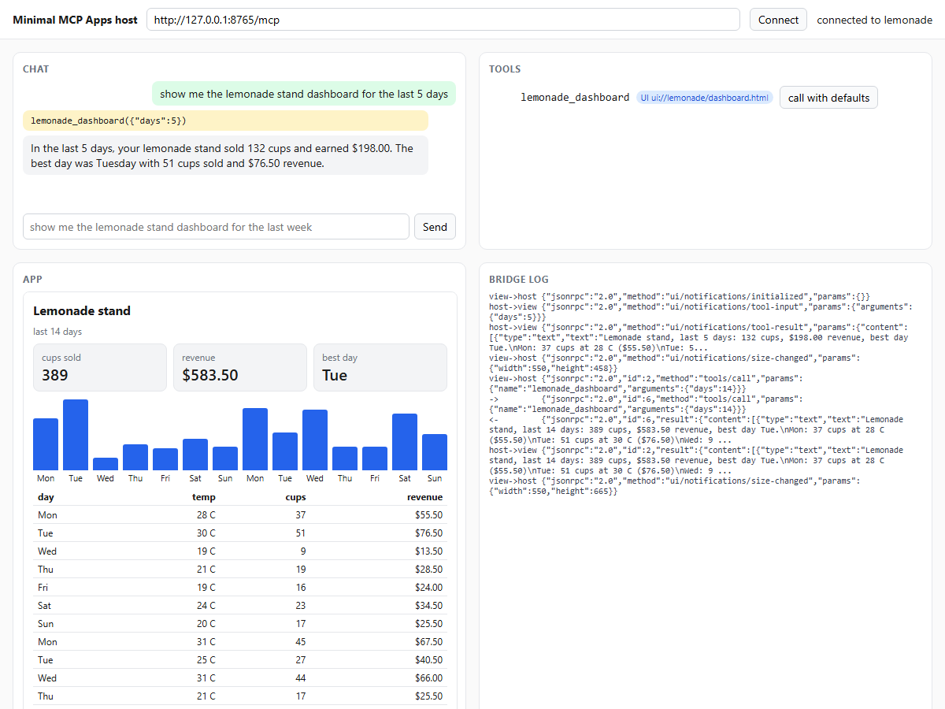
STEP 06.1 · QUICK DEMO
One sentence for the model, a dashboard for the iframe, and a frame that grew
132 cups · $198.00
the model's answer for lemonade_dashboard({"days":5}); best day Tuesday
550x458 → 550x665
size-changed reports: after mount, then after the view called tools/call for 14 days
Top left, the chat: the tool call and a one-sentence answer; the model read the text content only.
Bottom left, the app: the view in a sandboxed iframe, mounted from ui://lemonade/dashboard.html, shown after the 14-day click.
Right, the bridge log: ui/initialize, initialized, tool-input, tool-result, size-changed, in the fixed order.
The demo clicked "14 days" inside the view; the host proxied tools/call to the server and the frame grew.
Recorded by demo.py: both processes, a headless browser, the bridge log and this screenshot.
102
Notes:
Point at the two halves of the page. The chat shows the model's turn: it called lemonade_dashboard with five days and answered in one sentence, 132 cups and 198 dollars, best day Tuesday. The view on the right drew the same numbers as cards, bars and a table, from structuredContent the model never saw. The bridge log printed the fixed order of messages, then a size report of 550 by 458. The last five lines of the log are the interactive phase: the demo clicked the 14-day button inside the iframe, the view sent tools/call to the host, the host forwarded it to the server, and the frame grew to 550 by 665. Without a key the demo calls the tool directly and the log is the same.

Slide 103
STEP 06.2 · LEVEL 19 OF 23 · A THIRD-PARTY HOST (MCP APPS)
Ship both: text that stands alone, and a ui:// view for hosts that can mount it
Real hosts are built by other people. The report's rule for this side of the map is to ship both: text for any host, a view for hosts that can mount it.
register
tool.meta.ui.resourceUri → UI_TOOLS
The server and the browser host are unchanged from step 06.1; only the host changes.
harness/ is the harness codelab's step 26 MCP client, extended into a text host over stdio.
Registration remembers which tools carry a ui:// resource, from _meta.ui.resourceUri.
The resource is read once per session: title, MIME type, size, CSP; the template is static.
The result's structuredContent is queued as a card and drawn after the tool panel, not inside the call.
Claude Desktop and Goose mount the same resource in a real iframe; the configuration is one stdio command.
tools/call
text content → the model, unchanged
resources/read, once
title, MIME type, 7,876 bytes, CSP
structuredContent → text card
ui_text: dict as key: value, list as a table
drawn after the tool panel
queued: the call ran on a pool thread
The harness as an MCP Apps host in text. The model's string is the same as in step 26.
Takeaway The server did not change between three hosts; the host decides what it can show.
103
Notes:
Step 06.1 built a host to prove the protocol. This step asks what a host that was not written for the server does with it. The harness codelab's MCP client speaks stdio and shows text, so it becomes a text host: at registration it notes which tools carry a view, on the first call it reads the resource once and keeps four facts about it, and after the tool panel it draws the structuredContent as a card. The card is queued rather than drawn inside the call, because the call runs on a pool thread and the loop owns the terminal. The model's string does not change. Then the same server goes into Claude Desktop or Goose with one stdio command, and those hosts mount the HTML in a real iframe.

Slide 104
STEP 06.2 · CODE WALKTHROUGH
The call queues a card; the string the model reads does not change
[1] uri = UI_TOOLS.get(tool_name(server, tool))
2 if uri and not getattr(result, "isError", False):
3 PENDING_APPS.append((tool_name(server, tool), server, uri, result))
[2] return history.cap(text)
5
6
[3] def show_pending(name):
8 """Draw the card queued for one tool call, if any. The loop calls this afte…
9 for entry in PENDING_APPS:
10 if entry[0] == name:
11 PENDING_APPS.remove(entry)
12 show_app(*entry[1:])
13 return True
14 return False
1
UI_TOOLS was filled at registration from _meta.ui.resourceUri. A tool with a view and a non-error result gets its tuple queued in PENDING_APPS.
2
The return value is the same as in step 26: capped text. The model never learns that a card was drawn, and the prompt grows by the text lines only.
06_mcp_apps/step_02_mcp_app_in_a_real_host/harness/mcp_client.py
3
show_pending runs from the loop, right after ui.tool() drew the panel. The call itself ran on a pool thread and must not write the terminal.
One added line in harness/agent.py calls show_pending(name) after the tool panel.
104
Notes:
This is the tail of call_tool and the function the loop calls after it. The first three lines are the whole change to the call path: look up the view for this tool, and if the result is not an error, queue it. The return statement is unchanged from the harness codelab, which is the point: the model reads exactly the text it would have read before, and the recorded run confirms it, 2,093 to 2,227 prompt tokens for a table that never entered the context. show_pending is the other half. It is called by the loop, in order, after the tool panel, so the card lands under the tool that produced it.

Slide 105
STEP 06.2 · CODE WALKTHROUGH
What a host learns from resources/read, kept for the session
1 def read_ui_resource(server, uri):
2 """What a host learns from resources/read, kept per session: title, MIME ty…
3 from . import ui_text
4
5 if (server, uri) not in UI_RESOURCES:
[1] contents = client().read(server, uri).contents[0]
7 html = getattr(contents, "text", None) or ""
8 meta = getattr(contents, "meta", None) or {}
[2] UI_RESOURCES[(server, uri)] = {
10 "title": ui_text.title_of(html) or uri,
[3] "mimeType": contents.mimeType,
12 "size": len(html.encode("utf-8")),
13 "csp": (meta.get("ui") or {}).get("csp") or {},
14 }
15 return UI_RESOURCES[(server, uri)]
1
resources/read, once per (server, uri). The resource is a static template; a host may prefetch and cache it at connection time. This one reads it lazily.
2
Four facts go into the card's subtitle: the title from the HTML, the MIME type, the size in bytes and the declared CSP. In the demo: 7,876 bytes, restrictive default.
06_mcp_apps/step_02_mcp_app_in_a_real_host/harness/mcp_client.py
3
show_app checks the MIME type against text/html;profile=mcp-app and refuses anything else, which is what the spec asks of every host.
harness/ui_text.py then turns any structuredContent into lines: a dict as key: value, a list of flat dicts as a table.
105
Notes:
A host that cannot run HTML still reads the resource, because the resource carries facts the host should show and check. This function reads it once per session and keeps the title, the MIME type, the size and the content security policy. The MIME type check is in show_app: a resource that is not text/html with the mcp-app profile is noted and not rendered. The size and the policy go into the card's subtitle so the reader can see what the sandboxed view would have been. The renderer in ui_text knows nothing about lemonade: a list of flat dicts with the same keys becomes a table with right-aligned numbers, and a dict becomes indented key-value lines.

Slide 106
STEP 06.2 · QUICK DEMO
Two panels: the text the model saw, then the app as this host can show it
$ MCP_ALLOW=mcp__lemonade__* python -m harness.agent -p "Show me the
lemonade stand dashboard for the last 5 days. Answer in one sentence."
2,093 prompt · 23 completion · 1,792 cached
┌ mcp__lemonade__lemonade_dashboard 5 ─────────────────────────
│ Lemonade stand, last 5 days: 132 cups, $198.00 revenue, best day Tue.
│ Mon: 37 cups at 28 C ($55.50)
│ Tue: 51 cups at 30 C ($76.50)
│ ...
┌─ app · Lemonade dashboard ────────────────────────────────────
│ ui://lemonade/dashboard.html | text/html;profile=mcp-app
│ | 7,876 bytes | csp: restrictive default | rendered as text
│ days: 5
│ rows:
│ day temperature cups revenue
│ Tue 30 51 76.5
│ summary:
│ total_cups: 132
│ total_revenue: 198
│ best_day: Tue
2,227 prompt · 46 completion · 2,048 cached
2,093 → 2,227
prompt tokens across the tool call: the text lines only; the table never reached the model
7,876 bytes
the ui:// resource, read once over stdio, restrictive default CSP
The first panel is the tool result as the model saw it: text.
The second is the MCP App as a terminal can show it: the resource's identity, then the data as a table.
Claude Desktop and Goose mount the same resource in a real iframe with one stdio command; that run was not recorded.
Recorded by demo.py: the harness in print mode with server.py --stdio as a child process (condensed).
106
Notes:
Read the run top to bottom. The first model call cost 2,093 prompt tokens and produced one tool call. The tool panel shows the text content: a one-line summary and one line per day. Under it, the app card: the resource's URI, MIME type, size and policy in the subtitle, then the structuredContent as a table and a summary. The second model call cost 2,227 prompt tokens, so the prompt grew by the text lines only; the table came from data the view would have used and never entered the context. The demo leaves out the harness's late-injection panels; everything else is the harness's output as printed. Claude Desktop is installed on the build machine but driving it by hand was not recorded.

Slide 107
SUB-THEME 06 · COMPARE WITH SUB-THEME 02
One interface, two transports: same numbers, same picture, different contract
The lemonade dashboard could also be an AG-UI state object rendered by a page you own. The report's rule is not to choose: keep the interface as data and ship it on both roads.
AG-UI (sub-theme 02)
MCP Apps (sub-theme 06)
who owns the page
you
the host's vendor
your page, your event stream
Claude, ChatGPT, VS Code, Goose
the wire
SSE events to your page
MCP to your server
text, tool calls, state deltas
a tool result: text plus structured content; the view speaks JSON-RPC to the host
who renders
your renderer, from state
your HTML, in the host's sandbox
a catalog you drew
an iframe with a CSP the host built
who runs the loop
you
the host
your server drives the model
the model picks the tool; the view calls through the host
where it appears
your product
any compliant host
one surface you control
the same server, unchanged, in three hosts
Takeaway Sub-theme 07 takes the first road inside the harness; this sub-theme took the second. The server is the same either way.
107
Notes:
Close the sub-theme with the comparison from the step README. On the left, AG-UI: you own the page, your server streams events over SSE, your renderer draws from state, you run the loop, and the interface appears in your product. On the right, MCP Apps: the host's vendor owns the page, the host calls your MCP server and gets a tool result with text and structured content, your HTML renders inside the host's sandbox, the host runs the loop, and the interface can appear in any compliant host. The report does not ask you to choose. Keep the interface as data, render it with your own page where you own the product, and ship the same data with a ui:// view where you do not. Sub-theme 07 takes the first road inside the harness.

Slide 108
STEP 06.3 · LEVEL 20 OF 23 · A THIRD-PARTY HOST
The hybrid ships as a tool result, and its open-ended part runs one frame deeper
One tool result carries a catalog spec the view draws itself and one generated document the view mounts in a second sandbox.
host page
host.html on its own origin: the chat, the bridge, the MCP client
Step 01.4 built the report's hybrid on a page you own. This step puts it inside a host you do not control.
​lemonade_report(days, focus) returns components, six items in the shape of step 01.1, and generated, one HTML document.
The MCP server makes the model call for the region. MCP Apps keeps credentials on the server side; the host never sees the key.
The view renders the spec with four escaped renderers and mounts the document in a nested sandbox="allow-scripts" iframe.
The app's own iframe and policy from step 06.1 are unchanged. A srcdoc frame has no URL for frame-src to match, so it inherits the app's policy and adds its own.
The region can say one thing to the app: {type: "event", name, payload}. The app, not the region, speaks to the host.
app iframe
sandbox="allow-scripts" · the spec's CSP from _meta.ui.csp · the catalog
generated iframe
sandbox="allow-scripts" · the region's CSP first in <head> · the model's HTML
Two boundaries, two policies: the host trusts the app as far as the resource declared; the app trusts the region not at all.
Takeaway Catalog components stay cheap and trusted; the open-ended part pays its way inside a boundary the app owns.
108
Notes:
This is the report's hybrid pattern again, now on the MCP Apps transport. Point at the three nested boxes. The outer one is the host page from step 06.1, unchanged apart from the ports. The middle one is the app, under the policy the resource declared. The inner one is new: a second sandboxed iframe for the document the model wrote, with a stricter policy injected first in its head. Say who calls the model: the server, not the host, because MCP Apps keeps credentials on the server side. Then the one rule of the inner boundary: the region may post one message shape to the app, nothing else, and it cannot reach the host's bridge at all.

Slide 109
STEP 06.3 · THE PATTERN
Four catalog components the view owns, one generated region the server's model wrote
The same picture as step 01.4, now inside a tool result: components on the left, generated on the right.
Metric
generated
catalog primitive
Table
catalog primitive
BarChart
one HTML document from the server's model call, in a nested sandboxed iframe with its own CSP
catalog primitive
Text
catalog primitive
components: 829 bytes of JSON, no model call · generated: 1,565 bytes of HTML, 370 + 473 tokens
Takeaway A `GeneratedView` in the components list renders as a stub: markup runs only through `generated`, which has its own frame.
109
Notes:
Two halves, two costs. The left side is data the view already knows how to draw: six items, 829 bytes, no model call, and the host's restrictive policy applies to it. The right side is markup the model wrote for this call: about one and a half kilobytes and a few hundred completion tokens, and it needs a place to run. That place is the second iframe. Mention the fallback: without a key on the server, a hand-written region with the same slider takes over, and the view shows a note saying so. The tool never fails because of the model.

Slide 110
STEP 06.3 · CODE WALKTHROUGH
One call, two halves: the server's own model call sits inside the tool
1 @server.tool(meta={"ui": {"resourceUri": VIEW_URI}})
2 def lemonade_report(days: int = 7, focus: str = report.DEFAULT_FOCUS) -> types.CallToolResult:
3 """Sales report for the lemonade stand over the last `days` days (1 to 28), with one interactiv…
4 days = max(1, min(int(days), 28))
5 rows = data.sales(days)
[1] generated = report.generate_region(days, rows, focus) # the server's own model call
[2] text = data.as_text(days, rows) + f"\nThe interface also shows {focus} ({generated['source']})."
8 return types.CallToolResult(
9 content=[types.TextContent(type="text", text=text)],
[3] structuredContent={"days": days, "focus": focus, "components": report.components_for(days, …
1
generate_region calls the model from the server. The host and the view never see this key.
2
The text for the model says a region exists and where it came from, and nothing of its HTML.
06_mcp_apps/step_03_mcp_app_hybrid/server.py
3
components is the catalog spec; generated is the document plus its source, usage and size.
Step 06.1's resource, link and policy are unchanged; only what the tool returns is new.
110
Notes:
Read the tool top to bottom. Clamp the days, get the rows, then the one new line: the server's own model call, which returns the HTML, where it came from, the usage and the byte count. The content text stays short and now ends with one sentence about the region. The structured content has two parts. The model that called the tool reads the text only; the generated HTML goes to the iframe and never enters the context window.

Slide 111
STEP 06.3 · CODE WALKTHROUGH
Two sources, one listener: the host above, the region below, one accepted shape
1 window.addEventListener("message", (event) => {
[1] if (event.source === window.parent) return hostMessage(event.data);
[2] if (event.source === generated.contentWindow && isEvent(event.data)) return regionEvent(event.data);
4 // anything else, or any other shape, is dropped
5 });
6
7 function regionEvent({ name, payload }) {
8 app.events.push({ name, payload });
9 document.getElementById("events").textContent = `event from the generated region: ${name} ${JSON.stringify(payload …
10 // The region cannot reach the host. The app can: it hands the event on as model context, coalesced.
11 clearTimeout(contextTimer);
12 contextTimer = setTimeout(() => {
[3] const text = `In the report's interactive region the user set ${name}: ${JSON.stringify(payload ?? {})}.`;
14 request("ui/update-model-context", { content: [{ type: "text", text }] });
15 }, 250);
1
Messages from the parent are the host's JSON-RPC, as in step 06.1.
2
Messages from the inner frame must pass isEvent: {type: "event", name, payload}. A tools/call from the region is dropped.
3
The app forwards one sentence to the host as ui/update-model-context, debounced by 250 ms; the region never reaches the host.
06_mcp_apps/step_03_mcp_app_hybrid/view.html
Two source checks, one accepted shape: the region speaks to the app, and the app speaks to the host.
111
Notes:
Step 06.1's view had one listener for one source. This view has two sources and checks event.source before anything else. The parent is the host; the inner frame is the region. The region may only send an event of one shape, and only from its own window. It cannot use the bridge. The app can, and it forwards a sentence, not the raw payload, to the host with ui/update-model-context, so the next model turn knows what the user did. The debounce keeps a slider from flooding the host.

Slide 112
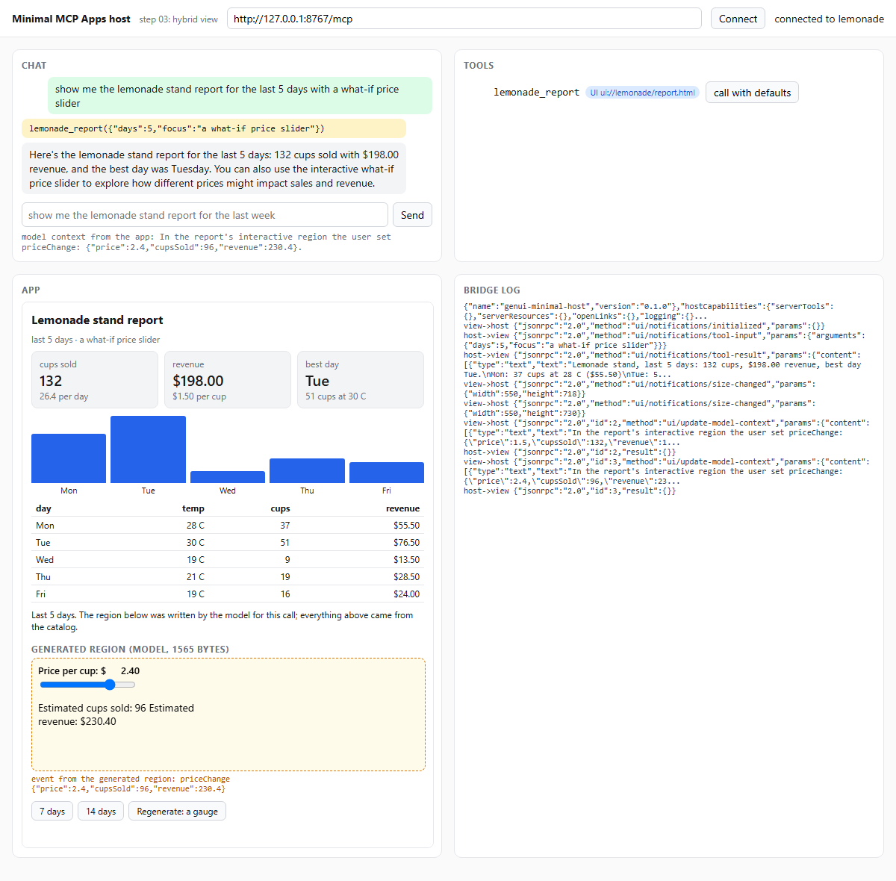
STEP 06.3 · QUICK DEMO
Catalog above, generated region below, and the region's event reached the host
370 + 473
tokens for the server's model call
1,565
bytes of generated HTML
The model called lemonade_report({"days":5,"focus":"a what-if price slider"}) and answered in two sentences.
Three metrics, a bar chart, a table and a line of text came from the catalog: 829 bytes of JSON, no model call.
The amber dashed frame is the generated region, one sandbox inside the other.
Under the chat: the model context the app forwarded after the slider moved, priceChange at price 2.4.
112
Notes:
The recorded run. The host page is step 06.1's on new ports. In the app panel the catalog components sit above and the generated region below, in an amber dashed frame that marks the second sandbox. The demo moved the slider two frames down, inside that region; the region posted priceChange, the app drew it under the frame and forwarded it to the host, which shows it under the chat. Read the numbers: the server's model call cost 370 prompt and 473 completion tokens for 1,565 bytes of HTML, while the six catalog components cost 829 bytes of JSON and nothing else.

Slide 113
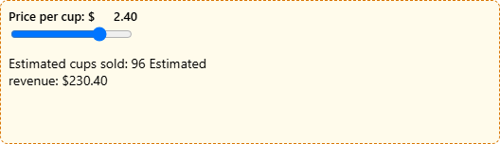
STEP 06.3 · QUICK DEMO
The inner region on its own: the model's script ran two frames down
2.4
price the demo set on the slider
230.4
revenue in the event payload
The document is the model's: a range input, a recompute on every input event (96 cups at 2.4), a parent.postMessage with the new values.
Its CSP is the region's own, injected first in the head: no network, inline style and script only.
The app accepted the event, drew it, and forwarded a sentence as ui/update-model-context; the host put it in the next turn.
113
Notes:
The second capture is the generated iframe alone, after the headless interaction. Everything in it was written by the model on the server for this call: the slider, the recompute, the message to the parent. The demo set the slider to 2.4 and the region estimated 96 cups and 230.4 in revenue. That payload climbed one frame to the app, which turned it into a sentence for the host. Close with the takeaway: two frames, two policies, one accepted message shape.

Slide 114
Sub-theme 07
Generative UI in the harness
The two codelabs meet here. The harness codelab ends with a coding agent that talks in prose and tool panels, then moves the loop onto TrueForge. This sub-theme gives both harnesses a rendering surface. Both steps are declarative generation in the report's terms; the transports are a terminal, a browser page fed over SSE, and the TrueForge SDK. Sub-theme 06 put an interface into a host the reader does not control; this one lets the reader's own agent answer with one.
07.1 A render_ui tool for the harness
07.2 TrueForge's generative UI, rendered in a page of ours
07.3 Hybrid on TrueForge
114
Notes:
The last sub-theme. Everything before it was a format or a transport studied on its own. Here the stage 15 loop from the harness codelab gains one tool and two surfaces, and then the hosted harness, TrueForge, is shown to already speak one of the formats from sub-theme 04. Step 07.1 is the local harness drawing a validated json-render element map on a terminal and a browser page. Step 07.2 captures an OpenUI Lang program over the TrueForge SDK and renders it line by line in a page of the reader's own. Both are declarative generation; only the transport differs.

Slide 115
STEP 07.1 · LEVEL 21 OF 23 · DECLARATIVE GENERATION · A TERMINAL
The spec is the interface: validate once, draw on any surface
Generative UI as one tool: the model emits a json-render element map, the harness validates it against a catalog, and every surface draws from that data.
model
calls render_ui with an element map
​harness/ is the stage 15 loop copied whole; nothing in the loop changes.
​genui.py holds a six-component catalog with typed props, a required list and a children flag.
​validate() returns every problem as a plain sentence; the model reads the list as the tool result.
​llm.py writes the catalog into the system prompt from the same dictionary the validator reads.
​ui.py draws one rich renderable per element; web.py pushes the spec to every open tab over SSE.
The model sees one sentence back. The picture is drawn by the surface, from data.
render_ui tool
next to bash and task, same permission check
validate against the catalog
problems go back as text; a good spec is published
two surfaces
a rich panel tree in the terminal · a DOM tree over SSE
Add a surface and nothing in the agent changes.
Takeaway One agent, one spec, two surfaces: the model composes from a catalog it saw once; a new surface changes nothing.
115
Notes:
The reader has the stage 15 harness and the flat element map from sub-theme 01. This step joins them without touching the loop. The catalog is one dictionary: the prompt is generated from it, the validator reads it, and each surface has one function per entry. That is the report's second rule, the catalog is the contract, applied to the harness. Point at the last node: the terminal and the browser page are the same shape, a lookup by type and a recursive walk from root. The model never sees either picture. It gets back one sentence, or a list of corrections if the spec was wrong.

Slide 116
STEP 07.1 · CODE WALKTHROUGH
Validate, publish, report: a bad spec comes back as corrections, not a crash
1 def render_ui(spec: dict) -> str:
2 """Validate a json-render element map and hand it to every surface.
3
4 The terminal draws it in ui.tool(); the web page gets it over SSE. The
5 model only sees this short string, never the picture: the spec is data
6 that the surfaces interpret, not something the model has to describe.
7 """
[1] problems = validate(spec)
9 if problems:
[2] return "Invalid spec, nothing rendered:\n- " + "\n- ".join(problems)
11 web.publish(spec)
[3] return f"Rendered {len(spec['elements'])} elements from root '{spec['root']}'."
1
validate() returns a list of sentences. An empty list means the spec is valid.
2
The problems go back to the model as the tool result. The loop continues; the model corrects and calls again.
07_harness_genui/step_01_render_ui_tool/harness/tools.py
3
The model only ever sees this line. The picture is drawn by the surfaces, not described to the model.
The tool sits behind the same execute() permission check as bash; the subagent does not get it.
116
Notes:
Two return values, and both are results. If validation finds problems, the tool returns them as text and nothing is rendered; the model reads the list and tries again. If the spec is valid, publish() hands it to every open browser tab and the terminal draws it inside the tool panel. The string the model receives is one sentence with a count and the root id. That is deliberate: the spec is data the surfaces interpret, not something the model has to describe. The subagent from step 15 is not given this tool; an explorer reports, it does not draw.

Slide 117
STEP 07.1 · CODE WALKTHROUGH
The prompt is generated from the catalog, so prompt and validator cannot drift
1 def catalog_prompt():
2 """The catalog as text for the system prompt: one line per component."""
3 lines = []
[1] for name, entry in CATALOG.items():
5 props = ", ".join(f"{p}: {t}" for p, t in entry["props"].items())
6 kids = " Takes children." if entry["children"] else ""
[2] lines.append(f"- {name}({props}): {entry['description']}{kids}")
8 return "\n".join(lines)
1
The same CATALOG dictionary that validate() checks against. One definition, three uses.
07_harness_genui/step_01_render_ui_tool/harness/genui.py
2
One line per component: name, typed props, description, and whether it takes children.
llm.py places this text in the system prompt under the instruction to call render_ui for dashboards, tables and charts.
117
Notes:
This is the smallest function in the step and the one that keeps it honest. The system prompt tells the model which element types exist, and that text is produced from the same dictionary the validator reads and the renderers key on. Add a Gauge entry and the prompt gains a line, the validator accepts it, and the tests fail until both surfaces can draw it. Remove an entry and the model stops being offered it. There is no second list to keep in sync. The checkpoint in the README asks the reader to add exactly that entry and watch the tests tell them what is missing.

Slide 118
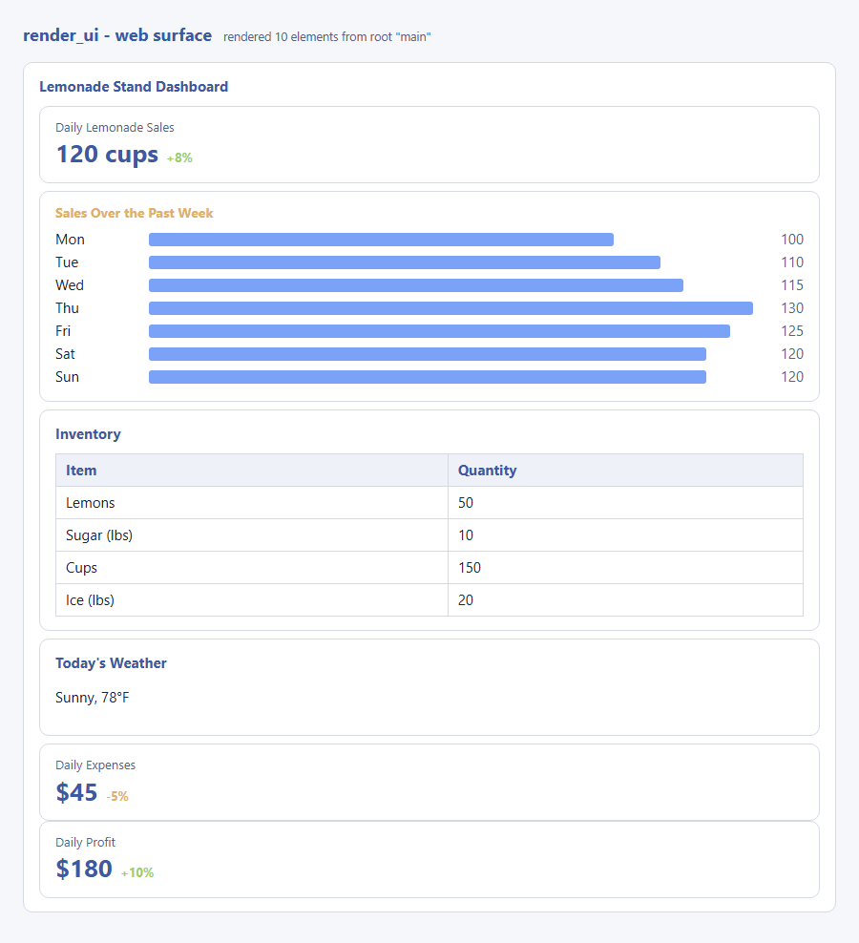
STEP 07.1 · QUICK DEMO
One prompt, a ten-element map, drawn by the terminal and the browser alike
1,365 · 308
prompt · completion tokens, first call
10
elements in the map
Metrics, a seven-bar chart, an inventory Table inside a nested Card, and a weather card, from one call.
The terminal drew the same spec inside the render_ui · 10 elements tool panel.
The demo script captured this picture headlessly from the web surface.
The model saw the catalog once, in the system prompt, and produced nested Cards, a Chart and a Table on the first call.
118
Notes:
The recorded run. The user asked for a lemonade stand dashboard. The first model call cost 1,365 prompt and 308 completion tokens and produced a ten-element map: metrics, a seven-bar chart, an inventory table inside a nested card, and a weather card. The terminal drew it as a rich panel tree; this screenshot is the browser page drawing the identical spec from the same SSE push. The second call, 1,690 prompt and 43 completion tokens, was the model's one-sentence summary after the tool returned. Nothing in the loop changed to make this happen; the tool and the catalog did the work.

Slide 119
STEP 07.2 · LEVEL 22 OF 23 · DECLARATIVE GENERATION · THE TRUEFORGE SDK
A hosted harness already speaks a UI language; any parser that knows the grammar can draw it
With generative_ui enabled, TrueForge's agent answers with an OpenUI Lang program inside a fence. This step renders that program in a page of its own.
TrueForge SDK stream
model.message.delta events on the main thread
​client/genui.py opens a session with generative UI on and streams one turn over the SDK.
​extract_program() pulls the text out of the first ```openui fence, even one that never closed.
​openui_parse.py is streaming-first: statements are name = expr; references may point forward.
A statement commits at the first newline where its brackets balance; a multi-line Card([ waits.
​server.py sends one line per SSE event; app.js feeds each line to the parser and redraws from root.
Unknown components become a labelled box, pending references a dashed placeholder.
extract the openui fence
the prose is for the chat; the fence is the interface
streaming parser
commit a line when its brackets balance; pending nodes for forward references
DOM renderer
one function per component name; dashed box while a reference is pending
The same parser exists in Python and JavaScript, tested against the same program.
Takeaway A UI language is a string with a grammar: any parser that knows the grammar can draw it, and streaming follows from statements that commit line by line.
119
Notes:
Step 07.1 taught the local harness to draw. TrueForge, the hosted harness from Part 7 of the harness codelab, already does this: enable generative_ui and its agent writes an OpenUI Lang program inside a fence, which the TrueForge chat client renders. Nothing about that is tied to the TrueForge UI. The program is a string, the fence marks where it starts, and any parser that knows the grammar can draw it. Two properties of the language carry the page: forward references, so the root line names children before they exist, and line-oriented statements, so a line is drawable the moment it ends. The server exploits the second by sending one line per SSE event.

Slide 120
STEP 07.2 · FORWARD REFERENCES
The root line names six children on line 1; the page draws the skeleton before their lines arrive
The recorded program, 25 lines in: four statements have landed, kpiStack is still open, and three children are dashed placeholders.
root = Stack([title, topFlavoursTable, revenueLineChartCard, kpiStack, statusTag, closingText], "column", "l", "center")
title = TextContent("Lemonade Stand Report", "large-heavy")
topFlavoursTable = Card([
CardHeader("Top 3 Flavours - Cups Sold & Price"),
])
revenueLineChartCard = Card([
CardHeader("Weekly Revenue Over Four Weeks"),
])
kpiStack = Stack([
statusTag = Tag("Performance", null, "md", "success")
closingText = TextContent("Sales are strong and trending upward, keep focusing on the top flavours to maximize revenue.", "default")
title
topFlavoursTable
revenueLineChartCard
kpiStack
waiting for its statement
statusTag
waiting for its statement
closingText
waiting for its statement
Bright lines have committed; dim lines are still to come. `kpiStack = Stack([` is held back until its closing bracket balances.
Takeaway Structure before content: the layout is known from the first line, and each box fills in when its statement lands.
120
Notes:
The lines on the left are from the recorded reply in sample_reply.md, with the table and chart bodies elided so the shape is visible. Line 1 is the root: a Stack of six named children, none of which exist yet. The parser keeps each reference and resolves it when the statement lands; until then the tree carries a Pending node, which the page draws as a dashed box. The mid-stream screenshot on a later slide is this exact moment, 25 lines in. Note the open Card statements: complete() is a bracket-balance check, so a Card that opens on one line and closes four lines later is committed once, as one statement, and every finished line is drawable at once.

Slide 121
STEP 07.2 · CODE WALKTHROUGH
A statement commits at the first newline where its brackets balance
1 def feed(self, text):
2 """Add a chunk. Every complete statement it finishes is parsed now."""
3 self.buffer += text
4 while True:
5 # the first newline at which the text before it is balanced ends a statement
6 start, cut = 0, None
7 while cut is None:
8 nl = self.buffer.find("\n", start)
9 if nl == -1:
[1] return # the rest is an unfinished line: hold it back
[2] if complete(self.buffer[:nl]):
12 cut = nl
13 start = nl + 1
14 line, self.buffer = self.buffer[:cut], self.buffer[cut + 1:]
[3] self.add_line(line.replace("\n", " "))
1
No newline yet: the rest of the buffer is an unfinished line and is held back for the next chunk.
2
complete() is a bracket-balance check. The loop walks newline by newline until the text before one balances.
07_harness_genui/step_02_trueforge_generative_ui/openui_parse.py
3
A multi-line Card([ becomes one statement; its inner newlines are folded to spaces before parsing.
feed() takes any chunk; complete statements are parsed at once, an open list waits for its closing bracket.
121
Notes:
The whole streaming story is this loop. Text arrives in any pieces; the parser appends it to a buffer and looks for the first newline at which everything before it is balanced. If there is no such newline, it returns and waits. If there is, the text up to it is one statement, inner newlines are folded to spaces, and add_line() parses it into the statements table. That is what makes a Card that opens on one line and closes four lines later harmless, in Python and in the JavaScript twin. The server sends one line per SSE event, so the page calls feed() once per line and redraws from root after each call.

Slide 122
STEP 07.2 · CODE WALKTHROUGH
Enabling generative_ui is the whole configuration; the agent was told nothing about OpenUI Lang
1 def open_session():
2 """A session on an inline agent with generative UI switched on."""
3 spec = AgentSpec(
4 model=Model(name=MODEL),
5 instructions=INSTRUCTIONS,
[1] config=RuntimeConfig(generative_ui=GenerativeUiConfig(enabled=True)),
7 )
[2] session = client().sessions.create(agent=SessionAgentSpecBody(spec=spec))
9 return session.data.id
1
The only difference from Part 7's client. The catalog, the grammar and the fence come from TrueForge's own harness prompt.
07_harness_genui/step_02_trueforge_generative_ui/client/genui.py
An inline agent spec on a session. ask() then streams one turn and collects model.message.delta events on the main thread.
2
extract_program() then returns what is inside the first ```openui fence, and copes with a fence a cut stream never closed.
122
Notes:
This is the client side. An AgentSpec with a model, one instruction sentence, and a RuntimeConfig with generative UI enabled. That flag is the entire configuration: the instructions say nothing about OpenUI Lang, components or fences. In the recorded turn 1,288 of the 6,954 input tokens are labelled harness in the usage breakdown, which is where TrueForge's catalog and grammar came from. The reply is prose around one fence; extract_program() pulls the program out and, if the stream was cut before the closing fence, still returns what arrived. The tests never touch a real server: they start a fake TrueForge on an ephemeral port and point the real SDK at it.

Slide 123
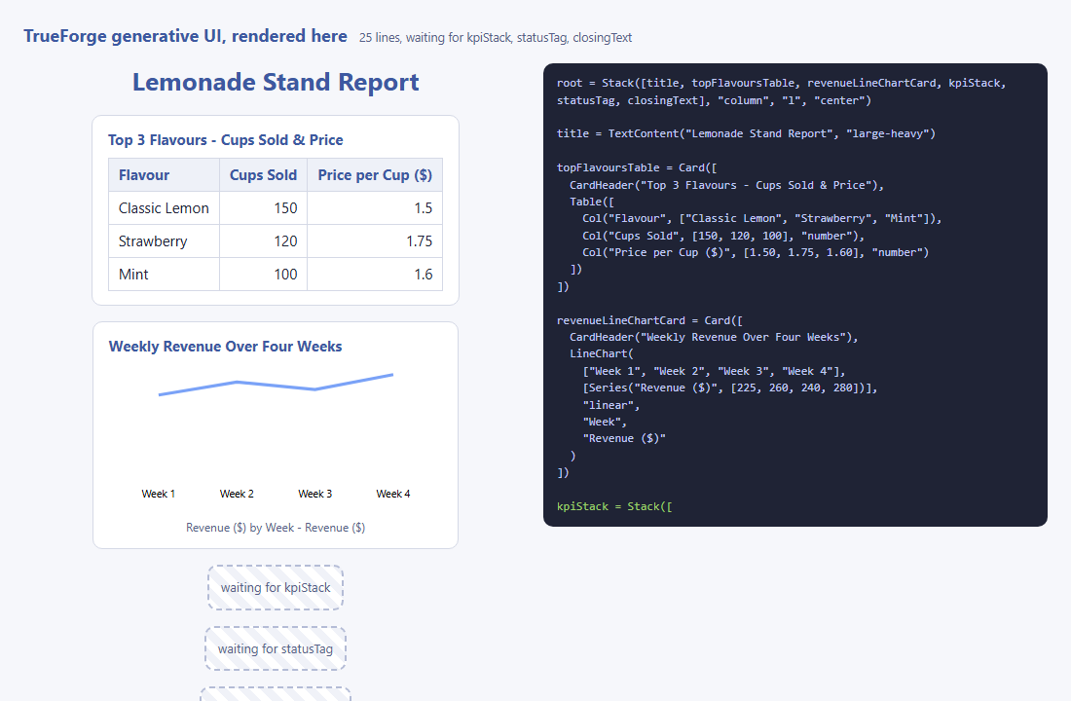
STEP 07.2 · QUICK DEMO · MID-STREAM
Twenty-five lines in: the root named six children, three are still dashed placeholders
25
lines received of 32
3 of 6
children still pending
The title, the flavours table and the revenue chart card have their statements and are drawn.
​kpiStack, statusTag and closingText are named on line 1 and wait as dashed boxes.
The program text beside the tree highlights the line that just arrived.
One line per SSE event; the tree is redrawn from root after every line.
123
Notes:
The page mid-stream, captured by the demo script 25 lines into the 32-line program. The root line named six children on line 1; the title, the table card and the line chart card have arrived and are drawn; the KPI stack, the status tag and the closing sentence are still dashed placeholders that read waiting for, and the name. This is the forward-reference property doing its work: the layout was known from the first line, and the user sees where each part will go before its statement lands. The step 01 page could not do this; a json-render map arrives whole per tool call.

Slide 124
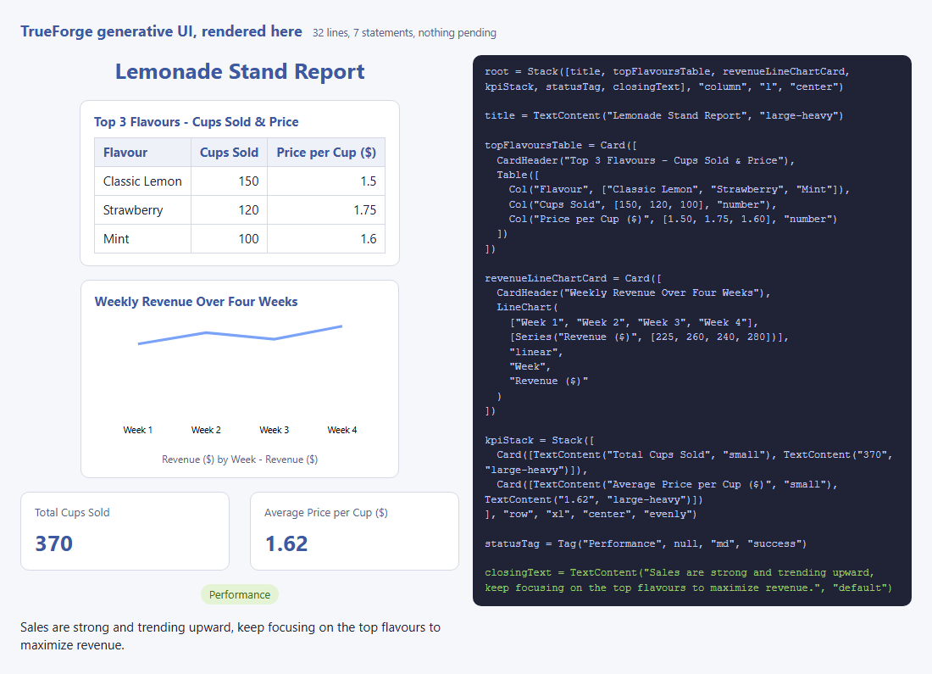
STEP 07.2 · QUICK DEMO · COMPLETE
A 32-line program of 7 statements, drawn by a page that never saw TrueForge's UI
6,954 · 352
input · output tokens for the turn
1,288
input tokens labelled harness: the catalog and grammar
A title, a table, a line chart card, two KPI cards, a tag and a sentence: every placeholder filled.
The renderer's positional args are a reading of what the agent emitted, not a copy of TrueForge's library.
Anything outside that reading lands in the unknown box with its args visible.
The step 01 model wrote 308 tokens of JSON for a comparable dashboard; the argument for OpenUI Lang is streaming, and larger UIs.
124
Notes:
The same page once the program is complete. The recorded turn cost 6,954 input and 352 output tokens, of which 1,288 input tokens are labelled harness, TrueForge's own prompt with the catalog and the grammar. The reply held a 32-line program with 7 statements: a title, a table, a line chart card, two KPI cards, a tag and a closing sentence. Compare the step 01 run, where the model wrote 308 output tokens of JSON for a comparable dashboard through a tool call. The token argument for OpenUI Lang in the report is about larger interfaces and about streaming: here every line was drawable the moment it ended. The checkpoint swaps two statements in the recorded reply; the tree is the same, only the moment each box fills in moves.

Slide 125
STEP 07.3 · LEVEL 23 OF 23 · THE TRUEFORGE SDK
The hosted harness sets the catalog; the surface adds the one component it lacks
TrueForge's generative UI is catalog-only. The report's hybrid needs one open-ended component, and it can live on the client side of the SDK.
Stack
HtmlArtifact
The agent's instructions allow one HtmlArtifact(title, document) statement inside the openui program.
Only when the user asks for something interactive; dashboards and reports stay in the catalog.
TrueForge hands the agent its catalog through a system tool, get_openui_instructions, before every reply.
The page renders the artifact in a sandboxed iframe with a Content Security Policy injected first in head.
Every other component goes through step 07.2's catalog renderer, unchanged.
The TrueForge chat UI does not know the component; this page is where the hybrid exists.
catalog primitive
Table
catalog primitive
Tag
sandboxed iframe, CSP first in head: only where the catalog does not reach
catalog primitive
TextContent
catalog primitive
Catalog primitives from TrueForge's own guide by default; one boxed open-ended component, added by the surface.
Takeaway A harness you do not own can still get an escape hatch, as long as the surface that renders its replies owns the box.
125
Notes:
Step 07.2 showed that TrueForge's generative UI is a program in a language any parser can draw. That catalog is static: a table, a chart, a tag. It cannot give the user a calculator. This step adds the report's other half without touching the server. The agent's instructions describe one extra component, HtmlArtifact, with rules copied from OpenUI's html-artifact example: only for interactive requests, inline CSS and JS only, one statement on one line. The catalog stays the default. Point at the diagram: the left column is TrueForge's own guide, the dashed box on the right is ours. Stress the last bullet: the TrueForge chat UI would show the statement as text; this page is the surface that knows it.

Slide 126
STEP 07.3 · CODE WALKTHROUGH
One renderer, two states: raw source while the line is open, an iframe once it closes
[1] HtmlArtifact([title = "Artifact", document = ""], partial) {
2 const box = el("section", "artifact");
3 box.dataset.state = partial ? "streaming" : "ready";
4 const head = el("div", "artifact-head");
5 head.append(el("strong", "", String(title)));
[2] if (partial) {
7 head.append(el("span", "artifact-status", `Generating artifact ... ${document.length} characters so far`)…
8 box.append(head, el("pre", "artifact-raw", document));
9 return box;
10 }
11 head.append(el("span", "artifact-status", `${document.length} characters, sandboxed iframe`));
12 const frame = el("iframe", "artifact-frame");
13 frame.title = String(title);
14 frame.setAttribute("sandbox", "allow-scripts");
15 frame.setAttribute("referrerpolicy", "no-referrer");
[3] frame.srcdoc = sandboxed(String(document));
1
The parser marks a statement whose line is still in the buffer as partial; the renderer gets that flag.
2
Streaming: a status line and the raw document so far, the way OpenUI's example shows an artifact generating.
3
Complete: srcdoc is the document with the CSP meta first in head; sandbox=allow-scripts, no referrer.
07_harness_genui/step_03_trueforge_hybrid/web/render.mjs
sandboxed() in web/sandbox.mjs removes any CSP the model wrote and injects default-src 'none' with inline style and script allowed.
126
Notes:
This is the whole open-ended half. An HtmlArtifact statement is one long line, so the parser cannot commit it until the closing quote arrives. Step 07.3 adds partial() to both parsers: a lenient read of the held-back line, so the tree carries a node marked partial with the document decoded as far as it goes. The renderer draws that as a status and the raw source. When the line closes, the same component mounts an iframe. The srcdoc goes through sandboxed(): any Content-Security-Policy meta the model wrote is removed, ours goes first in head, and the policy is default-src none with inline style and script allowed, because that is what the rules told the agent to write.

Slide 127
STEP 07.3 · CODE WALKTHROUGH
The instructions frame the surface's catalog as the guide's, minus the interactive parts, plus one
1 The surface that renders your reply is not the standard one. Its catalog is the one get_openui_instructions describes, with two changes:
[1] - REMOVED: Form, FormControl, Input, Buttons, Button, Action, $ state variables, @ functions and expressions. This surface does not implement them; a program that uses them renders as nothing. Never use them, and never invent components th…
[2] - ADDED: HtmlArtifact(title: string, document: string). The document is a self-contained HTML/CSS/JavaScript page, run in a sandboxed iframe. This is the only way to give the user something interactive on this surface.
4
5 Rules for HtmlArtifact:
[3] - Use it only when the user explicitly asks you to build something interactive: an app, game, simulation, calculator, visualization, or similar experience. Then the whole experience (every input, button and result) lives inside one documen…
1
REMOVED: the guide teaches Form, Input and $state; the page does not run them, so the model must not use them.
2
ADDED: HtmlArtifact, the only way to something interactive on this surface.
07_harness_genui/step_03_trueforge_hybrid/client/genui.py
3
The exact shape of an interactive reply, one intro and one artifact; without it the model split the calculator into four.
Three additions after live runs: an example, the REMOVED / ADDED framing, and the exact reply shape. Six artifacts in six runs after the third.
127
Notes:
Say what the live runs taught. TrueForge's harness prompt makes the agent call get_openui_instructions before any openui fence; the guide that comes back is about 4,400 tokens and arrives after the agent's instructions, and it teaches Form and Input. With a plain rule, gpt-4.1-mini answered the calculator prompt with the guide's forms in about half the runs and never wrote HtmlArtifact. Framing the catalog as the guide's minus those components plus HtmlArtifact stopped the forms, but the model invented components or split the calculator into four artifacts. Naming the exact reply shape fixed that. The lesson: on a hosted harness the instructions compete with the harness's own prompt, and the rule that wins is the one that describes the surface, not the one that forbids.

Slide 128
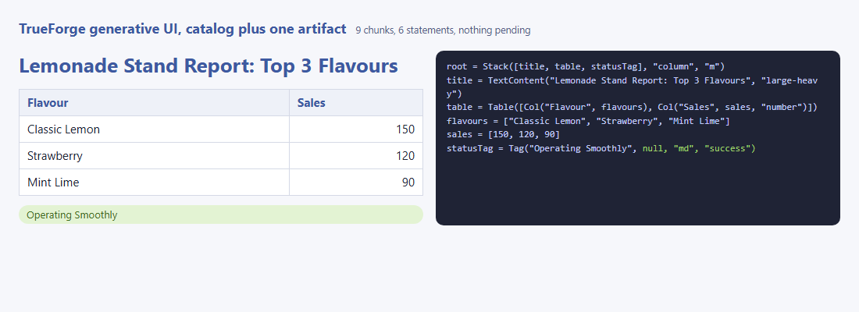
STEP 07.3 · QUICK DEMO
The report prompt: six catalog statements, no artifact
7,972
input tokens, two model calls
124
output tokens
The first model call asks for the catalog through get_openui_instructions; the second carries it and writes the reply.
Title, table with two columns, status tag: step 07.2's renderers, untouched.
The instructions describe HtmlArtifact, and the agent did not use it here: the catalog is the default.
Prompt: Show a lemonade stand report with a table of the top three flavours and a status tag.
128
Notes:
The first prompt is the control. It asks for a report and the agent answers with six catalog statements: a Stack, a TextContent, a Table with two Col statements, a Tag. No HtmlArtifact, although the instructions describe one. The cost is two model calls: about 1,500 input tokens for the agent to ask for the catalog guide, about 6,300 with the guide in context. Step 07.2's 6,954 input tokens were the same two calls. The page is the step 07.2 page, and this screenshot is the same shape as the previous step's.

Slide 129
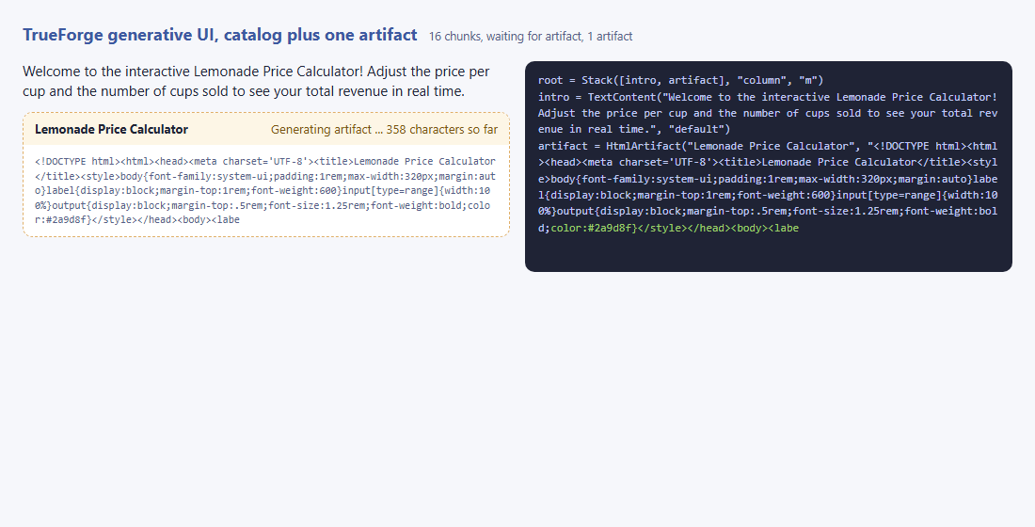
STEP 07.3 · QUICK DEMO
The calculator prompt mid-stream: the intro is drawn, the artifact shows its source growing
16
chunks in
358
characters of document so far
The intro TextContent committed on its own line; the artifact line is still open and shows as raw source.
The same characters are the tail of the program on the right: the server streams 40-character chunks, not lines.
The status reads waiting for artifact: the statement is not committed until its closing quote arrives.
Prompt: Build me an interactive lemonade price calculator I can play with, with a short intro.
129
Notes:
Mid-stream. The first two lines of the program committed, so the intro is drawn. The third line is the artifact, one long string, and the parser's partial() reads it as far as it goes, so the page shows a dashed artifact box with a status line and the raw document. This is what OpenUI's html-artifact example shows while generating. The server streams the program in 40-character chunks instead of one line per event, because a line-per-event server would show nothing of the artifact until it ended. The demo caught this state at 358 characters; the recorded run's mid-stream line says 438 because the screenshot and the print happen a chunk apart.

Slide 130
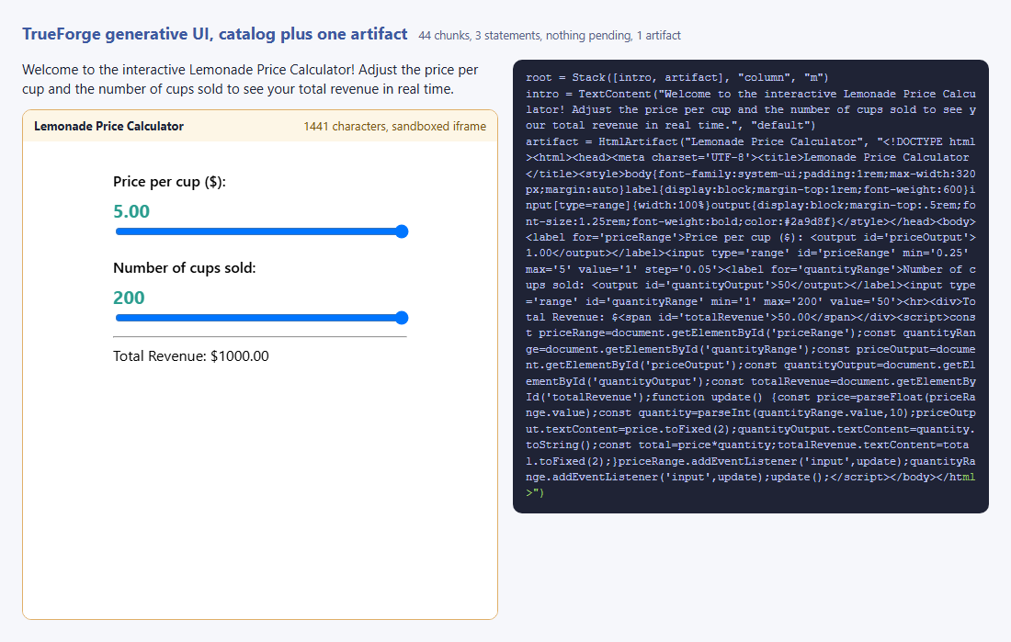
STEP 07.3 · QUICK DEMO
The artifact in its sandboxed iframe: two slider moves changed the total from $50.00 to $1000.00
85%
of the reply's tokens is the artifact document
1,441
characters of HTML, CSS and JS
sandbox=allow-scripts, referrerpolicy=no-referrer, and the CSP meta first in head: the demo checks all three.
The headless test set both sliders to their maximum inside the iframe; the document's own script updated the total.
checkDocument() found nothing to report: no external resource, no network call, no meta refresh.
379 of 447 reply tokens are the document (463 output tokens from turn.done); the catalog reply for the report was 108 tokens.
130
Notes:
The complete reply. The intro is a catalog TextContent; the artifact is a two-slider calculator in a sandboxed iframe, 1,441 characters of inline HTML, CSS and JavaScript. The demo proves the script ran under the policy: it moved both sliders to their maximum inside the iframe and the total went from $50.00 to $1000.00. The token share is the report's argument for the hybrid: 85 percent of this reply is the open-ended document, and the report reply cost 108 tokens in total. Pay for HTML only where a catalog component cannot do the job. Close on the boundary: default-src none, so a document that loaded a script from a CDN would be listed by checkDocument and blocked by the browser.

Slide 131
Choosing
Choosing for your own product
The report's decision framework, with the step that shows each option. Transport first, because your product decides it. Generation mode second, because it is a cost and control trade you can revisit.
1 pick the transport
2 pick the generation mode
3 check the measurements
4 keep the three rules
131
Notes:
The closing section turns the series into a decision. Two tables from the report, annotated with the steps that demonstrate each row, then the numbers this series measured, then the rules that held.

Slide 132
CHOOSING · TRANSPORT, THEN GENERATION
If this is your situation, use this, and this step shows it
If | Then | Step
the agent runs inside a product you build | AG-UI | 02.1 to 02.3
the agent must appear inside Claude, ChatGPT, VS Code or Goose | MCP Apps | 06.1, 06.2
both | ship both: the same UI, two transports | 06.2
the answer shapes are few and your design system is strict | static: prebuilt components, the agent fills props | 01.1
layouts vary and must stay inside your design system | declarative, from a catalog | 01.2 and one of 03, 04, 05
you need the lowest token cost and the earliest first paint | OpenUI Lang | 04.1 to 04.3
you render on Flutter, Angular or native, or need catalog negotiation | A2UI | 03.1 to 03.3
you render to PDF, email, a terminal or video as well as the browser | json-render | 05.1 to 05.3
one-off or creative output is part of the product | the hybrid: a catalog with a sandboxed generated view | 01.4, 04.4, 06.3, 07.3
132
Notes:
Walk the rows top to bottom. The first three are the transport choice. The rest are the generation choice, and each names the sub-theme that demonstrates it. The last row is the hybrid: the answer for products that need both control and freedom.

Slide 133
CHOOSING · WHAT THE SERIES MEASURED
Five questions the report raises, answered with recorded runs
Question | Measured in | Result
How much does open-ended HTML cost against a flat spec? | 01.3 | nine to ten times the tokens, eight times the wall time, over three runs
Does a flat element map paint earlier than a nested tree? | 01.2 | layout known at chunk 33 of 266, against chunk 408 of 408
Does the report's format table hold? | 04.3 | every cell reproduces: OpenUI Lang 4,800 tokens against 9,122 YAML, 9,948 C1 JSON, 10,180 patches
Does patch streaming help a real page? | 05.2 | first paint at 3.5 s against 10.1 s complete; the single-paint version took 5.8 s
How much of a hybrid reply is the open-ended part? | 04.4 | the artifact document was 292 of 341 completion tokens, 86%
What does a hosted harness's UI language look like on the wire? | 07.2 | an OpenUI Lang program of 32 lines and 7 statements inside a normal reply
Can the hybrid live inside a host you do not control, or on a hosted harness? | 06.3, 07.3 | yes: a generated region one sandbox deeper inside an MCP App; one artifact statement in a TrueForge reply, rendered by your own page
133
Notes:
These are the numbers to remember. Every one comes from a demo script in the repository, run against a real model on the recording machine. The token multiples for open-ended generation and the first-paint difference for flat maps are the two that change design decisions.

Slide 134
WRAP-UP
Three rules that held across all 23 steps
​Structure before content. Every format that streams well names the layout first and fills it later: flat maps, forward references, patches against ids. A nested document cannot paint until it closes.
​The catalog is the contract. Prompt, validation and rendering come from one definition. Change the definition and all three change. This is what keeps declarative generation safe.
​Errors are results. A spec that fails validation goes back to the model as text. A blocked script stays inside its iframe. The loop never ends because the agent drew something wrong.
The harness codelab ended with the same three rules for tools. They hold for interfaces too.
structure before content
layout first, holes filled later
the catalog is the contract
prompt = validator = registry
errors are results
invalid specs return as text
Takeaway Models are commodities. The harness is the product. The interface is where the product meets the user.
134
Notes:
Close on the rules. They are the same shape as the harness codelab's rules, which is the point: an interface layer is a harness concern. If a reader remembers one slide, it should be this one.

Slide 135
WHERE TO GO NEXT
Run it, then change it
​git clone https://github.com/dlmastery/simple-coding-harness and open genui/README.md: the written codelab with every snippet verified and every screenshot.
Start with genui/01_foundations/step_01_static_components: python demo.py records a run and a screenshot in under a minute.
Each README ends with a checkpoint: change the catalog, watch the prompt change; remove a prompt rule, watch the token count move.
The harness codelab in the repository root is the other half: the loop, tools, permissions, sandbox, sessions, and the same harness on TrueForge.
The State of Generative UI report is the map this series follows; the step READMEs cite the specification or library each one uses.
harness codelab · stages 1 to 51
the loop, tools, guardrails, context, durability, orchestration, TrueForge
generative UI series · 23 steps
static, declarative, open-ended; AG-UI, A2UI, OpenUI Lang, json-render, MCP Apps
your product
the transport your product needs, the generation mode your design system allows
135
Notes:
End with the call to action. Everything in the deck is runnable. The written codelab is the reference; the deck is the guided tour. The next thing a reader should do is run one step and change one thing.

