Slide 1
cudatrace
A parallel ray tracer written in CUDA/C
Dominick LoBraico
Laura Macaddino
11/29/11
Dominick LoBraico - Laura Macaddino cudatrace
Notes:
CMSC 22200 - Computer Architecture - A. Chien
11/28/11

Slide 2
Application
c-ray – Ray tracing benchmark created by John Tsiombikas
  Reads a scene file and outputs image/time taken
  Scene file, rays per pixel, height and width of output are all variables
Focus on scenario where output dimensions are only the variable
nvcc, cuda-gdb, cuda-memcheck, NVIDIA profiler (command line output), R/ggplot
11/29/11
Dominick LoBraico - Laura Macaddino cudatrace
Notes:
CMSC 22200 - Computer Architecture - A. Chien
11/28/11
CMSC 22200 - Computer Architecture - A. Chien

Slide 3

11/29/11
Dominick LoBraico - Laura Macaddino cudatrace

Slide 4
Initial Modification
Preliminary analysis of c-ray with gprof indicated ~70% time spent in tracing individual rays
Each thread in each block in each grid can trace rays in parallel
Image divided into 2D blocks of 256 threads
  16x16 threads, ensures broad cross-platform support
Blocks make up a 2D grid of dimensions
  (image width/# of threads)x(image height/# of threads)
Each thread needs to store its output into 1D array using index of form “x * grid width + y”
11/29/11
Dominick LoBraico - Laura Macaddino cudatrace
Notes:
CMSC 22200 - Computer Architecture - A. Chien
11/28/11

Slide 5
Initial Modification
Implement workaround for recursive function calls
Flatten linked lists into arrays and structs
Majority of parallelism for ray-tracing tapped
  Most non-trivial changes occurred in initial version
11/29/11
Dominick LoBraico - Laura Macaddino cudatrace
Notes:
CMSC 22200 - Computer Architecture - A. Chien
11/28/11

Slide 6
Initial Modification Evaluation
Performance dependent on resolution
  Less than ~2400x2400 px, sequential ~3 times faster
  Above this level, parallel version takes the lead
  At 576 mpx, sequential -> 7 min, parallel -> 90 s
CUDA limitations – majority of modifications during initial modification
CUDA overhead – poorer performance with smaller dimensions
11/29/11
Dominick LoBraico - Laura Macaddino cudatrace
Notes:
CMSC 22200 - Computer Architecture - A. Chien
11/28/11

Slide 7
Major/Final modification
Significant bottlenecks in initial version:
  Transfer time of device frame buffer array to host
  Overhead of CUDA calls
  Suboptimal block size
Objectives:
  Decrease transfer time
  Reduce the amount of CUDA calls
  Determine optimal thread/block size
11/29/11
Dominick LoBraico - Laura Macaddino cudatrace
Notes:
CMSC 22200 - Computer Architecture - A. Chien
11/28/11

Slide 8
Major/Final modification
Focus of effort remains on simultaneously tracing individual rays
Only able realize improvements noticeable above the 3-4 seconds of context creation
Only able to use block sizes of 22x22 and below
11/29/11
Dominick LoBraico - Laura Macaddino cudatrace
Notes:
CMSC 22200 - Computer Architecture - A. Chien
11/28/11

Slide 9
Major/Final modification
CUDA Limitations
  File output
    Writing to host files from device is impossible
    Organizing a large number of threads (~500) as they write to a file simultaneously is difficult
    Overhead
  File input
    Overhead of reading a file through the host too high to make parallelized file input efficient
11/29/11
Dominick LoBraico - Laura Macaddino cudatrace
Notes:
CMSC 22200 - Computer Architecture - A. Chien
11/28/11

Slide 10
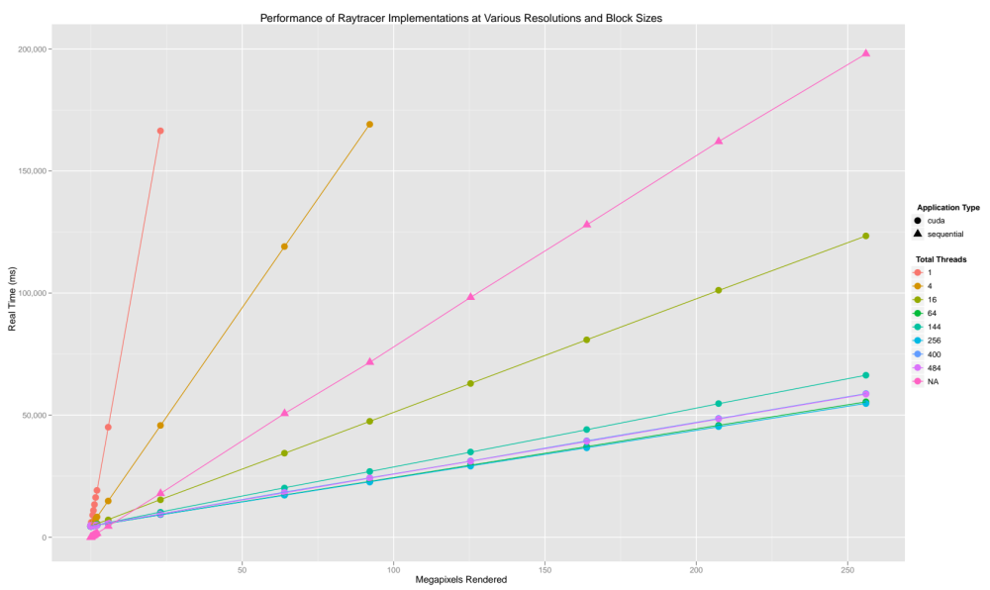
11/29/11
Dominick LoBraico - Laura Macaddino cudatrace

Slide 11
Evaluation
cudaHostMalloc - decreased time to transfer data between host and device
    More expensive than malloc
    Greater throughput when transferring memory
11/29/11
Dominick LoBraico - Laura Macaddino cudatrace
Notes:
CMSC 22200 - Computer Architecture - A. Chien
11/28/11

Slide 12
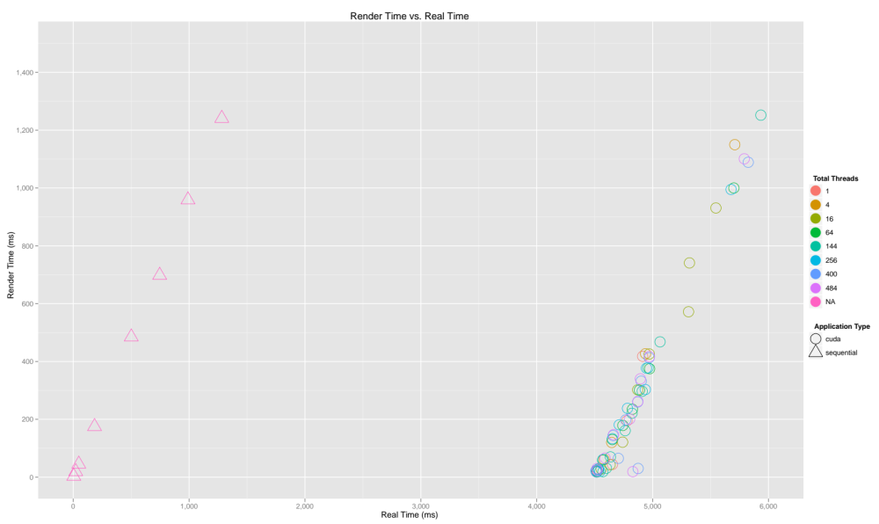
11/29/11
Dominick LoBraico - Laura Macaddino cudatrace

Slide 13
Evaluation
cudaHostMalloc - decreased time to transfer data between host and device
  More expensive than malloc
  Greater throughput when transferring memory
Experimented with varying block size
  16x16 appears to be optimal for broadest range
  Smaller blocks are more efficient at smaller resolutions
11/29/11
Dominick LoBraico - Laura Macaddino cudatrace
Notes:
CMSC 22200 - Computer Architecture - A. Chien
11/28/11

Slide 14
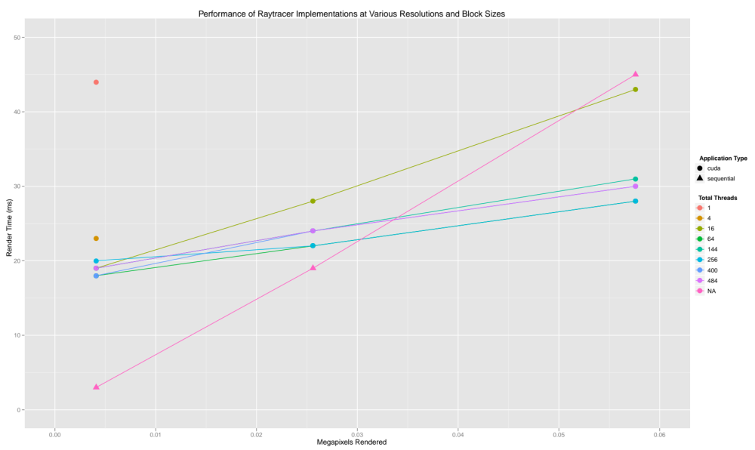
11/29/11
Dominick LoBraico - Laura Macaddino cudatrace

Slide 15
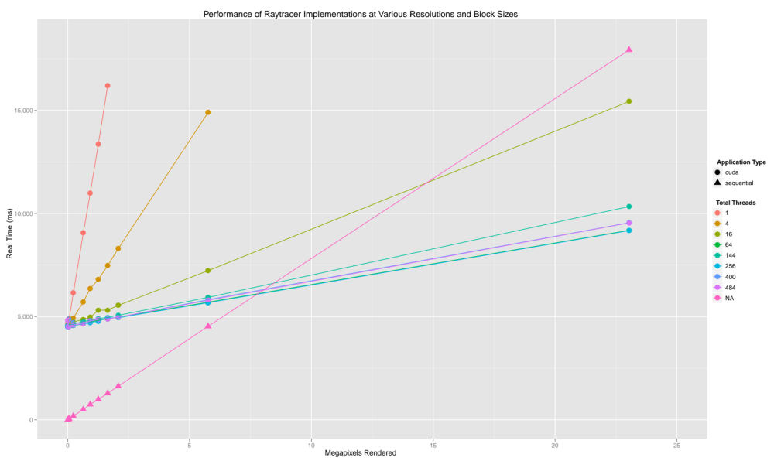
11/29/11
Dominick LoBraico - Laura Macaddino cudatrace

Slide 16
Evaluation
Reduced memory transfer time by utilizing cudaMallocHost for frame buffer – one modified line of code
Unavoidable bottleneck of context creation (3-4 seconds)
11/29/11
Dominick LoBraico - Laura Macaddino cudatrace
Notes:
CMSC 22200 - Computer Architecture - A. Chien
11/28/11

Slide 17
Summary
Ray-tracing is suited for parallelization
    Large amount of computations with no dependencies
    CUDA’s support of 2D threads and blocks
CUDA programming more suited for applications with guaranteed large number of computations
    With smaller number, overhead will trump gains from parallel computation
Impossible to avoid CUDA context creation overhead
    Usually occurs with first CUDA call
    Amdahl's law
CUDA's fast-paced and non-backwards compatible development roadmap will most likely render cudatrace ineffective in a number of years
Q & A
11/29/11
Dominick LoBraico - Laura Macaddino cudatrace
Notes:
CMSC 22200 - Computer Architecture - A. Chien
11/28/11

