Slide 1
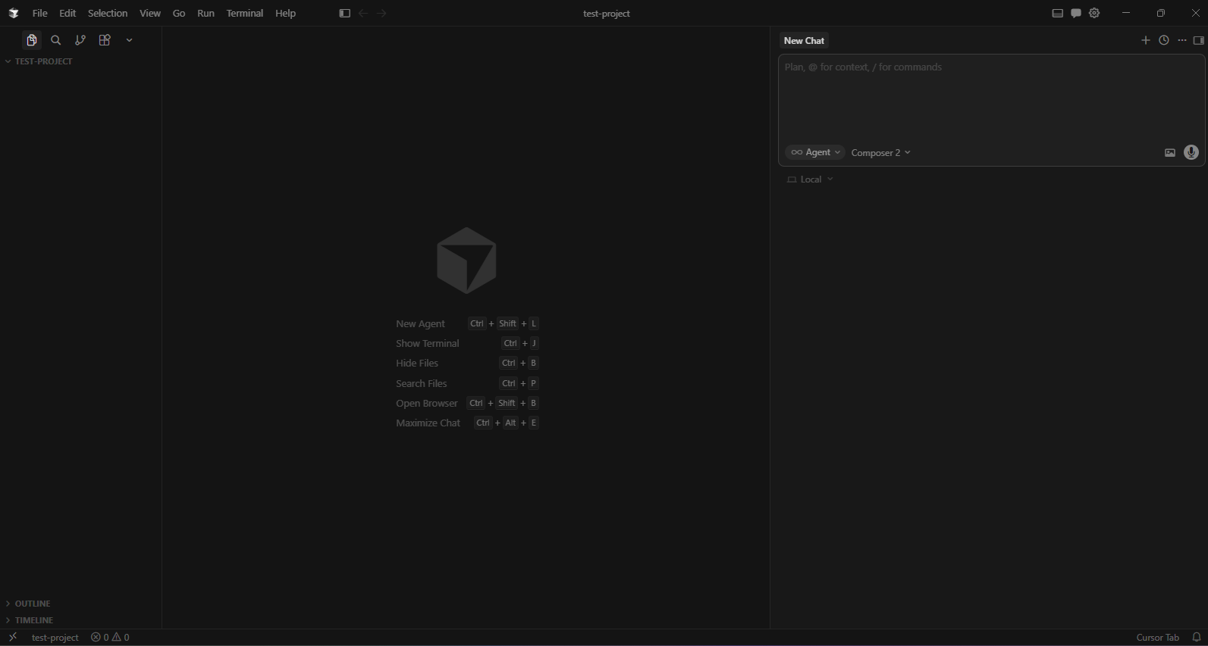
First Exercise: Vibe Coding
Step 1: Open blank project
Make a “test-project” folder in your home directory to hold your project
Run cursor (cursor.dev?) (already installed? Set API key?)
File → Open Folder → “test-project”

Slide 2
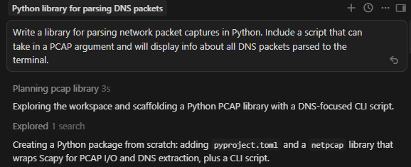
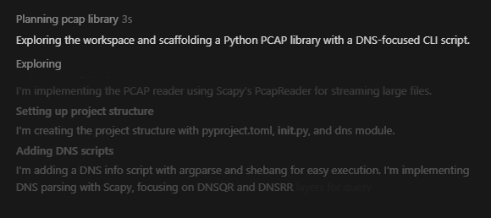
First Exercise: Vibe Coding
Step 2: Ask the AI to create your initial project
In the chat window on the right:
“Write a library for parsing network packet captures in Python. Include a script that can take in a PCAP argument, and will display info about all DNS packets parsed to the terminal.”
In the chat window, you can see the AI working through the problem step-by-step. You can click on one of the summaries in the chat window to see what the AI is “thinking.” These are the output tokens that the AI is producing on its way to producing code.

Slide 3
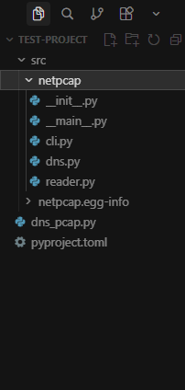
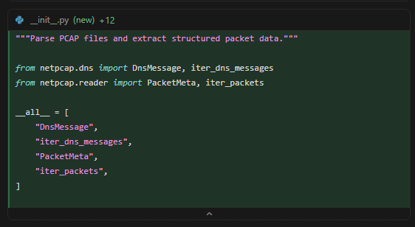
First Exercise: Vibe Coding
On the left, you can see the project’s files being filled in to whatever structure the AI decided on.
You can see lines of code being added in the chat window too.

Slide 4
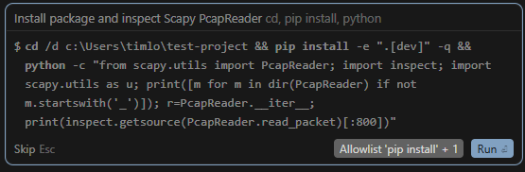
First Exercise: Vibe Coding
The AI needs permission to do things: perform web searches, write files, etc.
Discussion on allowlists, safety, etc.
How could this be abused? What sort of policy should you use to allow some things but not others? Best practices?

Slide 5
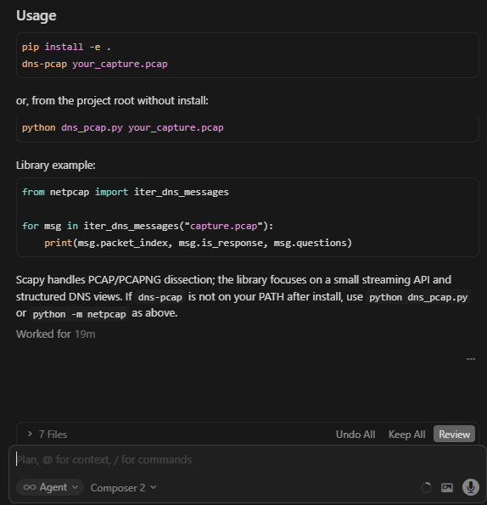
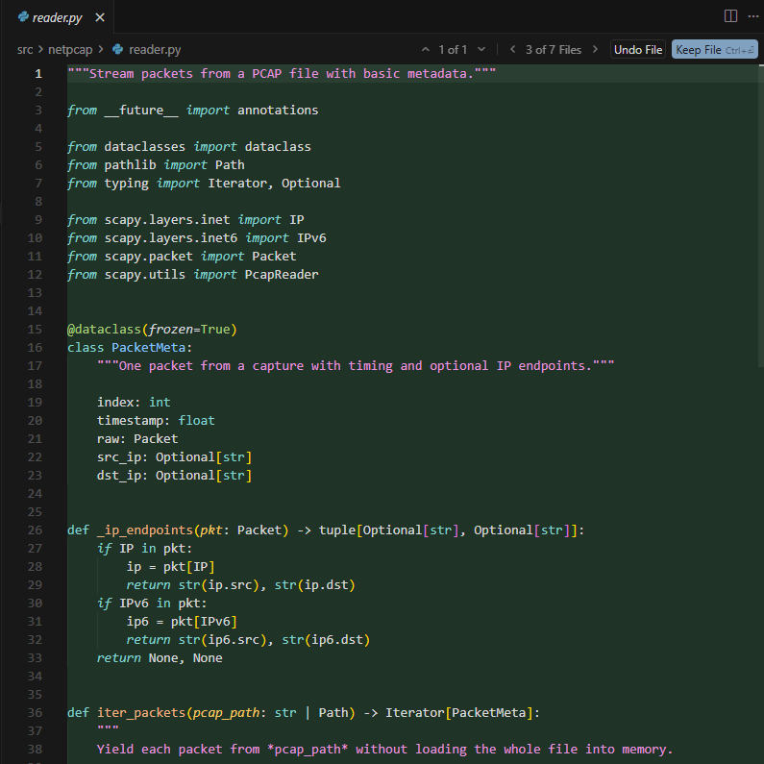
First Exercise: Vibe Coding
Wait for the AI to finish. It will look something like this when done.

Slide 6
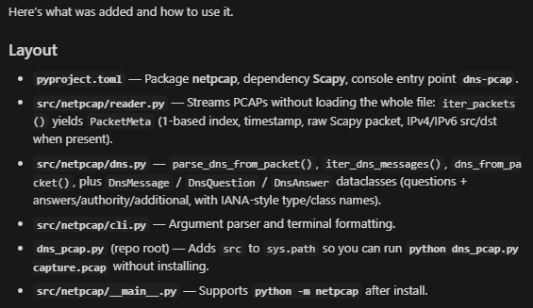
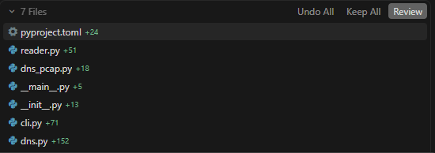
First Exercise: Vibe Coding
Step 3: Review what happened.
The AI will output a summary into the chat window at the end of what it did.
You can review the full set of changes (in this case, whole files) the AI wrote by expanding the bottom right. You can click through them to review and accept/reject each change.
Does it look good?

Slide 7
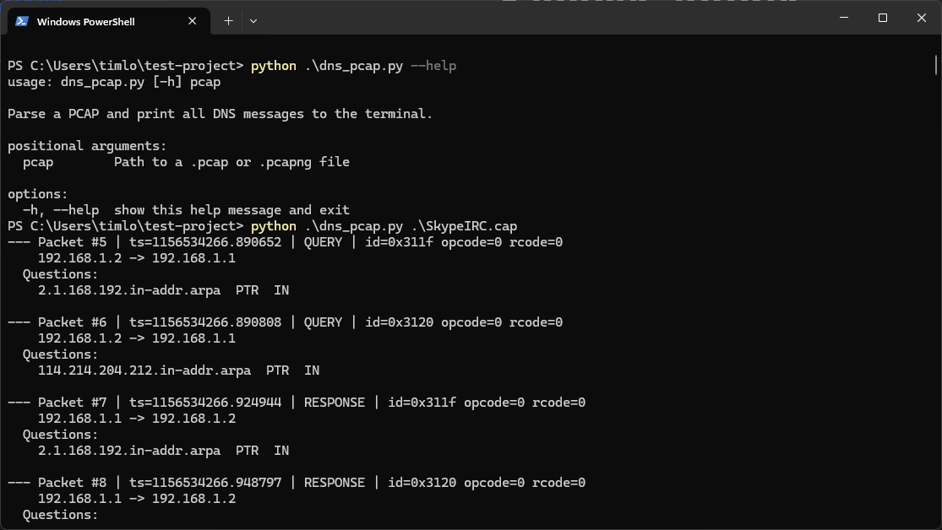
First Exercise: Vibe Coding
Step 4: Run it. Does it seem to work?
Some AI runs may have automatically produced their own tests. Should we trust those?
You can grab a test file with DNS traffic here: http://wiki.wireshark.org/samplecaptures

Slide 8
First Exercise: Vibe Coding
Step 5 (optional): Debug problems
If needed, ask the AI to fix any problems you find (output wrong, crash, etc.) You can often paste the error directly into the chat to get it started.
The first time I ran this tutorial, it failed the first test and needed fixes. The second time it worked right away. Shrug

Slide 9
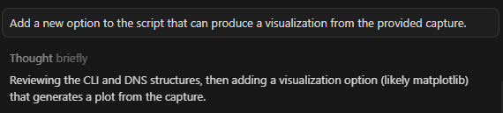
First Exercise: Vibe Coding
Step 6: Add cool visualization feature!
“Add a new option to the script that can produce a visualization from the provided capture.”

Slide 10
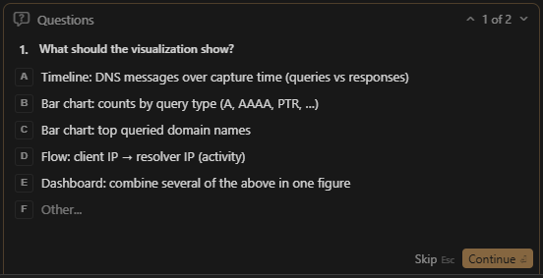
First Exercise: Vibe Coding
Sometimes the AI might ask you a question.
You can just click the multiple choice answer you like best, or give it your own custom answer.

Slide 11
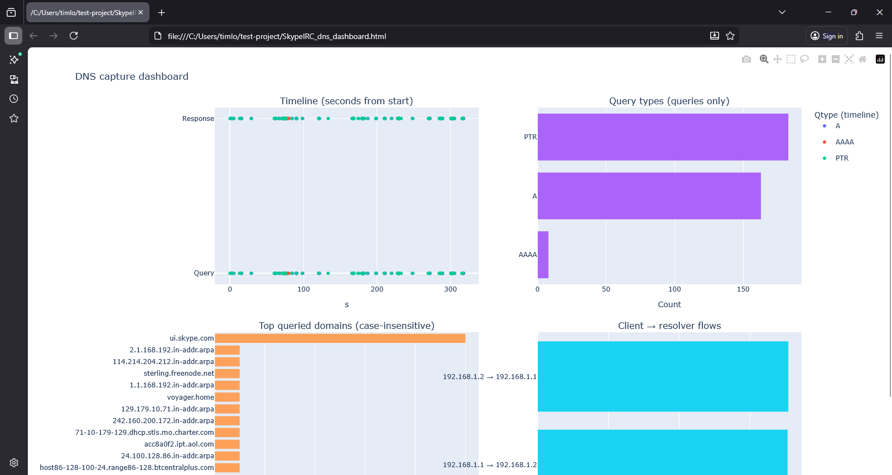
First Exercise: Vibe Coding
Then try out
the visualization:

Slide 12
First Exercise: Vibe Coding
This concludes the Vibe Coding exercise. Feel free to play around with Cursor for a bit.
Bonus content if done early

