Slide 1
Second Exercise: AI-Assisted Development
We tried vibe coding. Now let’s take back control.
In this exercise, we will be using Cursor to help us code again, but the project will be larger and we will try three different techniques: Planning, Incremental Improvement, and Managing
The project these slides are working on is: building an interactive call graph visualizer for x86 binaries
You can follow along with that goal, or create your own if you wish

Slide 2
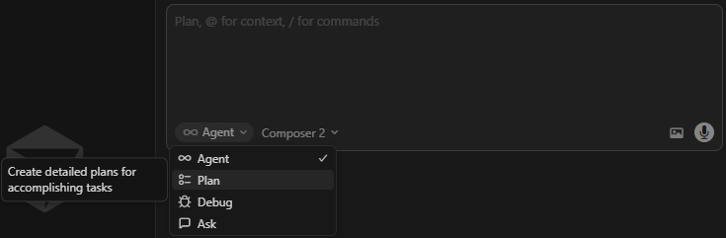
Second Exercise: AI-Assisted Development
Technique 1: Planning
Planning helps the agent do more complicated tasks, with a more well-specified goal for each step. It also allows you to see what design decisions the AI is making and approve or correct them as needed.
In the bottom left of the chat window, you can change your chat session type to “Agent” or “Plan” or “Ask”

Slide 3
Second Exercise: AI-Assisted Development
Technique 1: Planning
Agent: this mode is the default that we used earlier, it can do basic coding tasks.
Ask: this mode is for asking questions when you DON’T want the AI to write code. You can ask about the code base, ask it for ideas, etc.
Plan: this mode is for larger, more complicated coding tasks. Before writing any code, this mode will create a plan document that is essentially a series of prompts that the agent will use to break down and accomplish larger coding tasks.

Slide 4
Second Exercise: AI-Assisted Development
Technique 1: Planning
(Optional) You can also try co-designing your software’s MVP with a different AI, like through ChatGPT. Almost any AI can be helpful to help synthesize a design document and help find holes and problems and solutions.
MVP: Minimum Viable Product. What is the smallest subset of your intended program that you can build to have something that runs and can be tested/used?

Slide 5
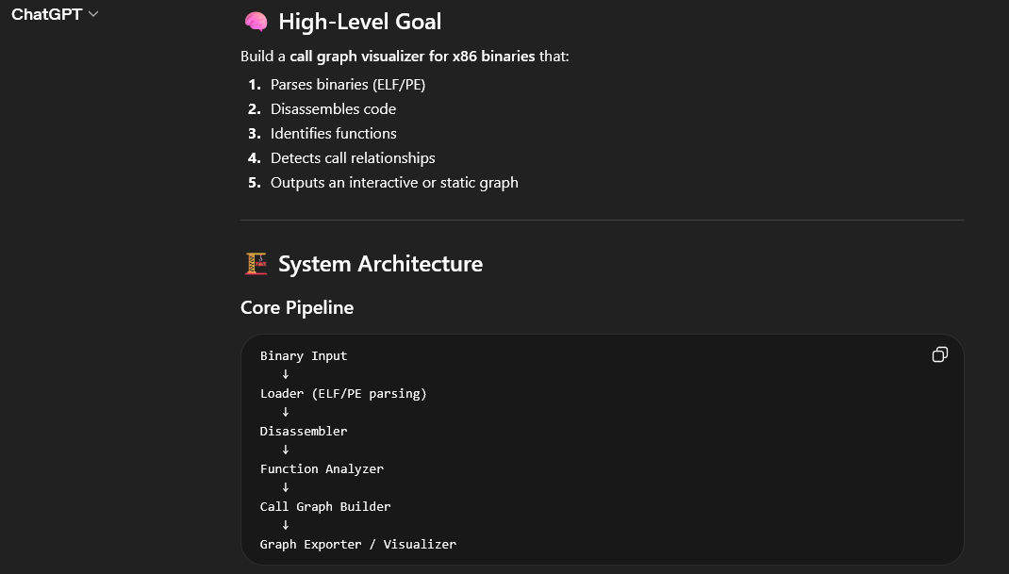
Second Exercise: AI-Assisted Development

Slide 6
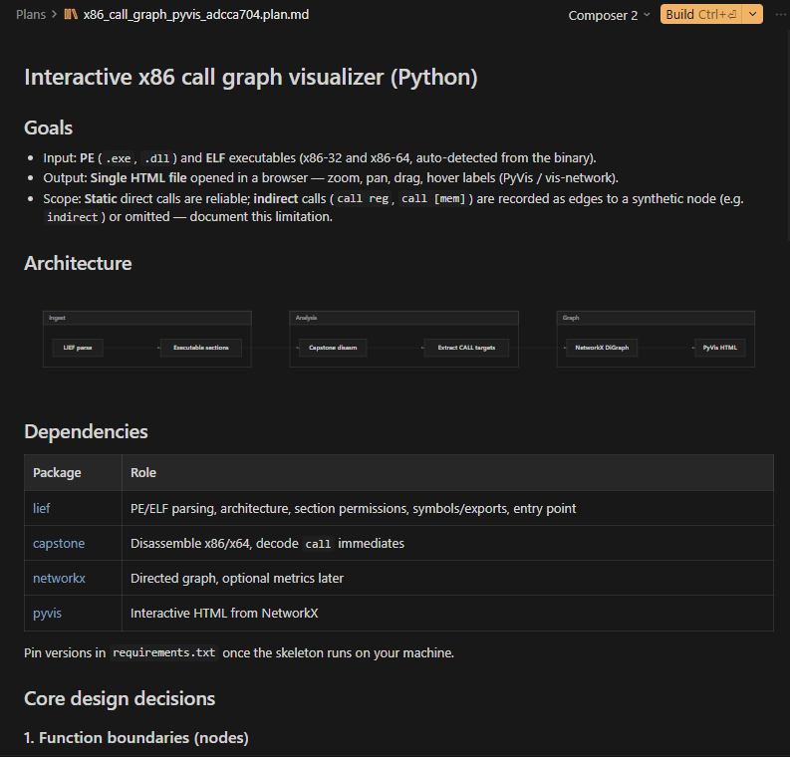
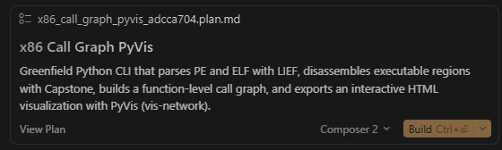
Second Exercise: AI-Assisted Development
Technique 1: Planning
After submitting a prompt in planning mode, you can view and edit the plan document
When ready, hit “Build”

Slide 7
Second Exercise: AI-Assisted Development
Technique 2: Incremental Improvement
Make incremental changes as small as possible, rather than trying to do the whole thing at once. The smaller and more defined the change – the more likely AI is to succeed.
Too Big: "I want the visualizer to be able to zoom in and out and move nodes around."
OK: "Add the ability to listen to keyboard input interactively."
OK: "When I press z, the visualization should zoom out by 25%.”
OK: “Add the ability to listen to mouse input interactively.”
OK: “When I click and drag a node, it should move (along with all the edges connected to it)”

Slide 8
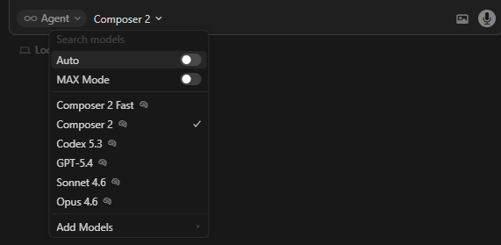
Second Exercise: AI-Assisted Development
Technique 2: Incremental Improvement
You can set the specific model used here
The model that gets used and its level of effort is important for determining how good the results you get are
Small, well-specified tasks can be safely given to stupider (cheaper) models
The big important stuff, like coming up with the plan, can benefit greatly from using a better model

Slide 9
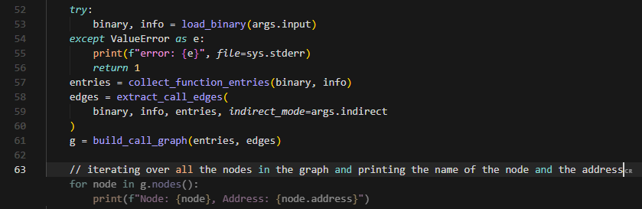
Second Exercise: AI-Assisted Development
Technique 2: Incremental Improvement
Cursor has an autocomplete feature
Useful when you know exactly how to do something, it is a bit tricky, and you want it done right: make the surgical changes yourself
Try writing a comment to describe what you are about to do

Slide 10
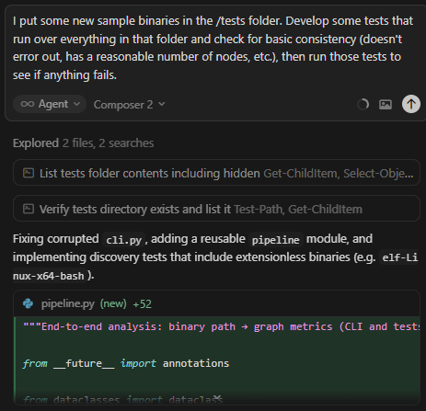
Second Exercise: AI-Assisted Development
Technique 3: Managing
The key to good AI coding practices is adopting many of the same good SWE practices that work for managing large software projects
Testing is an important one
If done right and well-specified, the AI can successfully debug problems in a loop on its own.
Be careful: in my experience, the AI decides removing tests is sometimes a good way to get things to pass the tests.

Slide 11
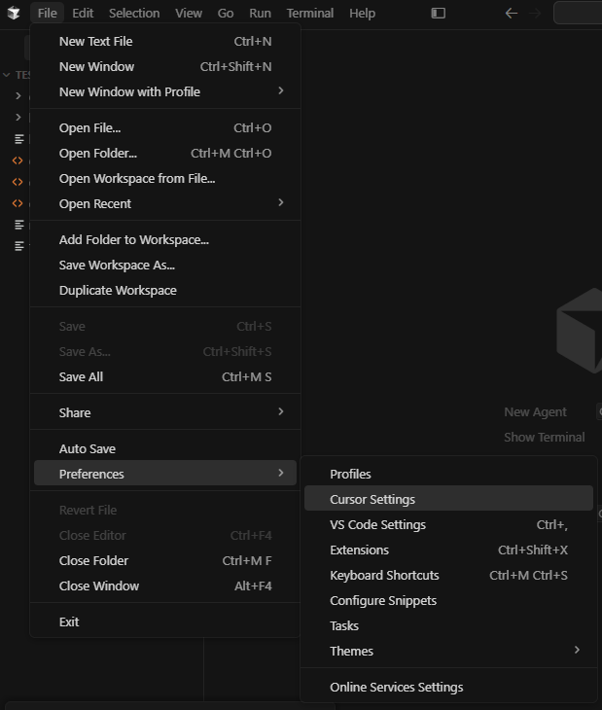
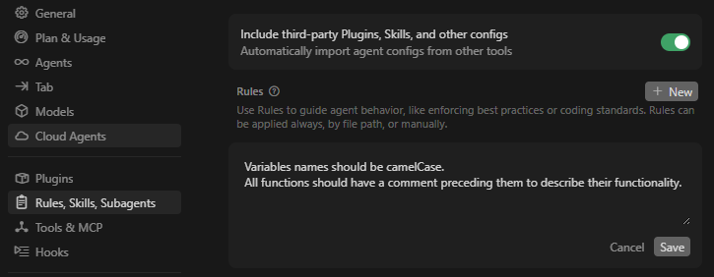
Second Exercise: AI-Assisted Development
Technique 3: Managing
Cursor has “rules” that allow you to more directly manage the system prompt provided to the AI. See: https://cursor.com/docs/rules
These rules are useful for project-level directives like formatting or coding style or overall architecture or “make sure you do/don’t do X”

Slide 12

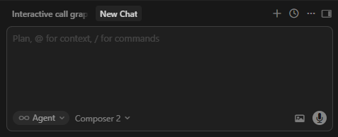
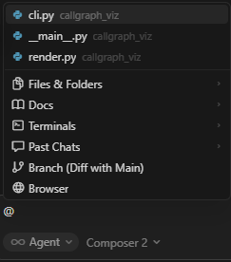
Second Exercise: AI-Assisted Development
Technique 3: Managing
You can also more explicitly manage the context window of the AI.
See current context usage →
Clear context in new chat window →
Add specific
context (file, URL,
etc.) with @ →

