Slide 1
Generating interactive spatial roleplay scenes for Vision Pro from scene descriptions
CS348K — Visual Computing Systems
Notes:
Intro: turn a written roleplay scenario into a runnable, interactable Vision Pro scene; a generation pipeline + an evaluation of where it works and breaks.

Slide 2

1
What we set out to build
Goal: Bring embodiment to roleplay — given a scene description, automatically generate a runnable, interactable Vision Pro scene that supports the embodied interactions relevant to intended practice scenarios.
Constraint 1 · Runs on Apple Vision Pro
Integrates with our research prototype — but Apple blocks runtime code generation, so we must build interactivity from existing interaction primitives.
Constraint 2 · Generates in minutes
No hand-authoring, no long offline 3D pipelines. A scene may take a few minutes; we keep learners busy with end-of-scene activities.
Constraint 3 · Generation, not retrieval
We want any scene a learner can imagine — generation is more likely to cover that space than retrieval from a fixed library.
Notes:
Problem + three constraints. Apple's no-code-gen rule is why we use a fixed primitive vocabulary.

Slide 3
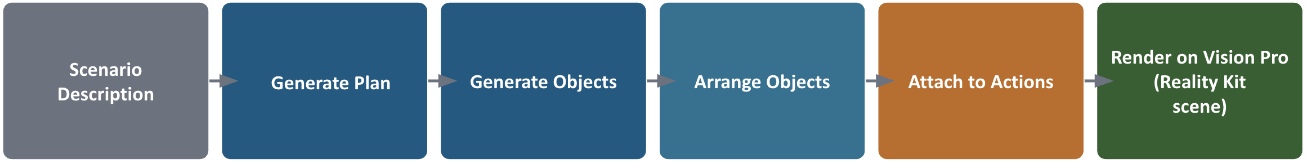
2
Why existing approaches don't fit
LLMR (Microsoft, CHI 2024)
Holodeck (CVPR 2024)
Our inspiration: speak interactive worlds into existence. But it generates C# code run in Unity via a self-debugging loop — too heavy to guarantee runnable in minutes, and it can't run in the Apple environment because of code-generation restrictions.
Generates room-scale environments for embodied-AI navigation by retrieving assets from a fixed library. Wrong regime: room-scale full environments, library-bounded not on-demand, an environment rather than an interactive task scene.
Our Approach: generate the necessary 3D interactive content to support embodied interaction; a partial scene that consists of 3D objects and a set of possible interactions relevant to a practice scenario
Notes:
LLMR inspiration but wrong tool (code-gen blocked on Apple); Holodeck wrong regime. Forces our three design choices.

Slide 4
3
Scenario Cards
mined from our own GELLI study corpus (292 scenes, 3 contexts, ~3,400 learner turns). Two data signals flag interactions that wanted a 3D representation:
Spatial references
Narrated stage directions
31% of turns used a demonstrative (“this one,” これ/それ) — a learner pointing at something absent. Spikes in shopping (32%) and open-ended scenes (35%).
Character turns already described physical objects and actions (“pulls out two jackets,” “withdraws the card”) — the text was simulating a 3D scene in prose.
Selected 9 scenarios that span all three contexts, exercise all five primitives, and include two deliberate stress cases (station, shrine). The evaluation then compares each card's demanded interactions against the generated plan.
Notes:
The scenarios are data-derived, not arbitrary. Two signals: deixis density + narrated stage directions. Sets up the card-vs-plan analysis.

Slide 5
HOW WE BUILT IT · SCENARIO CARD → GENERATED PLAN
HOW WE BUILT IT · SCENARIO CARD → GENERATED PLAN
From a written scene to a typed, runnable plan
Written roleplay → typed, runnable plan
Real exported example: cafe_paying_check. The LLM output is constrained into objects plus primitive tasks over those object ids.
Scenario card
LLM → Objects
LLM → Tasks
Validate
Typed plan
Written ScenarioCard
Generated typed plan
Cafe counter at the end of a meal
Objects
Goal: Pay the check and collect your receipt
cafe_counter · bill_tray · payment_card
card_reader · receipt · change
Two structured-output LLM calls
First the objects (typed specs constrained to supported kinds), then the tasks — mapping the card's natural interactions onto the five primitives.
Target interactions
Tasks
1.
request the check
request_the_check
indicate(bill_tray)
2.
place your card on the tray
place_card_on_tray
place(payment_card, bill_tray)
Typed, not code
3.
tap the card reader to pay
tap_card_reader
tap(card_reader)
Apple blocks runtime code generation, so we generate a validatable plan, not behavior code. That makes the output checkable and guaranteed runnable.
4.
take your receipt and change
take_receipt_and_change
drag(receipt)
Validation checks structure, not quality:
unique ids · no dangling object refs · only supported primitive kinds
Reliability strategy
Structured output is flaky — we retry up to 3×, validate structure (duplicate IDs, dangling refs, unsupported primitives), and log a failure as data rather than crashing.
Why this matters
The evaluation compares the written demand against this typed output: did the desired roleplay survive translation into runnable primitives?
Notes:
This slide replaces the abstract pipeline graphic with one real exported example from the final eval data: cafe_paying_check.
Left side is the written ScenarioCard. It contains natural roleplay demands: request the check, place your card on the tray, tap the reader, take receipt and change.
Right side is the generated typed plan. The objects are the concrete scene inventory: cafe_counter, bill_tray, payment_card, card_reader, receipt, and change. The tasks are executable primitive interactions over those exact object ids.
The key translation examples:
- “request the check” became indicate(bill_tray). This is a compromise but reasonable: the learner points/indicates the bill tray.
- “place your card on the tray” became place(payment_card, bill_tray), which is a faithful mapping.
- “tap the card reader to pay” became tap(card_reader), also faithful.
- “take your receipt and change” became drag(receipt), which is an imperfect compromise because it does not really model receiving both receipt and change. This is exactly why the evaluation has task fidelity ratings.
Validation happens after this typed plan is produced. It checks structural runnability: every object id is unique, every task id is unique, every task references objects that actually exist, and every expectedInteraction is one of the supported primitives. Validation does not judge whether the roleplay is faithful or visually good. That is what the manual evaluation is for.
Presenter line: “The central translation problem is turning natural roleplay language into a typed object-and-task plan. We can then score how much of the original roleplay survived that translation.”

Slide 6
HOW WE BUILT IT · GENERATED PLAN → REALIZED OBJECTS
Reconstructing the objects on demand
Typed plan
SAM 3D generation
mesh → USDZ
proxy fallback
objects ready
On-demand reconstruction
Each object is reconstructed by SAM 3D on a remote GPU. Model load + ~75s/object exceed request timeouts, so we run async jobs the app submits and polls, caching the results.
Render format
Gaussian splats don't render natively in RealityKit, so we take reconstruction through a mesh→USDZ path — the format the runtime can load.
Always-runnable fallback
Objects that fail to reconstruct fall back to primitive proxies, so a scene is never blocked on a single failed asset (apple_basket failed while the rest fell back).
Notes:
Realization half: async remote reconstruction, mesh to USDZ, proxy fallback. Objects exist; placing them coherently is the next hard part.

Slide 7
Laying out out a coherent scene
The problem. A model that emits 3D coordinates produces physically incoherent scenes — props float (the basket at y=1.0), overlap at the origin, ignore the counter. Spatial validity, not generation, was our bottleneck.
Holodeck’s insight. Derive proper placement from structured metadata. Holodeck has GPT-4 emit spatial relational constraints, then optimizes a room layout to satisfy them.
Our solution. A deterministic layout solver (“stage_surface_slots_v1”) that places objects from roles, task-derived relations, and reconstruction signal — never from the model's raw coordinates.
Notes:
This is the main technical challenge slide. The point is that the LLM was reasonably good at naming objects and interactions, but weak at geometry. Raw generated positions caused objects to float, overlap, sit on the floor, or scatter around the room.
The example on the slide is the concrete failure: in a convenience-store plan, the basket could be at y=1.0, the terminal could be at an arbitrary coordinate, and the menu could overlap another object. Those are legal numbers, but not a coherent reach-scale scene.
The key phrase: “layout was not just aesthetics; it determined whether the interaction could be performed.” If a card reader is on the couch, the payment task technically exists but no longer feels like the roleplay.
The Holodeck connection: Holodeck uses semantic constraints instead of trusting raw coordinates. Our version is much simpler and reach-scale: infer support surfaces and object relations from the generated task structure, then deterministically place objects into a small stage in front of the learner.
Presenter line: “The main systems problem became converting a semantic plan into a spatially coherent stage.” In the future, we would add complexity and then re-run an experiment like this, to account for the gaps in what we wanted to happen in a scene. If we parameterize it properly maybe we could even learn this. Could we somehow use code gen to evolve the code base to include more and more primitives and functions that support more and more interactiosn that it represents in it’s code? Then eventually if we run it for a while it would learn a crazy breadth of interactions and functions and support a lot of different scenes and interactions. It would have to observe the outputs rendered and evaluate them on what needs to improve, then update it’s code along these parameters and then observe the output again. Much like app generators.

Slide 8
How we place objects: metadata, relations, anchor
1 · Placement signal + screenshot review
2 · Metadata-driven roles
SAM 3D returns per-object translation + scale; we also derive an image-plane candidate (X from image left/right, Z from vertical position, depth from area). We used a VLM to review rendered screenshots and label it with pose estimation data, adjusting it until objects transferred plausibly.
Every object is tagged a role — surface, prop, or person-marker — with a support surface and a normalized size. The surface is snapped to a canonical reach pose ([0, 0.62, −0.95]).
3 · Relations from the task queue
4 · Deterministic finish
place-on / place-in tasks become spatial relations the solver applies — our analog to Holodeck's constraints (coin → inside the donation box, jacket → on the fitting hook).
Props are slotted and snapped onto the surface top (y = surfaceTop + height/2); support is enforced, overlaps repaired, markers stand at height. No floating, no overlap.
Notes:
Explain the layout solver as a deterministic cleanup pass after generation.
Step 1: find or insert a support surface. If the scene does not contain a counter/table/surface, the solver inserts a fallback interaction_surface. It normalizes the surface to a canonical reachable position in front of the learner.
Step 2: classify roles. Objects are tagged as surface, sourceObject, targetContainer, payment, uprightContext, personMarker, or contextObject. That role decides how the object should be placed. Small manipulable props go on the surface. Containers/trays/baskets become targets. NPC markers stand behind the surface. Menu boards and maps stand behind/on the surface. Payment devices go toward the back/right.
Step 3: infer relations from the task queue. If the task is place(payment_card, bill_tray), the solver infers that both objects belong on the surface and the tray should be near/right of the card. If the task taps a payment device, it gets terminal-like placement. This is our reach-scale analogue of a Holodeck layout plan: relations from semantics, not just coordinates.
Step 4: snap and repair. Non-person objects get y = surfaceTopY + objectHeight/2, so their bottoms rest on the surface. Then the solver clamps them within the surface bounds and nudges objects to repair overlap.
Step 5: attach asset/layout metadata. Each object gets an asset card: layout role, asset kind, supportSurfaceId, target size, and resting policy like bottomOnSupport. This metadata tells rendering/SAM3D how to treat the object.
Important nuance if asked: the implemented shipped solver uses roles, task-derived relations, canonical surface placement, snapping, and overlap repair. SAM3D reconstruction pose/scale was part of the broader layout investigation, but the reliable live pass is this deterministic stage-surface solver.

Slide 9
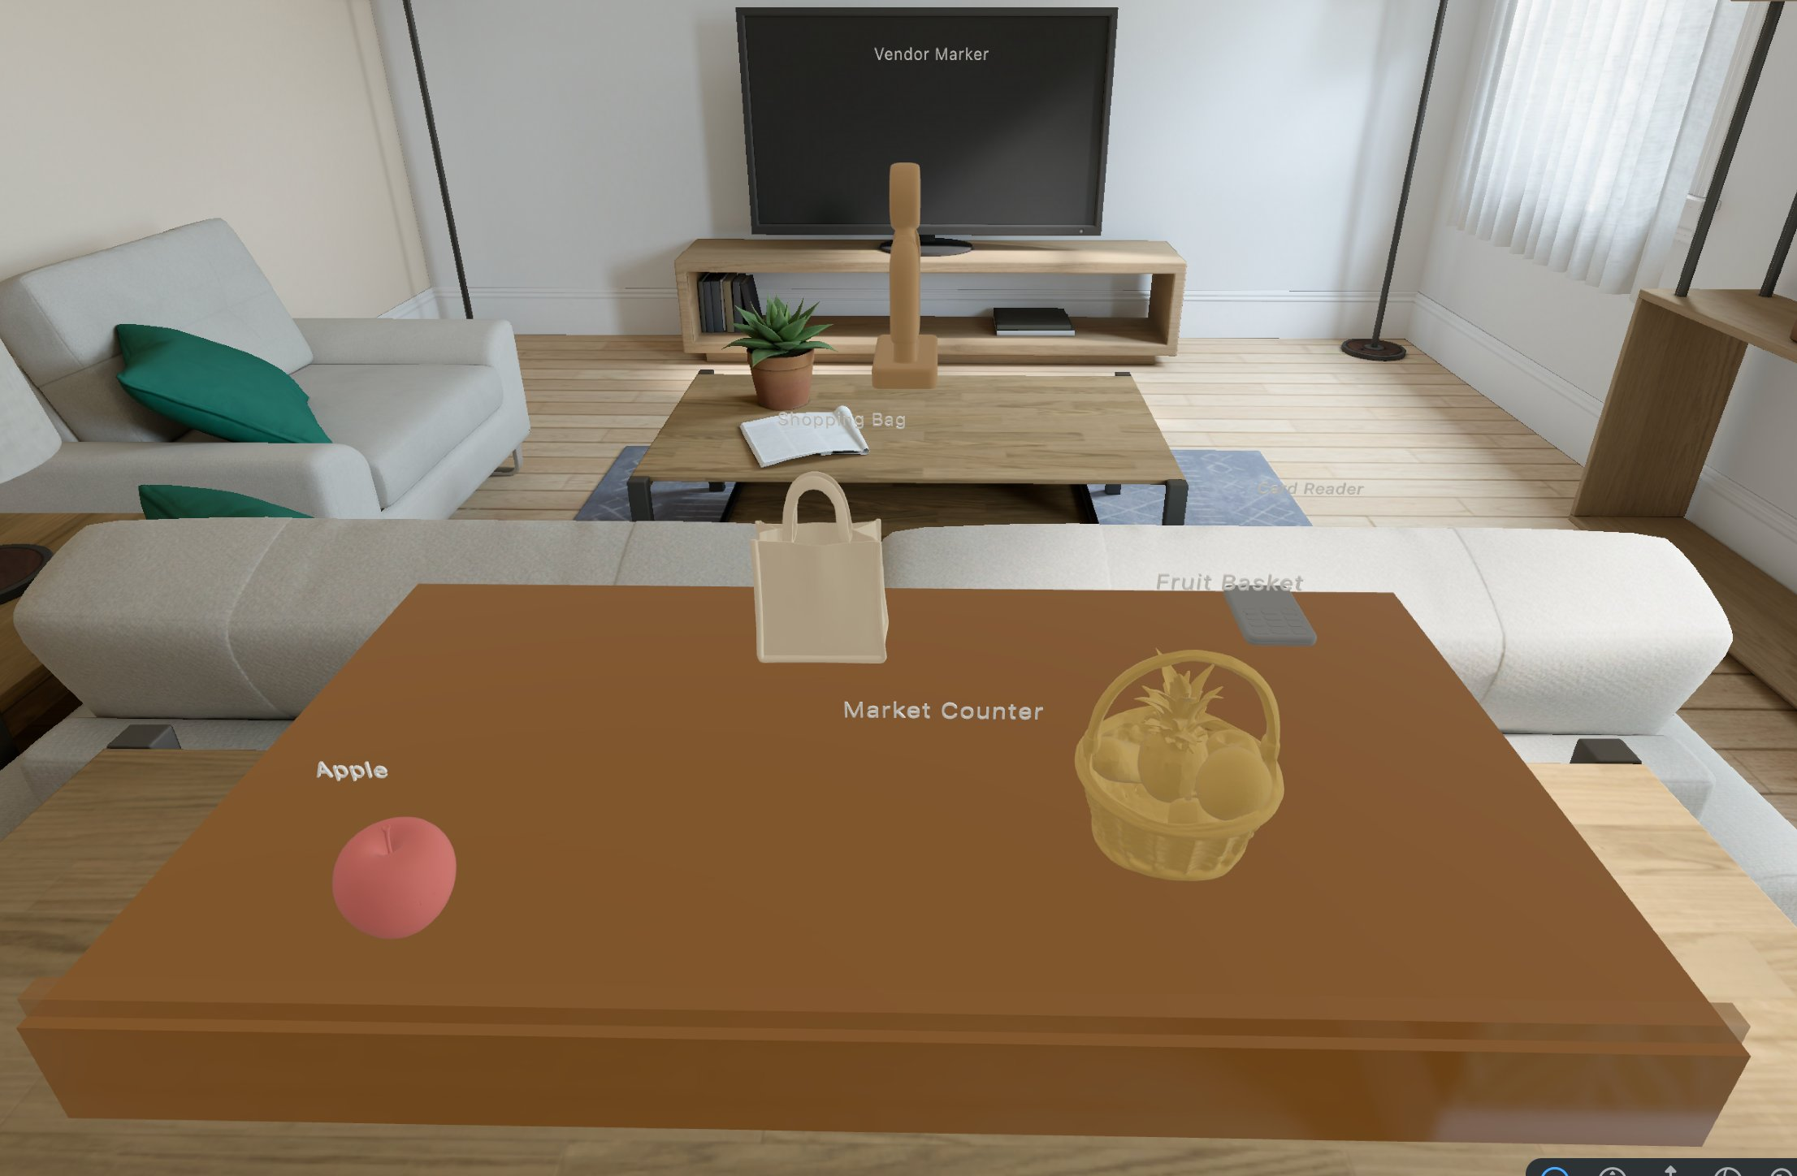
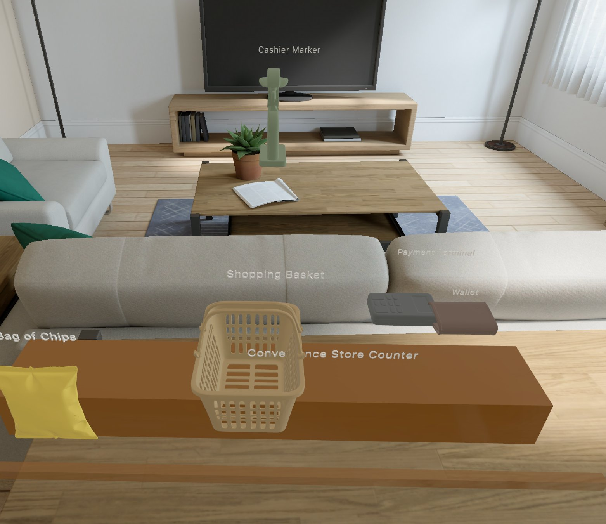
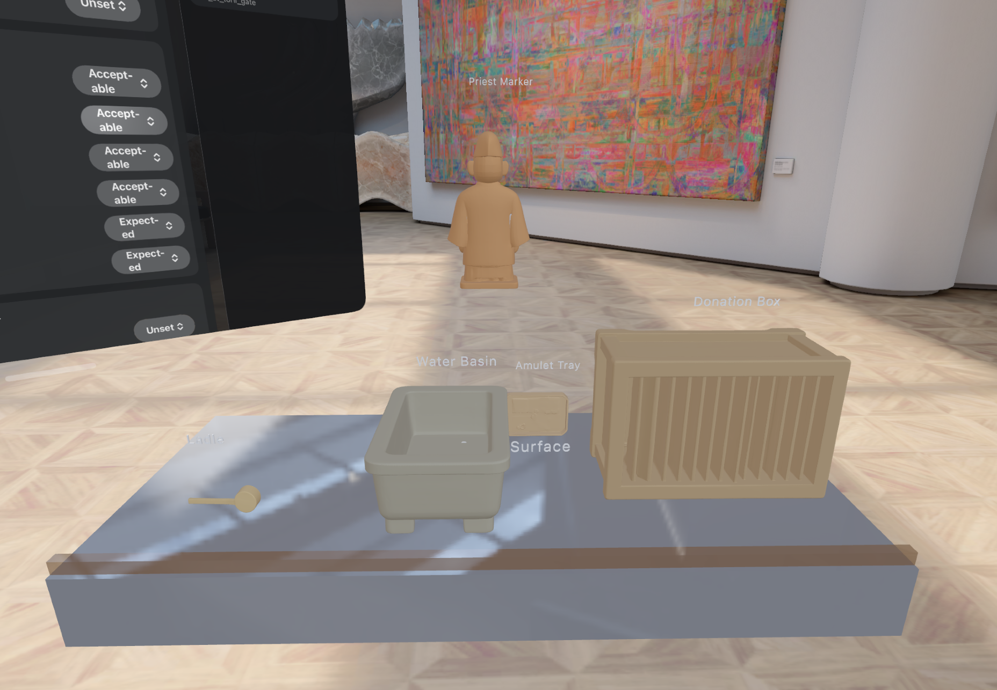
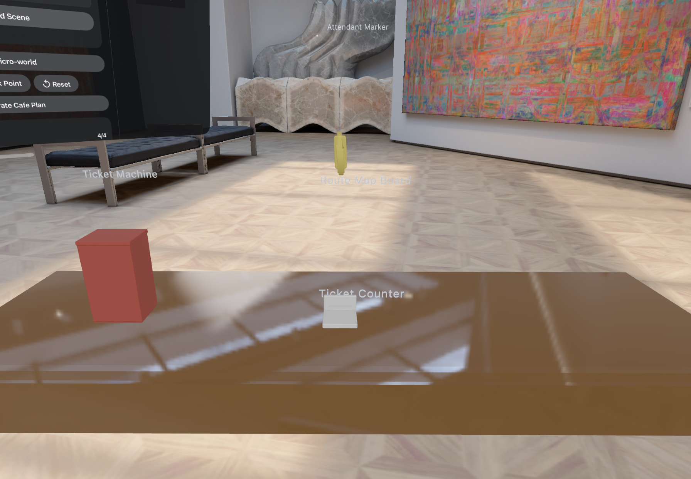
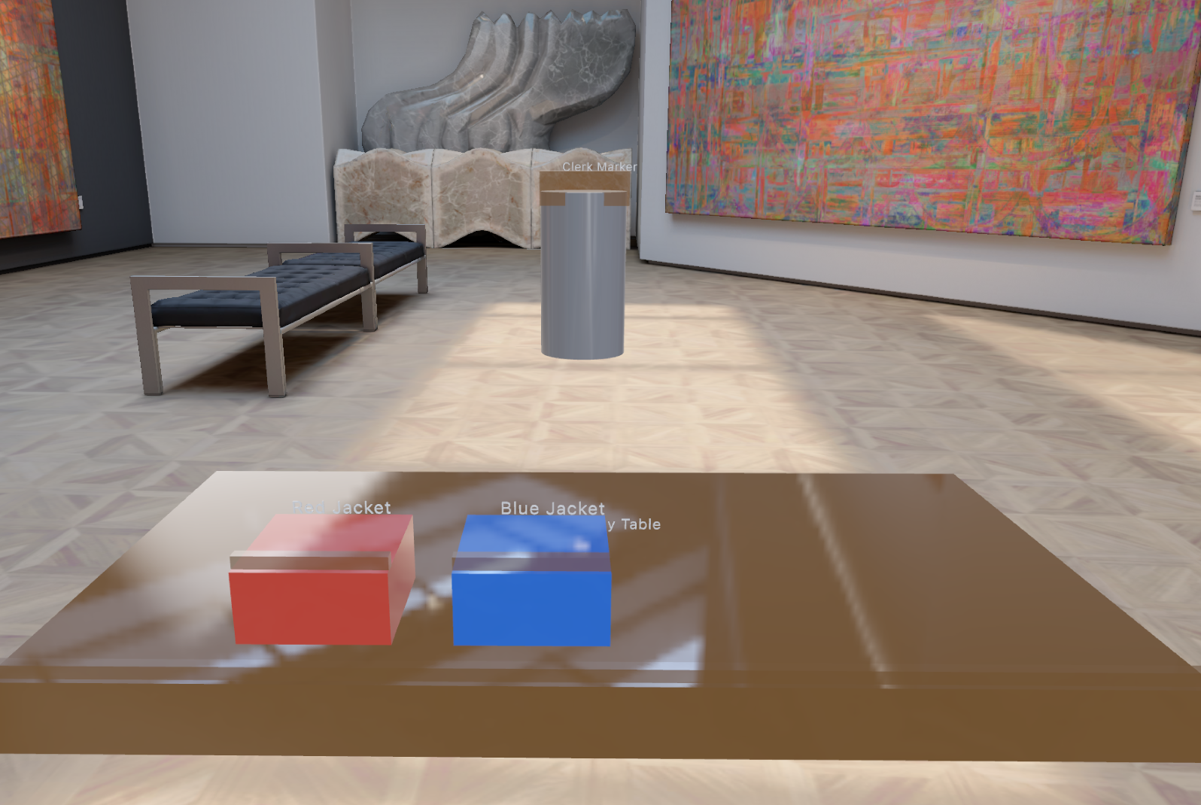
5
Results: the stack closes
4
Results: final scenes expose the system gaps
Final eval screenshots show the stack closes end-to-end, but the remaining defects are visible: surface grounding, object realism, and affordance wiring.
Shrine purification — many ritual objects present, but embodiment is compressed
Station ticketing — spatial layout reads, map/machine remain proxy-like
Clothing compare — generated jackets support the comparison task
Market stand — generated fruit basket, bag, apple, in-room
Convenience store — chips, basket, payment terminal on the counter
Recognizable: fruit basket, bags, chips. Rough: the apple is a smooth blob and layout is the main visual defect — which the rubric records as the realization gap.
Evaluation reveals which layer failed: plan alignment, visual realization, layout, or interactivity.
Notes:
Real output — stack closes end-to-end; honest about crude assets/layout.

Slide 10
4
How we evaluate: one demand, three gaps
5
How we evaluate the system outputs
We score the pipeline at three artifacts: the generated plan, the realized scene, and the runnable task execution. Each result graph later corresponds to one of these checks.
Every desired interaction either isn't expressible, is expressible but the generator misses it, or is generated but doesn't realize. We attribute each drop to a stage.
1 · Plan alignment
2 · Scene Rendering
3 · Runtime support
Desired
Expressible
Generated
Realized
Scenario card → typed plan
Typed plan → spatial scene
Scene → roleplay interaction
interactions from real transcripts (primitive-blind)
L1 · can the 5 primitives represent it? (analysis, no scenes)
L2 · does the LLM produce an aligned plan? (scored on the plan)
L3 · does it render, place, and play? (rubric + latency)
•
Object coverage: did it create the expected objects?
•
Object realization: are objects recognizable?
•
Affordance instrumentation: can the learner perform the intended action?
•
Task fidelity: faithful / compromise / missed / invalid
•
Spatial plausibility: reachable, grounded, non-overlapping?
•
Task completion: yes / partial / no after driving the task
•
Structural validity: no dangling refs, supported primitive kinds
•
Context sufficiency: does it read as the intended setting?
•
Latency: planning time from app logs; SAM3D time from output timestamps
L1 and L2 don't depend on scene quality — so the core results survive rough assets.
Notes:
This slide primes the results section. The key is that we are not giving one vague score for a scene. We score three different artifacts in the pipeline.
First: plan alignment. This is scenario card to typed plan. We look at whether the generated objects cover what the scenario asked for, and whether each generated task faithfully maps the written interaction to a supported primitive. Task fidelity ratings are faithful, compromise, missed, and invalid. Validation is also part of this level, but validation only checks structure: unique ids, no dangling object references, and supported primitive kinds.
Second: scene realization. This is typed plan to visual/spatial scene. We score object realization, spatial plausibility, and context sufficiency. Object realization means recognizable objects. Spatial plausibility means objects are grounded, reachable, and not overlapping in a weird way. Context sufficiency asks whether the scene has enough surrounding context to read as the intended setting.
Third: runtime support. This is the realized scene to actual roleplay execution. We score affordance instrumentation and task completion. Affordance instrumentation asks whether the needed interaction is wired: tap, place, drag, indicate, gesture. Task completion asks whether the learner could actually complete or partially complete the task in the scene. We also measure timing: LLM planning from app logs and SAM3D realization from output file timestamps.
This structure is important because it lets us attribute failure. If the task is missing from the plan, that is a planning/vocabulary issue. If it exists but the object is unrecognizable or floating, that is realization/layout. If it looks okay but cannot be interacted with, that is affordance/runtime.
Presenter line: “The evaluation is designed to localize failures, not just say the scene was good or bad.”

Slide 11
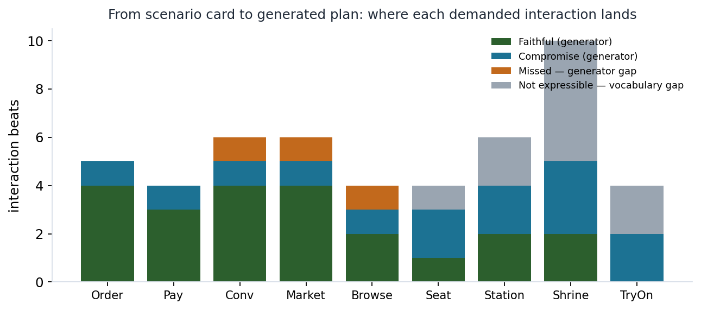
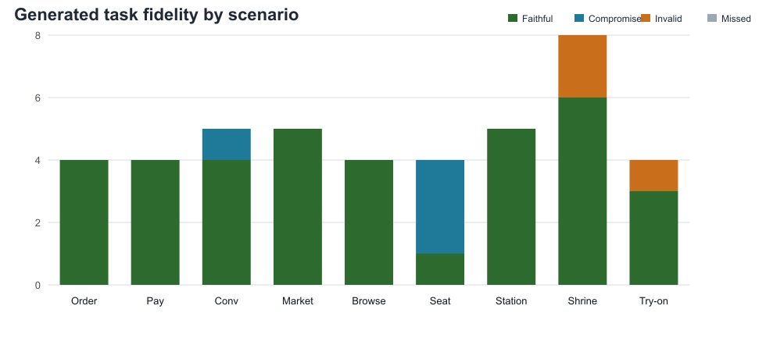
6
Results: from card to plan
6
Results: plans are well aligned
Illustrative data — re-runs unchanged on the real exported logs
Final eval set — generated tasks rated against each scenario card's desired interactions.
Transactional scenes translate faithfully
Evaluation point 1
Generated object ratings
Order, Conv, Market are mostly green — the generator picks the right primitive.
Does the scenario card translate into the right objects and interaction primitives?
42 expected
4
expected
acceptable
0 hallucinated
Loss is the vocabulary, not the LLM
36/43
40/43
Validation gate
generated tasks rated faithful
faithful or acceptable compromise
Shrine / Station / TryOn are dominated by gray (not expressible) — only ~3 beats were generator misses.
9/9
exported scenarios produced validated typed plans
3
Validation is structural, not semantic.
This is the card–plan difference
invalid primitive mappings to explain in the failure analysis
36/43
The gap between demanded and generated, split by cause.
task mappings faithful
4/43
compromised / partial
3/43
Invalid primitive mappings
Notes:
This slide visualizes the full plan-level evaluation.
Left chart: generated task fidelity by scenario. This is the card-to-task part of plan alignment. Faithful means the primitive captures the desired interaction; compromise means it preserves the main intent but loses detail; invalid means the primitive mapping is wrong; missed means the demanded interaction did not appear.
Right top graph: generated object ratings. Across the final eval set, 42 generated objects were rated expected, 4 acceptable, and 0 hallucinated. This answers the object side of plan alignment: did the generator create the right scene inventory?
Right middle graph: validation gate. All 9 exported scenarios produced validated typed plans. This means the runtime could load the plan structurally: unique ids, no dangling object references, and supported primitive kinds. It does not mean the plan was semantically perfect or visually good.
Bottom stats summarize the task side: 36/43 generated tasks faithful; 40/43 faithful or acceptable compromises; 3 invalid mappings. This supports the main result: written card to typed plan mostly works. Later slides show where the plan starts to break: realized-scene quality, affordance wiring, and SAM3D latency.
Presenter line: “At the plan level, both objects and tasks were mostly right. The bigger gap appears after the plan has to become a grounded, interactable scene.”

Slide 12
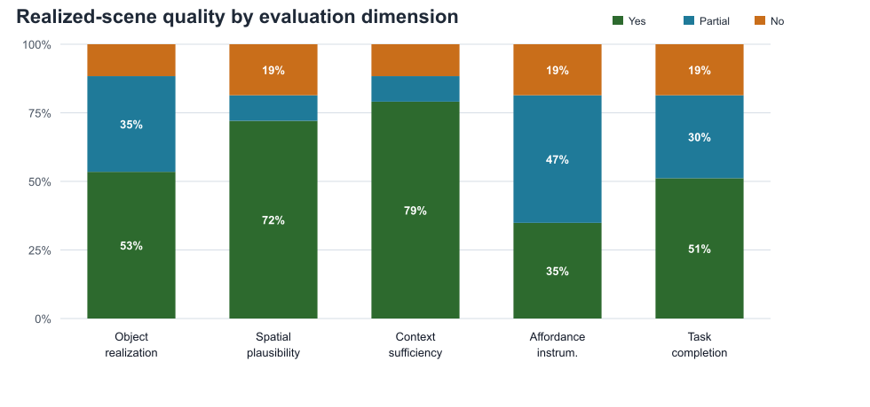
7
Results: scenes look and play OK
object/context/spatial plausibility are often stable, but affordance instrumentation and task completion are more frequently partial.

Slide 13
8
Achieved vs. intended — and what's next
8
8
Achieved vs. intended — and what’s next
Results: generation takes a little long but not terrible
SAM3D realization time: minutes, not seconds
We set out to generate runnable spatial roleplay scenes on Vision Pro, and the pipeline closes end-to-end: description → typed plan → reconstructed objects → interactable scene.
We set out to generate runnable spatial roleplay scenes on Vision Pro. The pipeline closes end-to-end, but the evaluation shows exactly where it stops feeling like the intended roleplay.
Recovered from output timestamps: reference.png → .usda. Labels show each object segment.
6
5.5m
terminal
What worked
Two fundamental gaps
Locomotion and bidirectional exchange recur across scenes — no gesture fixes them; they name the next primitives to add.
chips 0.5m
Scenario cards usually became valid typed plans: 40/43 generated tasks were faithful or acceptable compromises. LLM planning was not the main bottleneck.
4
cashier 0.5m
3.9m
basket 0.6m
vendor
minutes
wallet 1.2m
bag 0.5m
2.8m
reader 0.7m
ladle
What broke
tray
1.8m
2
The binding constraint
Generation is reliable; expressibility and asset realization are where it breaks — the work to innovate next.
counter 2.1m
apple 0.8m
box 0.9m
1.3m
attendant
Realization and interaction instrumentation lagged the plan: visual/spatial cues were often partial, and task completion depended on brittle affordance wiring.
fruit basket 1.4m
map 0.6m
hook
basin 1.0m
machine 0.7m
mirror
0
jacket 0.5m
Convenience
Market
Shrine
Station
Try-on
What needs innovation
6 objects
5 objects
4 objects
3 objects
3 objects
Honest scope
Ceremonial gestures (bow, clap) are a vocabulary scope gap, not a Vision Pro limit — cheap to extend.
The app export captures planning time; this chart reconstructs the expensive visual-realization stage from SAM3D output files.
Better reach-scale layout, richer gesture primitives, exchange/locomotion models, and cached reconstruction assets are the path from prototype to deployable system.
Notes:
This slide focuses only on timing. The key systems result is that SAM3D realization dominates latency. Each bar is one scene; each colored segment is one object, labeled with object name and reconstructed realization time. The total height is the sum of per-object times for that scene. Timings are reconstructed from SAM3D output files using reference.png timestamp to .usda timestamp, so they exclude model preload, app-side polling, and some queueing overhead. The order-of-magnitude result is still clear: seconds for planning, minutes for reconstruction/export. This is why caching, proxy fallback, and selective realization are necessary.

Slide 14
8
9
9
Results: SAM3D realization dominates latency
Achieved vs. intended — and what’s next
SAM3D realization time: minutes, not seconds
We set out to generate runnable spatial roleplay scenes on Vision Pro. The pipeline closes end-to-end, but the evaluation shows exactly where it stops feeling like the intended roleplay.
Recovered from output timestamps: reference.png → .usda. Labels show each object segment.
6
5.5m
terminal
What worked
chips 0.5m
Scenario cards usually became valid typed plans: 40/43 generated tasks were faithful or acceptable compromises. LLM planning was not the main bottleneck.
4
cashier 0.5m
3.9m
basket 0.6m
vendor
minutes
wallet 1.2m
bag 0.5m
2.8m
reader 0.7m
ladle
What didn’t
tray
1.8m
2
counter 2.1m
apple 0.8m
box 0.9m
attendant
1.3m
visual/spatial cues were often partial, and task completion depended on brittle affordances from a small primitive set.
fruit basket 1.4m
map 0.6m
hook
basin 1.0m
machine 0.7m
mirror
0
jacket 0.5m
Convenience
Market
Shrine
Station
Try-on
Future work
6 objects
5 objects
4 objects
3 objects
3 objects
The app export captures planning time; this chart reconstructs the expensive visual-realization stage from SAM3D output files.
Improved planner that does better at inventing ways to represent the interactions in the available primitives.
Better layout algorithm (possibly via better metadata / pose labeling with VLM)
Richer gesture primitives, improved asset generation quality and transfer.
Planning was fast (median 9.5s in app logs). The visual path was the systems bottleneck: multi-object scenes required minutes because each object was reconstructed and exported separately.
Notes:
Final synthesis. What worked: the typed-plan architecture worked. Scenario cards usually became valid primitive plans, and the LLM was not the main bottleneck. What broke: making those plans into playable spatial roleplay scenes remained hard. Visual realization was slow and inconsistent. Layout improved with the solver, but surface grounding and affordance wiring still caused partial task completion. What needs innovation: better reach-scale layout, richer gestures, explicit locomotion/exchange abstractions, and cached or reusable reconstructed assets. Closing line: We built an end-to-end pipeline and used the eval to localize the gap between generated plans and playable spatial roleplay.

