Slide 1

NumPy and Image Basics

Slide 2
Computer Vision with Python
Section Goals
Understand how to work with the basics of NumPy
Understand how to create arrays
Slice and index elements from arrays
Open and display images with NumPy

Slide 3
Let’s get started!

Slide 4
What is an image?

Slide 5
Computer Vision with Python
Before we talk about how to use numpy with image files, let’s first discuss how computers handle images.
Let’s imagine we wanted to build software that could sort out mail based on the zip code of the address.

Slide 6
Computer Vision with Python
Often mail is handwritten, which means we would need to begin to understand how to use computer vision to actual read in image data of these handwritten numbers.
How does a computer represent image data?

Slide 7
Computer Vision with Python
Let’s imagine we have a simple image of a handwritten number:

Slide 8
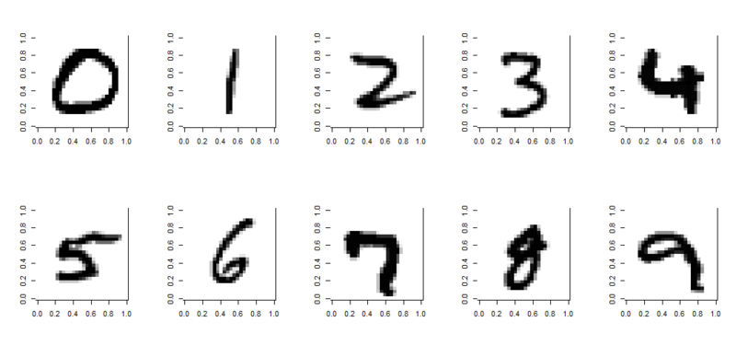
Computer Vision with Python
Each single digit image can be represented as an array

Slide 9
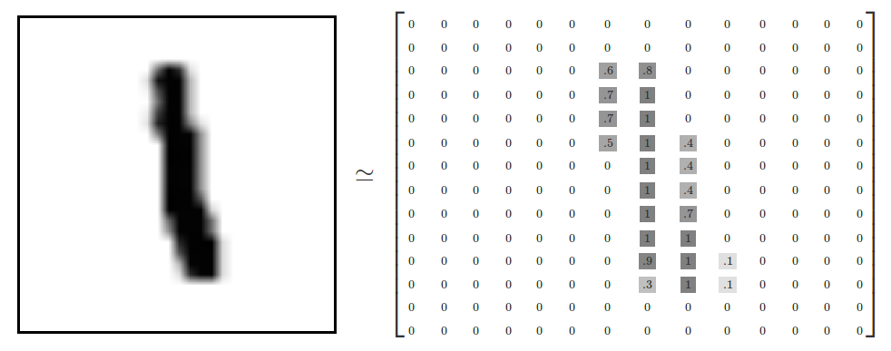
Computer Vision with Python
For example, here a number is 28 by 28 pixels

Slide 10
Computer Vision with Python
Then how dark a pixel should be can be represented as a value between 0 and 1.

Slide 11
Computer Vision with Python
Often the default images have values between 0 and 255

Slide 12
Computer Vision with Python
The range 0 to 255 has to do with how computers store 8-bit numbers.

Slide 13
Computer Vision with Python
But you can always divide all the values by 255 to normalize to between 0 and 1

Slide 14
Computer Vision with Python
Now that we’ve understood how grayscale images can be represented as arrays, what about color images?
Color images can be represented as a combination of Red, Green, and Blue.

Slide 15
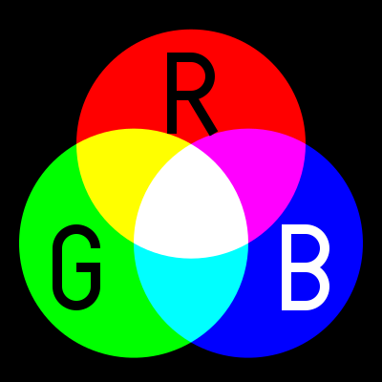
Computer Vision with Python
Additive color mixing allows us to represent a wide variety of colors by simply combining different amounts or R, G, B.

Slide 16
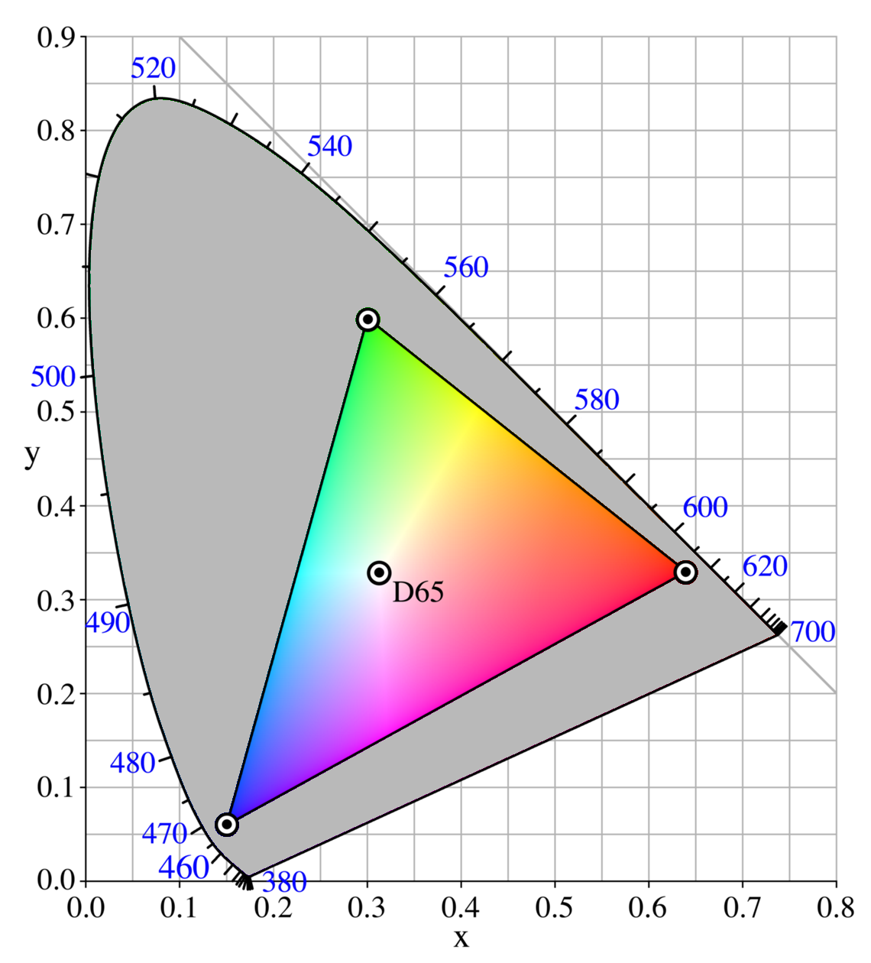
Computer Vision with Python
RGB allows to produce a range of colors

Slide 17
Computer Vision with Python
Later on in the course we will learn about alternative color mappings that can be applied to images.

Slide 18

Computer Vision with Python
Each color channel will have intensity values.
You may have already seen this sort of representation in other software with RGB sliders.

Slide 19
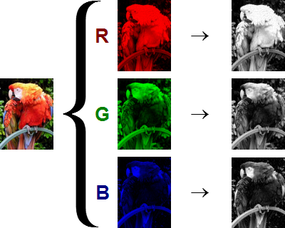
Computer Vision with Python
The shape of the color array then has 3 dimensions.
Height
Width
Color Channels

Slide 20
Computer Vision with Python
This means when you read in an image and check its shape, it will look something like:
(1280,720,3)
1280 pixel width
720 pixel height
3 color channels

Slide 21
Computer Vision with Python
This means when you read in an image and check its shape, it will look something like:
(720,1280,3)
720 pixel height
1280 pixel width
3 color channels
1st
3rd
2nd

Slide 22
Computer Vision with Python
Keep in mind the computer won’t “know” a channel is Red, it just knows that there are now 3 intensity channels.

Slide 23
Computer Vision with Python
The user needs to dictate which channel is for which color.
Each channel alone is essentially the same as a grayscale image.

Slide 24
Computer Vision with Python
Let’s explore this further with Numpy and Python!
I encourage you to also check out the Wikipedia article on RGB color channeling for more interesting details!

Slide 25
NumPy Arrays

Slide 26
Images and
NumPy

Slide 27
Numpy and Images
Assessment Overview

Slide 28
Numpy and Images
Assessment Solutions

