Slide 1
Introduction to Prometheus Operators (a beginner‘s point of view)
TechTalkThursday @nine
12.03.2020
Daniel Lorch, Enabling Services (Swisscom)
TechTalkThursday @nine

Slide 2
DevOps: The Three Ways (Gene Kim)
Flow
Feedback
Continual Learning
TechTalkThursday @nine

Slide 3
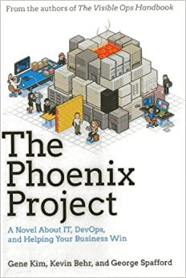
DevOps: The Three Ways (Gene Kim)
Flow
Feedback
Continual Learning
TechTalkThursday @nine

Slide 4
DevOps: The Three Ways (Gene Kim)
Flow
Feedback
Continual Learning
TechTalkThursday @nine

Slide 5

Monitoring and Alerting
Add instrumentation to your code or use exporter
Scrape metrics (HTTP)
Time Series Database
TechTalkThursday @nine

Slide 6
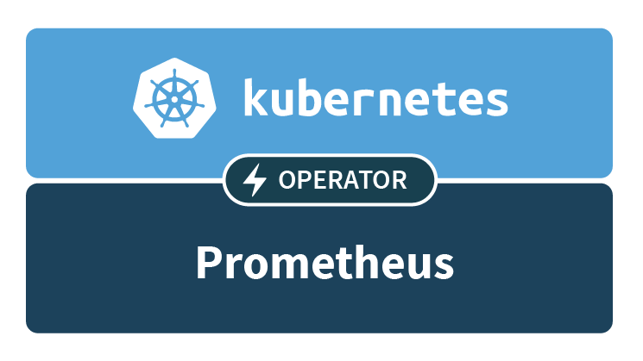
Monitoring and Alerting
Add instrumentation to your code or use exporter
Scrape metrics (HTTP)
Time Series Database
„An Operator represents human operational knowledge in software, to reliably manage an application“—Brandon Philips (CoreOS, 2016)
TechTalkThursday @nine

Slide 7
Monitoring and Alerting
Add instrumentation to your code or use exporter
Scrape metrics (HTTP)
Time Series Database
„An Operator represents human operational knowledge in software, to reliably manage an application“—Brandon Philips (CoreOS, 2016)
TechTalkThursday @nine
The Prometheus Operator: Managed Prometheus setups for Kubernetes

Slide 8
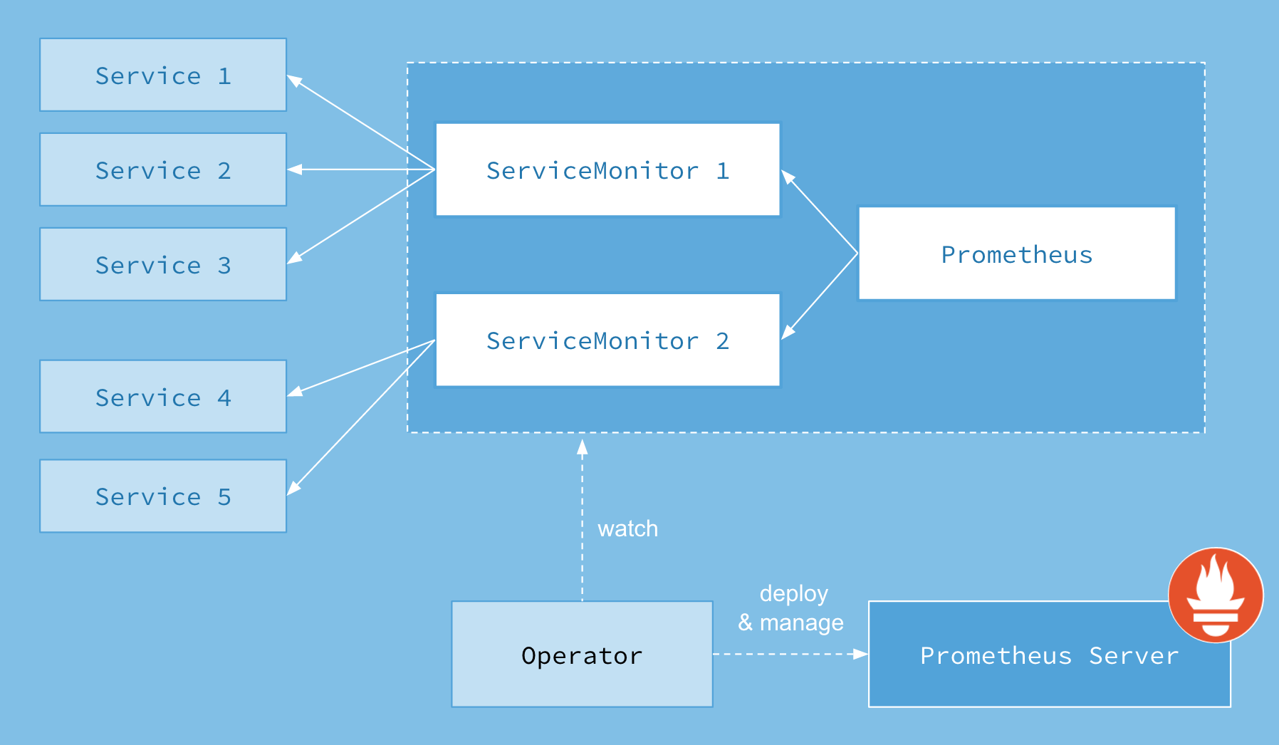
TechTalkThursday @nine
Operator workflow and relationships

Slide 9
Demo
$
TechTalkThursday @nine

Slide 10
Summary: The Prometheus Operator
Managed Prometheus setups for Kubernetes
Customizeable
Grafana Dashboards
TechTalkThursday @nine

Slide 11


TechTalkThursday @nine
DevOpsDays Zurich – September 8th and 9th 2020
https://landing.devopsdays.ch/
Cloud Native Day – September 10th 2020
https://cloudnativeday.ch/

