Slide 1
Site Reliability Engineering: What you need to know about Service Level Indicators (SLIs), Service Level Objectives (SLOs) and Error Budgets
1
TechTalkThursday@nine
22.07.2020
Daniel Lorch
TechTalkThursday @nine
Daniel Lorch | 2020

Slide 2
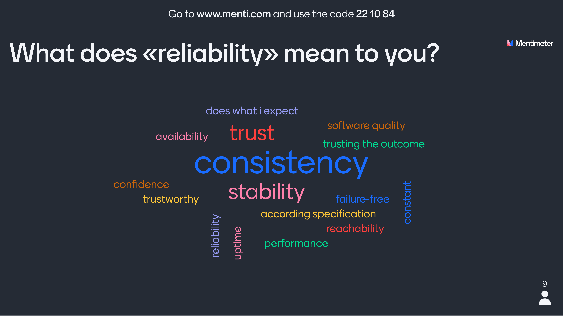
Go to www.menti.com and use the code 22 10 84
2
What does «reliability» mean to you?
TechTalkThursday @nine
Daniel Lorch | 2020

Slide 3
3
Reliability is the most important feature
of any system
TechTalkThursday @nine
Daniel Lorch | 2020

Slide 4
4
SLI: Service Level Indicator
A quantifiable measure of service reliability
TechTalkThursday @nine
Daniel Lorch | 2020

Slide 5
5
SLO: Service Level Objective
Set a reliability target for an SLI
TechTalkThursday @nine
Daniel Lorch | 2020

Slide 6
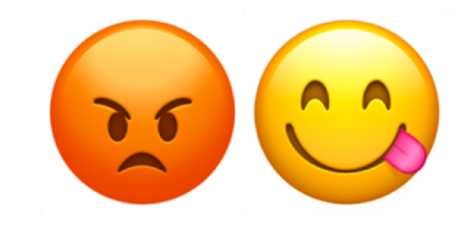
6
SLOs should capture the performance and availability levels that, if barely met, would keep the typical customer of a service happy
“meets SLO targets” ⇒ “happy customers”
“sad customers” ⇒ “misses SLO targets”
TechTalkThursday @nine
Daniel Lorch | 2020
Source: The Art of SLOs by Google https://cre.page.link/art-of-slos

Slide 7


SLOs and SLAs
7
Objective
Agreement
0 ms
200 ms
300 ms
“Ugh”
“HTTP GET / …”
Customer
TechTalkThursday @nine
Daniel Lorch | 2020
Source: The Art of SLOs by Google https://cre.page.link/art-of-slos

Slide 8
8
Error Budgets
An SLO implies an acceptable level of unreliability
This is a budget that can be allocated
TechTalkThursday @nine
Daniel Lorch | 2020

Slide 9
Choosing a good SLI
9
BAD
GOOD
metric
metric
time
time
good events
SLI :
× 100%
valid events
TechTalkThursday @nine
Daniel Lorch | 2020
Source: The Art of SLOs by Google https://cre.page.link/art-of-slos

Slide 10
10
SLI Menu
Request / Response | Availability Latency Quality
Data Processing | Coverage Correctness Freshness Throughput
Storage | Throughput Latency
TechTalkThursday @nine
Daniel Lorch | 2020
Source: The Art of SLOs by Google https://cre.page.link/art-of-slos

Slide 11
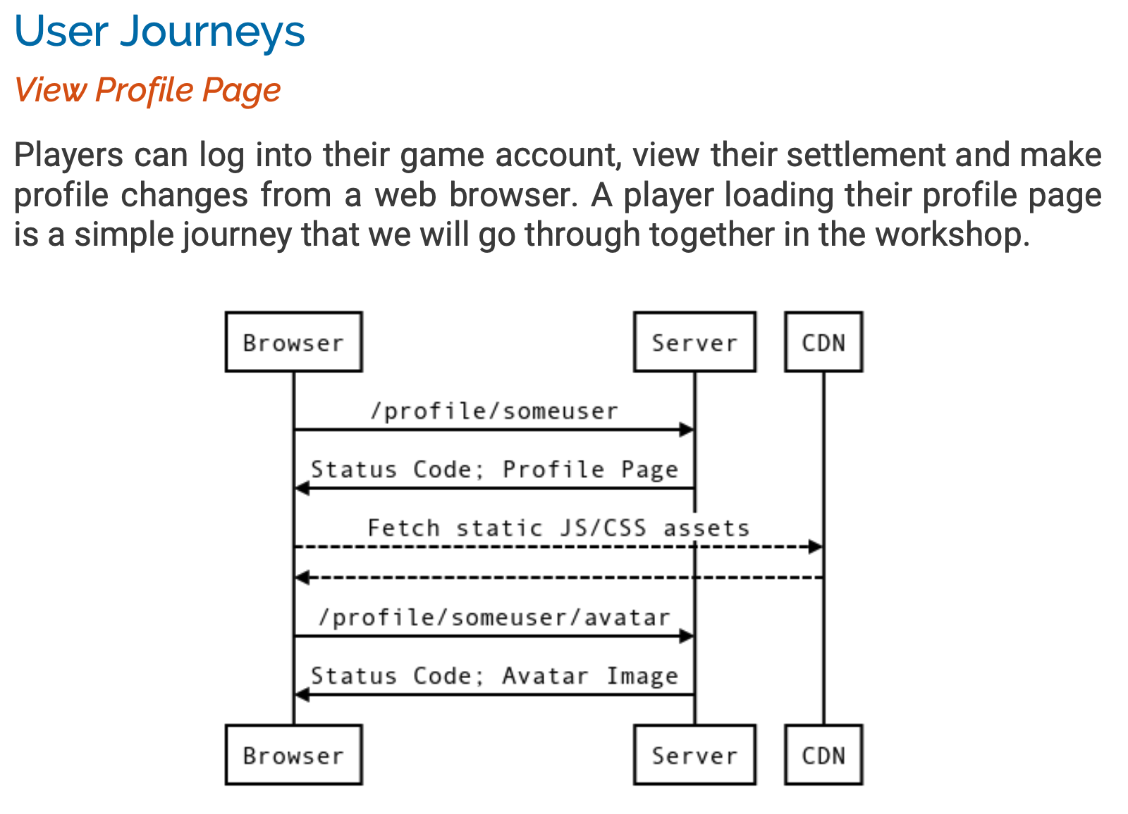
Example: Fang Faction Game
11
https://fangfactiongame.com/profile/someuser
SomeUser's Profile
Faction Name: | Tribe of Frog
Leader Name: | SomeUser
Email Address: | user@example.com
SomeUser
Tribe of Frog Faction Score: 31337
Midwest Canyon
1.
2.
3.
4.
5.
6.
Tri-Bool 65535
Tri Repetae 61995
Triassic Five 52391
Tricksy Hobbits 37164
Tribe of Frog 31337
Trite Examples 29243
Update
TechTalkThursday @nine
Daniel Lorch | 2020
Source: The Art of SLOs by Google https://cre.page.link/art-of-slos

Slide 12
Example: SLI Implementations
12
Availability
Latency
Proportion of HTTP GET requests for /profile/{user} or /profile/{user}/avatar that have 2XX, 3XX or 4XX (excl. 429) status measured at the load balancer
and
Proportion of HTTP GET requests for /profile/prober_user and all linked resources returning valid HTML containing "ProberUser" measured by a black-box prober every 5s
Proportion of HTTP GET requests for /profile/{user} that send their entire response within X ms measured at the load balancer
TechTalkThursday @nine
Daniel Lorch | 2020
Source: The Art of SLOs by Google https://cre.page.link/art-of-slos

Slide 13
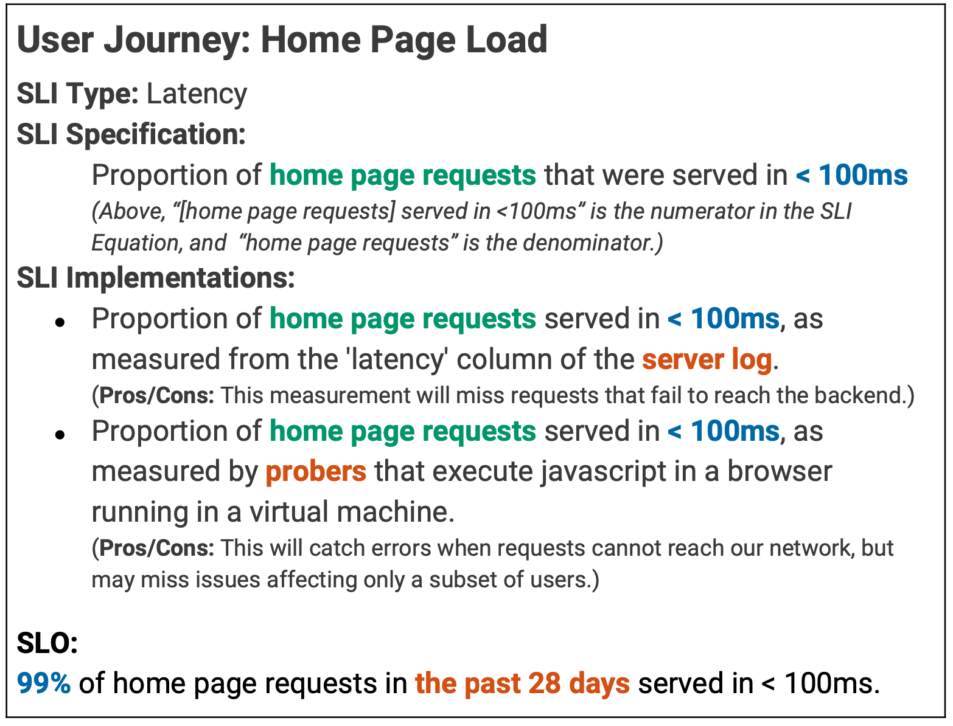
13
TechTalkThursday @nine
Daniel Lorch | 2020
Source: The Art of SLOs by Google https://cre.page.link/art-of-slos

Slide 14
Summary
14
SLI
service level indicator: a monitoring metric that is indicative of a user’s goal
SLO
service level objective: a target on an SLI that if barely met, keeps the user happy
SLA
service level agreement: SLO + consequences
Error Budget
the maximum amount of time the system can fail without contractual consequences. It is the remainder / inverse of the SLO
TechTalkThursday @nine
Daniel Lorch | 2020

Slide 15
Further Information
15
The ART of SLOs: https://cre.page.link/art-of-slos
Site Reliability Engineering: Measuring and Managing Reliability https://www.coursera.org/learn/site-reliability-engineering-slos
Site Reliability Engineering Books (free): https://landing.google.com/sre/books/
TechTalkThursday @nine
Daniel Lorch | 2020

