Slide 1
WRAL – Exposing a Loophole in Campaign Fundraising Ban
Reviewed by David Loshin
Notes:
Briefly summarize the main findings of the story.
Where did the data set(s) come from? Did the reporters have to build the data set themselves? Did they have to do extensive work to clean and prepare the data before analysis?
What did the reporter(s) do to bring the story to life, beyond the data findings? Who were the characters in the story, and how did they relate to the data analysis?
How did the reporter(s) communicate the data findings at the core of the story?
If you were reporting and telling the story, is there anything you would have done differently?

Slide 2

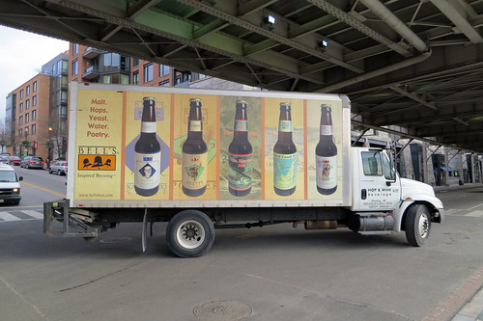
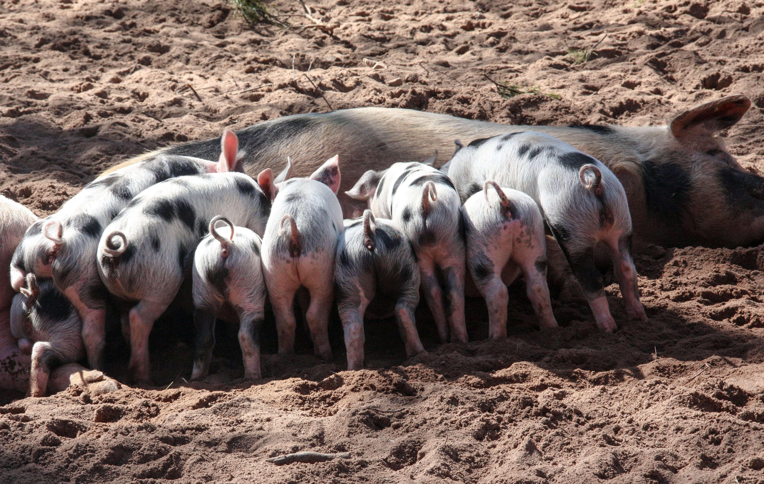
Main Summary
Although the law forbids campaign donations to campaign committees for General Assembly members from lobbyists and the entities that hire them while the Assembly is in session, a loophole allows CEOs and other top executives to contribute to campaigns during General Assembly sessions.
The reporter highlighted three key points:
Individuals nominally representing special interests who should be prevented from contributing to campaigns during the Assembly session were doing so because of a loophole.
There were certain legislators who seemed to benefit from these contributions.
There were specific special interests represented including solar tax credits, beer and wine wholesalers, and hog farmers.

Slide 3
Data Sources
NC State Board of Elections Campaign document and transaction search
Document search by entity
Document search by type
Transaction search by entity
The data sets wre loaded into OpenRefine and variations were normalized

Slide 4
Bringing the Story to Life
The story was told in a matter-of-fact manner
Key individuals involved in the contributions were called out:
Donors George Strobel and Robin Delmer
Senate President Pro Tem Phil Berger
Various member of the Assembly
Solar credit consultants, beer distributors, and hog farmers

Slide 5
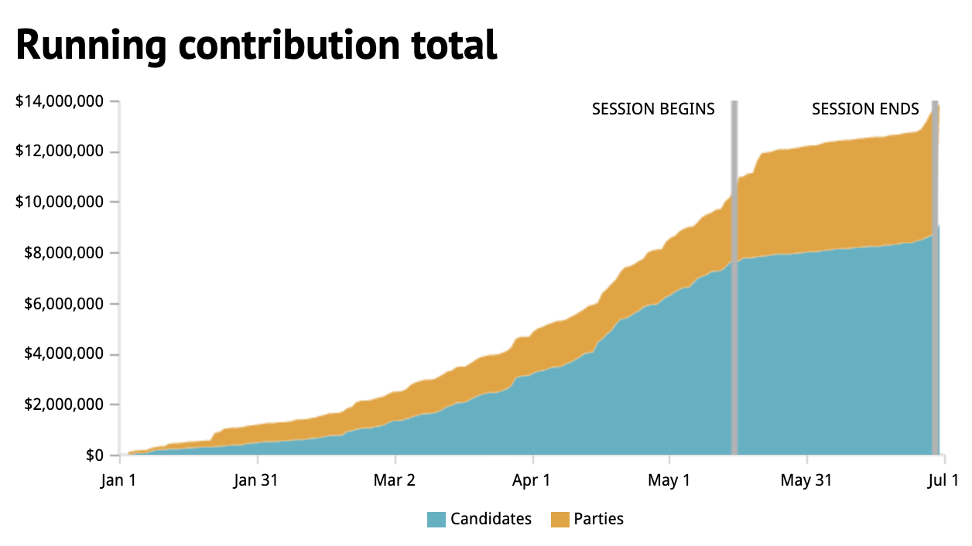
Communicating Data Findings
A combination of discussion in the text of newsworthy notes (such as individuals who had donated significant amounts during the Assembly session and assembly members who had been the recipients of large amounts), and
And a single visualization displaying the running total of contributions across the time frame that was reviewed.
Travis Fain, “CEOs gave heavily during legislative session, exposing loophole in NC's fundraising ban,”08/30/2018,accessed via https://www.wral.com/in-session-campaign-donations/17716104/

Slide 6
If I were the Reporter…
It would have been valuable to have seen tables listing the assembly members who were the beneficiaries of these questionable contributions instead of having to read through the text
The single visualization does not directly support the story – it does indicate a differentiation between types of contributions but does not speak to the main thesis of the article (presumably illegal contributions)
I would have liked to have been alerted to specific legislation under discussion that was linked to the contributing special interests

