Slide 1
Foundations of
Adversarial Learning
Daniel Lowd, University of Washington
Christopher Meek, Microsoft Research
Pedro Domingos, University of Washington

Slide 2
Motivation
Many adversarial problems
  Spam filtering
  Intrusion detection
  Malware detection
  New ones every year!
Want general-purpose solutions
We can gain much insight by modeling adversarial situations mathematically

Slide 3
Example: Spam Filtering
From: spammer@example.com
Cheap mortgage now!!!
1.
Feature Weights
2.
cheap = 1.0
mortgage = 1.5
3.
Total score = 2.5
> 1.0 (threshold)
Spam

Slide 4
Example: Spammers Adapt
From: spammer@example.com
Cheap mortgage now!!!
Cagliari Sardinia
1.
Feature Weights
2.
cheap = 1.0
mortgage = 1.5
Cagliari = -1.0
Sardinia = -1.0
3.
Total score = 0.5
< 1.0 (threshold)
OK

Slide 5
Example: Classifier Adapts
From: spammer@example.com
Cheap mortgage now!!!
Cagliari Sardinia
1.
Feature Weights
2.
cheap = 1.5
mortgage = 2.0
Cagliari = -0.5
Sardinia = -0.5
3.
Total score = 2.5
> 1.0 (threshold)
Spam
OK

Slide 6
Outline
Problem definitions
Anticipating adversaries (Dalvi et al., 2004)
  Goal: Defeat adaptive adversary
  Assume: Perfect information, optimal short-term strategies
  Results: Vastly better classifier accuracy
Reverse engineering classifiers (Lowd & Meek, 2005a,b)
  Goal: Assess classifier vulnerability
  Assume: Membership queries from adversary
  Results: Theoretical bounds, practical attacks
Conclusion

Slide 7
Definitions
Adversarial cost function
Instance space
Classifier
-
X₂
x
X₂
x
X₂
+
X₁
X₁
X₁
X = {X₁, X₂, …, X_{n}}
Each X_{i} is a feature
Instances, x ∈ X
(e.g., emails)
c(x): X → {+,−}
c ∈ C, concept class
(e.g., linear classifier)
a(x): X → R
a ∈ A
(e.g., more legible spam is better)

Slide 8
Adversarial scenario
-
-
+
+
Adversary’s Task:
Choose x to minimize a(x) subject to c(x) = −
Classifier’s Task:
Choose new c’(x) minimize (cost-sensitive) error

Slide 9
This is a game!
Adversary’s actions: {x ∈ X}
Classifier’s actions: {c ∈ C}
Assume perfect information
Finding a Nash equilibrium is triply exponential (at best)!
Instead, we’ll look at optimal myopic strategies:
Best action assuming nothing else changes

Slide 10
Initial classifier
Learned weights:
cheap = 1.0
mortgage = 1.5
Cagliari = -1.0
Sardinia = -1.0
Set weights using cost-sensitive naïve Bayes
Assume: training data is untainted

Slide 11
Adversary’s strategy
From: spammer@
example.com
Cheap mortgage now!!!
Cagliari Sardinia
From: spammer@
example.com
Cheap mortgage now!!!
cheap = 1.0
mortgage = 1.5
Cagliari = -1.0
Sardinia = -1.0
Use cost: a(x) = Σ_{i} w(x_{i}, b_{i})
Solve knapsack-like problem with dynamic programming
Assume: that the classifier will not modify c(x)

Slide 12
Classifier’s strategy
Learned weights:
cheap = 1.0
mortgage = 1.5
Cagliari = -1.0
Sardinia = -1.0
For given x, compute probability it was modified by adversary
Assume: the adversary is using the optimal strategy

Slide 13
Classifier’s strategy
Learned weights:
cheap = 1.5
mortgage = 2.0
Cagliari = -0.5
Sardinia = -0.5
For given x, compute probability it was modified by adversary
Assume: the adversary is using the optimal strategy

Slide 14
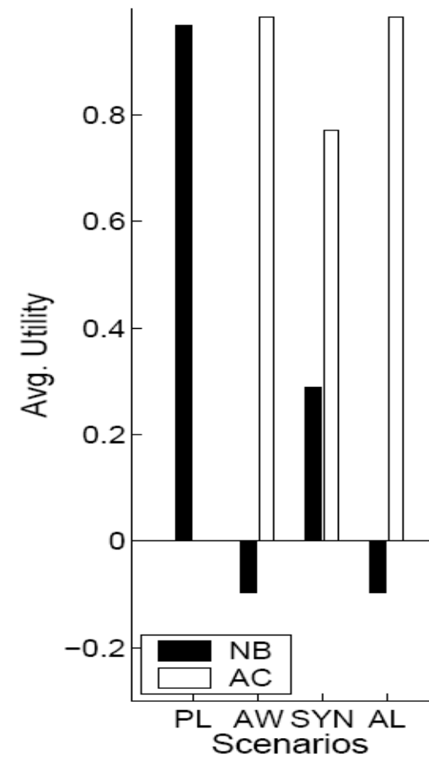
Evaluation: spam
Data: Email-Data
Scenarios
  Plain (PL)
  Add Words (AW)
  Synonyms (SYN)
  Add Length (AL)
Similar results with
Ling-Spam, different classifier costs
Score

Slide 15
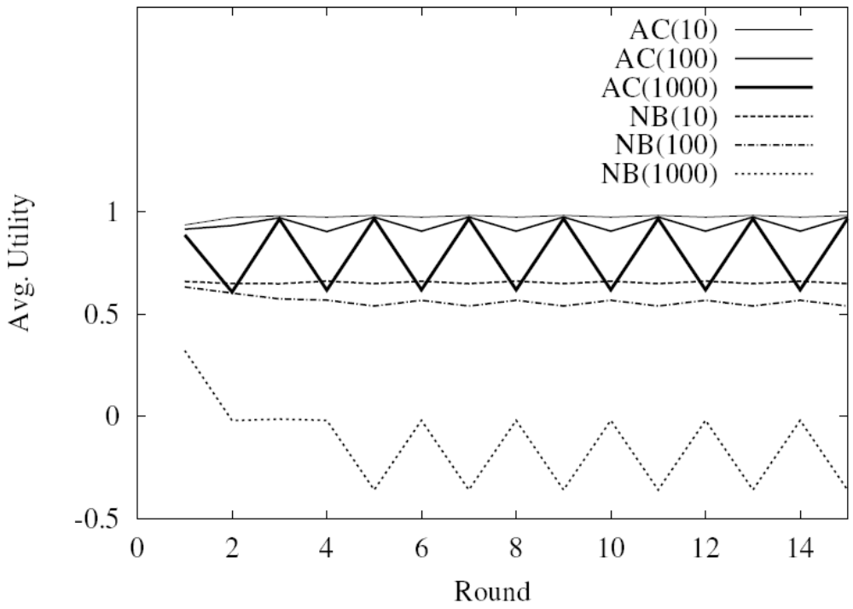
Repeated Game
Adversary responds to new classifier;
classifier predicts adversary’s revised response
Oscillations occur as adversaries switch strategies
back and forth.

Slide 16
Outline
Problem definitions
Anticipating adversaries (Dalvi et al., 2004)
  Goal: Defeat adaptive adversary
  Assume: Perfect information, optimal short-term strategies
  Results: Vastly better classifier accuracy
Reverse engineering classifiers (Lowd & Meek, 2005a,b)
  Goal: Assess classifier vulnerability
  Assume: Membership queries from adversary
  Results: Theoretical bounds, practical attacks
Conclusion

Slide 17
Imperfect information
What can an adversary accomplish with limited knowledge of the classifier?
Goals:
  Understand classifier’s vulnerabilities
  Understand our adversary’s likely strategies
“If you know the enemy and know yourself, you need not fear the result of a hundred battles.”
-- Sun Tzu, 500 BC

Slide 18
Adversarial Classification Reverse Engineering (ACRE)
-
+
Adversary’s Task:
Minimize a(x) subject to c(x) = −
Problem:
The adversary doesn’t know c(x)!

Slide 19
Adversarial Classification Reverse Engineering (ACRE)
?
?
?
?
X₂
-
?
+
?
?
?
Within a factor of k
X₁
Task: Minimize a(x) subject to c(x) = −
Given:
  Full knowledge of a(x)
  One positive and one negative instance, x⁺ and x⁻
  A polynomial number of membership queries

Slide 20
Comparison to other theoretical learning methods
Probably Approximately Correct (PAC): accuracy over same distribution
Membership queries: exact classifier
ACRE: single low-cost, negative instance

Slide 21
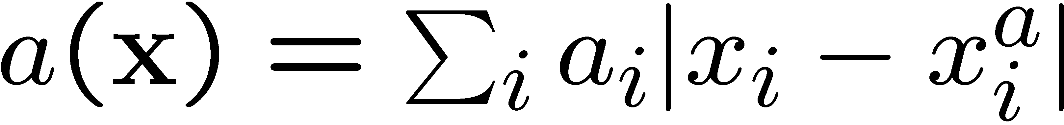
ACRE example
Linear classifier:
c(x) = +, iff (w ⋅ x > T)
Linear cost function:
X₂
X₂
xª
X₁
X₁

Slide 22
Linear classifiers with continuous features
ACRE learnable within a factor of (1+ε)
under linear cost functions
Proof sketch
  Only need to change the highest weight/cost feature
  We can efficiently find this feature using line searches
  in each dimension
X₂
xª
X₁

Slide 23
Linear classifiers with
Boolean features
Harder problem: can’t do line searches
ACRE learnable within a factor of 2
if adversary has unit cost per change:
xª
x⁻
c(x)
w_{i}
w_{j}
w_{k}
w_{l}
w_{m}

Slide 24
Algorithm
Iteratively reduce the cost in two ways:
Remove any unnecessary change: O(n)
Replace any two changes with one: O(n³)
c(x)
y
x⁻
xª
w_{i}
w_{j}
w_{k}
w_{l}
w_{m}
c(x)
y’
xª
w_{i}
w_{j}
w_{k}
w_{l}
w_{p}

Slide 25
Evaluation
Classifiers: Naïve Bayes (NB), Maxent (ME)
Data: 500k Hotmail messages, 276k features
Adversary feature sets:
  23,000 words (Dict)
  1,000 random words (Rand)
 | Cost | Queries
Dict NB | 23 | 261,000
Dict ME | 10 | 119,000
Rand NB | 31 | 23,000
Rand ME | 12 | 9,000

Slide 26
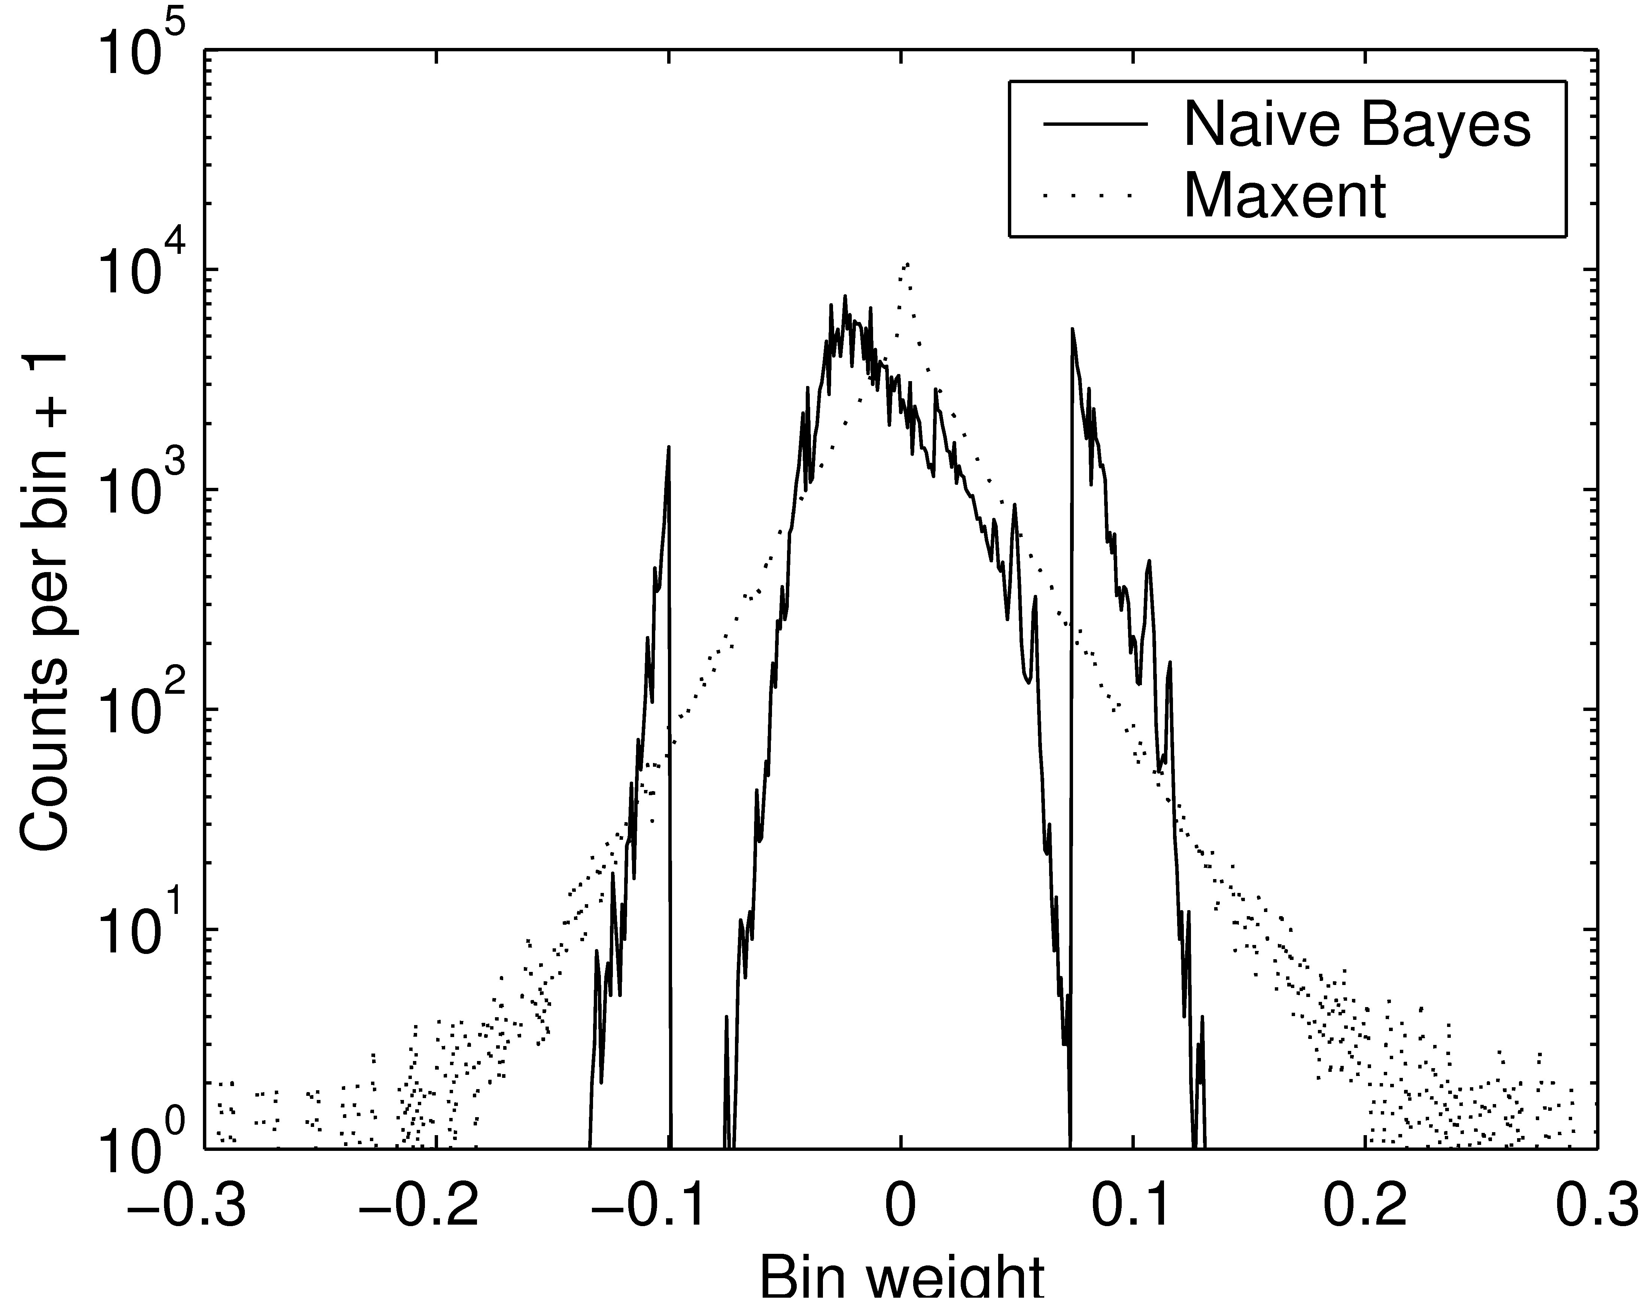
Comparison of Filter Weights
“good”
“spammy”
Notes:
Maxent has larger-magnitude weights than naïve Bayes.
(Naïve Bayes spikes are due to the words with very few counts interacting with the prior.)

Slide 27
Finding features
We can find good features (words) instead of good instances (emails)
Active attacks: Test emails allowed
Passive attacks: No filter access

Slide 28
Active Attacks
Learn which words are best by sending test messages (queries) through the filter
First-N: Find n good words using as few queries as possible
Best-N: Find the best n words

Slide 29
First-N Attack
Step 1: Find a “Barely spam” message
Original legit.
“Barely legit.”
“Barely spam”
Original
spam
Hi, mom!
now!!!
mortgage
now!!!
Cheap mortgage
now!!!
Legitimate
Spam
Threshold

Slide 30
First-N Attack
Step 2: Test each word
Good words
“Barely spam”
message
Legitimate
Spam
Less good words
Threshold

Slide 31
Best-N Attack
Legitimate
Spam
Better
Worse
Threshold
Key idea: use spammy words to sort the good words.

Slide 32
Results
Attack type | Naïve Bayes words (queries) | Maxent words (queries)
First-N | 59 (3,100) | 20 (4,300)
Best-N | 29 (62,000) | 9 (69,000)
ACRE (Rand) | 31* (23,000) | 12* (9,000)
* words added + words removed
Notes:
Less time explaining passive attacks on this slide?

Slide 33
Passive Attacks
Heuristics
  Select random dictionary words (Dictionary)
  Select most frequent English words (Freq. Word)
  Select highest ratio: English freq./spam freq. (Freq. Ratio)
Spam corpus: spamarchive.org
English corpora:
  Reuters news articles
  Written English
  Spoken English
  1992 USENET

Slide 34
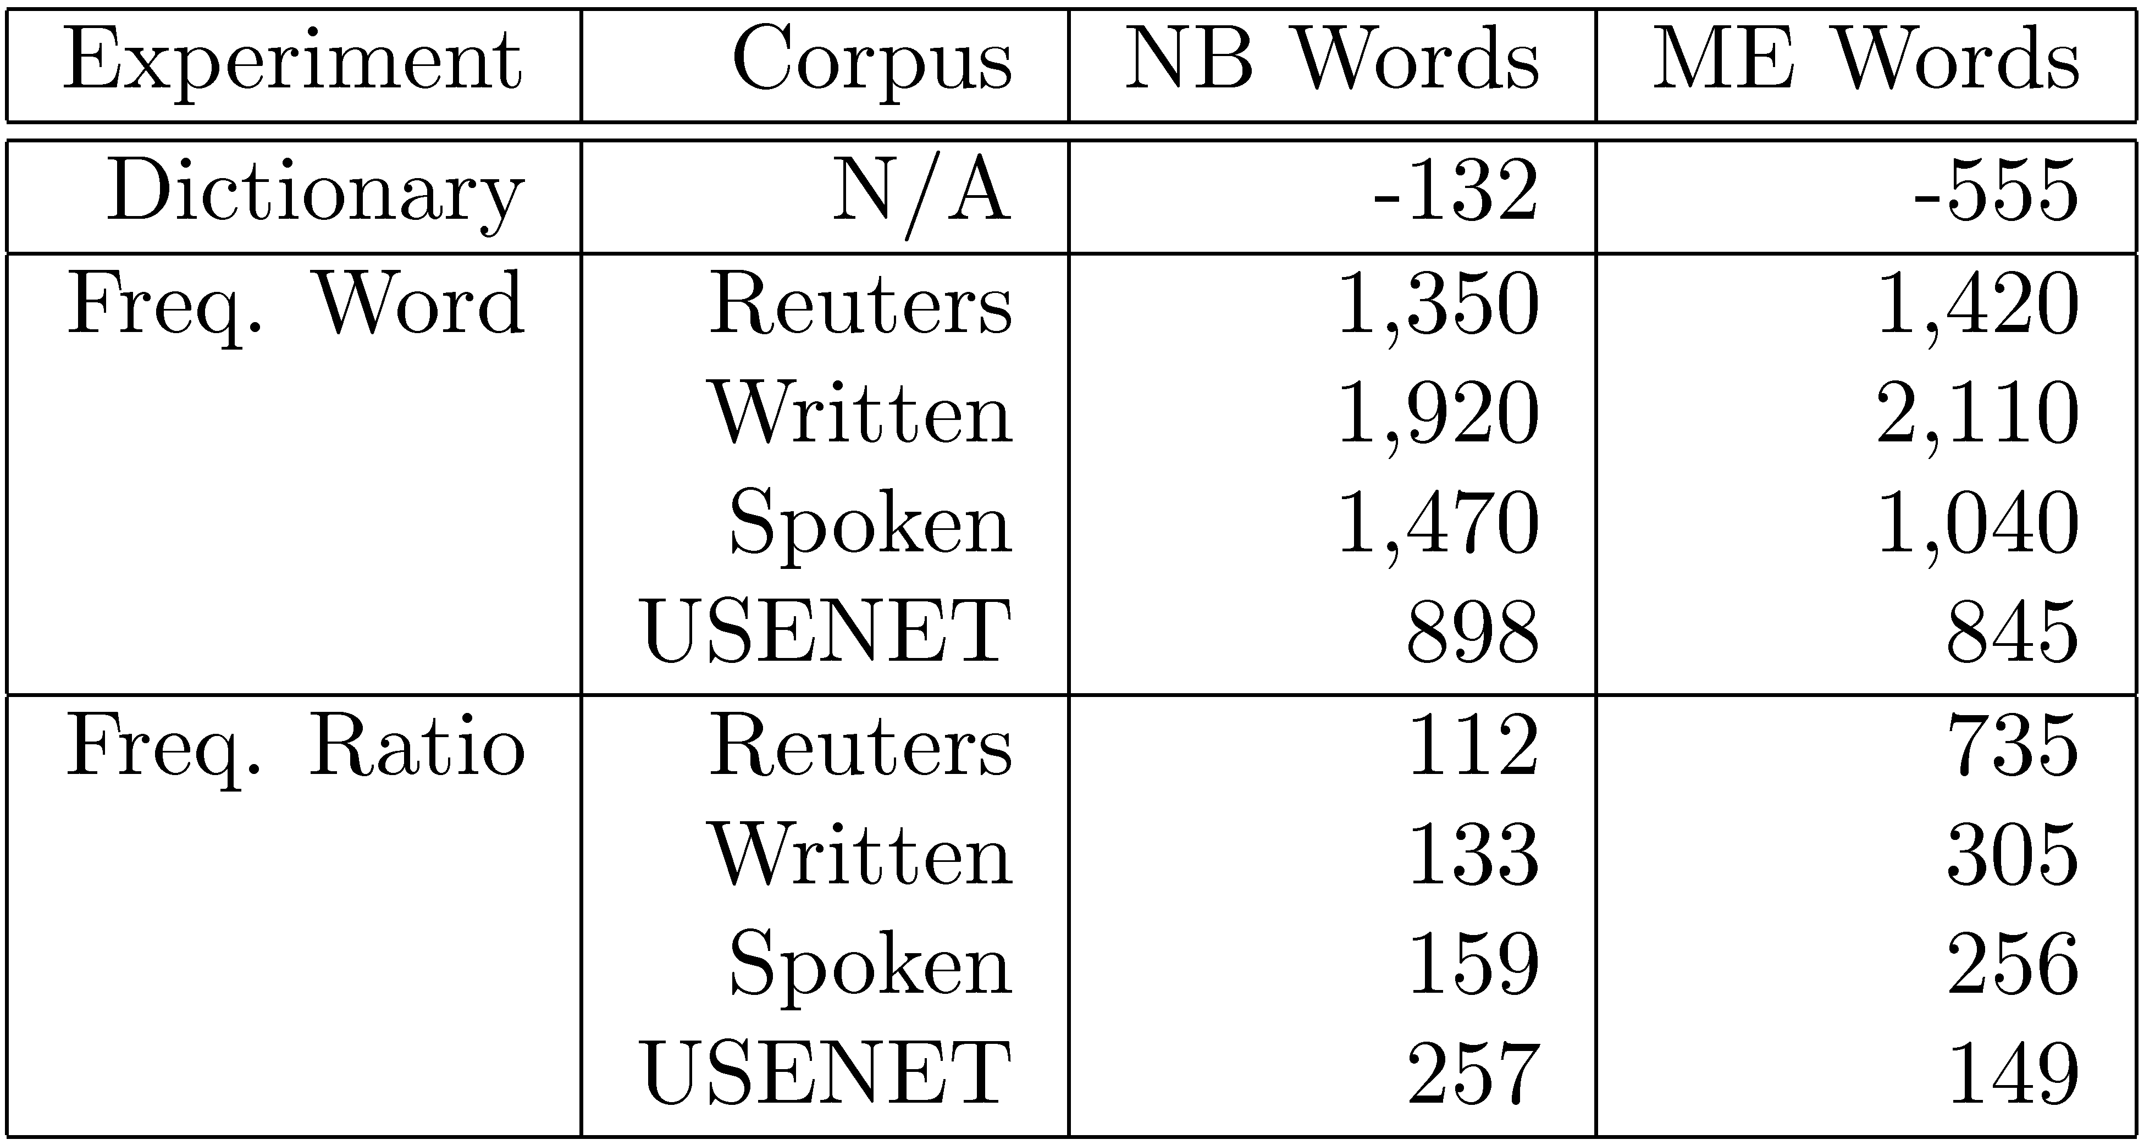
Passive Attack Results

Slide 35
Results
Attack type | Naïve Bayes words (queries) | Maxent words (queries)
First-N | 59 (3,100) | 20 (4,300)
Best-N | 29 (62,000) | 9 (69,000)
ACRE (Rand) | 31* (23,000) | 12* (9,000)
Passive | 112 (0) | 149 (0)
* words added + words removed
Notes:
Less time explaining passive attacks on this slide?

Slide 36
Conclusion
Mathematical modeling is a powerful tool in adversarial situations
  Game theory lets us make classifiers aware of and resistant to adversaries
  Complexity arguments let us explore the vulnerabilities of our own systems
This is only the beginning…
  Can we weaken our assumptions?
  Can we expand our scenarios?
Notes:
Show that we’ve lived up to claim.

Slide 37
Proof sketch (Contradiction)
Suppose there is some negative instance x with less than half the cost of y:
c(x)
xª
y
w_{i}
w_{j}
w_{k}
w_{l}
w_{m}
x
w_{p}
w_{r}
x’s average change is twice as good as y’s
We can replace y’s two worst changes with x’s single best change
But we already tried every such replacement!

