Slide 1
Foundations of
Adversarial Learning
Daniel Lowd, University of Washington
Christopher Meek, Microsoft Research
Pedro Domingos, University of Washington

Slide 2
Motivation
Many adversarial problems
  Spam filtering
  Intrusion detection
  Malware detection
  New ones every year!
Want general-purpose solutions
We can gain much insight by modeling adversarial situations mathematically

Slide 3
Outline
Problem definitions
Anticipating adversaries (Dalvi et al., 2004)
  Goal: Defeat adaptive adversary
  Assume: Perfect information, optimal short-term strategies
  Results: Vastly better classifier accuracy
Reverse engineering classifiers (Lowd & Meek, 2005a,b)
  Goal: Assess classifier vulnerability
  Assume: Membership queries from adversary
  Results: Theoretical bounds, practical attacks
Conclusion

Slide 4
Definitions
Adversarial cost function
Instance space
Classifier
-
X₂
x
X₂
x
X₂
+
X₁
X₁
X₁
X = {X₁, X₂, …, X_{n}}
Each X_{i} is a feature
Instances, x ∈ X
(e.g., emails)
c(x): X → {+,−}
c ∈ C, concept class
(e.g., linear classifier)
a(x): X → R
a ∈ A
(e.g., more legible spam is better)
Notes:
Adversarial cost: more succinct, clear (practice)

Slide 5
Adversarial scenario
-
-
+
+
Adversary’s Task:
Choose x to minimize a(x) subject to c(x) = −
Classifier’s Task:
Choose new c’(x) minimize (cost-sensitive) error

Slide 6
This is a game!
Adversary’s actions: {x ∈ X}
Classifier’s actions: {c ∈ C}
Assume perfect information
A Nash equilibrium exists…
…but finding it is triply exponential
(in easy cases).

Slide 7
Tractable approach
Start with a trained classifier
  Use cost-sensitive naïve Bayes
  Assume: training data is untainted
Compute adversary’s best action, x
  Use cost: a(x) = Σ_{i} w(x_{i}, b_{i})
  Solve knapsack-like problem with dynamic programming
  Assume: that the classifier will not modify c(x)
Compute classifier’s optimal response, c’(x)
  For given x, compute probability it was modified by adversary
  Assume: the adversary is using the optimal strategy
By anticipating the adversary’s strategy,
we can defeat it!

Slide 8
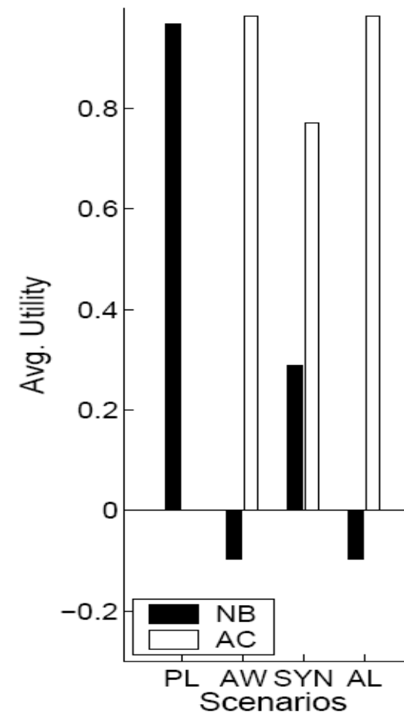
Evaluation: spam
Data: Email-Data
Scenarios
  Plain (PL)
  Add Words (AW)
  Synonyms (SYN)
  Add Length (AL)
Similar results with
Ling-Spam, different classifier costs
Score

Slide 9
Outline
Problem definitions
Anticipating adversaries (Dalvi et al., 2004)
  Goal: Defeat adaptive adversary
  Assume: Perfect information, optimal short-term strategies
  Results: Vastly better classifier accuracy
Reverse engineering classifiers (Lowd & Meek, 2005a,b)
  Goal: Assess classifier vulnerability
  Assume: Membership queries from adversary
  Results: Theoretical bounds, practical attacks
Conclusion

Slide 10
Imperfect information
What can an adversary accomplish with limited knowledge of the classifier?
Goals:
  Understand classifier’s vulnerabilities
  Understand our adversary’s likely strategies
“If you know the enemy and know yourself, you need not fear the result of a hundred battles.”
-- Sun Tzu, 500 BC
Notes:
Add better transition, clarifying different assumptions (outline)

Slide 11
Adversarial Classification Reverse Engineering (ACRE)
-
+
Adversary’s Task:
Minimize a(x) subject to c(x) = −
Problem:
The adversary doesn’t know c(x)!

Slide 12
Adversarial Classification Reverse Engineering (ACRE)
?
?
?
?
X₂
-
?
+
?
?
?
Within a factor of k
X₁
Task: Minimize a(x) subject to c(x) = −
Given:
  Full knowledge of a(x)
  One positive and one negative instance, x⁺ and x⁻
  A polynomial number of membership queries

Slide 13
Comparison to other theoretical learning methods
Probably Approximately Correct (PAC): accuracy over same distribution
Membership queries: exact classifier
ACRE: single low-cost, negative instance

Slide 14
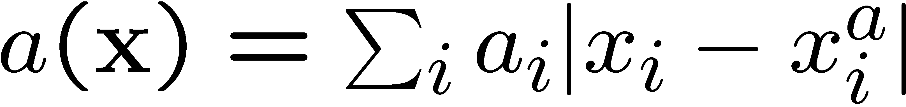
ACRE example
Linear classifier:
c(x) = +, iff (w ⋅ x > T)
Linear cost function:
X₂
X₂
xª
X₁
X₁

Slide 15
Linear classifiers with continuous features
ACRE learnable within a factor of (1+ε)
under linear cost functions
Proof sketch
  Only need to change the highest weight/cost feature
  We can efficiently find this feature using line searches
  in each dimension
X₂
xª
X₁

Slide 16
Linear classifiers with
Boolean features
Harder problem: can’t do line searches
ACRE learnable within a factor of 2
if adversary has unit cost per change:
xª
x⁻
c(x)
w_{i}
w_{j}
w_{k}
w_{l}
w_{m}

Slide 17
Algorithm
Iteratively reduce the cost in two ways:
Remove any unnecessary change: O(n)
Replace any two changes with one: O(n³)
c(x)
y
x⁻
xª
w_{i}
w_{j}
w_{k}
w_{l}
w_{m}
c(x)
y’
xª
w_{i}
w_{j}
w_{k}
w_{l}
w_{p}

Slide 18
Evaluation
Classifiers: Naïve Bayes (NB), Maxent (ME)
Data: 500k Hotmail messages, 250k features
Adversary feature sets:
  23,000 words (Dict)
  1,000 random words (Rand)
 | Cost | Queries
Dict NB | 23 | 261,000
Dict ME | 10 | 119,000
Rand NB | 31 | 23,000
Rand ME | 12 | 9,000

Slide 19
Finding features
We can find good features (words) instead of good instances (emails)
Passive attack: choose words common in English but uncommon in spam
First-N attack: choose words that turn a “barely spam” email into a non-spam
Best-N attack: use “spammy” words to sort
good words

Slide 20
Results
Attack type | Naïve Bayes words (queries) | Maxent words (queries)
Passive | 112 (0) | 149 (0)
First-N | 59 (3,100) | 20 (4,300)
Best-N | 29 (62,000) | 9 (69,000)
ACRE (Rand) | 31* (23,000) | 12* (9,000)
* words added + words removed
Notes:
Less time explaining passive attacks on this slide?

Slide 21
Conclusion
Mathematical modeling is a powerful tool in adversarial situations
  Game theory lets us make classifiers aware of and resistant to adversaries
  Complexity arguments let us explore the vulnerabilities of our own systems
This is only the beginning…
  Can we weaken our assumptions?
  Can we expand our scenarios?
Notes:
Show that we’ve lived up to claim.

Slide 22
Proof sketch (Contradiction)
Suppose there is some negative instance x with less than half the cost of y:
c(x)
xª
y
w_{i}
w_{j}
w_{k}
w_{l}
w_{m}
x
w_{p}
w_{r}
x’s average change is twice as good as y’s
We can replace y’s two worst changes with x’s single best change
But we already tried every such replacement!

