Slide 1
Adversarial Learning:
Practice and Theory
Daniel Lowd
University of Washington
July 14th, 2006
Joint work with Chris Meek, Microsoft Research
“If you know the enemy and know yourself, you need not fear the result of a hundred battles.”
-- Sun Tzu, 500 BC

Slide 2
Content-based Spam Filtering
From: spammer@example.com
Cheap mortgage now!!!
1.
Feature Weights
2.
cheap = 1.0
mortgage = 1.5
3.
Total score = 2.5
> 1.0 (threshold)
Spam

Slide 3
Good Word Attacks
From: spammer@example.com
Cheap mortgage now!!! Corvallis OSU
1.
Feature Weights
2.
cheap = 1.0
mortgage = 1.5
Corvallis = -1.0
OSU = -1.0
3.
Total score = 0.5
< 1.0 (threshold)
OK

Slide 4
Outline
Practice: good word attacks
  Passive attacks
  Active attacks
  Experimental results
Theory: ACRE learning
  Definitions and examples
  Learning linear classifiers
  Experimental results

Slide 5
Attacking Spam Filters
Can we efficiently find a list of “good words”?
Types of attacks
  Passive attacks -- no filter access
  Active attacks -- test emails allowed
Metrics
  Expected number of words required to get median (blocked) spam past the filter
  Number of query messages sent

Slide 6
Filter Configuration
Models used
  Naïve Bayes: generative
  Maximum Entropy (Maxent): discriminative
Training
  500,000 messages from Hotmail feedback loop
  276,000 features
  Maxent let 30% less spam through
Notes:
Trained using 500,000 messages from the Hotmail feedback loop (80% spam)
Large, but noisy, dataset -- error rates are overestimate because users are inconsistent
Maxent had about 30% fewer false negatives (missed spams) when we fixed the false positive rate.

Slide 7
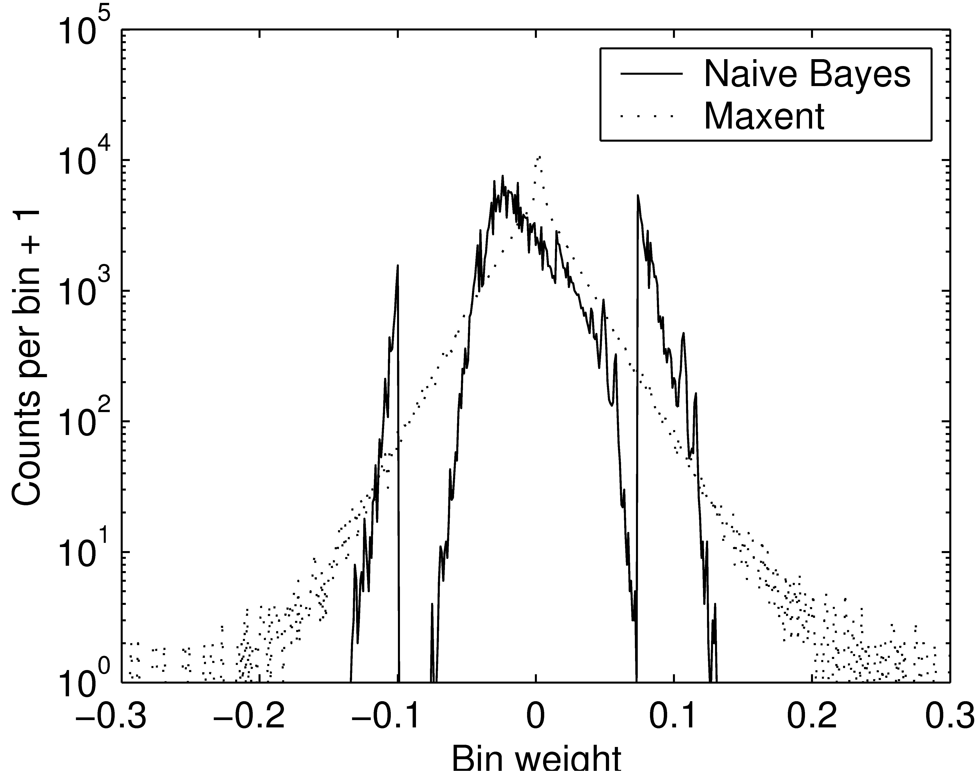
Comparison of Filter Weights
“good”
“spammy”
Notes:
Maxent has larger-magnitude weights than naïve Bayes.
(Naïve Bayes spikes are due to the words with very few counts interacting with the prior.)

Slide 8
Passive Attacks
Heuristics
  Select random dictionary words (Dictionary)
  Select most frequent English words (Freq. Word)
  Select highest ratio: English freq./spam freq. (Freq. Ratio)
Spam corpus: spamarchive.org
English corpora:
  Reuters news articles
  Written English
  Spoken English
  1992 USENET

Slide 9
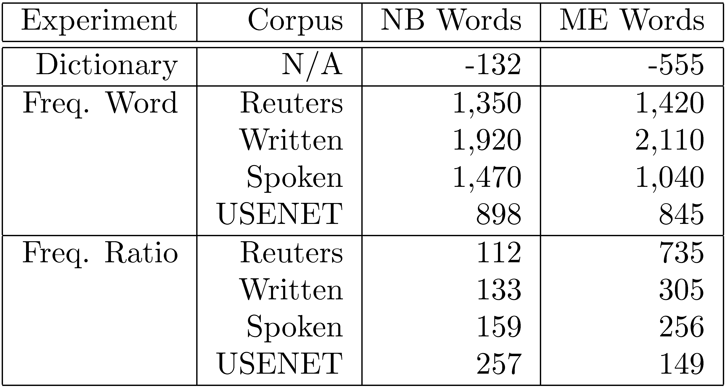
Passive Attack Results

Slide 10
Active Attacks
Learn which words are best by sending test messages (queries) through the filter
First-N: Find n good words using as few queries as possible
Best-N: Find the best n words

Slide 11
First-N Attack
Step 1: Find a “Barely spam” message
Original legit.
“Barely legit.”
“Barely spam”
Original
spam
Hi, mom!
now!!!
mortgage
now!!!
Cheap mortgage
now!!!
Legitimate
Spam
Threshold

Slide 12
First-N Attack
Step 2: Test each word
Good words
“Barely spam”
message
Legitimate
Spam
Less good words
Threshold

Slide 13
Best-N Attack
Legitimate
Spam
Better
Worse
Threshold
Key idea: use spammy words to sort the good words.

Slide 14
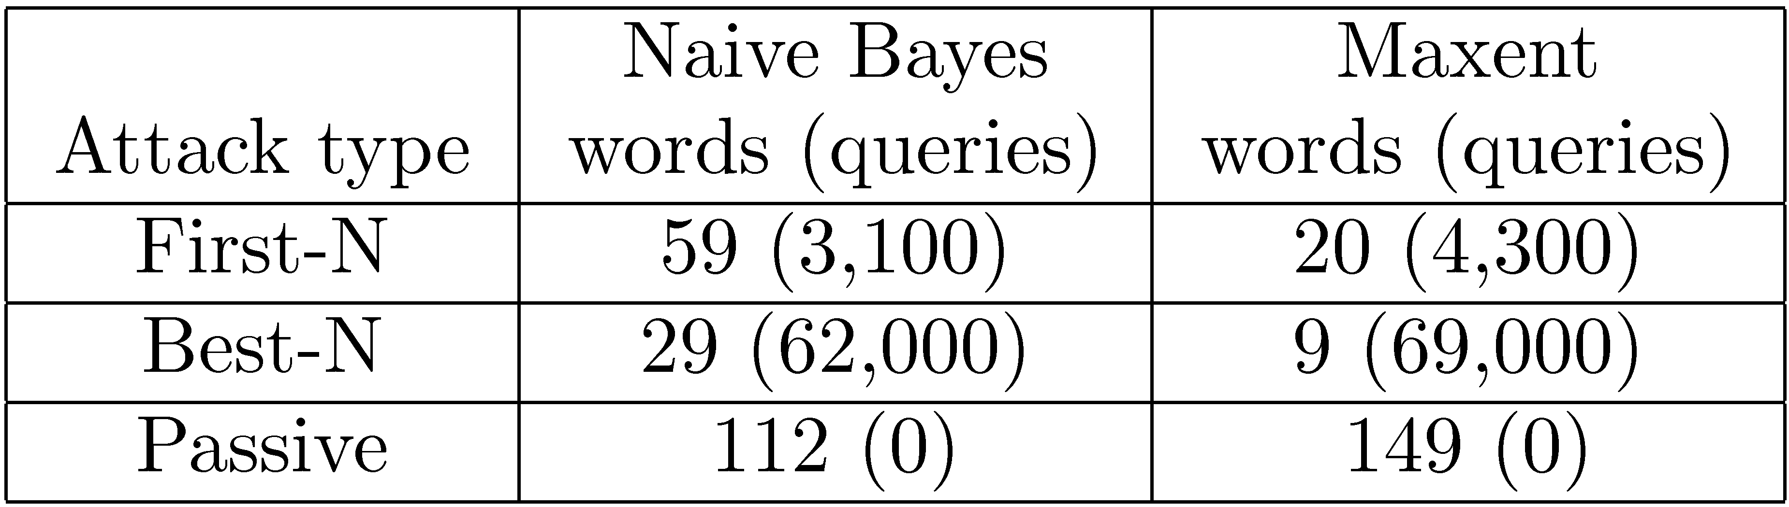
Active Attack Results
(n = 100)
Best-N twice as effective as First-N
Maxent more vulnerable to active attacks
Active attacks much more effective than passive attacks

Slide 15
Outline
Practice: good word attacks
  Passive attacks
  Active attacks
  Experimental results
Theory: ACRE learning
  Definitions and examples
  Learning linear classifiers
  Experimental results

Slide 16
How to formalize?
Q: What’s the spammer’s goal?
A: Find the best possible spam message that gets through a spam filter.
Q: How?
A: By sending test messages through the filter to learn about it.

Slide 17
Not just spam!
Credit card fraud detection
Network intrusion detection
Terrorist detection
Loan approval
Web page search rankings
…many more…

Slide 18
Definitions
Adversarial cost function
Instance space
Classifier
-
X₂
x
X₂
x
X₂
+
X₁
X₁
X₁
X = {X₁, X₂, …, X_{n}}
Each X_{i} is a feature
Instances, x ∈ X
(e.g., emails)
c(x): X → {+,−}
c ∈ C, concept class
(e.g., linear classifier)
a(x): X → R
a ∈ A
(e.g., more legible spam is better)

Slide 19
Adversarial Classifier Reverse Engineering (ACRE)
-
X₂
+
X₁
Task: minimize a(x) subject to c(x) = −
Problem: the adversary doesn’t know c(x)!

Slide 20
Adversarial Classifier Reverse Engineering (ACRE)
?
?
?
?
X₂
-
?
+
?
?
?
Within a factor of k
X₁
Task: minimize a(x) subject to c(x) = −
Given:
  Full knowledge of a(x)
  One positive and one negative instance, x⁺ and x⁻
  A polynomial number of membership queries

Slide 21
Adversarial Classifier Reverse Engineering (ACRE)
IF an algorithm exists that, for any a ∈ A, c ∈ C minimizes a(x) subject to c(x) = − within factor k
GIVEN
  Full knowledge of a(x)
  Positive and negative instances, x⁺ and x⁻
  A polynomial number of membership queries
THEN we say that concept class C is ACRE k-learnable under a set of cost functions A

Slide 22
Example: trivial cost function
Suppose A is the set of functions where:
  m instances have cost b
  All other instances cost b’ > b
Test each of the m b-cost instances
If none is negative, choose x⁻
X₂
-
+
X₁

Slide 23
Example: Boolean conjunctions
Suppose C is all conjunctions of Boolean literals (e.g., x₁ ∧ ¬x₃)
Starting with x⁺, toggle each x_{i} in turn:
x⁺ = (x₁ = T, x₂ = F, x₃ = F, x₄ = T)
Guess: (x₁ ∧ ¬x₂ ∧ ¬x₃ ∧ x₄)

Slide 24
Example: Boolean conjunctions
Suppose C is all conjunctions of Boolean literals (e.g., x₁ ∧ ¬x₃)
Starting with x⁺, toggle each x_{i} in turn:
x⁺ = (T, F, F, T)
Guess: (x₁ ∧ ¬x₂ ∧ ¬x₃ ∧ x₄)

Slide 25
Example: Boolean conjunctions
Suppose C is all conjunctions of Boolean literals (e.g., x₁ ∧ ¬x₃)
Starting with x⁺, toggle each x_{i} in turn:
x⁺ = (T, F, F, T)
x’ = (F, F, F, T)
c(x’) = −
Guess: (x₁ ∧ ¬x₂ ∧ ¬x₃ ∧ x₄)

Slide 26
Example: Boolean conjunctions
Suppose C is all conjunctions of Boolean literals (e.g., x₁ ∧ ¬x₃)
Starting with x⁺, toggle each x_{i} in turn:
x⁺ = (T, F, F, T)
x’ = (T, T, F, T)
c(x’) = +
Guess: (x₁ ∧ ¬x₂ ∧ ¬x₃ ∧ x₄)

Slide 27
Example: Boolean conjunctions
Suppose C is all conjunctions of Boolean literals (e.g., x₁ ∧ ¬x₃)
Starting with x⁺, toggle each x_{i} in turn:
x⁺ = (T, F, F, T)
x’ = (T, F, T, T)
c(x’) = −
Guess: (x₁ ∧ ¬x₂ ∧ ¬x₃ ∧ x₄)

Slide 28
Example: Boolean conjunctions
Suppose C is all conjunctions of Boolean literals (e.g., x₁ ∧ ¬x₃)
Starting with x⁺, toggle each x_{i} in turn:
x⁺ = (T, F, F, T)
x’ = (T, F, F, F)
c(x’) = +
Guess: (x₁ ∧ ¬x₂ ∧ ¬x₃ ∧ x₄)
Final Answer: (x₁ ∧ ¬x₃)

Slide 29
Example: Boolean conjunctions
Suppose C is all conjunctions of Boolean literals (e.g., x₁ ∧ ¬x₃)
Starting with x⁺, toggle each x_{i} in turn
Exact conjunction is learnable in n queries.
Now we can optimize any cost function.
In general: concepts learnable with membership queries are ACRE 1-learnable

Slide 30
Comparison to other theoretical learning methods
Probably Approximately Correct (PAC): accuracy over same distribution
Membership queries: exact classifier
ACRE: single low-cost, negative instance

Slide 31
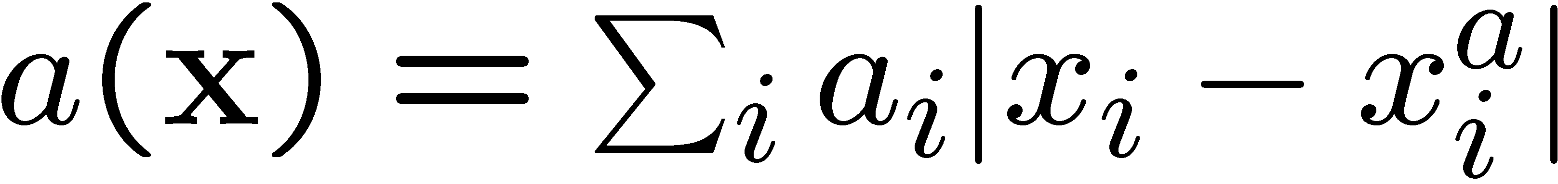
Linear Cost Functions
Cost is weighted L₁ distance from some “ideal” instance xª:
X₂
xª
X₁

Slide 32
Linear Classifier
c(x) = +, iff (w ⋅ x > T)
Examples: Naïve Bayes, maxent, SVM with linear kernel
X₂
X₁

Slide 33
Theorem 1:
Continuous features
Linear classifiers with continuous features are ACRE (1+ε)-learnable under linear cost functions
Proof sketch
  Only need to change the highest weight/cost feature
  We can efficiently find this feature using line searches in each dimension
X₂
xª
X₁

Slide 34
Theorem 2:
Boolean features
Linear classifiers with Boolean features are ACRE 2-learnable under uniform linear cost functions
Harder problem: can’t do line searches
Uniform linear cost: unit cost per “change”
xª
x⁻
c(x)
w_{i}
w_{j}
w_{k}
w_{l}
w_{m}

Slide 35
Algorithm
Iteratively reduce cost in two ways:
Remove any unnecessary change: O(n)
Replace any two changes with one: O(n³)
c(x)
y
x⁻
xª
w_{i}
w_{j}
w_{k}
w_{l}
w_{m}
c(x)
y’
xª
w_{i}
w_{j}
w_{k}
w_{l}
w_{p}

Slide 36
Proof Sketch (Contradiction)
Suppose there is some negative instance x with less than half the cost of y:
c(x)
xª
y
w_{i}
w_{j}
w_{k}
w_{l}
w_{m}
x
w_{p}
w_{r}
x’s average change is twice as good as y’s
We can replace y’s two worst changes with x’s single best change
But we already tried every such replacement!

Slide 37
Application: Spam Filtering
Spammer goal: minimally modify a spam message to achieve a spam that gets past a spam filter.
Corresponding ACRE problem:
spam filter linear classifier with Boolean features
“minimally modify” uniform linear cost function

Slide 38
Experimental Setup
Filter configuration (same as before)
  Naïve Bayes (NB) and maxent (ME) filters
  500,000 Hotmail messages for training
  > 250,000 features
Adversary feature sets
  23,000 English words (Dict)
  1,000 random English words (Rand)

Slide 39
Results
 | Cost | Ratio | Queries
Dict NB | 23 | 1.136 | 6,472k
Dict ME | 10 | 1.167 | 646k
Rand NB | 31 | 1.120 | 755k
Rand ME | 12 | 1.158 | 75k
Reduced feature set almost as good
Cost ratio is excellent
Number of queries is reasonable (parallelize)
Less efficient than good word attacks, but guaranteed to work

Slide 40
Future Work
Within the ACRE framework
  Other concept classes, cost functions
  Other real-world domains
ACRE extensions
  Adversarial Regression Reverse Engineering
  Relational ACRE
  Background knowledge (passive attacks)

Slide 41
Related Work
[Dalvi et al., 2004] Adversarial classification
  Game-theoretic approach
  Assume attacker chooses optimal strategy against classifier
  Assume defender modifies classifier knowing attacker strategy
[Kolter and Maloof, 2005] Concept drift
  Mixture of experts
  Theoretical bounds against adversary

Slide 42
Conclusion
Spam filters are very vulnerable
  Can make lists of good words without filter access
  With filter access, better attacks are available
ACRE learning is a natural formulation for adversarial problems
  Pick a concept class, C
  Pick a set of cost functions, A
  Devise an algorithm to optimize through querying

