Slide 1
Inference Complexity
As Learning Bias
Daniel Lowd
Dept. of Computer
and Information Science
University of Oregon
Joint work with Pedro Domingos

Slide 2
Don’t use model complexity as your learning bias …
Use inference complexity.

Slide 3
The Goal
Data
Model
Answers!
A
B
C
Learning algorithms
Inference algorithms
The actual task
This talk:
How to learn accurate and efficient models by
tightly integrating learning and inference
Experiments: exact inference in < 100ms
in models with treewidth > 100

Slide 4
Outline
Standard solutions (and why they fail)
Background
  Learning with Bayesian networks
  Inference with arithmetic circuits
Learning arithmetic circuits
  Scoring
  Search
  Efficiency
Experiments
Conclusion

Slide 5
Solution 1: Exact Inference
Data
Model
Jointree
Answers!
A
B
C
SLOW
SLOW

Slide 6
Solution 2: Approximate Inference
Data
Model
Approximation
Answers!
A
B
C
SLOW
Approximations are often too inaccurate.
More accurate algorithms tend to be slower.

Slide 7
Solution 3: Learn a tractable model
Related work: Thin junction trees
Data
Jointree
Answers!
Polynomial in data, but still exponential in treewidth
[E.g.: Chechetka & Guestrin, 2007]

Slide 8
Thin junction trees are thin
Their junction trees
Our junction trees
Maximum effective treewidth is 2-5
We have learned models with treewidth >100

Slide 9
Solution 3: Learn a tractable model
Our work: Arithmetic circuits with penalty on circuit size
Data
Circuit
Answers!
×
+
+
(
Model
)
A
B
C

Slide 10
Outline
Standard solutions (and why they fail)
Background
  Learning with Bayesian networks
  Inference with arithmetic circuits
Learning arithmetic circuits
  Overview
  Optimizations
Experiments
Conclusion

Slide 11
Bayesian networks
Problem: Compactly represent probability distribution over many variables
Solution: Conditional independence
P(A,B,C,D) = P(A) P(B|A) P(C|A) P(D|B,C)
A
B
C
D

Slide 12
… With decision-tree CPDs
Problem: Number of parameters is exponential in the maximum number of parents
Solution: Context-specific independence
P(D|B,C) =
B=?
true
false
0.2
C=?
true
false
0.5
0.7

Slide 13
… Compiled to circuits
Problem: Inference is exponential in treewidth
Solution: Compile to arithmetic circuits
×
+
+
×
×
×
×
λ_{A}
θ_{A}
λ_{¬A}
θ_{¬A}
λ_{B}
θ_{B}
λ_{¬B}
θ_{¬B}

Slide 14
Arithmetic circuits
×
+
+
×
×
×
×
λ_{A}
θ_{A}
λ_{¬A}
θ_{¬A}
λ_{B}
θ_{B}
λ_{¬B}
θ_{¬B}
Directed, acyclic graph with single root
  Leaf nodes are inputs
  Interior nodes are addition or multiplication
  Can represent any distribution
Inference is linear in model size!
  Never larger than junction tree
  Can exploit local structure to save time/space

Slide 15
ACs for Inference
Bayesian network:
P(A,B,C) = P(A) P(B) P(C|A,B)
Network polynomial:
λ_{A}λ_{B}λ_{C} θ_{A}θ_{B}θ_{C|AB} + λ_{¬A}λ_{B}λ_{C} θ_{¬A}θ_{B}θ_{C|¬AB} + …
Can compute arbitrary marginal queries by evaluating network polynomial.
Arithmetic circuits (ACs) offer efficient, factored representations of this polynomial.
Can take advantage of local structure such as context-specific independence.

Slide 16
BN Structure Learning
[Chickering et al., 1996]
Start with an empty network
Greedily add splits to decision trees one at a time, enforcing acyclicity
score(C,T) = log P(T|C) – k_{p} n_{p}(C)
(accuracy – # parameters)

Slide 17
Key Idea
For an arithmetic circuit C on an i.i.d. training sample T:
Typical cost function:
Our cost function:
score(C,T) = log P(T|C) – k_{p} n_{p}(C)
(accuracy – # parameters)
score(C,T) = log P(T|C) – k_{p} n_{p}(C) – k_{e} n_{e}(C)
(accuracy – # parameters – circuit size)
Notes:
Inference time is linear in circuit size, so this penalizes models with slow inference. Each split effects a constant change in model accuracy and number of parameters. The change in circuit size depends on circuit structure and may increase or decrease as other splits are applied.

Slide 18
Basic algorithm
Following Chickering et al. (1996), we induce our statistical models by greedily selecting splits for the decision-tree CPDs. Our approach has two key differences:
We optimize a different objective function
We return a Bayesian network that has already been
compiled into a circuit

Slide 19
Efficiency
Compiling each candidate AC from scratch at each step is too expensive.
Instead: Incrementally modify AC as we add splits.

Slide 20
Before split
×
×
λ_{A}
θ_{A}
λ_{¬A}
θ_{¬A}
λ_{B}
λ_{¬B}

Slide 21
After split
×
+
×
×
λ_{¬B}
λ_{B}
λ_{A}
θ_{A|B}
λ_{¬A}
θ_{¬A|B}
λ_{A}
θ_{A|¬B}
λ_{¬A}
θ_{¬A|¬B}

Slide 22
Algorithm
Create initial product of marginals circuit
Create initial split list
Until convergence:
For each split in list
Apply split to circuit
Score result
Undo split
Apply highest-scoring split to circuit
Add new child splits to list
Remove inconsistent splits from list

Slide 23
How to split a circuit
D: Parameter nodes to be split
V: Indicators for the splitting variable
M: First mutual ancestors of D and V
For each indicator λ in V,
Copy all nodes between M and D or V, conditioned on λ.
For each m in M,
Replace children of m that are ancestors of D or V with a sum over copies of the ancestors times the λ each copy was conditioned on.

Slide 24
Optimizations
We avoid rescoring splits every iteration by:
Noting that likelihood gain never changes, only number of edges added
Evaluating splits with higher likelihood gain first, since likelihood gain is an upper bound on score.
Re-evaluate number of edges added only when another split may have affected it (AC-Greedy).
Assume the number of edges added by a split only increases as the algorithm progresses (AC-Quick).

Slide 25
Experiments
Datasets:
  KDD-Cup 2000: 65 variables
  Anonymous MSWeb: 294 variables
  EachMovie (subset): 500 variables
Algorithms:
  WinMine toolkit + Gibbs sampling
  AC + Exact inference
Queries:
Generated queries from the test data with varying numbers of evidence and query variables

Slide 26
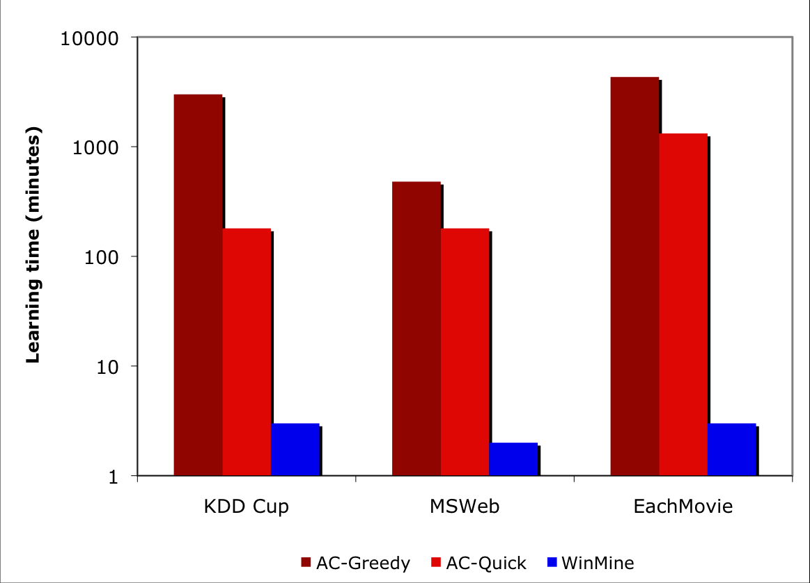
Learning time

Slide 27
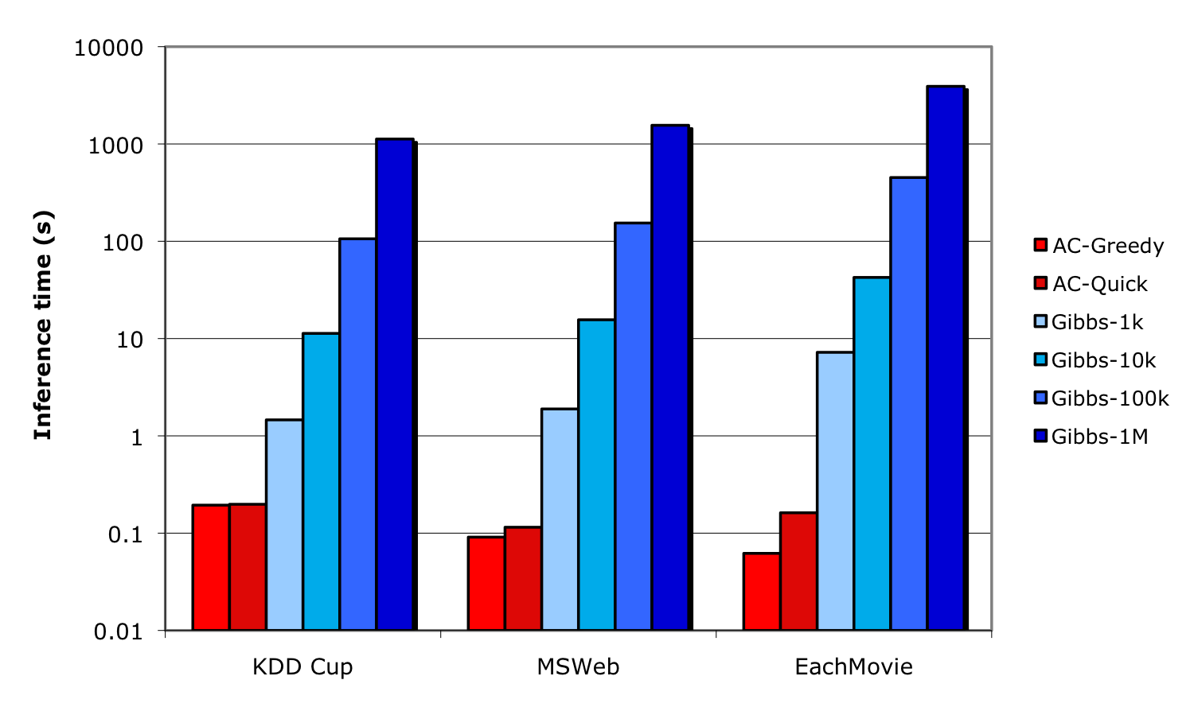
Inference time

Slide 28
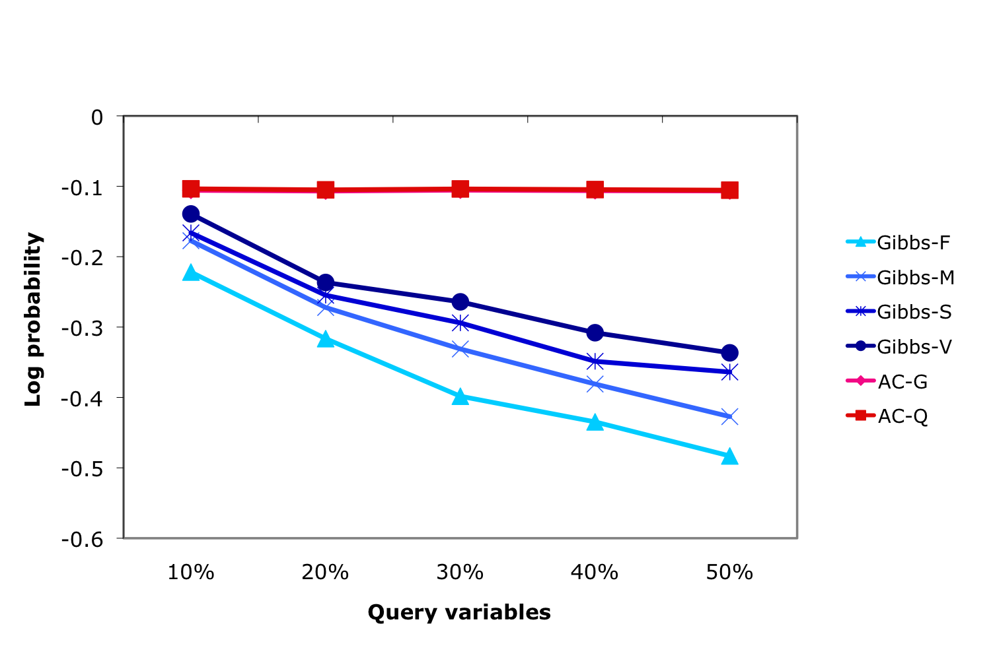
Accuracy: EachMovie
Notes:
30% evidence variables

Slide 29
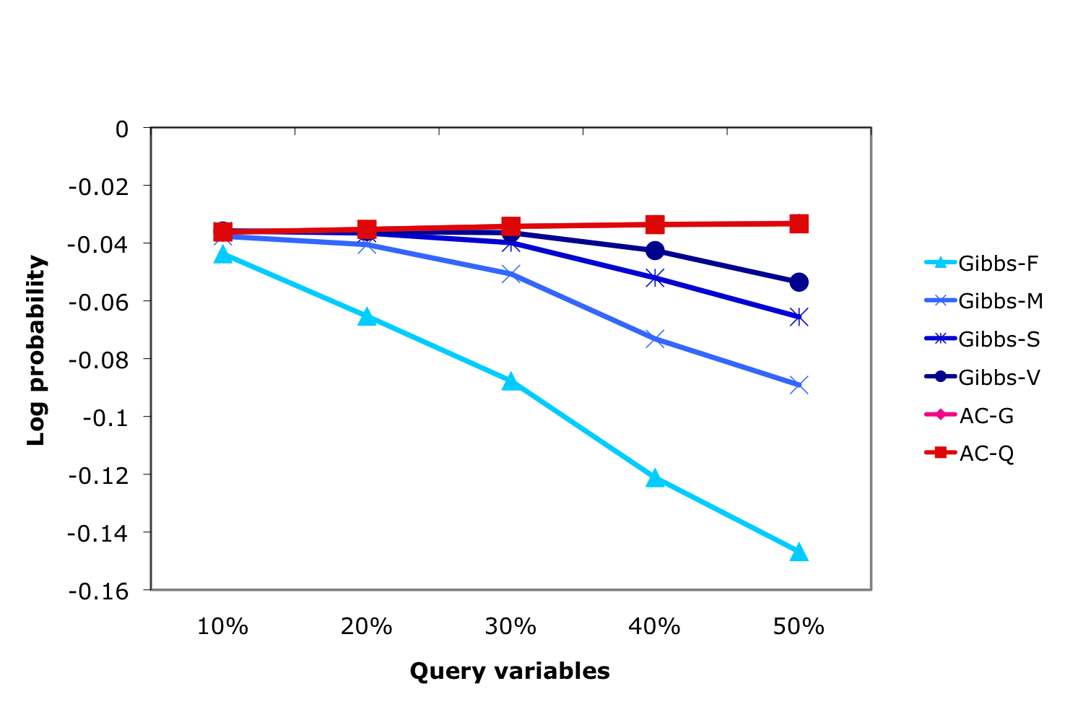
Accuracy: MSWeb
Notes:
30% evidence variables

Slide 30
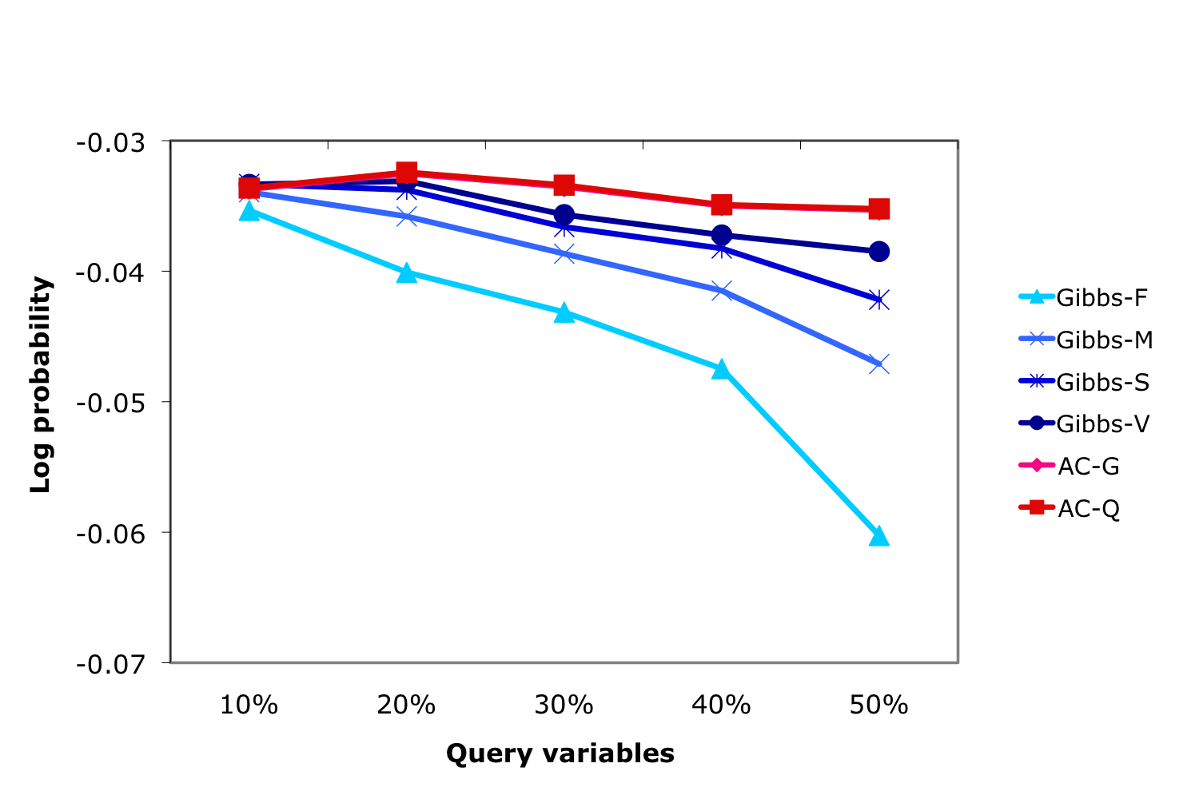
Accuracy: KDD Cup
Notes:
30% evidence variables

Slide 31
Our method learns complex, accurate models
Treewidth of learned models:
 | AC-Greedy | AC-Quick | WinMine
EachMovie | 35 | 54 | 281
KDD Cup | 38 | 38 | 53
MSWeb | 114 | 127 | 118
(2³⁵ = 34 billion)
Log-likelihood of test data:
 | AC-Greedy | AC-Quick | WinMine
EachMovie | –55.7 | –54.9 | –53.7
KDD Cup | –2.16 | –2.16 | –2.16
MSWeb | –9.85 | –9.85 | –9.69

Slide 32
Conclusion
Problem: Learning accurate intractable models = Learning inaccurate models
Solution: Use inference complexity as learning bias
Algorithm: Learn arithmetic circuits with penalty on circuit size
Result: Much faster and more accurate inference than standard Bayes net learning

