Slide 1
Good Word Attacks on Statistical Spam Filters
Daniel Lowd
University of Washington
(Joint work with Christopher Meek,
Microsoft Research)

Slide 2
Content-based Spam Filtering
From: spammer@example.com
Cheap mortgage now!!!
1.
Feature Weights
2.
cheap = 1.0
mortgage = 1.5
3.
Total score = 2.5
> 1.0 (threshold)
Spam

Slide 3
Good Word Attacks
From: spammer@example.com
Cheap mortgage now!!! Stanford CEAS
1.
Feature Weights
2.
cheap = 1.0
mortgage = 1.5
Stanford = -1.0
CEAS = -1.0
3.
Total score = 0.5
< 1.0 (threshold)
OK

Slide 4
Playing the Adversary
Can we efficiently find a list of “good words”?
Types of attacks
  Passive attacks -- no filter access
  Active attacks -- test emails allowed
Metrics
  Expected number of words required to get median (blocked) spam past the filter
  Number of query messages sent

Slide 5
Filter Configuration
Models used
  Naïve Bayes: generative
  Maximum Entropy (Maxent): discriminative
Training
  500,000 messages from Hotmail feedback loop
  276,000 features
  Maxent let 30% less spam through
Notes:
Trained using 500,000 messages from the Hotmail feedback loop (80% spam)
Large, but noisy, dataset -- error rates are overestimate because users are inconsistent
Maxent had about 30% fewer false negatives (missed spams) when we fixed the false positive rate.

Slide 6
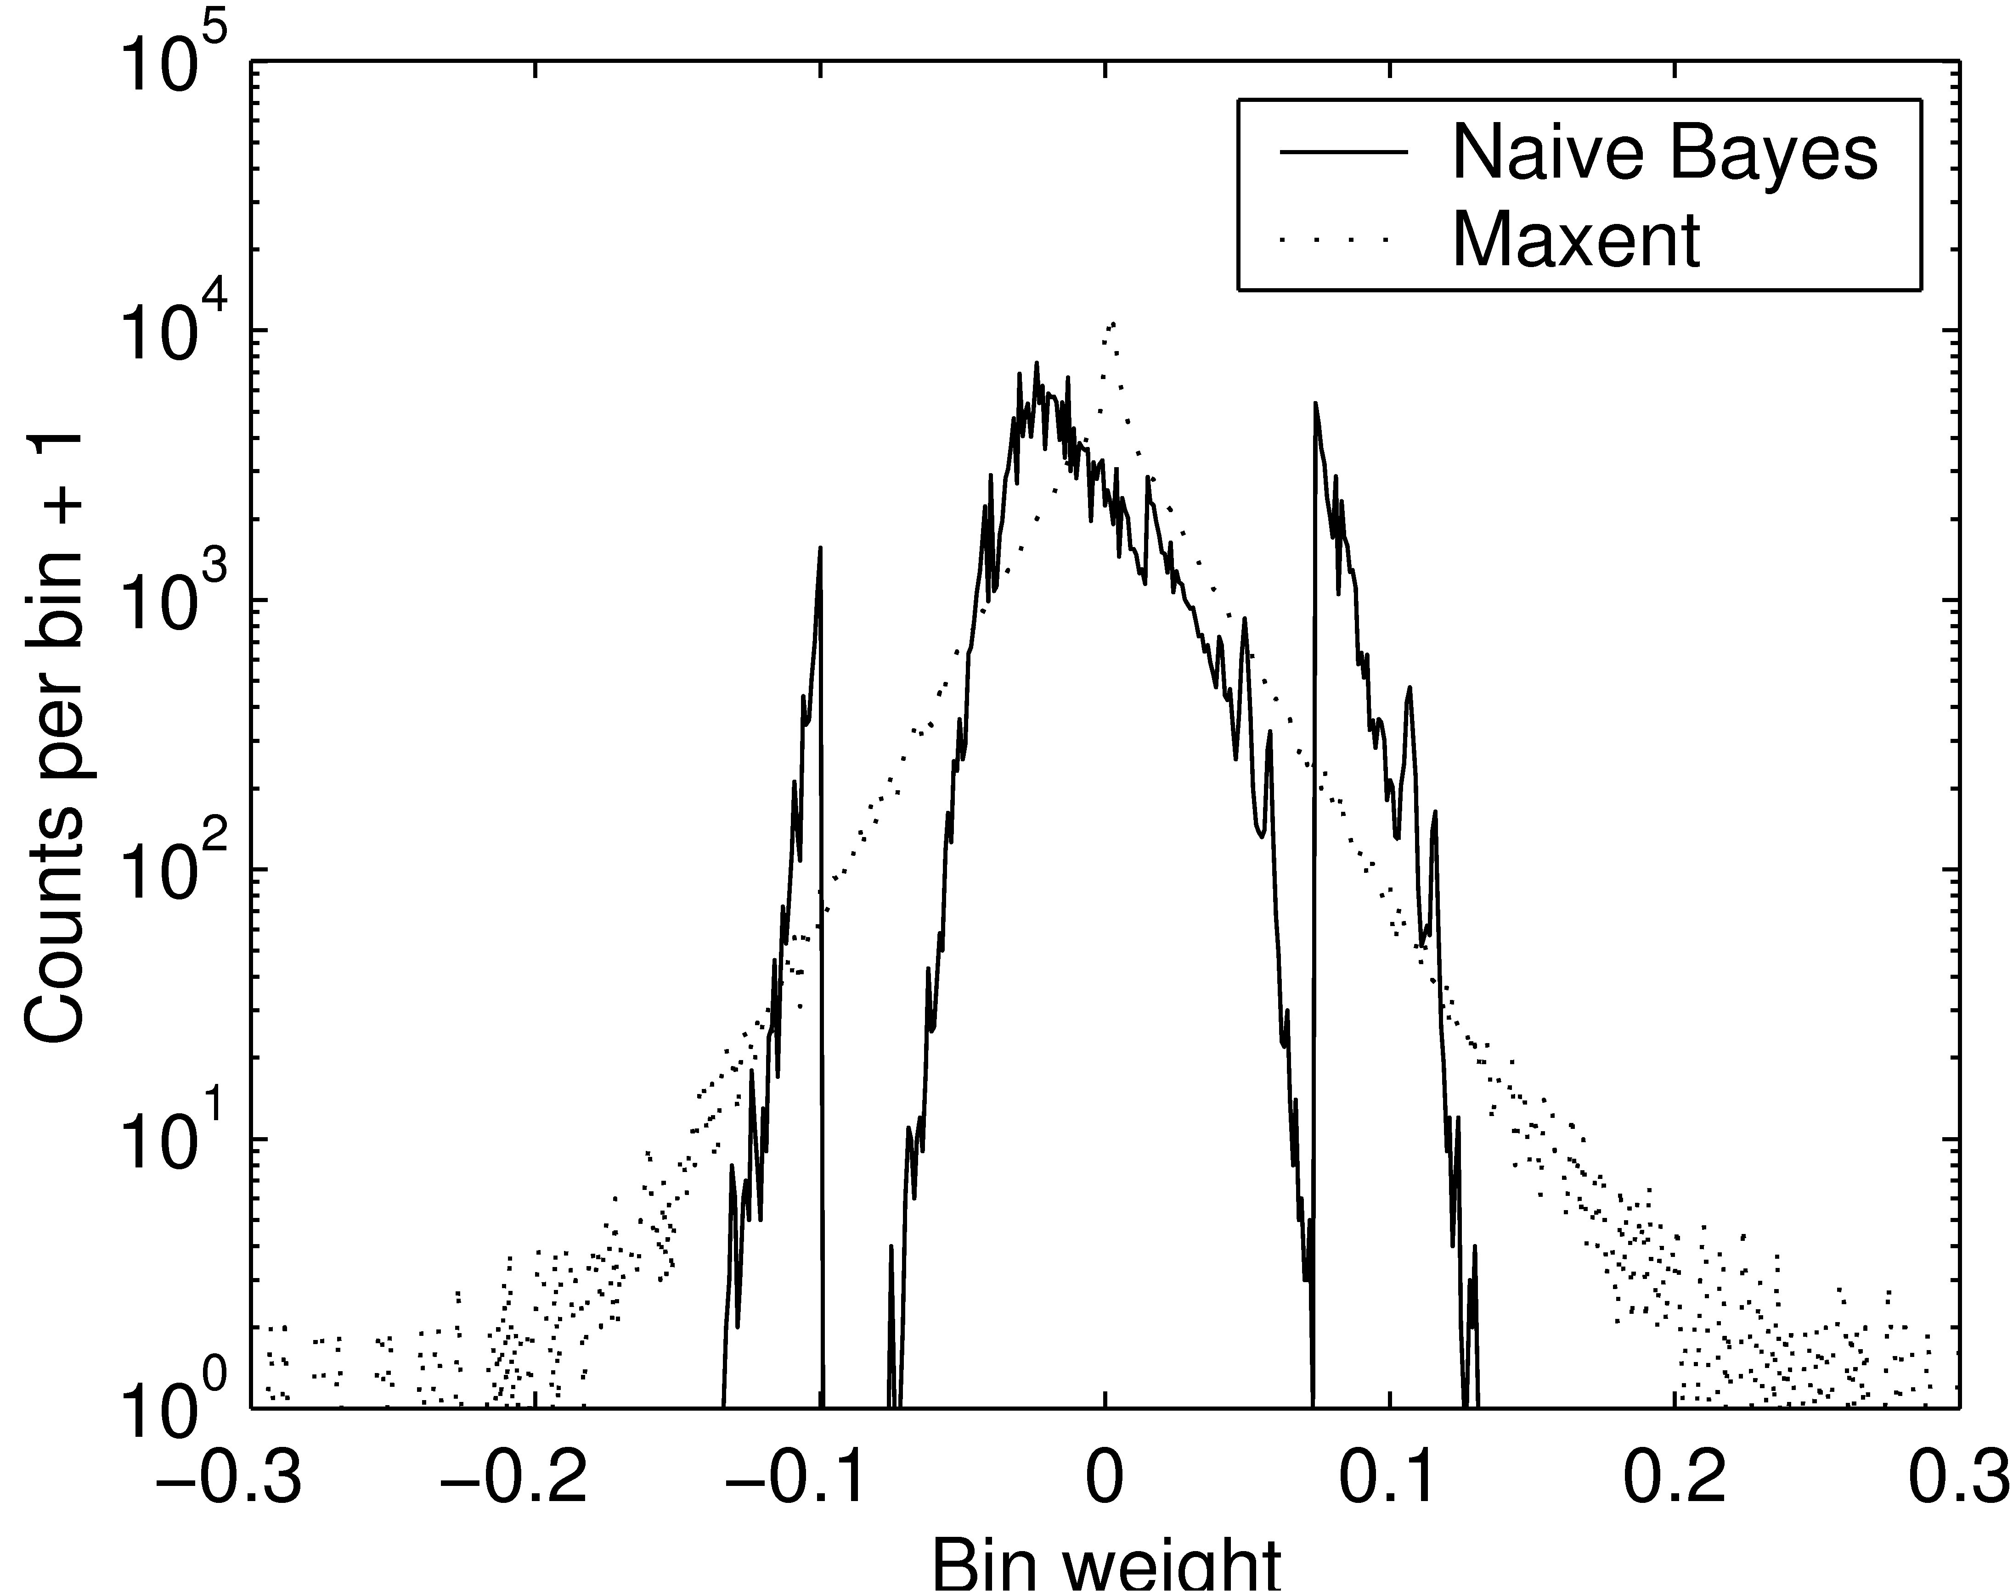
Comparison of Filter Weights
“good”
“spammy”
Notes:
TODO: redo this graph in color….
Maxent has larger-magnitude weights than naïve Bayes.
(Naïve Bayes spikes are due to the words with very few counts interacting with the prior.)

Slide 7
Passive Attacks
Heuristics
  Select random dictionary words (Dictionary)
  Select most frequent English words (Freq. Word)
  Select highest ratio: English freq./spam freq. (Freq. Ratio)
Spam corpus: spamarchive.org
English corpora:
  Reuters news articles
  Written English
  Spoken English
  1992 USENET

Slide 8
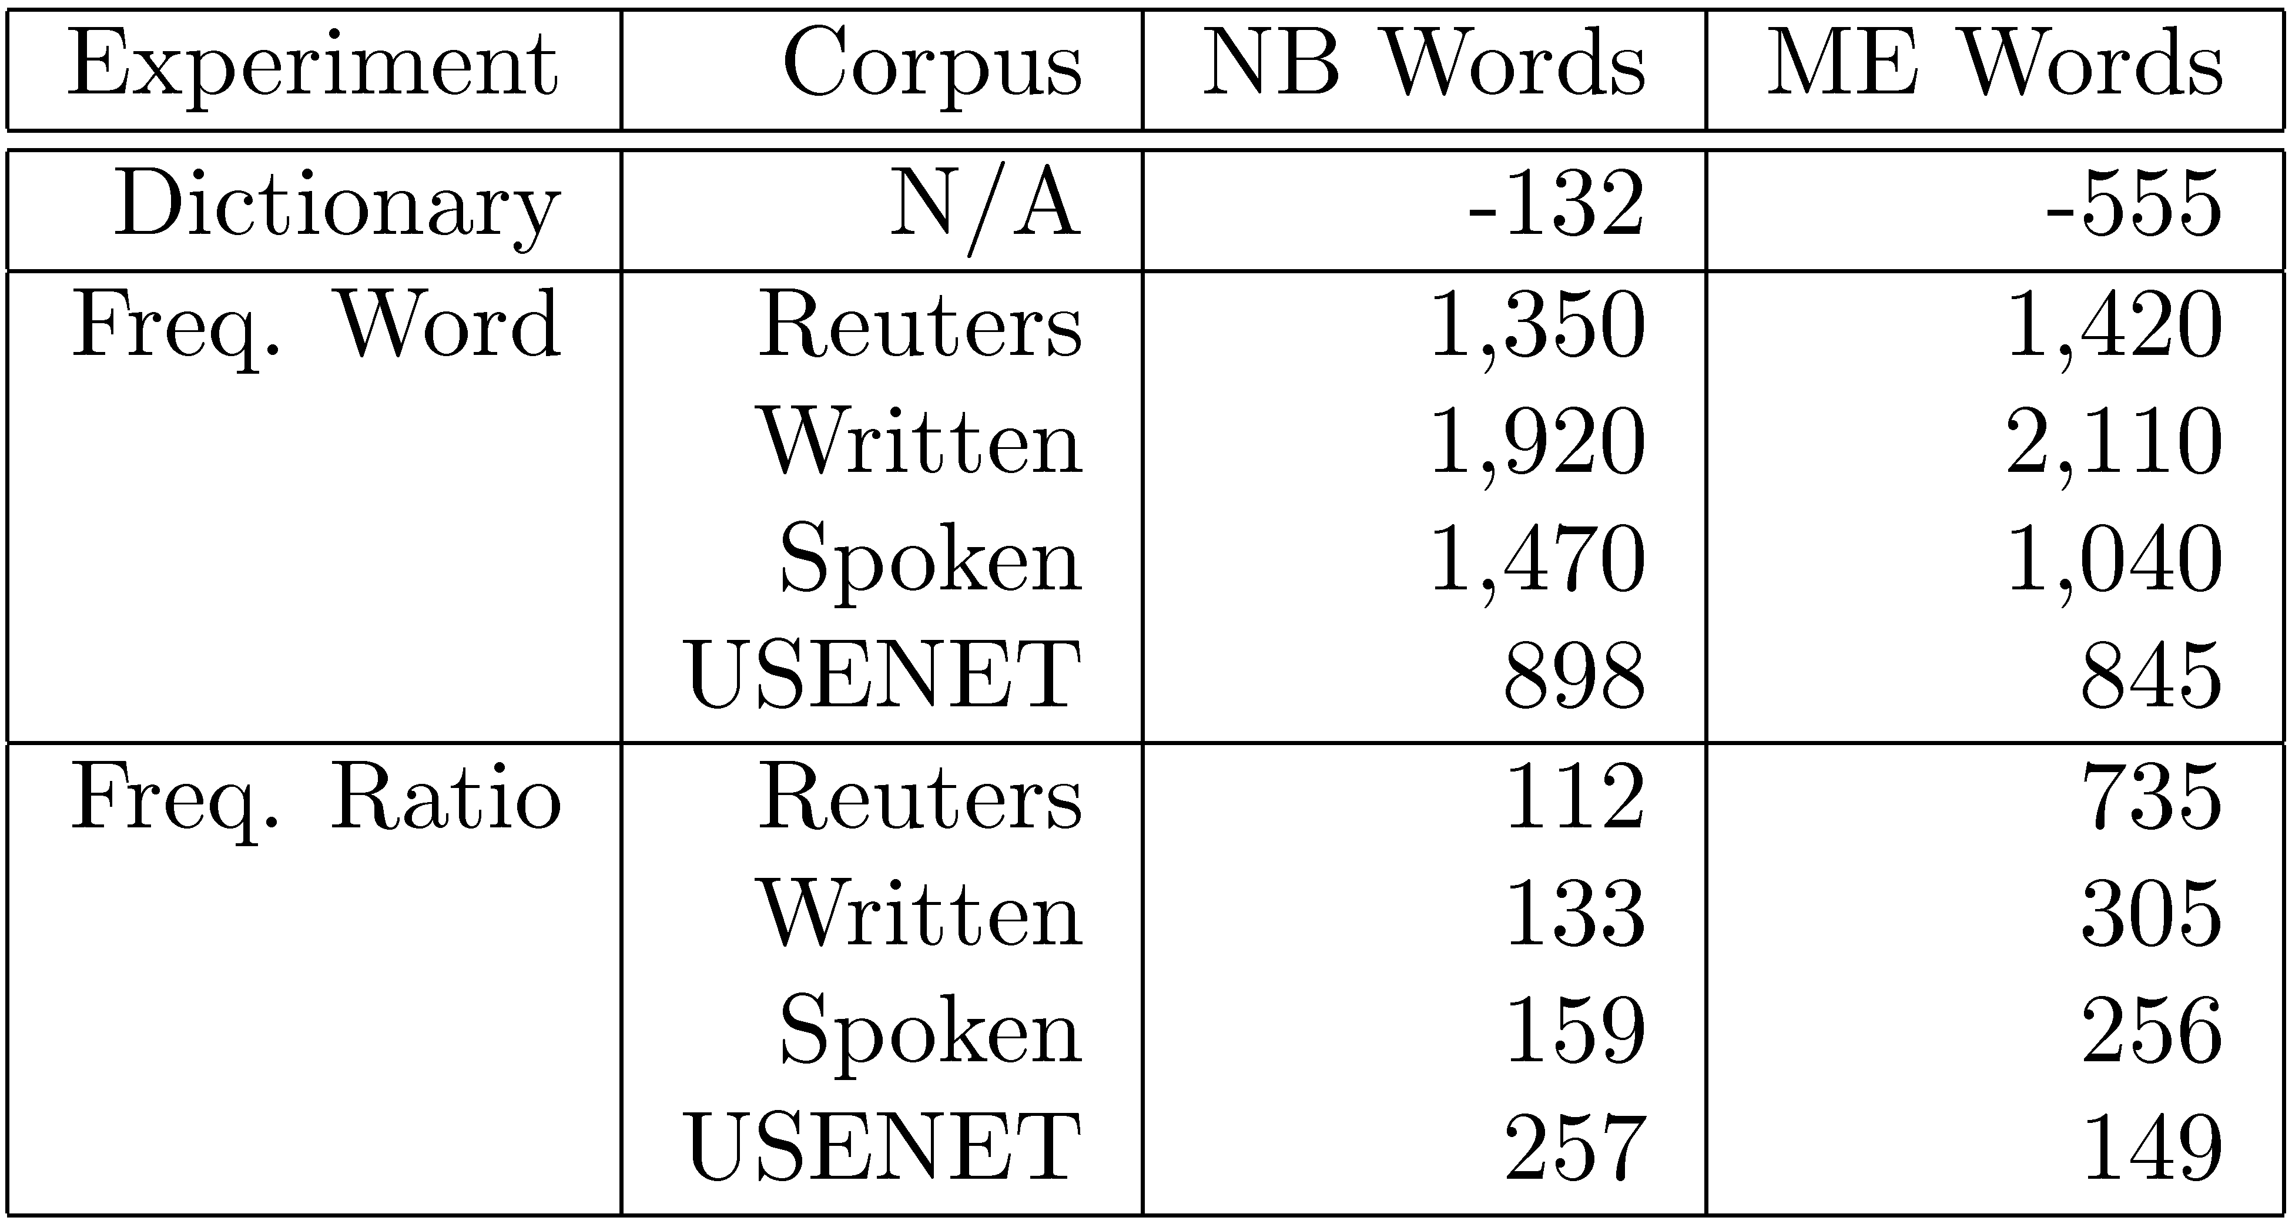
Passive Attack Results

Slide 9
Active Attacks
Learn which words are best by sending test messages (queries) through the filter
First-N: Find n good words using as few queries as possible
Best-N: Find the best n words

Slide 10
First-N Attack
Step 1: Find a “Barely spam” message
Original legit.
“Barely legit.”
“Barely spam”
Original
spam
Hi, mom!
now!!!
mortgage
now!!!
Cheap mortgage
now!!!
Legitimate
Spam
Threshold

Slide 11
First-N Attack
Step 2: Test each word
Good words
“Barely spam”
message
Legitimate
Spam
Less good words
Threshold

Slide 12
Best-N Attack
Legitimate
Spam
Better
Worse
Threshold
Key idea: use spammy words to sort the good words.

Slide 13
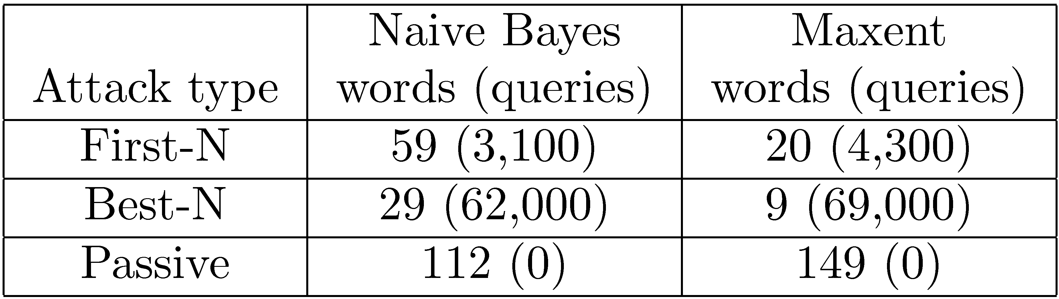
Active Attack Results
(n = 100)
Best-N twice as effective as First-N
Maxent more vulnerable to active attacks
Active attacks much more effective than passive attacks

Slide 14
Defenses
Add noise or vary threshold
  Intentionally reduces accuracy
  Easily defeated by sampling techniques
Language model
  Easily defeated by selecting passages
  Easily defeated by similar language models
Frequent retraining with case amplification
  Completely negates attack effectiveness
  No accuracy loss on original spam
  See paper for more details

Slide 15
Conclusion
Effective attacks do not require filter access.
Given filter access, even more effective attacks are possible.
Frequent retraining is a promising defense.
See also: Lowd & Meek, “Adversarial Learning,” KDD 2005

