Slide 1
Naïve Bayes Models for Probability Estimation
Daniel Lowd
University of Washington
(Joint work with Pedro Domingos)

Slide 2
One-Slide Summary
Using an ordinary naïve Bayes model:
One can do general purpose probability estimation and inference…
With excellent accuracy…
In linear time.
In contrast, Bayesian network inference is worst-case exponential time.
Notes:
…this is supported by extensive experiments.

Slide 3
Outline
Background
  General probability estimation
  Naïve Bayes and Bayesian networks
Naïve Bayes Estimation (NBE)
Experiments
  Methodology
  Results
Conclusion

Slide 4
Outline
Background
  General probability estimation
  Naïve Bayes and Bayesian networks
Naïve Bayes Estimation (NBE)
Experiments
  Methodology
  Results
Conclusion

Slide 5
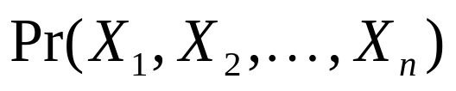
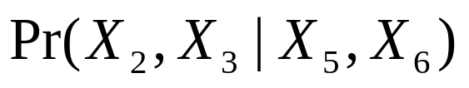
General Purpose
Probability Estimation
Want to efficiently:
  Learn joint probability distribution from data:
  Infer marginal and conditional distributions:
Many applications
Notes:
Applications: collaborative filtering, web usage modeling, robotics -- real time inference is important in these domains!
Only one sentence or two.

Slide 6
State of the Art
Learn a Bayesian network from data
  Structure learning, parameter estimation
Answer conditional queries
  Exact inference: #P complete
  Gibbs sampling: slow
  Belief propagation: may not converge; approximation may be bad

Slide 7
Naïve Bayes
Bayesian network with structure that allows linear time exact inference
All variables independent given C.
  In our application, C is hidden
Classification
  C represents the instance’s class
Clustering
  C represents the instance’s cluster
Notes:
“And we’re going to show you how” (re: linear time exact inference)

Slide 8
Naïve Bayes Clustering
C
Shrek
E.T.
Ray
…
Gigi
Model can be learned from data using expectation maximization (EM)

Slide 9
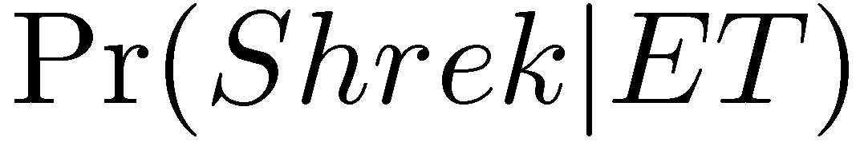
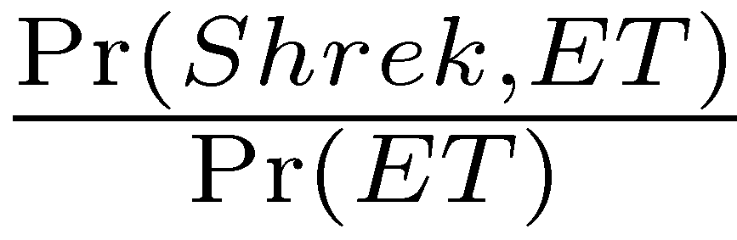
Inference Example
C
Shrek
ET
Ray
…
Gigi
Want to determine:
Equivalent to:
Problem reduces to computing marginal probabilities.

Slide 10
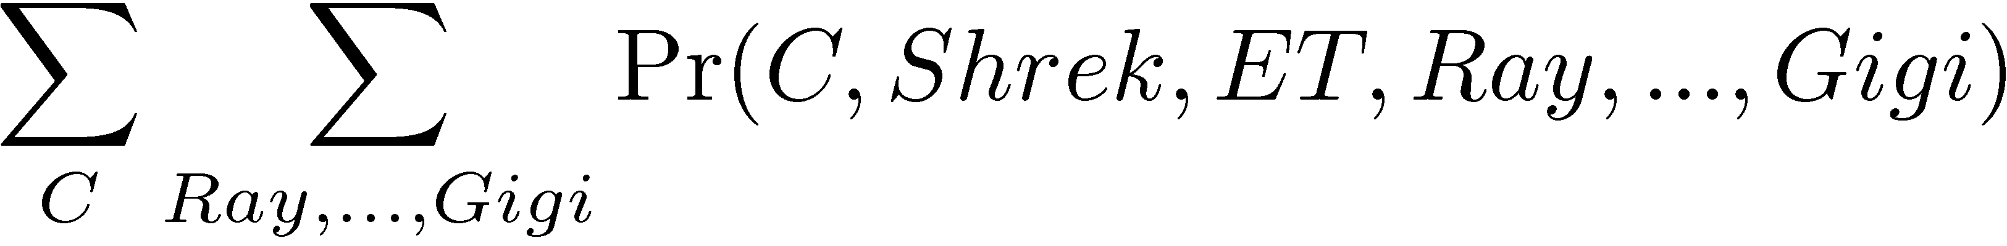
How to Find Pr(Shrek,ET)
1. Sum out C and all other movies, Ray to Gigi.

Slide 11
How to Find Pr(Shrek,ET)
2. Apply naïve Bayes assumption.

Slide 12
How to Find Pr(Shrek,ET)
3. Push probabilities in front of summation.

Slide 13
How to Find Pr(Shrek,ET)
4. Simplify -- Any variable not in the query (Ray,…,Gigi) can be ignored!

Slide 14
Outline
Background
  General probability estimation
  Naïve Bayes and Bayesian networks
Naïve Bayes Estimation (NBE)
Experiments
  Methodology
  Results
Conclusion

Slide 15
Naïve Bayes Estimation (NBE)
If cluster variable C was observed, learning parameters would be easy.
Since it is hidden, we iterate two steps:
  Use current model to “fill in” C for each example
  Use filled-in values to adjust model parameters
This is the Expectation Maximization (EM) algorithm (Dempster et al, 1977).
Notes:
NBE, at its core, is EM. Describe problem that we solve using EM, don’t describe EM separately.

Slide 16
Naïve Bayes Estimation (NBE)
repeat
Add k clusters, initialized with training examples
repeat
E-step: Assign examples to clusters
M-step: Re-estimate model parameters
Every 5 iterations, prune low-weight clusters
until convergence (according to validation set)
k = 2k
until convergence (according to validation set)
Execute E-step and M-step twice more, including validation set
Notes:
NBE, at its core, is EM. Describe problem that we solve using EM, don’t describe EM separately.
Similar to generic clustering algorithm
Improvements:
Use training examples to initialize clusters
Keep adding clusters as we go
Prune low-weight clusters

Slide 17
Speed and Power
Running time:
O(#EMiters x #clusters x #examples x #vars)
Representational power:
  In the limit, NBE can represent any probability distribution
  From finite data, NBE never learns more clusters than training examples

Slide 18
Related Work
AutoClass – naïve Bayes clustering
  (Cheeseman et al., 1988)
Naïve Bayes clustering applied to collaborative filtering
  (Breese et al., 1998)
Mixture of Trees – efficient alternative to Bayesian networks
  (Meila and Jordan, 2000)

Slide 19
Outline
Background
  General probability estimation
  Naïve Bayes and Bayesian networks
Naïve Bayes Estimation (NBE)
Experiments
  Methodology
  Results
Conclusion

Slide 20
Experiments
Compare NBE to Bayesian networks (WinMine Toolkit by Max Chickering)
50 widely varied datasets
  47 from UCI repository
  5 to 1,648 variables
  57 to 67,507 examples
Metrics
  Learning time
  Accuracy (log likelihood)
  Speed/accuracy of marginal/conditional queries

Slide 21
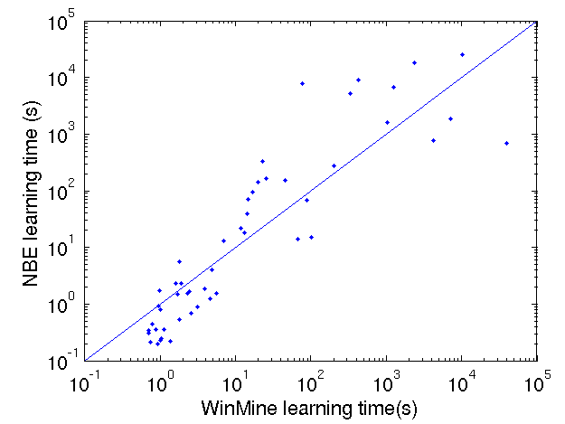
Learning Time
NBE slower
NBE faster

Slide 22
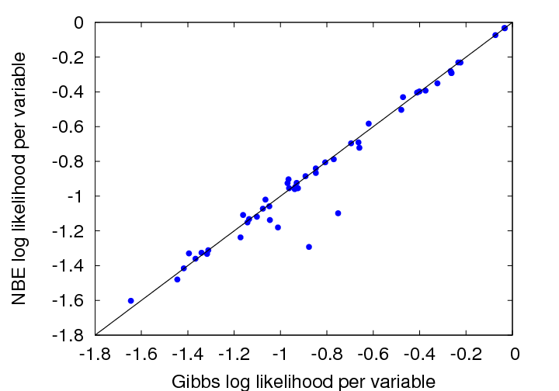
Overall Accuracy
NBE better
NBE worse
WinMine

Slide 23
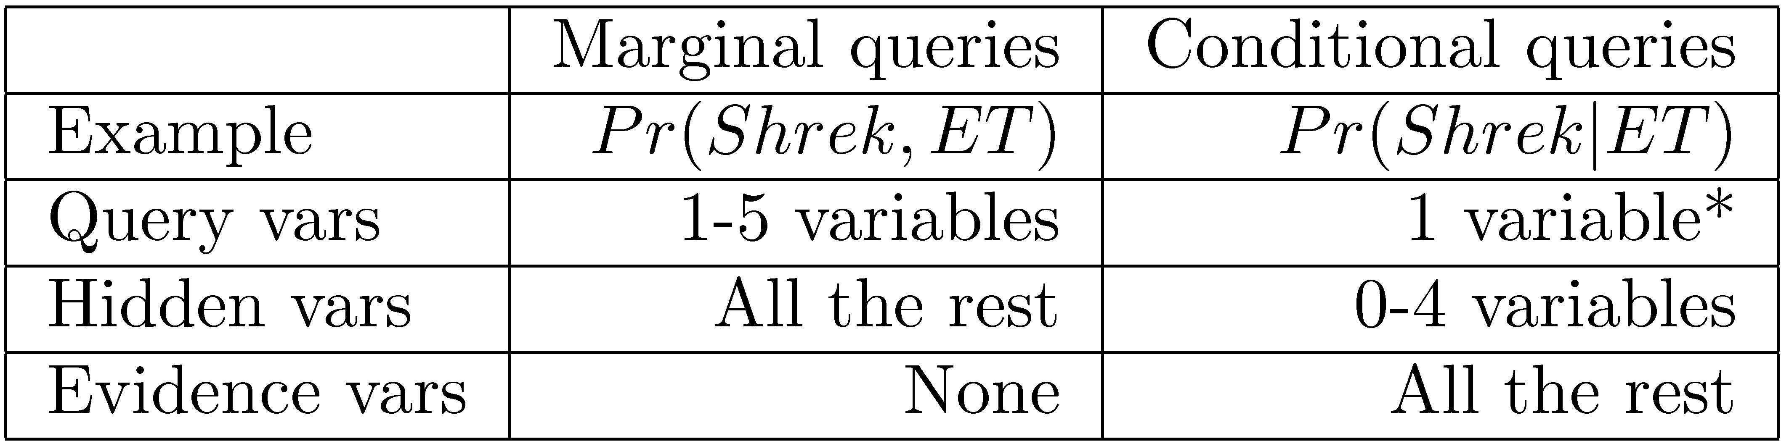
Query Scenarios
* – See paper for multiple-variable conditional results

Slide 24
Inference Details
NBE: Exact inference
Bayesian networks
  Gibbs sampling: 3 configurations
    1 chain, 1,000 sampling iterations
    10 chains, 1,000 sampling iterations per chain
    10 chains, 10,000 sampling iterations per chain
  Belief propagation, when possible

Slide 25
Marginal Query Accuracy
# of query variables | 1 | 2 | 3 | 4 | 5
1 chain, 1k samples | 38 | 40 | 41 | 47 | 47
10 chains, 1k samples | 28 | 36 | 39 | 39 | 41
10 chains, 10k samples | 23 | 29 | 31 | 30 | 29
Number of datasets (out of 50) on which NBE wins.

Slide 26
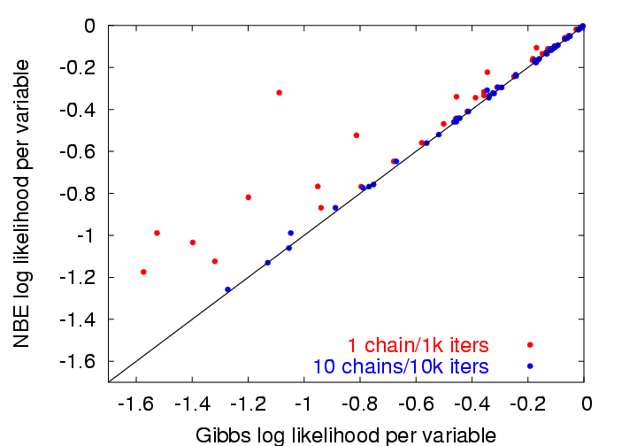
Detailed Accuracy Comparison
NBE better
NBE worse

Slide 27
Conditional Query Accuracy
# of hidden variables | 0 | 1 | 2 | 3 | 4
1 chain, 1k samples | 18 | 17 | 20 | 18 | 23
10 chains, 1k samples | 18 | 15 | 20 | 16 | 21
10 chains, 10k samples | 18 | 15 | 20 | 15 | 20
Belief propagation | 31 | 36 | 30 | 34 | 30
Number of datasets (out of 50) on which NBE wins.

Slide 28
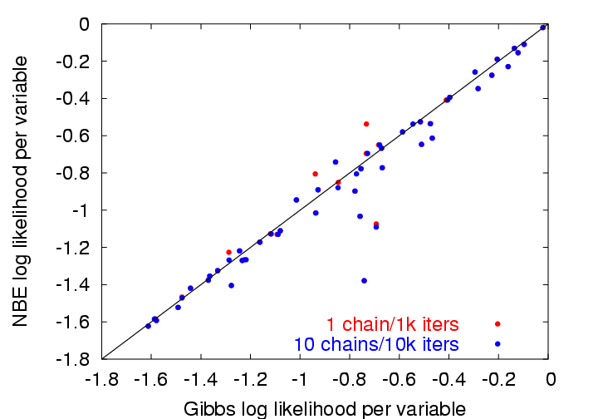
Detailed Accuracy Comparison
NBE better
NBE worse

Slide 29
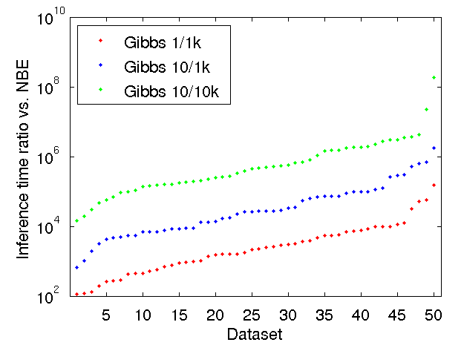
Marginal Query Speed
188,000,000
580,000
26,000
2,200
Notes:
Y axis is log scale!

Slide 30
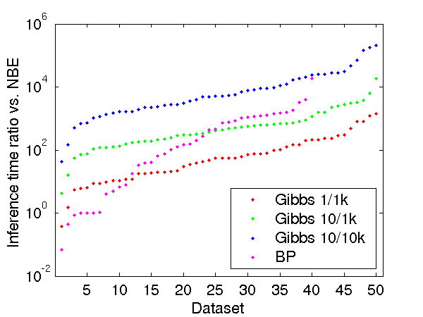
Conditional Query Speed
200,000
5,200
420
55

Slide 31
Summary of Results
Marginal queries
  NBE at least as accurate as Gibbs sampling
  NBE thousands, even millions of times faster
Conditional queries
  Easy for Gibbs: few hidden variables
  NBE almost as accurate as Gibbs
  NBE still several orders of magnitude faster
  Belief propagation often failed or ran slowly

Slide 32
Conclusion
Compared to Bayesian networks, NBE offers:
  Similar learning time
  Similar accuracy
  Exponentially faster inference
Try it yourself:
  Download an open-source reference implementation from:
  http://www.cs.washington.edu/ai/nbe
Notes:
“Taking the black art out of probability estimation”

