Slide 1
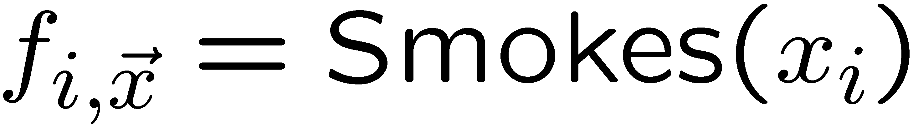
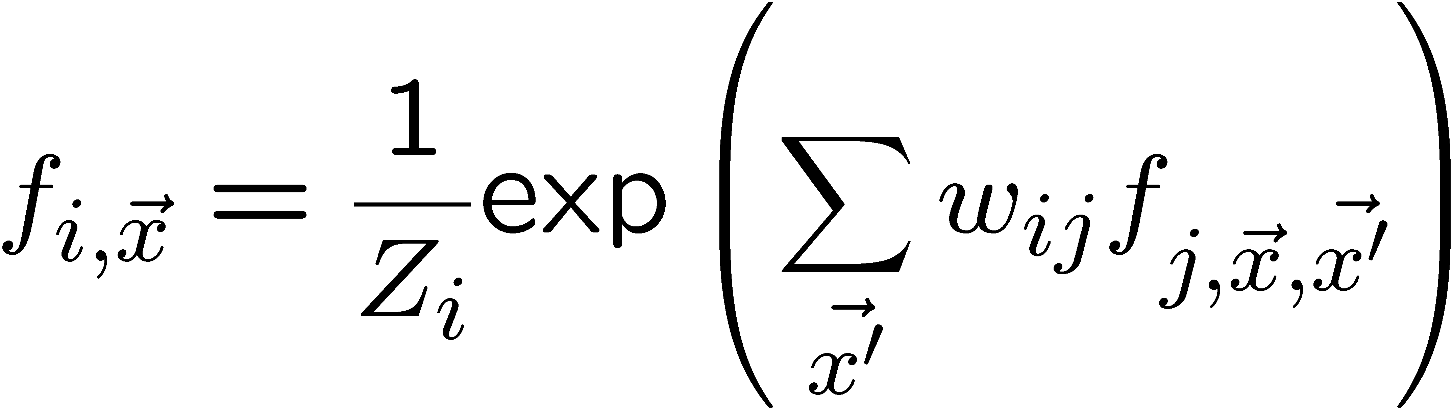
Recursive Random Fields
Daniel Lowd and Pedro Domingos
University of Washington
Overview: Intelligent systems must be able to handle the complexity and uncertainty of the real world. First-order logic deals well with complexity; statistical models handle uncertainty. Markov logic combines the two by making the top level of any first-order knowledge base probabilistic. Recursive random fields (RRFs) offer a more thorough unification by making the knowledge base probabilistic at every level. RRFs are trainable using a form of back-propagation, allowing them to naturally revise theories based on training data.
Motivating Example: Friends and Smokers
First-order logic (FOL):
FOL is powerful, but admits no uncertainty. The tree on the right represents three beliefs:
Smoking causes cancer
Friends of friends are friends (transitivity)
Everyone has a friend who smokes
…but these beliefs may not be true 100% of the time. In such cases, FOL is insufficient.
Markov logic networks (MLNs):
MLNs make knowledge bases probabilistic by turning the top-level conjunction and universal quantifiers into a log linear model (exponentiated weighted sum). Worlds that violate rules are less likely, but not impossible.
…but disjunctions and existential quantifiers remain purely logical.
Recursive random fields (RRFs):
RRFs replace conjunctions, disjunctions, and quantifiers with log linear models. Since an exponential weighted sum represents a soft conjunction, RRFs handle disjunctions and existential quantifiers through negation, via De Morgan’s laws.
∧
Logical
∀ x
∀ x,y,z
∀ x
∨
∨
∃ y
¬Sm(x)
Ca(x)
¬Fr(x,y)
¬Fr(y,z)
Fr(x,z)
Fr(x,y)
∧
Sm(y)
Probabilistic
w₁
1/Z exp(Σ …)
w₃
Σ x
w₂
Σ x
Σ x,y,z
∃ y
Logical
∨
∨
∧
¬Sm(x)
Ca(x)
¬Fr(x,y)
¬Fr(y,z)
Fr(x,z)
Fr(x,y)
Sm(y)
w₁
f₀
w₂
w₃
Probabilistic
∑_{x} f_{1,x}
∑_{x,y,z} f_{2,x,y,z}
∑_{x} f_{3,x}
w₄
w₅
w₆
w₇
w₈
w₉
Sm(x)
Ca(x)
Fr(x,y)
Fr(y,z)
Fr(x,z)
w₁₀
∑_{y} f_{4,x,y}
w₁₁
Where: f_{i,x} = 1/Z_{i} exp(Σ …)
Fr(x,y)
Sm(y)
Details on Recursive Random Fields
RRF features are parameterized and can be ground using objects in the domain
  Ground predicate feature:
  Recursive feature:
Logic representation
  AND: exponentiated sum
  OR: negated exponentiated sum
  ∀ x; ∃ x: sum out logical variable x
Inference: Gibbs sampling, ICM
Learning: Back-propagation
Theory Revision:
With enough connections, an RRF feature can represent any conjunction or disjunction. Use initial weights to encode theory, then adjust them using back-propagation. In this way, relationships can be discovered and theories can be corrected.
Concept | MLN | RRF
Non-relational MRF | Yes | Yes
Deterministic KB | Yes | Yes
Soft conjunction | Yes | Yes
Soft universal quant. | Yes | Yes
Soft disjunction | No | Yes
Soft existential quant. | No | Yes
Soft nested formulas | No | Yes
f₀
w_{i}
…
…
RRF Advantages:
powerful representation, natural theory revision
RRF Disadvantages:
hard to understand weights, slower to learn
f₁
f₂
f₃
…
f_{m}
w_{ij}
x₁
x₂
x₃
…
x_{n}

