Slide 1
Recursive Random Fields
Daniel Lowd
University of Washington
(Joint work with Pedro Domingos)

Slide 2
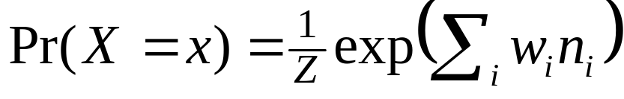
One-Slide Summary
Question:
How to represent uncertainty in relational domains?
State-of-the-Art: Markov logic [Richardson & Domingos, 2004]
  Markov logic network (MLN) = First-order KB with weights:
Problem: Only top-level conjunction and universal quantifiers are probabilistic
Solution: Recursive random fields (RRFs)
  RRF = MLN whose features are MLNs
  Inference: Gibbs sampling, iterated conditional modes
  Learning: Back-propagation

Slide 3
Overview
Example: Friends and Smokers
Recursive random fields
  Representation
  Inference
  Learning
Experiments: Databases with
probabilistic integrity constraints
Future work and conclusion

Slide 4
Example: Friends and Smokers
[Richardson and Domingos, 2004]
Predicates:
Smokes(x); Cancer(x); Friends(x,y)
We wish to represent beliefs such as:
Smoking causes cancer
Friends of friends are friends (transitivity)
Everyone has a friend who smokes

Slide 5
First-Order Logic
∧
∀ x
∀ x,y,z
∀ x
Logical
∃ y
∨
∨
∧
¬Sm(x)
Ca(x)
¬Fr(x,y)
¬Fr(y,z)
Fr(x,z)
Fr(x,y)
Sm(y)

Slide 6
Markov Logic
1/Z exp(Σ …)
Probabilistic
w₁
w₃
w₂
∀ x
∀ x,y,z
∀ x
∃ y
∨
∨
Logical
∧
¬Sm(x)
Ca(x)
¬Fr(x,y)
¬Fr(y,z)
Fr(x,z)
Fr(x,y)
Sm(y)

Slide 7
Markov Logic
1/Z exp(Σ …)
Probabilistic
w₁
w₃
w₂
Σ x
Σ x,y,z
Σ x
∃ y
∨
∨
Logical
∧
¬Sm(x)
Ca(x)
¬Fr(x,y)
¬Fr(y,z)
Fr(x,z)
Fr(x,y)
Sm(y)

Slide 8
Markov Logic
1/Z exp(Σ …)
Probabilistic
w₁
w₃
w₂
Σ x
Σ x,y,z
Σ x
∃ y
∨
∨
Logical
∧
¬Sm(x)
Ca(x)
¬Fr(x,y)
¬Fr(y,z)
Fr(x,z)
Fr(x,y)
Sm(y)
This becomes a disjunction
of n conjunctions.

Slide 9
Markov Logic
1/Z exp(Σ …)
Probabilistic
w₁
w₃
w₂
Σ x
Σ x,y,z
Σ x
∃ y
∨
∨
Logical
∧
¬Sm(x)
Ca(x)
¬Fr(x,y)
¬Fr(y,z)
Fr(x,z)
Fr(x,y)
Sm(y)
In CNF, each grounding
explodes into 2^{n} clauses!

Slide 10
Markov Logic
1/Z exp(Σ …)
Probabilistic
w₁
w₃
w₂
Σ x
Σ x,y,z
Σ x
∃ y
∨
∨
Logical
∧
¬Sm(x)
Ca(x)
¬Fr(x,y)
¬Fr(y,z)
Fr(x,z)
Fr(x,y)
Sm(y)

Slide 11
Markov Logic
f₀
Probabilistic
w₁
w₃
w₂
Σ x
Σ x,y,z
Σ x
∃ y
∨
∨
Logical
∧
¬Sm(x)
Ca(x)
¬Fr(x,y)
¬Fr(y,z)
Fr(x,z)
Fr(x,y)
Sm(y)
Where: f_{i} (x) = 1/Z_{i} exp(Σ …)

Slide 12
Recursive Random Fields
f₀
w₁
w₃
w₂
Probabilistic
∑_{x} f₃(x)
∑_{x} f₁(x)
∑_{x,y,z} f₂(x,y,z)
w₉
w₄
w₅
w₆
w₈
w₇
∑_{y} f₄(x,y)
Sm(x)
Ca(x)
Fr(x,y)
Fr(y,z)
w₁₀
w₁₁
Fr(x,z)
Fr(x,y)
Sm(y)
Where: f_{i} (x) = 1/Z_{i} exp(Σ …)

Slide 13
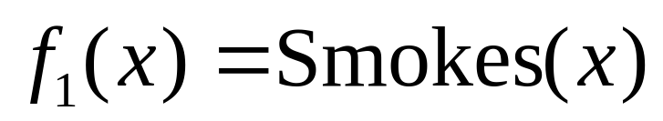
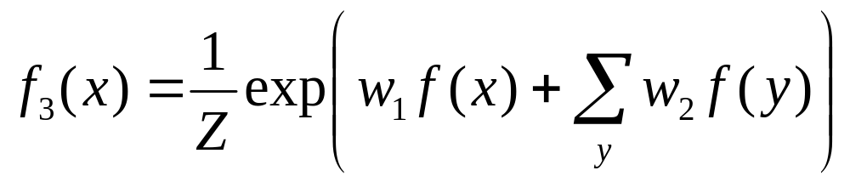
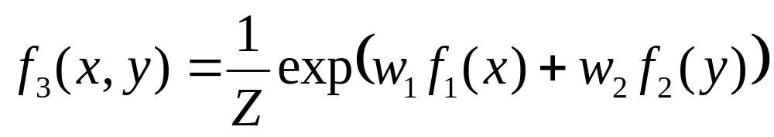
The RRF Model
RRF features are parameterized and are grounded using objects in the domain.
  Leaves = Predicates:
  Recursive features are built up from other RRF features:

Slide 14
Representing Logic: AND
(x₁ ∧ … ∧ x_{n}) →
1/Z exp(w₁x₁ + … + w_{n}x_{n})
P(World)
0
1
…
n
# true literals

Slide 15
Representing Logic: OR
(x₁ ∧ … ∧ x_{n}) →
1/Z exp(w₁x₁ + … + w_{n}x_{n})
(x₁ ∨ … ∨ x_{n}) →
¬(¬x₁ ∧ … ∧ ¬x_{n}) →
−1/Z exp(−w₁ x₁ +… + −w_{n}x_{n})
P(World)
0
1
…
n
# true literals
De Morgan:
(x ∨ y) ⬄ ¬(¬x ∧ ¬y)

Slide 16
Representing Logic: FORALL
(x₁ ∧ … ∧ x_{n}) →
1/Z exp(w₁x₁ + … + w_{n}x_{n})
(x₁ ∨ … ∨ x_{n}) →
¬(¬x₁ ∧ … ∧ ¬x_{n}) →
−1/Z exp(−w₁ x₁ +… + −w_{n}x_{n})
∀ a: f(a) →
1/Z exp(w x₁ + w x₂ + …)
P(World)
0
1
…
n
# true literals

Slide 17
Representing Logic: EXIST
(x₁ ∧ … ∧ x_{n}) →
1/Z exp(w₁x₁ + … + w_{n}x_{n})
(x₁ ∨ … ∨ x_{n}) →
¬(¬x₁ ∧ … ∧ ¬x_{n}) →
−1/Z exp(−w₁ x₁ +… + −w_{n}x_{n})
∀ a: f(a) →
1/Z exp(w x₁ + w x₂ + …)
∃ a: f(a) → ¬(∀ a: ¬f(a))
−1/Z exp(−w x₁ + −w x₂ + …)
P(World)
0
1
…
n
# true literals

Slide 18
Distributions MLNs and RRFs can compactly represent
Distribution | MLNs | RRFs
Propositional MRF | Yes | Yes
Deterministic KB | Yes | Yes
Soft conjunction | Yes | Yes
Soft universal quantification | Yes | Yes
Soft disjunction | No | Yes
Soft existential quantification | No | Yes
Soft nested formulas | No | Yes

Slide 19
Inference and Learning
Inference
  MAP: Iterated conditional modes (ICM)
  Conditional probabilities: Gibbs sampling
Learning
  Back-propagation
  Pseudo-likelihood
  RRF weight learning is more powerful than
  MLN structure learning (cf. KBANN)
  More flexible theory revision

Slide 20
Experiments: Databases with
Probabilistic Integrity Constraints
Integrity constraints: First-order logic
  Inclusion:
  “If x is in table R, it must also be in table S”
  Functional dependency:
  “In table R, each x determines a unique y”
Need to make them probabilistic
Perfect application of MLNs/RRFs

Slide 21
Experiment 1: Inclusion Constraints
Task: Clean a corrupt database
Relations
  ProjectLead(x,y) – x is in charge of project y
  ManagerOf(x,z) – x manages employee z
  Corrupt versions: ProjectLead’(x,y); ManagerOf’(x,z)
Constraints
  Every project leader manages at least one employee.
  i.e., ∀x.(∃y.ProjectLead(x,y)) ⇒ (∃z.Manages(x,z))
  Corrupt database is related to original database
  i.e., ProjectLead(x,y) ⇒ ProjectLead’(x,y)

Slide 22
Experiment 1: Inclusion Constraints
Data
  100 people, 100 projects
  25% are managers of ~10 projects each, and manage ~5 employees per project
  Added extra ManagerOf(x,y) relations
  Predicate truth values flipped with probability p
Models
  Converted FOL to MLN and RRF
  Maximized pseudo-likelihood

Slide 23
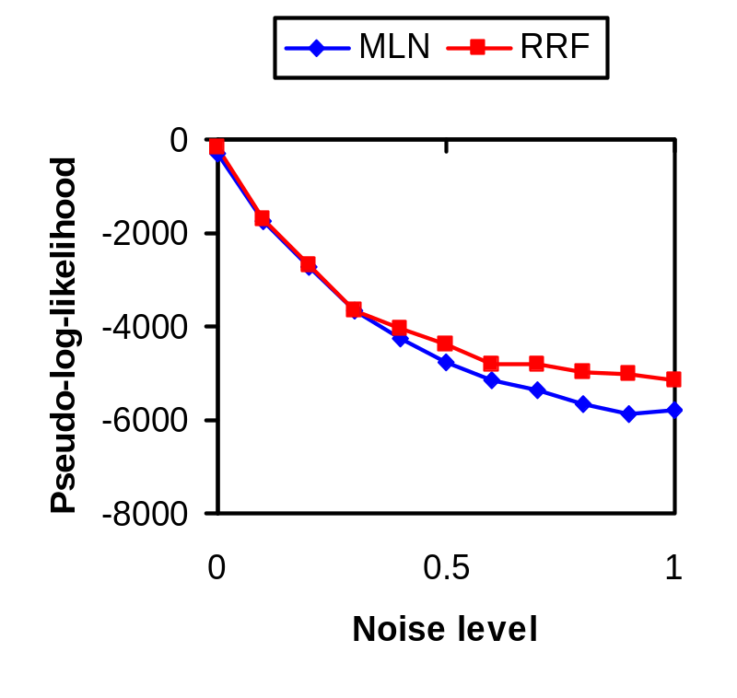
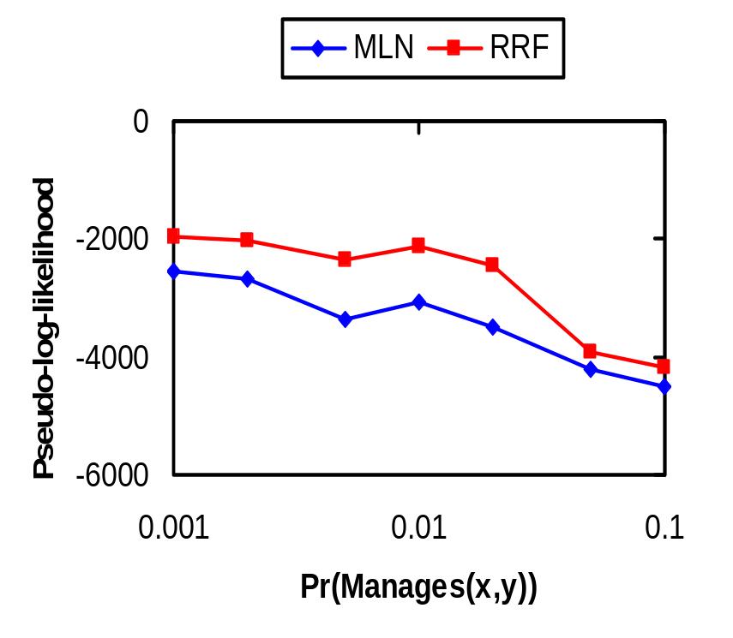
Experiment 1: Results

Slide 24
Experiment 2: Functional Dependencies
Task: Determine which names are pseudonyms
Relation:
  Supplier(TaxID,CompanyName,PartType) –
  Describes a company that supplies parts
Constraint
  Company names with same TaxID are equivalent
  i.e., ∀x,y₁,y₂.(∃ z₁,z₂.Supplier(x,y₁,z₁)
  ∧ Supplier(x,y₂,z₂) ) ⇒ y₁ = y₂

Slide 25
Experiment 2: Functional Dependencies
Data
  30 tax IDs, 30 company names, 30 part types
  Each company supplies 25% of all part types
  Each company has k names
  Company names are changed with probability p
Models
  Converted FOL to MLN and RRF
  Maximized pseudo-likelihood

Slide 26
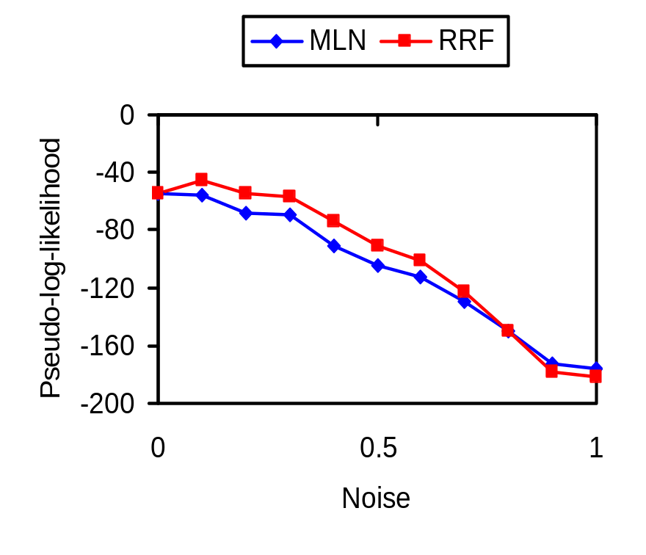
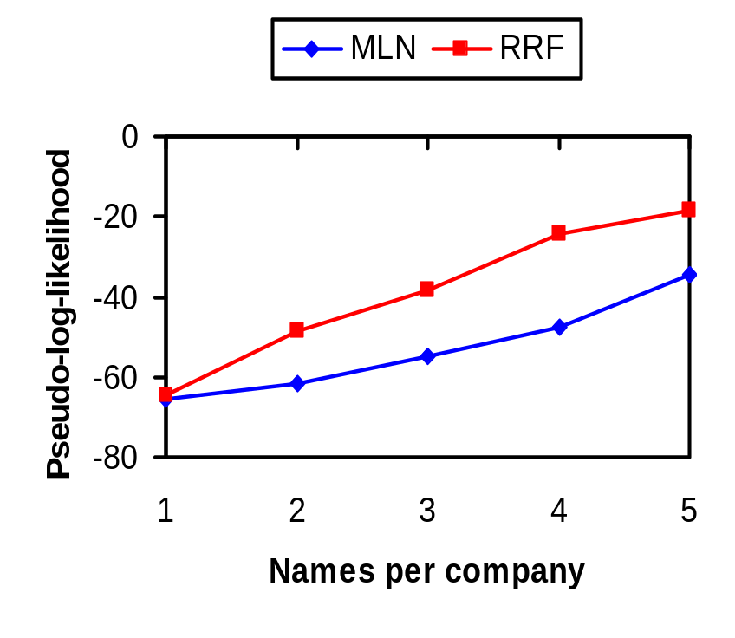
Experiment 2: Results

Slide 27
Future Work
Scaling up
  Pruning, caching
  Alternatives to Gibbs, ICM, gradient descent
Experiments with real-world databases
  Probabilistic integrity constraints
  Information extraction, etc.
Extract information a la TREPAN
(Craven and Shavlik, 1995)

Slide 28
Conclusion
Recursive random fields:
– Less intuitive than Markov logic
– More computationally costly
+ Compactly represent many distributions
MLNs cannot
+ Make conjunctions, existentials, and nested formulas probabilistic
+ Offer new methods for structure learning and theory revision
Questions: lowd@cs.washington.edu

