Slide 1
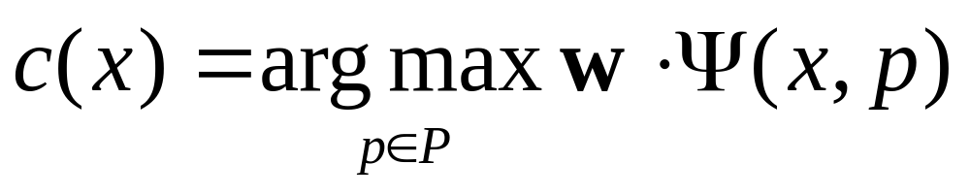

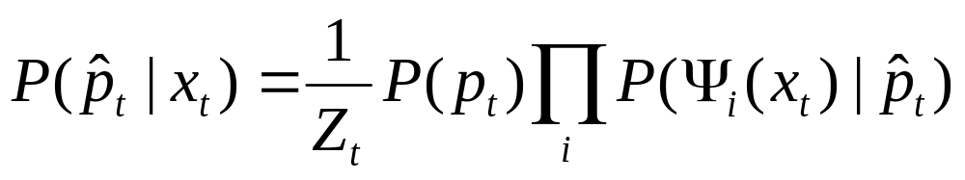
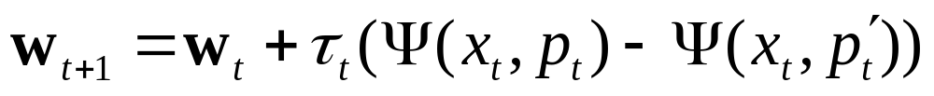
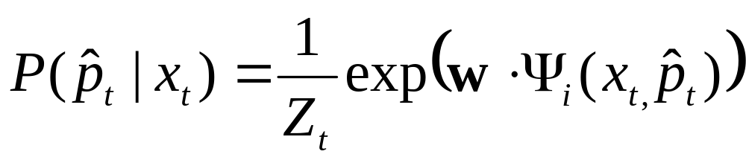
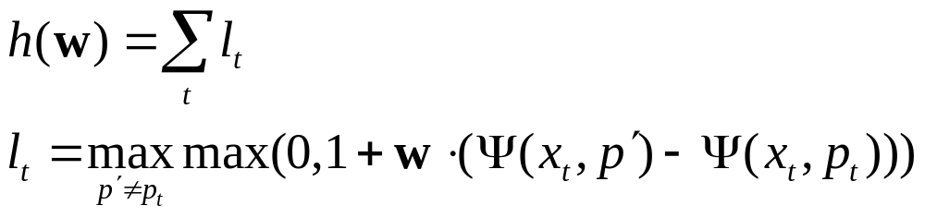
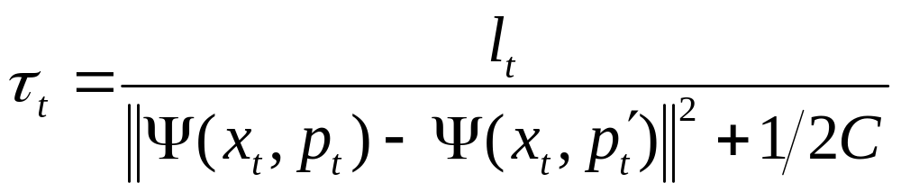
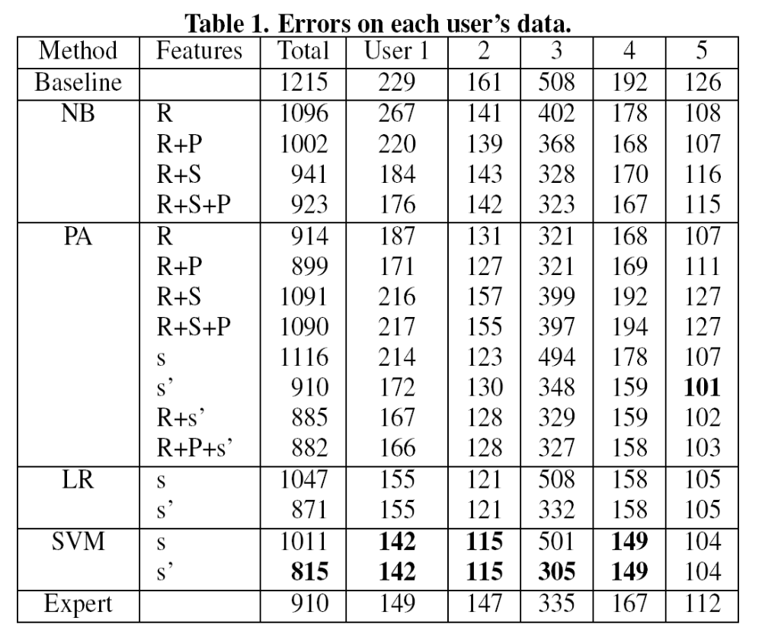
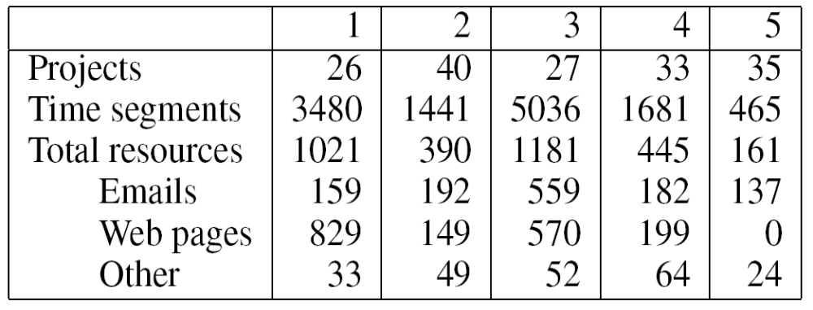
Using Salience to Segment Desktop Activity into Projects
Daniel Lowd
University of Washington
<lowd@cs.washington.edu>
http://foo.org/
http://asdf.com/
file://c:/xyz.doc
http://foo.org/bar/
Nicholas Kushmerick
Decho Corporation
<nicholask@decho.com>
W W W
W W W
. D O C
W W W
A
B
A
?
BACKGROUND: TaskTracer and SmartDesktop
TaskTracer and corporate spin-off SmartDesktop improve knowledge worker productivity by associating each desktop action with a project and using this information for time tracking, interruption recovery, and information retrieval.
OUR GOAL: Automatically infer the project for each action.
Previous work used generic methods that only considered content and compen-sated for poor accuracy by skipping predictions when confidence was low.
We present novel “salience” features that explicitly take into account both context and content. Using these features, we beat a finely tuned expert system.
Assumptions
Users specify projects
Users correct wrong predictions quickly and reliably
Requirements:
Prediction in < 100ms
Adapt quickly to new projects
Few “stupid” mistakes
TASK: Predict project label, p_{n}, given
Current and previous actions: (a₀, …, a_{n-1}, a_{n})
Previous project labels: (p₀, …, p_{n-1})
APPROACH: Linear classifier
Simple, fast, effective (with the right features)
Predicted
project
Weights
Features
FEATURES: Salience Links Content to Context
Resource Features describe the document or resource associated with the current action.
General
Full URI
URI subpath
Title words
Body words
Type
Email Only
Sender
Recipients
Thread-ID
Subject
Attachments
Folder
http://foo.org/
http://asdf.com/
file://c:/xyz.doc
http://foo.org/bar/
W W W
W W W
. D O C
W W W
Past Project Features indicate the project labels of the last four actions.
Salience Features compare the current action to recent actions. Each gives the number of resource features of a given type last seen with a given project.
Shared Salience Features share salience features across all projects, allowing generalization to new projects or users.
A
B
A
?
Example: Salience Features
Ψ(x,A) = {“URI subpath A” = 1, “Body words A” = 3}
Ψ(x,B) = {“Title words B” = 1, “Body words B” = 1, “Type B” = 1}
Example: Shared Salience Features
Ψ(x,A) = {“URI subpath” = 1, “Body words” = 3}
Ψ(x,B) = {“Title words” = 1, “Body words” = 1, “Type” = 1}
ALGORITHMS: Four Standard Approaches
Naïve Bayes (NB)
Assume observed features Ψ(x_{t}) are independent given class label (project).
Log probability is a linear model.
Weights are log conditional probabilities.
PRO: Simple and fast.
Often surprisingly effective.
CON: Overly strong assumptions.
Passive-Aggressive (PA)
After each example, update weights so that hinge loss l_{t} on most recent example is zero.
PRO: Simple and fast. Adapts quickly to new information. Less constrained than NB.
CON: May “forget” what it learned.
Logistic Regression (LR)
Probability is weighted exponential sum:
Log probability is linear model. Choose weights offline to minimize log loss of training data.
PRO: Less constrained than NB.
CON: More prone to overfitting.
Support Vector Machines (SVM)
Choose weights to minimize magnitude of the weight vector and hinge loss:
PRO: Longer memory than PA.
CON: Slower training.
where
Features of true project
Features of predicted project
(Dampening
term)
EXPERIMENTS: SVMs Beat Finely Tuned Expert Systems
We evaluated our features and algorithms on 2 weeks of data for each of five users. We compared against a finely tuned expert system, representing months of work, and a simple baseline that predicts the last project for the URI, last project for the resource type, or failing that, the last project.
NB and PA were trained online. LR and SVM were trained on four users and tested on the remaining one.
We report total errors to the right and several accuracies to the far right.
Results
Salience features greatly help NB and PA
SVM s’ is more accurate than expert system for every single user
Even Baseline is fairly accurate, because most resources are visited several times.
SVM accuracy increases in the second half of new URI predictions (unlike baseline and expert), suggesting long-term gains.
Statistics for each of the five users’ data.
Code | Features
R | Resource features
P | Past project features
S | Salience features
s | Shared salience features
s’ | Shared salience features, predict last project for URI
 | Per-Action Accuracy | Per-URI Accuracy | Per-URI Accuracy 2
Baseline | 86.7% | 55.6% | 55.4%
Expert | 89.0% | 64.7% | 65.2%
SVM s’ | 90.1% | 68.1% | 70.1%

