Slide 1
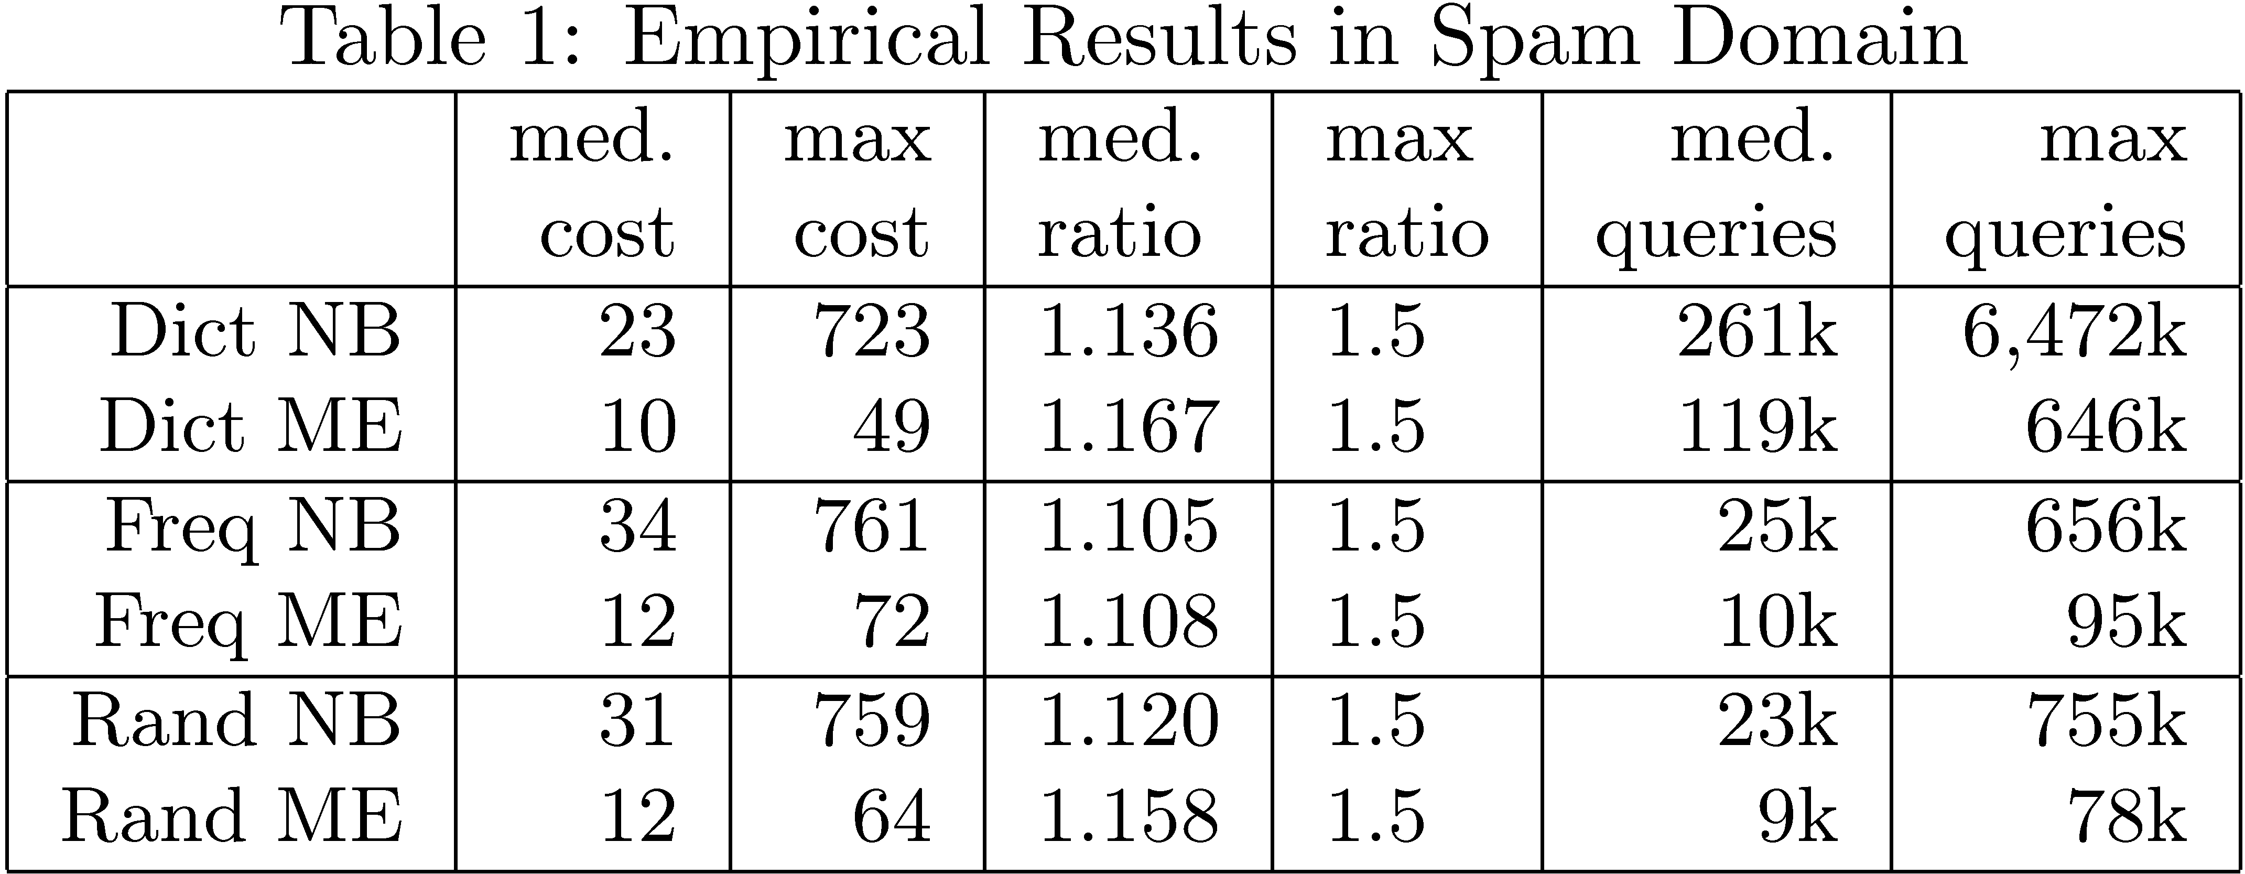
Daniel Lowd
University of Washington
lowd@cs.washington.edu
Adversarial Learning
Christopher Meek
Microsoft Research
meek@microsoft.com
“If you know the enemy and know yourself, you need not fear the result of a hundred battles.”
-- Sun Tzu, The Art of War
Abstract
Attacking Linear Classifiers
Many classification tasks, such as spam filtering, intrusion detection, and terrorism detection, are complicated by an adversary who wishes to avoid detection. Previous work on adversarial classification has made the unrealistic assumption that the attacker has perfect knowledge of the classifier [Dalvi et al., 2004]. In this paper, we introduce the adversarial classifier reverse engineering (ACRE) learning problem, the task of learning sufficient information about a classifier to construct adversarial attacks. We present efficient algorithms for reverse engineering linear classifiers with either continuous or Boolean features and demonstrate their effectiveness using real data from the domain of spam filtering.
…With Continuous Attributes
A linear cost function is of the form:
a(x) = ∑_{i} a_{i} |x_{i} - x_{i}ª|. Informally, a_{i} represents the cost of changing the ith feature by one unit, with respect to the base instance, xª.
X₂
xª
X₁
Theorem: Linear classifiers with continuous features are ACRE (1 + ε)-learnable under linear cost functions.
ACRE Learning
Proof Sketch: We only need to change one feature, the one with highest weight-to-cost ratio. We can efficiently find this feature by doing line searches in each dimension.
X₂
xª
-
X₁
A classifier, c(x), maps
n-dimensional feature vectors (instances) to classes + and - :
X₂
x
…With Boolean Attributes
+
X₁
A uniform linear cost function assigns unit cost to each changed feature, with respect to the base instance xª.
Theorem: Linear classifiers with Boolean features are ACRE 2-learnable under uniform linear cost functions.
Proof Sketch: Start with the negative example, x⁻. Initially, each changed feature f contributes some weight, w_{f} , to making x⁻ negative:
An adversarial cost function, a(x), represents the adversary’s preference for some instances over others. We visualize this as constant-cost contours in the instance space:
X₂
In an adversarial classifier reverse engineering (ACRE) learning problem, the adversary tries to minimize a(x) subject to the constraint c(x) = -.
X₁
c(x)
xª
x⁻
-
w_{i}
w_{j}
w_{k}
w_{l}
w_{m}
X₂
We iteratively reduce the cost in two ways.
1. Remove any individual change that is unnecessary:
+
X₁
c(x)
y
x⁻
The adversary is given one positive instance, one negative instance, and may issue membership queries to the classifier. In each query, the adversary learns the class of a single chosen instance.
?
?
?
xª
w_{i}
w_{j}
w_{k}
w_{l}
w_{l}
X₂
?
?
-
2. Replace any two changes with new, single change:
+
?
?
?
c(x)
xª
y’
X₁
w_{i}
w_{j}
w_{k}
w_{p}
w_{l}
A set of classifiers and cost functions is k-ACRE learnable if the adversary can always find a negative instance within a factor k of the minimum cost using a polynomial number of queries.
When neither modification can be made without yielding a positive example, the cost must be less than twice optimal.
Empirical Evaluation: Spam
Spammer goal: minimally modify a spam message to achieve a spam that gets past a spam filter.
Corresponding ACRE problem:
spam filter linear classifier with Boolean features
“minimally modify” uniform linear cost function
Filter configuration:
Naïve Bayes (NB) and maxent (ME) filters
500,000 Hotmail messages for training
> 250,000 features
Adversary feature sets:
23,000 English words (Dict)
1,000 most frequent English words (Freq)
1,000 random English words (Rand)
Results (see table):
Reduced feature set almost as good
Cost ratio is excellent
Number of queries is reasonable (parallelize)
Conclusion: ACRE algorithms are practical!
For each scenario, we list the median and maximum number of changes required, ratio (relative to optimal), and number of queries required.

